Slide 1

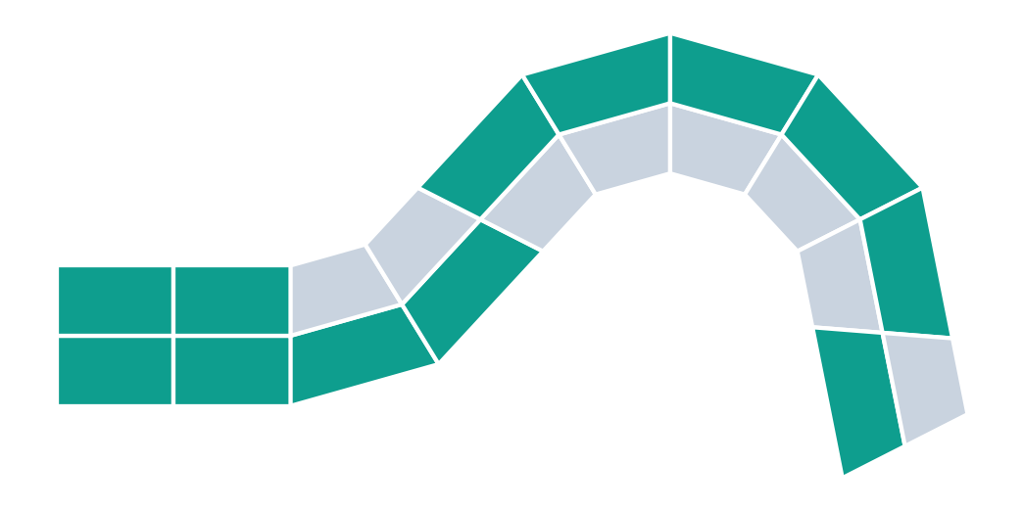
From Freehand 4D Printing to AI-Driven Fast Reverse Design
THE UNIVERSITY OF TEXAS AT DALLAS
print flat
trigger
Pavan Kailas Patil · Omar Khan
Based on Wang et al. (2025) and Jin et al. (2024)
programmed shape
Schematic illustration
Notes:
PRESENTER: Pavan
SCRIPT (≤30 s):
Good morning. I'm Pavan, and with Omar Khan we'll show how a 4D-printed part can be designed backwards: start from the shape you want, then let AI find the material layout. We build on Wang et al. 2025 and Jin et al. 2024, and finish with what our own fork of Wang's code does.
TRANSITION: First, what makes 4D printing different.

Slide 2





Print it flat. Trigger it. It transforms.
THE IDEA
1 Print
2 Trigger
3 Transform
two materials in one flat strip
heat, light, humidity, solvent…
mismatch bends it into shape
3D printing designs a shape. 4D printing designs how it changes. The question: where should each material go?
Stimuli as reviewed in Jin et al. 2024 [2]. Strip graphics are schematic.
Notes:
PRESENTER: Pavan
SCRIPT (≤30 s):
3D printing gives you a fixed object. 4D printing adds time. We print a flat strip from two materials that respond differently to a stimulus, like heat or solvent. When triggered, the mismatch makes it bend into a programmed shape. So the real design question is where each material goes.
TRANSITION: People first explored this by hand.

Slide 3



Freehand 4D: the pen path is the program
WHERE IT STARTED
Draw
Store
Heat
The turn
3D pen extrudes plastic along a hand-drawn path
stretching freezes strain into the path
strain releases; path shrinks and bends
Instead of guessing a path and hoping, start from the target shape and compute the material layout.
+ Huge geometric freedom: draw on curved surfaces, low-cost, interactive.
– Imprecise: hand paths vary, so the final shape is hard to predict.
4Doodle, Proc. CHI ’23, doi:10.1145/3544548.3581321 [3]; shrinkage modelling: Jin et al. 2024, Sec. 3.1 [2]. Diagram is schematic.
Notes:
PRESENTER: Pavan
SCRIPT (≤30 s):
Freehand 4D printing, as in 4Doodle, uses a handheld 3D pen. Extruding plastic stores strain along the path, and heating releases it, so the drawn path programs the bending. It's creative and flexible, but hand paths are imprecise, so the final shape is hard to predict. That's why we need computation.
TRANSITION: Here's why computing the design is hard.

Slide 4




Why computing the design is hard
THE PROBLEM
Nonlinear
Non-unique
big bends, swelling, temperature effects
many layouts → similar shapes
Huge space
Slow to simulate
2 × 10 beam = 1,048,576 layouts
each FE run is costly
≈219 days
54 min
1.97 s
learned surrogates make search practical
Chart: Sun et al., J. Mech. Phys. Solids 2024 [5] (FE + EA time is their estimate). Layout count from Wang et al. encoding [1].
Notes:
PRESENTER: Pavan
SCRIPT (≤30 s):
Four things make design hard: nonlinear behaviour, many layouts giving similar shapes, a huge design space, and slow simulation. The chart shows one published benchmark. Search with finite elements was estimated at 219 days, a learned surrogate cut it to 54 minutes, and a better optimiser reached about two seconds.
TRANSITION: Wang et al. push that speed further.

Slide 5
Fast reverse design
01
Wang et al., Advanced Science, 2025
Notes:
PRESENTER: Pavan
SCRIPT (≤30 s):
Part one: fast reverse design by Wang and colleagues.
TRANSITION: Here's their framework.

Slide 6
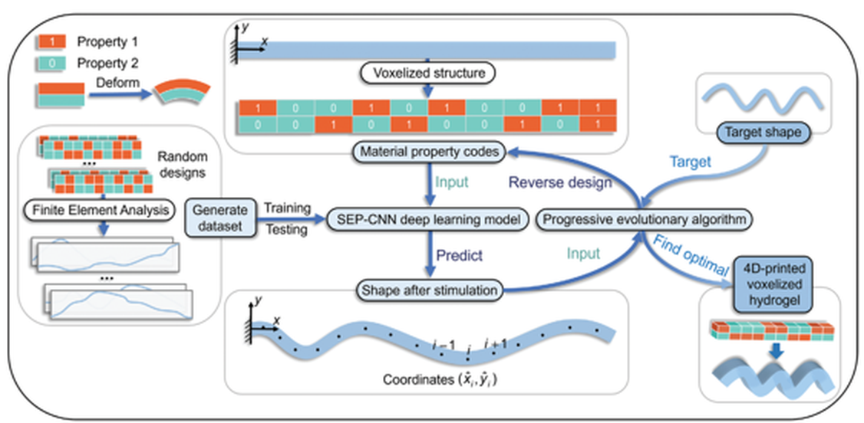
Simulate once, then design in seconds
WANG ET AL. (2025)
≈3 s
average time per design
2²⁰
≈1 million possible layouts
6,000
Wang et al. 2025, Fig. 1: overall framework
Solvent-responsive hydrogel beam · FE data → neural network → evolutionary search
FE samples was the best training-set size
Wang et al., Adv. Sci. 12(12), 2407825 (2025): abstract, Fig. 1, Fig. 4a [1].
Notes:
PRESENTER: Pavan
SCRIPT (≤30 s):
Wang et al. design hydrogel beams made of voxels. Finite-element simulations train a neural network that predicts the bent shape. Then an evolutionary algorithm searches for the layout that matches a target. They report about three seconds per design, across a space of over a million possible layouts.
TRANSITION: Let's look at how the voxels encode the shape.

Slide 7
Voxels are the design language
WANG ET AL. (2025)
2 × 10 layout (example)
1
active voxel: swells more
1
1
0
0
1
1
1
1
1
0
1
1
1
1
0
0
0
0
0
1
0
passive voxel: swells less
swells
↻
each column's mismatch sets its local bend
∿
the column sequence sets the whole curve: 200 (x, y) points
Wang et al. 2025, Fig. 1–2 captions, Sec. 2.2 [1]; (batch, 2, 10) → (batch, 2, 200) per repo Documentation.md [6]. Bent strip is schematic.
Notes:
PRESENTER: Pavan
SCRIPT (≤30 s):
Each voxel is either active, coded 1, which swells more, or passive, coded 0, which swells less. The beam is a 2-by-10 grid. In each column, the mismatch between layers sets the local bend, and the sequence of columns sets the overall curve. The model predicts that curve as 200 x-y points.
TRANSITION: Two engines do the work: predict and search.

Slide 8


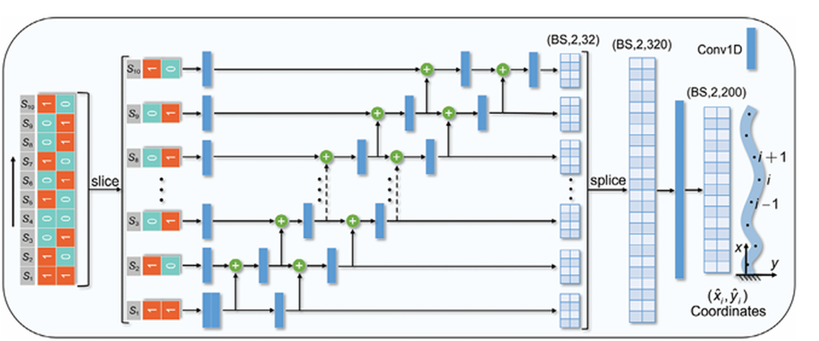
Two engines: predict fast, search smart
WANG ET AL. (2025)
PREDICT · SEP-CNN
SEARCH · Progressive EA
early
middle
final
Each voxel column gets its own channel and passes information to the next, like a sequence.
Locks in good columns one by one instead of guessing all 20 genes at once.
Repo: target read as a numeric curve from target_test.csv
Wang et al. 2025, Fig. 3
Wang et al. 2025, Fig. 3 and PEA description [1]; repository PEA_for_reverse_design.py [6]. Column-locking graphic is schematic.
Notes:
PRESENTER: Pavan
SCRIPT (≤30 s):
To predict, SEP-CNN processes each voxel column in its own channel and passes information to the next column, like a sequence. To search, the progressive evolutionary algorithm locks in good columns one at a time instead of guessing all twenty at once. In the repository, the target is a numeric curve read from a CSV file.
TRANSITION: Does it work?

Slide 9
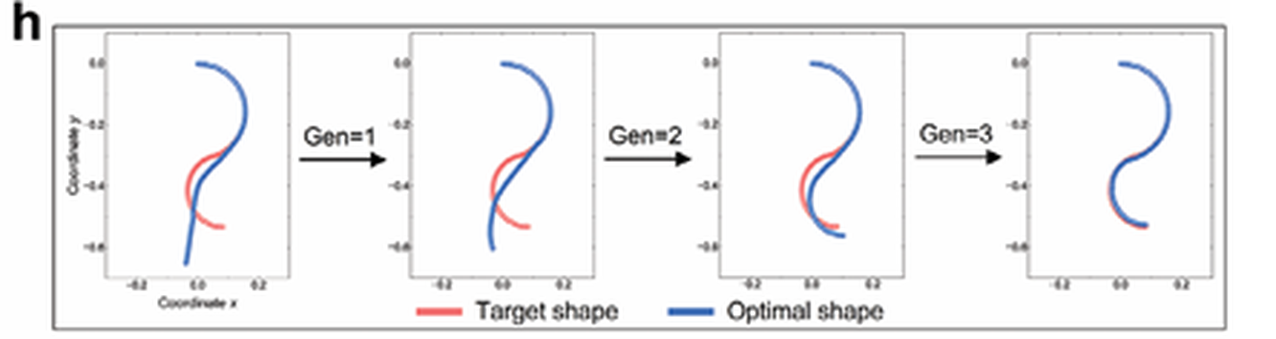
Result: on target within three generations
WANG ET AL. (2025)
98.7%
accuracy with progressive search
Target (red) vs. predicted optimal shape (blue), generations 0 → 3
vs 87.65%
with a standard evolutionary algorithm
Wang et al. 2025, PEA results figure, panels h–i [1]; bar chart recreated from the published table values.
Notes:
PRESENTER: Pavan
SCRIPT (≤30 s):
Yes. In Wang's example, the predicted shape matches the target within three generations. Over 2,000 reverse designs, progressive search reached 98.7 percent accuracy, compared with 87.65 for a standard evolutionary algorithm. The chart is recreated from the paper's own table. Omar takes over from here.
TRANSITION: Omar: Jin et al. and our work.

Slide 10
Any outline: pad it into a grid
JIN ET AL. (2024)
0
0
2
2
0
0
Search step | Jin et al. setting
Start | 5,000 random layouts
Score | RMSE: predicted vs. target coordinates
Keep | top 10% (elites)
Mix | 70% two-point column crossover
Mutate | 20% random column flip (1 ↔ 2)
0
2
1
1
2
0
2
1
1
2
1
2
0
1
2
2
1
0
0 empty 1 passive (TPU) 2 active (SMP)
Grid → ResNet (5 residual blocks) → predicted deformation
Why it matters: padding turns irregular shapes into fixed-size inputs a CNN can read.
Illustrative grid
Jin et al., Appl. Mater. Today 40, 102373 (2024), Secs. 2–4 [2].
Notes:
PRESENTER: Omar
SCRIPT (≤30 s):
Thanks, Pavan. Jin et al. solve a different problem: arbitrary shapes. They pad any outline into a grid, with 0 for empty, 1 for passive and 2 for active. A ResNet predicts the deformation, and an evolutionary algorithm searches with the settings in the table.
TRANSITION: Their results.

Slide 11
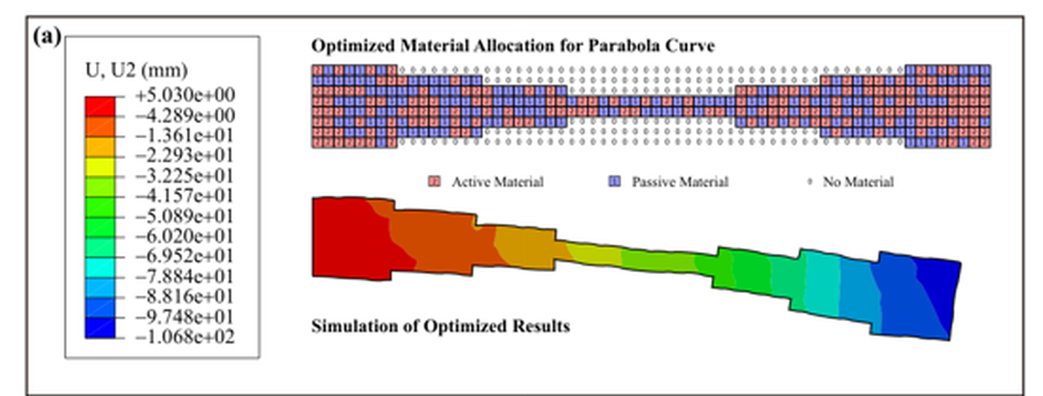
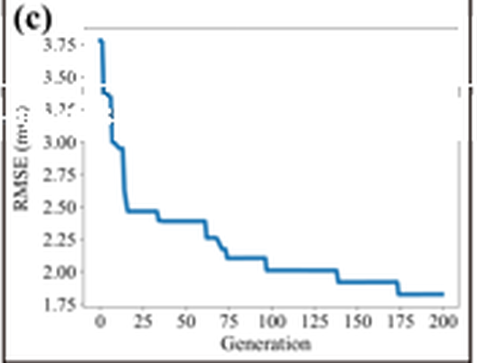
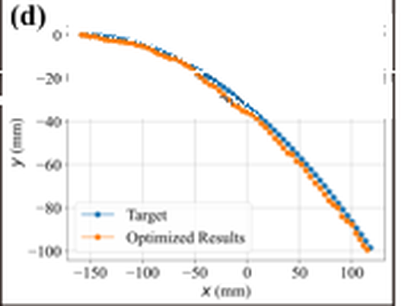

Result: curves matched, and a printed hand
JIN ET AL. (2024)
3.7 → 1.8 mm
best RMSE over 200 generations (read from Fig. 6c)
Printed hand shape
SMP/TPU part opens and closes on heating, like the target hand motion. Agreement is shown visually; no numeric printed error is reported.
Fig. 6: (a) optimised layout & FE result · (c) error vs. generation · (d) target vs. optimised
Jin et al. 2024, Fig. 6 and Fig. 7 [2]. Fig. 6 panels cleaned of a caption overlay from our source copy.
Notes:
PRESENTER: Omar
SCRIPT (≤30 s):
For a parabola target, the error drops from about 3.7 to 1.8 millimetres over 200 generations, and the optimised shape tracks the target closely. Most relevant to us, they printed a hand-shaped part that opens and closes on heating. That match is shown visually, not as a measured error.
TRANSITION: How do the two papers compare?

Slide 12
Same backbone, different goals
COMPARISON
Wang et al.
Jin et al.
Speed
Goal
Shape freedom
Hydrogel (solvent)
Material
SMP + TPU (heat)
2 × 10 binary beam
Layout
Padded 0/1/2 grid
SEP-CNN
Network
ResNet
Progressive EA
Search
Standard EA
≈3 s · 98.7%
Headline
≈1 mm inverse error
Compiled from Wang et al. 2025 [1] and Jin et al. 2024 [2]. Headline metrics are not directly comparable.
Notes:
PRESENTER: Omar
SCRIPT (≤30 s):
Same backbone, different goals. Wang optimises for speed in a small, structured beam. Jin optimises for geometric freedom with arbitrary outlines. Their metrics aren't directly comparable, so we treat them as complementary: Jin's representation with Wang's fast search is a natural next step.
TRANSITION: Part two: what we actually built.

Slide 13
What our repo does
02
A fork of Wang’s code with a ResNet experiment
Notes:
PRESENTER: Omar
SCRIPT (≤30 s):
Part two: what our repository actually does.
TRANSITION: We started by replacing the forward model.

Slide 14



Replacing the model: not plug-and-play
OUR FORK
Layout
(batch, 2, 10)
SEP-CNN or 2D ResNet
Predicted curve
(batch, 2, 200)
Score vs target
target_test.csv
PEA
search
Same input/output shapes. Still needed:
Matching preprocessing
Same output format
New trained weights
PEA integration
/1000 scaling, curve unification
2 × 200 predicted curve
retrained checkpoint
PEA_fair_resnet.py
Both trained with the same steps (10,000), batch size, learning rate, preprocessing and MSE loss on 6,000 train / 2,000 test samples.
Repository: train_*_fair.py, PEA_fair_sepcnn.py, PEA_fair_resnet.py, Documentation.md [6].
Notes:
PRESENTER: Omar
SCRIPT (≤30 s):
In our fork, we replaced SEP-CNN with a retrained 2D ResNet. Both take a 2-by-10 layout and predict a 2-by-200 curve. But it wasn't plug-and-play. We needed matching preprocessing, consistent outputs, new trained weights and a separate PEA script. Both models were trained under the same documented setup.
TRANSITION: What did we find?

Slide 15

Three tests, three different answers
OUR FORK
Held-out test MSE
Two selected designs
Same 1,024 candidates
Mixed
≈41× lower (ResNet)
neither model lower on both designs
1,016 / 1,024
2,000 test samples · predictive accuracy only
where SEP-CNN error was lower · this set only
All errors are model predictions vs. a numeric target, not FE or physical validation. No universal winner.
Documentation.md (test MSE, 2-design check); cross_model_1024_results.csv [6].
Notes:
PRESENTER: Omar
SCRIPT (≤30 s):
Three separate results. On held-out test data, ResNet's MSE was about 41 times lower. On two hand-picked designs, the result was mixed. On one shared set of 1,024 candidates, SEP-CNN had lower error on 1,016. All of these are model predictions against the target, not physical validation.
TRANSITION: So where does this lead?

Slide 16


The 4D vision (proposed, not yet built)
WHAT’S NEXT
Hand scan
Target shape
Voxel grid
Surrogate + PEA
FE check
4D print
Needs first: digitize the target curve, resample to 200 points, and match coordinates and scale. Our separate FreiHAND prototype is not part of this code.
1
2
3
Representation decides what you can design
Test the surrogate inside the search loop
Validate designs with FE and printing
Proposed research direction. Demonstrated hand-shape actuation: Jin et al. 2024, Fig. 7 [2].
Notes:
PRESENTER: Omar
SCRIPT (≤30 s):
Our vision, which is proposed and not built, goes from a patient's hand scan to a printed orthosis. A drawn or scanned target would first need digitizing, resampling to 200 points, and scaling. Our separate FreiHAND prototype isn't part of this code. Takeaways: representation matters, test the surrogate inside the loop, and validate physically.
TRANSITION: Thank you; questions welcome.

Slide 17

Questions?
References
[1] M. Wang et al., Adv. Sci. 12(12), 2407825, 2025. doi:10.1002/advs.202407825
[2] L. Jin et al., Appl. Mater. Today 40, 102373, 2024. doi:10.1016/j.apmt.2024.102373
[3] “4Doodle,” Proc. CHI ’23, ACM. doi:10.1145/3544548.3581321
[4] X. Sun et al., Adv. Funct. Mater. 32(10), 2109805, 2022. doi:10.1002/adfm.202109805
[5] X. Sun et al., J. Mech. Phys. Solids, 105561, 2024. doi:10.1016/j.jmps.2024.105561
[6] github.com/proknapz/Fast-reverse-design-of-4D-printing (fork of MengtaoWANG/…)
Which validation step should come first: an FE check, a printed measurement, or new target shapes?
Pavan Kailas Patil · Omar Khan · UT Dallas
Notes:
PRESENTER: Omar
SCRIPT (≤30 s):
Thank you. Our question for you: which validation step should come first before moving toward orthoses? Is it a finite-element check, a printed measurement, or testing new target shapes?
TRANSITION: (Q&A)

