Slide 1

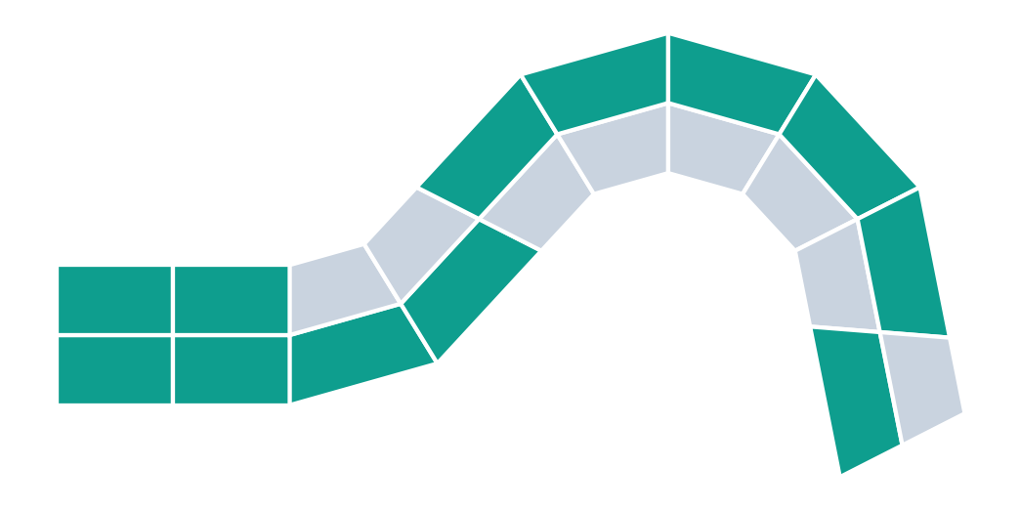
From Freehand 4D Printing to AI-Driven Fast Reverse Design
THE UNIVERSITY OF TEXAS AT DALLAS
print flat
trigger
Pavan Kailas Patil · Omar Khan
Based on Wang et al. (2025) and Jin et al. (2024)
programmed shape
Schematic illustration
Notes:
PRESENTER: Pavan
SCRIPT (≤30 s):
Good morning. I'm Pavan, and with Omar Khan we'll show how a 4D-printed part can be designed backwards: start from the shape you want, then compute the material layout. We review Wang et al. 2025 and Jin et al. 2024, and finish with what our own fork of Wang's code does.
TRANSITION: Let's start with a hands-on example of 4D printing.

Slide 2
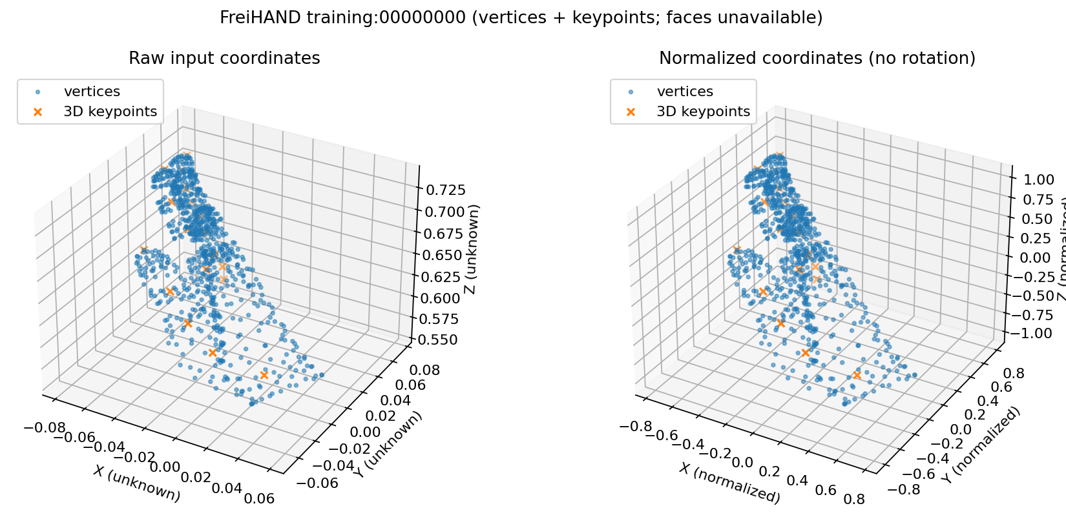
FREIHAND - SEPARATE GEOMETRY PROTOTYPE
Normalize real FreiHAND hand geometry
REAL TRAINING SAMPLE
778 vertices
21 keypoints
Loader: annotations + metadata.
Normalization creates a reversible, uniformly scaled copy; axes are unchanged.
50 sampled records passed prototype checks.
Not fit or clinical validation.
Real FreiHAND training sample 00000000 [5]; loader and normalization checks [6].
2

Slide 3
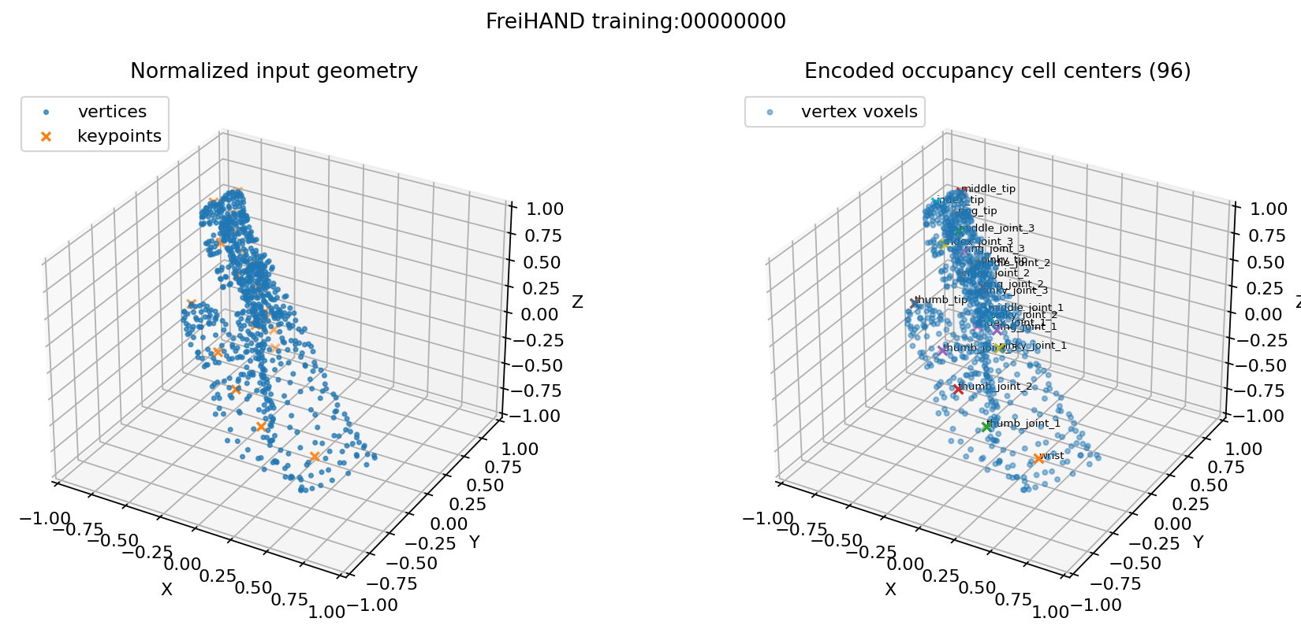
FREIHAND - IMPLEMENTED SPATIAL ENCODER
Voxelize vertices and named keypoints
96³ × 22
binary uint8 tensor
Channel 0
Observed-vertex occupancy
Channels 1–21
One named keypoint per channel
Transform and scale stored as metadata.
LIMITATION No face topology is supplied: channel 0 marks sampled vertices, not a continuous hand surface. Not an orthosis-fit or clinical validation system.
FreiHAND representation and 50-sample inspection [6]; dataset source [5].
3

Slide 4




Freehand 4D: a pen path programs the shape
A HANDS-ON STARTING POINT
THIS TALK
Reverse design
Draw
Store
Heat
Target shape
↓ compute
Material layout
3D pen extrudes plastic along a hand-drawn path
stretching freezes strain into that path
strain releases and the part bends
Fabrication-side example: the person chooses the path; the shape follows.
Our repo: target is a numeric curve loaded from CSV. No sketch or drawing input.
Freehand fabrication is background only; it is not implemented in our code.
4Doodle, Proc. CHI ’23, doi:10.1145/3544548.3581321 [3]; strain release on heating: Jin et al. 2024, Sec. 3.1 [2]. Icons schematic.
Notes:
PRESENTER: Pavan
SCRIPT (≤30 s):
Freehand 4D printing, as in 4Doodle, uses a handheld 3D pen. Extruding plastic stores strain along the drawn path, and heating releases it, so the path programs the shape change. That's the fabrication side. The rest of our talk is a different problem, reverse design: given a target shape, choose the material layout. Our repository does not take hand-drawn sketches; its target is a numeric curve loaded from a CSV file.
TRANSITION: Wang et al. tackle reverse design directly.

Slide 5
Fast reverse design
01
Wang et al., Advanced Science, 2025
Notes:
PRESENTER: Pavan
SCRIPT (≤30 s):
Part one: fast reverse design by Wang and colleagues.
TRANSITION: Here's their framework.

Slide 6
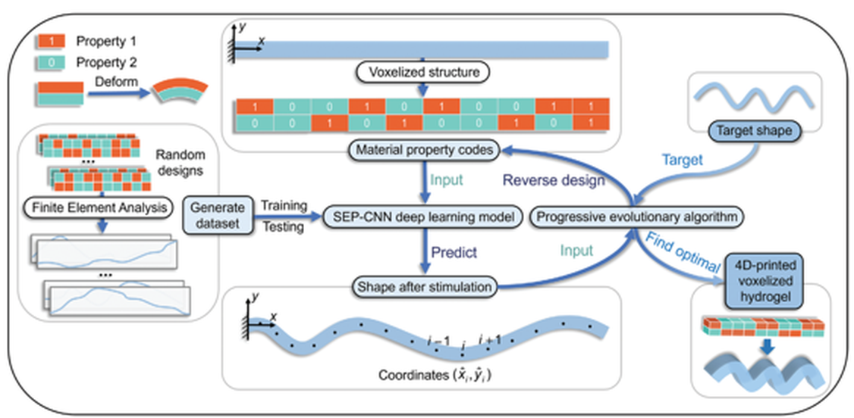
Simulate once, then design in seconds
WANG ET AL. (2025)
≈3 s
average time per design
2²⁰
≈1 million possible layouts
6,000
Wang et al. 2025, Fig. 1: overall framework
Solvent-responsive hydrogel beam · FE data → neural network → evolutionary search
FE samples was the best training-set size
Wang et al., Adv. Sci. 12(12), 2407825 (2025): abstract, Fig. 1, Fig. 4a [1].
Notes:
PRESENTER: Pavan
SCRIPT (≤30 s):
Wang et al. design hydrogel beams made of voxels. Finite-element simulations train a neural network that predicts the bent shape. An evolutionary algorithm then searches for the layout that matches a target. They report about three seconds per design, in a space of over a million possible layouts.
TRANSITION: Let's look at how voxels encode the shape.

Slide 7
Voxels are the design language
WANG ET AL. (2025)
2 × 10 layout (example)
1
active voxel: swells more
1
1
0
0
1
1
1
1
1
0
1
1
1
1
0
0
0
0
0
1
0
passive voxel: swells less
swells
↻
each column's mismatch sets its local bend
∿
the column sequence sets the whole curve: 200 (x, y) points
Wang et al. 2025, Fig. 1–2 captions, Sec. 2.2 [1]; (batch, 2, 10) → (batch, 2, 200) per repo Documentation.md [4]. Bent strip is schematic.
Notes:
PRESENTER: Pavan
SCRIPT (≤30 s):
Each voxel is either active, coded 1, which swells more, or passive, coded 0, which swells less. The beam is a 2-by-10 grid. Each column's mismatch sets its local bend, and the sequence of columns sets the overall curve. The model predicts that curve as 200 x-y points.
TRANSITION: Two engines do the work: predict and search.

Slide 8


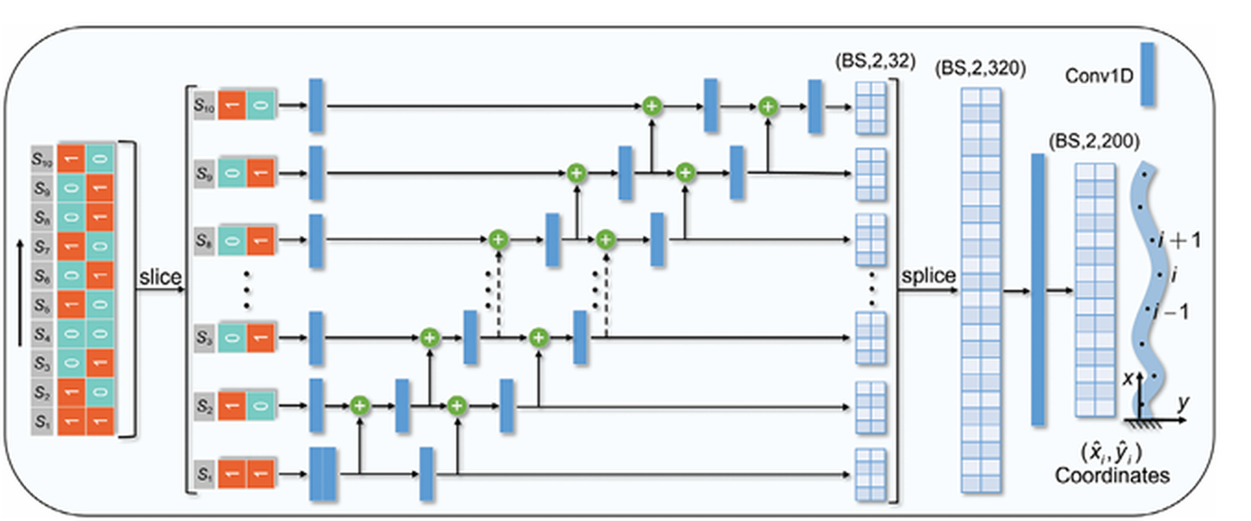
Two engines: predict fast, search smart
WANG ET AL. (2025)
PREDICT · SEP-CNN
SEARCH · Progressive EA
early
middle
final
Each voxel column gets its own channel and passes information to the next, like a sequence.
Locks in good columns one by one instead of guessing all 20 genes at once.
Repo: target read as a numeric curve from target_test.csv
Wang et al. 2025, Fig. 3
Wang et al. 2025, Fig. 3 and PEA description [1]; repository PEA_for_reverse_design.py [4]. Column-locking graphic is schematic.
Notes:
PRESENTER: Pavan
SCRIPT (≤30 s):
To predict, SEP-CNN processes each voxel column in its own channel and passes information along to the next. To search, the progressive evolutionary algorithm locks in good columns one at a time instead of guessing all twenty genes at once. In the repository, the target is a numeric curve read from a CSV file.
TRANSITION: What do Wang et al. report?

Slide 9
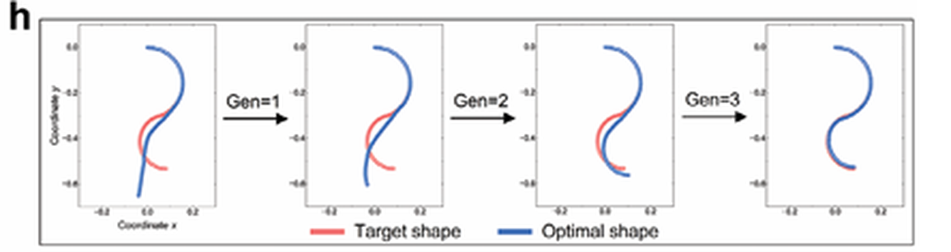
Wang et al. report: target hit by generation 3
WANG ET AL. (2025)
98.7%
overall accuracy S with progressive search (DL-PEA)
Wang et al.: target (red) vs. optimal shape (blue), generations 0 → 3
vs 87.65%
with a standard EA (DL-EA)
Reported by Wang et al.; not reproduced in our repo
Wang et al. 2025, PEA results figure, panels h–i [1]. S = overall accuracy in their table of 2,000 reverse designs; exact definition per paper.
Notes:
PRESENTER: Pavan
SCRIPT (≤30 s):
These are Wang et al.'s reported results, not ours. In their example, the optimal shape matches the target by generation 3. Their table of 2,000 reverse designs reports an overall accuracy, S, of 98.7 percent with progressive search versus 87.65 for a standard evolutionary algorithm. The chart is recreated from that table. Omar takes over.
TRANSITION: Omar: Jin et al. and our work.

Slide 10
Any outline: pad it into a grid
JIN ET AL. (2024)
0
0
2
2
0
0
Search step | Jin et al. setting
Start | 5,000 random layouts
Score | RMSE: predicted vs. target coordinates
Keep | top 10% (elites)
Mix | 70% two-point column crossover
Mutate | 20% random column flip (1 ↔ 2)
0
2
1
1
2
0
2
1
1
2
1
2
0
1
2
2
1
0
0 empty 1 passive (TPU) 2 active (SMP)
Grid → ResNet (5 residual blocks) → predicted deformation
Why it matters: padding turns irregular shapes into fixed-size inputs a CNN can read.
Illustrative grid
Jin et al., Appl. Mater. Today 40, 102373 (2024), Secs. 2–4 [2].
Notes:
PRESENTER: Omar
SCRIPT (≤30 s):
Thanks, Pavan. Jin et al. solve a different problem: arbitrary shapes. They pad any outline into a grid, with 0 for empty, 1 for passive and 2 for active. A ResNet predicts the deformation, and an evolutionary algorithm searches with the settings in the table.
TRANSITION: Their results.

Slide 11
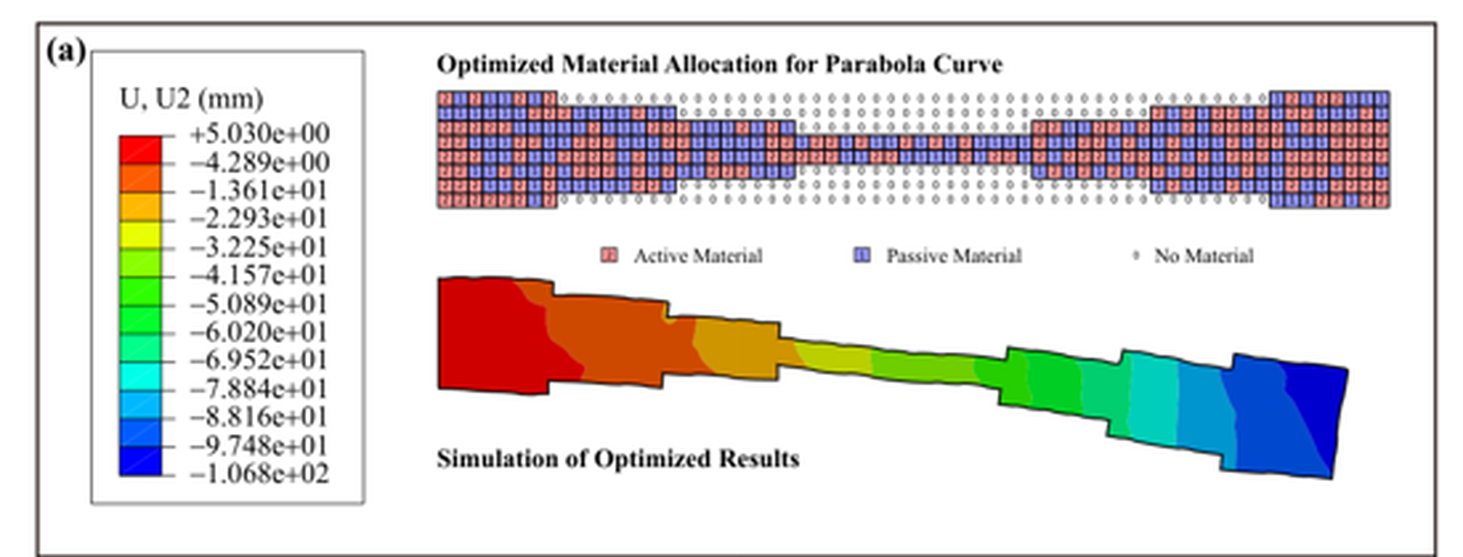
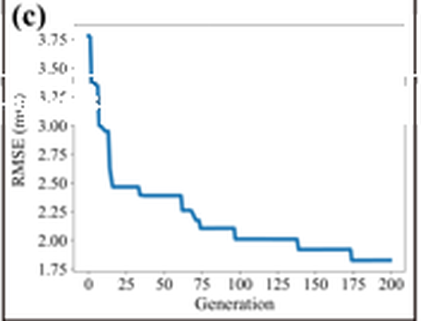
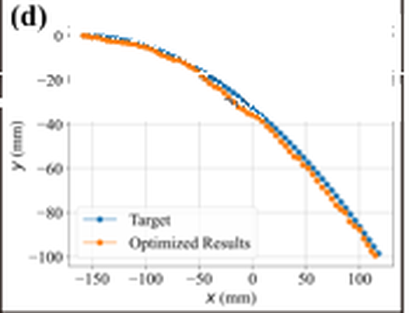

Result: curves matched, and a printed hand
JIN ET AL. (2024)
3.7 → 1.8 mm
best RMSE over 200 generations (read from Fig. 6c)
Printed hand shape
SMP/TPU part opens and closes on heating, like the target hand motion. Agreement is shown visually; no numeric printed error is reported.
Fig. 6: (a) optimised layout & FE result · (c) error vs. generation · (d) target vs. optimised
Jin et al. 2024, Fig. 6 and Fig. 7 [2]. Fig. 6 panels cleaned of a caption overlay from our source copy.
Notes:
PRESENTER: Omar
SCRIPT (≤30 s):
For a parabola target, Jin et al. report the best error falling from about 3.7 to 1.8 millimetres over 200 generations, with the optimised shape tracking the target. They also printed a hand-shaped part that opens and closes on heating. That match is shown visually, not as a measured error.
TRANSITION: How do the two papers compare?

Slide 12
Related workflow, different models and goals
COMPARISON
Wang et al.
Jin et al.
Speed
Goal
Shape freedom
Hydrogel (solvent)
Material
SMP + TPU (heat)
2 × 10 binary beam
Layout
Padded 0/1/2 grid
SEP-CNN
Network
ResNet
Progressive EA
Search
Standard EA
≈3 s · 98.7%
Headline
≈1 mm inverse error
Compiled from Wang et al. 2025 [1] and Jin et al. 2024 [2]. Both pair a learned forward model with evolutionary search; metrics are not directly comparable.
Notes:
PRESENTER: Omar
SCRIPT (≤30 s):
The workflow is related: a learned forward model plus evolutionary search. But the models and goals differ. Wang uses SEP-CNN and progressive search for speed in a small beam. Jin uses ResNet and a standard evolutionary algorithm for arbitrary outlines. Their metrics aren't directly comparable.
TRANSITION: Part two: what our repository does.

Slide 13
What our repo does
02
A fork of Wang’s code with a ResNet experiment
Notes:
PRESENTER: Omar
SCRIPT (≤30 s):
Part two: what our repository actually does.
TRANSITION: We started by replacing the forward model.

Slide 14



Replacing the model: not plug-and-play
OUR FORK
Layout
(batch, 2, 10)
SEP-CNN or 2D ResNet
Predicted curve
(batch, 2, 200)
Score vs target
target_test.csv
PEA
search
Same input/output shapes. Still needed:
Matching preprocessing
Same output format
New trained weights
PEA integration
/1000 scaling, curve unification
2 × 200 predicted curve
retrained checkpoint
PEA_fair_resnet.py
Both trained on the same 6,000 samples (10,000 steps, same batch size, learning rate, preprocessing, MSE loss) and evaluated on a separate held-out test set of 2,000.
Repository: train_*_fair.py, PEA_fair_sepcnn.py, PEA_fair_resnet.py, Documentation.md [4].
Notes:
PRESENTER: Omar
SCRIPT (≤30 s):
In our fork we replaced SEP-CNN with a retrained 2D ResNet. Both map a 2-by-10 layout to a 2-by-200 curve, but it wasn't plug-and-play. We needed matching preprocessing, the same output format, a new checkpoint and PEA integration. Both models were trained on the same 6,000 samples and tested on a separate held-out set of 2,000.
TRANSITION: What did we find?

Slide 15

Three tests, three different answers
OUR FORK
Held-out test MSE
Two selected designs
Shared gen-5 set: 1,024
Mixed
≈41× lower (ResNet)
neither model lower on both designs
1,016 / 1,024
separate 2,000-sample test set · prediction only
SEP-CNN lower target-curve prediction error · this set only
All errors are model predictions vs. a numeric target curve, not physical performance. These experiments do not establish a universal winner.
Documentation.md (test MSE, 2-design check); cross_model_1024_results.csv [4].
Notes:
PRESENTER: Omar
SCRIPT (≤30 s):
Three separate results. On the held-out test set, ResNet's MSE was about 41 times lower. On two selected designs, the result was mixed. On one shared set of 1,024 generation-5 candidates, SEP-CNN had lower target-curve prediction error on 1,016. These are model predictions, not physical performance, and they don't establish a universal winner.
TRANSITION: So where does this lead?

Slide 16



The 4D vision (proposed, not yet built)
WHAT’S NEXT
Hand scan
Target shape
Voxel grid
Surrogate + PEA
FE check
4D print
Needs first: digitize the target curve, resample to 200 points, and match coordinates and scale. The FreiHAND geometry prototype is separate from this PEA pipeline.
1
2
3
Representation decides what you can design
Test the surrogate inside the search loop
Validate designs with FE and printing
Proposed research direction. Demonstrated hand-shape actuation: Jin et al. 2024, Fig. 7 [2].
Notes:
PRESENTER: Omar
SCRIPT (≤30 s):
Our vision, which is proposed and not built, goes from a patient's hand scan to a printed orthosis. A drawn or scanned target would first need digitizing, resampling to 200 points, and scaling. Our separate FreiHAND prototype isn't part of this code. Takeaways: representation matters, test the surrogate inside the loop, and validate physically.
TRANSITION: Thank you; questions welcome.

Slide 17

Questions?
References
[1] M. Wang et al., Adv. Sci. 12(12), 2407825, 2025. doi:10.1002/advs.202407825
[2] L. Jin et al., Appl. Mater. Today 40, 102373, 2024. doi:10.1016/j.apmt.2024.102373
[3] “4Doodle,” Proc. CHI ’23, ACM. doi:10.1145/3544548.3581321
[4] github.com/proknapz/Fast-reverse-design-of-4D-printing (fork of github.com/MengtaoWANG/Fast-reverse-design-of-4D-printing)
[5] FreiHAND v2 dataset and reference code: github.com/lmb-freiburg/freihand.
[6] Loader, normalizer, encoder, and validation reports: this repository's FreiHAND/ folder.
Which validation step should come first: an FE check, a printed measurement, or new target shapes?
Pavan Kailas Patil · Omar Khan · UT Dallas
Notes:
PRESENTER: Omar
SCRIPT (≤30 s):
Thank you. Our question for you: which validation step should come first before moving toward orthoses? Is it a finite-element check, a printed measurement, or testing new target shapes?
TRANSITION: (Q&A)

