Slide 1
Swapping the Forward Model: SEP-CNN to ResNet in a Deep-Learning Progressive Evolutionary Algorithm for 4D-Printed Shape Inverse Design
A computational step toward patient-specific 4D-printed hand orthoses
Omar Khan · 2026
Notes:
Today I'll present a controlled experiment: we took Wang et al.'s fast reverse-design framework for 4D printing and replaced only its neural-network forward model (SEP-CNN) with a ResNet, then asked whether that single change alters the design the optimizer finds. First I'll give the background, including the freehand-drawing idea, then a few slides on Wang et al., then our method, results, a candid validity check, and the road toward hand orthoses.

Slide 2

The question behind the project
Already shown — but only separately
1
Hand geometry → customised orthoses
Can AI/ML learn the link between patient-specific hand geometry, 4D-printable material layouts and the resulting shape change — and use it to design a personalised hand orthosis automatically?
2
4D printing → shape-changing orthoses / exoskeletons
3
Deep learning (e.g. ResNet) → predicts 4D deformation
4
ML + optimisation → inverse design of 4D structures
5
Computer vision → extracts target shapes (freehand lines)
This study stress-tests the ML + optimisation core.
Notes:
The long-term goal is an AI pipeline that goes from a patient's hand to a 4D-printed orthosis. Each ingredient exists in the literature, but separately. This presentation focuses on the computational core: a learned forward model plus an evolutionary optimizer. Before scaling to orthoses we need to know how sensitive that core is to the choice of forward model.

Slide 3
Background: from a freehand sketch to a 4D-printed shape
01
Why inverse design needs a fast learned forward model

Slide 4




From freehand to 4D: draw the target, the algorithm finds the material
Draw
See
Design
Print & trigger
User sketches the desired final curve by hand
Computer vision extracts the line as target coordinates
ML model + evolutionary algorithm search the voxel layout
Multi-material beam is printed straight, then morphs into the drawing
Why it matters here: in the orthosis vision, a patient's hand scan takes the place of the freehand sketch — the target comes from the person, the material layout comes from the algorithm.
Sun et al., Adv. Funct. Mater. (2022); Sun et al., J. Mech. Phys. Solids (2024)
Notes:
The 'freehand' idea comes from H. Jerry Qi's group. In Sun et al. 2022 (Advanced Functional Materials) a person draws a line, computer vision turns it into target coordinates, an ML model plus evolutionary algorithm chooses which voxels of a straight beam are active or passive, and the printed beam transforms into the drawn profile when stimulated. Their 2024 JMPS follow-up (ML + sequential subdomain optimisation) does the same with hand-drawn targets in seconds. This is exactly the 'target in, material layout out' pattern we want — for an orthosis, the target comes from the patient's hand instead of a sketch.

Slide 5
Learned surrogates: from days to seconds
≈219 days
FE simulation inside an EA loop (estimated)
54 min
ML forward model + EA
1.97 s
ML + sequential subdomain optimisation
Lesson: the FE forward simulation is the bottleneck — replace it with a trained network, then let the optimiser query it thousands of times.
Data: Sun et al., J. Mech. Phys. Solids (2024)
Notes:
Why do we need a neural network at all? Because inverse design calls the forward model thousands of times. For one benchmark shape in the Qi group's 2024 paper, a finite-element-plus-EA search was estimated to take about 219 days; swapping FE for an ML model brought it to 54 minutes; a smarter optimiser brought it to about 2 seconds. Note the log scale. Wang et al., which we build on, reports about 3 seconds per design for a different (hydrogel) problem.

Slide 6
Two problems: forward and inverse
FORWARD
Material layout
(which voxel is which)
Forward model
FE simulation or neural net
Deformed shape
(200 x,y points)
INVERSE
Target shape
(sketch, scan, curve)
Optimiser (EA / PEA)
queries forward model
Best material layout
to print
Key idea: the network predicts, the evolutionary algorithm searches — so the network's errors steer the search.
Notes:
Forward: given a material layout, predict the shape. Inverse: given a target shape, find the layout. Inverse design has no direct formula, so an evolutionary algorithm proposes layouts and asks the forward model to score them. This is the crux of our study: the optimiser trusts the forward model, so any bias in the network can push the search toward a different answer.

Slide 7
Reference study: Wang et al. (2025) — Fast Reverse Design
02
Advanced Science 12(12), 2407825 · SEP-CNN + Progressive Evolutionary Algorithm

Slide 8
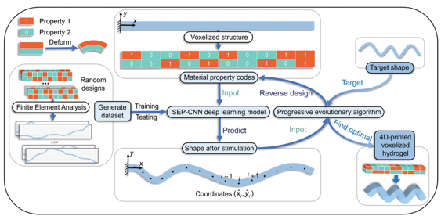
Wang et al.: the DL-PEA framework at a glance
2 × 10
voxel design (binary codes)
2²⁰ ≈ 1.05 M
possible material layouts
Wang et al. (2025), Fig. 1 — framework schematic
≈ 3.04 s
Solvent-responsive hydrogel beam built from 2 × 10 voxels, each one of two swelling properties
Randomised FE simulations generate the training data
average reverse-design time
Notes:
Wang et al. design voxelised hydrogel beams: 2 rows by 10 columns, each voxel one of two materials with different swelling. That is 2 to the 20, about a million layouts. FE simulations of random layouts train a deep network (SEP-CNN) that predicts the deformed beam as 200 coordinate points; a progressive evolutionary algorithm then searches for the layout matching a target. They report about 3 seconds per design on average.

Slide 9
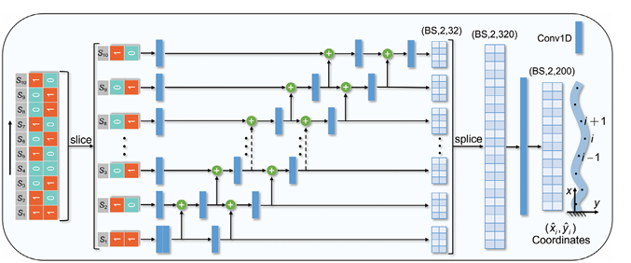
SEP-CNN: the forward model we replaced
Input: 2 × 10 property codes, sliced into 10 columns
Each column gets its own Conv1D branch; branches are chained by addition (the “sequence-enhanced” part)
Spliced to 2 × 320, then Conv1D → 2 × 200: the (x, y) coordinates of the deformed beam
Blends CNN parallelism with RNN-style sequence handling; Wang found LSTM slightly more accurate but SEP-CNN faster to train
Wang et al. (2025) — SEP-CNN architecture
2,000 predictions: ≈2.51 s vs ≈34.67 h FE
Notes:
SEP-CNN slices the 10 voxel columns into parallel 1-D convolution branches and chains them with additions, so information flows along the beam like a sequence. The concatenated features are projected to 2 by 200 outputs, which are the x and y coordinates of 200 points on the deformed beam. Wang compared it with plain CNN and LSTM; LSTM was a bit more accurate, SEP-CNN trained more efficiently. And it's fast: 2,000 predictions in about 2.5 seconds versus about 35 hours of FE.

Slide 10
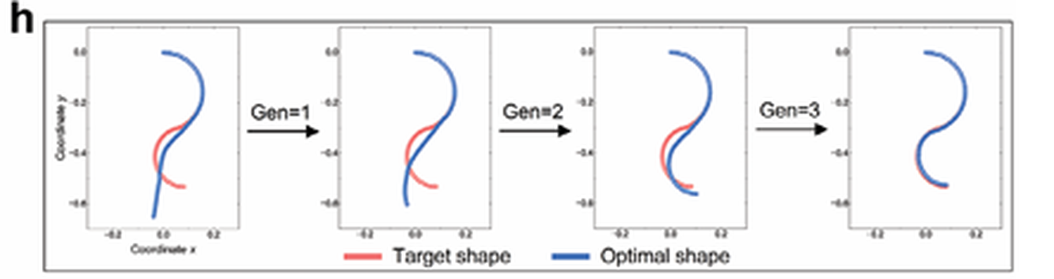
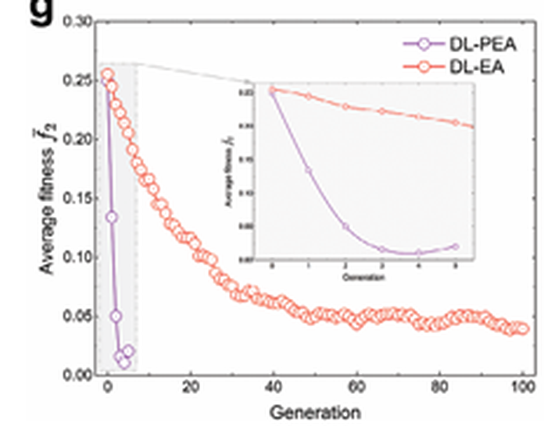
Progressive EA: optimise column by column
Scores each candidate by comparing the SEP-CNN prediction with the target
Fixes voxel columns progressively instead of evolving all 20 genes at once
Converges in a handful of generations
Target (red) vs optimal shape (blue) — matched by generation 3
Average fitness: PEA (purple) drops within ~5 generations; plain EA needs ~100
Panels from Wang et al. (2025), Fig. 5
Notes:
The progressive evolutionary algorithm is Wang's second contribution. Rather than evolving all 20 genes together, it optimises the beam column by column, keeping good prefixes. In their example the optimal shape matches the target within three generations, and over 2,000 reverse-design tests DL-PEA reached 98.7% accuracy versus 87.65% for a conventional EA with the same network. Importantly for us: this progressive structure makes the final stage nearly deterministic, which matters when we interpret our repeatability results.

Slide 11
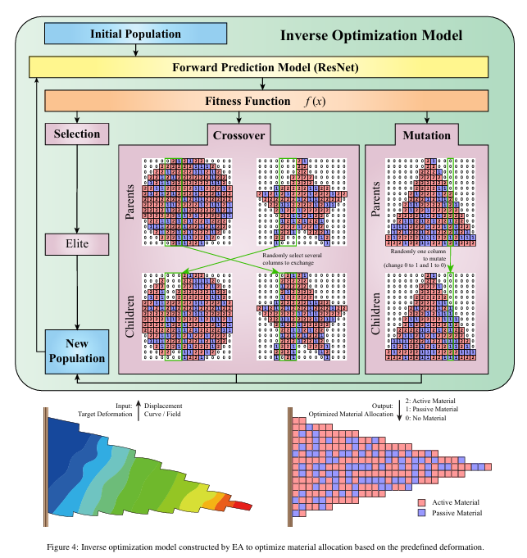




Jin et al. (2024): ResNet as the forward model
Input
Material allocation per cell: active, passive or empty
ResNet
Shortcut connections let gradients flow through deeper nets (less vanishing gradient)
EA search
Selection, crossover and mutation over material maps
Reported
Forward loss < 10⁻² mm; inverse error ≈ 1 mm
Our question: can a ResNet slot into Wang's PEA in place of SEP-CNN — and does it change the answer?
Jin et al. (2024), Fig. 4
Notes:
Jin et al. independently use the same predict-then-search recipe for hierarchical architectures of arbitrary shape, but with a ResNet forward model. ResNet's residual shortcuts make deeper convolutional networks trainable. They report forward loss below 10^-2 mm and inverse-design error around 1 mm. That raises our question: if we drop a ResNet into Wang's PEA, keeping everything else fixed, do we get the same design?

Slide 12
Two reference pipelines, one shared pattern
Feature | Jin et al. (2024) | Wang et al. (2025)
Forward model | ResNet | SEP-CNN
Optimiser | Evolutionary algorithm | Progressive EA (column-wise)
Structure | Hierarchical, arbitrary shapes | Voxelised hydrogel beam (2 × 10)
Main goal | Predict + design material allocation | Accelerate reverse design
Headline result | Inverse error ≈ 1 mm | ≈ 3.04 s per design; 98.7% accuracy
Common pattern: design → learned deformation prediction → evolutionary search → target shape
Notes:
Both papers share the pattern: a learned forward model and an evolutionary optimiser. They differ in the network and the structure. Because the forward model is the only part that 'knows' the physics, it's natural to ask how much the final design depends on which network we pick.

Slide 13
Our study: controlled replacement of SEP-CNN with ResNet
03
Same data, same optimiser, same budget — only the forward model changes

Slide 14





Research question and objectives
Does changing only the learned forward model materially change the solution that PEA finds?
Reproduce
Wang's SEP-CNN + PEA as a controlled baseline
Convert
2D ResNet with the identical 2×10 → 2×200 interface
Match training
Same data, optimiser, seed and number of updates
Plug in
Each model drives the identical PEA search
Cross-check
Score the same 1,024 PEA candidates with both models
Compare
Final designs, shape error, repeatability, runtime
Notes:
The research question is narrow on purpose: we change one thing, the forward model, and ask whether the optimiser's answer changes. We reproduced Wang's code, wrote a ResNet with the exact same input and output shapes, trained both under identical conditions, ran each inside the same PEA, and then compared at three levels: test error, error on a common set of candidate designs, and the final designs themselves.

Slide 15
Method: only the forward model changes
Candidate
chromosome 2 × 10
SEP-CNN
Predicted shape
2 × 200
Fitness = error
vs target
PEA selects
next candidates
2D ResNet
ResNet conversion (same input/output contract)
2 × 10 input
Add channel
2 × 10 × 1
Conv2D stem
3 residual blocks
Project to
200 features
Reduce →
2 × 200
Residual (skip) connections preserve information across blocks. The PEA, fitness definition, data split and target shape are untouched — so any change in the answer is attributable to the forward model.
Notes:
The PEA interface is: chromosome in, predicted shape out, fitness equals error against the target. We keep that loop identical and swap only the box in the middle. The ResNet takes the same 2 by 10 input, adds a channel dimension, applies a 2D convolution stem and three residual blocks, projects to 200 features and reduces back to 2 by 200 — exactly the output SEP-CNN produces. Because nothing else changes, differences in outcome come from the forward model.

Slide 16
Protocol: matched training, three evaluations
1
Held-out test MSE
How well does each network predict FE shapes it has never seen?
Matched training
Data 6,000 train / 2,000 test FE samples
Optimiser Adam, learning rate 1×10⁻⁴
2
Same 1,024 candidates
Score PEA's generation-5 candidates with both networks — isolates the model from the search path
Batch 60
Budget Exactly 10,000 updates
Seed 42 (fixed)
3
Full PEA runs
Each network drives its own search: final design, shape error, 10 repeat runs, runtime
Pre-processing Wang's scaling + curve unification
Notes:
Training was matched: same data split from Wang's FE dataset, same Adam learning rate, batch size, seed and exactly 10,000 updates for each model. Then three evaluations. One: conventional held-out test error. Two — the important one — we take the 1,024 candidate designs PEA produced at generation 5 and score them with both networks, so both see exactly the same inputs. Three: the full search with each network, repeated 10 times.

Slide 17
Result 1 — ResNet reaches ≈41× lower test MSE
5.59×10⁻⁵ vs 2.29×10⁻³
Clear forward-model win — but does it carry over to the search?
Training logs: repo Documentation.md
Notes:
Left: training curves from our logs, log scale. ResNet drops below 10^-4 within about 4,000 steps; SEP-CNN is still around 2×10^-3 at step 10,000 and still falling. Right: held-out test MSE, 5.6×10^-5 for ResNet versus 2.3×10^-3 for SEP-CNN, about 41 times lower. On a normal ML benchmark we'd stop here and declare ResNet the winner. But the optimiser doesn't feed the network test-set designs — so we checked.

Slide 18

Result 2 — but on PEA's own candidates, SEP-CNN wins
1,016 / 1,024
generation-5 candidates on which SEP-CNN gave the lower error
Why? The optimiser presents a different distribution of designs than the random test set. Lower held-out error does not guarantee lower error where the search actually operates.
Notes:
Here's the twist. We took the same 1,024 candidate designs from PEA's final generation and scored them with both networks. SEP-CNN had lower error on 1,016 of them, and a lower mean, 0.021 versus 0.037. So the 41× test-set advantage does not transfer uniformly. The optimiser concentrates on a particular region of design space that may differ from the random training distribution. Methodologically this is the most important finding: evaluate a surrogate where the optimiser uses it, not only on a held-out set.

Slide 19
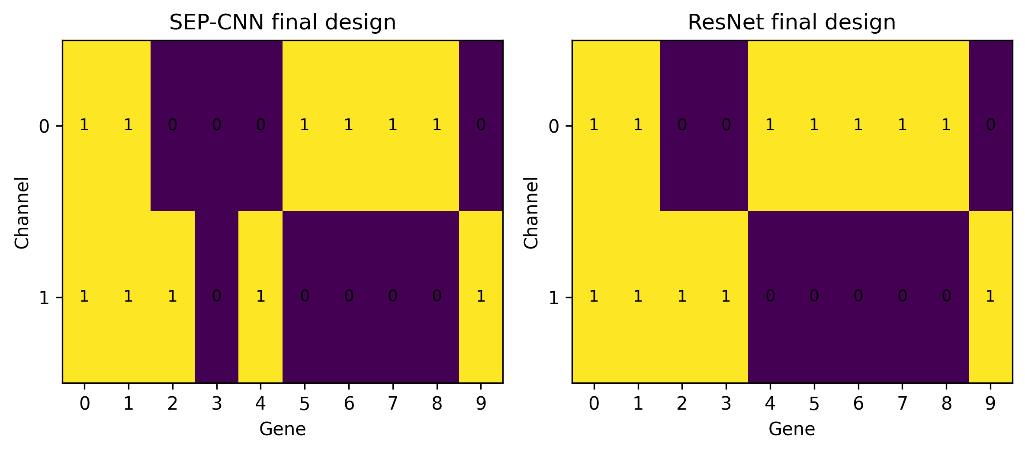
Result 3 — the two searches return different designs
3 / 20
genes differ (15% Hamming distance)
#961
candidate index chosen by both
Final chromosomes (yellow = 1, purple = 0). Rows = channels, columns = genes.
10 / 10
SEP-CNN
ResNet
[1,1,0,0,0,1,1,1,1,0] / [1,1,1,0,1,0,0,0,0,1]
[1,1,0,0,1,1,1,1,1,0] / [1,1,1,1,0,0,0,0,0,1]
runs reproduced each result
Notes:
The final designs differ in 3 of 20 genes — 15%. Both runs report candidate index 961, but that index is a position in the final-stage enumeration, not a design: because the progressive EA had already fixed different prefixes, index 961 maps to different chromosomes for the two models. Each result was identical across 10 runs, which reflects the deterministic final stage of PEA under this configuration.

Slide 20
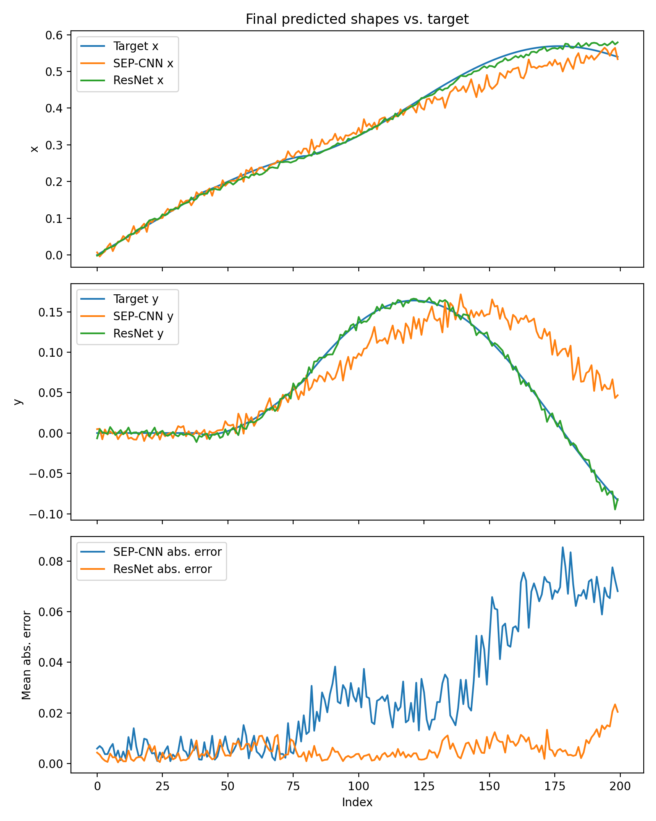
Result 4 — ResNet's design tracks the target closely
Final PEA metric | SEP-CNN | ResNet | Ratio
MSE | 3.41×10⁻³ | 1.16×10⁻⁴ | ≈29×
Mean abs. error | 0.0277 | 0.0053 | ≈5.2×
Max abs. error | 0.1425 | 0.0395 | ≈3.6×
x-trajectory: both close; ResNet nearly overlays the target
y-trajectory: ResNet reproduces the rise-and-fall; SEP-CNN drifts high after index ~120
SEP-CNN error grows toward the free end of the beam; ResNet's stays small
Errors = each model's predicted shape vs target (surrogate-predicted)
Notes:
Plotting the final predicted shapes against the target: ResNet nearly overlays the target in both x and y, including the rise and fall of y. SEP-CNN stays close early but drifts after about index 120, and its absolute error grows toward the free end. In numbers: about 29× lower MSE, 5× lower mean absolute error, 3.6× lower maximum error. One caveat I'll return to: these are each network's own predictions against the target, not FE-verified shapes.

Slide 21
Result 5 — better accuracy costs ≈1.9× runtime
10.54 ± 1.91 s
SEP-CNN per inverse-design run
19.84 ± 2.24 s
ResNet per inverse-design run
Trade-off, not a knockout
≈29× lower final shape error for ≈1.88× compute. Both still finish in seconds.
Notes:
ResNet is deeper, so each PEA run takes about 19.8 seconds versus 10.5 for SEP-CNN — roughly 1.9 times longer. For a single design that's still seconds, so it is an accuracy-versus-compute trade-off rather than a decisive loss. Our absolute times are higher than Wang's 3.04 s; our runs were on CPU-only TensorFlow 2.10, which I'll flag on the validity slide.

Slide 22
All results at a glance
Metric | SEP-CNN | ResNet | Better
Held-out test MSE | 2.29×10⁻³ | 5.59×10⁻⁵ | ResNet (≈41×)
Mean MSE on same 1,024 candidates | 0.0208 | 0.0367 | SEP-CNN (1,016 / 1,024)
Final PEA MSE | 3.41×10⁻³ | 1.16×10⁻⁴ | ResNet (≈29×)
Final PEA MAE / max abs. error | 0.0277 / 0.1425 | 0.0053 / 0.0395 | ResNet
Mean PEA runtime | 10.54 ± 1.91 s | 19.84 ± 2.24 s | SEP-CNN (≈1.9× faster)
Final candidate / repeatability | #961 · 10/10 | #961 · 10/10 | Tie
Final designs differ in 3 / 20 genes (15%).
Notes:
This table collects everything. The pattern to notice is that the 'winner' flips depending on what we measure: ResNet on held-out error and final search error, SEP-CNN on the shared candidate pool and runtime.

Slide 23
Three findings
Test error ≠ search performance
The forward model changes the answer
Model × design interaction
ResNet was ≈41× better on held-out data, yet SEP-CNN was better on 1,016 of 1,024 PEA candidates.
Swapping only the network gave a different final design (3/20 genes) and ≈29× lower final shape error.
Neither network is uniformly superior — choose forward models by evaluating them inside the full optimisation loop.
1,016 / 1,024
≈29× lower MSE
Evaluate in-loop
Notes:
Three take-aways. One: a better test score does not automatically mean a better optimiser partner. Two: the forward model is not a plug-and-play component — changing it changed the design and the error. Three: there is a model-by-design interaction, so forward models should be selected by evaluating the whole pipeline, not in isolation.

Slide 24




Validity check: what a reviewer will ask
Surrogate-only errors
Final 29× gain compares each network's own prediction with the target — verify both designs with FE (and printing).
Fixed 10k-step budget
SEP-CNN loss was still falling at step 10,000; add a converged comparison so the gap isn't just training speed.
One target, one setting
10/10 repeats reflect PEA's deterministic final stage; test more targets, seeds and mutation rates.
Clarify “candidate 961”
It is an index in the final-stage enumeration, not a shared design — say so explicitly.
Convergence figure
Only generation 5 is plotted; log the full generation-by-generation trajectory.
Runtime context
10.5 s vs Wang's ≈3.04 s — report hardware (CPU-only TF 2.10) and PEA settings.
Notes:
Being candid about limitations. Most important: the final shape errors are surrogate-predicted, so the next check is to run both final designs through FE. Second, the training budget was fixed at 10,000 updates, and the SEP-CNN log shows its loss was still decreasing, so part of the gap may be convergence speed; a converged comparison would strengthen the claim. Third, one target and one PEA configuration; the 10/10 repeatability reflects the deterministic final stage. Also: clarify what 'candidate 961' means, plot the full convergence trajectory, and report hardware for runtime. Also beyond these, the 2×10 design space is far smaller than an orthosis, and there's no physical print yet.

Slide 25
Next phase: from a 2 × 10 beam to an orthosis
1
2
3
4
5
6
Spatial grid
Multi-material
Spatial ResNet
Spatial PEA
Patient target
Validate
Replace 2×10 chromosome with an N×M orthosis grid
Separate channels for empty, passive, active
Map grid → deformed orthosis coordinates
Scale the search to the larger design space
Hand scan → target orthosis geometry
FE simulation, then 4D print
Carry forward: evaluate each forward model inside the full PEA loop and on FE-verified designs.
Notes:
The roadmap. First, replace the compact chromosome with a spatial grid describing the orthosis, with separate channels for empty, passive and active material. Train the ResNet on that grid, adapt PEA to the bigger search, then introduce a scan-derived target from the patient's hand — the 'freehand sketch' of our application. Finally validate with FE and an actual 4D print. The lesson from today carries forward: judge forward models inside the loop.

Slide 26
Conclusion: the forward model is not a swappable part
Same PEA, same data — swapping SEP-CNN for ResNet changed the design and cut final shape error ≈29×, at ≈1.9× runtime, even though SEP-CNN scored better on most PEA candidates.
A validated computational base for patient-specific 4D-printed orthosis design.
Notes:
To conclude: in a controlled experiment, changing only the forward model changed what the evolutionary algorithm designed. ResNet gave much lower final shape error at about twice the compute, while the shared-candidate test shows neither network is uniformly better. This gives us a validated computational starting point for the orthosis work. Happy to take questions.

Slide 27

References and code
[1] M. Wang et al., “Fast Reverse Design of 4D-Printed Voxelized Composite Structures Using Deep Learning and Evolutionary Algorithm,” Advanced Science 12(12), 2407825, 2025. doi:10.1002/advs.202407825
[2] L. Jin et al., “Machine learning driven forward prediction and inverse design for 4D printed hierarchical architecture with arbitrary shapes,” Applied Materials Today 40, 102373, 2024. doi:10.1016/j.apmt.2024.102373
[3] X. Sun et al., “Machine Learning-Evolutionary Algorithm Enabled Design for 4D-Printed Active Composite Structures,” Adv. Funct. Mater. 32(10), 2109805, 2022 (freehand-drawn targets).
[4] X. Sun et al., “Machine learning and sequential subdomain optimization for ultrafast inverse design of 4D-printed active composite structures,” J. Mech. Phys. Solids, 2024. doi:10.1016/j.jmps.2024.105561
Our code: github.com/proknapz/Fast-reverse-design-of-4D-printing
Forked from github.com/MengtaoWANG/Fast-reverse-design-of-4D-printing
Notes:
References and the repository. Our fork contains the fair-training scripts for both models, the instrumented PEA runs, the 1,024-candidate cross-model diagnostic and the analysis scripts.

