Slide 1
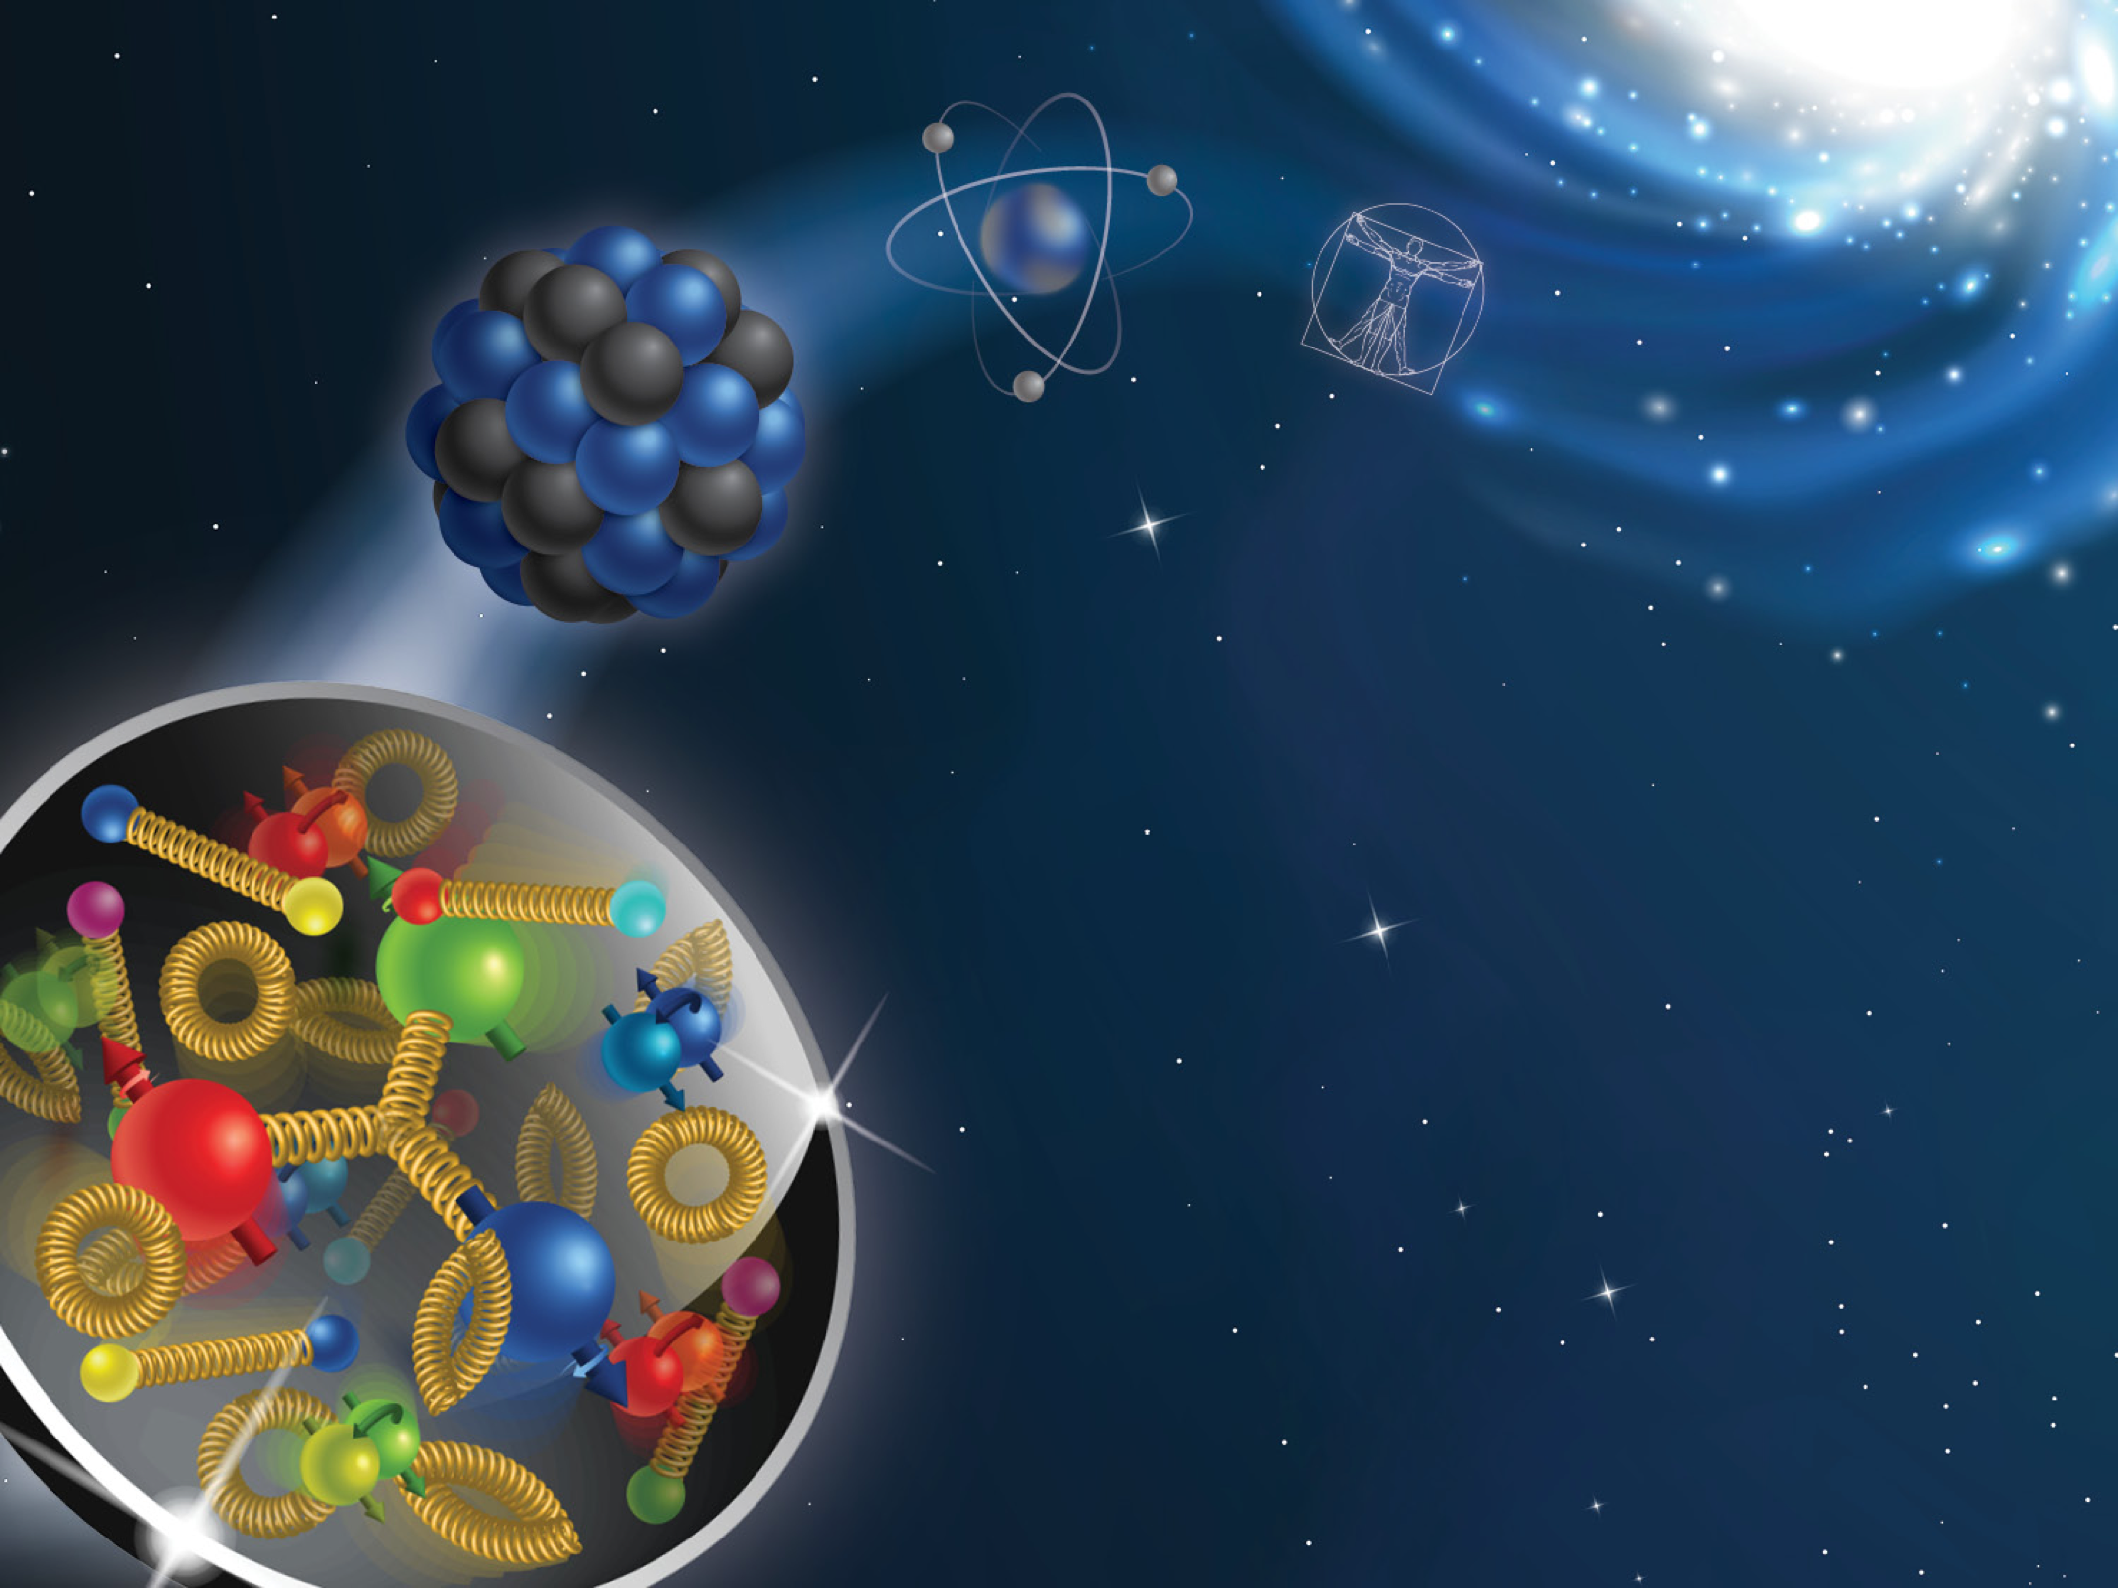
3D structure of the nucleon in the momentum space and the Electron-Ion Collider

Slide 2
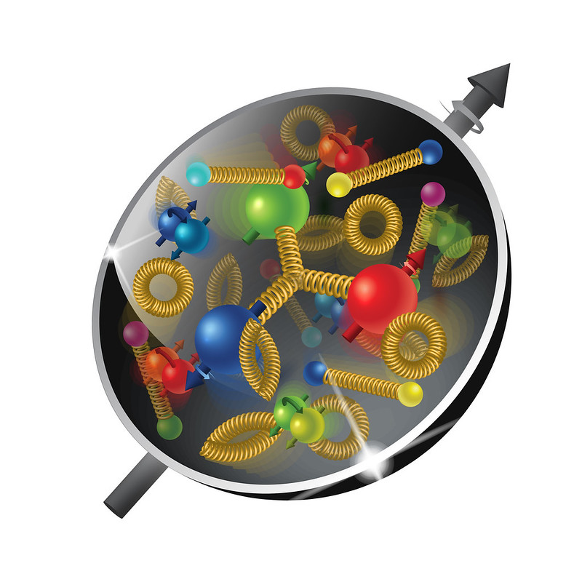
The plan
Lecture I:
Structure of the nucleon
Transverse Momentum Dependent distributions (TMDs)
Semi Inclusive Deep Inelastic Scattering (SIDIS)
Calculations of SIDIS structure functions in google colab
Lecture II:
Solution of TMD evolution equations
Collins-Soper-Sterman (CSS) formalism
Lecture III: Giuseppe Bozzi
Phenomenology of unpolarized TMDs

Slide 3
Tmd evolution equations

Slide 4
CSS solution of evolution equations

