Slide 1
Classification and Performance
Flynn’s Taxonomy
Performance, peak performance and sustained performance
Example of parallel computing
Computation graph, scheduling and execution time

Slide 2
Flynn’s Taxonomy
Computing is basically executing instructions that operate on data.
Flynn’s taxonomy classifies the system based on the parallelism in instruction stream and parallel in data stream.
single instruction stream or multiple instruction streams.
single data stream or multiple data streams.

Slide 3
Flynn’s taxonomy
Single Instruction Single Data (SISD)
Single Instruction Multiple Data (SIMD)
Multiple Instructions Multiple Data (MIMD)
Multiple Instructions Single Data (MISD)

Slide 4
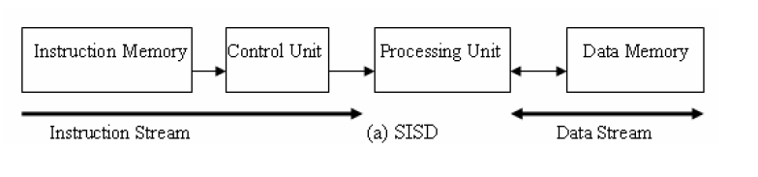
SISD
At one time, one instruction operates on one data
Traditional sequential architecture, Von Neumann architecture.

Slide 5
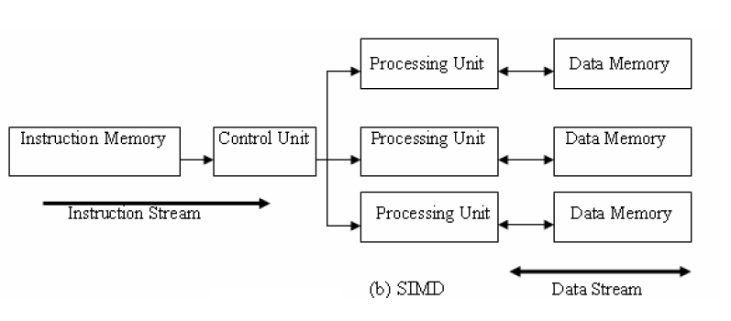
SIMD
Single control unit and multiple processing units. The control unit fetches an instruction and broadcast control to all processing units. The instruction operates on different data.
Can achieve massive processing power with minimum control logic
SIMD instructions allow for sequential reasoning.

Slide 6
SIMD
Exploit data-level parallelism
Matrix-oriented scientific computing and deep learning applications
Media (image and sound) processing
Vector machines, MMX, SSE (Streaming SIMD Extensions), AVX (Advanced Vector eXtensions), GPU

Slide 7
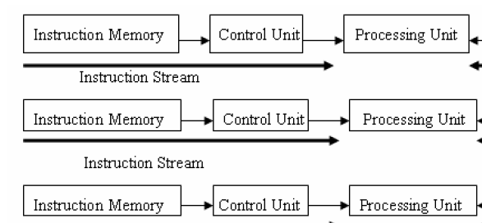

MISD
Not commonly seen, no general purpose MISD computer has been built.
Systolic array is one example of an MISD architecture.

Slide 8
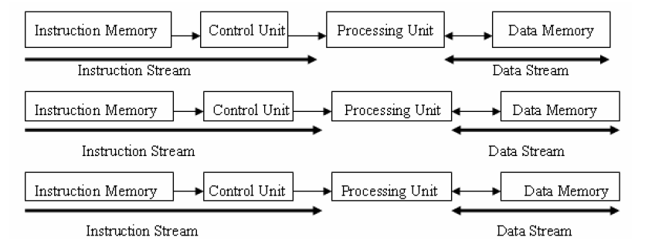
MIMD
Multiple instruction streams operating on multiple data streams
MIMD can be thought of as many copies of SISD machine.
Distributed memory multi-computers, shared memory multi-processors, multi-core computers.

Slide 9
Flynn’s Taxonomy
Type | Instruction Streams | Data Streams | Examples
SISD | 1 | 1 | Early computers, Von Neumann architecture, turing machine
SIMD | 1 | N | Vector architectures, MMX, SSE, AVX, GPU
MISD | N | 1 | No general purpose machine, systolic array
MIMD | N | N | Multi-core, multi-processor, multi-computer, cluster

Slide 10
Modern classification (Sima, Fountain, Kacsuk)
Based on how parallelism is achieved
Data parallelism: same function operating on many data
Function parallelism: performing many functions in parallel
Control parallelism, task parallelism depending on the level of the functional parallelism.
Parallel architectures
Data-parallel
architectures
Function-parallel
architectures

Slide 11
Functional-parallel architectures
Function-parallel architectures
Thread level Parallel Arch
Process level Parallel Arch
Instruction level Parallel Arch
(ILPs)
(MIMDs)
Distributed Memory MIMD
Pipelined processors
Superscalar processors
Shared Memory MIMD
VLIWs

Slide 12
Modern classification (Sima, Fountain, Kacsuk)
by operating on multiple data: data parallelism
by performing many functions in parallel: function parallelism
Control parallelism, task parallelism depending on the level of the functional parallelism.
Parallel architectures
Data-parallel
architectures
Function-parallel
architectures

Slide 13
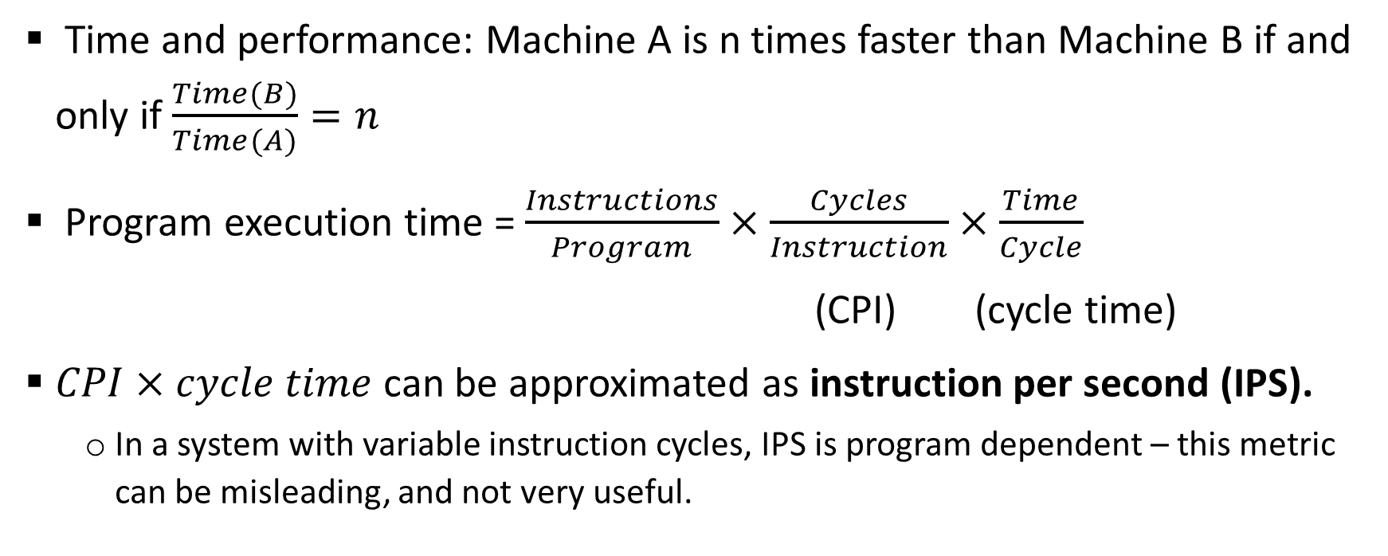
Performance
Time and performance: Machine A is n times faster than Machine B if and only if $\frac{Time(B)}{Time(A)}=n$
Program execution time = $\frac{Instructions}{Program}×\frac{Cycles}{Instruction}×\frac{Time}{Cycle}$
(CPI) (cycle time)
$CPI×cycle time$ can be approximated as instruction per second (IPS).
In a system with variable instruction cycles, IPS is program dependent – this metric can be misleading, and not very useful.

Slide 14
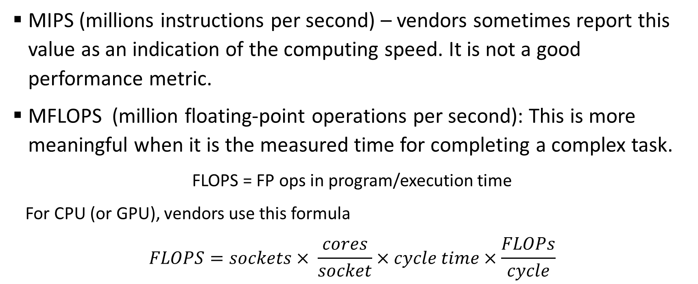
Performance
MIPS (millions instructions per second) – vendors sometimes report this value as an indication of the computing speed. It is not a good performance metric.
MFLOPS (million floating-point operations per second): This is more meaningful when it is the measured time for completing a complex task.
FLOPS = FP ops in program/execution time
For CPU (or GPU), vendors use this formula
$$FLOPS=sockets× \frac{cores}{socket}×cycle time×\frac{FLOPs}{cycle}$$

Slide 15
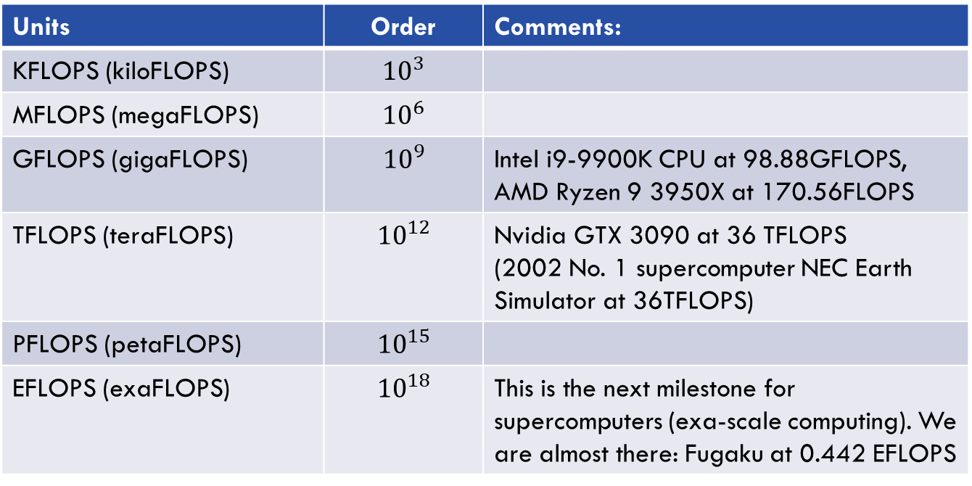
FLOPs units
Units | Order | Comments:
KFLOPS (kiloFLOPS) | $${10}^{3}$$
MFLOPS (megaFLOPS) | $${10}^{6}$$
GFLOPS (gigaFLOPS) | $${10}^{9}$$ | Intel i9-9900K CPU at 98.88GFLOPS, AMD Ryzen 9 3950X at 170.56FLOPS
TFLOPS (teraFLOPS) | $${10}^{12}$$ | Nvidia GTX 3090 at 36 TFLOPS (2002 No. 1 supercomputer NEC Earth Simulator at 36TFLOPS)
PFLOPS (petaFLOPS) | $${10}^{15}$$
EFLOPS (exaFLOPS) | $${10}^{18}$$ | This is the next milestone for supercomputers (exa-scale computing). We are almost there: Fugaku at 0.442 EFLOPS
You can find the FLOPS for up-to-date CPUs at
https://setiathome.berkeley.edu/cpu_list.php

Slide 16
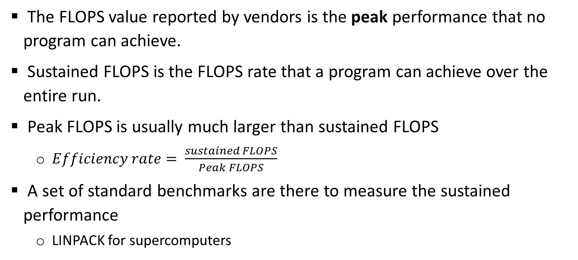
Peak and sustained performance
The FLOPS value reported by vendors is the peak performance that no program can achieve.
Sustained FLOPS is the FLOPS rate that a program can achieve over the entire run.
Peak FLOPS is usually much larger than sustained FLOPS
$Efficiency rate= \frac{sustained FLOPS}{Peak FLOPS}$
A set of standard benchmarks are there to measure the sustained performance
LINPACK for supercomputers

Slide 17
Parallel computing and parallel programming
Parallel computing: using multiple processing elements in parallel to solve problems more quickly than with a single processing element.
Fully utilize the computing power in contemporary computing systems.
Parallel programming:
Specification of operations that can be executed in parallel
A parallel program is decomposed into sequential subcomputations (tasks)
Parallel programming constructs define task creation, termination, and interaction.

Slide 18
Parallel programming example
See lect2/sum.cpp and lect2/sum_omp.cpp
“#pragma omp parallel sections” specifies task creation and termination
“#pragma omp section” specifies the two tasks in the program.
Notice that the parallel program runs slower when the array size is small.
lect2/sum_omp.cpp consists of four sub-tasks.
A: the sequential part before the parallel region
B, C: the two parallel sub-tasks
D: the part after the parallel sub-tasks join back.
A
B
C
D

Slide 19
Parallel programming example
Notice that this parallel program is non-trivial
The calculation of sum in the loop has dependency inside.
To overcome that,
Decompose the problem into two tasks, each compute partial sums
Combine the results to get the final answer
sum
T[0]
+
T[1]
+
T[size-1]
+

Slide 20
Modeling the execution of a parallel program
The execution of a parallel program can be represented as a computation graph (CG) or parallel program dependence graph that allows for reasoning about the execution.
Nodes are sequential subtasks
Edges represent the dependency constraints
Both control dependency and data dependency are captured.
A CG is a directed acyclic graph (DAG) since a node cannot depend on itself.
CG describes a set of computational tasks and the dependencies between them.

Slide 21
Computation graph example
The computation graph for lect2/sum_omp.cpp
Node A must be executed before Node B if there is a path from A to B in the graph
CG can be used as a visualization technique to help us understand the complexity of the algorithms.
CG can also be used as a data structure for the compiler or the system to schedule the execution of the sub-tasks.
A
B
C
D

Slide 22
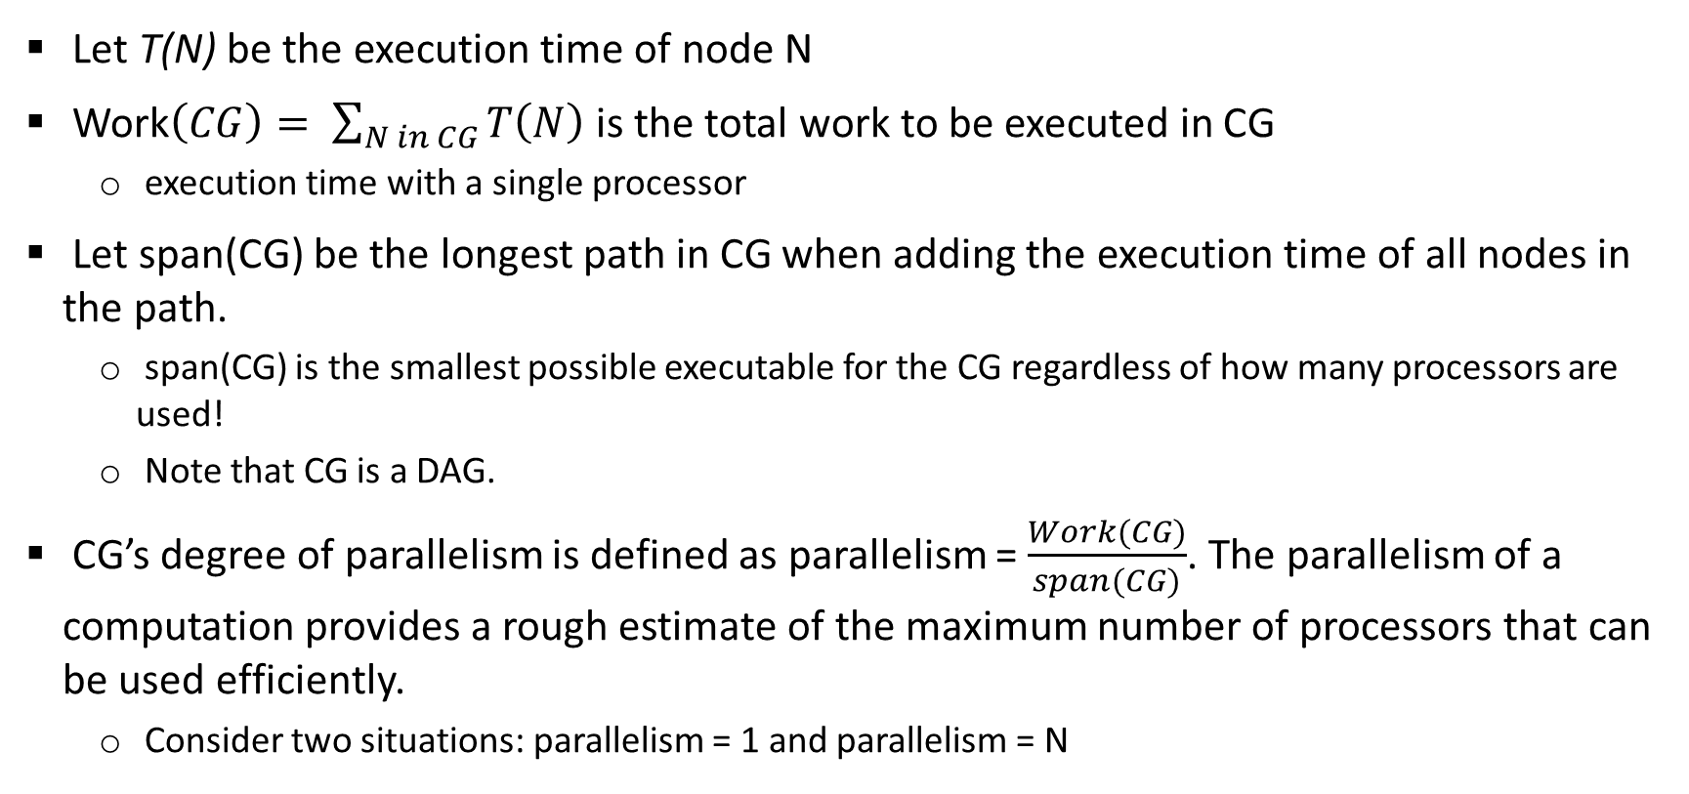
Complexity with computation graph
Let T(N) be the execution time of node N
Work$\left(CG\right)= \sum_{N in CG}{T\left(N\right)}$ is the total work to be executed in CG
execution time with a single processor
Let span(CG) be the longest path in CG when adding the execution time of all nodes in the path.
span(CG) is the smallest possible executable for the CG regardless of how many processors are used!
Note that CG is a DAG.
CG’s degree of parallelism is defined as parallelism = $\frac{Work(CG)}{span(CG)}$. The parallelism of a computation provides a rough estimate of the maximum number of processors that can be used efficiently.
Consider two situations: parallelism = 1 and parallelism = N

Slide 23
Let the time for each node be 1, compute the work, span, and parallelism for the following two computation graphs
A
A
B
C
D
E
B
C
D
F
E
F
G
G

Slide 24
What are the work, span and parallelism of the following CG?
A: 1
B: 2
C: 4
D: 1
E: 2
F: 1
G: 2
H: 1
I: 2

Slide 25
Scheduling of a computation graph
Assume each node takes 1 time steps.
A task can be allocated only when all of its predecessors have been executed.
A
B
C
Task scheduling:
Time step P0 P1
1 A -
2 B C
3 D E
4 H F
5 G -
6 I -
7 J -
D
E
F
G
H
I
J

Slide 26
Scheduling of a computation graph
A
Another schedule: better than the previous one
B
C
Task scheduling (2 processors)
Time step P0 P1
1 A -
2 B C
3 D E
4 F G
5 H I
6 J -
D
E
F
G
H
I
J

Slide 27
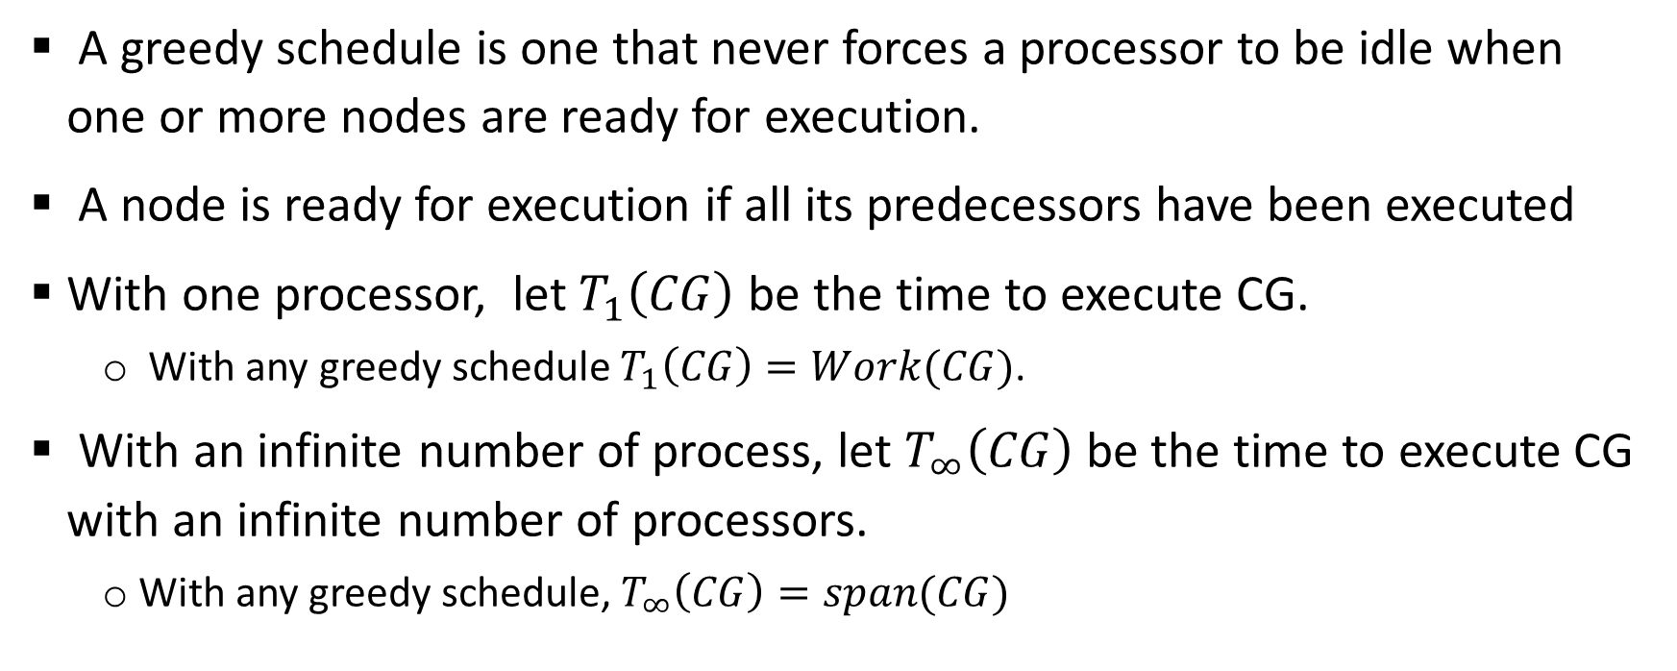
Greedy schedule
A greedy schedule is one that never forces a processor to be idle when one or more nodes are ready for execution.
A node is ready for execution if all its predecessors have been executed
With one processor, let $T_{1}\left(CG\right)$ be the time to execute CG.
With any greedy schedule $T_{1}\left(CG\right)=Work(CG)$.
With an infinite number of process, let $T_{∞}\left(CG\right)$ be the time to execute CG with an infinite number of processors.
With any greedy schedule, $T_{∞}\left(CG\right)=span(CG)$

Slide 28
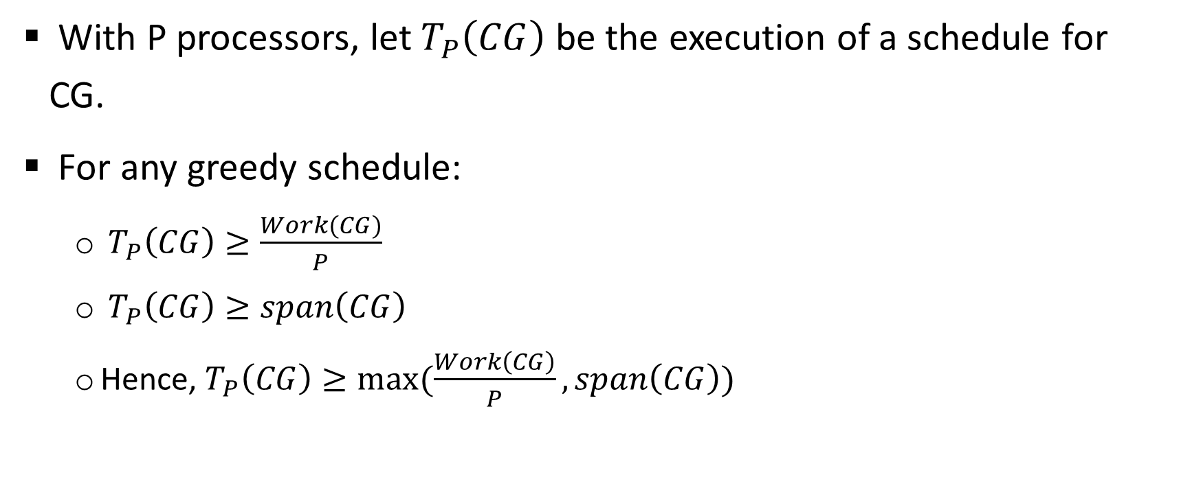
Greedy schedule
With P processors, let $T_{P}\left(CG\right)$ be the execution of a schedule for CG.
For any greedy schedule:
$T_{P}\left(CG\right)≥\frac{Work(CG)}{P}$
$T_{P}\left(CG\right)≥span\left(CG\right)$
Hence, $T_{P}\left(CG\right)≥max⁡(\frac{Work\left(CG\right)}{P}, span\left(CG\right))$

Slide 29
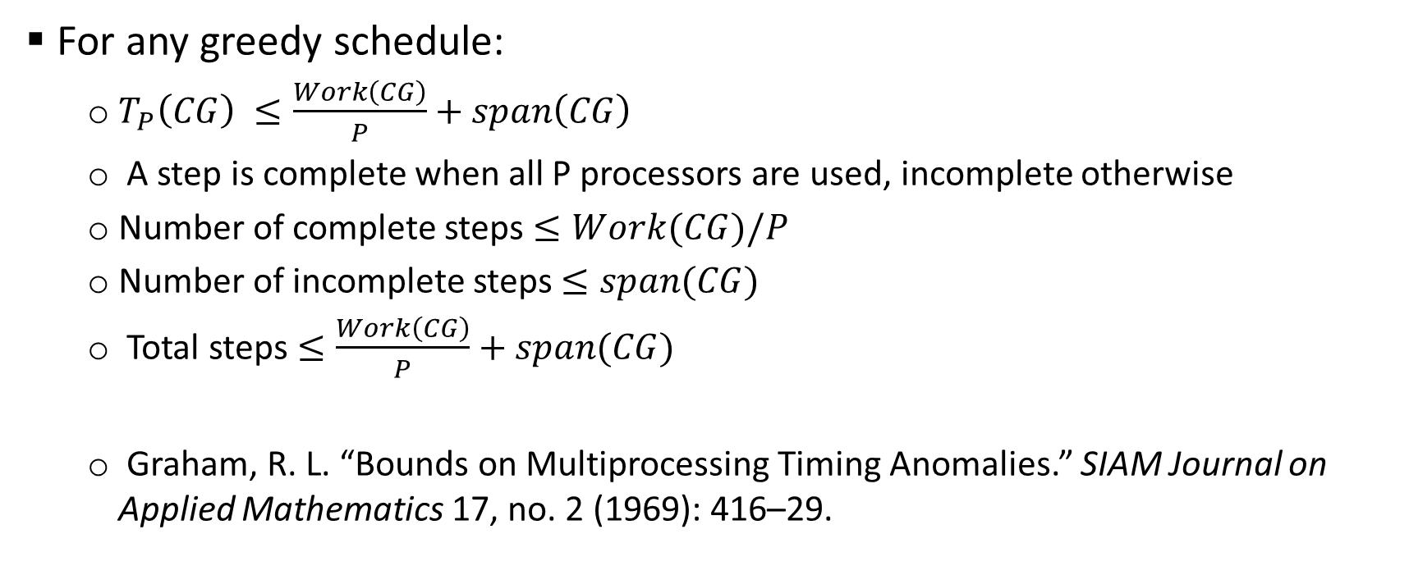
Greedy schedule
For any greedy schedule:
$T_{P}\left(CG\right) ≤\frac{Work\left(CG\right)}{P}+span\left(CG\right)$
A step is complete when all P processors are used, incomplete otherwise
Number of complete steps $≤Work(CG)/P$
Number of incomplete steps $≤span(CG)$
Total steps $≤\frac{Work\left(CG\right)}{P}+span(CG)$
Graham, R. L. “Bounds on Multiprocessing Timing Anomalies.” SIAM Journal on Applied Mathematics 17, no. 2 (1969): 416–29.

Slide 30
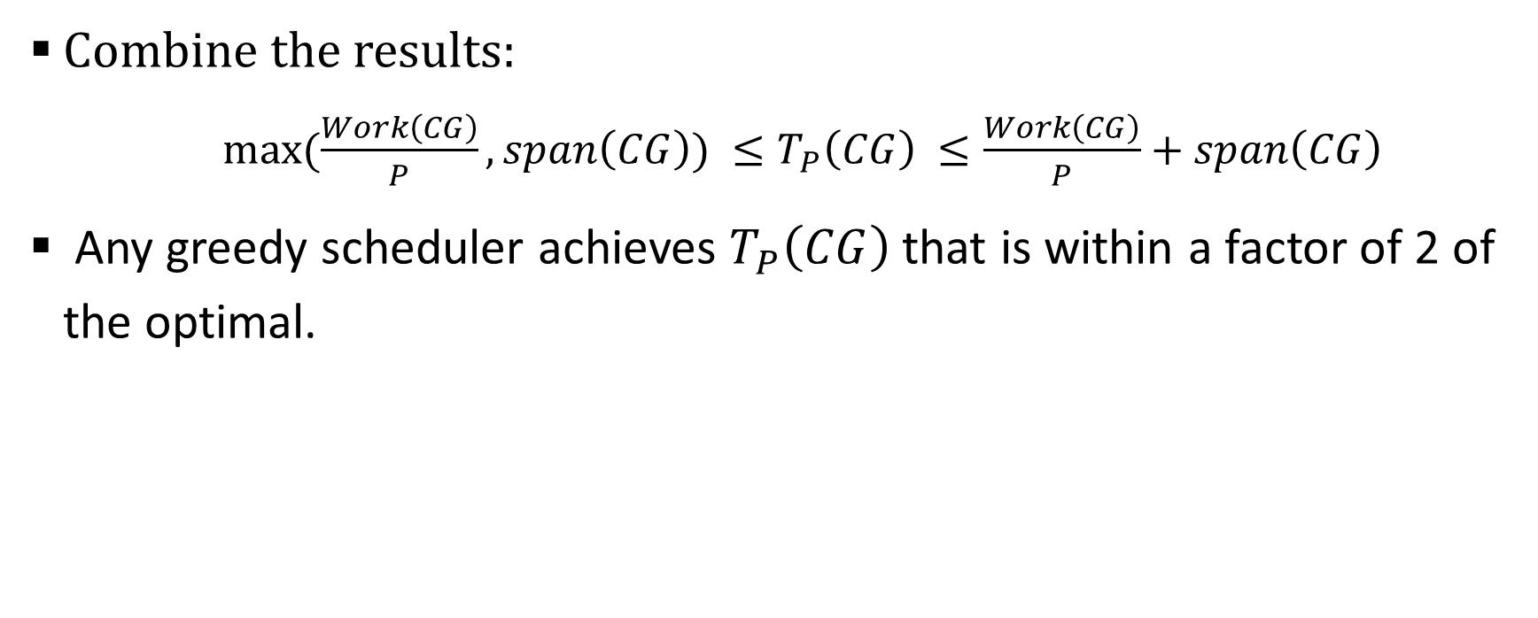
Greedy schedule
Combine the results:
$max⁡(\frac{Work\left(CG\right)}{P}, span\left(CG\right)) ≤T_{P}\left(CG\right) ≤\frac{Work\left(CG\right)}{P}+span\left(CG\right)$
Any greedy scheduler achieves $T_{P}\left(CG\right)$ that is within a factor of 2 of the optimal.

Slide 31
Summary
Flynn’s taxonomy: SISD, SIMD, MISD, MIMD
Performance metrics MIPS, GFLOPS.
Peak performance and sustained performance.
Computation graph: describe the dependencies between tasks in a parallel computation.
Parallelism = Work(G) / span(G), an approximation of the number of processors that can be used effectively in the computation.
Greedy scheduler assigns tasks to processors whenever a task is ready and a processor is available. The execution time with a greedy scheduler is at most 2 times that of the optimal scheduler.

