Slide 1


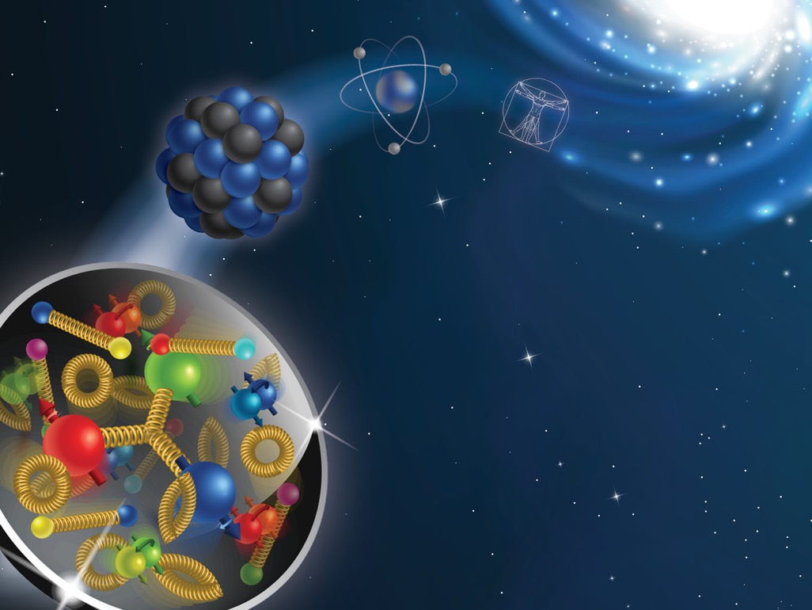
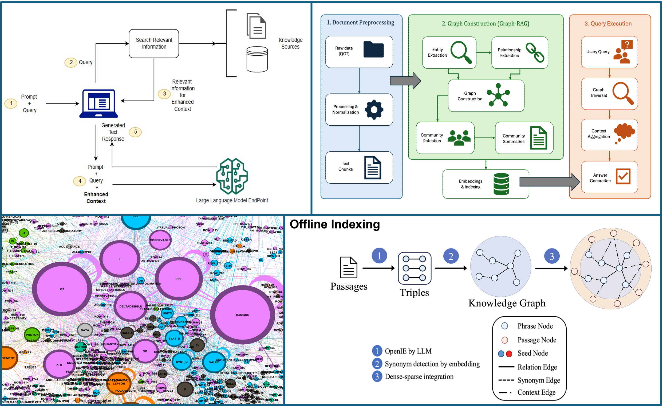

Graph-Based Retrieval-Augmented LLMs for Science
M.Raghavendra¹, S. Kuwadia⁴, M. Singla¹, L. Gamberg², A. Prokudin^{2,3}
¹ Penn State University, University Park, PA, ² Penn State University Berks, Reading, PA, ³ Theory Center, Jefferson Lab, Newport News, VA , ⁴ Microsoft
introduction
Current Steps and Progress
Hippo RAG Query Example
Quark-gluon-tomography (QGT) Collaboration studies how quarks and gluons are arranged and move inside protons and neutrons, which are the building blocks that make up atomic nuclei. Although protons and neutrons may seem fundamental, they are in fact built from quarks and gluons. Together, quarks and gluons are often called partons. A major goal of modern nuclear physics is to understand how these partons behave, how their momentum is distributed, and how they give rise to the overall structure of matter. Because partons cannot be observed directly, physicists rely on scattering experiments and theoretical models to infer their properties from measurable data.
Retrieval-Augmented Generation, or RAG, is a method that improves how large language models answer questions by allowing them to search for relevant information before generating a response. On their own, language models generate answers based on patterns learned during training, but they do not always have access to the exact documents, datasets, or recent information a user may need. RAG addresses this limitation by combining two steps: retrieval and generation. First, the system searches a database or collection of documents for information related to the user’s question. Then, the language model uses that retrieved information to produce a more accurate, grounded, and context-aware answer.
Different RAG architectures retrieve knowledge in different ways. VectorRAG is the standard form of RAG, where document chunks are embedded into vectors and the system retrieves the chunks most similar to the user’s query. This works well for direct question answering, but it can struggle when information is spread across multiple documents. GraphRAG adds more structure by building a knowledge graph of entities and relationships from the corpus, allowing the system to answer both local questions about specific concepts and global questions about broader themes in the dataset. HippoRAG goes a step further by using graph-based associative retrieval inspired by human memory (the hippocampus), making it especially useful for reasoning tasks where the answer depends on connecting several related facts. In short, VectorRAG retrieves by similarity, GraphRAG retrieves by structure, and HippoRAG retrieves by association.
The QGT-database is a repository of QGT-related experimental literature and extracted tabular data, with linked papers, notes, and example notebooks for reading and visualization. RAG can help QGT researchers by focusing LLM outputs in the QGT-database rather than relying on model memory alone. However, QGT data is linking numerical tables, metadata, observables, experiments, and papers, in which a graph-based RAG approach is especially valuable. When combined with an agentic LLM, the system can plan multi-step research tasks, traverse relationships across the database, call analysis tools, verify outputs, and return traceable scientific summaries. In this way, agentic RAG can function as a research assistant that accelerates literature review, data interpretation, and exploratory analysis while preserving scientific context.
Currently, we are working on improving our Agentic model by crafting an evaluation dataset, consisting of questions relating to pertinent information in the database. The questions range in difficulty and depth, ranging from simple retrieval of information that can be found within the dataset, to tasks that require a deep understanding of multiple papers, cross-referencing mathematical equations and facts to create responses that extrapolate on the information provided in the papers. These questions will provide an important perspective on how the model operates, providing key insight on processes that allow us to diagnose any potential issues early on, such as inconsistent responses, issues with the raw data itself, or limitations within our own code that can all be fixed before the model is published. Ultimately, this evaluation process is essential for validating the model’s accuracy, identifying weaknesses, and ensuring that the final system is dependable enough for real scientific use in QGT research.
Q: What are the types of leptons and energies used in the measurements and how it is reflected in the publications?
Thinking: To answer this question, I need to extract, for each referenced publication, the types of leptons used (electron, positron, etc.) and the beam energies, and note how these are reflected in the documentation (README notes, tables, etc.). Ref. 4: The lepton type is an electron, with a beam energy of 5.7 GeV. This is stated in the "Notes" section: "The lepton type used in this experiment was an electron," and "Elepton denotes the lepton beam energy... (measured at 5.7 GeV).“ Ref. 10: The lepton type is electrons, with a beam energy of 4.8 GeV. This is in the "Notes": "Elepton denotes the lepton beam energy... (measured at 4.8 GeV). The lepton type(s) used in this experiment were electrons.“ Ref. 26: The lepton type is electrons, with a beam energy of 10.6 GeV. "The lepton beam energy... (measured at 10.6 GeV). The lepton type(s) used... electrons.“ Ref. 29: The lepton types are electrons and positrons, with a beam energy of 27.6 GeV. "The lepton beam energy... (measured at 27.6 GeV). The lepton type(s) used... electrons and positrons.“ Ref. 30: The lepton type is electrons, with a beam energy of 27.6 GeV. "The lepton beam energy... (measured at 27.6 GeV). The lepton type(s) used... electrons.“ How is this reflected in the publications? In each README, the lepton type and energy are explicitly stated in the "Notes" section. In cases with tables (e.g., Ref. 4, Ref. 10), the symbol "Elepton" is defined in the Definitions & Units Table as "Incident electron beam energy," with units GeV. In references without tables (e.g., Ref. 26, 29, 30), the lepton type and energy are still stated in the "Notes" section.
Answer: The measurements use electrons (Refs. 4, 10, 26, 30) and both electrons and positrons (Ref. 29) as lepton types, with beam energies of 4.8 GeV (Ref. 10), 5.7 GeV (Ref. 4), 10.6 GeV (Ref. 26), and 27.6 GeV (Refs. 29, 30). These details are explicitly stated in the "Notes" section of each publication's README, and, where tables are present, the beam energy is also defined as "Elepton" in the Definitions & Units Table.
$$l$$
Top-left: Vector-RAG diagram
Top-right: Graph-RAG overview
Bottom-right: Hippo-RAG diagram
Bottom-left: QGT database graph generated by GraphRAG
Conclusions and outlook
RAG, especially when combined with graph-based retrieval and agentic LLM workflows, can make scientific databases much more useful for researchers. Rather than only finding similar text, these systems can connect papers, data tables, metadata, and scientific relationships in a more meaningful way. Our current focus on building an evaluation dataset is helping us test the model carefully and improve it before release. In the long term, this can lead to an AI research assistant that helps scientists explore data, understand papers, and draw connections across the QGT literature more efficiently.
Acknowledgements
references
This project was made possible, in part, by a seed grant from the Penn State Office of the Vice President for Commonwealth Campuses. This work was supported in part by the U.S. Department of Energy under contract No. DE-AC05-06OR23177, under which Jefferson Science Associates, LLC operates Jefferson Lab, and by the National Science Foundation under Grants No. PHY-2310031 and No. PHY-2335114.
[1] QGT Collaboration: https://qgtcollab.github.io
[2] Amazon, “What is RAG? - Retrieval-Augmented Generation Explained - AWS,” Amazon Web Services, Inc., 2024.
[3] M. K. Singla, “Graph-Based Retrieval-Augmented LLMs for Structured Physics Data,” B.S. thesis, Dept. of Engineering, Schreyer Honors College, Pennsylvania State Univ., University Park, PA, USA, 2026. [4] OSU-NLP-Group, “HippoRAG 2: From RAG to Memory,” GitHub repository. [Online]. Available: https://github.com/osu-nlp-group/hipporag
[5] QGT Database: https://github.com/qgtcollab/QGT-database/

