Slide 1
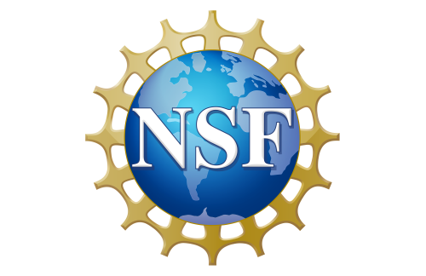

Applying Physics-Informed Neural Networks to Maxwell’s Equations
Agustin Menjivar², Haley Rathman¹, Antonio Falbo¹, Ava Oberrender¹, Talan Nguyen¹, Sahil Kuwadia⁴, Nobuo Sato³, Alexey Prokudin¹,³
¹ The Pennsylvania State University – Berks Campus
² The Pennsylvania State University – University Park
³ Jefferson Lab
⁴ Microsoft

Slide 2
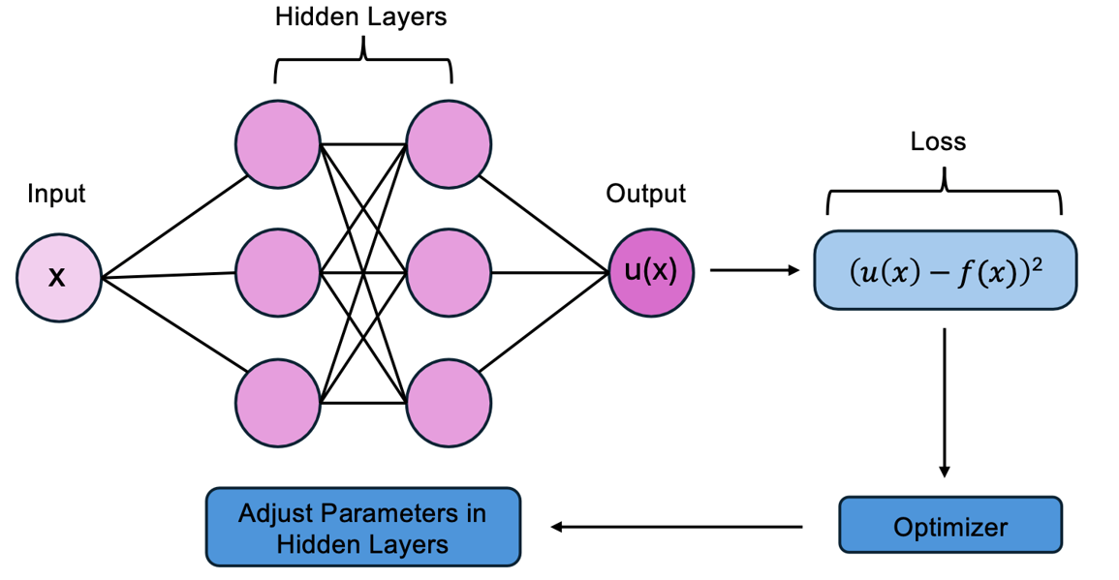
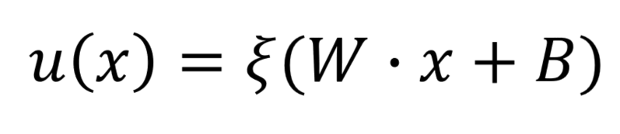
What is a Neural Network?
Neurons as mathematical units interacting via weights and biases
Processing layers for functional approximation
Equation:
W = weight matrix
B = bias
ξ = activation function
Network Output:
General Schematic of a Neural Network

Slide 3
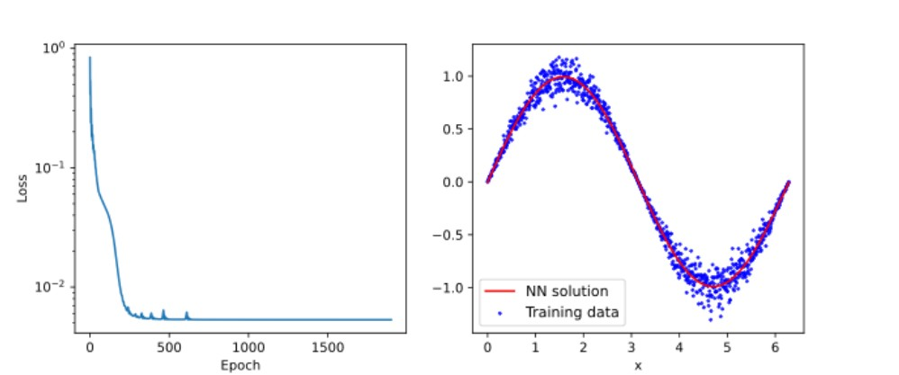
Neural Networks: Sine Modeling
Task: Learning harmonic oscillation (sin x)
Training data: 1000 data points from [0, 2pi] with 10% Gaussian noise
Setup: Single-layer net, 20 nodes, Tanh activation
Neural Network modeling sin(x) with training data.

Slide 4
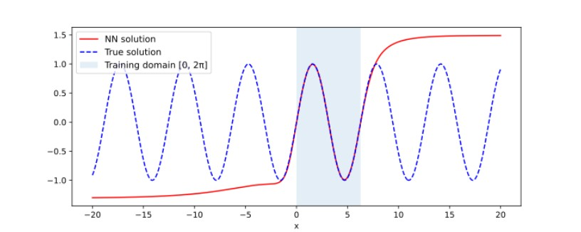
The Pitfalls of the Standard Neural Network
'Interpolation Trap': Excellent in-domain prediction, but struggles outside of domain.
Memorization of points but drifts to activation function behavior (Tanh) outside of training.
Neural Network modeling sin(x) with training data.

Slide 5
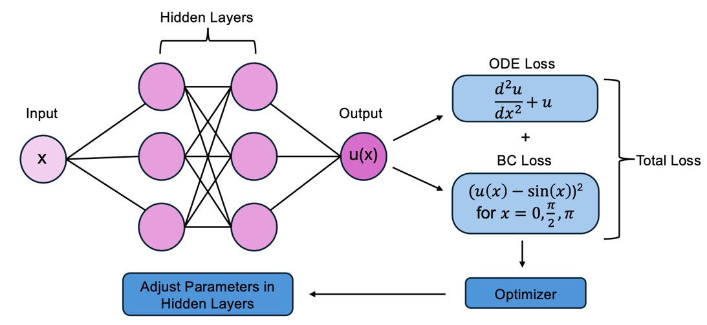
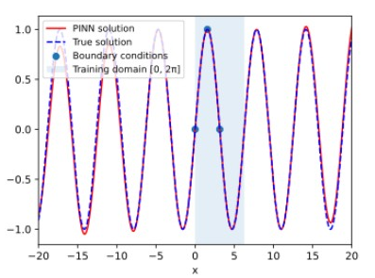
The Physics-Informed Neural Network (PINN) Solution
Raissi Framework (2019): Embedding laws directly into the Loss Function
Total Loss = ODE Loss + BC Loss
Schematic of a Physics-Informed Neural Network (PINN).
Enforces a physical 'conscience' even in zero-data regions
Physics-informed Fourier neural network prediction of sin(x).
Notes:
Raissi, M., Perdikaris, P., & Karniadakis, G. E. (2019). Physics-informed neural networks: A deep learning framework for solving forward and inverse problems involving nonlinear partial differential equations. Journal of Computational Physics, 378, 686–707. https://doi.org/10.1016/j.jcp.2018.10.045

Slide 6
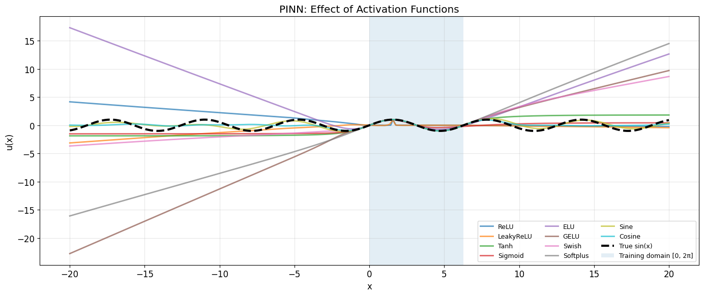
Optimization: Activation Function Choice
Comparison of 10+ activation functions
Standard Tanh leads to numerical drift
Cosine Activation was superior, as the behavior of the activation function should reflect the behavior of the differential equation (Wang et al., 2023)
Behavior of 10+ activation functions with PINN.
Notes:
Wang, H., Lu, L., Song, S., & Huang, G. (2023). Learning specialized activation functions for physics-informed neural networks. Communications in Computational Physics, 34(4), 1125–1151. https://doi.org/10.4208/cicp.OA-2023-0058

Slide 7
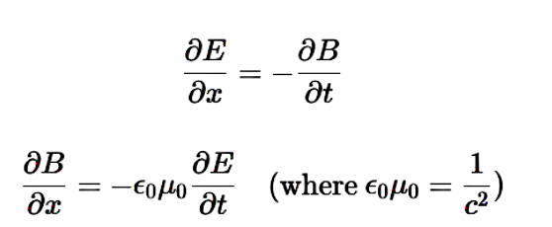
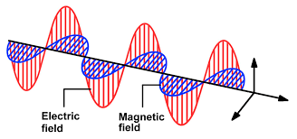
The Next Target: Maxwell’s Equations
Coupled first-order Partial Differential Equations (Faraday and Ampere Laws)
Predicting (E, B) from (x, t)
Self-sustaining interaction of electromagnetic fields as the target behavior
The Target Behavior of Maxwell’s Equations.

Slide 8
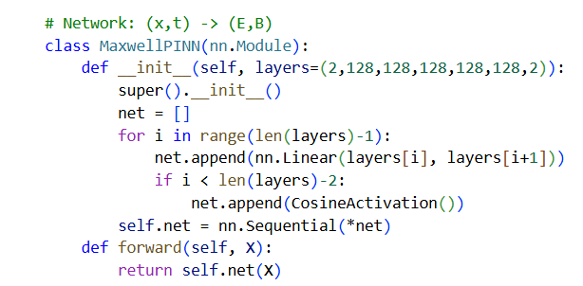
The Architecture to Scale to Maxwell’s Equations
Utilizes a deep 6-layer architecture
High-Dimensional Mapping: Maps (x, t) input coordinates into a dual-output vector field
Physics-Aligned Activation: Implements Cosine activation functions.
Python implementation of Maxwell PINN architecture.

Slide 9
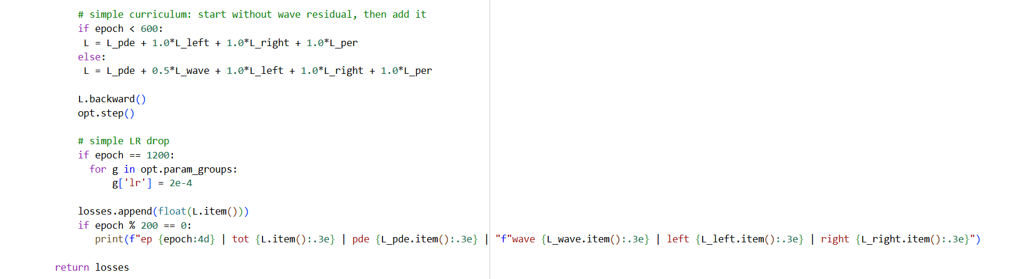
Utilizing Curriculum Learning
Optimization Stability: Prevents divergence in complex training by navigating the loss landscape as suggested by Krishnapriyan et al. (2021).
Phase 1 (Epoch 0-600): Focuses on mastery of first-order Maxwell coupling.
Phase 2 (Epoch 600+): Injection of second-derivative wave residuals.
Python two-phase curriculum learning strategy
Notes:
Krishnapriyan, A. S., Gholami, A., Zhe, S., Kirby, R. M., & Mahoney, M. W. (2021). Characterizing possible failure modes in physics-informed neural networks. Advances in Neural Information Processing Systems, 34, 26581–26594. https://arxiv.org/abs/2109.01050

Slide 10
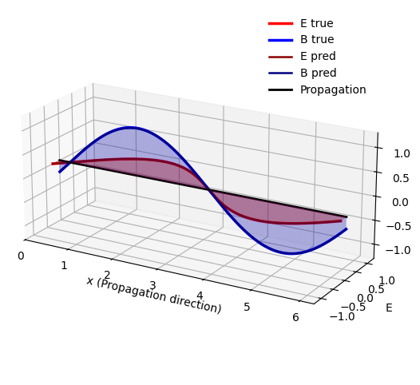
Maxwell Results: High-Resolution Reconstruction
Perfect phase alignment without interior data
Driven purely by Boundary Conditions and Physics Residuals
Final loss minimized to high-precision engineering scales
3D reconstruction of coupled fields,

Slide 11

Future Work: Nucleon Structure
Inverse Problem Solvers: Identifying unknown material properties
Modeling DGLAP Equations: Integro-differential encoding of nucleon structure.
QR code to our Maxwell’s Equations Google Colab notebook

Slide 12
Acknowledgments & Questions
I would like to thank Co-authors, Jefferson Lab, and NSF Support!
I will now take questions!

