Slide 1


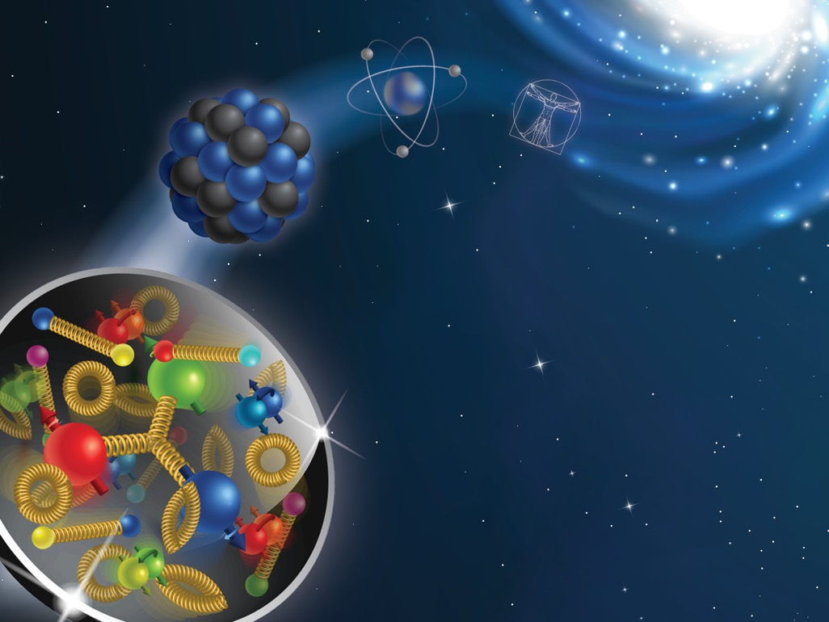






The origin of hadron production in Deep Inelastic Scattering
S. Dolan¹, L. Gamberg¹, A. Prokudin^{1,2}, M. Boglione³, M. Diefenthaler², W. Melnitchouk², N. Sato², D. Pitonyak⁴
¹ Division of Science, Penn State University Berks, Reading, PA, ² Theory Center, Jefferson Lab, Newport News, VA, ³ University of Turin, Italy, ⁴ Lebanon Valley College
introduction
The SELECTION CRITERIA
DATA Analysis
Protons and neutrons (nucleons), which make up the nucleus of an atom, are not fundamental constituents of matter, but are themselves made up of particles called quarks. These quarks are “glued” together by the strong nuclear force, which is mediated by another particle called the gluon. Collectively quarks and gluons are called partons. Any particle containing quarks is called a hadron. Moreover, the quarks are not static inside of a nucleon – they have an intrinsic momentum even for a nucleon at rest. Understanding the underlying structure of the nucleon in terms of partons is one of the central goals of modern nuclear physics. Partons are not directly accessible by experiment, but rather experimental measurements are related by factorization theorems to functions that describe partonic structure of the nucleon.
One of the ways to access intrinsic motion is through a process called semi-inclusive deep inelastic scattering (SIDIS). In this reaction, a high-energy electron scatters off a quark within the nucleon. This quark forms a hadron in the final-state (e.g., a pion), which is detected along with the scattered electron (see Fig. 1).
In general, pions in this reaction are produced from the remnants of the struck nucleon, or from gluons radiated in the process Ref. [1]. In this figure we show regions of pion production in rapidity, y, and transverse momentum q_{T} plane:
In our study we determine the portion of the data that corresponds to the current fragmentation region, and in particular, the one described by Transverse Momentum Dependent factorization theorems that describe the nucleon’s three dimensional structure in the momentum space.
We can see that generically there are at least four regions of pion production in SIDIS. Each region has significant experimental and theoretical interest, and each is important for understanding the nucleon structure. The precise demarcation of these regions is not exactly known yet is needed for phenomenological extraction of the nucleon structure. Factorization theorems allow one to relate each region to specific characteristics of nucleon structure. The purpose of this project is to identify the regions of momentum space for SIDIS data indicated in Fig. 1. Recently, Ref. [2] we introduced ratio criteria, R₀, R₁, R₂ for the various regions in SIDIS. Each ratio is a function of underlying parton kinematics. For instance, if all R₀, R₁, R₂ $≪$1, then the corresponding region of the data is the Transverse Momentum Dependent (TMD) current fragmentation region. Concentrating on the “current region” allows access to the intrinsic motion of quarks and gluons in hadrons: this is known as the three-dimensional structure.
In Fig. 2 the TMD-”current region” is indicated for future EIC kinematics.
Here we implemented ratios R₀, R₁, R₂ and calculated their values for each point for the future measurements at the Electron Ion Collider [3]. The kinematical coverage for the EIC in terms of x_{Bj} and Q² is shown in Fig. 2. In each kinematical bin we show a panel with possible measured bins in P_{T} and z_{h} . We further evaluate the closeness, the “affinity”, of each bin to the TMD current region of SIDIS by performing Monte Carlo samplings of parton kinematics and ratios R₀, R₁, R₂. The affinity of the bin is determined as the ration of number of times our MC results in this region over the total number of times we perform MC generation. Affinity is between 0% and 100% and is indicated with color bar in Fig. 2. The size of symbols in panels of Fig. 2 is proportional to the affinity. This estimate provides an intuitive tool to identify the data associated with TMD physics.
Figure 1: Schematic diagram of semi-inclusive deep inelastic scattering (SIDIS): a high-energy electron knocks a quark out of the nucleon. The quark or spectators from the proton forms a pion in the final state, which is detected along with the scattered electron.
Figure 2: Future EIC data bins as a function of P_{T} and z_{h}. The color bar represents the affinity to the TMD region.
Figure 3: Sketch of kinematical regions of SIDIS in terms of the produced hadron’s Breit frame rapidity and transverse momentum. In each region, the type of suppression factors that give factorization are shown. From Ref.[2].
$$l′$$
}
$$l$$
Target
fragmentation
region
$$N$$
}
Current
fragmentation
region
Conclusions and outlook
Acknowledgements
We have successfully applied the ratio criteria, R₀, R₁, R₂, proposed in Ref. [2], to future SIDIS data. Moreover, we have shown that the region of applicability of TMD factorization is compatible with naïve expectations, namely, low P_{T} region and large z_{h} . The next step step of our analysis will be to include a phenomenological fit of the data and to extract the underlying TMDs. We will also investigate the influence of the choice of parton kinematics on the ratios, and the subsequent determination of TMDs.
This tool that we have developed will help to demarcate regions of pion production in SIDIS and will be useful for both experimental and phenomenological communities of hadron physics and help sharpen the physics goals of the EIC project.
We would like to acknowledge support from NSF under Contracts No. PHY-2012002(AP, SD), PHY-2011763 (DP) and DOE under Contract No. DE-FG02-07ER41460 (LG), and TMD Collaboration within DOE topical collaboration grant.
[1] M. Boglione, et al., Phys. Lett. B766, 245-253 (2017)
[2] M. Boglione, et al., JHEP 10, 122 (2019)
[3] A. Accardi, et al., Eur.Phys. J.A52, 268 (2016)

