Slide 1

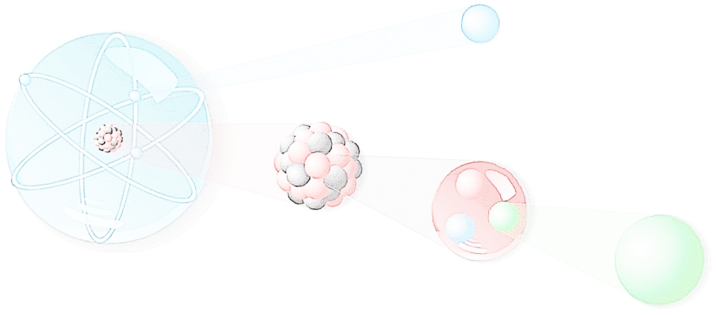
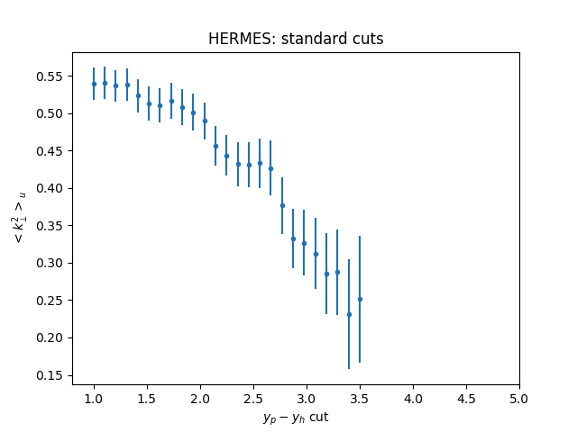
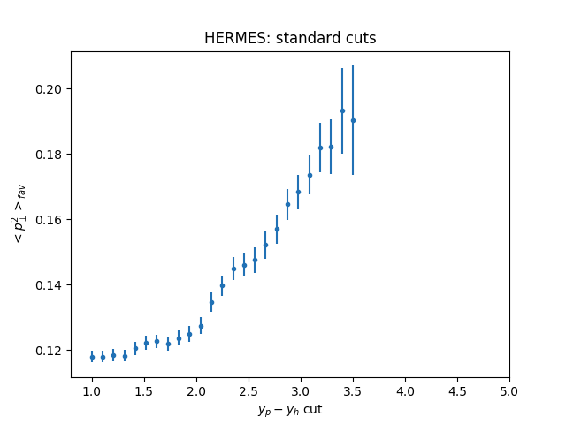
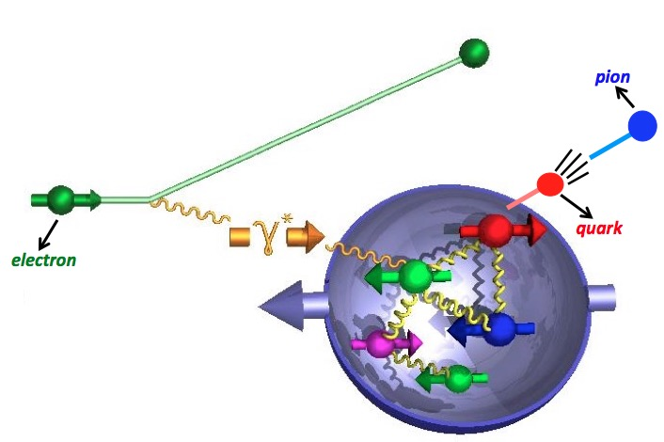
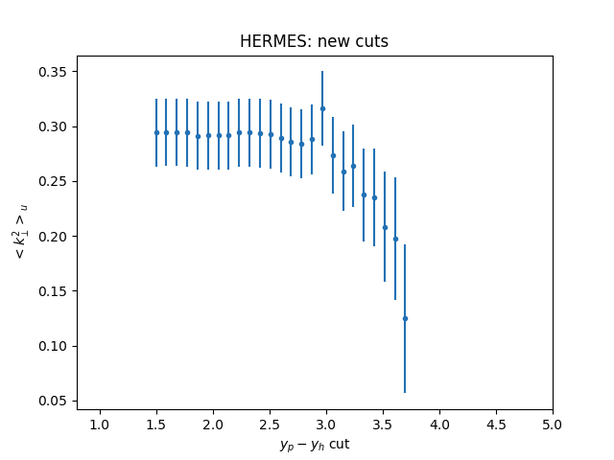
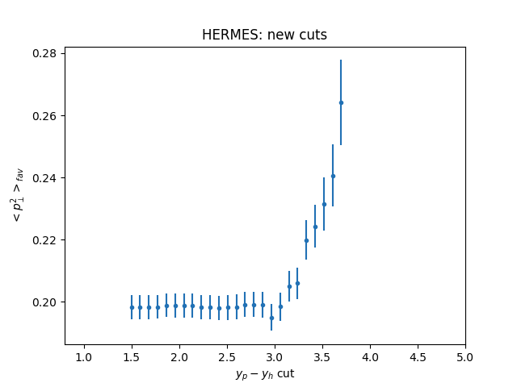
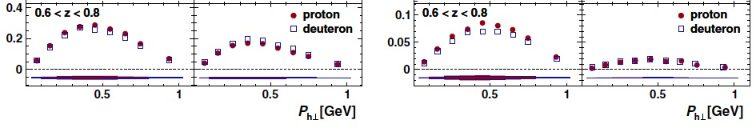
Spinning Protons and the Hidden Life of Their Constituents Longitudinally Polarized TMDs from JLAB Data
M. Albright¹, S.Dolan¹, A.Duong¹, L. Gamberg², D. Pitonyak², A. Prokudin^{2,3}, Z.Scalyer¹, D.Xu¹
¹ Division of Science, Penn State University
² Division of Science, Penn State University Berks
³ Theory Center, Jefferson Lab, Newport News
introduction
The model
RESULTS
Protons and neutrons (nucleons), which make up the nucleus of an atom, are not fundamental constituents of matter, but rather are themselves made up of particles called quarks. These quarks are “glued” together by the strong nuclear force, which is mediated by another particle called the gluon. Any particle containing quarks and gluons is called a hadron. Moreover, the quarks are not static inside of a nucleon – they have an intrinsic momentum even for a nucleon at rest. One of the ways to access this intrinsic motion is through a process called semi-inclusive deep-inelastic scattering (SIDIS). In this reaction, a high-energy electron scatters off of a quark inside of the nucleon. This quark forms a hadron in the final-state (e.g., a pion), which is detected along with the scattered electron (see Fig. 1).
The production of charged pions and kaons
in SIDIS at low transverse momentum can be described in terms of convolutions of TMDs for distribution and fragmentation:
The transverse motion of the quarks is approximated through parton model kinematics into the observed transverse momentum of the hadron. This enables us to gather information from SIDIS for exploration of TMDs. We will use the following simple parametrizations for TMD distribution and fragmentation functions:
where are the parton distribution and fragmentation functions for a particular quark type , and are parameters that characterize the widths of TMD distributions. These widths can be quark flavor dependent and therefore depend on a particular fragmentation channel.
In our description of HERMES data, we use 5 parameters to describe the widths: , which correspond, respectively, to a width for an up quark in the proton, down quark in the proton, a universal width for all sea quarks in the proton, and two widths for the favored (e.g., ) and unfavored (e.g., ) fragmentation.
Using this model, the HERMES multiplicity can be written as
where and a is the quark flavor.
First we perform the analysis of the HERMES data using standard cuts. The number of data points range from 972 for y_{p} – y_{h} > 1 to 35 for
y_{p} – y_{h} > 3.5 and the range from 1.2 to 0.3
One can see that for y_{p} – y_{h} > 1 we reproduce results of ref. [3] with
,
while in the region where current fragmentation should dominate we have ,
We conclude that selection of the data is crucial for determination of parameters that describe TMDs.
Second we perform the analysis of HERMES data using new cuts. The number of data points range from 460 for y_{p} – y_{h} > 1.5 to 47 for
y_{p} – y_{h} > 3.7 and the range from 1.4 to 1.3.
We see that cuts in rapidity have impact on the fitted values of parameters, but this impact is much less pronounced for new cuts compared to standard cuts. We observe similar trends and values of parameters in the region of current fragmentation y_{p} – y_{h} > 3 in both cases.
Figure 1: Schematic diagram of semi-inclusive deep-inelastic scattering (SIDIS): a high-energy electron knocks a quark out of the nucleon. The quark forms a pion in the final state, which is detected along with the scattered electron.
The Purpose
The purpose of this project is to perform a phenomenological analysis of SIDIS data from HERMES on an unpolarized target. This study gives us information on the intrinsic motion of quarks inside nucleons, which is encoded in so-called transverse momentum dependent functions (TMDs). Knowledge of TMDs allows one to create a momentum space 3-D image of the nucleon.
(1)
DATA SELECTION AND Analysis
The DATA
We apply Eq.(1) to the data using appropriate isospin relations for the proton and deuteron targets. The analysis of the data will be done using the standard minimization procedure.
The main objective of our analysis is understanding of the correct criteria for data selection. A recent paper [2] studied SIDIS process and limits of TMD factorization. The authors propose a criteria for identifying the current fragmentation region — the kinematical region where a factorization picture with fragmentation functions is appropriate for studies of transverse-momentum-dependent (TMD) functions - based on a rapidity selection filter of the data. We apply a cut on the boost invariant difference of the target nucleon rapidity, and the produced hadron rapidity in the Breit frame, y_{p} - y_{h}. It was pointed out that for current region this difference should be of order of 3-4 units in rapidity.
In our fits we will utilize the following additional cuts. The standard cut from Ref. [3]
We will also introduce a new set of cuts motivated by validity of TMD factorization [2]:
The data used in this analysis is from the HERMES Collaboration. The experiment scattered 27.6 GeV electrons on an unpolarized proton or deuteron target and detected either pions or kaons in the final state. Measurements were made of the hadron multiplicity, defined as the ratio of the SIDIS to the inclusive DIS cross sections for a particular target n and hadron h:
HERMES collected data for 1 < Q² < 10 GeV², 0.023 < x_{B} < 0.6, P_{hT} < 2 GeV, and 0.1 < z_{h} < 0.9. Some of the data is shown in Fig. 2.
Conclusions and outlook
We performed a phenomenological analysis of HERMES data on the electroproduction of charged pions and Kaons from both proton and deuteron targets. The determination of the nonperturbative parameters of TMDs requires very careful selection of the experimental data compatible with factorization. We suggest that cut in rapidity can be used for such a selection.
Multiplicity
pion
kaon
Acknowledgements
Figure 2: HERMES multiplicity data as a function of P_{hT}. Plots are from Ref. [1]
We would like to acknowledge partial support from NSF under Contract No. PHY-1623454, DOE under Contracts No. DE-FG02-07ER41460, by the U.S. Department of Energy, Office of Science, Office of Nuclear Physics, within the framework of the TMD Topical Collaboration.
[1] A. Airapetian, et al., Phys. Rev. D87, 074029 (2013), [2] M. Boglione, et al., Phys. Lett. B766, 245-253 (2017), [3] M. Anselmino, et al., JHEP 1404, 005 (2014)

