Slide 1

SentiNEWS: Bilingual Summarization and Sentiment Analysis App for Efficient and Accessible News Consumption

Slide 2

Problem Statement
Overwhelming amount of news sources
Time constraints hinder comprehensive news consumption
News reading seems boring and mundane
Accessibility issues for individuals with disabilities(no text to voice capabilities)
Difficulty in quickly analyzing sentiment
A sheer volume of content adds to the challenge

Slide 3
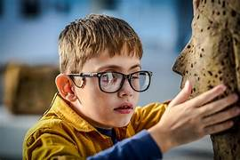
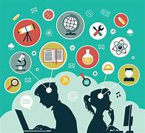
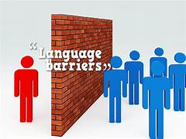
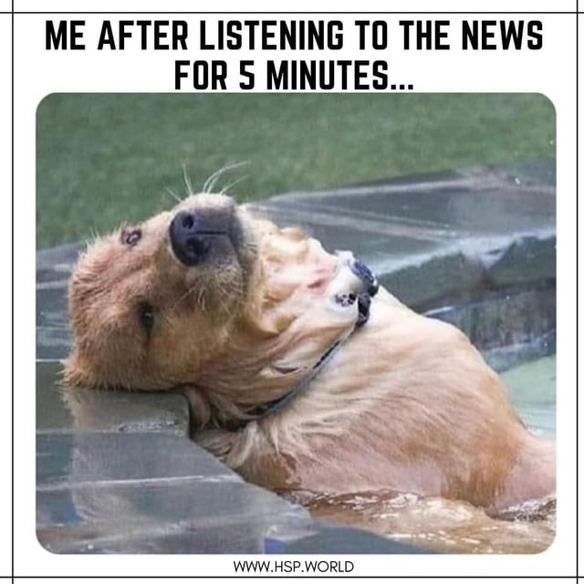
Motivation for the problem
Beneficiaries:
Individuals seeking efficient news consumption methods.
People with disabilities, especially visual impairments, who need accessible news.
Those lacking time to read entire articles but still wish to stay informed(through graphics and images).
Anyone interested in multilingual news.
Why it's of Interest:
This problem resonates deeply because it addresses the crucial intersection of information accessibility, readability, and technology. By solving this, we empower individuals to stay informed effortlessly.

Slide 4



Literature Review:
Literature Review:
Google News
inShorts
Dailyhunt

Slide 5

Literature Review (Research Papers)
1. Balahur, A., Steinberger, R., Kabadjov, M., Zavarella, V., van der Goot, E., Halkia, M., Pouliquen, B., and Belyaeva, J. (2010): Sentiment analysis in the news. In: Proceedings of LREC’10, ELRA.
2. Kbadjov, M., Steinberger, J., Pouliquen, B., Steinberger, R., Poesio, M. (2009): Multilingual statistical news summarisation: Preliminary experiments with English. In: Proceedings of the Workshop on Intelligent Analysis and Processing of Web News Content at the IEEE/WIC/ACM International Conferences on Web Intelligence and 5 Intelligent Agent Technology (WIIAT), ACM.
3. Wenxin Jiang, Nicholas Synovic, Matt Hyatt, Taylor R. Schorlemmer, Rohan Sethi, Yung-Hsiang Lu, George K. Thiruvathukal, James C. Davis, "An Empirical Study of Pre-Trained Model Reuse in the Hugging Face Deep Learning Model Registry", ACM/IEEE 45th International Conference on Software Engineering (ICSE) 2023, Cornell University, 2023.
4. Maximilian Speicher, Andreas Both, Martin Gaedke, "S.O.S.: Does Your Search Engine Results Page (SERP) Need Help?", 33rd Annual ACM Conference on Human Factors in Computing Systems, 2015, pp: 1005-1014.

Slide 6
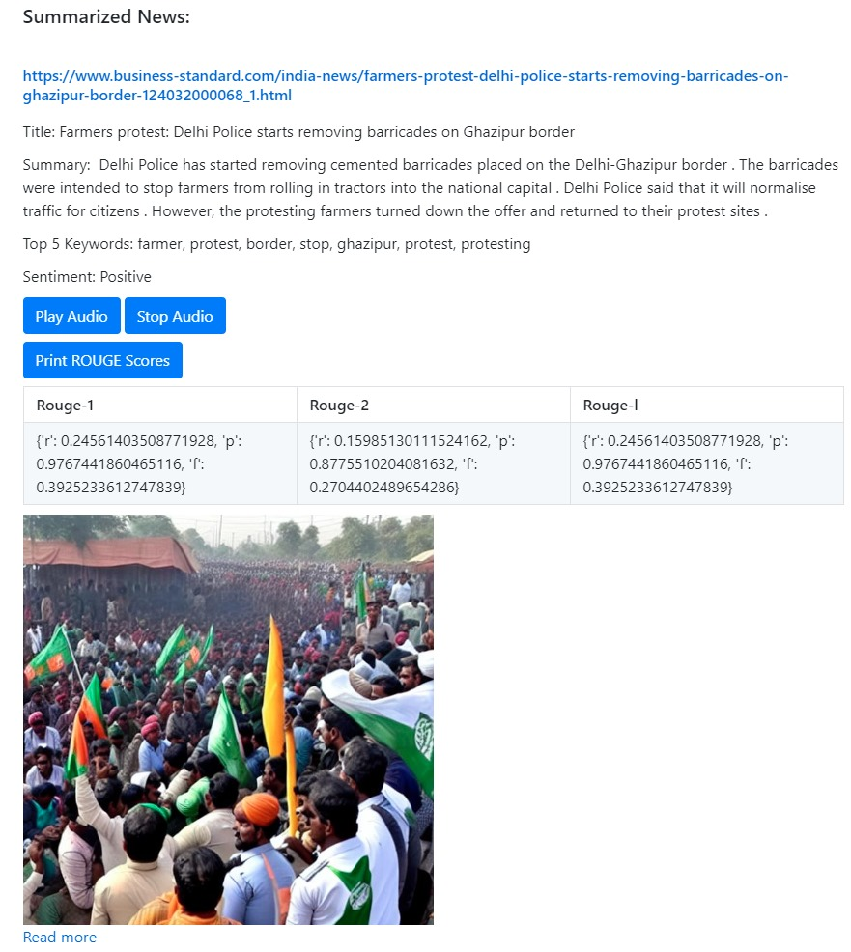
Novelty and Added Value
Text to Speech of summaries for visually challenged
Crafting images from most essential keywords to make them more exciting and enhance understanding
Bi-lingual (Hindi and English) news generation for wider accessibility and acceptability.
Fusing Advanced Models and APIs seamlessly.
Elevating Text Summarization through refined Keyword Extraction.
Analyzing the tone of the article

Slide 7
Proposed Solution 1
Gyan Alert:
BART model pre-trained in the English language and fine-tuned on CNN Daily Mail, first released in [this repository (https://github.com/pytorch/fairseq/tree/master/examples/bart)
Text Processing and Summarization
Utilization of NLTK and Newspaper Library Integration
Generates a summary of the article using the BART “bart-large-cnn” summarization model from the Transformers library.
Sentiment Analysis
Utilization of NLTK's SentimentIntensityAnalyzer
Lexicon-based Approach: The analyzer assesses sentiment using a lexicon-based approach, assigning polarity scores to individual words and aggregating them to determine overall sentiment.
Text-to-Speech
gTTS: Converts text to speech using Google's API.
Pygame: Python library for audio playback and control.
In English

Slide 8
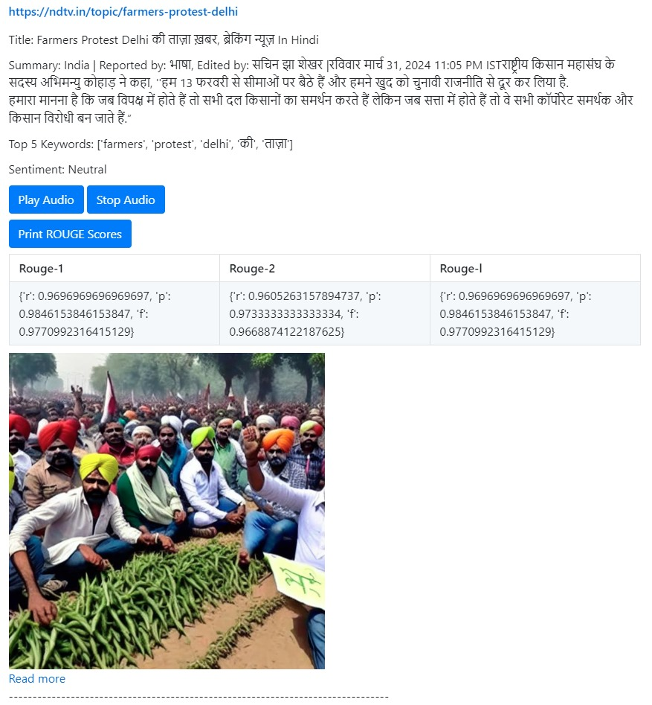
Proposed Solution 2
Gyan Alert:
Diffusers library (HuggingFace) enables using SoTA diffusion models for generating images, audio, 3D structures of molecules.
Crucial Keyword Generation
TF-IDF Analysis
Dynamic Image Generation
Utilization of Hugging Face's Standard Diffusion Model: The method `generate_image(prompt)` utilizes Hugging Face's standard diffusion model integrated with CUDA for efficient and high-quality image generation.
Optimized Performance: Dynamic image generation ensures optimized performance and visually captivating results by leveraging CUDA for GPU acceleration and utilizing a pre-trained model designed explicitly for image generation tasks.
BiLingual
Leveraging libraries like NLTK for English and Indic NLP Toolkit for Hindi
In Hindi

Slide 9
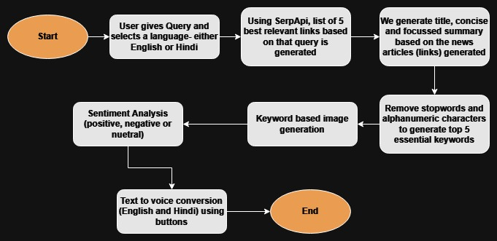
Methodology

Slide 10
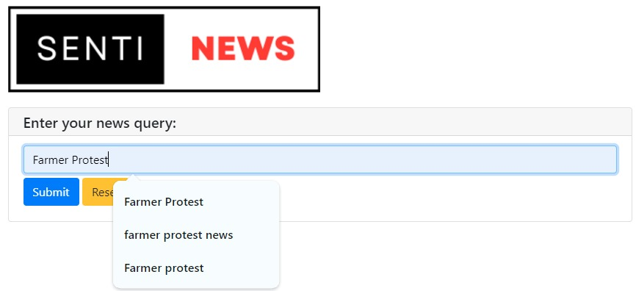
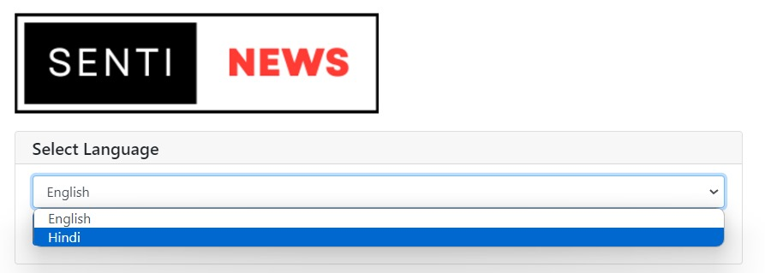
Result/UI-1

Slide 11
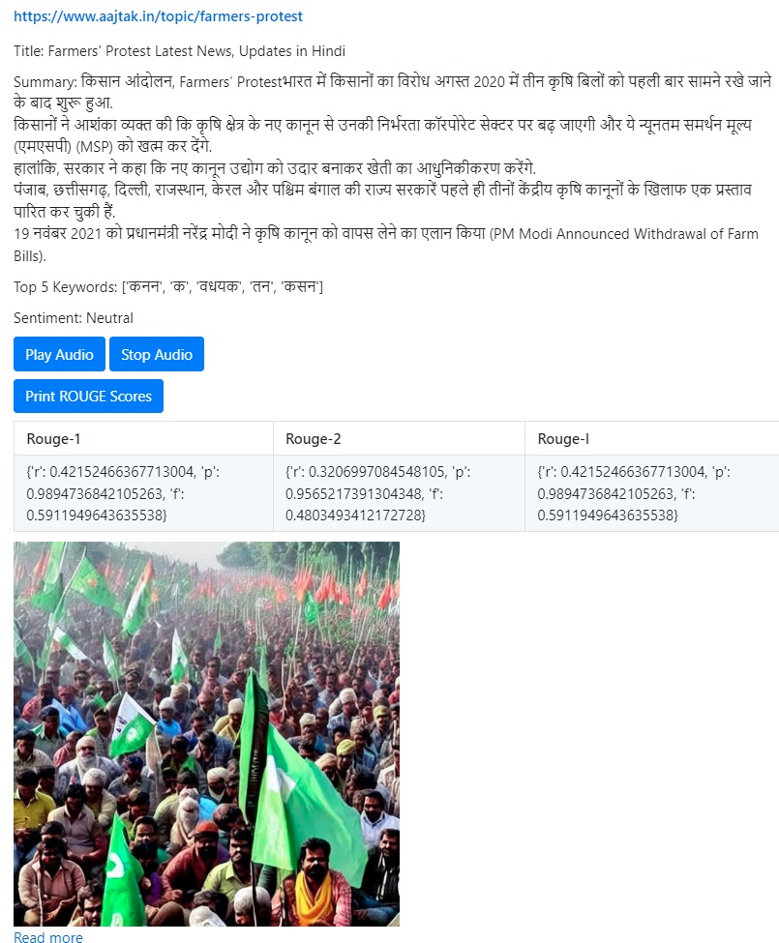
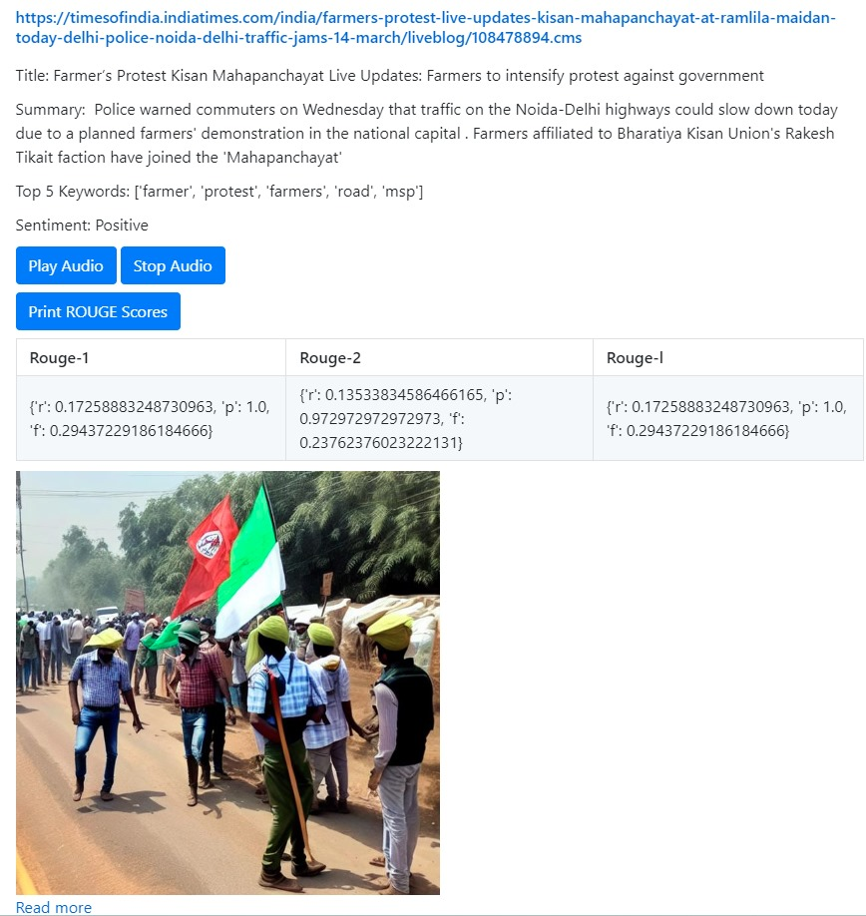
Result/UI-2

Slide 12
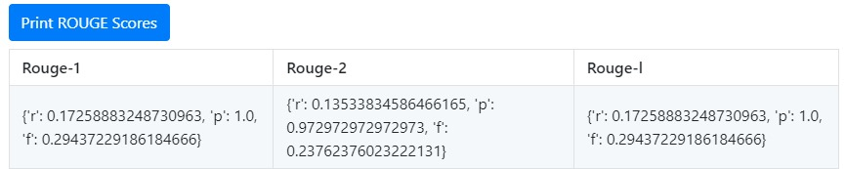
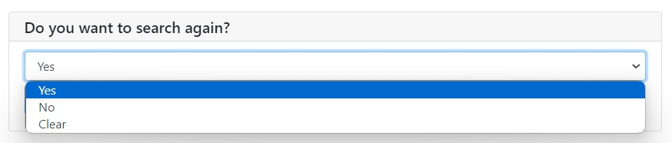
Result/UI-3

Slide 13
Thank You

