Slide 1
Agenda
overall
Guiding principles
Technical features
.NET I
Code walkthrough & demo
.net II
WCF code walkthrough & demo
Service layer binding & security
WWF code walkthrough & demo

Slide 2
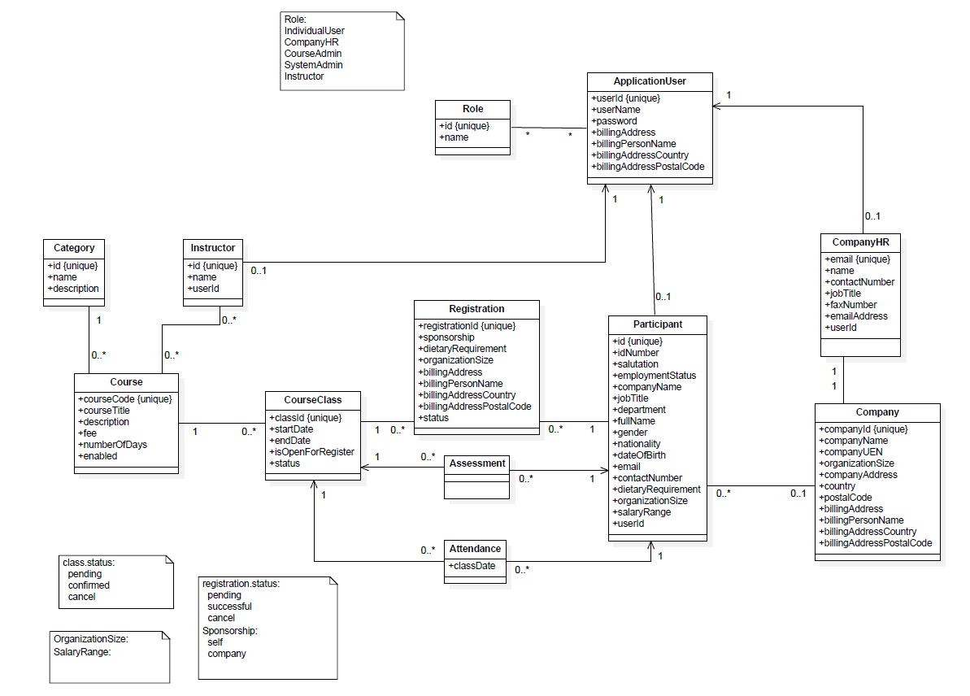
Guiding principles
Domain model

Slide 3
Guiding principles
System architecture
Browser
External
System
Presentation Layer
Service Layer
Domain
Model
ASP.NET
Identity
ASP.NET MVC
WEBFORM
WWF
WCF
Business Logic Layer
Data Access Layer
Entity Framework
DB

Slide 4
Technical features
Model: Code first Approach
DAL: unitofwork + repository
BLL: Domain Model Pattern, Singleton
PRL:
MVC for external user(Individual user & HR)
Webform for internal user(Admins)
Security: base on Asp.Net Membership
Notes:
Justifications:
Code First: no need to do DB design. Design domain model then let EF take care of database is more like a domain driven development approach
DAL: Generic repository, per thread unitofwork
BLL:
Domain Model pattern: Anemic Domain Model, model is a container of data without any real operation
Singleton with lazy instantiation: assure for those BLL class there is only one global access to only one instance.
it is stateless, so thread saft
it is lazy instantiation means only be instantiated when is invoked.

Slide 5
Code walkthrough & Demo
Model
DAL
BLL
PRL
Webform (Course, Class management)
MVC (Course registration)
User Management, Security
Notes:
Model: base model
DAL:
PRL: collect data from request,
invoke BLL
BLL: business rule validation,
perform business logic
invoke DAL

Slide 6
Code Walkthrough
DAL inner structure
Business Logic Layer
Data Access Layer
UnitOfWork
Course
Repository
Registration
Repository
……
DBContext
Entity Framework
DB

Slide 7
WCF
Functionality implementation
Course Registration
Attendance System
Functionality Demo
Host & Configuration

Slide 8
Justifications
It provides interoperability with non-WCF clients that support the WS* stack.
It supports the WS* stack, including reliable messaging, message security, and secure transactions.
WsHttpBinding messages are encrypted by default and achieve Message security. . We can also include Transport security .
It allows the service to be hosted in IIS 5.0 or IIS 6.0.
If you choose message security, you can use certificate, username, Windows, or issue token authentication (Windows CardSpace).
If you choose transport security, you can use certificate, Windows, or token authentication.

Slide 9
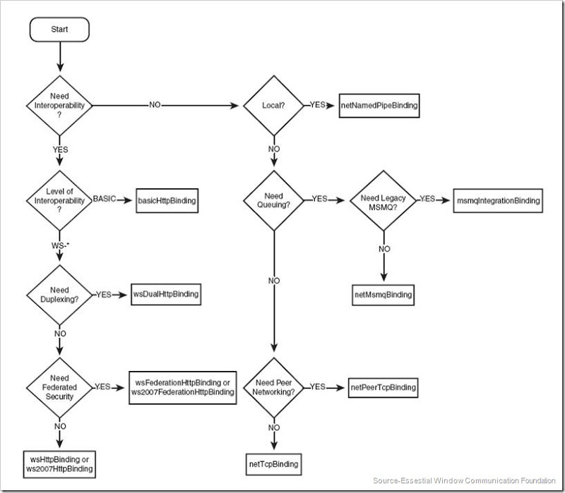
Binding Decision Tree

Slide 10
WWF
Course confirm process
Code walkthrough
Demo
Course completion process
Code walkthrough
Demo

