Slide 1
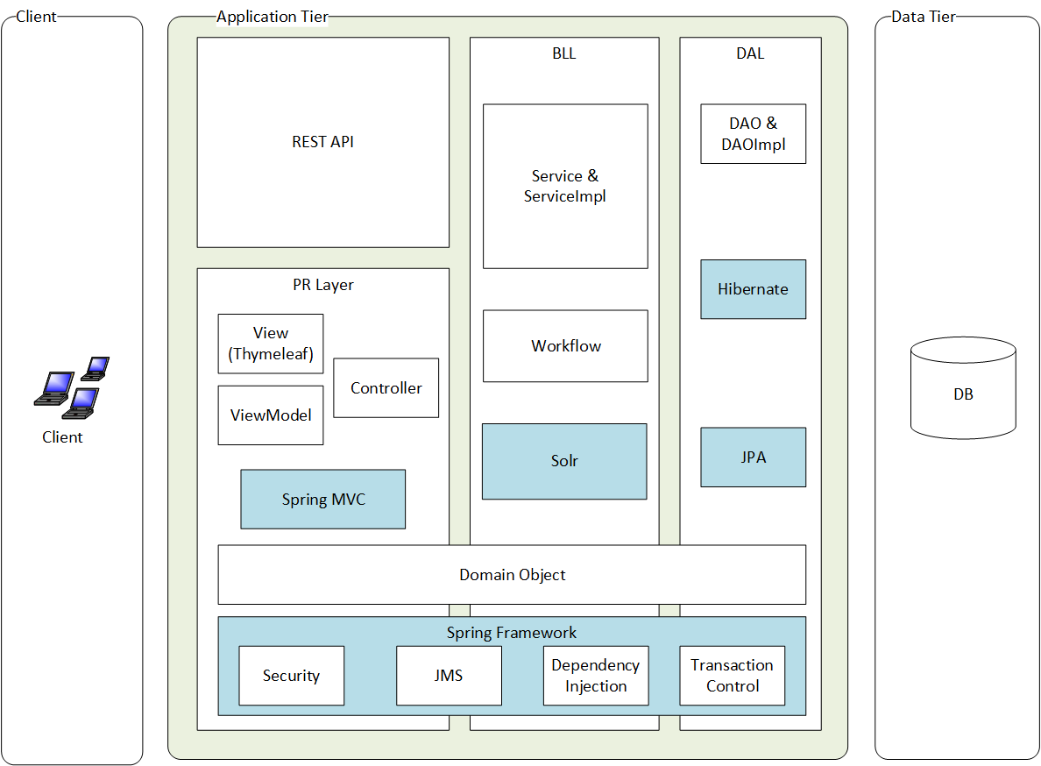
Architecture (v4.0)

Slide 2
Design
Follow Agile manifesto
Working software over comprehensive documentation
Only High-level design and architectural decision is documented, such as
Choosing the Spring Framework over EJB3
Using Solr to achieve catalog browsing and searching
Notes:
http://www.broadleafcommerce.com/blog/why-broadleaf-continues-to-choose-spring

Slide 3
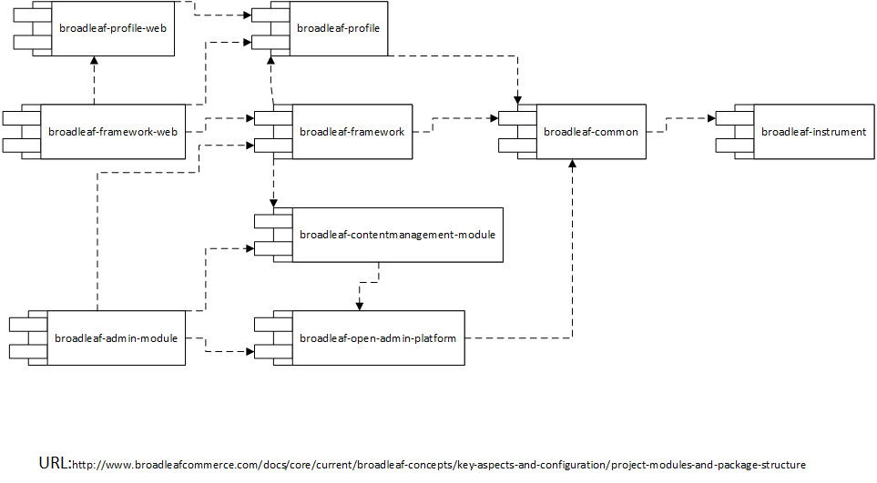
Framework Modules (v4.0)
Notes:
http://www.broadleafcommerce.com/docs/core/current/broadleaf-concepts/key-aspects-and-configuration/project-modules-and-package-structure

Slide 4
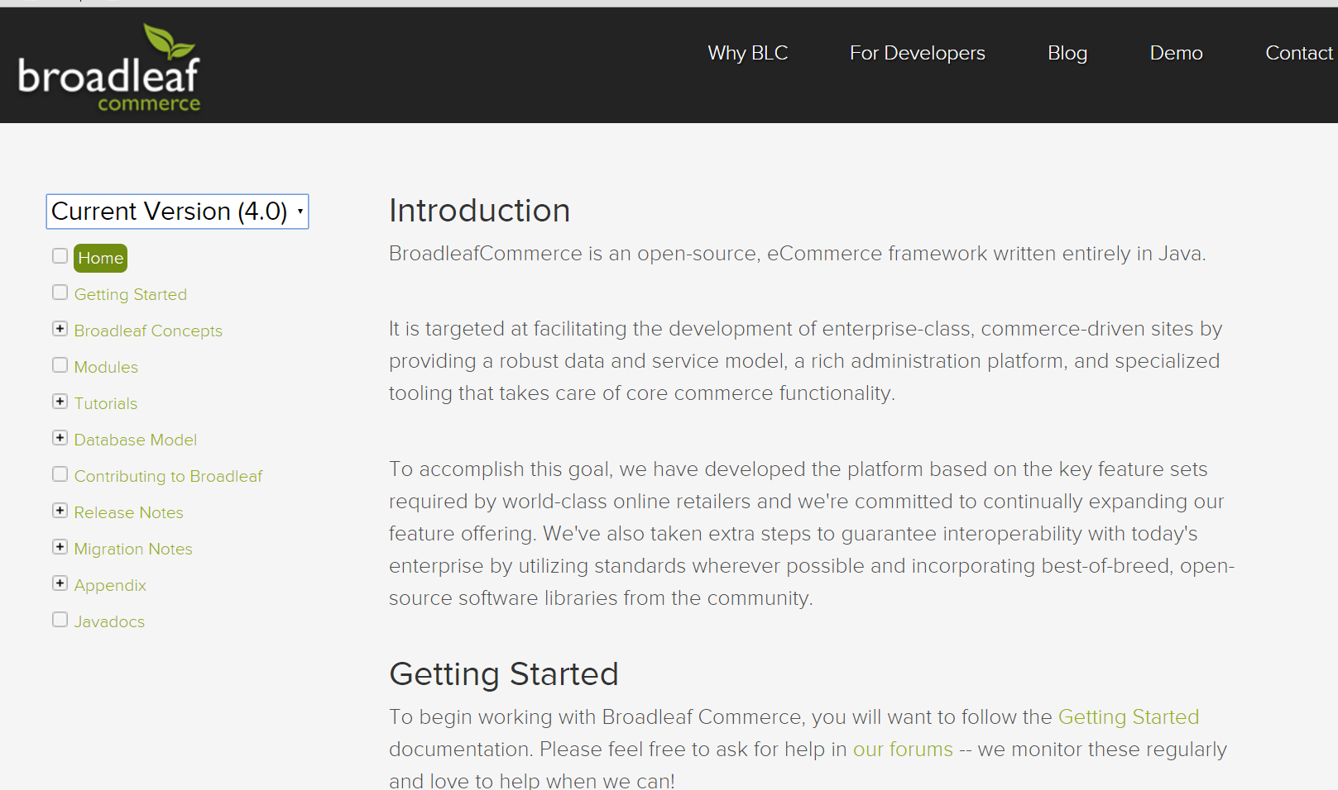
Documentation
For all the versions they still maintain
Notes:
Refer to http://www.broadleafcommerce.com/docs/core/current/modules

Slide 5
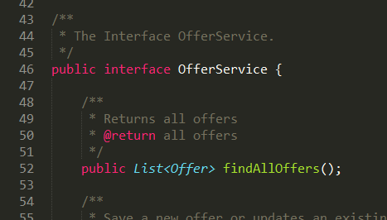
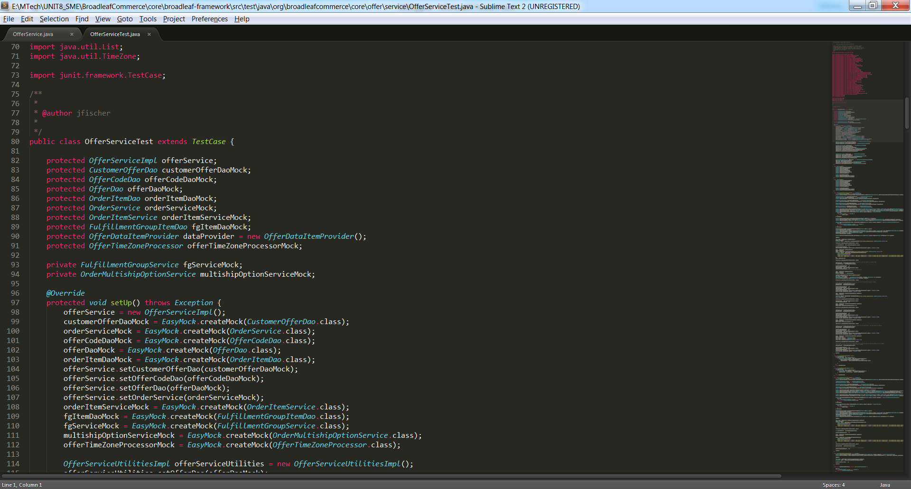
Testing
Unit Test for class with Business Logic
Integration Test
Use Spock/Groovy to perform integration tests

Slide 6
Defect Management
Reporting
Forum (http://forum.broadleafcommerce.com/)
GitHub Issue tracker
Information Required to report an issue
Broadleaf version you are using
Steps to reproduce
Any stack traces that you receive (if applicable)
Any additional information that allows us to help you faster
Any potential fixes you might have already tested
Notes:
http://www.broadleafcommerce.com/docs/core/current/tutorials/testing-tutorials/groovy-spock-integration-test

Slide 7
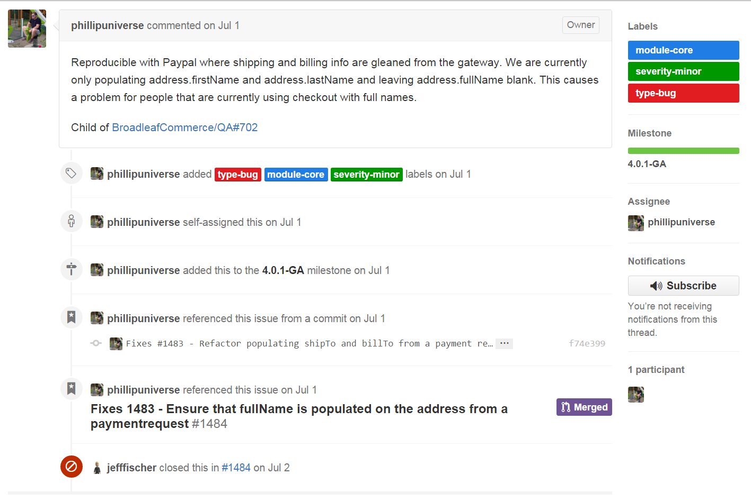
Repair and release
Repair and release Process
Step1 – Analyze the issue
classify and label the issue

Slide 8
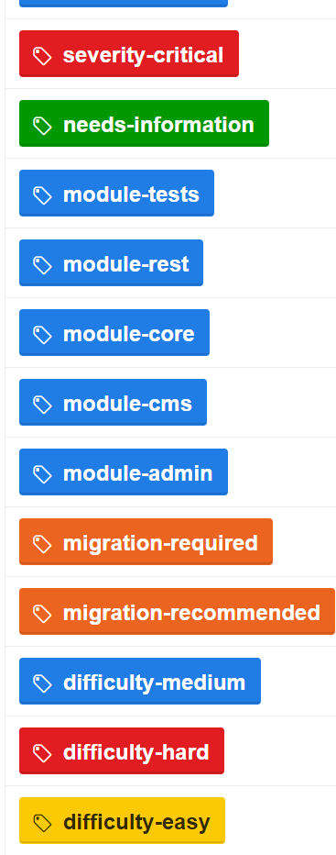
Category Labels
Severity-(critical/major/minor)
Module-(admin/cms/core/rest/tests)
Type-(bug/enhancement/feature).
Difficulty-(hard/medium/easy)
Affects
Target to Release

Slide 9
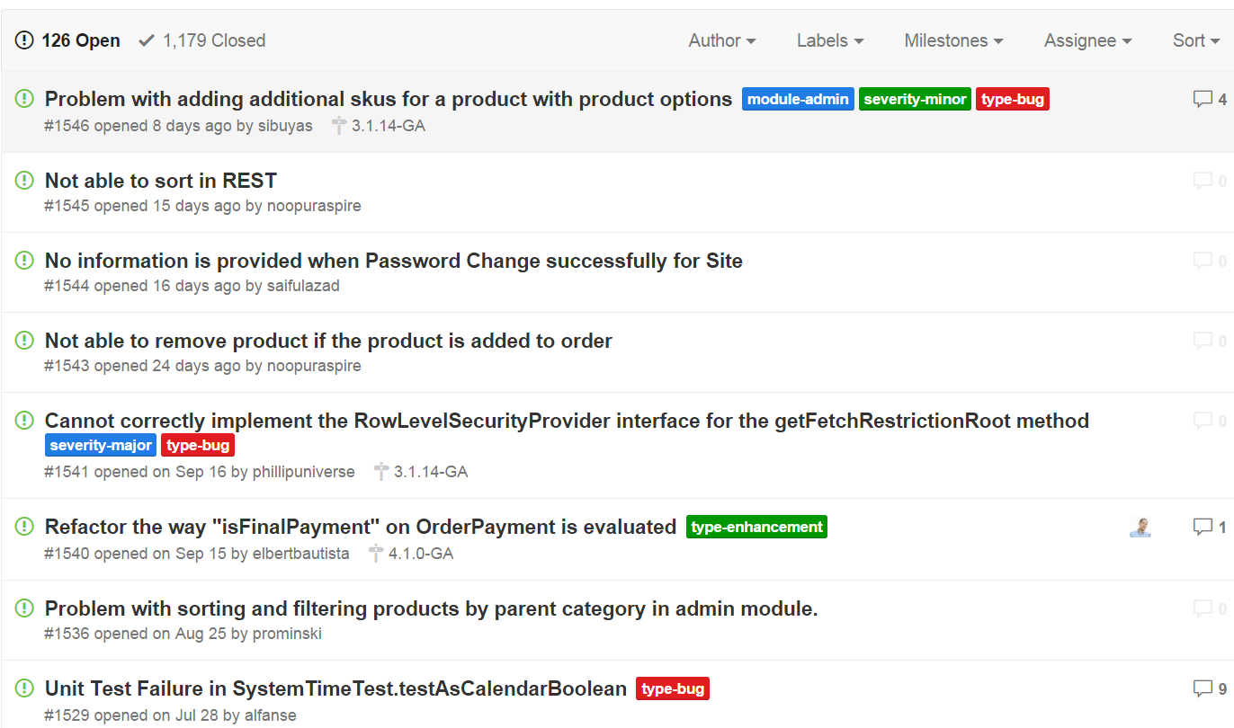
Repair and release Process
Step2 - select issues for next Broadleaf sprint / patch release

Slide 10
Repair and release Process
Step3 - assign a milestone indicating the release that targets for the issue
Assign milestone

Slide 11
Repair and release Process
Step4 - mark the issue as closed generally once the developer has committed the fix
Fix and close

Slide 12
Repair and release Process
Step5 - We release the patch (or new major version) of the software

Slide 13
Or Fix it yourself
Issues may not guarantee to be fixed on a specific timeline as expected
fix the issue then send a pull request
It requires
Understand the branch strategy
Follow code style
Change must pass all tests

Slide 14
