Slide 1
Software Maintenance & Evolution
XU MINSHENG
Achyut Suresh Rao
LIU XINZHUO
XIE JIABAO

Slide 2
Agenda
Project Description
Product History
Product structure
Defect Management
Appraisal of the Product and Management

Slide 3

Goal
Facilitates development of enterprise-class, commerce driven sites by providing a robust and service oriented platform that takes care of core functionality.

Slide 4
Product
Enterprise level open-source E-Commerce framework written in Java on top of Spring Framework.
The Broadleaf framework is designed to allow you to extend any entity, add your own custom entities, and replace or extend any service, DAO, or create custom controllers.
Content Management System: Products and catalog information management.
Multi-Everything: Multi-tenant, multi-site, multi-currency and multi-channel.
Customer Management

Slide 5
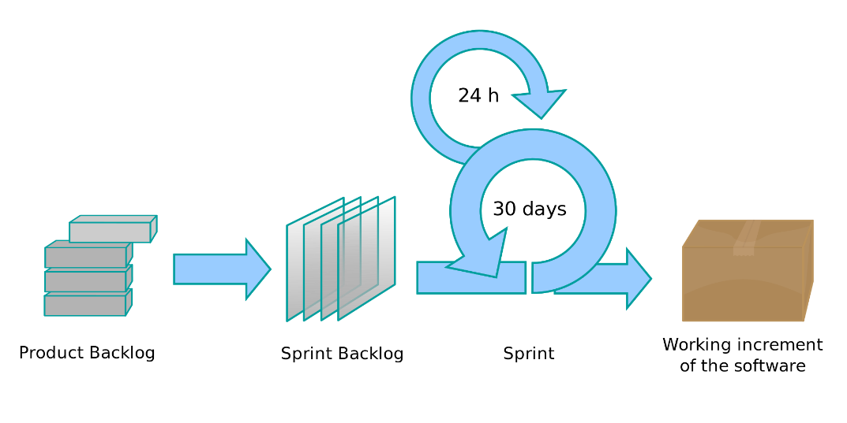

Process
Agile Scrum
Evidence

Slide 6
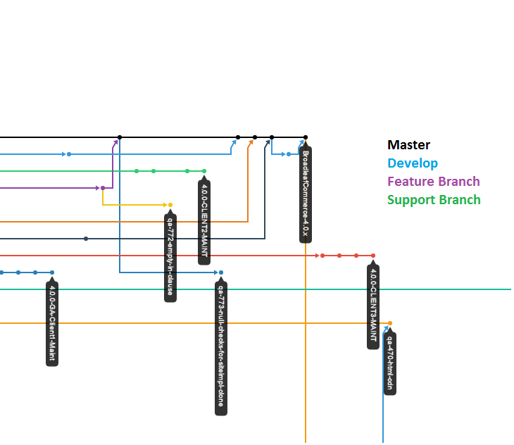
Product History
Releases
The master branch will always represent the latest GA release
The develop branch is what we generally work on day to day and holds the latest code
They also have support branches, which generally take the form BroadleafCommerce-2.0.0-M1-x
Feature branches do not necessarily adhere to any specific naming strategy

Slide 7
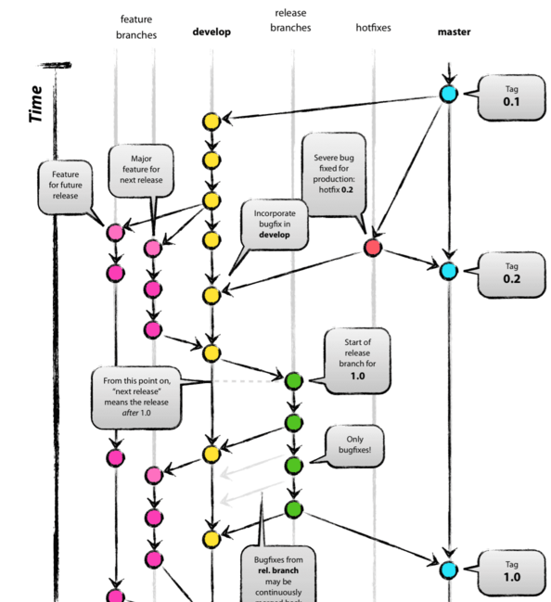
Branching Strategy

Slide 8
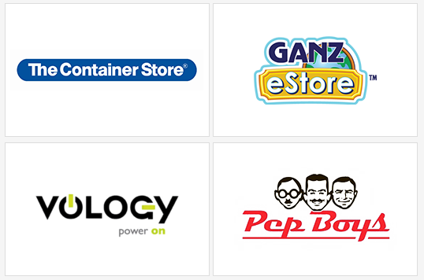
Adoption
The Container Store : Home/Office supplies
Vology : Network Hardware store
Pep Boys : Auto parts store
Ganz eStore : Buy virtual pets used for Webkinz.com

Slide 9
Appraisal of the Product and Management Standards Compliance
W3C
HTTP, SMTP
SOAP, RESTful (Jersey)
MVC (Spring MVC), ORM (Hibernate)
Issue Tracking Strategy
Pull Request & Branching Strategy
Code Style
Notes:
Jersey
http://www.broadleafcommerce.com/technology-stack

Slide 10
Maintainability
Code Level
Integration of many frameworks may cause tight coupling between application class and framework class.
High usage of frameworks means it is hard to re-engineer.
Design Level
No design documents found
Traceability
Server log, QoS (Quality Of Service)
Notes:
Code level
Example1: http://www.broadleafcommerce.com/blog/why-broadleaf-continues-to-choose-spring
QoS
http://www.broadleafcommerce.com/docs/core/current/broadleaf-concepts/additional-configuration/qos-configuration

Slide 11
Usability
Appropriateness recognisability
- Features List
- Demo site
Learnability
- Tuition documents
Operability
- Provide CMS to customize UI
- Provide admin dashboard to control and operate all store business
- Provides over 4000 Java classes and can be extend entities and services
Notes:
Appropriateness recognisability (Users can recognize whether a product is appropriate for their needs)
Features List http://www.broadleafcommerce.com/features
Demo site http://demo.broadleafcommerce.org/
Learnability
Tuition documents
Demo site
Operability
Provide admin console to control and operate all store business
All front-end interface can be customized.(cms)
(cms)
Broadleaf has a large suite of default functionality built in, so it's possible that you will only need to customize the UI and some configuration files.
Broadleaf provides over 4000 Java classes that represent business services, data access objects, entities, and utilities. And also developer can extend entities and implement business services and data access interfaces to customize behavior. And related tuition documents are provided.
http://www.broadleafcommerce.com/docs/core/current/tutorials/core-tutorials/extending-entities-tutorial
http://www.broadleafcommerce.com/docs/core/current/tutorials/core-tutorials/extending-services-tutorial

Slide 12
Extensibility
Spring MVC and Thymeleaf provide with dynamic user interface and templating engineer so user can choose their favorite UI template and customize. And also they can implement more entities and services for extension.
Broadleaf Commerce is an eCommerce development framework. As a framework, Broadleaf provides a mechanism to extend, override, and customize any part of the core functionality without changing the code.
Notes:
http://www.broadleafcommerce.com/technology-stack
http://www.broadleafcommerce.com/faq?recaptchaPublicKey=6Lct6_ESAAAAAA1rzWdQDmWx1WC8804UaOaBEj2t#q9

Slide 13
Portability
Server
- Require servlet container
- Have tested with Tomcat, Jetty, JBoss, WebLogic and WebSphere
Database
- Require SQL data storage
- Have tested with MySQL 5.1, Oracle 9i and 10g, and HSQLDB
Cloud
- Have deployed on Amazon EC2, Rackspace Cloud, CloudBees, CloudFoundry, Hiroku, and Amazon Elastic Beanstalk
* Integrated many frameworks which may cause risk to port application.
Notes:
Broadleaf requires a servlet container such as Apache Tomcat. Broadleaf has also been tested with Jetty, JBoss Application Server, Oracle WebLogic Application Server, and IBM WebSphere Application Server. http://www.broadleafcommerce.com/faq?recaptchaPublicKey=6Lct6_ESAAAAAA1rzWdQDmWx1WC8804UaOaBEj2t#q2
You can use any relational database that Hibernate supports. But no noSQL data storage. We have done the majority of our testing with MySQL 5.1, Oracle 9i and 10g, and HSQLDB.
http://www.broadleafcommerce.com/faq?recaptchaPublicKey=6Lct6_ESAAAAAA1rzWdQDmWx1WC8804UaOaBEj2t#q4
We have deployed Broadleaf Commerce to Amazon EC2, Rackspace Cloud, CloudBees, CloudFoundry, Hiroku, and Amazon Elastic Beanstalk.
http://www.broadleafcommerce.com/faq?recaptchaPublicKey=6Lct6_ESAAAAAA1rzWdQDmWx1WC8804UaOaBEj2t#q5
Integrate many frameworks which may cause risk to port application

Slide 14
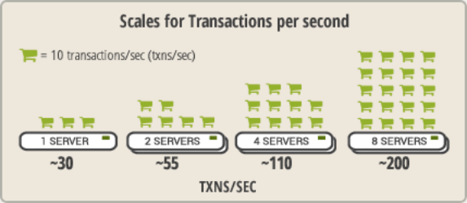
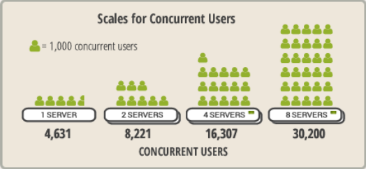
Scalability
Broadleaf Commerce scales horizontally by adding additional servers

