Slide 1
Software Maintenance & Evolution
XU MINSHENG
Achyut Suresh Rao
LIU XINZHUO
XIE JIABAO

Slide 2
Agenda
Project Description
Product History
Product structure
Defect Management
Appraisal of the Product and Management

Slide 3

Goal
Facilitates development of enterprise-class, commerce driven sites by providing a robust and service oriented platform that takes care of core functionality.

Slide 4
Product
Enterprise level open-source E-Commerce framework written in Java on top of Spring Framework.
The Broadleaf framework is designed to allow you to extend any entity, add your own custom entities, and replace or extend any service, DAO, or create custom controllers.
Content Management System: Products and catalog information management.
Multi-Everything: Multi-tenant, multi-site, multi-currency and multi-channel.
Customer Management

Slide 5
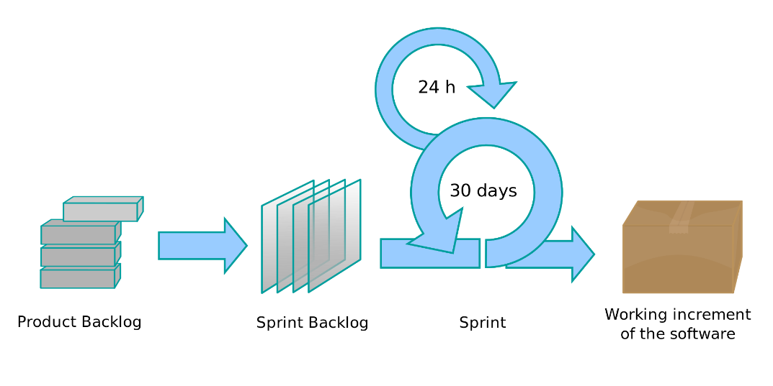

Process
Agile Scrum
Evidence

Slide 6
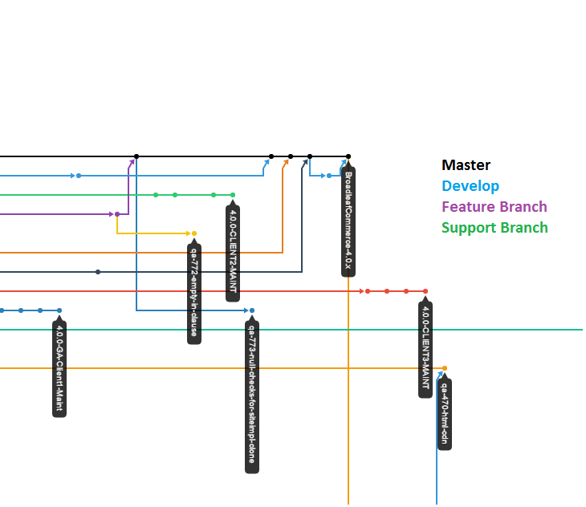
Product History
Releases
The master branch will always represent the latest GA release
The develop branch is what we generally work on day to day and holds the latest code
They also have support branches, which generally take the form BroadleafCommerce-2.0.0-M1-x
Feature branches do not necessarily adhere to any specific naming strategy

Slide 7
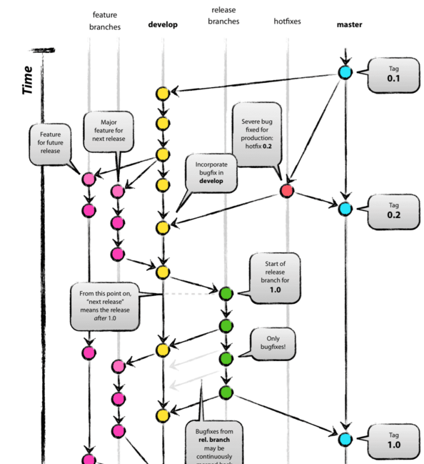
Branching Strategy

Slide 8
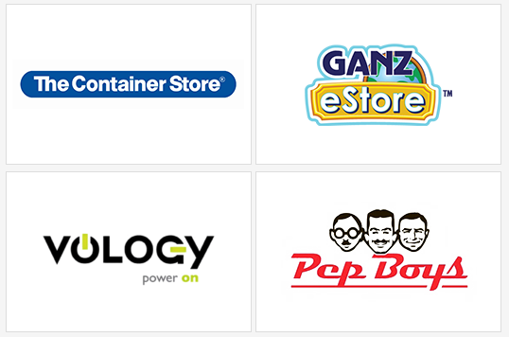
Adoption
The Container Store : Home/Office supplies
Vology : Network Hardware store
Pep Boys : Auto parts store
Ganz eStore : Buy virtual pets used for Webkinz.com

Slide 9
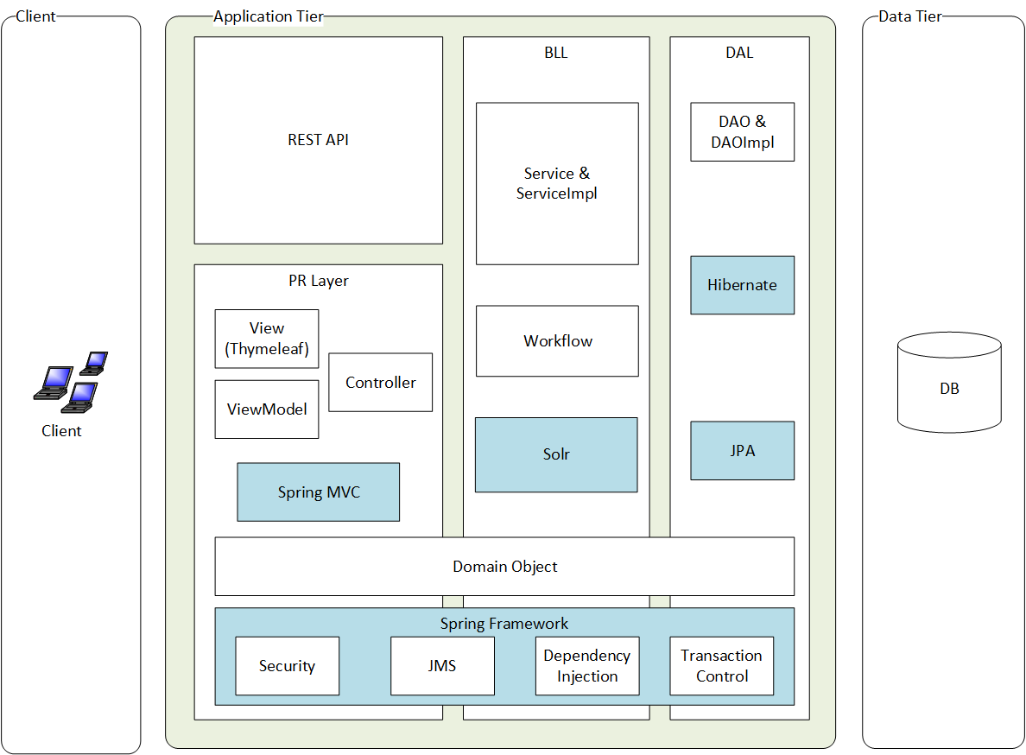
Architecture (v4.0)

Slide 10
Design
Follow Agile manifesto
Working software over comprehensive documentation
Only High-level design and architectural decision is documented, such as
Choosing the Spring Framework over EJB3
Using Solr to achieve catalog browsing and searching
Notes:
http://www.broadleafcommerce.com/blog/why-broadleaf-continues-to-choose-spring

Slide 11
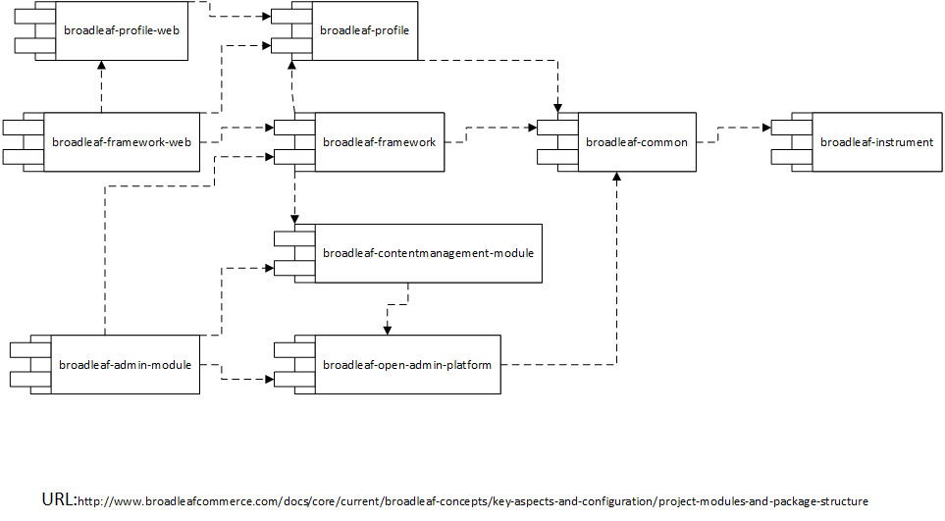
Framework Modules (v4.0)
Notes:
http://www.broadleafcommerce.com/docs/core/current/broadleaf-concepts/key-aspects-and-configuration/project-modules-and-package-structure

Slide 12
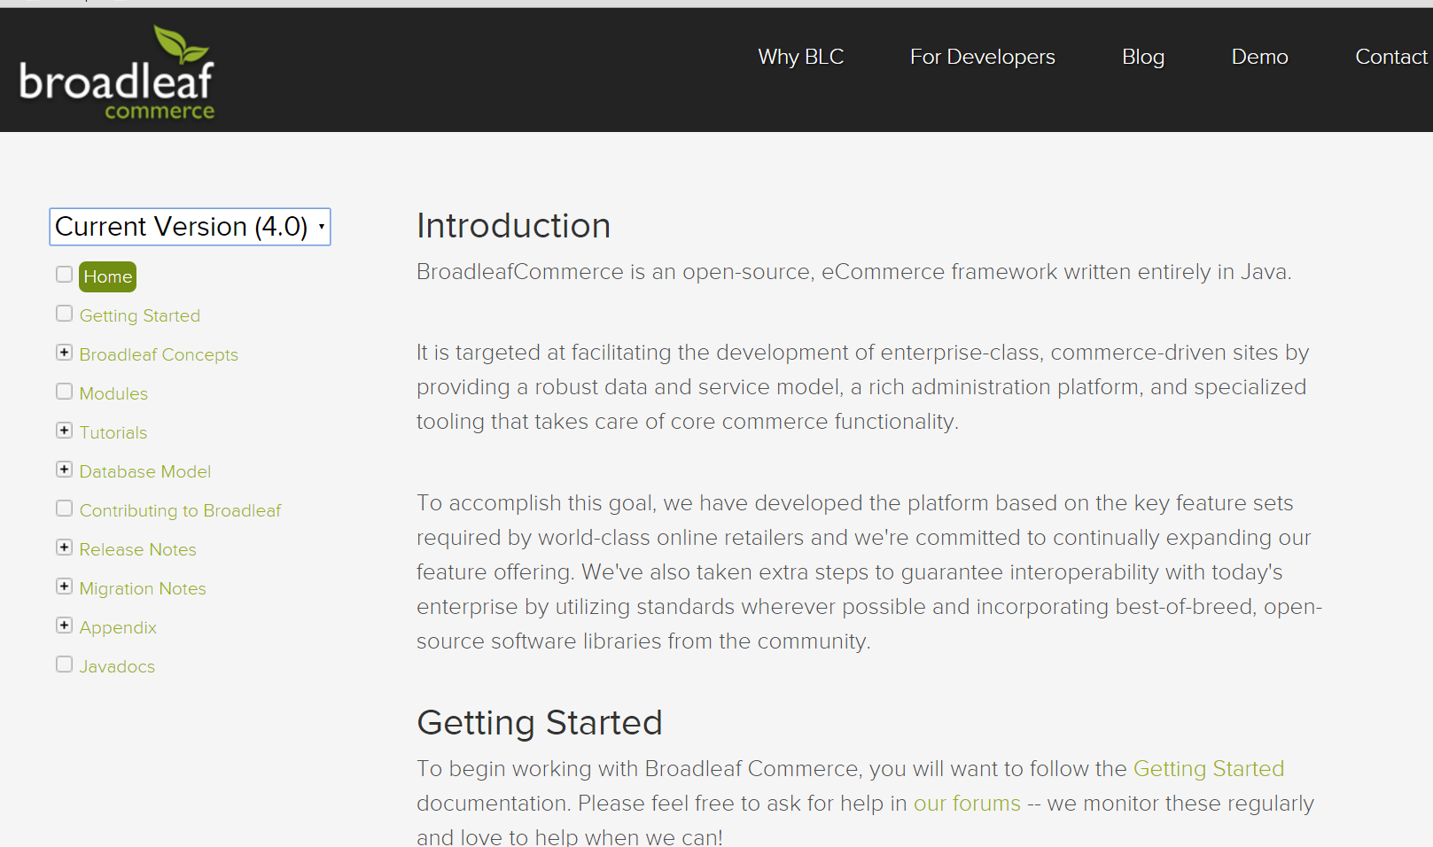
Documentation
For all the versions they still maintain
Notes:
Refer to http://www.broadleafcommerce.com/docs/core/current/modules

Slide 13
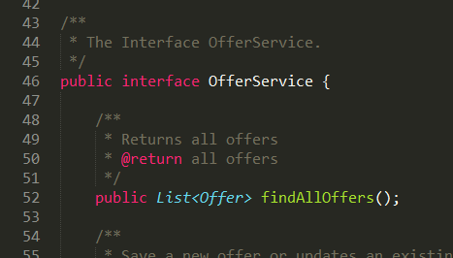
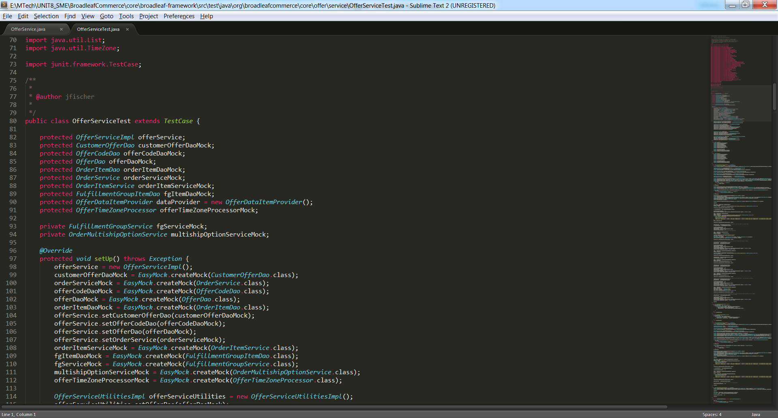
Testing
Unit Test for class with Business Logic
Integration Test
Use Spock/Groovy to perform integration tests

Slide 14
Defect Management
Reporting
Forum (http://forum.broadleafcommerce.com/)
GitHub Issue tracker
Information Required to report an issue
Broadleaf version you are using
Steps to reproduce
Any stack traces that you receive (if applicable)
Any additional information that allows us to help you faster
Any potential fixes you might have already tested
Notes:
http://www.broadleafcommerce.com/docs/core/current/tutorials/testing-tutorials/groovy-spock-integration-test

Slide 15
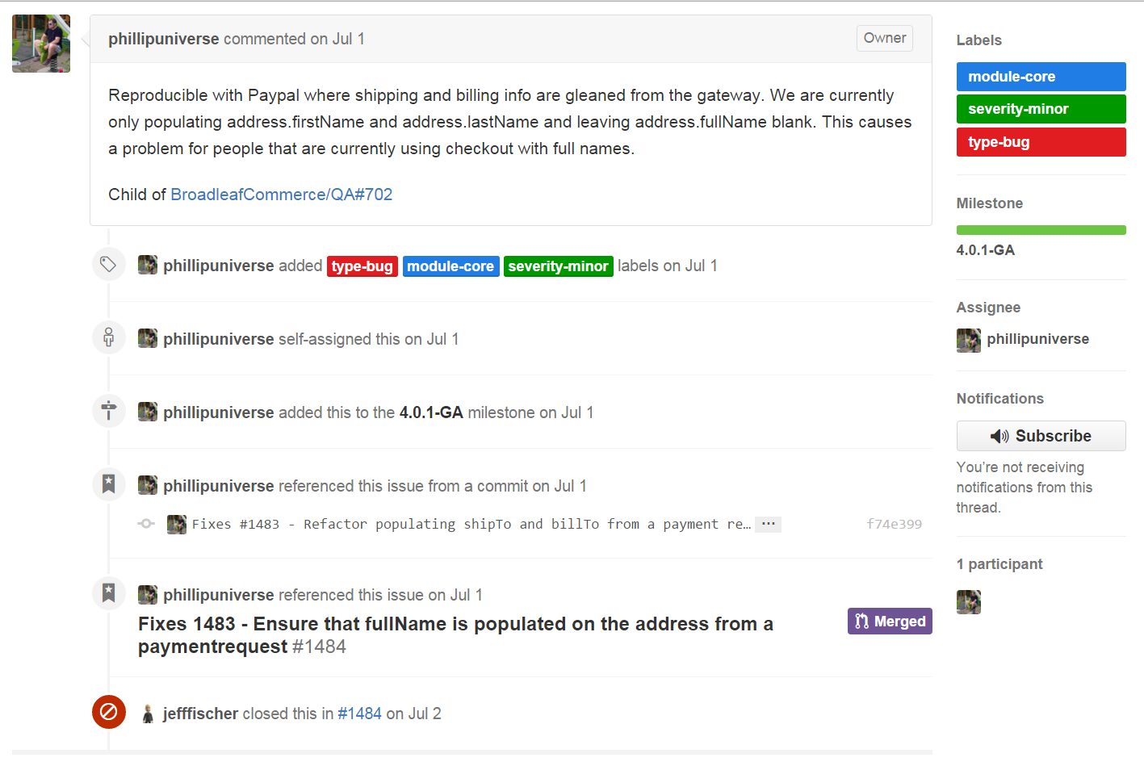
Repair and release
Repair and release Process
Step1 – Analyze the issue
classify and label the issue

Slide 16
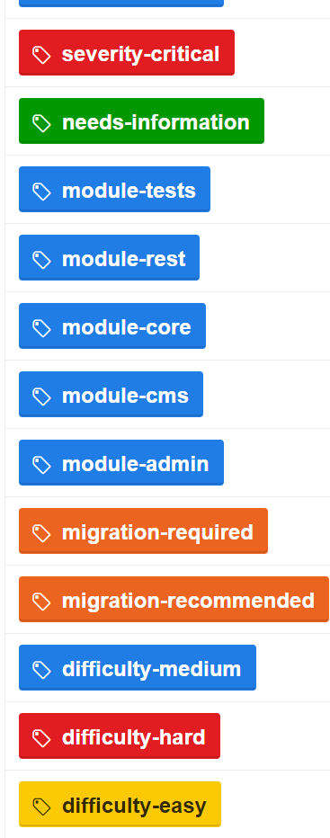
Category Labels
Severity-(critical/major/minor)
Module-(admin/cms/core/rest/tests)
Type-(bug/enhancement/feature).
Difficulty-(hard/medium/easy)
Affects
Target to Release

Slide 17
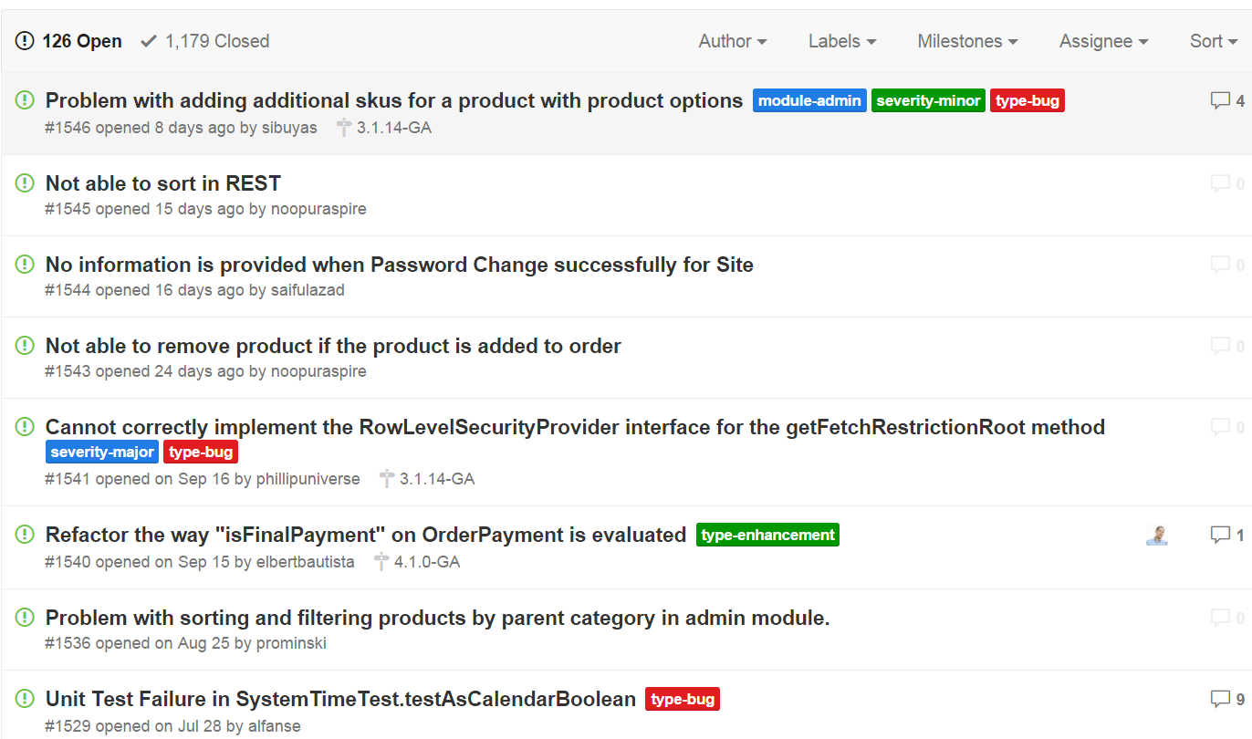
Repair and release Process
Step2 - select issues for next Broadleaf sprint / patch release

Slide 18
Repair and release Process
Step3 - assign a milestone indicating the release that targets for the issue
Assign milestone

Slide 19
Repair and release Process
Step4 - mark the issue as closed generally once the developer has committed the fix
Fix and close

Slide 20
Repair and release Process
Step5 - We release the patch (or new major version) of the software

Slide 21
Or Fix it yourself
Issues may not guarantee to be fixed on a specific timeline as expected
fix the issue then send a pull request
It requires
Understand the branch strategy
Follow code style
Change must pass all tests

Slide 22
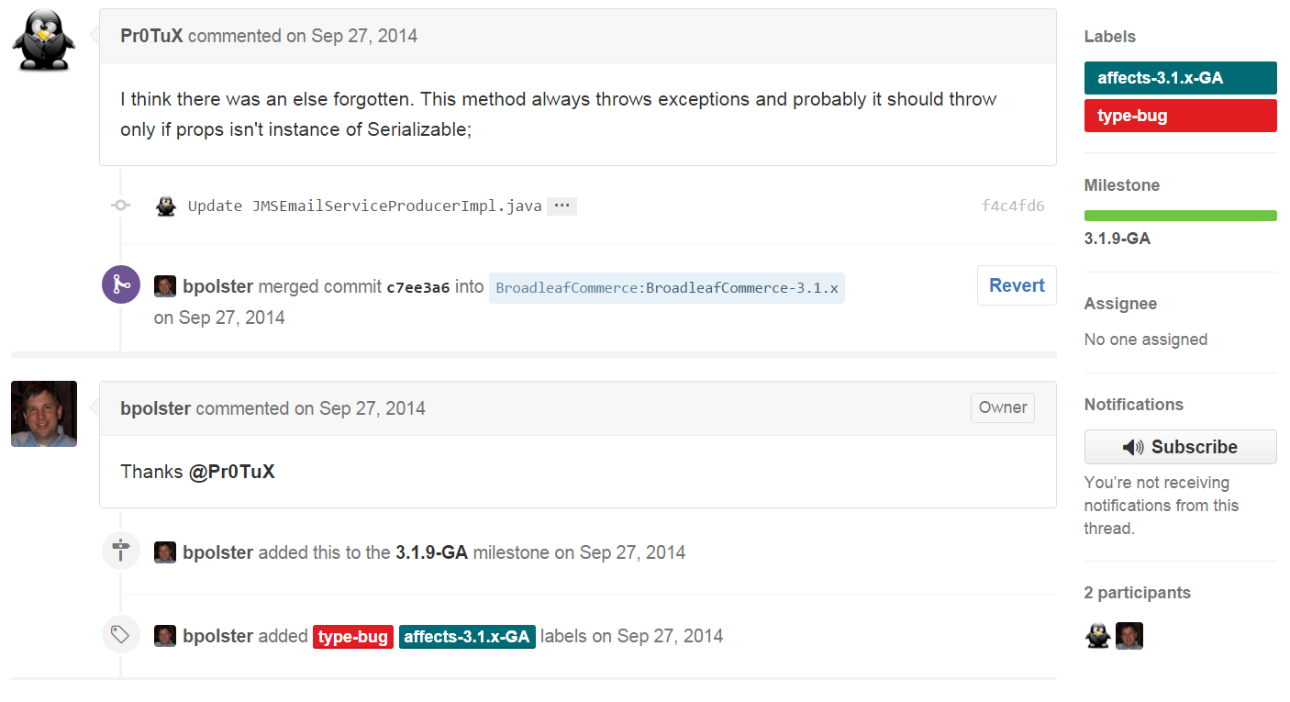
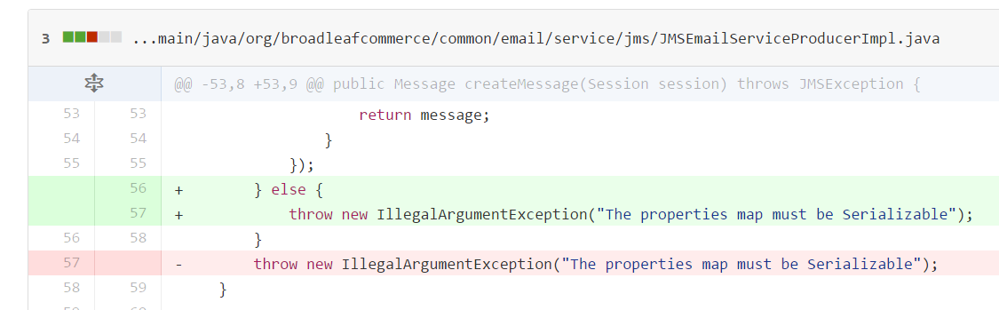

Slide 23
Appraisal of the Product and Management Standards Compliance
W3C
HTTP, SMTP
SOAP, RESTful (Jersey)
MVC (Spring MVC), ORM (Hibernate)
Issue Tracking Strategy
Pull Request & Branching Strategy
Code Style
Notes:
Jersey
http://www.broadleafcommerce.com/technology-stack

Slide 24
Maintainability
Code Level
Integration of many frameworks may cause tight coupling between application class and framework class.
High usage of frameworks means it is hard to re-engineer.
Design Level
No design documents found
Traceability
Server log, QoS (Quality Of Service)
Notes:
Code level
Example1: http://www.broadleafcommerce.com/blog/why-broadleaf-continues-to-choose-spring
QoS
http://www.broadleafcommerce.com/docs/core/current/broadleaf-concepts/additional-configuration/qos-configuration

Slide 25
Usability
Appropriateness recognisability
- Features List
- Demo site
Learnability
- Tuition documents
Operability
- Provide CMS to customize UI
- Provide admin dashboard to control and operate all store business
- Provides over 4000 Java classes and can be extend entities and services
Notes:
Appropriateness recognisability (Users can recognize whether a product is appropriate for their needs)
Features List http://www.broadleafcommerce.com/features
Demo site http://demo.broadleafcommerce.org/
Learnability
Tuition documents
Demo site
Operability
Provide admin console to control and operate all store business
All front-end interface can be customized.(cms)
(cms)
Broadleaf has a large suite of default functionality built in, so it's possible that you will only need to customize the UI and some configuration files.
Broadleaf provides over 4000 Java classes that represent business services, data access objects, entities, and utilities. And also developer can extend entities and implement business services and data access interfaces to customize behavior. And related tuition documents are provided.
http://www.broadleafcommerce.com/docs/core/current/tutorials/core-tutorials/extending-entities-tutorial
http://www.broadleafcommerce.com/docs/core/current/tutorials/core-tutorials/extending-services-tutorial

Slide 26
Extensibility
Spring MVC and Thymeleaf provide with dynamic user interface and templating engineer so user can choose their favorite UI template and customize. And also they can implement more entities and services for extension.
Broadleaf Commerce is an eCommerce development framework. As a framework, Broadleaf provides a mechanism to extend, override, and customize any part of the core functionality without changing the code.
Notes:
http://www.broadleafcommerce.com/technology-stack
http://www.broadleafcommerce.com/faq?recaptchaPublicKey=6Lct6_ESAAAAAA1rzWdQDmWx1WC8804UaOaBEj2t#q9

Slide 27
Portability
Server
- Require servlet container
- Have tested with Tomcat, Jetty, JBoss, WebLogic and WebSphere
Database
- Require SQL data storage
- Have tested with MySQL 5.1, Oracle 9i and 10g, and HSQLDB
Cloud
- Have deployed on Amazon EC2, Rackspace Cloud, CloudBees, CloudFoundry, Hiroku, and Amazon Elastic Beanstalk
* Integrated many frameworks which may cause risk to port application.
Notes:
Broadleaf requires a servlet container such as Apache Tomcat. Broadleaf has also been tested with Jetty, JBoss Application Server, Oracle WebLogic Application Server, and IBM WebSphere Application Server. http://www.broadleafcommerce.com/faq?recaptchaPublicKey=6Lct6_ESAAAAAA1rzWdQDmWx1WC8804UaOaBEj2t#q2
You can use any relational database that Hibernate supports. But no noSQL data storage. We have done the majority of our testing with MySQL 5.1, Oracle 9i and 10g, and HSQLDB.
http://www.broadleafcommerce.com/faq?recaptchaPublicKey=6Lct6_ESAAAAAA1rzWdQDmWx1WC8804UaOaBEj2t#q4
We have deployed Broadleaf Commerce to Amazon EC2, Rackspace Cloud, CloudBees, CloudFoundry, Hiroku, and Amazon Elastic Beanstalk.
http://www.broadleafcommerce.com/faq?recaptchaPublicKey=6Lct6_ESAAAAAA1rzWdQDmWx1WC8804UaOaBEj2t#q5
Integrate many frameworks which may cause risk to port application

Slide 28
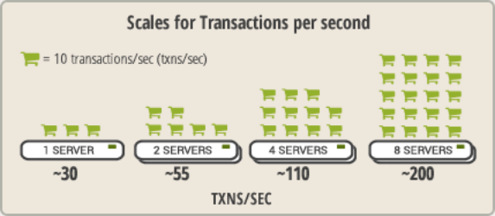
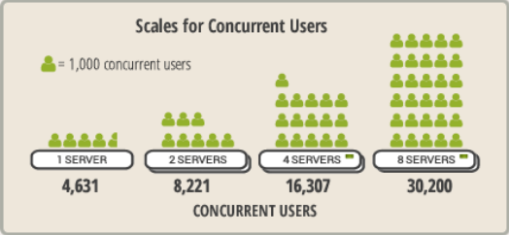
Scalability
Broadleaf Commerce scales horizontally by adding additional servers

Slide 29
Thank you

