Slide 1
Software Maintenance & Evolution
XU MINSHENG
Achyut Suresh Rao
LIU XINZHUO
XIE JIABAO

Slide 2

Goal
Facilitates development of enterprise-class, commerce driven sites by providing a robust and service oriented platform that takes care of core functionality.

Slide 3
Product
Enterprise level open-source E-Commerce framework written in Java on top of Spring Framework.
The Broadleaf framework is designed to allow you to extend any entity, add your own custom entities, and replace or extend any service, DAO, or create custom controllers.
Content Management System: Products and catalog information management.
Multi-Everything: Multi-tenant, multi-site, multi-currency and multi-channel.
Customer Management

Slide 4
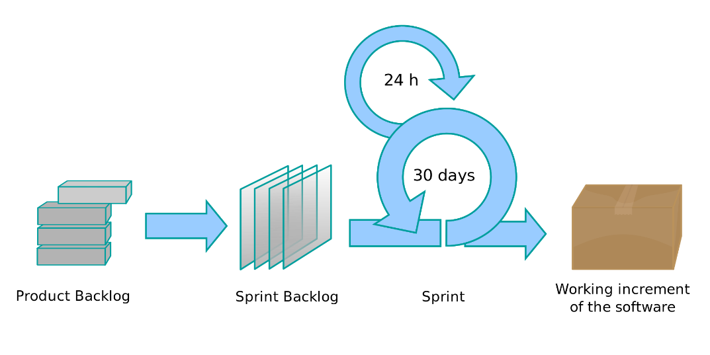

Process
Agile Scrum
Evidence

Slide 5
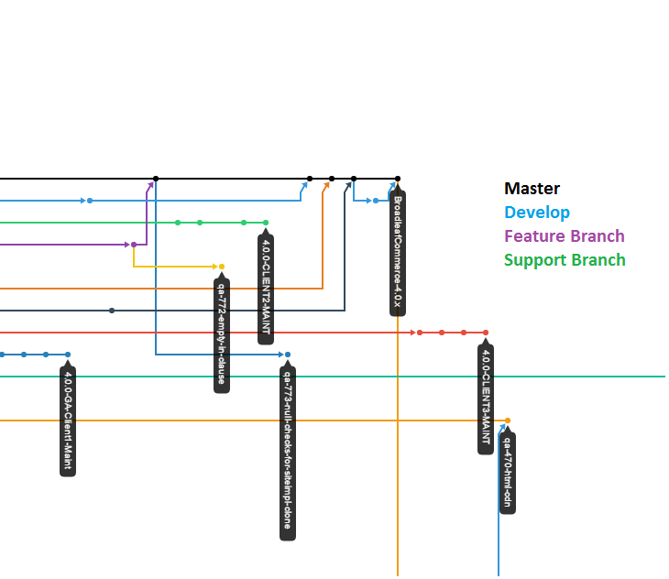
Product History
Releases
The master branch will always represent the latest GA release
The develop branch is what we generally work on day to day and holds the latest code
They also have support branches, which generally take the form BroadleafCommerce-2.0.0-M1-x
Feature branches do not necessarily adhere to any specific naming strategy

Slide 6
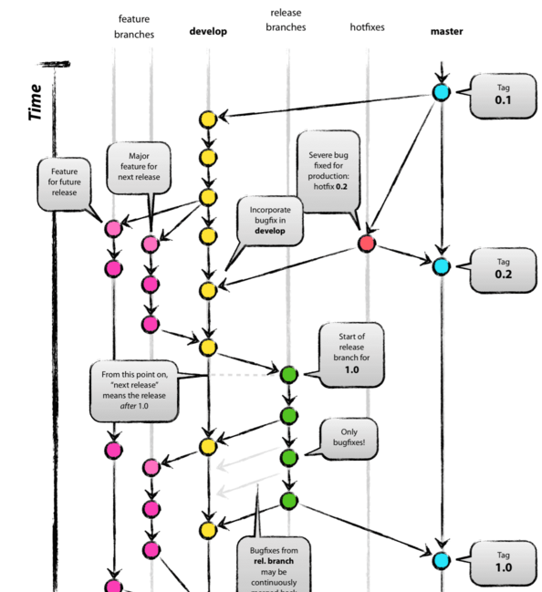
Branching Strategy

Slide 7
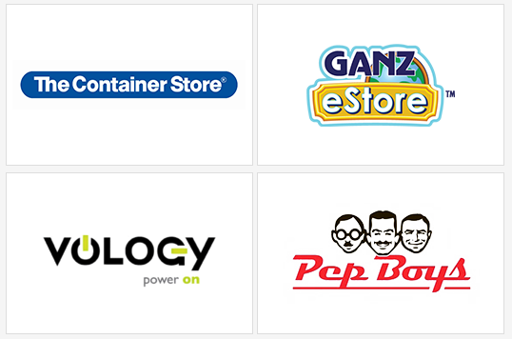
Adoption
The Container Store : Home/Office supplies
Vology : Network Hardware store
Pep Boys : Auto parts store
Ganz eStore : Buy virtual pets used for Webkinz.com

Slide 8
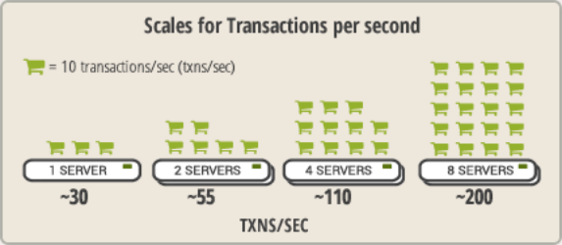
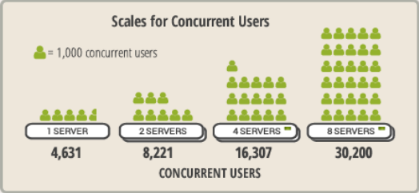
Scalability
Broadleaf Commerce scales horizontally by adding additional servers

