Slide 1
Greedy Algorithms

Slide 2
Algorithm Design Methods
Algorithm types we will consider include:
Simple recursive algorithms
Backtracking algorithms
Divide and conquer algorithms
Dynamic programming algorithms
Greedy algorithms
Branch and bound algorithms
Brute force algorithms
Randomized algorithms

Slide 3
Some method not covered
Linear Programming
Integer Programming
Simulated Annealing
Neural Networks
Genetic Algorithms
Tabu Search

Slide 4
Optimization problems
An optimization problem is one in which you want to find, not just a solution, but the best solution
A problem in which some functions(called the optimization or objective function) is to be optimized(usually minimized or maximized) subject to some constraints
A “greedy algorithm” sometimes works well for optimization problems
Notes:
2

Slide 5
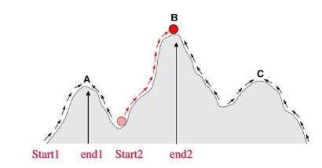
Optimization problems
A greedy algorithm works in phases. At each phase:
You take the best you can get right now, without regard for future consequences
You hope that by choosing a local optimum at each step, you will end up at a global optimum

Slide 6
Example: Make money
Suppose you have a friend who has a lot of coins including $5, $10, $20.
You need only $35
Example: To make $35, you can choose:
5+ 5+ 5+ 5+ 5+ 5+ 5
20+5+5+5, to make 35
10+10+5+10, to make 35
20+10+5
Your friend agree to give you the minimum number of coins
A greedy algorithm would do this would be:
At each step, take the largest possible bill or coin that does not overshoot
Notes:
3

Slide 7
A failure of the greedy algorithm
In some (fictional) monetary system, “krons” come in 1 kron, 7 kron, and 10 kron coins
Using a greedy algorithm to count out 15 krons, you would get
A 10 kron piece
Five 1 kron pieces, for a total of 15 krons
This requires six coins
A better solution would be to use two 7 kron pieces and one 1 kron piece
This only requires three coins
The greedy algorithm results in a solution, but not in an optimal solution
Notes:
4

Slide 8
A scheduling problem
You have to run nine jobs, with running times of 3, 5, 6, 10, 11, 14, 15, 18, and 20 minutes
You have three processors on which you can run these jobs
You decide to do the longest-running jobs first, on whatever processor is available
P1
P2
P3
20
10
3
18
11
6
15
14
5
Time to completion: 18 + 11 + 6 = 35 minutes
This solution isn’t bad, but we might be able to do better
Notes:
5

Slide 9
Another approach
What would be the result if you ran the shortest job first?
Again, the running times are 3, 5, 6, 10, 11, 14, 15, 18, and 20 minutes
P1
P2
P3
3
10
15
5
11
18
6
14
20
That wasn’t such a good idea; time to completion is now 6 + 14 + 20 = 40 minutes
Note, however, that the greedy algorithm itself is fast
All we had to do at each stage was pick the minimum or maximum
Notes:
6

Slide 10
An optimum solution
Better solutions do exist:
P1
P2
P3
20
14
18
11
5
15
10
6
3
This solution is clearly optimal (why?)
Clearly, there are other optimal solutions (why?)
How do we find such a solution?
One way: Try all possible assignments of jobs to processors
Unfortunately, this approach can take exponential time
Notes:
7

Slide 11
Huffman encoding
The Huffman encoding algorithm is a greedy algorithm
Given the percentage the each character appears in a corpus, determine a variable-bit pattern for each char.
You always pick the two smallest percentages to combine.
100%
54%
27%
46%
15%
22% 12% 24% 6% 27% 9% A B C D E F

Slide 12
Huffman Encoding
100%
100%
54%
0
1
A=00 B=100 C=01 D=1010 E=11 F=1011
54%
27%
46%
0
1
27%
E
46%
15%
A
C
B
15%
A B C D E F
D
F
Average bits/char: 0.22*2 + 0.12*3 + 0.24*2 + 0.06*4 + 0.27*2 + 0.09*4 = 2.42
The solution found doing this is an optimal solution.
The resulting binary tree is a full tree.

Slide 13
Minimum spanning tree
A minimum spanning tree is a least-cost subset of the edges of a graph that connects all the nodes
Start by picking any node and adding it to the tree
Repeatedly: Pick any least-cost edge from a node in the tree to a node not in the tree, and add the edge and new node to the tree
Stop when all nodes have been added to the tree
6
The result is a least-cost (3+3+2+2+2=12) spanning tree
If you think some other edge should be in the spanning tree:
Try adding that edge
Note that the edge is part of a cycle
To break the cycle, you must remove the edge with the greatest cost
This will be the edge you just added
4
2
1
4
5
3
2
3
3
2
3
3
2
4
4

Slide 14
Analysis
A greedy algorithm typically makes (approximately) n choices for a problem of size n
(The first or last choice may be forced)
Hence the expected running time is: O(n * O(choice(n))), where choice(n) is making a choice among n objects
Counting: Must find largest useable coin from among k sizes of coin (k is a constant), an O(k)=O(1) operation;
Therefore, coin counting is (n)
Huffman: Must sort n values before making n choices
Therefore, Huffman is O(n log n) + O(n) = O(n log n)
Notes:
11

Slide 15
Activity-Selection Problem
Problem: get your money’s worth out of a festival
Buy a wristband that lets you onto any ride
Lots of rides, each starting and ending at different times
Your goal: ride as many rides as possible
Another, alternative goal that we don’t solve here: maximize time spent on rides
Welcome to the activity selection problem

Slide 16
Activity-selection Problem
Input: Set S of n activities, a₁, a₂, …, a_{n}.
s_{i} = start time of activity i.
f_{i} = finish time of activity i.
Output: Subset A of maximum number of compatible activities.
Two activities are compatible, if their intervals don’t overlap.
Example:
Activities in each line
are compatible.
2
5
3
6
1
4
7

Slide 17
Optimal Substructure
Assume activities are sorted by finishing times.
f₁ ≤ f₂ ≤ … ≤ f_{n}.
Suppose an optimal solution includes activity a_{k}.
This generates two subproblems.
Selecting from a₁, …, a_{k-1}, activities compatible with one another, and that finish before a_{k} starts (compatible with a_{k}).
Selecting from a_{k+1}, …, a_{n}, activities compatible with one another, and that start after a_{k} finishes.
The solutions to the two subproblems must be optimal.
Prove using the cut-and-paste approach.

Slide 18
Greedy Choice Property
Dynamic programming? Memoize? Yes, but…
Activity selection problem also exhibits the greedy choice property:
Locally optimal choice ⇒ globally optimal sol’n

Slide 19
Greedy-choice Property
The problem also exhibits the greedy-choice property.
There is an optimal solution to the subproblem S_{ij}, that includes the activity with the smallest finish time in set S_{ij}.
Can be proved easily.
Hence, there is an optimal solution to S that includes a₁.
Therefore, make this greedy choice without solving subproblems first and evaluating them.
Solve the subproblem that ensures as a result of making this greedy choice.
Combine the greedy choice and the solution to the subproblem.

Slide 20
Recursive Algorithm
Recursive-Activity-Selector (s, f, i, j)
m ← i+1
while m < j and s_{m} < f_{i}
do m ← m+1
if m < j
then return {a_{m}} ∪
Recursive-Activity-Selector(s, f, m, j)
else return φ
Initial Call: Recursive-Activity-Selector (s, f, 0, n+1)
Complexity: Θ(n)
Straightforward to convert the algorithm to an iterative one.

Slide 21
Typical Steps
Cast the optimization problem as one in which we make a choice and are left with one subproblem to solve.
Prove that there’s always an optimal solution that makes the greedy choice, so that the greedy choice is always safe.
Show that greedy choice and optimal solution to subproblem ⇒ optimal solution to the problem.
Make the greedy choice and solve top-down.
May have to preprocess input to put it into greedy order.
Example: Sorting activities by finish time.

Slide 22
Activity Selection: A Greedy Algorithm
So actual algorithm is simple:
Sort the activities by finish time
Schedule the first activity
Then schedule the next activity in sorted list which starts after previous activity finishes
Repeat until no more activities
Intuition is even more simple:
Always pick the shortest ride available at the time

Slide 23
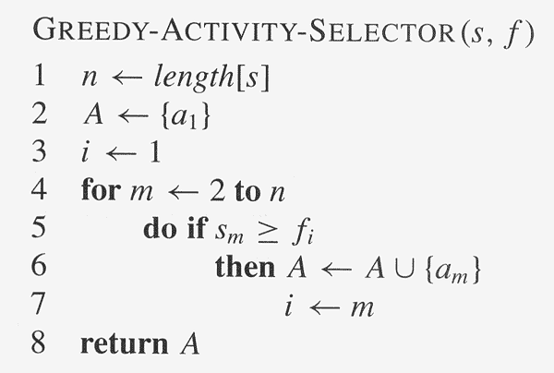
Copyright © The McGraw-Hill Companies, Inc. Permission required for reproduction or display.

Slide 24
Elements of Greedy Algorithms
Greedy-choice Property.
A globally optimal solution can be arrived at by making a locally optimal (greedy) choice.
Optimal Substructure.

Slide 25
Collecting coins
A checkerboard has a certain number of coins on it
A robot starts in the upper-left corner, and walks to the bottom left-hand corner
The robot can only move in two directions: right and down
The robot collects coins as it goes
You want to collect all the coins using the minimum number of robots
Example:
Do you see a greedy algorithm for doing this?
Does the algorithm guarantee an optimal solution?
Can you prove it?
Can you find a counterexample?

Slide 26
The End
Notes:
12

Slide 27
Implement any algorithm which follow greedy strategy.
Remaining Tasks:
Quick Sort
0/1 and fractional Knapsack Problem
Dynamic Programming: LCS

Slide 28
Greedy Strategy
Matrix
 | 1 | 2 | 3 | 4 | 5
1 | 0 | 0.125 | 0.52 | 0.35 | 0.81
2 | 0.56 | 0 | 0.45 | 0.25 | 0.85
3 | 0.25 | 0.27 | 0 | 0.66 | 0.20
4 | 0.10 | 0.45 | 0.88 | 0 | 0.91
5 | 0.25 | 0.20 | 0.30 | 0.89 | 0
Threshold Value > 0.40
1.
2.
3.
4.
5.

