Slide 1
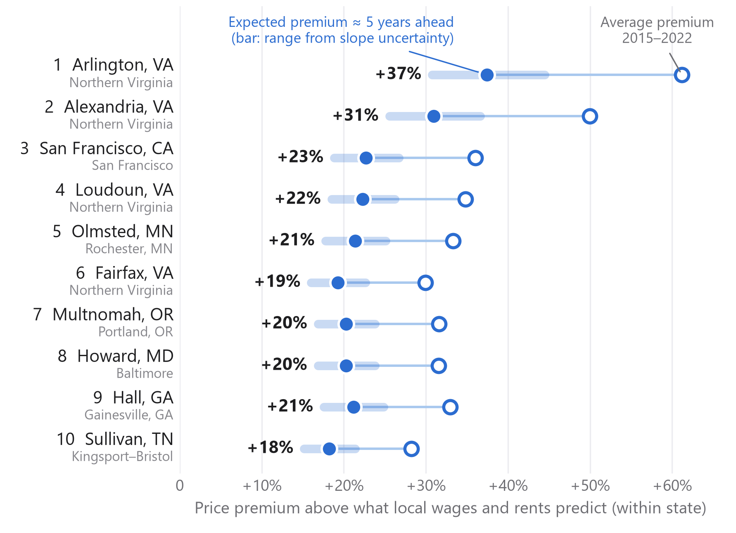
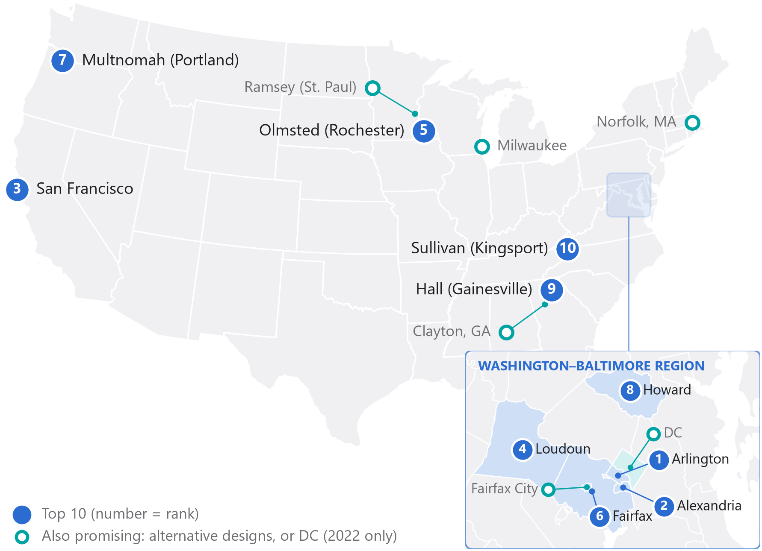

01 WHERE SHOULD WE OPEN OUR NEXT PRESCHOOL?
Ten counties where parents are expected to pay 18–37% more than local costs predict, an advantage that has lasted since 2015
TOP 10 · PRICE PREMIUM ABOVE WHAT LOCAL COSTS PREDICT
LOCATION · 1, 2, 4 AND 6 FORM ONE MARKET: NORTHERN VIRGINIA
MGT 403 Data Project · Carson Tavares, Lee Itzhaki, Vusala Suleymanova, Philipp Romberg. Sample: 998 metro counties (2022), prices 2015–2022. Premium = actual price vs. price predicted from childcare-worker wages and rents within the same state; expected premium = after typical fading (slide 5); bar = range from the uncertainty of the fading slope.
1

Slide 2
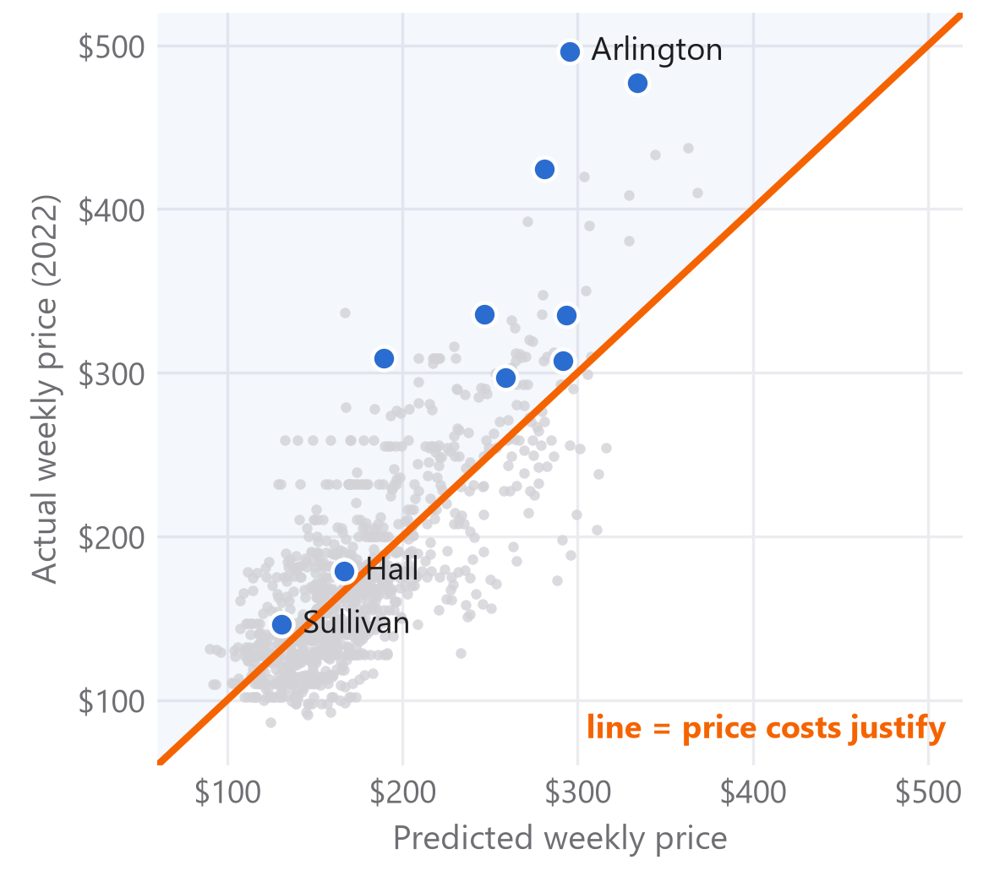
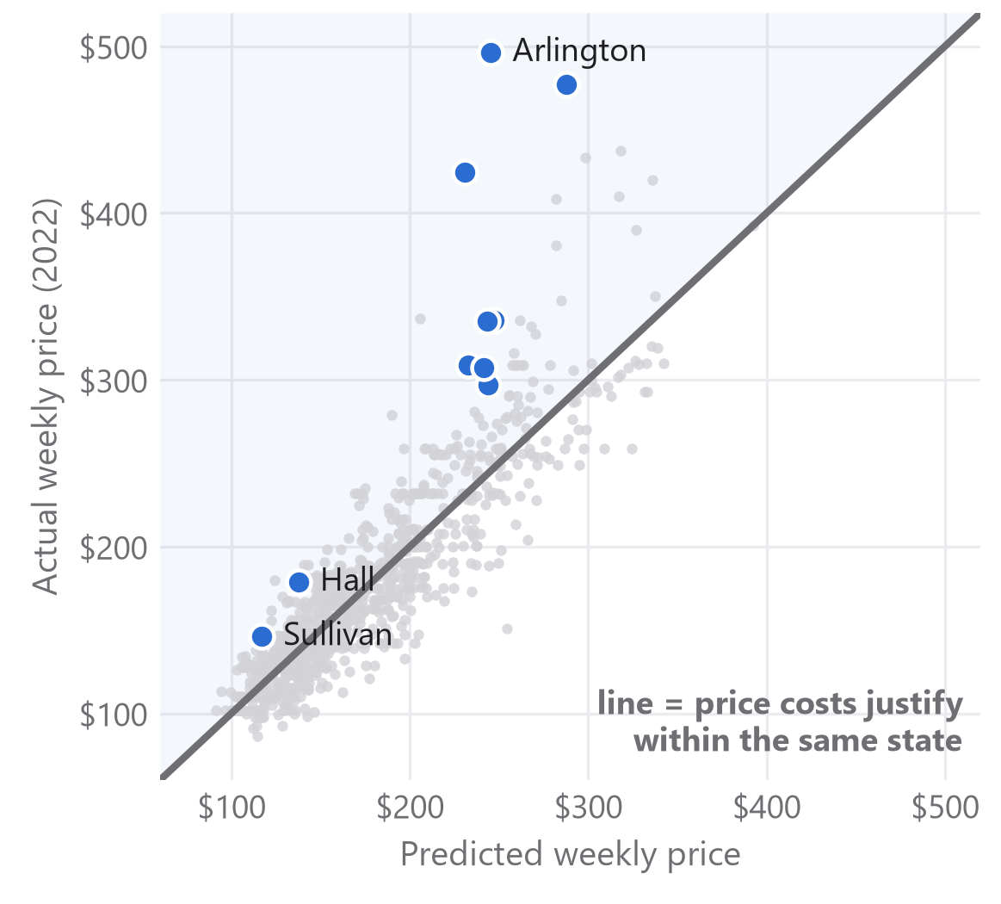
02 FROM MODEL “C” TO OUR PREDICTION
Comparing each county with its own state lifts explained price variation from 61% to 81% and reveals hidden premiums
STEP 1 · MODEL “C”
STEP 2 · WITHIN STATE, IN %
Price = −88 + 7.09·wage + 5.91·rent
+10% wage → +3.6% · +10% rent → +5.2%
WHY THE TWO STEPS
State dummies: states set rate zones and staffing rules, so each county is compared with its own state.
Logs: the gap becomes a % premium; $50 means more in Tennessee than in SF.
2022, N = 998 | Model “c” | Final
Wage | 7.09 (0.58) | 0.37 (0.09)
Rent | 5.91 (0.92) | 0.53 (0.04)
State dummies | – | yes (43)
R² | 0.61 | 0.81
Model “c”: $/week per $1,000 wage, $100 rent. Final: % change in price per 1% change. (SE, clustered by metro.) Like for like in $: R² 0.61 → 0.80 with state effects; forecast error on unseen prices −14% (App. C).
EXAMPLE: HALL, GA (RANK 9), 2022
Parents pay $179/week.
Model “c” predicts $167: +7%, looks ordinary.
Within Georgia: $138 predicted, so a +30% premium.
Above the line, parents pay more than costs justify. Here Hall and Sullivan look like ordinary markets.
Against their own state, all ten counties lie above the line.
Model “c” (pre-analysis): price = a + b₁·wage + b₂·rent. Final: log(price) = a + b₁·log(wage) + b₂·log(rent) + state dummies, estimated per year 2015–2022. 2022: N = 998, 44 states/DC, SEs clustered by metro area. NDCP price, BLS OEWS childcare-worker wage, ACS median gross rent, 2022 $. Premium = residual. Appendix B–C.
2

Slide 3
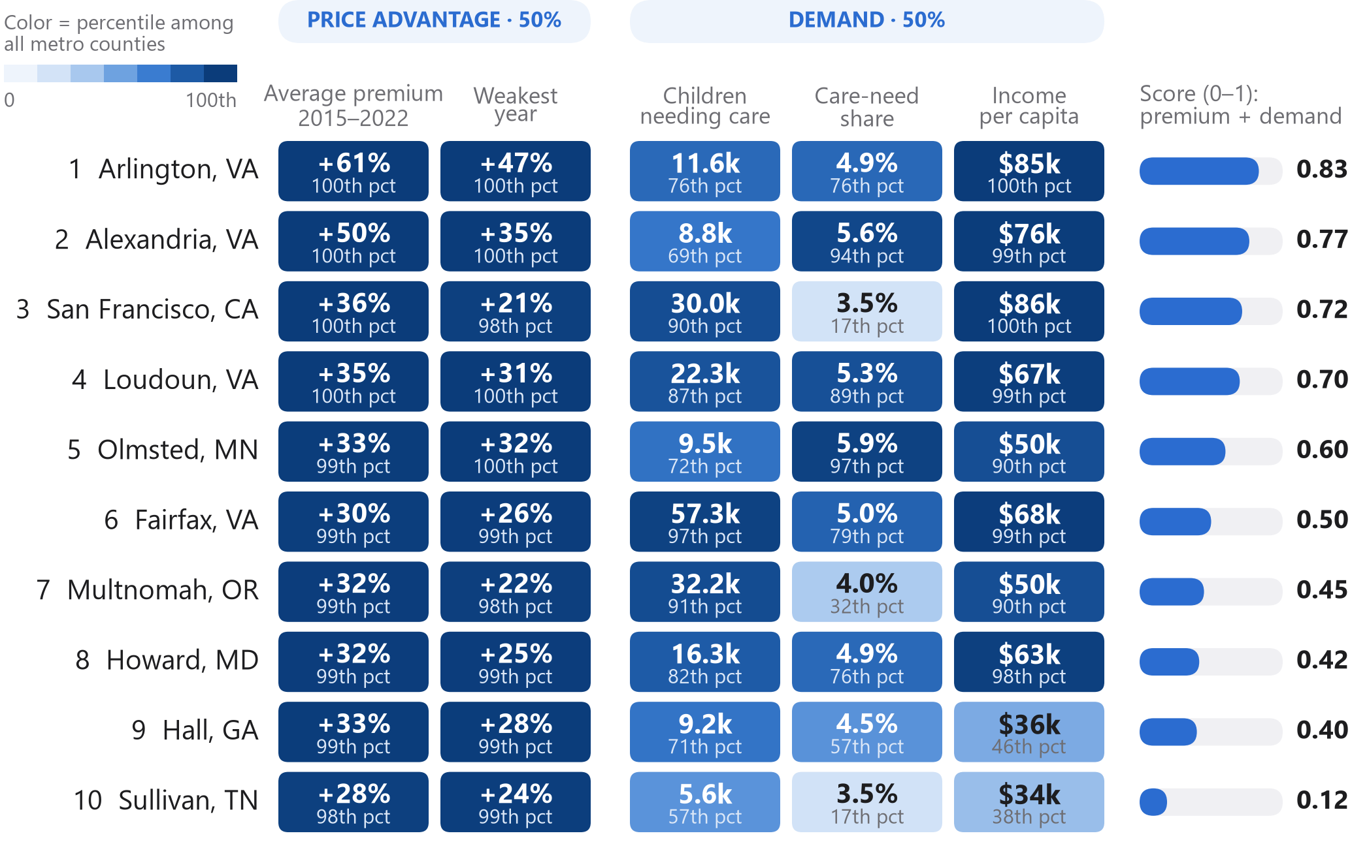
03 HOW WE SELECTED
From 1,159 counties to ten: a large, lasting price advantage, a market big enough to fill a center, and demand to rank them
THE FUNNEL: FROM ALL METRO COUNTIES TO TEN
MARKET CHARACTERISTICS OF THE TEN
1,159
metro counties with price, wage and rent data
NDCP prices × BLS wages × ACS rents, 2015–2022
972
in the 2022 data, observed ≥ 5 of 8 years
current market evidence + enough history
460
positive premium also nationally
not just pricey relative to a cheap state
20
largest average within-state premium
within-state model, averaged over 2015–2022
20
premium positive in every single year
lasting, not a one-off spike
10
≥ 4,286 children needing care
median market size; the other 10 fail only here
Top 10
ranked by score, removes none
50% premium + 50% demand rank
Premium = within-state % premium (slide 2), averaged over observed years 2015–2022 (≥ 5). Market size = children under 6 whose resident parents all work (ACS B23008). Score = 50% premium rank + 50% demand rank (children needing care, their share, income) among the ten; it only orders them. Female college share not used (r = 0.83 with income). Appendix D.
3

Slide 4
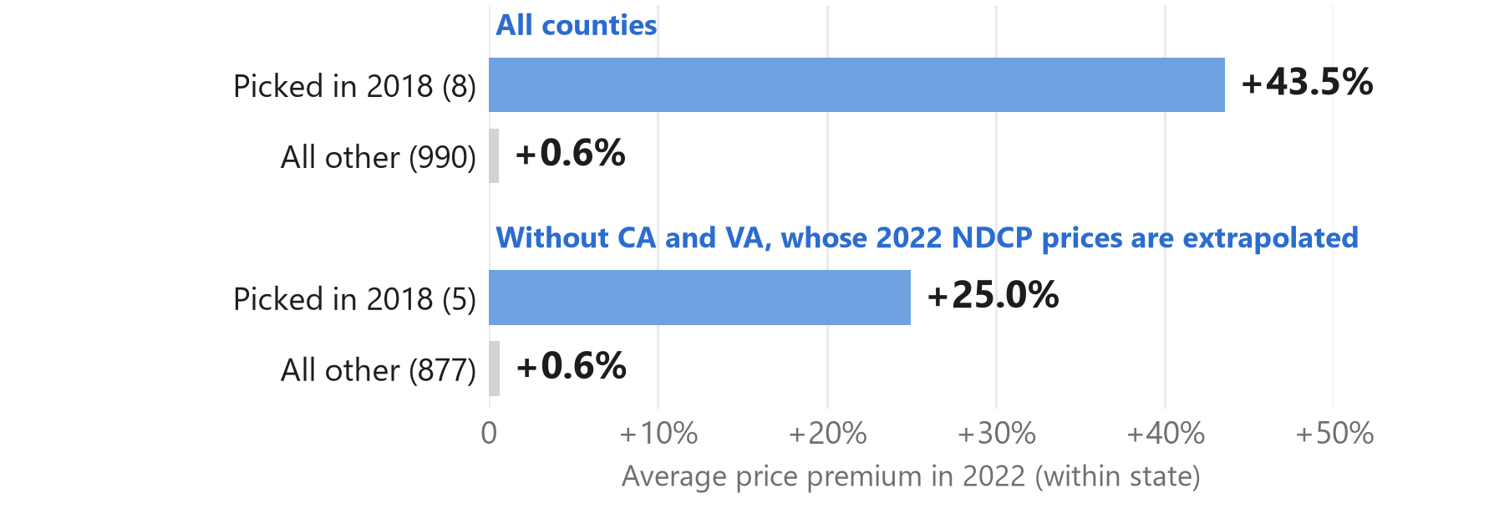
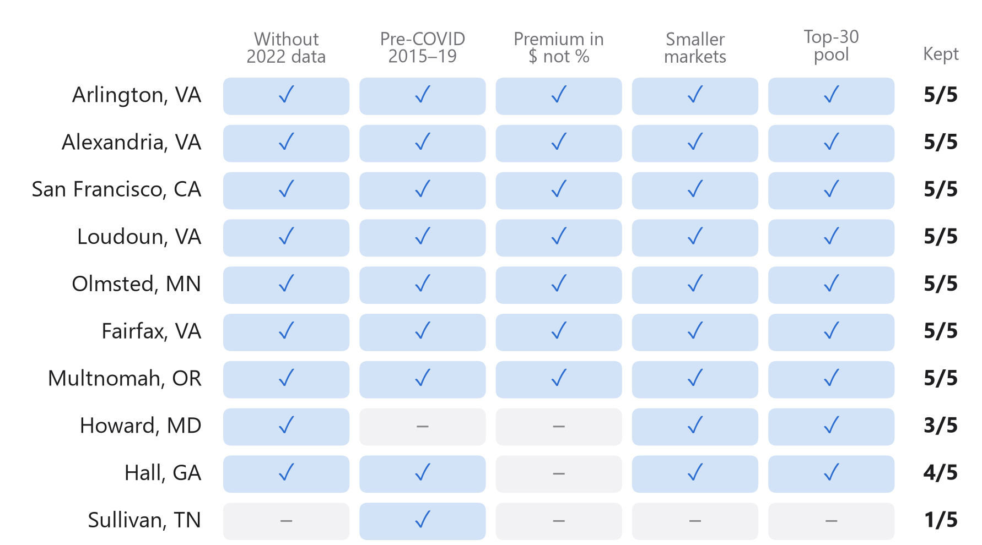
04 HOW RELIABLE IS THE PREDICTION?
With 2018 data only, our rule already picked 7 of today’s ten, and the list barely changes when we vary the design
BACKTEST: AS IF WE HAD DECIDED IN 2018
ROBUSTNESS: 7 OF 10 SELECTED IN ALL 5 ALTERNATIVE DESIGNS
STATISTICAL CHECKS
≥ +27%
−14%
10/10
average premium of every one of the ten in its direct survey years only (no interpolated prices)
forecast error of our cost model vs. model “c” on 2022 prices it never saw (fitted 2015–20)
same list with both wage measures (8/10 if the teacher wage replaces ours)
Not counted: weights 70/30 or 30/70 and “one weak year allowed” cannot change the list by construction. Weighting counties by children keeps 6 of 10.
Portfolio view (max. 2 per metro): Loudoun and Fairfax give way to Ramsey, MN and Trumbull, OH; the other 8 stay.
Backtest: complete rule applied with 2015–2018 data only (these years are also part of today’s average); outcome = within-state premium in 2022 (8 of 10 picks still in the 2022 sample). Robustness: whole rule rerun with one change at a time. Appendix C and E.
4

Slide 5
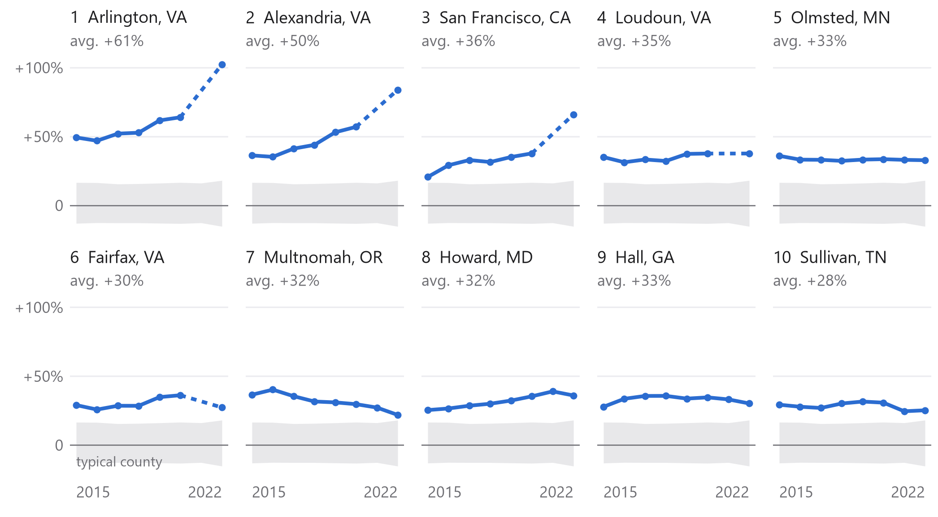
05 ARE THE PREMIUMS STABLE OVER TIME?
Premiums above cost-based predictions last for years, but fade: about two thirds remain after five years
PREMIUM PER YEAR: EACH TOP-10 COUNTY VS. TYPICAL COUNTIES (GRAY: 10TH–90TH PCT.)
HOW MUCH OF A PREMIUM SURVIVES?
0.67
74%
of a premium (log scale) remains ≈ 5 years later (survey prices only)
of counties keep the sign of their premium
95% CI for the slope: [0.57, 0.78]; correlation 0.67
Counties in the top fifth in… | still top fifth in 2022 | still positive
2015 | 56% | 82%
2018 | 63% | 89%
2019 | 73% | 97%
If premiums were random | 20% | ≈ 50%
So we plan with the expected premium: each county’s average premium, faded by the slope of 0.67 on the log scale: +18% to +37% for our ten (slide 1).
Dashed: 2021 missing (no NDCP prices for CA, VA). The 2022 jumps in Arlington, Alexandria and San Francisco come from NDCP-extrapolated CA/VA prices, so we rank on the 8-year average.
Within-state premium per county and year, 2015–2022 (log model, fitted per year). Survey test: two direct NDCP survey prices ≈ 4.7 years apart, 1,038 counties, 46 states, SE clustered by state. Quintile test: counties observed every year, incl. interpolated years (may overstate stability). Appendix D.
5

Slide 6
06 WHAT THE MODEL DOES NOT SEE YET
Our recommendation: open first in Northern Virginia, one market with four top counties, after checking local prices on the ground
FIVE LOCAL CHECKS THE COST MODEL CANNOT SEE
✓ typical ! watch ✕ risk (vs. all metro counties)
County | Competition | Child trend | Wage growth | Rent growth | Public pre-K*
Why it matters | Centers per 1,000 children needing care. ! above 6.24 (crowded) or below 3.86 (untested) | Children <6, 2015–22: future demand. ! below median (−4.4%), ✕ below −10.0% | 2019–22: staff cost pressure. ! top quarter (above +6.1%) | 2015–22: site cost pressure. ! top quarter (above +12.0%) | Free public pre-K competes directly. ! if free for all incomes (universal)
Arlington, VA | ✓ 5.44 typical | ✓ −3.3% | ✓ +5.0% | ✓ −1.3% | ✓ targeted only
Alexandria, VA | ✓ 5.67 typical | ! −5.9% | ✓ +5.0% | ✓ +3.3% | ✓ targeted only
San Francisco, CA | ! 14.22 dense | ! −5.5% | ✓ −1.3% | ! +20.4% | ! universal (TK + city)
Loudoun, VA | ! 6.54 dense | ✓ +0.8% | ✓ +5.0% | ✓ +6.6% | ✓ targeted only
Olmsted, MN | ✓ 5.24 typical | ! −5.7% | ✓ −1.9% | ! +16.8% | ✓ targeted only
Fairfax, VA | ✓ 6.22 typical | ! −9.5% | ✓ +5.0% | ✓ +0.1% | ✓ targeted only
Multnomah, OR | ! 12.16 dense | ✕ −15.8% | ! +7.6% | ! +27.3% | ! Preschool for All
Howard, MD | ! 7.00 dense | ✓ +0.5% | ! +8.6% | ✓ −1.5% | ✓ income-tiered only
Hall, GA | ! 2.60 thin | ! −5.1% | ! +13.3% | ✓ +11.3% | ! universal (state)
Sullivan, TN | ! 3.03 thin | ! −6.4% | ! +6.4% | ✓ +6.7% | ✓ targeted only
WHERE TO START: NORTHERN VIRGINIA
Arlington, Alexandria, Loudoun, Fairfax
Lasting premiums of +30% to +61%, large care-need markets, at most one minor flag.
One market, not four bets: shared wage, labor market and state survey, so open one site first. Virginia’s last direct price surveys are from 2015 and 2018: check current prices locally.
Next in line: Olmsted and Howard.
NOT IN OUR DATA YET
• Commercial rents and sites (we use residential rent)
• Staff availability and turnover, not just average wages
• Local licensing rules and quality mix of competitors
• Remote work; federal job changes (DC area)
• Price data: only 2–5 direct survey years per county
Benchmarks: quartiles of all metro counties with data (882–974 counties). Competition: Census County Business Patterns (NAICS 624410, 2022), children needing care (ACS). *Public pre-K: state/county program rules, accessed Oct 2026 (sources in Appendix F).
6

