Slide 1
A linear approach to predicting house prices

Slide 2
Key Takeaway
Why exploring the data is very important
Provide an understanding of the initial approach to a dataset
What distributions could tell us about the data
Using a linear regression as oppose to a more complicated model
Understanding the model evaluation method, root mean square log error
Reducing Bias and Variance
Evaluating the model’s prediction

Slide 3
Why data exploration is important
Business: Come up with an optimal business solution to the problem
Data exploration allows us to:
check if the data given is appropriate (integrity, missing values, outliers etc.)
Brainstorm ideas
See the behavior of the data
Communicate the data to stakeholders to help explain your prediction
Different tools you can use: Python, Tableau, Excel!

Slide 4
Initial approach
1.Install all the libraries.
2.Import your file like CSV,TSV,EXCEL etc.
3.Perform all the basic like dimensions,column details,description of the dataset etc
4.Checking for outlier.
5.Checking for Skewness.
6.Performing EDA.

Slide 5
Did your tool read in the data correctly?
Do a simple data type check after reading in the data
Important to correct this first: leads to a better model performance and exploration
Should we change
anything?

Slide 6
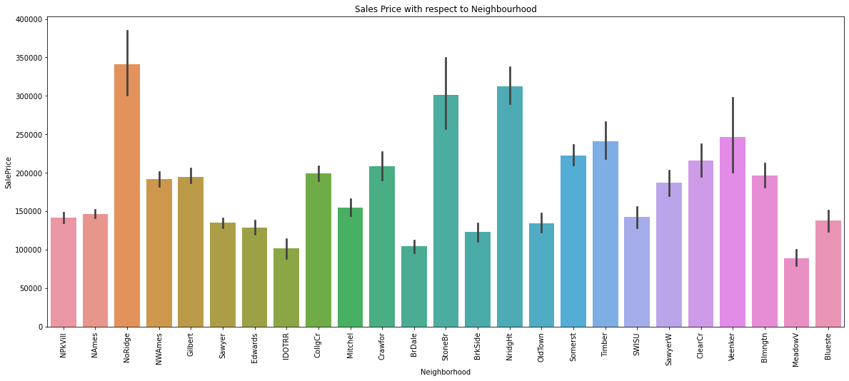
Statistical summaries are important

Slide 7
Missing Values
#Checking "NaN" Values have any impact on the Sale Price or not
# Replace NA with None in the following columns below
df[col]=df[col].fillna('None')

Slide 8
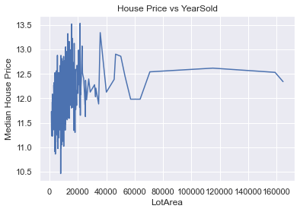
Checking variable relationships

Slide 9
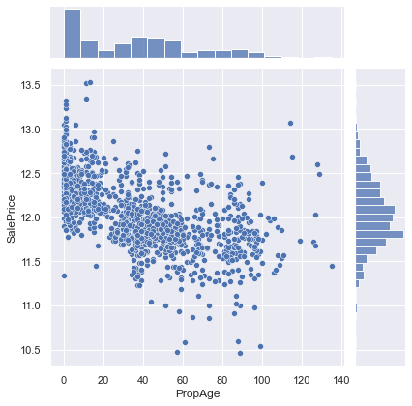
Checking the spread of the data using boxplots or Distributions

Slide 10
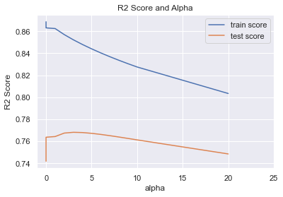
Let’s do some Machine Learning

Slide 11
Ridge Regression
Fitting 11 folds for each of 28 candidates, totalling 308 fits
The optimum alpha is 3
The R2 Score of the model on the test dataset for optimum alpha is -82977945.60819073
The MSE of the model on the test dataset for optimum alpha is 189272.7668626664

Slide 12
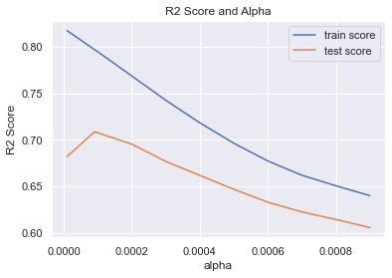
Lasso Regression

Slide 13
Lasso Regression Results
Fitting 11 folds for each of 11 candidates, totalling 121 fits
The optimum alpha is 9e-05
The R2 Score of the model on the test dataset for optimum alpha is -820853769.1048197
The MSE of the model on the test dataset for optimum alpha is 1872368.148503379

Slide 14
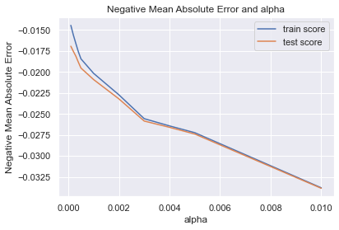
# plotting mean test and train scoes with alpha

