Slide 1
Future Challenges for Software Data Collection and Analysis
Barry Boehm, USC-CSSE
PROMISE 2009 Keynote
May 18, 2009
Notes:
Many people have provided us with valuable insights on the challenge of integrating systems and software engineering, especially at the OSD/USC workshops in October 2007 and March 2008. We would particularly like to thank Bruce Amato (OSD), Elliot Axelband (Rand/USC), William Bail (Mitre), J.D. Baker (BAE Systems), Kristen Baldwin (OSD), Kirstie Bellman (Aerospace), Winsor Brown (USC), Jim Cain (BAE Systems), David Castellano (OSD), Clyde Chittister (CMU-SEI), Les DeLong (Aerospace), Chuck Dreissnack (SAIC/MDA), Tom Frazier (IDA), George Friedman (USC), Brian Gallagher (CMU-SEI), Stuart Glickman (Lockheed Martin), Gary Hafen (Lockheed Martin), Dan Ingold (USC), Judy Kerner (Aerospace), Kelly Kim (Boeing), Sue Koolmanojwong (USC), Per Kroll (IBM), DeWitt Latimer (USAF/USC), Rosalind Lewis (Aerospace), Azad Madni (ISTI), Mark Maier (Aerospace), Darrell Maxwell (USN), Ali Nikolai (SAIC), Lee Osterweil (UMass), Karen Owens (Aerospace), Adrian Pitman (Australia DMO), Art Pyster (Stevens), Shawn Rahmani (Boeing), Bob Rassa (Raytheon), Don Reifer (RCI/USC), John Rieff (Raytheon), Stan Rifkin (Master Systems), Wilson Rosa (USAF), Walker Royce (IBM), Kelly Schlegel (Boeing), Tom Schroeder (BAE Systems), David Seaver (Price Systems), Rick Selby (Northrop Grumman), Stan Settles (USC), Neil Siegel (Northrop Grumman), Frank Sisti (Aerospace), Peter Suk (Boeing), Denton Tarbet (Galorath), Rich Turner (Stevens), Gan Wang (BAE Systems), and Marilee Wheaton (Aerospace), for their valuable contributions to the study.

Slide 2
Future Software Measurement Challenges
Emergent requirements
  Example: Virtual global collaboration support systems
  Need to manage early concurrent engineering
Rapid change
  In competitive threats, technology, organizations, environment
Net-centric systems of systems
  Incomplete visibility and control of elements
Model-driven, service-oriented, Brownfield systems
  New phenomenology, counting rules
Always-on, never-fail systems
  Need to balance agility and discipline
May 18, 2009
Copyright © USC-CSSE

Slide 3

Emergent Requirements
– Example: Virtual global collaboration support systems
View sharing, navigation, modification;agenda control; access control
Mix of synchronous and asynchronous participation
No way to specify collaboration support requirements in advance
Need greater investments in concurrent engineering
  of needs, opportunities, requirements, solutions, plans, resources
May 18, 2009
Copyright © USC-CSSE

Slide 4
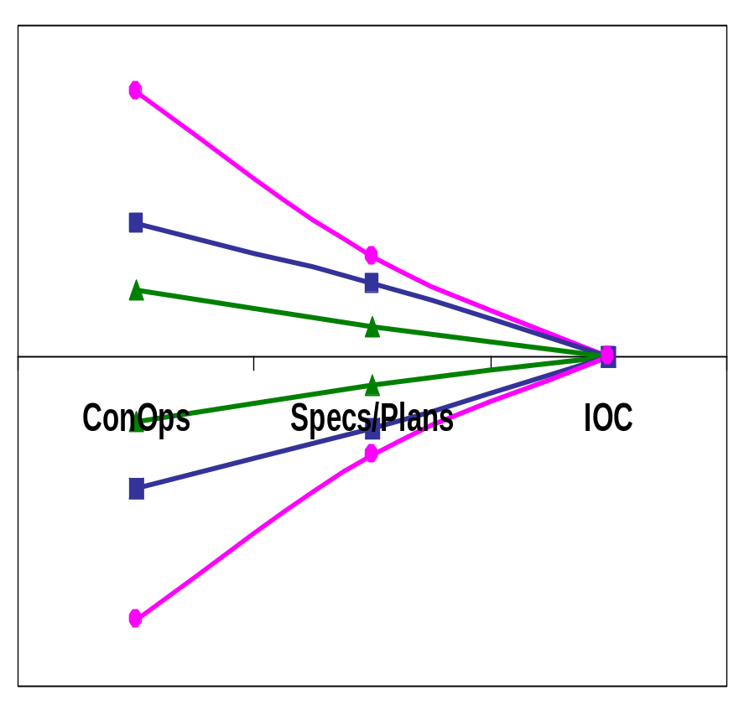
The Broadening Early Cone of Uncertainty (CU)
Need greater investments in narrowing CU
  Mission, investment, legacy analysis
  Competitive prototyping
  Concurrent engineering
  Associated estimation methods and management metrics
Larger systems will often have subsystems with narrower CU’s
X8
Global Interactive,
Brownfield
X4
X2
Batch, Greenfield
Local Interactive,
Some Legacy
Copyright © USC-CSSE
May 18, 2009

Slide 5
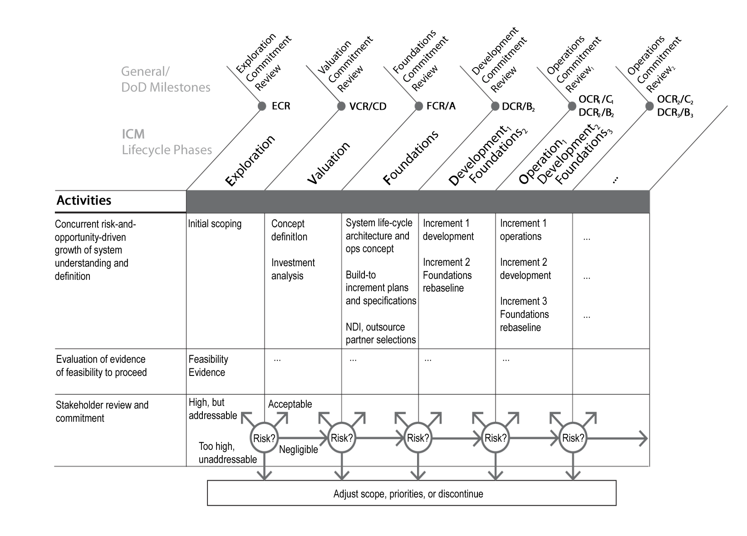
The Incremental Commitment Life Cycle Process: Overview
Stage I: Definition
Stage II: Development and Operations
Anchor Point Milestones
Synchronize, stabilize concurrency via FEDs
Risk patterns determine life cycle process
May 18, 2009
Copyright © USC-CSSE
Notes:
The Incremental Commitment Life Cycle Process: Overview
This slide shows how the ICM spans the life cycle process from concept exploration to operations. Each phase culminates with an anchor point milestone review. At each anchor point, there are 4 options, based on the assessed risk of the proposed system. Some options involve go-backs. These options result in many possible process paths.
The life cycle is divided into two stages: Stage I of the ICM (Definition) has 3 decision nodes with 4 options/node, culminating with incremental development in Stage II (Development and Operations). Stage II has an additional 2 decision nodes, again with 4 options/node.
One can use ICM risk patterns to generate frequently-used processes with confidence that they fit the situation. Initial risk patterns can generally be determined in the Exploration phase. One then proceeds with development as a proposed plan with risk-based evidence at the VCR milestone, adjusting in later phases as necessary. For complex systems, a result of the Exploration phase would be the Prototyping and Competition Plan discussed above.
Risks associated with the system drive the life cycle process. Information about the risk(s) (feasibility assessments) supports the decision to proceed, adjust scope or priorities, or cancel the program.
A more detailed description of the activities going on in each phase is provided in chart 78.

Slide 6
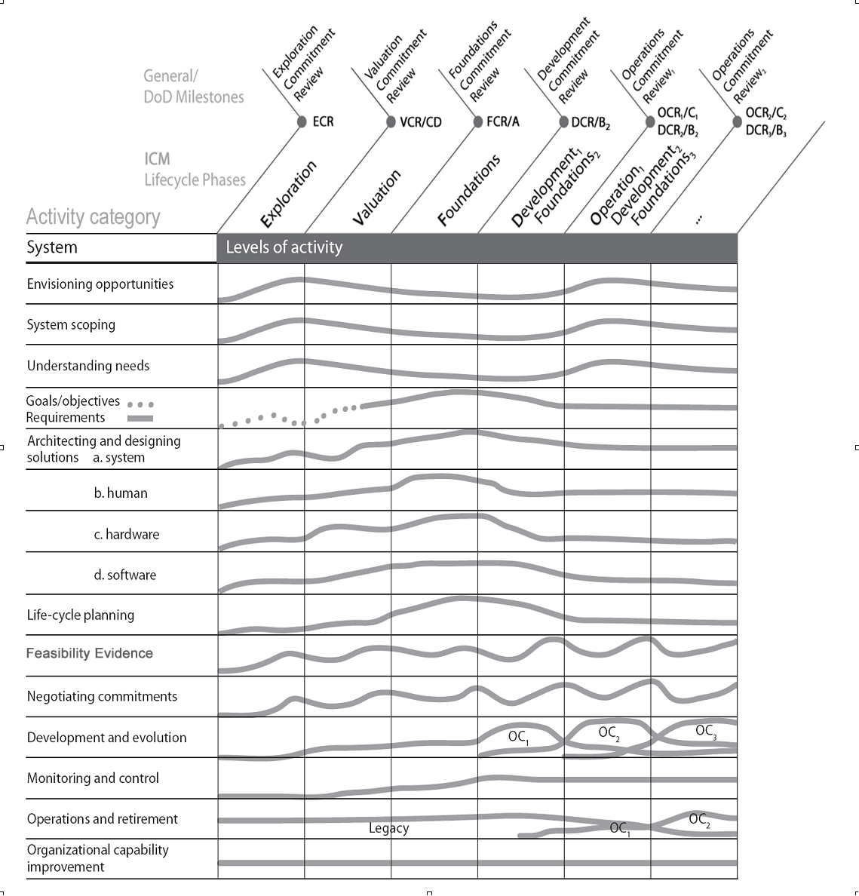
ICM HSI Levels of Activity for Complex Systems
May 18, 2009
Copyright © USC-CSSE
Notes:
ICM HSI Levels of Activity for Complex Systems
As mentioned earlier, with the ICM, a number of system aspects are being concurrently engineered at an increasing level of understanding, definition, and development. The most significant of these aspects are shown in this slide, an extension of a similar view of concurrently engineered software projects developed as part of the RUP (shown in a backup slide).
As with the RUP version, it should be emphasized that the magnitude and shape of the levels of effort will be risk-driven and likely to vary from project to project. In particular, they are likely to have mini risk/opportunity-driven peaks and valleys, rather than the smooth curves shown for simplicity in this slide. The main intent of this view is to emphasize the necessary concurrency of the primary success-critical activities shown as rows. Thus, in interpreting the Exploration column, although system scoping is the primary objective of the Exploration phase, doing it well involves a considerable amount of activity in understanding needs, envisioning opportunities, identifying and reconciling stakeholder goals and objectives, architecting solutions, life cycle planning, evaluation of alternatives, and negotiation of stakeholder commitments.

Slide 7
Nature of FEDs and Anchor Point Milestones
Evidence provided by developer and validated by independent experts that:
If the system is built to the specified architecture, it will
  Satisfy the specified operational concept and requirements
    Capability, interfaces, level of service, and evolution
  Be buildable within the budgets and schedules in the plan
  Generate a viable return on investment
  Generate satisfactory outcomes for all of the success-critical stakeholders
Shortfalls in evidence are uncertainties and risks
  Should be resolved or covered by risk management plans
Assessed in increasing detail at major anchor point milestones
  Serves as basis for stakeholders’ commitment to proceed
  Serves to synchronize and stabilize concurrently engineered elements
  Can be used to strengthen current schedule- or event-based reviews
03/19/2008
©USC-CSSE
Notes:
The Feasibility Evidence Description (FED) does not assess a single sequentially developed system definition element, but the consistency, compatibility, and feasibility of several concurrently-engineered elements. To make this concurrency work, a set of anchor point milestone reviews are performed to ensure that the many concurrent activities are synchronized, stabilized, and risk-assessed at the end of each phase. Each of these anchor point milestone reviews is focused on developer-produced and expert-validated evidence, documented in the FED, to help the key stakeholders determine whether to proceed into the next level of commitment.
The FED is based on evidence from simulations, models, or experiments with planned technologies and increasingly detailed analysis of development approaches and projected productivity rates. The parameters used in the analyses should be based on measured component performance or on historical data showing relevant past performance, cost estimation accuracy, and actual developer productivity rates.
A shortfall in feasibility evidence indicates a level of program execution uncertainty and a source of program risk. It is often not possible to fully resolve all risks at a given point in the development cycle, but known, unresolved risks need to be identified and covered by risk management plans, including the necessary staffing and funding to address them. The nature of the evidence shortfalls, the strength and affordability of the risk management plans, and the stakeholders’ degrees of risk acceptance or avoidance will determine their willingness to commit the necessary resources to proceed. A program with risks is not necessarily bad, particularly if it has strong risk management plans. A program with no risks may be high on achievability, but low on ability to produce a timely competitive advantage.
A program more familiar with a sequential waterfall or V-model can achieve most of the effect of a FED-based anchor point milestone review by adding a FED to the set of artifacts to be developed and reviewed for adequacy and satisfaction at a System requirements Review (SRR), System Functional Review (SFR), or Preliminary Design Review (PDR). In principle, some guidance documents indicate that such feasibility evidence should be produced and reviewed. But since the evidence is not generally specified as a developer deliverable and is vaguely defined, it is generally inadequate as a basis for stakeholder commitments.

Slide 8
Key Point: Need to Show Evidence
Not just traceability matrices and PowerPoint charts
Evidence can include results of
  Prototypes: networks, robots, user interfaces, COTS interoperability
  Benchmarks: performance, scalability, accuracy
  Exercises: mission performance, interoperability, security
  Models: cost, schedule, performance, reliability; tradeoffs
  Simulations: mission scalability, performance, reliability
  Early working versions: infrastructure, data fusion, legacy compatibility
  Representative past projects
  Combinations of the above
Validated by independent experts
  Realism of assumptions
  Representativeness of scenarios
  Thoroughness of analysis
  Coverage of key off-nominal conditions
Much more effort data, product data to collect and analyze
4/15/05
© USC-CSE
Notes:
The major difference in the example project proceeding without and with an FR was that the need to provide evidence of feasibility requires the project to develop and exercise benchmarks and prototypes that expose both infeasible solutions and unnecessarily ambitious requirements.
Not only does the evidence need to be produced, but it needs to be validated by independent experts. The risk of validating just nominal-case scenarios is shown in the next chart.

Slide 9
COSYSMO Operational Concept
# Requirements
# Interfaces
# Scenarios
# Algorithms
Volatility Factor
Size
Drivers
COSYSMO
  Effort
Effort
Multipliers
Application factors
  8 factors
Team factors
  6 factors
Schedule driver
Calibration
WBS guided by
ISO/IEC 15288
May 18, 2009
Copyright © USC-CSSE

Slide 10
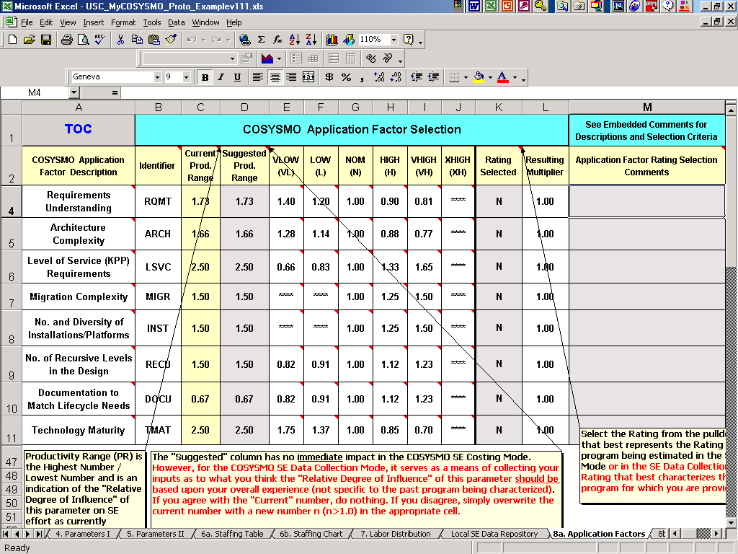
4. Rate Cost Drivers - Application

Slide 11
Next-Generation Systems Challenges
Emergent requirements
  Example: Virtual global collaboration support systems
  Need to manage early concurrent engineering
Rapid change
  In competitive threats, technology, organizations, environment
Net-centric systems of systems
  Incomplete visibility and control of elements
Model-driven, service-oriented, Brownfield systems
  New phenomenology, counting rules
Always-on, never-fail systems
  Need to balance agility and discipline

Slide 12
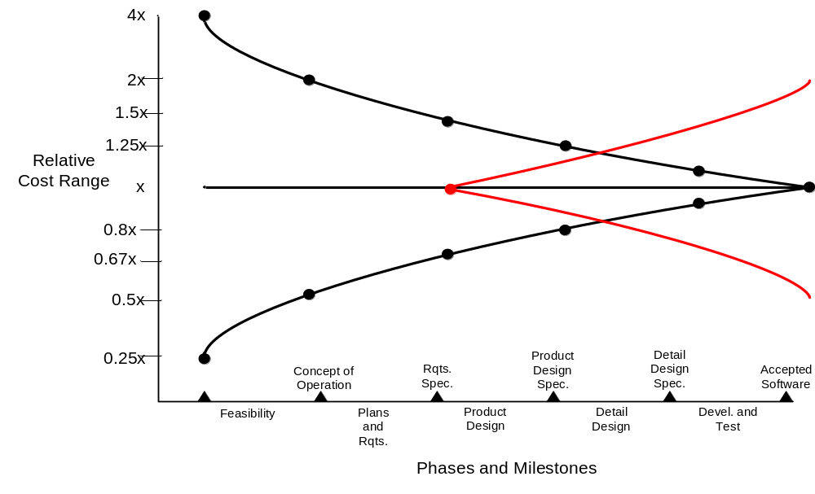
Rapid Change Creates a Late Cone of Uncertainty
– Need evolutionary/incremental vs. one-shot development
- - No simple boundary between development and maintenance
Uncertainties in competition, technology, organizations, mission priorities
May 18, 2009
Copyright © USC-CSSE
Notes:
There is Another Cone of Uncertainty: Shorter increments are better
Uncertainties in competition and technology evolution and changes in organizations and mission priorities, can wreak havoc with the best of system development programs. In addition, the longer the development cycle, the more likely it will be that several of these uncertainties or changes will occur and make the originally-defined system obsolete. Therefore, planning to develop a system using short increments helps to ensure that early, high priority capabilities can be developed and fielded and changes can be more easily accommodated in future increments.

Slide 13
Incremental Development Productivity Decline (IDPD)
Example: Site Defense BMD Software
  5 builds, 7 years, $100M
  Build 1 productivity over 300 SLOC/person month
  Build 5 productivity under 150 SLOC/PM
    Including Build 1-4 breakage, integration, rework
    318% change in requirements across all builds
    IDPD factor = 20% productivity decrease per build
  Similar trends in later unprecedented systems
  Not unique to DoD: key source of Windows Vista delays
Maintenance of full non-COTS SLOC, not ESLOC
  Build 1: 200 KSLOC new; 200K reused@20% = 240K ESLOC
  Build 2: 400 KSLOC of Build 1 software to maintain, integrate
May 18, 2009
Copyright © USC-CSSE

Slide 14
“Equivalent SLOC” Paradoxes
Not a measure of software size
Not a measure of software effort
Not a measure of delivered software capability
A quantity derived from software component sizes and reuse factors that helps estimate effort
Once a product or increment is developed, its ESLOC loses its identity
  Its size expands into full SLOC
  Some people apply reuse factors to this to determine an ESLOC quantity for the next increment
    But this has no relation to the product’s size
May 18, 2009
Copyright © USC-CSSE

Slide 15
IDPD Cost Drivers:
Conservative 4-Increment Example
Some savings: more experienced personnel (5-20%)
  Depending on personnel turnover rates
Some increases: code base growth, diseconomies of scale, requirements volatility, user requests
  Breakage, maintenance of full code base (20-40%)
  Diseconomies of scale in development, integration (10-25%)
  Requirements volatility; user requests (10-25%)
Best case: 20% more effort (IDPD=6%)
Worst case: 85% (IDPD=23%)
May 18, 2009
Copyright © USC-CSSE

Slide 16
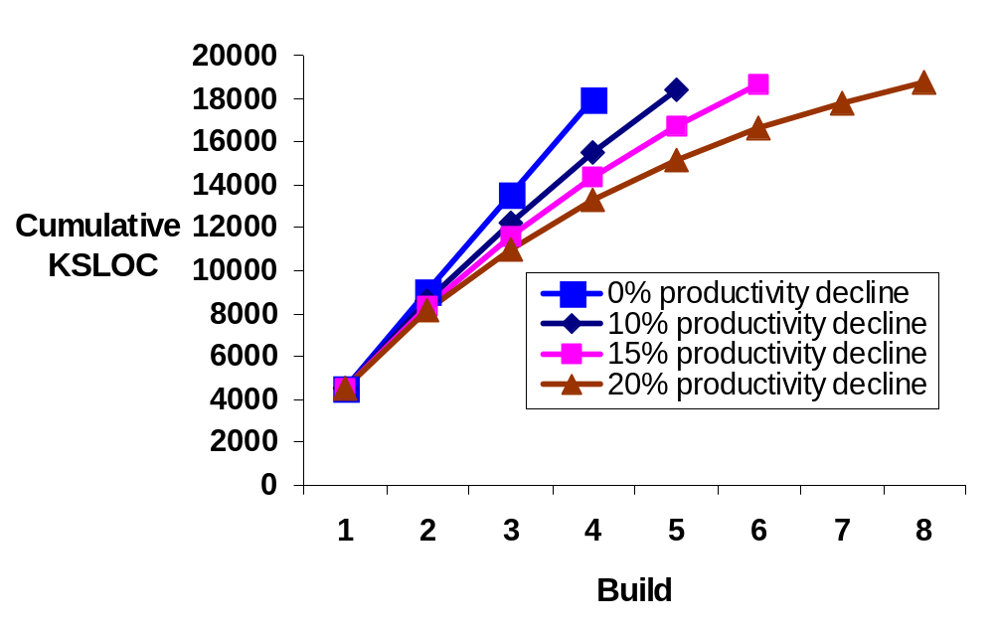
Effects of IDPD on Number of Increments
Model relating productivity decline to number of builds needed to reach 8M SLOC Full Operational Capability
Assumes Build 1 production of 2M SLOC @ 100 SLOC/PM
  20000 PM/ 24 mo. = 833 developers
  Constant staff size for all builds
Analysis varies the productivity decline per build
  Extremely important to determine the incremental development productivity decline (IDPD) factor per build
SLOC
8M
2M
May 18, 2009
Copyright © USC-CSSE

Slide 17
Choosing and Costing
Incremental Development Forms
Type
Examples
Pros
Cons
Cost Estimation
Evolutionary Sequential
Small: Agile
Large: Evolutionary Development
Adaptability to change
Easiest-first; late, costly breakage
Small: Planning-poker-type
Large: Parametric with IDPD
Prespecified Sequential
Platform base plus PPPIs
Prespecifiable full-capability requirements
Emergent requirements or rapid change
COINCOMO with no increment overlap
Overlapped Evolutionary
Product lines with ultrafast change
Modular product line
Cross-increment breakage
Parametric with IDPD and Requirements Volatility
Rebaselining Evolutionary
Mainstream product lines;
Systems of systems
High assurance with rapid change
Highly coupled systems with very rapid change
COINCOMO, IDPD for development; COSYSMO for rebaselining
IDPD: Incremental Development Productivity Decline, due to earlier increments breakage, increasing code base to integrate
PPPIs: Pre-Planned Product Improvements
COINCOMO: COCOMO Incremental Development Model (COCOMO II book, Appendix B)
COSYSMO: Systems Engineering Cost Model (in-process COSYSMO book)
All Cost Estimation approaches also include expert-judgment cross-check.
May 18, 2009
Copyright © USC-CSSE

Slide 18
Next-Generation Systems Challenges
Emergent requirements
  Example: Virtual global collaboration support systems
  Need to manage early concurrent engineering
Rapid change
  In competitive threats, technology, organizations, environment
Net-centric systems of systems
  Incomplete visibility and control of elements
Model-driven, service-oriented, Brownfield systems
  New phenomenology, counting rules
Always-on, never-fail systems
  Need to balance agility and discipline
May 18, 2009
Copyright © USC-CSSE

Slide 19
Further Attributes of Future Challenges
Type | Examples | Pros | Cons | Cost Estimation
Systems of Systems | Directed: Future Combat Systems Acknowledged: Missile Defense Agency | Interoperability Rapid Observe-Orient-Decide-Act (OODA) loop | Often-conflicting partner priorities Change processing very complex | Staged hybrid models Systems engineering: COSYSMO Multi-organization development costing Lead Systems integrator costing Requirements volatility effects Integration&test: new cost drivers
Model-Driven Development | Business 4th-generation languages (4GLs) Vehicle-model driven development | Cost savings User-development advantages Fewer error sources | Multi-model composition incapabilities Model extensions for special cases (platform-payload) Brownfield complexities User-development V&V | Models directives as 4GL source code Multi-model composition similar to COTS integration, Brownfield integration
Brownfield | Legacy C4ISR System Net-Centric weapons platform Multicore-CPU upgrades | Continuity of service Modernization of infrastructure Ease of maintenance | Legacy re-engineering often complex Mega-refactoring often complex | Models for legacy re-engineering, mega-refactoring Reuse model for refactored legacy
May 18, 2009
Copyright © USC-CSSE

Slide 20
Further Attributes of Future Challenges (Continued)
Type | Examples | Pros | Cons | Cost Estimation
Ultrareliable Systems | Safety-critical systems Security-critical systems High-performance real-time systems | System resilence, survivability Service-oriented usage opportunities | Conflicts among attribute objectives Compatibility with rapid change | Cost model extensions for added assurance levels Change impact analysis models
Competitive Prototyping | Stealth vehicle fly-offs Agent-based RPV control Combinations of challenges | Risk buy-down Innovation modification In-depth exploration of alternatives | Competitor evaluation often complex Higher up-front cost But generally good ROI Tech-leveling avoidance often complex | Competition preparation, management costing Evaluation criteria, scenarios, testbeds Competitor budget estimation Virtual, proof-of-principle, robust prototypes
May 18, 2009
©USC-CSSE
Copyright © USC-CSSE

Slide 21
Net-Centric Systems of Systems Challenges
Need for rapid adaptation to change
  See first, understand first, act first, finish decisively
Built-in authority-responsibility mismatches
  Increasing as authority decreases through Directed, Acknowledged, Collaborative, and Virtual SoS classes
    Incompatible element management chains, legacy constraints, architectures, service priorities, data, operational controls, standards, change priorities...
High priority on leadership skills, collaboration incentives, negotiation support such as cost models
  SoS variety and complexity makes compositional cost models more helpful than one-size-fits-all models
May 18, 2009
Copyright © USC-CSSE

Slide 22
Example: SoSE Synchronization Points
Rebaseline/
Adjustment FCR₁
FCR₁
DCR₁
OCR₁
OCR₂
SoS-Level
Exploration
Valuation
Architecting
Develop
Operation
• • •
Candidate Supplier/
Strategic Partner n
LCO-type
Proposal &
Feasibility
Info
●
●
●
Source
Selection
Candidate Supplier/
Strategic Partner 1
OCR_{x1}
OCR_{x2}
OCR_{x3}
OCR_{x4}
OCR_{x5}
System x
• • •
Develop
Operation
Operation
Operation
Operation
• • •
●
● ●
FCR_{C}
DCR_{C}
OCR_{C1}
OCR_{C2}
System C
• • •
Exploration
Valuation
Architecting
Develop
Operation
• • •
FCR_{B}
DCR_{B}
OCR_{B1}
OCR_{B2}
System B
• • •
Exploration
Valuation
Architecting
Develop
Operation
• • •
FCR_{A}
DCR_{A}
OCR_{A1}
System A
• • •
Exploration
Valuation
Architecting
Develop
Operation
• • •
May 18, 2009
Copyright © USC-CSSE

Slide 23
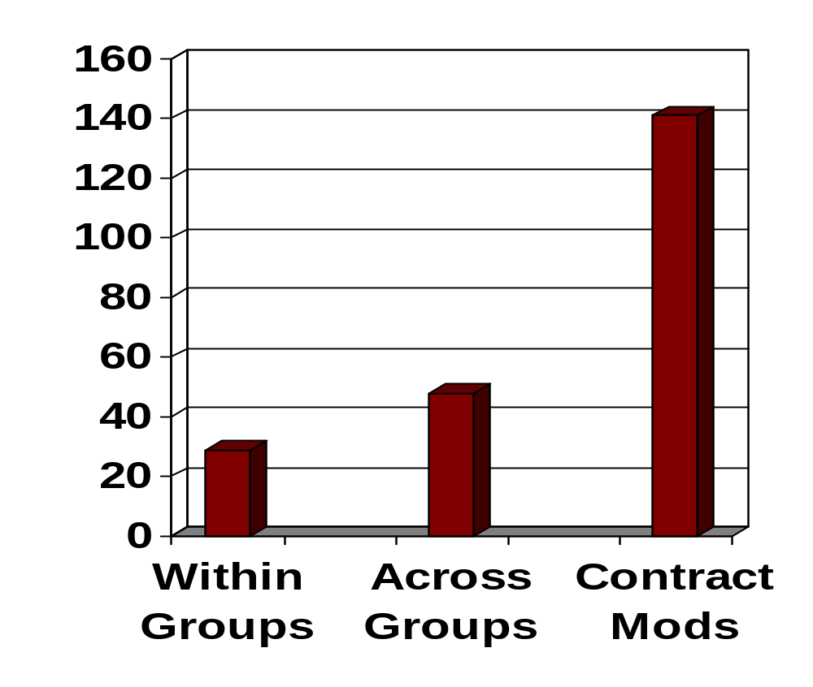
Average Change Processing Time:
Two Complex Systems of Systems
Average workdays to process changes
Incompatible with turning within adversary’s OODA loop
03/19/2008
May 18, 2009
©USC-CSSE
Copyright © USC-CSSE
Notes:
This chart shows data from two complex systems of systems that illustrates the challenge of executing tight OODA loops that involve coordinating changes across closely coupled systems of systems [Boehm, 2007]. The average time in workdays (longer than in calendar days) was 27 workdays to close a change request within an individual platform or capability group; 48 workdays if the change required coordination across multiple platform or capability groups; and 141 workdays if the change involved a change in performers’ contracts. These were typical high-content U.S. build-to-specification contracts, which [Hall, 1976] found averaged 10 times as long as high-context French contracts. Corroborative data was provided at the workshop in [Schroeder, 2007],who found that the length of such changes was proportional to the number of contracts requiring changes. Other Workshop attendees reported even longer contract change turnaround times for large complex systems. Clearly, improvements are needed in change-facilitating architectures, processes, and contracts if DoD is to stand any chance of keeping its change-adapting OODA loops within those of its adversaries.

Slide 24
Compositional approaches: Directed systems of systems
LCO
LCA
IOC₁
Elaboration
Source SoS
Selection Architecting
Increments
2,… n
Inception
Increment 1
Effort COSYSMO-like.
Schedule = Effort/Staff
RFP, SOW, Evaluations, Contracting
Assess sources of change; Negotiate rebaselined LCA₂ package at all levels
Similar, with
added change
traffic from
users…
Customer,
Users
LSI –
Agile
Try to model
ideal staff size
Effort/Staff
Rework LCO → LCA
Packages at all levels
Assess
compatibility, short-falls
LSI IPTs –
Agile
COSOSIMO
-like
COSOSIMO
-like
Effort/staff
at all levels
Suppliers –
Agile
LCA₁
LCA₂
Develop to spec, V&V
Similar, with
added re-
baselineing risks
and rework…
Suppliers –
PD – V&V
Proposals
CORADMO
-like
risks,
rework
risks,
rework
Risk-manage slow-performer, completeness
risks,
rework
Degree of Completeness
Integrate
LSI –
Integrators
Proposal Feasibility
COSOSIMO
-like
risks,
rework
LCA₂ shortfalls
May 18, 2009
Copyright © USC-CSSE

Slide 25
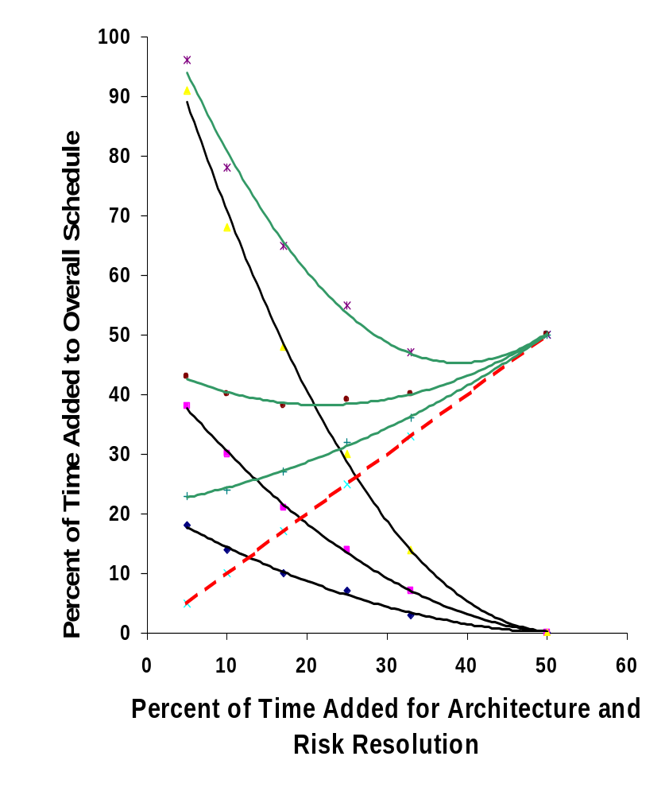
How Much Architecting is Enough?
- Larger projects need more
10000
KSLOC
Percent of Project Schedule Devoted to Initial Architecture and Risk Resolution
Added Schedule Devoted to Rework
(COCOMO II RESL factor)
Total % Added Schedule
Sweet Spot
100 KSLOC
Sweet Spot Drivers:
Rapid Change: leftward
High Assurance: rightward
10 KSLOC
May 18, 2009
Copyright © USC-CSSE
Notes:
Suppose that the mitigation strategy discussed on the previous chart is applied to a 10 million line software system normally requiring 9 years to develop. If the system is architected to enable 10 1-million-line components to be concurrently developed in 4 years to plug and play, a great deal of integration and rework time is saved.
The figure above shows how this tradeoff between architecting time and rework time can be analyzed by the well-calibrated COCOMO II Architecture and Risk Resolution Factor [Boehm et al., 2000]. It shows that for a 10,000-KSLOC system, the “sweet spot” minimizing the sum of architecting time and rework time occurs at about 37% of the development time for architecting, with a relatively flat region between 30% and 50%. Below 30%, the penalty curve for premature issuance of supplier specifications is steep: a 17% investment in architecting yields a rework penalty of 48% for a total delay of 65% compared with a rework penalty of 20% and a total delay of 50% for the 30% architecting investment.
For the 10,000-KSLOC system above, investing 33% of a 9-year development schedule for architecting would use 3 years. If the 10 components developed in 4 years were then able to plug and play, the system would be delivered in 7 years vs. 9. Note on the chart that rapid change would require some effort and delay in revising the architecture, but this could add up to 2 years and the project would still be ahead.
This figure and its implications were convincing enough to help one recent very large software-intensive system to add 18 months to its schedule to improve the architectural specifications before committing to development.

Slide 26
Comparison of Cost Model Parameters
Parameter Aspects | COSYSMO | COSOSIMO
Size drivers | # of system requirements # of system interfaces # operational scenarios # algorithms | # of SoS requirements # of SoS interface protocols # of constituent systems # of constituent system organizations # operational scenarios
“Product” characteristics | Size/complexity Requirements understanding Architecture understanding Level of service requirements # of recursive levels in design Migration complexity Technology risk #/ diversity of platforms/installations Level of documentation | Size/complexity Requirements understanding Architecture understanding Level of service requirements Component system maturity and stability Component system readiness
Process characteristics | Process capability Multi-site coordination Tool support | Maturity of processes Tool support Cost/schedule compatibility SoS risk resolution
People characteristics | Stakeholder team cohesion Personnel/team capability Personnel experience/continuity | Stakeholder team cohesion SoS team capability
May 18, 2009
Copyright © USC-CSSE

Slide 27
Model-Driven, Service-Oriented, Brownfield Systems
New phenomenology, counting rules
Product generation from model directives
  Treat as very high level language: count directives
Model reuse feasibility, multi-model incompatibilities
  Use Feasibility Evidence progress tracking measures
Functional vs. service-oriented architecture mismatches
  Part-of (one-many) vs. served-by (many-many)
Brownfield legacy constraints, reverse engineering
  Reverse-engineer legacy code to fit new architecture
  Elaborate COSYSMO Migration Complexity cost driver
  Elaborate COCOMO II reuse model for reverse engineering
May 18, 2009
Copyright © USC-CSSE

Slide 28
Failed Greenfield Corporate Financial System
Used waterfall approach
  Gathered requirements
  Chose best-fit ERP system
  Provided remaining enhancements
Needed to ensure continuity of service
  Planned incremental phase-in of new services
Failed due to inability to selectively phase out legacy services
  Dropped after 2 failed tries at cost of $40M
May 18, 2009
Copyright © USC-CSSE

Slide 29
Legacy Systems Patched, Highly Coupled Financial and Non-Financial Services
Legacy Business Services
Contract Services
Project Services
Budgeting
Staffing
Deliverables
Management
Billing
Earned Value Management
Subcontracting
Change Tracking
Progress Tracking
Work Breakdown Structure
Scheduling
Reqs, Configuration Management
May 18, 2009
Copyright © USC-CSSE

Slide 30
ICM Approach to Brownfield Engineering
Understanding needs
  Analysis of legacy system difficulties
Envisioning opportunities
  Concurrently decouple legacy financial and non-financial services, explore new system phase-in and architecture options
System scoping and architecting
  Extract legacy financial, non-financial services
  Prioritize, plan for incremental financial services phase-in/out
Feasibility evidence development
  Successful examples of representative service extractions
  Evidence of cost, schedule, performance feasibility
May 18, 2009
Copyright © USC-CSSE

Slide 31
Result of Legacy Re-engineering
Legacy Business Services
Contract Services
Project Services
Contract Financial Services
Billing
Subcontract payments
...
Contract Non-Financial Services
Deliverables mgmt.
Terms compliance
...
General Financial Services
Accounting
Budgeting
Earned value
Payroll
...
General Non-Financial Services
Progress tracking
Change tracking
...
Project Financial Services
WBS
Expenditure categories
...
Project Non-Financial Services
Scheduling
Staffing
Reqs CM
...
May 18, 2009
Copyright © USC-CSSE

Slide 32
Always-on, never-fail systems
Consider using “weighted SLOC” as a productivity metric
Some SLOC are “heavier to move into place” than others
  And largely management uncontrollables
  Examples: high values of COCOMO II cost drivers
    RELY: Required Software Reliability
    DATA: Database Size
    CPLX: Software Complexity
    DOCU: Required Documentation
    RUSE: Required Development for Future Reuse
    TIME: Execution Time Constraint
    STOR: Main Storage Constraint
    SCED: Required Schedule Compression
Provides way to compare productivities across projects
  And to develop profiles of project classes
May 18, 2009
Copyright © USC-CSSE

Slide 33
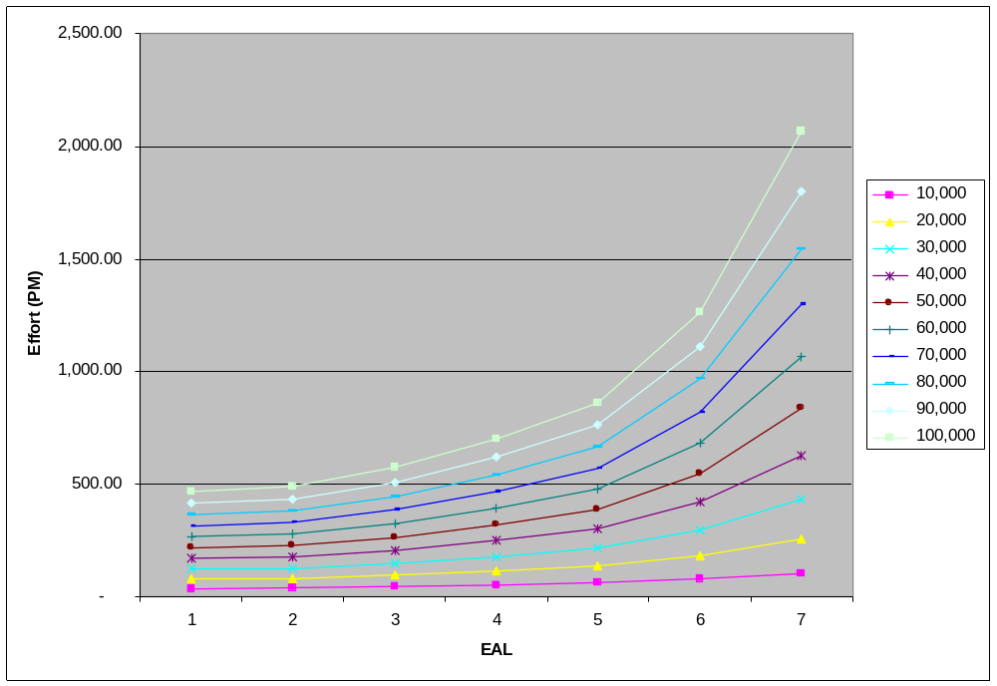
COSECMO Estimation Trends
Effort by Assurance Levels for Different Size Projects
Plot of projects where only SECU & effort increasing drivers
Efforts seem a little low based on values from Orange Book projects
Copyright © USC-CSSE
May 18, 2009
Notes:
Costing Secure Systems Update, USC-CSE 20th Annual COCOMO/SCF Forum
© 2002-6 USC-CSE

Slide 34
Balancing Agility and Assurance
No one-size-fits-all estimation and metrics approach
  Need compositional approach for both phases and components
ICM decision table provides criteria for component processes, estimation methods, management metrics
  Agile: Planning poker/ Wideband Delphi; story burndown
  Architected agile: planning and implementation sprints: agile plus FED preparation estimation and progress monitoring
  Mission platforms: hardware, software cost models plus FED preparation estimation and progress monitoring; Leading Indicators and Macro Risk Tool
  Systems of Systems: composite estimation models; FED estimation and monitoring; extended Macro Risk Tool
May 18, 2009
Copyright © USC-CSSE

Slide 35
Common Risk-Driven Special Cases of the ICM
Special Case |  | Example | Size, Complexity | Change Rate % /Month | Criticality | NDI Support | Org, Personnel Capability | Key Stage I Activities : Incremental Definition | Key Stage II Activities: Incremental Development, Operations | Time per Build; per Increment
1 | Use NDI | Small Accounting |  |  |  | Complete |  | Acquire NDI | Use NDI
2 | Agile | E-services | Low | 1 – 30 | Low-Med | Good; in place | Agile-ready Med-high | Skip Valuation , Architecting phases | Scrum plus agile methods of choice | <= 1 day; 2-6 weeks
3 | Architected Agile | Business data processing | Med | 1 – 10 | Med-High | Good; most in place | Agile-ready Med-high | Combine Valuation, Architecting phases. Complete NDI preparation | Architecture-based Scrum of Scrums | 2-4 weeks; 2-6 months
4 | Formal Methods | Security kernel or safety-critical LSI chip | Low | 0.3 – 1 | Extra high | None | Strong formal methods experience | Precise formal specification | Formally-based programming language; formal verification | 1-5 days; 1-4 weeks
5 | HW component with embedded SW | Multi-sensor control device | Low | 0.3 – 1 | Med-Very High | Good; In place | Experienced; med-high | Concurrent HW/SW engineering. CDR-level ICM DCR | IOC Development, LRIP, FRP. Concurrent Version N+1 engineering | SW: 1-5 days; Market-driven
6 | Indivisible IOC | Complete vehicle platform | Med – High | 0.3 – 1 | High-Very High | Some in place | Experienced; med-high | Determine minimum-IOC likely, conservative cost. Add deferrable SW features as risk reserve | Drop deferrable features to meet conservative cost. Strong award fee for features not dropped | SW: 2-6 weeks; Platform: 6-18 months
7 | NDI- Intensive | Supply Chain Management | Med – High | 0.3 – 3 | Med- Very High | NDI-driven architecture | NDI-experienced; Med-high | Thorough NDI-suite life cycle cost-benefit analysis, selection, concurrent requirements/ architecture definition | Pro-active NDI evolution influencing, NDI upgrade synchronization | SW: 1-4 weeks; System: 6-18 months
8 | Hybrid agile / plan-driven system | C4ISR | Med – Very High | Mixed parts: 1 – 10 | Mixed parts; Med-Very High | Mixed parts | Mixed parts | Full ICM; encapsulated agile in high change, low-medium criticality parts (Often HMI, external interfaces) | Full ICM ,three-team incremental development, concurrent V&V, next-increment rebaselining | 1-2 months; 9-18 months
9 | Multi-owner system of systems | Net-centric military operations | Very High | Mixed parts: 1 – 10 | Very High | Many NDIs; some in place | Related experience, med-high | Full ICM; extensive multi-owner team building, negotiation | Full ICM; large ongoing system/software engineering effort | 2-4 months; 18-24 months
10 | Family of systems | Medical Device Product Line | Med – Very High | 1 – 3 | Med – Very High | Some in place | Related experience, med – high | Full ICM; Full stakeholder participation in product line scoping. Strong business case | Full ICM. Extra resources for first system, version control, multi-stakeholder support | 1-2 months; 9-18 months
C4ISR: Command, Control, Computing, Communications, Intelligence, Surveillance, Reconnaissance. CDR: Critical Design Review.
DCR: Development Commitment Review. FRP: Full-Rate Production. HMI: Human-Machine Interface. HW: Hard ware.
IOC: Initial Operational Capability. LRIP: Low-Rate Initial Production. NDI: Non-Development Item. SW: Software
May 18, 2009
Copyright © USC-CSSE
Notes:
Common Risk-Driven Special Cases of the ICM: Because of its complexity, ICM examples have been developed to show users how to use the framework to create a development process appropriate for their system of interest. These cases cover the very small to the very large as well as the use of commercial off-the-shelf (COTS) software products to the development of a large, complex custom software application or integrated sets of software applications. Each of these situations presents risks at the various stages of development, some risks more critical than others. The goal of the ICM is to identify these risks and then tailor the process to include rigor where necessary to investigate and manage the risks and to streamline the process when risks are negligible, allowing the development team to be more agile when possible. This table contains a list of the special cases of the ICM and an example of each case. Each of the special cases is described in further detail in a companion briefing. In general, a project will be able to identify its special case by the end of the Exploration phase.
Common Risk-Driven Special Cases of the ICM
As mentioned before, as the ICM is used, different risk patterns can be identified, leading to the development of special cases of the ICM to handle these risk patterns. This slide highlights some of the more common risk patterns, describes their characteristics, and explains how the ICM can be most effectively used to develop this type of system.
For each familiar risk pattern, the table identifies the counterpart familiar life cycle process pattern, along with a representative example project type, the project’s key Stage I and Stage II activities, and a rough estimate of the length of its internal builds and deliverable increments. In general, the risk patterns will be well enough established during the ICM Exploration phase to enable the project to determine and switch to the appropriate familiar process without having to go thorough the full generality of the ICM framework.
For example, Row 1 indicates that if a small accounting application can be completely supported by an NDI package, its life cycle process is to acquire and tailor the NDI package. Row 2 corresponds to the agile project described as Example A in chart 22.
The following slides elaborate on two more of these special cases.

Slide 36
Conclusions
Future trends imply need to concurrently address new estimation and management metrics challenges
  Emergent requirements, rapid change, net-centric systems of systems, MDD/SOA/Brownfield, ultrahigh assurance
Need to work out cost drivers, estimating relationships for new phenomena
  Incremental Development Productivity Decline (IDPD)
  ESLOC and milestone definitions
  Compositional approach for systems of systems
  NDI, model, and service composability
  Re-engineering, migration of legacy systems
  Ultra-reliable systems development
  Cost/schedule tradeoffs
Need adaptive data collection & analysis feedback cycle
May 18, 2009
Copyright © USC-CSSE

Slide 37
TRW/COCOMO II Experience Factory: II
Rescope
No
Execute
project
to next
Milestone
System objectives:
fcn’y, perf., quality
Cost,
Sched,
Risks
Revise
Milestones,
Plans,
Resources
COCOMO II
Ok?
Yes
Corporate parameters:
tools, processes, reuse
M/S
Results
Milestone plans,
resources
Ok?
No
Milestone expectations
Revised
Expectations
Yes
Done?
No
Yes
End
May 18, 2009
Copyright © USC-CSSE

Slide 38
TRW/COCOMO II Experience Factory: IV
Rescope
No
Execute
project
to next
Milestone
System objectives:
fcn’y, perf., quality
Cost,
Sched,
Risks
Revise
Milestones,
Plans,
Resources
COCOMO II
Ok?
Yes
Corporate parameters:
tools, processes, reuse
M/S
Results
Milestone plans,
resources
Ok?
No
Improved
Corporate
Parameters
Cost, Sched,
Quality drivers
Milestone expectations
Revised
Expectations
Yes
Evaluate
Corporate
SW
Improvement
Strategies
Accumulate
COCOMO II
calibration
data
Done?
Recalibrate
COCOMO II
No
Yes
End
May 18, 2009
Copyright © USC-CSSE

Slide 39
References
Boehm, B., “Some Future Trends and Implications for Systems and Software Engineering Processes”, Systems Engineering 9(1), pp. 1-19, 2006.
Boehm, B. and Lane J., "21st Century Processes for Acquiring 21st Century Software-Intensive Systems of Systems." CrossTalk: Vol. 19, No. 5, pp.4-9, 2006.
Boehm, B., and Lane, J., “Using the ICM to Integrate System Acquisition, Systems Engineering, and Software Engineering,” CrossTalk, October 2007, pp. 4-9.
Boehm, B., Brown, A.W.. Clark, B., Madachy, R., Reifer, D., et al., Software Cost Estimation with COCOMO II, Prentice Hall, 2000.
Dahmann, J. (2007); “Systems of Systems Challenges for Systems Engineering”, Systems and Software Technology Conference, June 2007.
Department of Defense (DoD), Defense Acquisition Guidebook, version 1.6, http://akss.dau.mil/dag/, 2006.
Department of Defense (DoD), Instruction 5000.2, Operation of the Defense Acquisition System, May 2003.
Department of Defense (DoD), Systems Engineering Plan Preparation Guide, USD(AT&L), 2004.
Galorath, D., and Evans, M., Software Sizing, Estimation, and Risk Management, Auerbach, 2006.
Lane, J. and Boehm, B., “Modern Tools to Support DoD Software-Intensive System of Systems Cost Estimation, DACS State of the Art Report, also Tech Report USC-CSSE-2007-716
Lane, J., Valerdi, R., “Synthesizing System-of-Systems Concepts for Use in Cost Modeling,” Systems Engineering, Vol. 10, No. 4, December 2007.
Madachy, R., “Cost Model Comparison,” Proceedings 21st, COCOMO/SCM Forum, November, 2006, http://csse.usc.edu/events/2006/CIIForum/pages/program.html
Maier, M., “Architecting Principles for Systems-of-Systems”; Systems Engineering, Vol. 1, No. 4 (pp 267-284).
Northrop, L., et al., Ultra-Large-Scale Systems: The Software Challenge of the Future, Software Engineering Institute, 2006.
Reifer, D., “Let the Numbers Do the Talking,” CrossTalk, March 2002, pp. 4-8.
Valerdi, R, Systems Engineering Cost Estimation with COSYSMO, Wiley, 2009 (to appear)
May 18, 2009
Copyright © USC-CSSE

Slide 40
List of Acronyms
AA Assessment and Assimilation
AAF Adaptation Adjustment Factor
AAM Adaptation Adjustment Modifier
COCOMO Constructive Cost Model
COSOSIMO Constructive System of Systems Integration Cost Model
COSYSMO Constructive Systems Engineering Cost Model
COTS Commercial Off-The-Shelf
CU Cone of Uncertainty
DCR Development Commitment Review
DoD Department of Defense
ECR Exploration Commitment Review
ESLOC Equivalent Source Lines of Code
EVMS Earned Value Management System
FCR Foundations Commitment Review
FDN Foundations, as in FDN Package
FED Feasibility Evidence Description
GD General Dynamics
GOTS Government Off-The-Shelf
May 18, 2009
Copyright © USC-CSSE

Slide 41
List of Acronyms (continued)
ICM Incremental Commitment Model
IDPD Incremental Development Productivity Decline
IOC Initial Operational Capability
LCA Life Cycle Architecture
LCO Life Cycle Objectives
LMCO Lockheed Martin Corporation
LSI Lead System Integrator
MDA Model-Driven Architecture
NDA Non-Disclosure Agreement
NDI Non-Developmental Item
NGC Northrop Grumman Corporation
OC Operational Capability
OCR Operations Commitment Review
OO Object-Oriented
OODA Observe, Orient, Decide, Act
O&M Operations and Maintenance
PDR Preliminary Design Review
PM Program Manager
May 18, 2009
Copyright © USC-CSSE

Slide 42
List of Acronyms (continued)
RFP Request for Proposal
SAIC Science Applications international Corporation
SLOC Source Lines of Code
SoS System of Systems
SoSE System of Systems Engineering
SRDR Software Resources Data Report
SSCM Systems and Software Cost Modeling
SU Software Understanding
SW Software
SwE Software Engineering
SysE Systems Engineering
Sys Engr Systems Engineer
S&SE Systems and Software Engineering
ToC Table of Contents
USD (AT&L) Under Secretary of Defense for Acquisition, Technology, and Logistics
VCR Validation Commitment Review
V&V Verification and Validation
WBS Work Breakdown Structure
May 18, 2009
Copyright © USC-CSSE

