Slide 1
Topic Modelling and Sentiment Analysis On Customer Reviews of British Airways

Slide 2
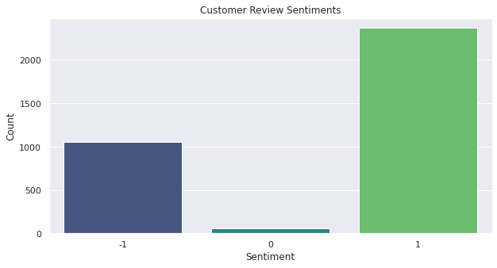
Insights
Overall British airways has a positive sentiment.
A large majority of customers are satisfied with the airline services British Airways offers

Slide 3
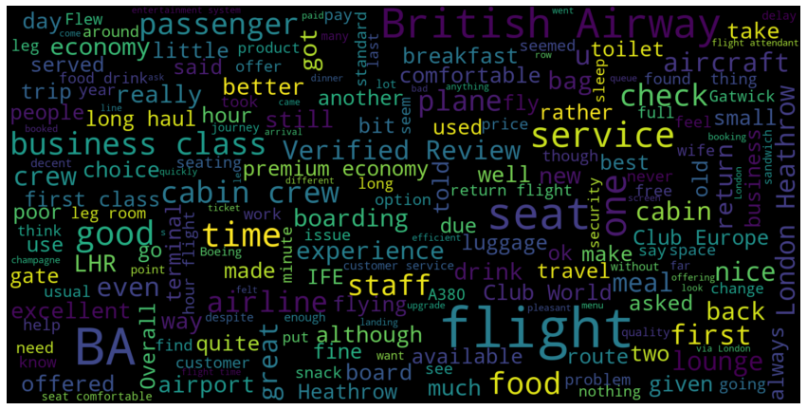
This is the word cloud for words used by customers which have a positive association

Slide 4
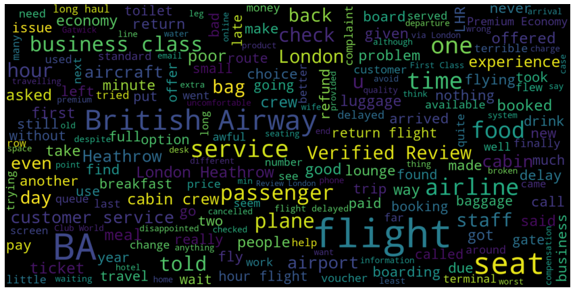
This is the word cloud for words used by customers which have a negative association

Slide 5
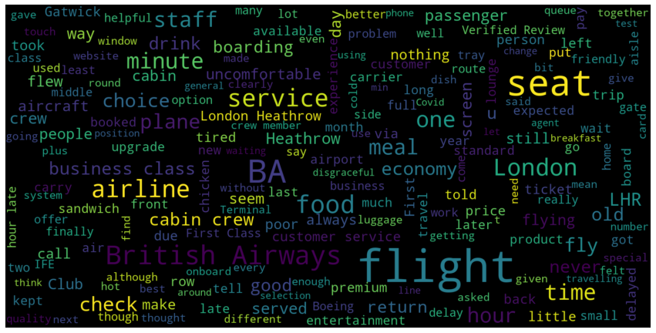
This is the word cloud for words used by customers which have a neutral association

