Slide 1
1. Business problem & approach
Where do delays occur, what predicts them, and how to prioritize scarce review capacity? (DEMO — synthetic data)
Approach: quality-controlled pipeline → diagnostics → approval-time risk model → capacity simulation.

Slide 2
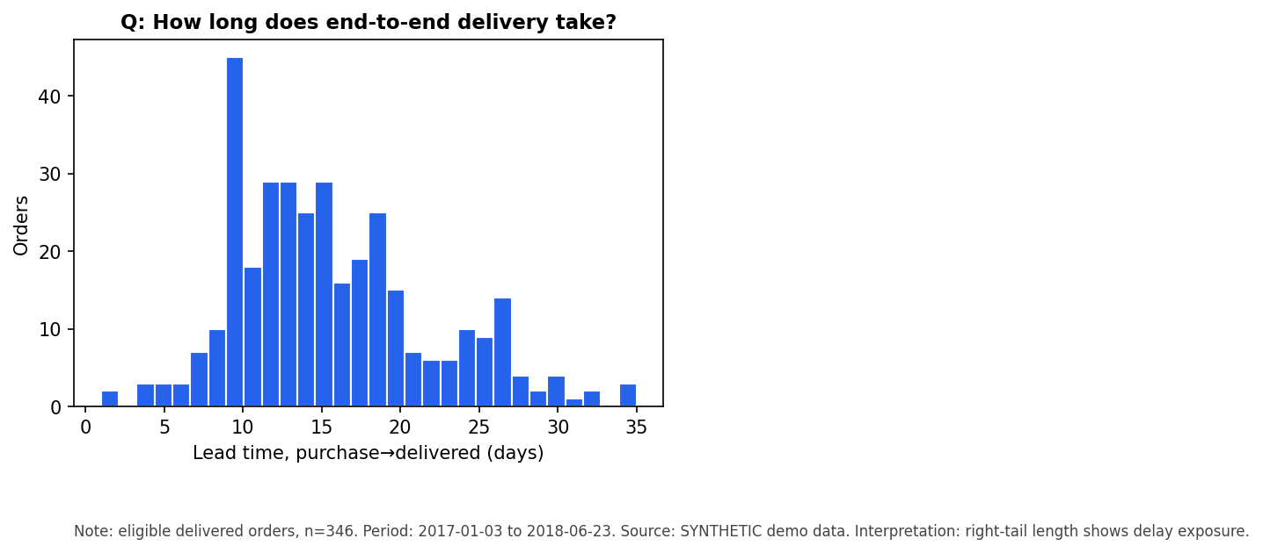
2. Operational performance
Eligible orders: 346; late rate: 0.5405 | mean lead time: 15.6d; approval→carrier: 4.87d; carrier→delivered: 9.72d.

Slide 3
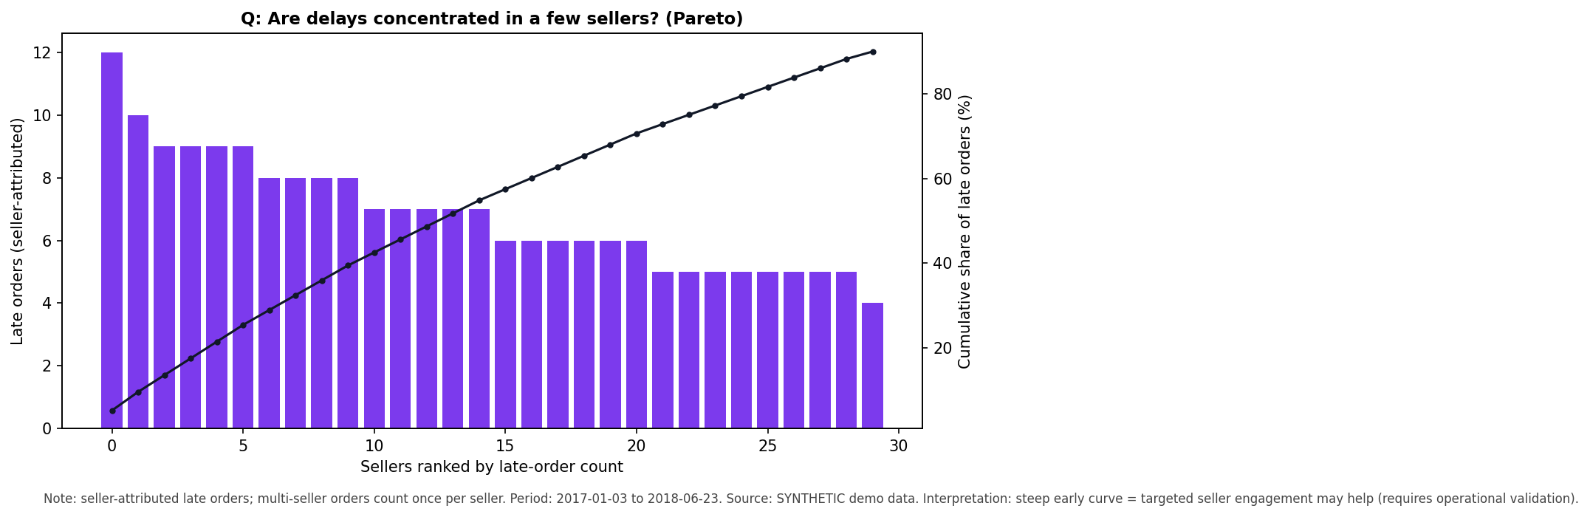
3. Delay concentrations & potential drivers
Pareto + segment late rates show where delays concentrate. Treat as potential contributing factors — operational validation required.

Slide 4
4. Early warning & capacity trade-offs
Risk scores at approval time rank orders for review. logistic: ROC-AUC 0.6338, PR-AUC 0.6615 | hgb: ROC-AUC 0.5859, PR-AUC 0.6042. Thresholds from validation; test held out.

Slide 5
5. Recommendations, limitations, next steps
1) Prioritize top-risk reviews within daily capacity. 2) Validate seller/segment patterns operationally. 3) Track rescued-rate before claiming savings. Limits: no inventory/cost/counterfactual data; undelivered orders excluded from late rates; fixture numbers are illustrative.

