Slide 1

O’REILLY LIVE
Codex
& Coffee
Mark Kashef
DAY 8
Editing videos with Codex
Notes:
DAY 8 · Editing videos with Codex
0–0.5 minutes (0.5 minutes)
SAY
Welcome to Day 8. No earlier lesson is required. Today we use Codex to plan and run an edit, with familiar video tools doing the media work.
DO
Introduce the outcome: a clean short video, an editable cut plan and a repeatable check.
CHECK
Audience knows the outcome and the lesson context.
Sources verified November 3, 2026:
https://learn.chatgpt.com/docs/models
https://learn.chatgpt.com/docs/pricing
https://ffmpeg.org/ffmpeg-filters.html
https://ffmpeg.org/ffmpeg.html
https://auphonic.com/help/algorithms/index.html
https://github.com/heygen-com/hyperframes/blob/main/docs/developers/cli.mdx
Local source: YouTube Command Centre current editing skill and October 30 handoff. Fictional media: learner-kit/source/. Model test: production/qa/terra-events.jsonl.
Production used background renders only; presenter must listen to the supplied clips before class.

Slide 2
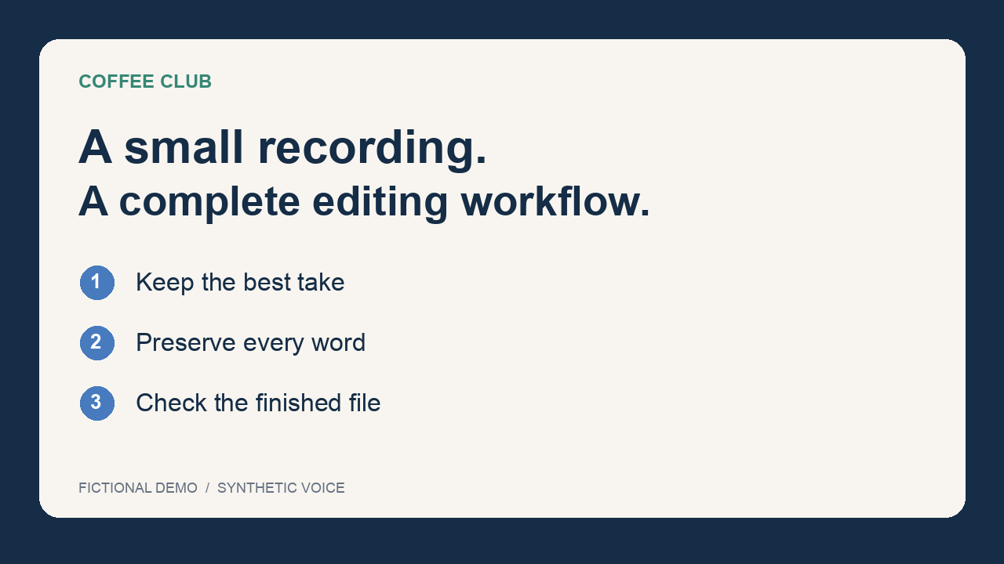
What if this recording were ready?
OUR RAW TAKE
A false start
A corrected price
A useful pause
CODEX & COFFEE
DAY 8 · 2
Notes:
DAY 8 · What if this recording were ready?
0.5–1.75 minutes (1.25 minutes)
SAY
A false start, a wrong price and a long pause are different editorial problems. Listen for all three. This is a deliberately constructed recording with a synthetic voice.
DO
Play learner-kit/source/rough-recording.mp4 in the presenter’s chosen player. Ask learners to note what to remove and what to keep. Fallback: read the transcript excerpts.
CHECK
Identify the abandoned take, corrected price and useful pause.
Sources verified November 3, 2026:
https://learn.chatgpt.com/docs/models
https://learn.chatgpt.com/docs/pricing
https://ffmpeg.org/ffmpeg-filters.html
https://ffmpeg.org/ffmpeg.html
https://auphonic.com/help/algorithms/index.html
https://github.com/heygen-com/hyperframes/blob/main/docs/developers/cli.mdx
Local source: YouTube Command Centre current editing skill and October 30 handoff. Fictional media: learner-kit/source/. Model test: production/qa/terra-events.jsonl.
Production used background renders only; presenter must listen to the supplied clips before class.

Slide 3
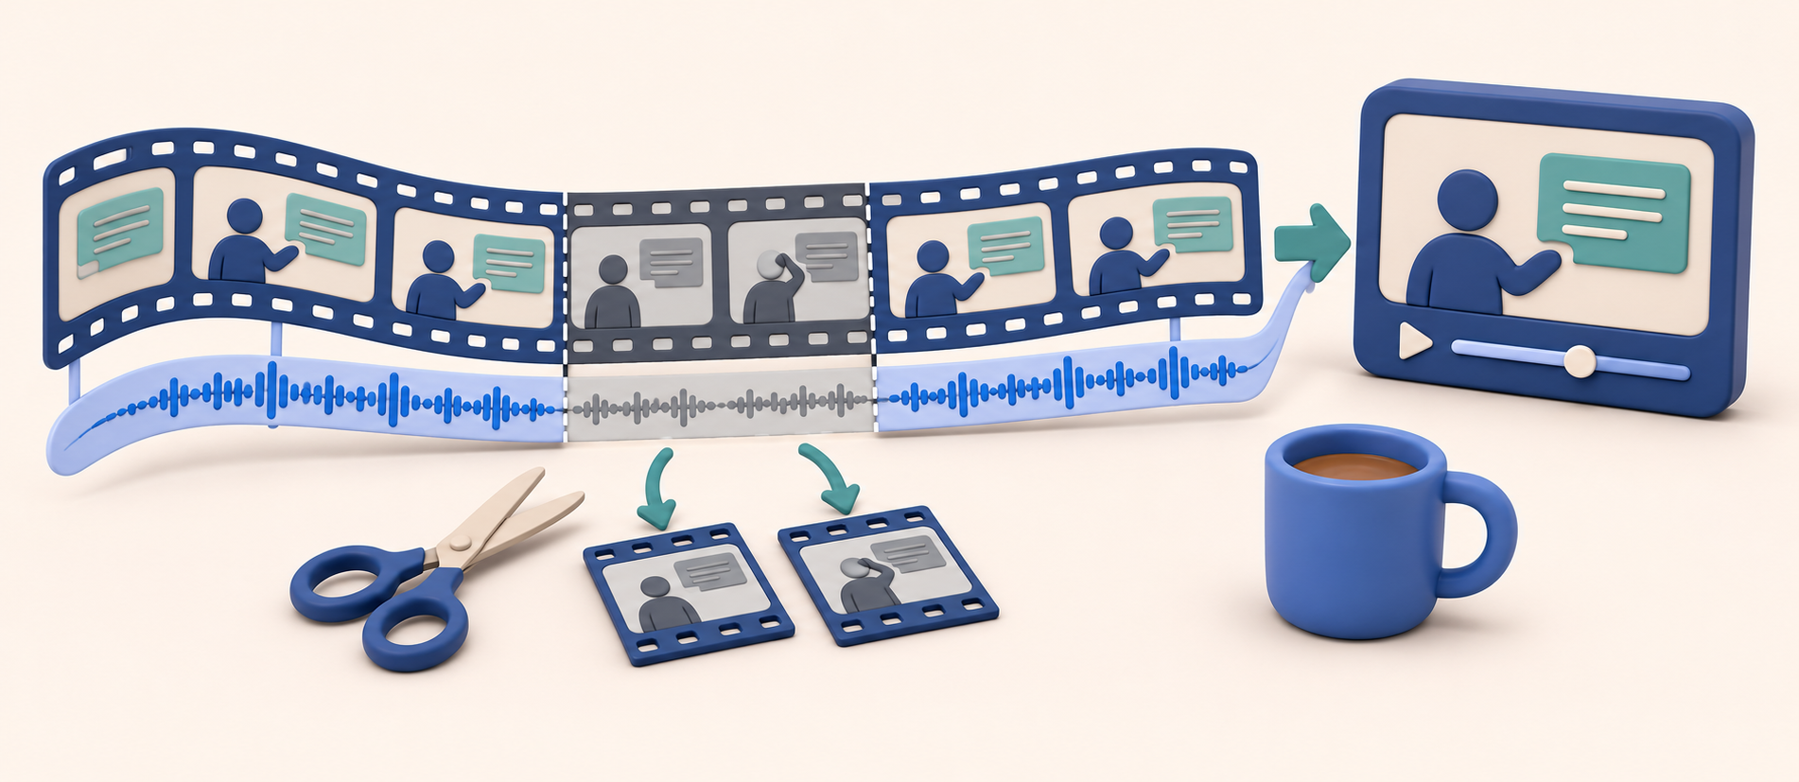
A good edit keeps the meaning
CODEX & COFFEE
DAY 8 · 3
Notes:
DAY 8 · A good edit keeps the meaning
1.75–2.5 minutes (0.75 minutes)
SAY
Shorter is useful only when the viewer still gets the complete thought. Our job is to remove the abandoned takes without clipping the price or the offer.
DO
Point to the retained phrase “fifteen dollars … before you buy”.
CHECK
Meaning and complete words take priority over minimum duration.
Sources verified November 3, 2026:
https://learn.chatgpt.com/docs/models
https://learn.chatgpt.com/docs/pricing
https://ffmpeg.org/ffmpeg-filters.html
https://ffmpeg.org/ffmpeg.html
https://auphonic.com/help/algorithms/index.html
https://github.com/heygen-com/hyperframes/blob/main/docs/developers/cli.mdx
Local source: YouTube Command Centre current editing skill and October 30 handoff. Fictional media: learner-kit/source/. Model test: production/qa/terra-events.jsonl.
Production used background renders only; presenter must listen to the supplied clips before class.

Slide 4

From recording to finished file
Recording
Cut plan
Finished video
CODEX & COFFEE
DAY 8 · 4
Notes:
DAY 8 · From recording to finished file
2.5–3 minutes (0.5 minutes)
SAY
We will inspect the original, plan cuts, make the edit, improve presentation, and verify the export. You will then write your own editing request.
DO
Trace the three pictured stages: original recording, cut plan and finished video. Explain that inspection happens before the cuts and a review happens after export.
CHECK
Learners can describe the workflow in plain language.
Sources verified November 3, 2026:
https://learn.chatgpt.com/docs/models
https://learn.chatgpt.com/docs/pricing
https://ffmpeg.org/ffmpeg-filters.html
https://ffmpeg.org/ffmpeg.html
https://auphonic.com/help/algorithms/index.html
https://github.com/heygen-com/hyperframes/blob/main/docs/developers/cli.mdx
Local source: YouTube Command Centre current editing skill and October 30 handoff. Fictional media: learner-kit/source/. Model test: production/qa/terra-events.jsonl.
Production used background renders only; presenter must listen to the supplied clips before class.

Slide 5



The video-editing toolkit
Codex
FFmpeg
HyperFrames
Auphonic
Plans the edit
Cuts and exports
Builds graphics
Optional audio cleanup
CODEX & COFFEE
DAY 8 · 5
Notes:
DAY 8 · The video-editing toolkit
3–4 minutes (1 minutes)
SAY
These four tools cover the workflow we are using. Codex plans and coordinates the work. FFmpeg makes the cuts and exports the file. HyperFrames creates graphics and animation. Auphonic is an optional audio-cleanup step. Start with Codex and FFmpeg, then add the other tools when the video benefits from them.
DO
Introduce the four logos and point to the job under each. Use this as the map for the rest of the session.
CHECK
Learners can identify which tool plans, which cuts, which makes graphics and which cleans audio.
Sources verified November 3, 2026:
https://learn.chatgpt.com/docs/models
https://learn.chatgpt.com/docs/pricing
https://ffmpeg.org/ffmpeg-filters.html
https://ffmpeg.org/ffmpeg.html
https://auphonic.com/help/algorithms/index.html
https://github.com/heygen-com/hyperframes/blob/main/docs/developers/cli.mdx
Local source: YouTube Command Centre current editing skill and October 30 handoff. Fictional media: learner-kit/source/. Model test: production/qa/terra-events.jsonl.
Production used background renders only; presenter must listen to the supplied clips before class.
Logo sources: Codex from installed ChatGPT app resources (OpenAI); FFmpeg original SVG via Wikimedia Commons; HyperFrames favicon from hyperframes.studio; Auphonic original vector mark from auphonic.com.

Slide 6
Codex directs the editing tools
Your request
Codex
Video tools
“Make this video shorter and keep the good take.”
CODEX & COFFEE
DAY 8 · 6
Notes:
DAY 8 · Codex directs the editing tools
4–5 minutes (1 minutes)
SAY
Codex reads files, plans the steps and runs tools. FFmpeg does the media processing. You make the editorial call and check the result. The model does not replace video codecs.
DO
Trace the simple request / Codex / tools / finished file flow.
CHECK
Separate editorial instructions from encoding work.
Sources verified November 3, 2026:
https://learn.chatgpt.com/docs/models
https://learn.chatgpt.com/docs/pricing
https://ffmpeg.org/ffmpeg-filters.html
https://ffmpeg.org/ffmpeg.html
https://auphonic.com/help/algorithms/index.html
https://github.com/heygen-com/hyperframes/blob/main/docs/developers/cli.mdx
Local source: YouTube Command Centre current editing skill and October 30 handoff. Fictional media: learner-kit/source/. Model test: production/qa/terra-events.jsonl.
Production used background renders only; presenter must listen to the supplied clips before class.

Slide 7
Terra is our starting model
GPT-6.1 Terra
A practical starting point for routine editing tasks
codex -m gpt-6.1-terra
Clear cut plans · Caption fixes · Small revisions
CODEX & COFFEE
DAY 8 · 7
Notes:
DAY 8 · Terra is our starting model
5–6.5 minutes (1.5 minutes)
SAY
Mark’s practical starting choice for routine trims, caption fixes and clear scoped edits is GPT-6.1 Terra. Ask it to inspect and plan before rendering. Use a stronger model or more reasoning when editorial choices or pipeline problems remain ambiguous.
DO
Show the exact model name. In Codex choose it if available. CLI equivalent: codex -m gpt-6.1-terra. Explain workspace availability may vary.
CHECK
This is a starting recommendation, not a tested universal best model.
Sources verified November 3, 2026:
https://learn.chatgpt.com/docs/models
https://learn.chatgpt.com/docs/pricing
https://ffmpeg.org/ffmpeg-filters.html
https://ffmpeg.org/ffmpeg.html
https://auphonic.com/help/algorithms/index.html
https://github.com/heygen-com/hyperframes/blob/main/docs/developers/cli.mdx
Local source: YouTube Command Centre current editing skill and October 30 handoff. Fictional media: learner-kit/source/. Model test: production/qa/terra-events.jsonl.
Production used background renders only; presenter must listen to the supplied clips before class.

Slide 8
What “good value” means here
STANDARD OUTPUT CREDITS PER 1 MILLION TOKENS
Terra
125
Sol
250
Astra
1250
Terra’s listed token rates are half Sol’s
CODEX & COFFEE
DAY 8 · 8
Notes:
DAY 8 · What “good value” means here
6.5–7 minutes (0.5 minutes)
SAY
The official standard credit rates list Terra at half Sol’s rate for input, cached input and output tokens. This chart shows output only. Actual task cost also depends on context, output and retries. FFmpeg render time depends on your machine and settings.
DO
Read the chart metric explicitly: standard output credits per million tokens, not dollars or per-video price.
CHECK
No confusion between token cost, task cost and render speed.
Sources verified November 3, 2026:
https://learn.chatgpt.com/docs/models
https://learn.chatgpt.com/docs/pricing
https://ffmpeg.org/ffmpeg-filters.html
https://ffmpeg.org/ffmpeg.html
https://auphonic.com/help/algorithms/index.html
https://github.com/heygen-com/hyperframes/blob/main/docs/developers/cli.mdx
Local source: YouTube Command Centre current editing skill and October 30 handoff. Fictional media: learner-kit/source/. Model test: production/qa/terra-events.jsonl.
Production used background renders only; presenter must listen to the supplied clips before class.

Slide 9
Before the first edit
OPEN THE LEARNER-KIT FOLDER IN CODEX
“Check whether this computer has what we need to edit a video. Tell me if anything is missing.”
Start in the learner-kit folder
CODEX & COFFEE
DAY 8 · 9
Notes:
DAY 8 · Before the first edit
7–7.75 minutes (0.75 minutes)
SAY
Open the learner-kit folder in Codex. Ask whether the tools needed to edit a video are ready to use. Codex can check the installation and explain anything missing. You can also follow the lesson with the finished examples, without installing anything.
DO
Run ffmpeg -version and ffprobe -version, or ask Codex to check them. Read learner-kit/SETUP.md. Use the supplied examples if setup takes more than a minute.
CHECK
The project is open and required local tools are available, or the learner chooses the no-install exercise.
Sources verified November 3, 2026:
https://learn.chatgpt.com/docs/models
https://learn.chatgpt.com/docs/pricing
https://ffmpeg.org/ffmpeg-filters.html
https://ffmpeg.org/ffmpeg.html
https://auphonic.com/help/algorithms/index.html
https://github.com/heygen-com/hyperframes/blob/main/docs/developers/cli.mdx
Local source: YouTube Command Centre current editing skill and October 30 handoff. Fictional media: learner-kit/source/. Model test: production/qa/terra-events.jsonl.
Production used background renders only; presenter must listen to the supplied clips before class.

Slide 10
One folder keeps the edit traceable
learner-kit/
source/
edits/
graphics/
exports/
scripts/
Open this folder
Original recording + transcript
Cut plan + reasons
Editable animation
New finished files
Local rendering helper
CODEX & COFFEE
DAY 8 · 10
Notes:
DAY 8 · One folder keeps the edit traceable
7.75–8.75 minutes (1 minutes)
SAY
Open the learner-kit folder as the project. Source holds untouched originals, edits holds the decisions, graphics holds editable visuals, and exports holds generated results. The scripts folder contains the tested local render helper.
DO
Show the folder tree and explain which folder to open. Learners without FFmpeg can compare the supplied source and example export and write a cut plan.
CHECK
Each learner knows where the original and the result live.
Sources verified November 3, 2026:
https://learn.chatgpt.com/docs/models
https://learn.chatgpt.com/docs/pricing
https://ffmpeg.org/ffmpeg-filters.html
https://ffmpeg.org/ffmpeg.html
https://auphonic.com/help/algorithms/index.html
https://github.com/heygen-com/hyperframes/blob/main/docs/developers/cli.mdx
Local source: YouTube Command Centre current editing skill and October 30 handoff. Fictional media: learner-kit/source/. Model test: production/qa/terra-events.jsonl.
Production used background renders only; presenter must listen to the supplied clips before class.

Slide 11
The original stays untouched
SOURCE
NEW EXPORT
rough-recording.mp4
clean-edit.mp4
Keep the real original available for repairs
CODEX & COFFEE
DAY 8 · 11
Notes:
DAY 8 · The original stays untouched
8.75–9.75 minutes (1 minutes)
SAY
A file named latest may already have missing words. Start from the genuine untrimmed recording. Work from copies and save edits under a new name. A Screen Studio project and a flat exported video are different kinds of source.
DO
Explain why you never overwrite the only original. Note no real private recordings are bundled.
CHECK
Recovering a clipped word requires the original, not another rewrite.
Sources verified November 3, 2026:
https://learn.chatgpt.com/docs/models
https://learn.chatgpt.com/docs/pricing
https://ffmpeg.org/ffmpeg-filters.html
https://ffmpeg.org/ffmpeg.html
https://auphonic.com/help/algorithms/index.html
https://github.com/heygen-com/hyperframes/blob/main/docs/developers/cli.mdx
Local source: YouTube Command Centre current editing skill and October 30 handoff. Fictional media: learner-kit/source/. Model test: production/qa/terra-events.jsonl.
Production used background renders only; presenter must listen to the supplied clips before class.

Slide 12
What should we know about this video?
LIVE DEMO · Open learner-kit/ in Codex
Take a look at the video in the source folder. Is there anything I should know before we start editing? Keep the original untouched.
CHECK
A useful starting summary · Original unchanged
CODEX & COFFEE
DAY 8 · 12
Notes:
DAY 8 · What should we know about this video?
9.75–11.25 minutes (1.5 minutes)
SAY
You do not have to ask for codecs or metadata. Ask Codex to look at the video and flag what matters before editing. It can tell you how long it is, whether it has sound and how many pictures it plays each second.
DO
Use the exact ordinary-language prompt. The workspace instructions handle the saved observations and file names.
CHECK
A short understandable answer, with the original unchanged.
EXACT INPUT
Take a look at the video in the source folder. Is there anything I should know before we start editing? Keep the original untouched.
Sources verified November 3, 2026:
https://learn.chatgpt.com/docs/models
https://learn.chatgpt.com/docs/pricing
https://ffmpeg.org/ffmpeg-filters.html
https://ffmpeg.org/ffmpeg.html
https://auphonic.com/help/algorithms/index.html
https://github.com/heygen-com/hyperframes/blob/main/docs/developers/cli.mdx
Local source: YouTube Command Centre current editing skill and October 30 handoff. Fictional media: learner-kit/source/. Model test: production/qa/terra-events.jsonl.
Production used background renders only; presenter must listen to the supplied clips before class.

Slide 13

Two seconds can be 50 frames
25 pictures each second
30 pictures each second
2 seconds = 50 frames
2 seconds = 60 frames
CODEX & COFFEE
DAY 8 · 13
Notes:
DAY 8 · Two seconds can be 50 frames
11.25–12.5 minutes (1.25 minutes)
SAY
Video is a series of still pictures called frames. At 25 pictures each second, two seconds contains 50 frames. At 30 pictures each second, the same two seconds contains 60. Our practice video runs at 30. A tiny time adjustment can move a cut across several pictures and the start of a word.
DO
Point to the single front picture, then the stack. Say 25 times 2 is 50, and 30 times 2 is 60. Connect this to reviewing the exact place a cut lands.
CHECK
Learners understand that the frame count depends on the frame rate.
Sources verified November 3, 2026:
https://learn.chatgpt.com/docs/models
https://learn.chatgpt.com/docs/pricing
https://ffmpeg.org/ffmpeg-filters.html
https://ffmpeg.org/ffmpeg.html
https://auphonic.com/help/algorithms/index.html
https://github.com/heygen-com/hyperframes/blob/main/docs/developers/cli.mdx
Local source: YouTube Command Centre current editing skill and October 30 handoff. Fictional media: learner-kit/source/. Model test: production/qa/terra-events.jsonl.
Production used background renders only; presenter must listen to the supplied clips before class.

Slide 14
A transcript helps you find the cut
ORIGINAL RECORDING · SOURCE TIMES
15.400–19.733 seconds
“The starter kit costs fifty dollars. Sorry, fifteen dollars.”
20.533–25.033 seconds
“The starter kit costs fifteen dollars, and you can try it before you buy.”
CODEX & COFFEE
DAY 8 · 14
Notes:
DAY 8 · A transcript helps you find the cut
12.5–14 minutes (1.5 minutes)
SAY
A transcript maps words to moments in the source. It is a search aid, not proof of a safe audio boundary. Real automatic transcripts can miss words or drift. This demo uses manually assembled phrase boundaries, not a claimed transcription result.
DO
Point to the abandoned price take and the corrected complete take. Describe forced alignment as matching known words to audio more closely. Mark’s current workflow uses Gemini transcription and wav2vec2 alignment.
CHECK
Distinguish transcript words, approximate times and reviewed audio boundaries.
Sources verified November 3, 2026:
https://learn.chatgpt.com/docs/models
https://learn.chatgpt.com/docs/pricing
https://ffmpeg.org/ffmpeg-filters.html
https://ffmpeg.org/ffmpeg.html
https://auphonic.com/help/algorithms/index.html
https://github.com/heygen-com/hyperframes/blob/main/docs/developers/cli.mdx
Local source: YouTube Command Centre current editing skill and October 30 handoff. Fictional media: learner-kit/source/. Model test: production/qa/terra-events.jsonl.
Production used background renders only; presenter must listen to the supplied clips before class.

Slide 15
Some silence helps the viewer
“WATCH THE SCREEN WHILE I SHOW THESE THREE STEPS.”
2.4 seconds
Time for the viewer to read the screen
Silence detection can find pauses. You decide their purpose.
CODEX & COFFEE
DAY 8 · 15
Notes:
DAY 8 · Some silence helps the viewer
14–15.5 minutes (1.5 minutes)
SAY
Silence detection finds candidates. A pause can mean a bad take, a breath or time needed to read a screen. Quiet consonants can also look like silence. Keep the intentional inspection pause in this sample.
DO
Invite the room to decide about the 2.4-second screen pause. Replay that passage if useful.
CHECK
Learners explain why removing every pause is a bad default.
Sources verified November 3, 2026:
https://learn.chatgpt.com/docs/models
https://learn.chatgpt.com/docs/pricing
https://ffmpeg.org/ffmpeg-filters.html
https://ffmpeg.org/ffmpeg.html
https://auphonic.com/help/algorithms/index.html
https://github.com/heygen-com/hyperframes/blob/main/docs/developers/cli.mdx
Local source: YouTube Command Centre current editing skill and October 30 handoff. Fictional media: learner-kit/source/. Model test: production/qa/terra-events.jsonl.
Production used background renders only; presenter must listen to the supplied clips before class.

Slide 16
Ask for a cut plan first
LIVE DEMO · Inspect the plan before rendering
Help me tighten up this video. Cut the false start and the take with the wrong price. Keep the full sentence with the correct price, and leave enough time for people to read the screen. Show me your suggested cuts before you change anything.
CHECK
Keep the right take · Keep full sentences · Leave time to read
CODEX & COFFEE
DAY 8 · 16
Notes:
DAY 8 · Ask for a cut plan first
15.5–17.5 minutes (2 minutes)
SAY
Ask for the edit you want in the language you would use with another person. Name what should go and what must stay. Request the suggested cuts before it changes the video. The workspace instructions make the underlying cut-list file.
DO
Paste the plan prompt. Read the plain-language choices first, then optionally open edits/cut-list.json to show the saved plan.
CHECK
The corrected price, offer and inspection pause survive.
EXACT INPUT
Help me tighten up this video. Cut the false start and the take with the wrong price. Keep the full sentence with the correct price, and leave enough time for people to read the screen. Show me your suggested cuts before you change anything.
Sources verified November 3, 2026:
https://learn.chatgpt.com/docs/models
https://learn.chatgpt.com/docs/pricing
https://ffmpeg.org/ffmpeg-filters.html
https://ffmpeg.org/ffmpeg.html
https://auphonic.com/help/algorithms/index.html
https://github.com/heygen-com/hyperframes/blob/main/docs/developers/cli.mdx
Local source: YouTube Command Centre current editing skill and October 30 handoff. Fictional media: learner-kit/source/. Model test: production/qa/terra-events.jsonl.
Production used background renders only; presenter must listen to the supplied clips before class.

Slide 17
Two cuts keep the good takes
KEEP THESE PARTS OF THE ORIGINAL
Opening + backup advice
5.700–14.700 seconds
Correct price + screen + ending
20.300–36.633 seconds
CODEX & COFFEE
DAY 8 · 17
Notes:
DAY 8 · Two cuts keep the good takes
17.5–18.5 minutes (1 minutes)
SAY
The conversational request produced two keep ranges. The first keeps the clean opening and backup advice. The second keeps the correct price, the screen-reading pause and the closing advice. The cut list uses the original recording’s times.
DO
Show the actual two-range plan generated during the conversational-prompt rehearsal.
CHECK
The class can explain one removed range and one protected range.
Sources verified November 3, 2026:
https://learn.chatgpt.com/docs/models
https://learn.chatgpt.com/docs/pricing
https://ffmpeg.org/ffmpeg-filters.html
https://ffmpeg.org/ffmpeg.html
https://auphonic.com/help/algorithms/index.html
https://github.com/heygen-com/hyperframes/blob/main/docs/developers/cli.mdx
Local source: YouTube Command Centre current editing skill and October 30 handoff. Fictional media: learner-kit/source/. Model test: production/qa/terra-events.jsonl.
Production used background renders only; presenter must listen to the supplied clips before class.

Slide 18
Picture and sound move together
ONE APPROVED SOURCE RANGE
20.533–25.033 seconds
Picture: trim → reset start
Sound: atrim → reset start
Then join each matching pair
Picture and sound use the same boundaries
CODEX & COFFEE
DAY 8 · 18
Notes:
DAY 8 · Picture and sound move together
18.5–19.5 minutes (1 minutes)
SAY
If you remove two seconds from the picture but leave audio unchanged, lip sync and timing drift. The helper trims both streams to the same ranges, resets each start time and joins the matching pairs.
DO
Show one short trim / atrim pair as supporting code. Explain the words before the identifiers. Fast copy cuts may land on nearby keyframes; exact cuts usually require encoding.
CHECK
Understand the pairing, without needing to memorize FFmpeg syntax.
Sources verified November 3, 2026:
https://learn.chatgpt.com/docs/models
https://learn.chatgpt.com/docs/pricing
https://ffmpeg.org/ffmpeg-filters.html
https://ffmpeg.org/ffmpeg.html
https://auphonic.com/help/algorithms/index.html
https://github.com/heygen-com/hyperframes/blob/main/docs/developers/cli.mdx
Local source: YouTube Command Centre current editing skill and October 30 handoff. Fictional media: learner-kit/source/. Model test: production/qa/terra-events.jsonl.
Production used background renders only; presenter must listen to the supplied clips before class.

Slide 19
Turn the plan into a video
LIVE DEMO · Once the cuts look right
That plan looks good. Make the edited video and save it as a new file. Keep the original, and check that the finished video has sound and matches the plan.
CHECK
A new video · Sound included · Original kept
CODEX & COFFEE
DAY 8 · 19
Notes:
DAY 8 · Turn the plan into a video
19.5–21.5 minutes (2 minutes)
SAY
Accept the suggested cuts and ask for a new video. You do not need to dictate the encoding command. The helper uses the approved plan and keeps the original safe.
DO
Use the render prompt. Open the resulting export. Fall back to the supplied example if a local tool is unavailable.
CHECK
Export exists, source hash is unchanged, and duration matches the plan.
EXACT INPUT
That plan looks good. Make the edited video and save it as a new file. Keep the original, and check that the finished video has sound and matches the plan.
Sources verified November 3, 2026:
https://learn.chatgpt.com/docs/models
https://learn.chatgpt.com/docs/pricing
https://ffmpeg.org/ffmpeg-filters.html
https://ffmpeg.org/ffmpeg.html
https://auphonic.com/help/algorithms/index.html
https://github.com/heygen-com/hyperframes/blob/main/docs/developers/cli.mdx
Local source: YouTube Command Centre current editing skill and October 30 handoff. Fictional media: learner-kit/source/. Model test: production/qa/terra-events.jsonl.
Production used background renders only; presenter must listen to the supplied clips before class.

Slide 20
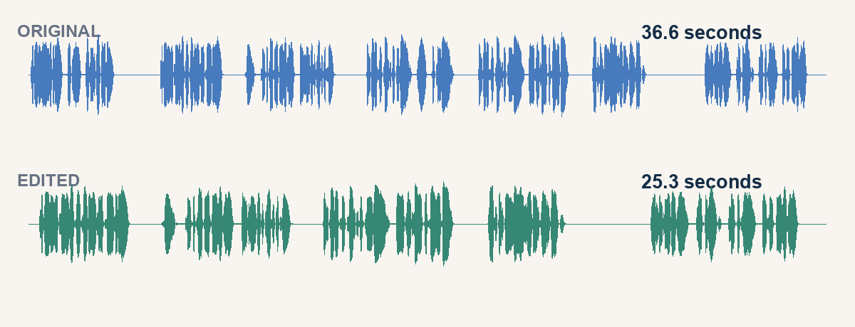
Watch the edited version
CODEX & COFFEE
DAY 8 · 20
Notes:
DAY 8 · Watch the edited version
21.5–23.5 minutes (2 minutes)
SAY
Listen for the complete price and “before you buy”. The long pause stays because the viewer needs to read. Removing the abandoned takes is more important than forcing an arbitrary duration.
DO
Play examples/clean-edit.mp4 and compare with the rough original. Have the group name one improvement and one thing deliberately retained.
CHECK
Every required phrase survives; pace remains understandable.
Sources verified November 3, 2026:
https://learn.chatgpt.com/docs/models
https://learn.chatgpt.com/docs/pricing
https://ffmpeg.org/ffmpeg-filters.html
https://ffmpeg.org/ffmpeg.html
https://auphonic.com/help/algorithms/index.html
https://github.com/heygen-com/hyperframes/blob/main/docs/developers/cli.mdx
Local source: YouTube Command Centre current editing skill and October 30 handoff. Fictional media: learner-kit/source/. Model test: production/qa/terra-events.jsonl.
Production used background renders only; presenter must listen to the supplied clips before class.

Slide 21
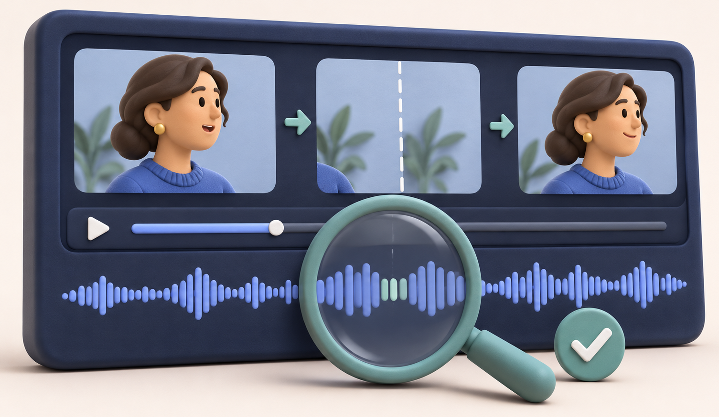
The joins deserve a close listen
CODEX & COFFEE
DAY 8 · 21
Notes:
DAY 8 · The joins deserve a close listen
23.5–25 minutes (1.5 minutes)
SAY
A successful command is not a good edit by itself. Listen immediately before and after each join. Check for missing consonants, clicks, repeated syllables and sudden audio changes.
DO
Use examples/join-review.wav or the full export. Show the timestamp mapping in the JSON receipt. Do not claim automated metadata checks prove perceptual quality.
CHECK
The instructor or learner listens to the actual result.
Sources verified November 3, 2026:
https://learn.chatgpt.com/docs/models
https://learn.chatgpt.com/docs/pricing
https://ffmpeg.org/ffmpeg-filters.html
https://ffmpeg.org/ffmpeg.html
https://auphonic.com/help/algorithms/index.html
https://github.com/heygen-com/hyperframes/blob/main/docs/developers/cli.mdx
Local source: YouTube Command Centre current editing skill and October 30 handoff. Fictional media: learner-kit/source/. Model test: production/qa/terra-events.jsonl.
Production used background renders only; presenter must listen to the supplied clips before class.

Slide 22
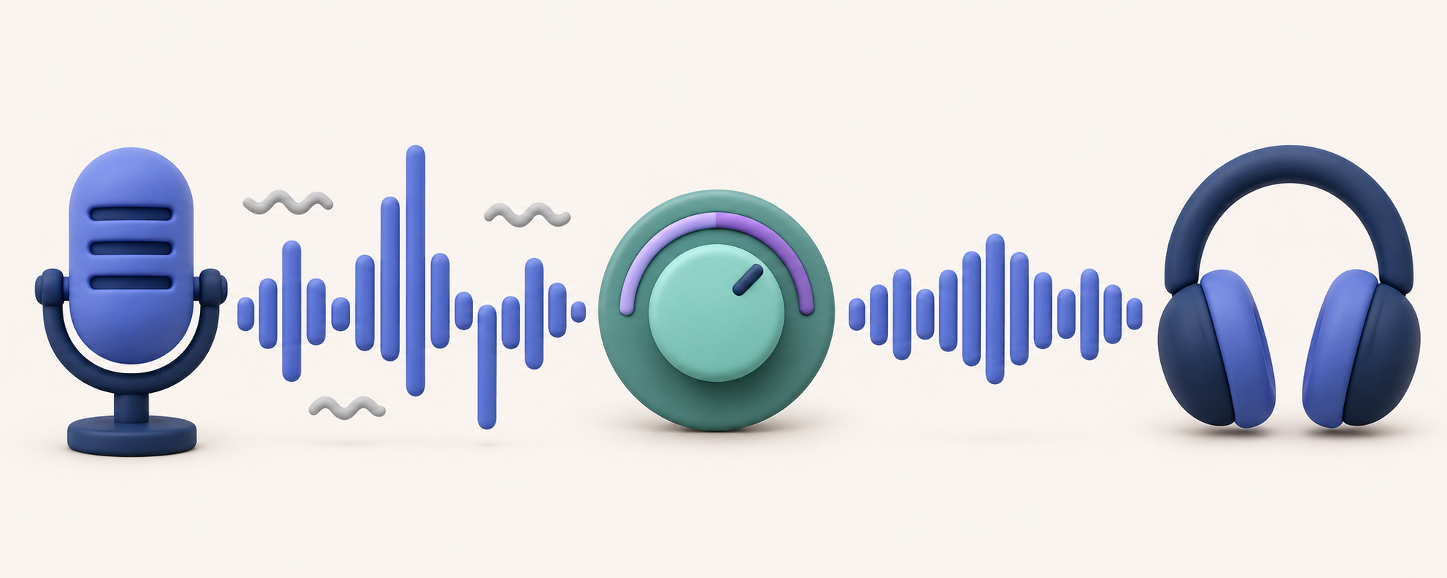
Audio cleanup is another decision
Recorded sound
Adjust levels
Listen back
CODEX & COFFEE
DAY 8 · 22
Notes:
DAY 8 · Audio cleanup is another decision
25–25.75 minutes (0.75 minutes)
SAY
Leveling makes speech more even. Noise reduction can help steady room noise. Too much processing can make a voice metallic. Start conservatively and compare the same passage before and after.
DO
Use the illustrated uneven and more even waveforms to explain leveling. Point to the headphones to remind the audience to listen. This is an illustration of the idea, not a claimed Auphonic test result.
CHECK
Learners know to compare the sound, not just a loudness number.
Sources verified November 3, 2026:
https://learn.chatgpt.com/docs/models
https://learn.chatgpt.com/docs/pricing
https://ffmpeg.org/ffmpeg-filters.html
https://ffmpeg.org/ffmpeg.html
https://auphonic.com/help/algorithms/index.html
https://github.com/heygen-com/hyperframes/blob/main/docs/developers/cli.mdx
Local source: YouTube Command Centre current editing skill and October 30 handoff. Fictional media: learner-kit/source/. Model test: production/qa/terra-events.jsonl.
Production used background renders only; presenter must listen to the supplied clips before class.

Slide 23
Where Auphonic fits
Edited audio
Auphonic
Checked audio
Keep timing unchanged when replacing the track
Optional cloud step · Account and upload required
CODEX & COFFEE
DAY 8 · 23
Notes:
DAY 8 · Where Auphonic fits
25.75–27.25 minutes (1.5 minutes)
SAY
Auphonic can level and clean up a mixed mono or stereo track. It is a separate cloud step with its own account and usage. If replacing audio under a locked video edit, leave time-changing cuts off and verify duration and sync after replacement.
DO
Walk the optional input / cleanup / replacement flow. Explain this lesson did not upload or process audio in Auphonic. A -14 LUFS, -1 dBTP target is an example for web delivery, not a universal rule.
CHECK
No surprise uploads, changed duration or universal loudness claim.
Sources verified November 3, 2026:
https://learn.chatgpt.com/docs/models
https://learn.chatgpt.com/docs/pricing
https://ffmpeg.org/ffmpeg-filters.html
https://ffmpeg.org/ffmpeg.html
https://auphonic.com/help/algorithms/index.html
https://github.com/heygen-com/hyperframes/blob/main/docs/developers/cli.mdx
Local source: YouTube Command Centre current editing skill and October 30 handoff. Fictional media: learner-kit/source/. Model test: production/qa/terra-events.jsonl.
Production used background renders only; presenter must listen to the supplied clips before class.

Slide 24
Captions follow the finished edit
CAPTIONS ON THE EDITED TIMELINE
1
00:00:09,233 --> 00:00:13,733
The starter kit costs fifteen dollars,
and you can try it before you buy.
Check prices, names and words like “not”
CODEX & COFFEE
DAY 8 · 24
Notes:
DAY 8 · Captions follow the finished edit
27.25–28.25 minutes (1 minutes)
SAY
Cut first, then make or retime captions to the final timeline. Check names, prices and negation words such as “not”. SRT is an editable timed text file; burned-in captions become part of the picture.
DO
Show a short SRT example at the corrected price. Emphasize exact words over animated styling.
CHECK
The learner checks timing against the final video, not source time.
Sources verified November 3, 2026:
https://learn.chatgpt.com/docs/models
https://learn.chatgpt.com/docs/pricing
https://ffmpeg.org/ffmpeg-filters.html
https://ffmpeg.org/ffmpeg.html
https://auphonic.com/help/algorithms/index.html
https://github.com/heygen-com/hyperframes/blob/main/docs/developers/cli.mdx
Local source: YouTube Command Centre current editing skill and October 30 handoff. Fictional media: learner-kit/source/. Model test: production/qa/terra-events.jsonl.
Production used background renders only; presenter must listen to the supplied clips before class.

Slide 25
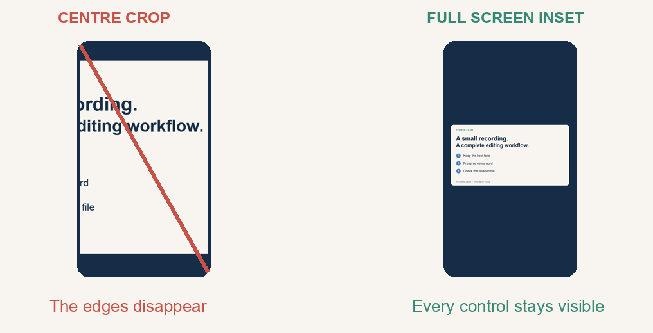
A vertical crop needs a decision
CODEX & COFFEE
DAY 8 · 25
Notes:
DAY 8 · A vertical crop needs a decision
28.25–29.25 minutes (1 minutes)
SAY
A tall crop can hide the button a viewer needs to see. For screen demos, preserve the whole interface, then decide whether to use a tall canvas with the screen inset. Keep captions away from important controls.
DO
Compare a centre crop with a full-screen inset on a tall canvas. Explain that Screen Studio zoom and cursor treatments may already be baked in.
CHECK
No automatic crop presented as universally safe.
Sources verified November 3, 2026:
https://learn.chatgpt.com/docs/models
https://learn.chatgpt.com/docs/pricing
https://ffmpeg.org/ffmpeg-filters.html
https://ffmpeg.org/ffmpeg.html
https://auphonic.com/help/algorithms/index.html
https://github.com/heygen-com/hyperframes/blob/main/docs/developers/cli.mdx
Local source: YouTube Command Centre current editing skill and October 30 handoff. Fictional media: learner-kit/source/. Model test: production/qa/terra-events.jsonl.
Production used background renders only; presenter must listen to the supplied clips before class.

Slide 26
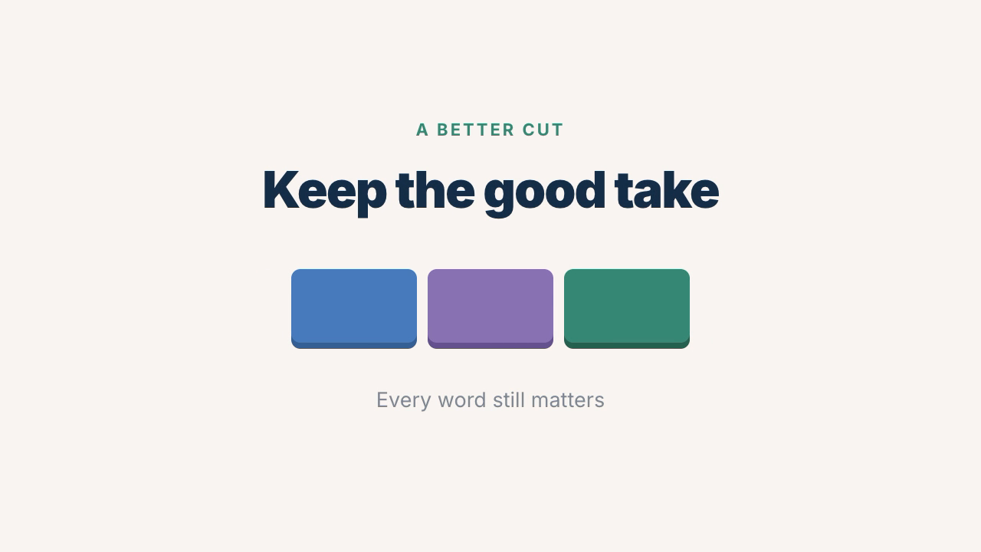
A graphic should explain something
CODEX & COFFEE
DAY 8 · 26
Notes:
DAY 8 · A graphic should explain something
29.25–30.25 minutes (1 minutes)
SAY
Add a title, a short callout or a simple visual when it clarifies the story. Keep the recorded screen visible when it is the evidence. Our short animated card reinforces why complete words matter.
DO
Show two frames of the actual HyperFrames render. Avoid suggesting a new animation on every sentence.
CHECK
Every graphic has a teaching purpose.
Sources verified November 3, 2026:
https://learn.chatgpt.com/docs/models
https://learn.chatgpt.com/docs/pricing
https://ffmpeg.org/ffmpeg-filters.html
https://ffmpeg.org/ffmpeg.html
https://auphonic.com/help/algorithms/index.html
https://github.com/heygen-com/hyperframes/blob/main/docs/developers/cli.mdx
Local source: YouTube Command Centre current editing skill and October 30 handoff. Fictional media: learner-kit/source/. Model test: production/qa/terra-events.jsonl.
Production used background renders only; presenter must listen to the supplied clips before class.

Slide 27
HyperFrames makes editable motion
graphics/
index.html
compositions/title.html
assets/
renders/title-card.mp4
index.html
Puts the scene on the timeline
title.html
Defines the design and movement
title-card.mp4
The rendered video file
CODEX & COFFEE
DAY 8 · 27
Notes:
DAY 8 · HyperFrames makes editable motion
30.25–32 minutes (1.75 minutes)
SAY
HyperFrames turns HTML and a timeline into video. A scene declares when its elements appear. A paused timeline can be placed at any moment, letting the renderer capture frames consistently. The source stays editable.
DO
Open graphics/index.html as text and the rendered title-card.mp4. Explain start, duration and the headline variable in plain terms.
CHECK
Learners recognize HTML source, timing and rendered output as distinct.
Sources verified November 3, 2026:
https://learn.chatgpt.com/docs/models
https://learn.chatgpt.com/docs/pricing
https://ffmpeg.org/ffmpeg-filters.html
https://ffmpeg.org/ffmpeg.html
https://auphonic.com/help/algorithms/index.html
https://github.com/heygen-com/hyperframes/blob/main/docs/developers/cli.mdx
Local source: YouTube Command Centre current editing skill and October 30 handoff. Fictional media: learner-kit/source/. Model test: production/qa/terra-events.jsonl.
Production used background renders only; presenter must listen to the supplied clips before class.

Slide 28
Change one thing, then render
LIVE DEMO · Work on a copy of graphics/
Change the title in our graphic to “Every word still matters”. Keep the same look and timing, and save a new video so we can compare the two.
CHECK
Right title · Same style · Finished video checked
CODEX & COFFEE
DAY 8 · 28
Notes:
DAY 8 · Change one thing, then render
32–34 minutes (2 minutes)
SAY
A specific small change is a good Terra task. Keep the look and timing, change the headline, then inspect the render. Avoid vague “make it cinematic” requests when you already have a usable design.
DO
Use prompts/graphics.txt on a copy, or show the supplied render. Run the CLI from graphics/. Use installed-version help when flags differ.
CHECK
New headline is correct at the beginning, middle and end.
EXACT INPUT
Change the title in our graphic to “Every word still matters”. Keep the same look and timing, and save a new video so we can compare the two.
Sources verified November 3, 2026:
https://learn.chatgpt.com/docs/models
https://learn.chatgpt.com/docs/pricing
https://ffmpeg.org/ffmpeg-filters.html
https://ffmpeg.org/ffmpeg.html
https://auphonic.com/help/algorithms/index.html
https://github.com/heygen-com/hyperframes/blob/main/docs/developers/cli.mdx
Local source: YouTube Command Centre current editing skill and October 30 handoff. Fictional media: learner-kit/source/. Model test: production/qa/terra-events.jsonl.
Production used background renders only; presenter must listen to the supplied clips before class.

Slide 29
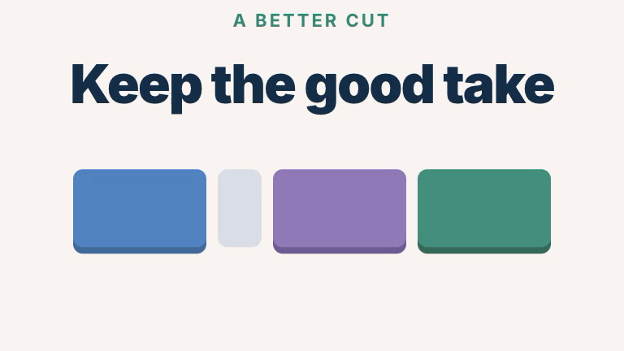

Check a few frames, then watch the video
Beginning
Middle
End
1 second
3 seconds
5 seconds
Then play the full six-second clip
CODEX & COFFEE
DAY 8 · 29
Notes:
DAY 8 · Check a few frames, then watch the video
34–35 minutes (1 minutes)
SAY
Codex checks the graphic, looks at stills from the beginning, middle and end, and then saves a video. You can ask for that in one normal sentence. The exact commands remain in the kit for anyone who wants them.
DO
Compare the actual graphic at 1, 3 and 5 seconds, then play the complete six-second video. These pictures are frames extracted from the supplied render, not illustrative mockups.
CHECK
The saved MP4 is six seconds and the three review frames are readable.
Sources verified November 3, 2026:
https://learn.chatgpt.com/docs/models
https://learn.chatgpt.com/docs/pricing
https://ffmpeg.org/ffmpeg-filters.html
https://ffmpeg.org/ffmpeg.html
https://auphonic.com/help/algorithms/index.html
https://github.com/heygen-com/hyperframes/blob/main/docs/developers/cli.mdx
Local source: YouTube Command Centre current editing skill and October 30 handoff. Fictional media: learner-kit/source/. Model test: production/qa/terra-events.jsonl.
Production used background renders only; presenter must listen to the supplied clips before class.

Slide 30
The exported file gets the final check
CHECK THE FILE YOU WILL ACTUALLY SHARE
Technical check
Duration · size · codecs · audio
Editorial check
Complete words · correct price · useful pauses
Screen check
Readable details · captions · private information
CODEX & COFFEE
DAY 8 · 30
Notes:
DAY 8 · The exported file gets the final check
35–36.5 minutes (1.5 minutes)
SAY
Check the file you will share. Verify size, frame rate, codecs, duration and audio. Then check the complete price, each join, caption timing and any private screen details. Metadata and listening answer different questions.
DO
Show the saved verification report and play a join. Auphonic and caption changes need a new sync check.
CHECK
No claim of completion based only on file creation.
EXACT INPUT
Check the finished video for missing words, awkward cuts or sound problems. Tell me what you checked, and what I should watch or listen to myself.
Sources verified November 3, 2026:
https://learn.chatgpt.com/docs/models
https://learn.chatgpt.com/docs/pricing
https://ffmpeg.org/ffmpeg-filters.html
https://ffmpeg.org/ffmpeg.html
https://auphonic.com/help/algorithms/index.html
https://github.com/heygen-com/hyperframes/blob/main/docs/developers/cli.mdx
Local source: YouTube Command Centre current editing skill and October 30 handoff. Fictional media: learner-kit/source/. Model test: production/qa/terra-events.jsonl.
Production used background renders only; presenter must listen to the supplied clips before class.

Slide 31
Your turn: write the editing request
YOUR TURN · Use the transcript or work in Codex
I want a tighter version of this video, around 20–25 seconds. Keep the correct price, the offer to try before buying, and the pause where people read the screen. Show me your suggested cuts first.
CHECK
Clear suggested cuts · Original kept · Meaning preserved
CODEX & COFFEE
DAY 8 · 31
Notes:
DAY 8 · Your turn: write the editing request
36.5–40.5 minutes (4 minutes)
SAY
Use the example request or write your own version. The important parts are what you want to remove, what must stay and asking to see the suggested cuts first.
DO
Give two minutes to write or adapt the request, then two minutes to compare choices. Learners without tools can mark the transcript.
CHECK
Prompt names output, preserves source, keeps price and offer, and includes a check.
EXACT INPUT
I want a tighter version of this video, around 20–25 seconds. Keep the correct price, the offer to try before buying, and the pause where people read the screen. Show me your suggested cuts first.
Sources verified November 3, 2026:
https://learn.chatgpt.com/docs/models
https://learn.chatgpt.com/docs/pricing
https://ffmpeg.org/ffmpeg-filters.html
https://ffmpeg.org/ffmpeg.html
https://auphonic.com/help/algorithms/index.html
https://github.com/heygen-com/hyperframes/blob/main/docs/developers/cli.mdx
Local source: YouTube Command Centre current editing skill and October 30 handoff. Fictional media: learner-kit/source/. Model test: production/qa/terra-events.jsonl.
Production used background renders only; presenter must listen to the supplied clips before class.

Slide 32
Compare your plan with the example
Keep
The correct $15 price
“before you buy”
The screen-reading pause
Remove
The abandoned opening
The wrong-price take
CODEX & COFFEE
DAY 8 · 32
Notes:
DAY 8 · Compare your plan with the example
40.5–42 minutes (1.5 minutes)
SAY
Different cut plans can be valid. The boundary is whether the required content survives and timing remains coherent. Our example is about 25.33 seconds and keeps the inspection pause. Shortening it further needs a reason.
DO
Show examples/cut-list.json. Ask learners to compare one choice, then read their check aloud. In a quiet room, annotate two alternatives yourself.
CHECK
Learners assess the output against the request instead of copying a preferred number.
Sources verified November 3, 2026:
https://learn.chatgpt.com/docs/models
https://learn.chatgpt.com/docs/pricing
https://ffmpeg.org/ffmpeg-filters.html
https://ffmpeg.org/ffmpeg.html
https://auphonic.com/help/algorithms/index.html
https://github.com/heygen-com/hyperframes/blob/main/docs/developers/cli.mdx
Local source: YouTube Command Centre current editing skill and October 30 handoff. Fictional media: learner-kit/source/. Model test: production/qa/terra-events.jsonl.
Production used background renders only; presenter must listen to the supplied clips before class.

Slide 33
The Command Centre makes this repeatable
Originals
Transcript + cut decisions
Graphics + audio choices
Export + review record
CODEX & COFFEE
DAY 8 · 33
Notes:
DAY 8 · The Command Centre makes this repeatable
42–43 minutes (1 minutes)
SAY
The bigger system stores originals, transcripts, cut decisions, graphics, exports and review evidence. Each video still needs editorial judgment. A reusable skill can enforce the steps without hard-coding one recording’s timestamps.
DO
Connect to Mark’s YouTube Command Centre practice, with no private directories or projects on screen. Mention the current tools: Screen Studio, FFprobe/FFmpeg, transcript plus alignment, HyperFrames and optional audio cleanup.
CHECK
Reusable process stays separate from per-video facts.
Sources verified November 3, 2026:
https://learn.chatgpt.com/docs/models
https://learn.chatgpt.com/docs/pricing
https://ffmpeg.org/ffmpeg-filters.html
https://ffmpeg.org/ffmpeg.html
https://auphonic.com/help/algorithms/index.html
https://github.com/heygen-com/hyperframes/blob/main/docs/developers/cli.mdx
Local source: YouTube Command Centre current editing skill and October 30 handoff. Fictional media: learner-kit/source/. Model test: production/qa/terra-events.jsonl.
Production used background renders only; presenter must listen to the supplied clips before class.

Slide 34
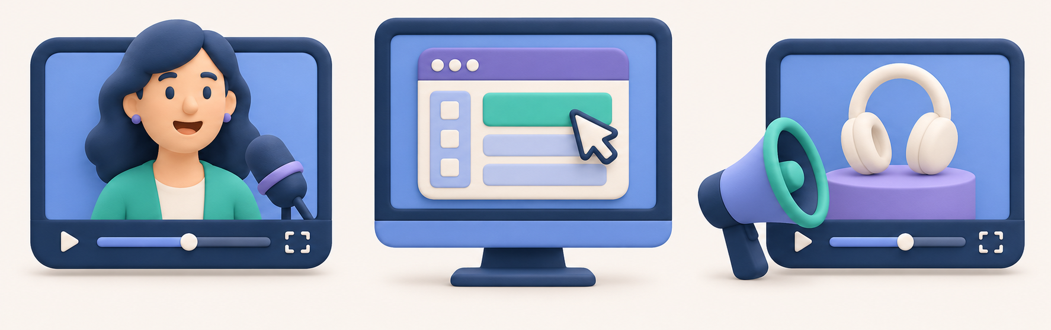
Three useful jobs for tomorrow
Talking-head video
Screen demo
Announcement
CODEX & COFFEE
DAY 8 · 34
Notes:
DAY 8 · Three useful jobs for tomorrow
43–44.5 minutes (1.5 minutes)
SAY
Start small: clean a talking-head take, make a readable screen-demo excerpt, or create a short announcement from approved footage. Define what must survive, the audience and the destination.
DO
Point to the pictured talking-head, screen-demo and announcement examples. Ask learners to choose one and describe the edit they want. If quiet, model a 30-second product update and a 60-second tutorial.
CHECK
A task has a specific audience, source, result and review check.
Sources verified November 3, 2026:
https://learn.chatgpt.com/docs/models
https://learn.chatgpt.com/docs/pricing
https://ffmpeg.org/ffmpeg-filters.html
https://ffmpeg.org/ffmpeg.html
https://auphonic.com/help/algorithms/index.html
https://github.com/heygen-com/hyperframes/blob/main/docs/developers/cli.mdx
Local source: YouTube Command Centre current editing skill and October 30 handoff. Fictional media: learner-kit/source/. Model test: production/qa/terra-events.jsonl.
Production used background renders only; presenter must listen to the supplied clips before class.

Slide 35
Your next edit starts here
Open the learner kit
README.md
source/ prompts/ scripts/
examples/ graphics/
Plan the cuts. Render a copy. Watch and listen.
CODEX & COFFEE
DAY 8 · 35
Notes:
DAY 8 · Your next edit starts here
44.5–45 minutes (0.5 minutes)
SAY
Take the source, prompts, scripts and finished example with you. Start with Terra on a scoped request, inspect the plan, then watch and listen to the result.
DO
Point to learner-kit/README.md. Remind them the optional cloud-audio step was explained, not executed.
CHECK
Learners can reproduce the local example and know its limits.
Sources verified November 3, 2026:
https://learn.chatgpt.com/docs/models
https://learn.chatgpt.com/docs/pricing
https://ffmpeg.org/ffmpeg-filters.html
https://ffmpeg.org/ffmpeg.html
https://auphonic.com/help/algorithms/index.html
https://github.com/heygen-com/hyperframes/blob/main/docs/developers/cli.mdx
Local source: YouTube Command Centre current editing skill and October 30 handoff. Fictional media: learner-kit/source/. Model test: production/qa/terra-events.jsonl.
Production used background renders only; presenter must listen to the supplied clips before class.

