Slide 1

O’REILLY LIVE
Codex
& Coffee
Mark Kashef
DAY 13
Rebuild an app with Codex
Notes:
DAY 13 · Rebuild an app with Codex
0–0.5 minutes (0.5 minutes)
SAY
We will use an app I use when presenting. We will inspect its behavior, turn the observations into a plan, build our own Mac version and check the result.
SHOW / DO
Show the visual, explain the relationship, and use the stated observation or example.
CHECK
Ask the group to identify the input, action and observable result.
SOURCE
https://learn.chatgpt.com/docs/prompting

Slide 2
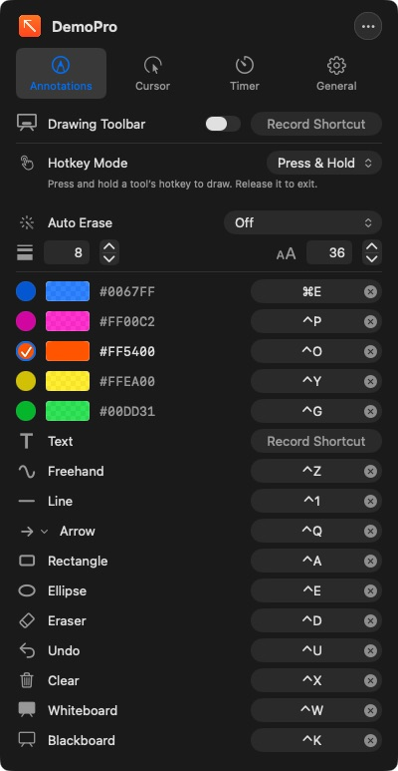
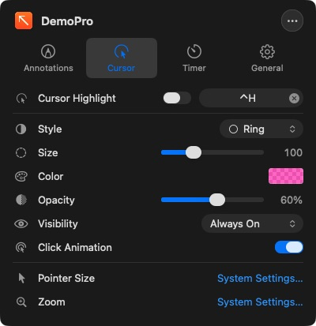
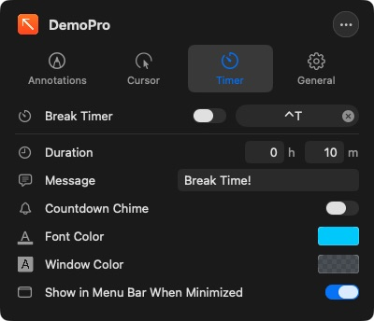
The app we are studying
CODEX & COFFEE
DAY 13 · 2
Notes:
DAY 13 · The app we are studying
0.5–1.5 minutes (1 minutes)
SAY
DemoPro is the installed Mac annotation tool. Point out drawing, cursor and timer settings. These are actual captured app windows. The goal is to understand both what the controls look like and what they do.
SHOW / DO
Open the three settings captures. Ask which features people recognize from a presentation tool.
CHECK
Identify drawing, cursor highlighting and the break timer.
SOURCE
https://www.demoproapp.com/faq.html

Slide 3

Inspect appearance, behavior and code
CODEX & COFFEE
DAY 13 · 3
Notes:
DAY 13 · Inspect appearance, behavior and code
1.5–2.25 minutes (0.75 minutes)
SAY
The interface is the visible part of a program. The behavior includes its response to input, the modes it remembers and what happens when we change state. An independent implementation needs a clear description of those interactions.
SHOW / DO
Point to the window, the interaction layer and the internals in the illustration. Ask what a screenshot alone can establish.
CHECK
Learners name a visible fact and a behavior that needs an interaction.
SOURCE
https://learn.chatgpt.com/docs/prompting

Slide 4
The investigation and rebuild
Observe
Specify
Plan
Build
Compare
CODEX & COFFEE
DAY 13 · 4
Notes:
DAY 13 · The investigation and rebuild
2.25–3.25 minutes (1 minutes)
SAY
Follow the same loop throughout the lesson. Observe the app, save a specification, make a plan, build in stages and compare. When a check fails, return to the evidence and refine the implementation.
SHOW / DO
Trace the five steps. Explain that a failed comparison sends us back to the specification.
CHECK
The group can place a screenshot, a plan and a test result in the sequence.
SOURCE
https://learn.chatgpt.com/docs/prompting

Slide 5

Observe the original
CODEX & COFFEE
DAY 13 · 5
Notes:
DAY 13 · Observe the original
3.25–3.5 minutes (0.25 minutes)
SAY
Start by making the target explicit. We are studying DemoPro 4.1 on this Mac, and recording the specific screens and behaviors we can inspect.
SHOW / DO
Show the visual, explain the relationship, and use the stated observation or example.
CHECK
Ask the group to identify the input, action and observable result.
SOURCE
https://learn.chatgpt.com/docs/prompting

Slide 6
Read the controls closely
Activation · Colours · Width
CODEX & COFFEE
DAY 13 · 6
Notes:
DAY 13 · Read the controls closely
3.5–4.75 minutes (1.25 minutes)
SAY
A full screen capture preserves context. A close view makes the important controls readable. In this pane, inspect how a tool activates, the available colors, the width value and the command that clears the screen. A label alone does not establish what happens when it is used.
SHOW / DO
Point to the full pane, then the enlarged activation and width controls. Keep the source capture visible.
CHECK
Identify the activation choice, width setting and drawing tools.
SOURCE
https://learn.chatgpt.com/docs/prompting

Slide 7
The same tool has different states
Press & Hold
Hold key → draw → release
Toggle
Press key → draw → press again
CODEX & COFFEE
DAY 13 · 7
Notes:
DAY 13 · The same tool has different states
4.75–6 minutes (1.25 minutes)
SAY
The distinction between holding and toggling a key changes the interaction. In hold mode, releasing ends drawing. In toggle mode, another press ends drawing. The app underneath must receive input again at the correct time.
SHOW / DO
Mime holding a key and releasing it, then pressing once and pressing again. Describe these as documented modes.
CHECK
Ask when the app underneath should regain the pointer.
SOURCE
https://www.demoproapp.com/faq.html

Slide 8
Ask Codex to inspect the app · 1 of 2
TRY THIS IN CODEX
Use Computer Use to inspect DemoPro on this Mac. Go through every settings tab, menu, drawing tool and visible mode. Capture clean screenshots. For each feature, record how I start it, what changes on screen, and how I exit it. Try the main drawing actions on a harmless sample screen.
CODEX & COFFEE
DAY 13 · 8
Notes:
DAY 13 · Ask Codex to inspect the app · 1 of 2
6–6.75 minutes (0.75 minutes)
SAY
This is a teaching prompt for the next interaction. Its wording is supplied for reuse. The test report identifies which underlying actions were actually completed.
SHOW / DO
Read this prompt on screen. The complete copyable version is in the learner kit and the HTML viewer.
CHECK
Point out the requested outcome, the evidence to collect and the proposed check.
SOURCE
https://learn.chatgpt.com/docs/prompting
FULL PROMPT
Use Computer Use to inspect DemoPro on this Mac. Go through every settings tab, menu, drawing tool and visible mode. Capture clean screenshots. For each feature, record how I start it, what changes on screen, and how I exit it. Try the main drawing actions on a harmless sample screen. Pay attention to spacing, colours, line widths, shortcuts, and switching back to the application underneath. Separate what you observed from anything you inferred. Save an illustrated feature inventory and a list of anything you could not test.

Slide 9
Ask Codex to inspect the app · 2 of 2
TRY THIS IN CODEX
Pay attention to spacing, colours, line widths, shortcuts, and switching back to the application underneath. Separate what you observed from anything you inferred. Save an illustrated feature inventory and a list of anything you could not test.
CODEX & COFFEE
DAY 13 · 9
Notes:
DAY 13 · Ask Codex to inspect the app · 2 of 2
6.75–7.5 minutes (0.75 minutes)
SAY
This is a teaching prompt for the next interaction. Its wording is supplied for reuse. The test report identifies which underlying actions were actually completed.
SHOW / DO
Read this prompt on screen. The complete copyable version is in the learner kit and the HTML viewer.
CHECK
Point out the requested outcome, the evidence to collect and the proposed check.
SOURCE
https://learn.chatgpt.com/docs/prompting
FULL PROMPT
Use Computer Use to inspect DemoPro on this Mac. Go through every settings tab, menu, drawing tool and visible mode. Capture clean screenshots. For each feature, record how I start it, what changes on screen, and how I exit it. Try the main drawing actions on a harmless sample screen. Pay attention to spacing, colours, line widths, shortcuts, and switching back to the application underneath. Separate what you observed from anything you inferred. Save an illustrated feature inventory and a list of anything you could not test.

Slide 10
The feature inventory
Part | What to record
Drawing | Tools, colours, line width, undo and clear
Interaction | Activation, exit, keyboard shortcuts
Presentation | Cursor highlight, board and timer
Appearance | Spacing, sizes and selected states
CODEX & COFFEE
DAY 13 · 10
Notes:
DAY 13 · The feature inventory
7.5–8.5 minutes (1 minutes)
SAY
An inventory groups visible controls into behavior we can check. It also records uncertainty instead of inventing details about the internals.
SHOW / DO
Use one row to turn a control into an observation to collect. Record unknown behavior as untested.
CHECK
Each proposed requirement has a visible action or result.
SOURCE
https://www.demoproapp.com/faq.html

Slide 11
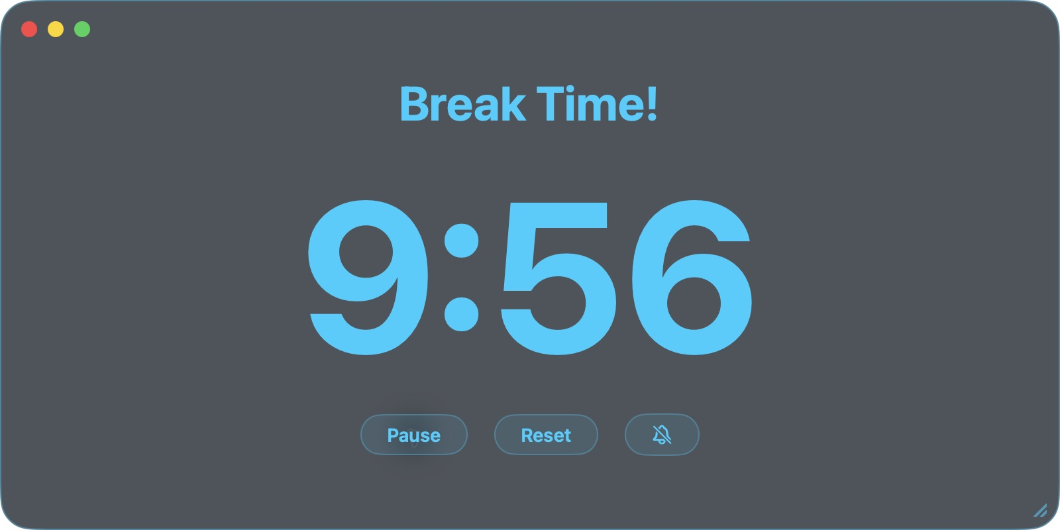
One action, one visible result
CODEX & COFFEE
DAY 13 · 11
Notes:
DAY 13 · One action, one visible result
8.5–9.75 minutes (1.25 minutes)
SAY
Use the original timer as a verified example. Starting it changed the display from 10:00 to 9:56. Pause stopped the countdown and reset restored the configured duration. The drawing hotkeys could not be activated through our current Computer Use route, so that interaction remains unverified.
SHOW / DO
Show the captured 9:56 timer, then explain the recorded start, pause and reset checks.
CHECK
The changed time is evidence of a running timer. Drawing activation remains unverified.
SOURCE
https://learn.chatgpt.com/docs/prompting

Slide 12
Turn behavior into repeatable checks
TRY THIS IN CODEX
Watch what happens when I enter drawing mode, draw an arrow, return to the app underneath, and clear the arrow. Repeat using the other activation mode. Write down each starting state, action and visible result. Turn those observations into checks we can repeat on our own app.
CODEX & COFFEE
DAY 13 · 12
Notes:
DAY 13 · Turn behavior into repeatable checks
9.75–10.75 minutes (1 minutes)
SAY
This is a teaching prompt for the next interaction. Its wording is supplied for reuse. The test report identifies which underlying actions were actually completed.
SHOW / DO
Read this prompt on screen. The complete copyable version is in the learner kit and the HTML viewer.
CHECK
Point out the requested outcome, the evidence to collect and the proposed check.
SOURCE
https://learn.chatgpt.com/docs/prompting
FULL PROMPT
Watch what happens when I enter drawing mode, draw an arrow, return to the app underneath, and clear the arrow. Repeat using the other activation mode. Write down each starting state, action and visible result. Turn those observations into checks we can repeat on our own app.

Slide 13
Choose the inspection tools
CODEX & COFFEE
DAY 13 · 13
Notes:
DAY 13 · Choose the inspection tools
10.75–11 minutes (0.25 minutes)
SAY
Some questions are answered by operating the interface. Others require files, package metadata or code analysis. Choose the tool for the fact you need.
SHOW / DO
Show the visual, explain the relationship, and use the stated observation or example.
CHECK
Ask the group to identify the input, action and observable result.
SOURCE
https://learn.chatgpt.com/docs/prompting

Slide 14
How Computer Use inspects an app
Read screen
Choose action
Click or type
Observe again
CODEX & COFFEE
DAY 13 · 14
Notes:
DAY 13 · How Computer Use inspects an app
11–12.25 minutes (1.25 minutes)
SAY
Codex reads the app state and screenshot, chooses an action, then observes the result. Repeating this loop provides an interaction record. The operating system and the app permissions determine what it can control.
SHOW / DO
Walk around the four boxes once with the example of pressing Start on the timer.
CHECK
Ask what Codex must observe after the click.
SOURCE
https://learn.chatgpt.com/docs/computer-use

Slide 15
REA connects Codex to analysis tools
Reverse Engineer Anything
Codex
REA
Analysis tools
MCP tools return evidence to the agent
CODEX & COFFEE
DAY 13 · 15
Notes:
DAY 13 · REA connects Codex to analysis tools
12.25–13.5 minutes (1.25 minutes)
SAY
REA is an MCP server and command-line tool. It connects the coding agent to inspection engines and returns evidence. MCP is the interface that lets the agent request a named tool and read its result.
SHOW / DO
Expand MCP as Model Context Protocol. Trace a request through REA and the result back to Codex.
CHECK
Learners identify REA as the connection to inspection tools.
SOURCE
https://github.com/morluto/rea

Slide 16
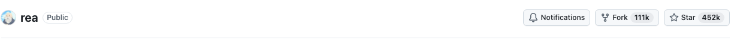
Why REA attracted attention
Familiar coding-agent interface
451,542
Many kinds of software
GitHub stars · 11 November 2026
Demonstrations with visible results
Possible reasons for interest
CODEX & COFFEE
DAY 13 · 16
Notes:
DAY 13 · Why REA attracted attention
13.5–14.75 minutes (1.25 minutes)
SAY
The GitHub API snapshot records 451,542 stars on 11 November 2026. Star counts measure repository attention. Our explanation of appeal is an interpretation of the documented features: a familiar coding-agent interface, many target types and runnable examples. We do not have causal analytics proving which feature drove growth.
SHOW / DO
Show the dated star count and describe the three possible reasons. Separate the measured count from the explanation.
CHECK
The repository count is sourced; the popularity explanation is an interpretation.
SOURCE
https://github.com/morluto/rea

Slide 17
Match the tool to the question
Question | Tool
What happens when I click? | Computer Use
What files and frameworks are present? | REA package inspection
What does compiled code do? | Hopper, Ghidra, IDA or Kuna
What happens while it runs? | Runtime tracing and captured events
CODEX & COFFEE
DAY 13 · 17
Notes:
DAY 13 · Match the tool to the question
14.75–16.25 minutes (1.5 minutes)
SAY
Read the questions first. Computer Use supplies interaction evidence. Static app inspection supplies metadata and files. Disassemblers and decompilers read native machine code. Runtime tools reveal selected live behavior. Each answers a different question.
SHOW / DO
Ask the class to choose a tool for a hidden calculation rule, then for a button whose behavior is unclear.
CHECK
Match internal-code questions to analysis tools and visible-interaction questions to Computer Use.
SOURCE
https://github.com/morluto/rea/blob/main/docs/reverse-engineering-tools.md

Slide 18
What sits inside the application
App folder
Runnable program
Mac system libraries
CODEX & COFFEE
DAY 13 · 18
Notes:
DAY 13 · What sits inside the application
16.25–17.25 minutes (1 minutes)
SAY
An app bundle contains the executable and its supporting resources. The executable links to system frameworks. REA can inspect these declarations before any deeper code analysis.
SHOW / DO
Show the visual, explain the relationship, and use the stated observation or example.
CHECK
Ask the group to identify the input, action and observable result.
SOURCE
Local REA metadata inspection

Slide 19
Reading compiled code
Machine instructions
Code analysis
Approximate code
Check the behavior
CODEX & COFFEE
DAY 13 · 19
Notes:
DAY 13 · Reading compiled code
17.25–18.5 minutes (1.25 minutes)
SAY
An executable contains machine instructions. A disassembler exposes those instructions. A decompiler proposes a code-like representation. The agent uses calls, strings and observed results to interpret what it finds. The reconstructed explanation must still be checked.
SHOW / DO
Show the visual, explain the relationship, and use the stated observation or example.
CHECK
Ask the group to identify the input, action and observable result.
SOURCE
https://github.com/morluto/rea/blob/main/docs/guides/native/native-investigation.md

Slide 20
REA’s published Calculator example
After addition
After multiplication
200 + 10% = 220
200 × 10% = 20
10% of the first number
10% becomes 0.1
CODEX & COFFEE
DAY 13 · 20
Notes:
DAY 13 · REA’s published Calculator example
18.5–19.5 minutes (1 minutes)
SAY
REA’s published Calculator case study traced the percentage handler. After addition, the percentage is taken from the first number. After multiplication, it converts the current number to a fraction. This is the project author’s published example, not a run we performed in this lesson.
SHOW / DO
Show the visual, explain the relationship, and use the stated observation or example.
CHECK
Ask the group to identify the input, action and observable result.
SOURCE
https://rea.tools/#calculator

Slide 21
Trace the rule, then test it
Choose the action
Read its handler
Follow the branch
Check the result
CODEX & COFFEE
DAY 13 · 21
Notes:
DAY 13 · Trace the rule, then test it
19.5–20.5 minutes (1 minutes)
SAY
The published investigation follows the operator branch, names the values and checks the reconstructed result. Reading code becomes useful when it resolves a specific behavior question.
SHOW / DO
Show the visual, explain the relationship, and use the stated observation or example.
CHECK
Ask the group to identify the input, action and observable result.
SOURCE
https://rea.tools/#calculator

Slide 22
What REA found in DemoPro
Observed fact | Result
Installed version | 4.1 · build 18
Processors in the executable | Apple Silicon and Intel
Native frameworks | AppKit, SwiftUI, CoreGraphics
Compiled interface archives | None found by the archive probe
CODEX & COFFEE
DAY 13 · 22
Notes:
DAY 13 · What REA found in DemoPro
20.5–21.75 minutes (1.25 minutes)
SAY
These facts came from actual local REA inspection commands. Mach-O is the executable format used by this Mac application. The package declares version 4.1. Native dependency inspection finds the listed frameworks. This tells us about packaging and dependencies, not every internal function.
SHOW / DO
Open the saved metadata results if anyone wants to see the raw output. Point to version, processors and frameworks.
CHECK
The facts match the saved local REA results.
SOURCE
Local REA inspect-macho, inspect-plist and decode-interface-builder results in production/research

Slide 23
A missing engine limits deeper analysis
Worked
App metadata and framework inspection
Unavailable
Native decompiler provider
Continue with
Observed screens and behavior
CODEX & COFFEE
DAY 13 · 23
Notes:
DAY 13 · A missing engine limits deeper analysis
21.75–22.5 minutes (0.75 minutes)
SAY
Our basic metadata inspections worked. The deeper inspect request reported that Ghidra, Hopper and IDA were unavailable. Keep that limit visible. We can still build from observed behavior, while internal function analysis remains unverified.
SHOW / DO
Show the three statuses. Explain that this exercise continued using observed behavior and metadata.
CHECK
Do not describe an internal DemoPro function as recovered.
SOURCE
Local REA inspect result and doctor diagnostics

Slide 24
Ask REA a focused question
TRY THIS IN CODEX
Use REA to inspect DemoPro on this Mac. Tell me its version, supported processor types and native frameworks. Show which tool returned each fact. Then check whether deeper native-code analysis is available. If a required engine is missing, explain exactly what remains unknown. Save the findings so we can use them in a rebuild plan.
CODEX & COFFEE
DAY 13 · 24
Notes:
DAY 13 · Ask REA a focused question
22.5–23.25 minutes (0.75 minutes)
SAY
This is a teaching prompt for the next interaction. Its wording is supplied for reuse. The test report identifies which underlying actions were actually completed.
SHOW / DO
Read this prompt on screen. The complete copyable version is in the learner kit and the HTML viewer.
CHECK
Point out the requested outcome, the evidence to collect and the proposed check.
SOURCE
https://learn.chatgpt.com/docs/prompting
FULL PROMPT
Use REA to inspect DemoPro on this Mac. Tell me its version, supported processor types and native frameworks. Show which tool returned each fact. Then check whether deeper native-code analysis is available. If a required engine is missing, explain exactly what remains unknown. Save the findings so we can use them in a rebuild plan.

Slide 25

Write the plan
CODEX & COFFEE
DAY 13 · 25
Notes:
DAY 13 · Write the plan
23.25–23.5 minutes (0.25 minutes)
SAY
The next prompt converts recorded evidence into an implementable plan. We save that plan so the build has explicit behavior and checks.
SHOW / DO
Show the visual, explain the relationship, and use the stated observation or example.
CHECK
Ask the group to identify the input, action and observable result.
SOURCE
https://learn.chatgpt.com/docs/prompting

Slide 26
Turn observations into a specification
Observed behavior | Check for our app
Return to the app below | Underlying button responds
Undo removes one drawing | Earlier drawing remains
Clear removes the drawing set | Canvas is empty
Timer counts down | Displayed time decreases
CODEX & COFFEE
DAY 13 · 26
Notes:
DAY 13 · Turn observations into a specification
23.5–24.75 minutes (1.25 minutes)
SAY
Translate each observation into a requirement and a test. This is where vague imitation becomes a small engineering task. The example rows describe interaction outcomes rather than an internal implementation we cannot see.
SHOW / DO
Pick the timer row. Ask what evidence would prove it works and what the reset action should show.
CHECK
A requirement names a repeatable result.
SOURCE
https://www.demoproapp.com/faq.html

Slide 27
Ask for a plan before code · 1 of 2
USED IN THE EXERCISE CHAT
Use the DemoPro observations to plan a small Mac app I can use during a presentation. List the screens, drawing modes, keyboard controls and saved settings. Explain what each part will do in plain English. Build in stages so I can try drawing first, then switching back to the app underneath, then shapes and the timer.
CODEX & COFFEE
DAY 13 · 27
Notes:
DAY 13 · Ask for a plan before code · 1 of 2
24.75–25.5 minutes (0.75 minutes)
SAY
This exact prompt was sent to the prepared exercise chat. Open the saved prompt and resulting plan or build record after reading it.
SHOW / DO
Read this prompt on screen. The complete copyable version is in the learner kit and the HTML viewer.
CHECK
Compare the request with the saved result in the exercise chat.
SOURCE
https://learn.chatgpt.com/docs/prompting
FULL PROMPT
Use the DemoPro observations to plan a small Mac app I can use during a presentation. List the screens, drawing modes, keyboard controls and saved settings. Explain what each part will do in plain English. Build in stages so I can try drawing first, then switching back to the app underneath, then shapes and the timer. For every stage, say how we will check that it works. Show which parts of the plan are supported by observations and which are design choices. Save the plan before writing the application.

Slide 28
Ask for a plan before code · 2 of 2
USED IN THE EXERCISE CHAT
For every stage, say how we will check that it works. Show which parts of the plan are supported by observations and which are design choices. Save the plan before writing the application.
CODEX & COFFEE
DAY 13 · 28
Notes:
DAY 13 · Ask for a plan before code · 2 of 2
25.5–26.25 minutes (0.75 minutes)
SAY
This exact prompt was sent to the prepared exercise chat. Open the saved prompt and resulting plan or build record after reading it.
SHOW / DO
Read this prompt on screen. The complete copyable version is in the learner kit and the HTML viewer.
CHECK
Compare the request with the saved result in the exercise chat.
SOURCE
https://learn.chatgpt.com/docs/prompting
FULL PROMPT
Use the DemoPro observations to plan a small Mac app I can use during a presentation. List the screens, drawing modes, keyboard controls and saved settings. Explain what each part will do in plain English. Build in stages so I can try drawing first, then switching back to the app underneath, then shapes and the timer. For every stage, say how we will check that it works. Show which parts of the plan are supported by observations and which are design choices. Save the plan before writing the application.

Slide 29
The saved build plan
Drawing layer
Input modes
Tools and styles
Boards and timer
Run and check the app after each stage
CODEX & COFFEE
DAY 13 · 29
Notes:
DAY 13 · The saved build plan
26.25–27.75 minutes (1.5 minutes)
SAY
Walk through the actual plan produced in the exercise chat. Each stage leaves a running program and has a check. Explain any design decision that differs from the original and point to the evidence it uses.
SHOW / DO
Open BUILD-PLAN.md in the prepared exercise chat. Walk through the four stages and their checks.
CHECK
The plan exists before the build source in the exercise record.
SOURCE
https://learn.chatgpt.com/docs/prompting

Slide 30
Keep a working version at each stage
Working stage
One change
Run the check
Save the result
CODEX & COFFEE
DAY 13 · 30
Notes:
DAY 13 · Keep a working version at each stage
27.75–28.75 minutes (1 minutes)
SAY
A saved working stage lets you compare and return if the next change fails. Use a local commit or the project’s normal checkpoint process. The practical point is knowing which version produced which observed result.
SHOW / DO
Show the checkpoints folder from the exercise. Explain which build corresponds to which test.
CHECK
A reported result can be linked to a saved stage.
SOURCE
https://learn.chatgpt.com/docs/prompting

Slide 31

Build and inspect
CODEX & COFFEE
DAY 13 · 31
Notes:
DAY 13 · Build and inspect
28.75–29 minutes (0.25 minutes)
SAY
Move from the plan to the small app. The exercise uses an independent Mac implementation and checks each stage through its normal controls.
SHOW / DO
Show the visual, explain the relationship, and use the stated observation or example.
CHECK
Ask the group to identify the input, action and observable result.
SOURCE
https://learn.chatgpt.com/docs/prompting

Slide 32
Ask Codex to build in stages · 1 of 2
USED IN THE EXERCISE CHAT
Build a Mac application from the observed specification and saved plan. Give it its own name and use original code and artwork. Start with a transparent drawing layer and a clear way to switch between drawing and using the app underneath. Then add the observed pen, shapes, colours, undo and clear controls.
CODEX & COFFEE
DAY 13 · 32
Notes:
DAY 13 · Ask Codex to build in stages · 1 of 2
29–29.75 minutes (0.75 minutes)
SAY
This exact prompt was sent to the prepared exercise chat. Open the saved prompt and resulting plan or build record after reading it.
SHOW / DO
Read this prompt on screen. The complete copyable version is in the learner kit and the HTML viewer.
CHECK
Compare the request with the saved result in the exercise chat.
SOURCE
https://learn.chatgpt.com/docs/prompting
FULL PROMPT
Build a Mac application from the observed specification and saved plan. Give it its own name and use original code and artwork. Start with a transparent drawing layer and a clear way to switch between drawing and using the app underneath. Then add the observed pen, shapes, colours, undo and clear controls. Add the board and timer in separate stages. Keep each working stage so we can compare it with the next. After each stage, launch the app and test the actual behavior. Keep a record of what works, what failed and what remains incomplete.

Slide 33
Ask Codex to build in stages · 2 of 2
USED IN THE EXERCISE CHAT
Add the board and timer in separate stages. Keep each working stage so we can compare it with the next. After each stage, launch the app and test the actual behavior. Keep a record of what works, what failed and what remains incomplete.
CODEX & COFFEE
DAY 13 · 33
Notes:
DAY 13 · Ask Codex to build in stages · 2 of 2
29.75–30.5 minutes (0.75 minutes)
SAY
This exact prompt was sent to the prepared exercise chat. Open the saved prompt and resulting plan or build record after reading it.
SHOW / DO
Read this prompt on screen. The complete copyable version is in the learner kit and the HTML viewer.
CHECK
Compare the request with the saved result in the exercise chat.
SOURCE
https://learn.chatgpt.com/docs/prompting
FULL PROMPT
Build a Mac application from the observed specification and saved plan. Give it its own name and use original code and artwork. Start with a transparent drawing layer and a clear way to switch between drawing and using the app underneath. Then add the observed pen, shapes, colours, undo and clear controls. Add the board and timer in separate stages. Keep each working stage so we can compare it with the next. After each stage, launch the app and test the actual behavior. Keep a record of what works, what failed and what remains incomplete.

Slide 34
How our drawing layer works
Our drawing layer
Drawing
receives input
Pointer mode
passes input through
The app you are using
CODEX & COFFEE
DAY 13 · 34
Notes:
DAY 13 · How our drawing layer works
30.5–31.75 minutes (1.25 minutes)
SAY
A transparent window sits above the content. In drawing mode it receives pointer input and stores the drawing. In pointer mode the underlying app receives input. The design needs to handle the switch without losing or trapping the pointer.
SHOW / DO
Show the visual, explain the relationship, and use the stated observation or example.
CHECK
Ask the group to identify the input, action and observable result.
SOURCE
Independent implementation design from the saved plan; original activation controls were inspected

Slide 35
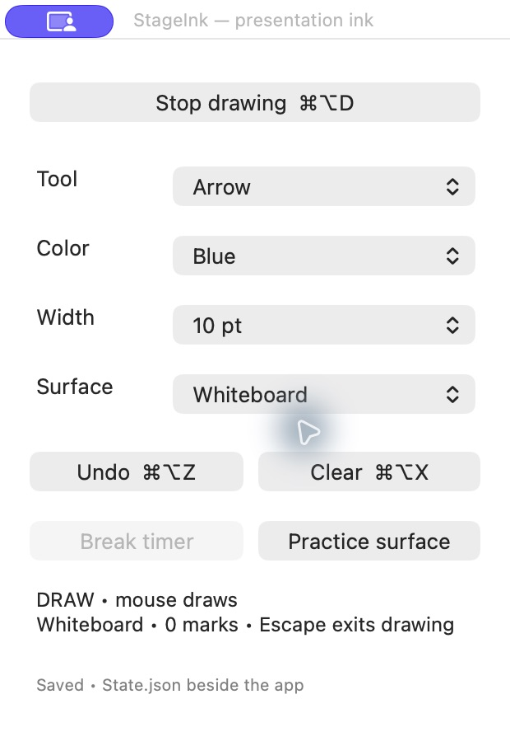
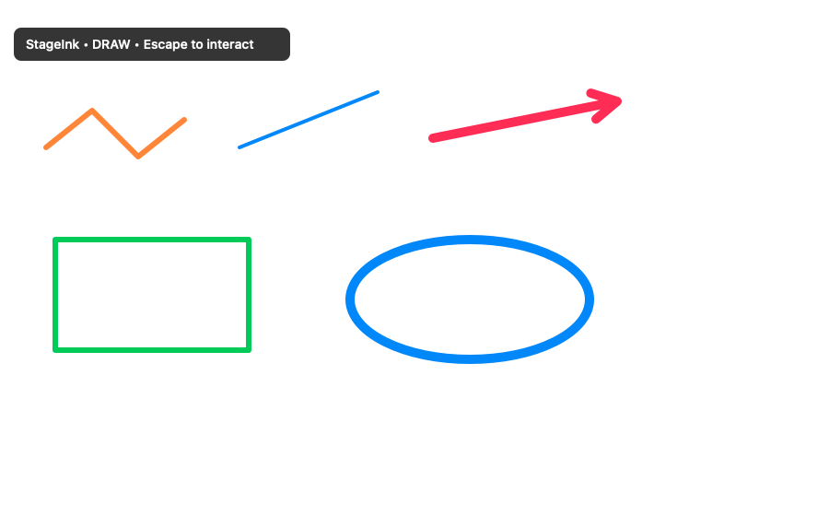
The app and its drawing components
App controls
Drawing component test
CODEX & COFFEE
DAY 13 · 35
Notes:
DAY 13 · The app and its drawing components
31.75–33.25 minutes (1.5 minutes)
SAY
The left image is the actual StageInk palette. The right image was rendered by a component test using the production drawing code. Twenty focused checks passed for drawing data, rendering, undo, clear, persistence and timer logic. Desktop mouse delivery remains unverified through Computer Use.
SHOW / DO
Open StageInk from the rebuild folder or show the final capture. Use only the actions marked verified in the results.
CHECK
The app is launched and the named visible control changes are supported by evidence.
SOURCE
https://learn.chatgpt.com/docs/prompting

Slide 36
When the test cannot reach the canvas
Expected
Dragging creates a visible mark
Observed
Computer Use could not reach the canvas
Next check
Draw directly on the Mac
CODEX & COFFEE
DAY 13 · 36
Notes:
DAY 13 · When the test cannot reach the canvas
33.25–34.75 minutes (1.5 minutes)
SAY
Use a recorded issue or explicit comparison gap from the exercise. State the expected result, the observed result, and the next check. If no reproducible defect remains, use the documented limitation and show why it remains unverified.
SHOW / DO
Read the expected input and the observed tool error. Explain why a failed input delivery cannot prove whether drawing logic works.
CHECK
Separate the input-routing limitation from a demonstrated application defect.
SOURCE
https://learn.chatgpt.com/docs/prompting

Slide 37
Ask for a focused correction
TRY THIS IN CODEX
Reproduce the problem using the same screen and actions. Explain which behavior differs from the specification. Fix the cause, then repeat that check and the nearby drawing controls. Show the result and tell me what still needs testing.
CODEX & COFFEE
DAY 13 · 37
Notes:
DAY 13 · Ask for a focused correction
34.75–35.5 minutes (0.75 minutes)
SAY
This is a teaching prompt for the next interaction. Its wording is supplied for reuse. The test report identifies which underlying actions were actually completed.
SHOW / DO
Read this prompt on screen. The complete copyable version is in the learner kit and the HTML viewer.
CHECK
Point out the requested outcome, the evidence to collect and the proposed check.
SOURCE
https://learn.chatgpt.com/docs/prompting
FULL PROMPT
Reproduce the problem using the same screen and actions. Explain which behavior differs from the specification. Fix the cause, then repeat that check and the nearby drawing controls. Show the result and tell me what still needs testing.

Slide 38
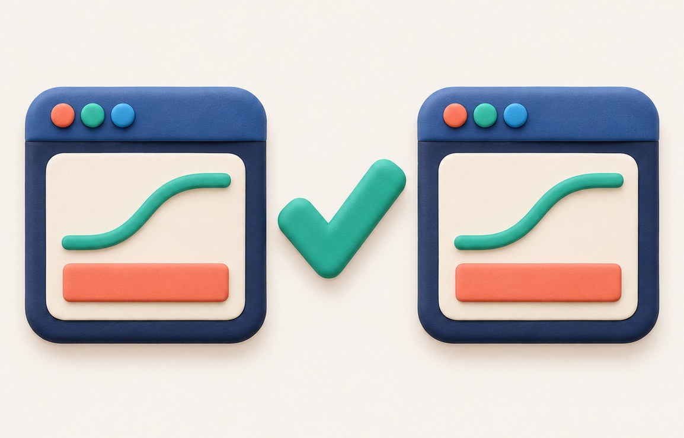
Compare the results
CODEX & COFFEE
DAY 13 · 38
Notes:
DAY 13 · Compare the results
35.5–35.75 minutes (0.25 minutes)
SAY
Use the same starting screen and input sequence on both programs. Then compare appearance and behavior separately.
SHOW / DO
Show the visual, explain the relationship, and use the stated observation or example.
CHECK
Ask the group to identify the input, action and observable result.
SOURCE
https://learn.chatgpt.com/docs/prompting

Slide 39
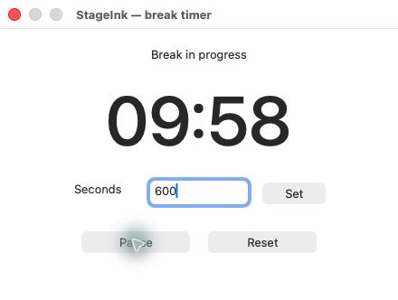
Compare the same timer actions
DemoPro
Our app
CODEX & COFFEE
DAY 13 · 39
Notes:
DAY 13 · Compare the same timer actions
35.75–37.25 minutes (1.5 minutes)
SAY
Compare the original and rebuilt timer. Use the same duration and check start, pause and reset. A countdown provides a visible behavior comparison. Desktop drawing needs its own input check; the timer result does not establish drawing equivalence.
SHOW / DO
Show both captured timers. Compare start, pause and reset using the verification record.
CHECK
A matching time display alone is insufficient; inspect the sequence of actions.
SOURCE
https://learn.chatgpt.com/docs/prompting

Slide 40
Ask for an evidence-based review · 1 of 2
USED IN THE EXERCISE CHAT
Launch each working stage and test it through its normal visible controls. Verify drawing, switching to the underlying harmless fixture, every shape, colors, width, undo, clear, whiteboard, blackboard and the break timer. Record exact passes, failures and untested behavior.
CODEX & COFFEE
DAY 13 · 40
Notes:
DAY 13 · Ask for an evidence-based review · 1 of 2
37.25–38 minutes (0.75 minutes)
SAY
This exact prompt was sent to the prepared exercise chat. Open the saved prompt and resulting plan or build record after reading it.
SHOW / DO
Read this prompt on screen. The complete copyable version is in the learner kit and the HTML viewer.
CHECK
Compare the request with the saved result in the exercise chat.
SOURCE
https://learn.chatgpt.com/docs/prompting
FULL PROMPT
Launch each working stage and test it through its normal visible controls. Verify drawing, switching to the underlying harmless fixture, every shape, colors, width, undo, clear, whiteboard, blackboard and the break timer. Record exact passes, failures and untested behavior. If Computer Use cannot deliver input to a window, retain the exact error and run separately labeled tests of the actual event handlers and saved data. Do not mark those tests as end-to-end UI passes. Package the runnable app, editable source and evidence.

Slide 41
Ask for an evidence-based review · 2 of 2
USED IN THE EXERCISE CHAT
If Computer Use cannot deliver input to a window, retain the exact error and run separately labeled tests of the actual event handlers and saved data. Do not mark those tests as end-to-end UI passes. Package the runnable app, editable source and evidence.
CODEX & COFFEE
DAY 13 · 41
Notes:
DAY 13 · Ask for an evidence-based review · 2 of 2
38–38.75 minutes (0.75 minutes)
SAY
This exact prompt was sent to the prepared exercise chat. Open the saved prompt and resulting plan or build record after reading it.
SHOW / DO
Read this prompt on screen. The complete copyable version is in the learner kit and the HTML viewer.
CHECK
Compare the request with the saved result in the exercise chat.
SOURCE
https://learn.chatgpt.com/docs/prompting
FULL PROMPT
Launch each working stage and test it through its normal visible controls. Verify drawing, switching to the underlying harmless fixture, every shape, colors, width, undo, clear, whiteboard, blackboard and the break timer. Record exact passes, failures and untested behavior. If Computer Use cannot deliver input to a window, retain the exact error and run separately labeled tests of the actual event handlers and saved data. Do not mark those tests as end-to-end UI passes. Package the runnable app, editable source and evidence.

Slide 42
What the actual checks show
Check | Observed result
Original timer | Start, pause and reset observed
Rebuilt controls | Mode and board choices observed
Drawing components | 20 focused checks passed
Rebuilt timer | Start, pause, reset and finish observed
Desktop drawing input | Direct mouse check still needed
CODEX & COFFEE
DAY 13 · 42
Notes:
DAY 13 · What the actual checks show
38.75–40.25 minutes (1.5 minutes)
SAY
Read the actual verification record. A pass needs a matching visible or recorded result. A failure needs reproduction steps. An untested item stays explicit until the required environment or interaction is available.
SHOW / DO
Read the final test table. Explain the difference between a component check and an end-to-end desktop interaction.
CHECK
Every pass, failure and untested item has supporting evidence.
SOURCE
Actual exercise verification report

Slide 43
Make one deliberate improvement
TRY THIS IN CODEX
Add an option that fades a drawing after five seconds. Keep the existing manual clear option. Test a single drawing, several drawings made at different times, and leaving drawing mode while a fade is pending. Show the result before calling it complete.
CODEX & COFFEE
DAY 13 · 43
Notes:
DAY 13 · Make one deliberate improvement
40.25–41.25 minutes (1 minutes)
SAY
This is a teaching prompt for the next interaction. Its wording is supplied for reuse. The test report identifies which underlying actions were actually completed.
SHOW / DO
Read this prompt on screen. The complete copyable version is in the learner kit and the HTML viewer.
CHECK
Point out the requested outcome, the evidence to collect and the proposed check.
SOURCE
https://learn.chatgpt.com/docs/prompting
FULL PROMPT
Add an option that fades a drawing after five seconds. Keep the existing manual clear option. Test a single drawing, several drawings made at different times, and leaving drawing mode while a fade is pending. Show the result before calling it complete.

Slide 44
Choose your next application
The application
One feature
Evidence to collect
The first check
CODEX & COFFEE
DAY 13 · 44
Notes:
DAY 13 · Choose your next application
41.25–44.25 minutes (3 minutes)
SAY
Give the group three minutes to choose one app and one feature. Ask them to write the action, expected result, useful reference screen and first check. In a quiet room, use a simple screenshot-cropping tool as the worked example and speak through the four decisions.
SHOW / DO
Give people three minutes to choose an app and one feature. In a quiet room, work through a screenshot-cropping tool using the four fields.
CHECK
Each learner has a feature, a source of evidence and a repeatable first check.
SOURCE
https://learn.chatgpt.com/docs/prompting

Slide 45

Keep the evidence with the build
Observations
Specification
Plan
Working app
Checks
CODEX & COFFEE
DAY 13 · 45
Notes:
DAY 13 · Keep the evidence with the build
44.25–45 minutes (0.75 minutes)
SAY
Finish with the recorded observation, specification, plan, source and checks. The learner kit keeps the pieces together so people can repeat the method on their own Mac.
SHOW / DO
Show the learner kit and the prepared exercise chat. Point to the prompts, plan, source and test report.
CHECK
Learners know where to start and where to find the observed limits.
SOURCE
https://learn.chatgpt.com/docs/prompting

