Slide 1

O’REILLY LIVE
Codex
& Coffee
Mark Kashef
DAY 12
Your personal assistant, in Codex and beyond
Notes:
DAY 12 · Your personal assistant, in Codex and beyond
0–0.5 minutes (0.5 minutes)
SAY
Today is about two ways to get an assistant that works for you: use the features already in Codex, or build your own interface with Codex underneath.
DO
Use the prepared visual. No live typing is required.
CHECK
Ask learners to explain the relationship in their own words.
SOURCE
https://learn.chatgpt.com/docs/

Slide 2

The question behind this lesson
“How can we make Claude or Codex work for us … with tasks that run in the background without interference?”
CODEX & COFFEE
DAY 12 · 2
Notes:
DAY 12 · The question behind this lesson
0.5–1.5 minutes (1 minutes)
SAY
The request was for background work that does not require supervising every step. We will use that as the test for both approaches. The target is not a clever answer once. It is a repeatable job that starts when needed, has the right information, and leaves a result you can inspect. Keep those three questions in mind throughout the lesson.
DO
Point to background work in the quoted request. Ask everyone to think of one job they would like handled while away from their desk.
CHECK
The goal is a repeatable job with a reviewable result.
SOURCE
Learner question supplied by Mark; excerpt with omission marked

Slide 3
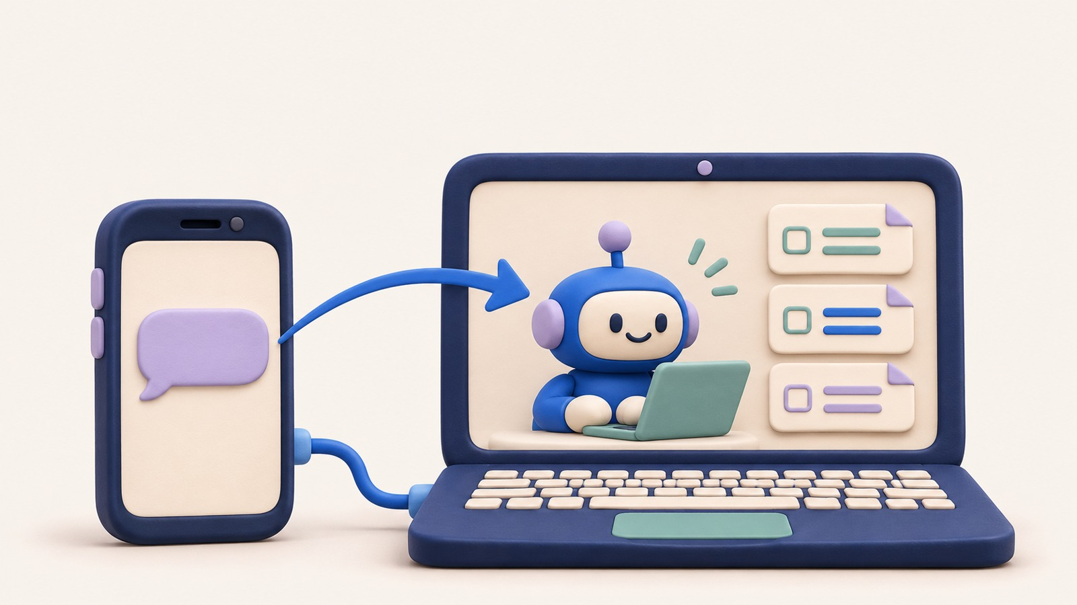
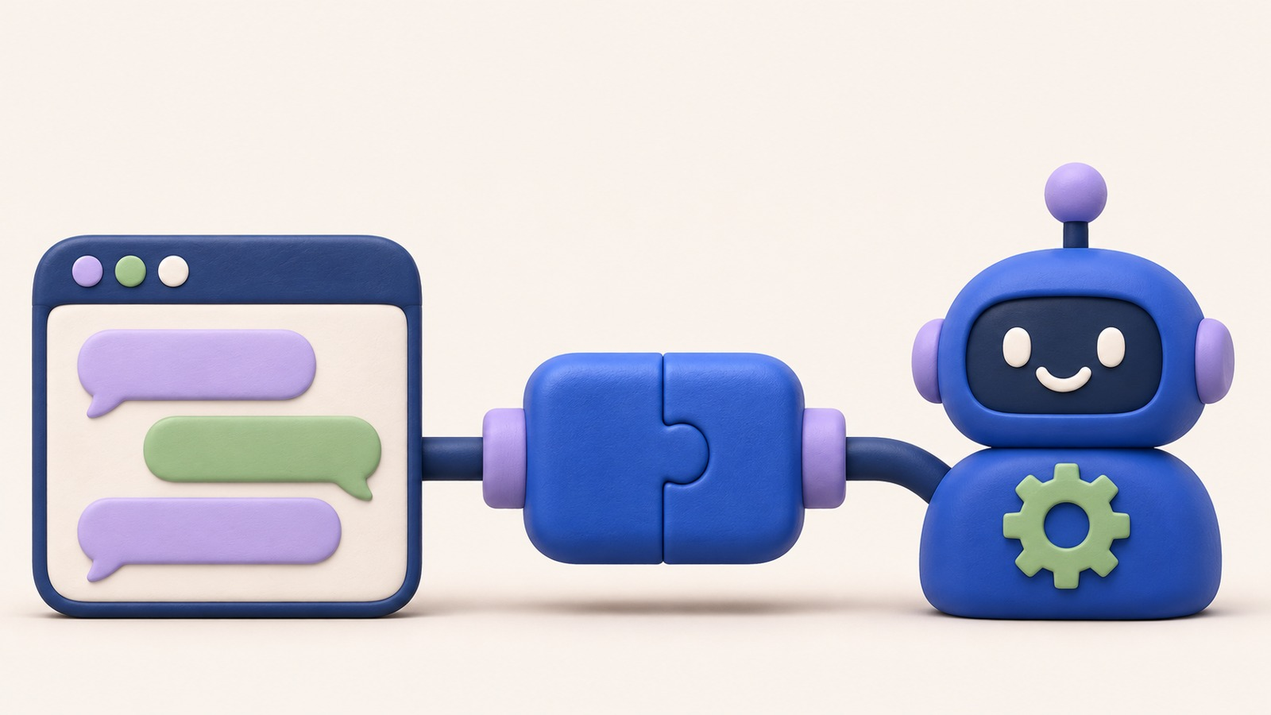
Two ways to make your assistant
Use Codex itself
Build your own app
Projects · plugins · schedules · phone
Your interface · Codex SDK · your rules
CODEX & COFFEE
DAY 12 · 3
Notes:
DAY 12 · Two ways to make your assistant
1.5–3 minutes (1.5 minutes)
SAY
First use the app you already have. Then see what changes when you build a custom app. The underlying model is only one part of either system. On the left, Codex supplies the screen, chats, tool connections and scheduling controls. On the right, you choose the screen and workflow and connect it to Codex. A custom app is useful when its design solves a problem the existing interface does not.
DO
Trace the two paths with the pointer. Explain that both can use Codex, but someone has to provide the surrounding features.
CHECK
Learners can name the difference between using an app and building an app.
SOURCE
https://learn.chatgpt.com/docs/

Slide 4
Use Codex itself
CODEX & COFFEE
DAY 12 · 4
Notes:
DAY 12 · Use Codex itself
3–3.25 minutes (0.25 minutes)
SAY
Start with the assistant you can use today inside the existing Codex app.
DO
Use the prepared visual. No live typing is required.
CHECK
Ask learners to explain the relationship in their own words.
SOURCE
https://learn.chatgpt.com/docs/

Slide 5
The native assistant building blocks
Instructions + files
Plugins + tools
Your Codex
assistant
Scheduled work
Phone access
CODEX & COFFEE
DAY 12 · 5
Notes:
DAY 12 · The native assistant building blocks
3.25–5.25 minutes (2 minutes)
SAY
A useful assistant needs an ongoing job, information and tools, a way to start work, and a way for you to review it. Codex already supplies these building blocks. Follow the diagram around the centre: instructions tell it what the job is; files and tools provide material; a schedule starts the work; phone access lets you steer and review. A missing source cannot be replaced by a more enthusiastic prompt. Start with the fewest connected parts the job needs.
DO
Walk around all four branches, spending about 20 seconds on the role of each. Return to the centre and explain why the pieces work together.
CHECK
A schedule starts a defined job; it does not define the job for you.
SOURCE
https://learn.chatgpt.com/docs/projects
https://learn.chatgpt.com/docs/plugins
https://learn.chatgpt.com/docs/automations
https://learn.chatgpt.com/docs/mobile

Slide 6
One project, focused conversations
Assistant project
Files + instructions
Research
Drafting
Follow-up
CODEX & COFFEE
DAY 12 · 6
Notes:
DAY 12 · One project, focused conversations
5.25–6.75 minutes (1.5 minutes)
SAY
Use a project for related files and instructions. Give repeated jobs distinct chats. A project is shared context, not a guarantee that every conversation reads every other transcript. A research conversation and a drafting conversation can use the same project files without becoming the same conversation. Save important conclusions to a file when another job needs them. That gives the next job an explicit source instead of relying on an unseen chat.
DO
Trace project to research, then project to drafting. Explain where a reusable research summary would be saved.
CHECK
Shared files and chat history are different sources of context.
SOURCE
https://learn.chatgpt.com/docs/projects

Slide 7
Define the job before scheduling it
Field | Your assistant’s brief
Job | Help me prepare for my working day
Sources | The project files and connected tools I name
Result | A short brief with links and open questions
Limits | Draft for review; ask before external changes
CODEX & COFFEE
DAY 12 · 7
Notes:
DAY 12 · Define the job before scheduling it
6.75–8.25 minutes (1.5 minutes)
SAY
The character can have a name, but its working brief matters. This is a proposed configuration, not a new special file format. Read this as the specification for one assistant. The job names the purpose; sources define what it can know; the result describes what you expect to receive; limits describe where it stops. This small table is more useful than a long personality description.
DO
Read the four rows once, then show how a research assistant could keep the structure while changing the job and sources.
CHECK
A learner can fill in all four rows for a real recurring task.
SOURCE
https://learn.chatgpt.com/docs/automations

Slide 8
Give the chat a standing job
REQUEST TO USE IN CODEX
Help me run this project as my personal assistant. Use the files and tools I name. Keep replies short, link to your sources, and tell me what is missing. Draft messages for my review. Ask before sending anything or changing information in another app.
The first response should use the named material and make missing information visible.
CODEX & COFFEE
DAY 12 · 8
Notes:
DAY 12 · Give the chat a standing job
8.25–9.75 minutes (1.5 minutes)
SAY
This is a setup request learners can adapt. Keep one small job and review the first result. You do not need three assistants before one works. Break the request into job, sources, output style and action boundary. You can change the job and length without removing source links or the review step. The first manual answer tells you whether the brief is specific enough.
DO
Point to each part of the exact prompt. Explain one edit you would make for a research job: replace the general project job with a named research question.
CHECK
The first response should use the named material and make missing information visible.
EXACT PROMPT
Help me run this project as my personal assistant. Use the files and tools I name. Keep replies short, link to your sources, and tell me what is missing. Draft messages for my review. Ask before sending anything or changing information in another app.
SOURCE
https://learn.chatgpt.com/docs/projects
https://learn.chatgpt.com/docs/plugins

Slide 9
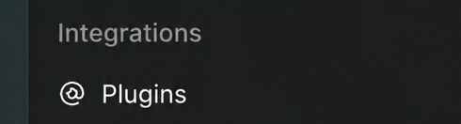
Plugins provide the connections
CODEX & COFFEE
DAY 12 · 9
Notes:
DAY 12 · Plugins provide the connections
9.75–11 minutes (1.25 minutes)
SAY
A plugin gives the assistant a supported way to work with another service. Install the one you need and connect the correct account. A model does not gain account access because you mention an app name. The connection belongs to an account and a set of allowed tools. A connected service may support reading, writing or both. Test one small read before a recurring job depends on it. Desktop availability and remote availability also need to match the place the job runs.
DO
Show the actual Plugins entry. Describe selecting the needed service, checking its account, then testing one small request. Do not connect a live account during this prepared lesson.
CHECK
The assistant can actually retrieve a named source from the intended account.
SOURCE
https://learn.chatgpt.com/docs/plugins

Slide 10
A prompt becomes a scheduled job
Test the request
Choose timing
and destination
Inspect a
completed run
CODEX & COFFEE
DAY 12 · 10
Notes:
DAY 12 · A prompt becomes a scheduled job
11–13 minutes (2 minutes)
SAY
Try the request manually first. When it works, add a schedule and choose where the result returns. After the first scheduled run, inspect the result. A saved schedule is not evidence that the job completed. The sequence is manual result, schedule configuration, completed result. Each step answers a different question: can the job work, when should it start, and did the unattended run work? Save the instruction only after the manual result is useful.
DO
Trace the arrows. Pause at the third box and distinguish a saved configuration from a completed run.
CHECK
A completed result is the evidence that the background job ran.
SOURCE
https://learn.chatgpt.com/docs/automations

Slide 11
Schedule the job in this chat
REQUEST TO USE IN CODEX
Every weekday at 8:30 AM, America/Toronto, return to this chat. Review the project updates available to you and give me a short brief: what changed, what needs my attention, and what you need from me. Link to sources. If nothing needs attention, say so briefly. Do not send messages or change other apps.
The schedule has the intended time, destination and first usable result.
CODEX & COFFEE
DAY 12 · 11
Notes:
DAY 12 · Schedule the job in this chat
13–14.5 minutes (1.5 minutes)
SAY
This template uses the existing conversation. The time zone is explicit. It deliberately reports what changed rather than repeating all information each morning. Change the time and the project material to suit the job. Keep the time zone and destination explicit. A useful recurring brief reports what changed and what needs attention, rather than reproducing everything it can find.
DO
Read the time zone, return-to-this-chat wording, and expected result. Describe inspecting the generated schedule before relying on it.
CHECK
The schedule has the intended time, destination and first usable result.
EXACT PROMPT
Every weekday at 8:30 AM, America/Toronto, return to this chat. Review the project updates available to you and give me a short brief: what changed, what needs my attention, and what you need from me. Link to sources. If nothing needs attention, say so briefly. Do not send messages or change other apps.
SOURCE
https://learn.chatgpt.com/docs/automations

Slide 12
Choose where scheduled results appear
Choice | What happens
Schedule inside this chat | Returns to this conversation and its context
Standalone schedule | Starts a new chat for each run
Scheduled view | Review runs, change the task or pause it
CODEX & COFFEE
DAY 12 · 12
Notes:
DAY 12 · Choose where scheduled results appear
14.5–16 minutes (1.5 minutes)
SAY
Use the same chat when previous context matters; use an independent run when each result should stand alone. Both can run in the background. Inspect Scheduled to manage runs. Choose the same chat for an ongoing conversation you plan to steer. Choose a fresh run when every report should begin independently. Neither choice gives access to files or services missing from that execution environment.
DO
Compare the first two table rows with one example: an ongoing project conversation versus a separate weekly report. Point to Scheduled for later inspection.
CHECK
The learner knows where the next result will appear.
SOURCE
https://learn.chatgpt.com/docs/automations

Slide 13
Your phone can steer your computer
CODEX & COFFEE
DAY 12 · 13
Notes:
DAY 12 · Your phone can steer your computer
16–17.5 minutes (1.5 minutes)
SAY
The phone is the remote control. Work runs on the connected computer or in Cloud. Start, guide, approve and review from your phone. This is how the native app can feel like a personal assistant on the go. The diagram is a mental model, not an app screenshot. The phone carries your request to the working environment and brings the result back. A long task can continue while you are away; if it needs a decision, you can respond from the phone.
DO
Trace request from phone to computer and result back. Explain that the tools and files remain at the execution location.
CHECK
Phone access is a control surface, not a new copy of all your desktop tools.
SOURCE
https://learn.chatgpt.com/docs/mobile
https://learn.chatgpt.com/docs/remote-connections

Slide 14
Connect your phone to Codex
On your computer
On your phone
Settings → Connections
Control this Mac or PC
Set up / Add
Scan the QR code
Confirm the same account
Choose host + project
CODEX & COFFEE
DAY 12 · 14
Notes:
DAY 12 · Connect your phone to Codex
17.5–19.5 minutes (2 minutes)
SAY
These are the documented setup labels. Start at the computer, scan the QR code and use the same account and workspace. Availability depends on the app rollout and workspace settings. We are not creating a pairing in this prepared lesson. The phone and computer must be paired through the supported flow. A nearby phone alone is not sufficient. After setup, test a small read from the intended project before trusting a larger job. This lesson provides the documented route; a learner still needs to complete it on their own devices.
DO
Walk left to right through the visible steps. Call out the same account and host choice. Describe a harmless first test, such as listing files in the intended project.
CHECK
The phone reaches the intended host and project.
SOURCE
https://learn.chatgpt.com/docs/mobile
https://learn.chatgpt.com/docs/remote-connections

Slide 15
What you can ask from your phone
“In my project, what changed since this morning? Give me the three things I need to know.”
“Continue the draft in this chat. Save it for my review; do not send it.”
CODEX & COFFEE
DAY 12 · 15
Notes:
DAY 12 · What you can ask from your phone
19.5–21 minutes (1.5 minutes)
SAY
A phone request is still a normal request. Keep it specific. You can also respond to a question or approve a requested action without returning to your desk. The first prompt is a review request; the second continues work. They sound like ordinary messages because the project and conversation already establish the context. When context is ambiguous, name the project or file explicitly.
DO
Compare the two prompts. Explain that an approval request from an existing task can also be handled from the phone.
CHECK
The request identifies the work without requiring terminal commands.
SOURCE
https://learn.chatgpt.com/docs/mobile
https://learn.chatgpt.com/docs/remote-connections

Slide 16
Where the work actually runs
Route | What must be available
Connected computer | Host awake, online, app running; host tools and files
Cloud | Cloud environment with uploaded or connected sources
Your phone | The interface for prompts, approvals and review
CODEX & COFFEE
DAY 12 · 16
Notes:
DAY 12 · Where the work actually runs
21–23 minutes (2 minutes)
SAY
Remote access reaches the host and its existing environment. The phone is not suddenly running the Mac tools. If the host sleeps or goes offline, the remote path is unavailable. Cloud work uses the sources and tools available in Cloud. A powered-off laptop cannot execute local work. A cloud task is a separate environment with the sources made available there. Decide the execution route before you promise an always-available assistant. Remote control and cloud execution solve different parts of the problem.
DO
Read each row as a dependency check. Use the sleeping-laptop example to make the distinction concrete.
CHECK
The learner can identify what must be awake, online or connected.
SOURCE
https://learn.chatgpt.com/docs/mobile
https://learn.chatgpt.com/docs/remote-connections

Slide 17
Native assistant or custom app?
Native Codex
Custom assistant
Use the existing interface and features
Choose the interface and build its behavior
CODEX & COFFEE
DAY 12 · 17
Notes:
DAY 12 · Native assistant or custom app?
23–24.5 minutes (1.5 minutes)
SAY
Most people should first try the built-in app. Building becomes useful when you want a very different interface or repeated workflow. Gratis is our concrete example of that second path. The custom path buys control over interaction and workflow, but brings responsibility for all the missing pieces. If the native screen already does the job, begin there. The next section shows the custom path because Gratis is a real example of where that extra work can be worthwhile.
DO
Recap native setup in one sentence. Use the paired pictures to introduce interface choice as the reason to build.
CHECK
A custom app has a reason beyond merely renaming the assistant.
SOURCE
https://learn.chatgpt.com/docs/

Slide 18
Build your own assistant
CODEX & COFFEE
DAY 12 · 18
Notes:
DAY 12 · Build your own assistant
24.5–24.75 minutes (0.25 minutes)
SAY
Now we separate the reusable engine from the app around it.
DO
Use the prepared visual. No live typing is required.
CHECK
Ask learners to explain the relationship in their own words.
SOURCE
https://learn.chatgpt.com/docs/

Slide 19
An SDK is a ready-made developer kit
Software Development Kit
Your app
Ready-made connector
Codex
CODEX & COFFEE
DAY 12 · 19
Notes:
DAY 12 · An SDK is a ready-made developer kit
24.75–26.75 minutes (2 minutes)
SAY
SDK stands for software development kit. It is a collection of code your app can use. The Codex SDK lets your app ask Codex to work, continue a conversation, and receive the result. You are not training a model. Think of the kit as a reusable connection your program can call. Without it, the developer would do more of the connection work themselves. With it, they can focus on the application. The connector is real code; the picture is a simplified explanation of its role.
DO
Point to your app, the connector, and Codex in that order, then reverse the path for the result.
CHECK
The SDK connects software to Codex; it is neither a new model nor a finished personal assistant.
SOURCE
https://learn.chatgpt.com/docs/codex-sdk

Slide 20
API, SDK, and app server
Name | Plain English
API | A defined way for software to talk to software
Codex SDK | Ready-made code that starts and continues Codex work
Codex app server | The interface for a fuller custom Codex client
CODEX & COFFEE
DAY 12 · 20
Notes:
DAY 12 · API, SDK, and app server
26.75–28.75 minutes (2 minutes)
SAY
An API is the agreed way programs talk. An SDK is ready-made code for using a service. Codex app server exposes richer pieces for clients that need chat history, approvals and live events. They are related, not interchangeable product names. An API describes how software can request something. An SDK provides convenient code for making those requests. Codex app server offers a richer conversation interface for clients that need things such as approval events and authentication flows. The right choice follows what you are building.
DO
Use one sentence per row. Avoid teaching transport protocols or asking anyone to write code.
CHECK
Learners can explain the names without confusing them with models or subscription plans.
SOURCE
https://learn.chatgpt.com/docs/codex-sdk
https://learn.chatgpt.com/docs/app-server

Slide 21
Your app keeps the interface
Your screen
Your app’s
backend
Codex SDK
Codex
Your request goes in. Progress and a result come back.
CODEX & COFFEE
DAY 12 · 21
Notes:
DAY 12 · Your app keeps the interface
28.75–30.25 minutes (1.5 minutes)
SAY
The user types into your interface. Your local backend calls the SDK, which controls Codex. Responses come back and your interface displays them. The SDK is not the visible chat window. The backend is the part of your app doing work behind the screen. It can keep the Codex connection away from browser code, receive progress, and pass displayable results to the interface. The user can still see a friendly chat with no technical commands.
DO
Trace all four boxes. Name backend as the behind-the-scenes part of the app, then trace the response backwards.
CHECK
The interface and the Codex execution are separate pieces.
SOURCE
https://learn.chatgpt.com/docs/codex-sdk

Slide 22
Using a Codex subscription
Connection | What pays for the work
Codex signed in with ChatGPT | Eligible Codex subscription access and its limits
Codex / API using a Platform key | Separate usage-based API billing
Your app’s other services | Their own account access and charges
CODEX & COFFEE
DAY 12 · 22
Notes:
DAY 12 · Using a Codex subscription
30.25–32.25 minutes (2 minutes)
SAY
The supported Codex client can sign in with ChatGPT. That is different from calling the general OpenAI API with a Platform key. The entitlement and limits follow the sign-in path. Each person uses their own eligible account; do not build a public proxy around your personal login. An SDK package itself is not a new subscription. What matters is how the Codex client authenticates. The demonstrated app used ChatGPT sign-in; a Platform API key follows separate API billing. Connected paid services can still charge independently.
DO
Read the two authentication routes before the third-party-services row. State clearly which route the recorded demo used.
CHECK
No one leaves believing that a ChatGPT subscription includes every OpenAI API call or outside service.
SOURCE
https://learn.chatgpt.com/docs/auth
https://learn.chatgpt.com/docs/app-server#authentication-modes

Slide 23
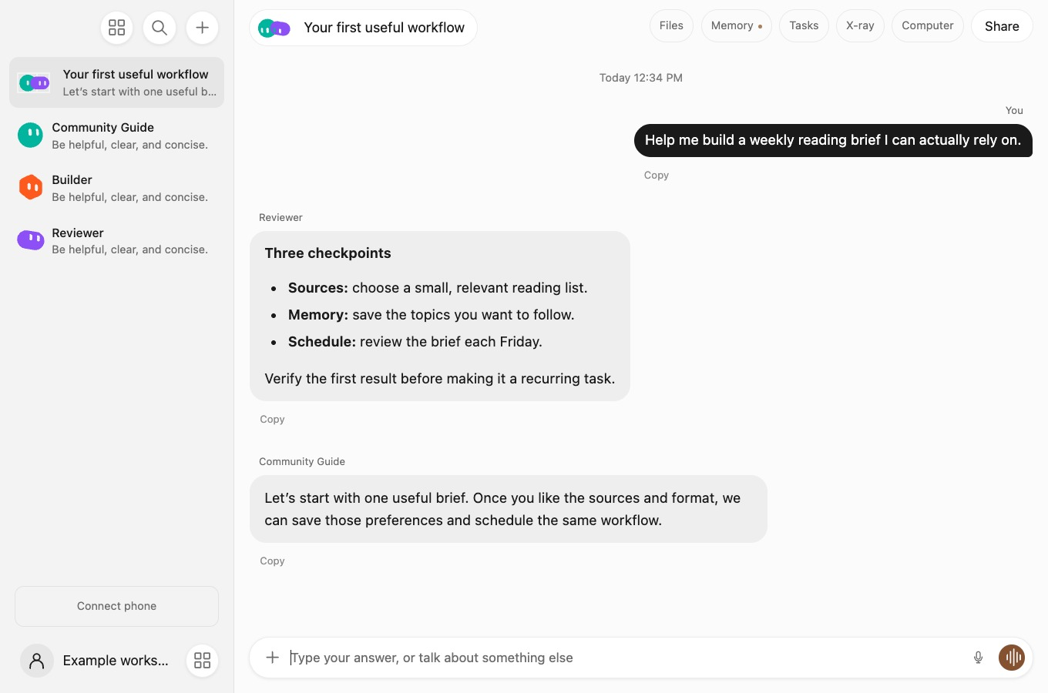
Gratis: a real custom assistant app
CODEX & COFFEE
DAY 12 · 23
Notes:
DAY 12 · Gratis: a real custom assistant app
32.25–33.75 minutes (1.5 minutes)
SAY
Gratis is Mark’s app. The installed build includes the Codex SDK. It has its own bots, conversations, memory, schedules and phone connection. This screenshot is a synthetic example from the app’s source, not Mark’s private history. Look at the custom conversation list and the central chat. Those are Gratis design decisions. The same app can support provider choices behind its interface. We verified its Codex integration in the installed package; this image is used to teach the interface, not prove which provider generated a particular message.
DO
Show the overall workspace first. Point to the assistant list and the chat area. Keep the walkthrough brief and move to the setup screen.
CHECK
This is Mark’s actual app and its own interface, not a reskinned screenshot claimed to be native Codex.
SOURCE
Local installed Gratis 0.23.0: package.json, src/codex-backend.mjs, src/codex-client.mjs; public source https://github.com/earlyaidopters/gratis-community

Slide 24
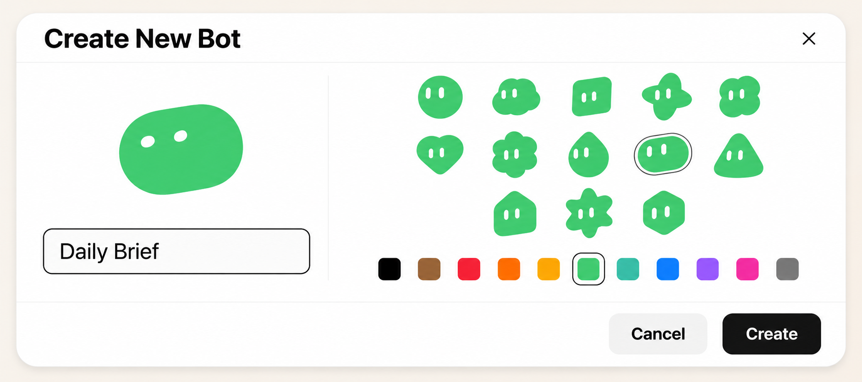
Give an assistant its own identity
CODEX & COFFEE
DAY 12 · 24
Notes:
DAY 12 · Give an assistant its own identity
33.75–35.25 minutes (1.5 minutes)
SAY
This is an AI-recreated illustration of the Gratis create-bot controls, rearranged into a wide layout for teaching. A name and avatar help people recognize the assistant. They do not create its behavior; the instructions, model and tools do. The actual app may place these controls differently.
DO
Point out the name, avatar choices and colour swatches. Show how these identify the assistant, then move to the next slide for the working parts.
CHECK
Identity and behavior are separate configuration choices.
SOURCE
AI-generated landscape illustration based on the Gratis create-bot reference; not a screenshot. Original reference: gratis-community-create-bot.png.

Slide 25
What an assistant is made of
Part | What it controls
Name and image | How you recognize it
Instructions | Its job, tone and boundaries
Model and tools | How it reasons and what it can do
History and memory | What it can carry into later work
Schedule | When the app starts the job
CODEX & COFFEE
DAY 12 · 25
Notes:
DAY 12 · What an assistant is made of
35.25–36.75 minutes (1.5 minutes)
SAY
This is the plain-language skeleton of a bot. The software enforces tool access; an avatar or a prompt cannot grant it. A name and image make it recognizable. Instructions define the task. Model and tool choices determine available capabilities. History and saved memory provide continuity. A schedule decides when the app starts the work. Some controls belong to the app rather than the prompt.
DO
Walk down the five rows. Use one assistant throughout rather than inventing five examples.
CHECK
An avatar is one small part of a working assistant.
SOURCE
Local installed Gratis 0.23.0: package.json, src/codex-backend.mjs, src/codex-client.mjs; public source https://github.com/earlyaidopters/gratis-community

Slide 26
What Gratis adds around Codex
Chat interface
Memory + files
Codex SDK
Agent work
Own scheduler
Own tool connections
CODEX & COFFEE
DAY 12 · 26
Notes:
DAY 12 · What Gratis adds around Codex
36.75–38.75 minutes (2 minutes)
SAY
The installed app constructs a Codex SDK client, starts or resumes a thread, and reads streamed events. Gratis supplies its own interface, memory, scheduler and tool bridge. Those capabilities did not appear merely by installing the SDK. The SDK connection in the middle performs agent work. The surrounding app still owns its chat experience, saved information, timing and connections. This is the architectural reason a custom assistant can feel different while using the same Codex engine.
DO
Point to each outer box before returning to the centre. Explain that these boxes are responsibilities, not separate intelligence models.
CHECK
The SDK does not automatically bring every native Codex app feature into a new application.
SOURCE
Local installed Gratis 0.23.0: package.json, src/codex-backend.mjs, src/codex-client.mjs; public source https://github.com/earlyaidopters/gratis-community

Slide 27
The small piece that calls Codex
const codex = new Codex();
Connect to Codex
const chat = codex.startThread();
Start a conversation
const result = await chat.run(request);
Send the request
show(result.finalResponse);
Display the result
CODEX & COFFEE
DAY 12 · 27
Notes:
DAY 12 · The small piece that calls Codex
38.75–40.25 minutes (1.5 minutes)
SAY
This is the key idea, not a coding exercise. A few lines start a conversation and request work. Production apps also handle failures, stop controls, storage and permissions. The example on the next slide actually ran through the SDK. You do not need to memorize the syntax. Follow the four actions on the right. Create the connection, start a conversation, request work, then display the result. The last line uses a display helper to explain the idea; the learner kit contains the actual working server and interface.
DO
Reveal the meaning of each line from top to bottom. Do not type or run these four lines as a complete standalone program.
CHECK
A non-developer can explain the four-step flow.
SOURCE
https://learn.chatgpt.com/docs/codex-sdk

Slide 28
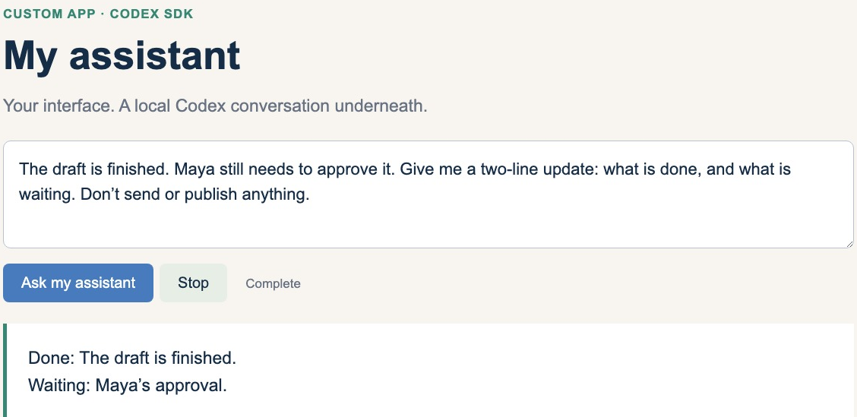
A tiny app using the real SDK
CODEX & COFFEE
DAY 12 · 28
Notes:
DAY 12 · A tiny app using the real SDK
40.25–42 minutes (1.75 minutes)
SAY
This small teaching app calls the installed Codex client through the SDK. The response is from a real run using ChatGPT sign-in. It is deliberately small so the connection is easy to see. The request intentionally contains two states: writing is done, approval is waiting. The actual answer kept that distinction. That is a better test than receiving a generic hello, because there is something concrete to inspect. The local example also includes a Stop control.
DO
Read the short request and answer. Point to Ask my assistant and Stop. This screenshot is sufficient if the live local server is not running.
CHECK
The visible answer was produced through an actual SDK call and preserves the pending approval.
SOURCE
Recorded local SDK demonstration; production/sdk-demo/test-receipt.json

Slide 29
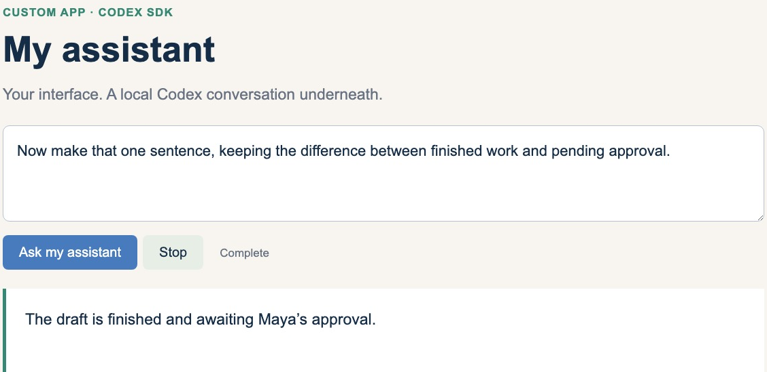
The same conversation can continue
CODEX & COFFEE
DAY 12 · 29
Notes:
DAY 12 · The same conversation can continue
42–43 minutes (1 minutes)
SAY
The second request refers to the first result. The backend reused the same thread, so the answer kept Maya and the pending approval. Starting a new thread would need that context again. The follow-up does not repeat the name or the situation. Keeping the same thread lets the app refer back to the prior exchange. It is still the developer’s job to retain or resume the appropriate conversation when the app restarts.
DO
Read only the new request and answer. Compare with the previous slide and explain what context was carried forward.
CHECK
The second request continued the first conversation; durable restart storage is a separate feature.
SOURCE
Recorded local SDK demonstration; production/sdk-demo/test-receipt.json

Slide 30
Choose the integration for the job
You want to build… | Start with…
A local task runner or simple assistant | Codex SDK
A rich chat client with approval flows | Codex app server
An assistant without writing an app | Native Codex features
CODEX & COFFEE
DAY 12 · 30
Notes:
DAY 12 · Choose the integration for the job
43–44.5 minutes (1.5 minutes)
SAY
The SDK is a good starting point for embedding Codex tasks. App server is the documented choice for a rich client with authentication, approvals and detailed events. Neither is permission to skip user controls. The simplest useful integration is preferable to the richest one. A local task runner needs less client machinery than a full chat product with authentication and approvals. Someone who only wants a recurring assistant may need no custom code at all.
DO
Walk down the three use cases. Connect each choice to its goal rather than describing one as universally better.
CHECK
The integration choice follows the application’s needs.
SOURCE
https://learn.chatgpt.com/docs/codex-sdk
https://learn.chatgpt.com/docs/app-server

Slide 31
A prompt to build your first version
REQUEST TO USE IN CODEX
Build me a simple local personal-assistant app using the Codex SDK and my existing Codex sign-in. Give it a chat, a Stop button, and saved conversations. Keep credentials out of the browser. Start with text only. Show me a real response and a follow-up in the same conversation. Ask before adding paid services, account connections, or remote access.
The requested build has a narrow first milestone and a visible acceptance test.
CODEX & COFFEE
DAY 12 · 31
Notes:
DAY 12 · A prompt to build your first version
44.5–46.5 minutes (2 minutes)
SAY
This is a build brief, not a claim that one prompt completes a production app. Start with the narrowest useful local version and prove the engine connection before adding tools, memory or schedules. Read this as a staged brief: start local, keep the engine connection behind the interface, prove a real answer and follow-up, then add capabilities. Saved conversations are requested for the next version; the tiny demonstration keeps continuity only while its server is running.
DO
Annotate the prompt aloud in four parts: interface, Codex connection, proof, and scope. Explain what to inspect before asking for further features.
CHECK
The requested build has a narrow first milestone and a visible acceptance test.
EXACT PROMPT
Build me a simple local personal-assistant app using the Codex SDK and my existing Codex sign-in. Give it a chat, a Stop button, and saved conversations. Keep credentials out of the browser. Start with text only. Show me a real response and a follow-up in the same conversation. Ask before adding paid services, account connections, or remote access.
SOURCE
https://learn.chatgpt.com/docs/codex-sdk
https://learn.chatgpt.com/docs/app-server

Slide 32
The SDK does not build every feature
Capability | Who provides it?
Codex reasoning and agent work | Codex runtime through SDK / app server
Your screens and saved conversations | Your application
Recurring jobs and phone connection | Native product, or your app’s implementation
Connected accounts and paid services | Explicit integrations and their providers
CODEX & COFFEE
DAY 12 · 32
Notes:
DAY 12 · The SDK does not build every feature
46.5–48 minutes (1.5 minutes)
SAY
The model is not the scheduler, database or permission system. You choose which capabilities to add, how they are stored and what users approve. Gratis is evidence of an app combining these pieces, not a guarantee the SDK supplies them. List what your app must own before asking someone to build it. The SDK can run Codex work; it does not make product decisions about storage, recurring triggers or accounts. Native product features remain native unless the custom application implements an equivalent.
DO
Use the table to explain why simply installing a package does not produce a full Gratis clone.
CHECK
Each product capability has an owner.
SOURCE
https://learn.chatgpt.com/docs/codex-sdk
Local installed Gratis 0.23.0: package.json, src/codex-backend.mjs, src/codex-client.mjs; public source https://github.com/earlyaidopters/gratis-community

Slide 33
Native Codex and Gratis, side by side
Capability | Native Codex | Gratis
Where you work | Codex chats and projects | Custom bots and group chats
Recurring work | Scheduled tasks | Its own scheduler
On the go | Codex mobile / remote | Its own phone pairing
Engine connection | Built in | Provider adapter + SDK
CODEX & COFFEE
DAY 12 · 33
Notes:
DAY 12 · Native Codex and Gratis, side by side
48–49.5 minutes (1.5 minutes)
SAY
These are alternative interfaces and systems. Native Codex supplies its features. Gratis implements its own equivalents and can use Codex as one backend. The installed Gratis UI was on Claude during inspection; Codex support was verified in the installed code. Choose based on workflow and interface requirements. Both routes can support recurring work, but their schedules and mobile connections are their own implementations. The table compares capabilities, not identical behaviour or shared storage.
DO
Trace one row across both products. Recap the installed-package verification and avoid attributing the existing Claude chat to Codex.
CHECK
The class understands what is built in and what Gratis implements.
SOURCE
https://learn.chatgpt.com/docs/mobile
https://learn.chatgpt.com/docs/automations
Local installed Gratis 0.23.0: package.json, src/codex-backend.mjs, src/codex-client.mjs; public source https://github.com/earlyaidopters/gratis-community

Slide 34
Design one assistant worth keeping
Decision | Your answer
Job | What repeated work should it handle?
Route | Native Codex or custom app?
Sources and tools | What information can it actually access?
Review | What must you inspect or approve?
CODEX & COFFEE
DAY 12 · 34
Notes:
DAY 12 · Design one assistant worth keeping
49.5–54.5 minutes (5 minutes)
SAY
Give learners five minutes. They choose the native path or custom app path, name a useful job, and decide the first result they would inspect. Ask two people to explain why they chose their path. Use the first minute to choose a job. Spend the next two minutes deciding native or custom and naming the actual sources. Use the fourth minute to write the first result you would inspect. In the final minute, compare two answers or explain your own if the room is quiet. No account setup is needed to finish this exercise.
DO
Run a five-minute design exercise from the four visible rows. In a quiet room, work through a research brief yourself and show why native features are enough for its first version.
CHECK
The answer includes a real job, execution route, sources and a concrete review step.
SOURCE
Learner design activity

Slide 35
Your assistant starts with one useful job
Native features
when you want to use it
The SDK
when you want to build it
CODEX & COFFEE
DAY 12 · 35
Notes:
DAY 12 · Your assistant starts with one useful job
54.5–55 minutes (0.5 minutes)
SAY
Native Codex is the shortest path to useful background work. The SDK lets you put Codex behind your own experience. Choose the path because of the job, not because a bigger system sounds more impressive.
DO
Use the prepared visual. No live typing is required.
CHECK
Ask learners to explain the relationship in their own words.
SOURCE
https://learn.chatgpt.com/docs/

