Slide 1

O’REILLY LIVE
Codex
& Coffee
Mark Kashef
DAY 5
Computer Use: Inside the Click
CODEX & COFFEE
DAY 5 · 1
Notes:
DAY 5 · Computer Use: Inside the Click
SAY AND SHOW
OPEN
“When Codex clicks something, what actually happens? Today we will look inside that loop, then use it for three jobs you could give an assistant.”
All examples are independent and use fictional local training data.
SURFACE
All optional demos use the internal @Browser. The user does not need to write code to request Computer Use.
TIMING
Core explanation: 30 minutes in total. Read selected use cases; use the remaining examples as a reference.
SOURCES AND SCOPE
https://learn.chatgpt.com/docs/computer-use
https://learn.chatgpt.com/docs/browser
https://learn.chatgpt.com/docs/extend/mcp
https://developers.openai.com/api/docs/guides/tools-computer-use
https://developers.openai.com/api/docs/guides/tools-computer-use-sdk-drivers
CUA_REPL details come from the observed, exposed tool documentation in this teaching session. Public OpenAI Docs search returned no exact cua_repl page. Do not present this session’s wrapper as a universal public API.
VISUALS
Diagrams explain observable interfaces and responsibilities; they do not describe undisclosed model internals. Screenshots show fictional local fixtures. Concept art is an illustration, not execution evidence. Checked 30 October 2026.

Slide 2
Today’s agenda
1
What could you hand over?
A broad map of business uses
2
What is CUA_REPL?
The control room behind the actions
3
What happens after a click?
Snapshots, structure, decisions and checks
4
Optional walkthroughs
The prepared examples are at the end
CODEX & COFFEE
DAY 5 · 2
Notes:
DAY 5 · Today’s agenda
SAY AND SHOW
Today is a deeper explanation of the machinery. First, show the range of work this can support. Then take one action apart. We can use a prepared walkthrough at the end if it helps answer a question. There is no requirement to run all three demos.
SURFACE
All optional demos use the internal @Browser. The user does not need to write code to request Computer Use.
TIMING
Core explanation: 30 minutes in total. Read selected use cases; use the remaining examples as a reference.
SOURCES AND SCOPE
https://learn.chatgpt.com/docs/computer-use
https://learn.chatgpt.com/docs/browser
https://learn.chatgpt.com/docs/extend/mcp
https://developers.openai.com/api/docs/guides/tools-computer-use
https://developers.openai.com/api/docs/guides/tools-computer-use-sdk-drivers
CUA_REPL details come from the observed, exposed tool documentation in this teaching session. Public OpenAI Docs search returned no exact cua_repl page. Do not present this session’s wrapper as a universal public API.
VISUALS
Diagrams explain observable interfaces and responsibilities; they do not describe undisclosed model internals. Screenshots show fictional local fixtures. Concept art is an illustration, not execution evidence. Checked 30 October 2026.

Slide 3
The useful boundary is the interface
Observe
Operate
Check
Read text, inspect layout and compare
Click, type, select, scroll and navigate
Capture evidence and inspect the outcome
48 examples follow. Each depends on app support, access and a clear check.
CODEX & COFFEE
DAY 5 · 3
Notes:
DAY 5 · The useful boundary is the interface
SAY AND SHOW
The list is deliberately broad, but it is not a guarantee that every application or every action works. Think of the underlying moves: observe an interface, operate its controls and check what changed. New workflows are combinations of those moves. Use a direct connector when it gives the needed data or action more reliably.
SURFACE
All optional demos use the internal @Browser. The user does not need to write code to request Computer Use.
TIMING
Core explanation: 30 minutes in total. Read selected use cases; use the remaining examples as a reference.
SOURCES AND SCOPE
https://learn.chatgpt.com/docs/computer-use
https://learn.chatgpt.com/docs/browser
https://learn.chatgpt.com/docs/extend/mcp
https://developers.openai.com/api/docs/guides/tools-computer-use
https://developers.openai.com/api/docs/guides/tools-computer-use-sdk-drivers
CUA_REPL details come from the observed, exposed tool documentation in this teaching session. Public OpenAI Docs search returned no exact cua_repl page. Do not present this session’s wrapper as a universal public API.
VISUALS
Diagrams explain observable interfaces and responsibilities; they do not describe undisclosed model internals. Screenshots show fictional local fixtures. Concept art is an illustration, not execution evidence. Checked 30 October 2026.

Slide 4
Customer and revenue work
Possible workflows to scope and verify
1
Update CRM fields from approved notes
5
Compare customer portal records
2
Find duplicate customer records
6
Reproduce a support issue
3
Check a lead-capture form
7
Prepare a campaign in a draft state
4
Inspect a quote before sending
8
Capture evidence for a customer handoff
CODEX & COFFEE
DAY 5 · 4
Notes:
DAY 5 · Customer and revenue work
SAY AND SHOW
These are possible business applications, not 48 tested automations. Read only the examples that resonate with this audience, then ask which one they would actually delegate. Update CRM fields from approved notes. Find duplicate customer records. Check a lead-capture form. Inspect a quote before sending. Compare customer portal records. Reproduce a support issue. Prepare a campaign in a draft state. Capture evidence for a customer handoff. Preparation, inspection and comparison do not authorize sending, buying, hiring or publishing. For people-related workflows, this list concerns administrative preparation, not consequential employment decisions. For financial examples, keep transactions and approvals with the authorized person.
SURFACE
All optional demos use the internal @Browser. The user does not need to write code to request Computer Use.
TIMING
Core explanation: 30 minutes in total. Read selected use cases; use the remaining examples as a reference.
SOURCES AND SCOPE
https://learn.chatgpt.com/docs/computer-use
https://learn.chatgpt.com/docs/browser
https://learn.chatgpt.com/docs/extend/mcp
https://developers.openai.com/api/docs/guides/tools-computer-use
https://developers.openai.com/api/docs/guides/tools-computer-use-sdk-drivers
CUA_REPL details come from the observed, exposed tool documentation in this teaching session. Public OpenAI Docs search returned no exact cua_repl page. Do not present this session’s wrapper as a universal public API.
VISUALS
Diagrams explain observable interfaces and responsibilities; they do not describe undisclosed model internals. Screenshots show fictional local fixtures. Concept art is an illustration, not execution evidence. Checked 30 October 2026.

Slide 5
Operations and administration
Possible workflows to scope and verify
9
Export a filtered order list
13
Prepare a service-booking request
10
Reconcile a dashboard with its download
14
Check an onboarding checklist
11
Check an inventory exception
15
Organize files through an app
12
Move approved data between apps
16
Inspect a recurring report before delivery
CODEX & COFFEE
DAY 5 · 5
Notes:
DAY 5 · Operations and administration
SAY AND SHOW
These are possible business applications, not 48 tested automations. Read only the examples that resonate with this audience, then ask which one they would actually delegate. Export a filtered order list. Reconcile a dashboard with its download. Check an inventory exception. Move approved data between apps. Prepare a service-booking request. Check an onboarding checklist. Organize files through an app. Inspect a recurring report before delivery. Preparation, inspection and comparison do not authorize sending, buying, hiring or publishing. For people-related workflows, this list concerns administrative preparation, not consequential employment decisions. For financial examples, keep transactions and approvals with the authorized person.
SURFACE
All optional demos use the internal @Browser. The user does not need to write code to request Computer Use.
TIMING
Core explanation: 30 minutes in total. Read selected use cases; use the remaining examples as a reference.
SOURCES AND SCOPE
https://learn.chatgpt.com/docs/computer-use
https://learn.chatgpt.com/docs/browser
https://learn.chatgpt.com/docs/extend/mcp
https://developers.openai.com/api/docs/guides/tools-computer-use
https://developers.openai.com/api/docs/guides/tools-computer-use-sdk-drivers
CUA_REPL details come from the observed, exposed tool documentation in this teaching session. Public OpenAI Docs search returned no exact cua_repl page. Do not present this session’s wrapper as a universal public API.
VISUALS
Diagrams explain observable interfaces and responsibilities; they do not describe undisclosed model internals. Screenshots show fictional local fixtures. Concept art is an illustration, not execution evidence. Checked 30 October 2026.

Slide 6
Finance and procurement
Possible workflows to scope and verify
17
Download an approved invoice batch
21
Collect supplier quote details
18
Compare a purchase order with an invoice
22
Check renewal dates across portals
19
Spot missing fields in expense claims
23
Prepare a purchasing request
20
Review a billing portal
24
Compare report totals with source records
CODEX & COFFEE
DAY 5 · 6
Notes:
DAY 5 · Finance and procurement
SAY AND SHOW
These are possible business applications, not 48 tested automations. Read only the examples that resonate with this audience, then ask which one they would actually delegate. Download an approved invoice batch. Compare a purchase order with an invoice. Spot missing fields in expense claims. Review a billing portal. Collect supplier quote details. Check renewal dates across portals. Prepare a purchasing request. Compare report totals with source records. Preparation, inspection and comparison do not authorize sending, buying, hiring or publishing. For people-related workflows, this list concerns administrative preparation, not consequential employment decisions. For financial examples, keep transactions and approvals with the authorized person.
SURFACE
All optional demos use the internal @Browser. The user does not need to write code to request Computer Use.
TIMING
Core explanation: 30 minutes in total. Read selected use cases; use the remaining examples as a reference.
SOURCES AND SCOPE
https://learn.chatgpt.com/docs/computer-use
https://learn.chatgpt.com/docs/browser
https://learn.chatgpt.com/docs/extend/mcp
https://developers.openai.com/api/docs/guides/tools-computer-use
https://developers.openai.com/api/docs/guides/tools-computer-use-sdk-drivers
CUA_REPL details come from the observed, exposed tool documentation in this teaching session. Public OpenAI Docs search returned no exact cua_repl page. Do not present this session’s wrapper as a universal public API.
VISUALS
Diagrams explain observable interfaces and responsibilities; they do not describe undisclosed model internals. Screenshots show fictional local fixtures. Concept art is an illustration, not execution evidence. Checked 30 October 2026.

Slide 7
People and knowledge work
Possible workflows to scope and verify
25
Prepare an employee onboarding workspace
29
Review a policy acknowledgement flow
26
Check whether a training flow works
30
Collect reference material into a brief
27
Organize approved candidate records
31
Check knowledge-base navigation
28
Compare leave-calendar entries
32
Prepare an offboarding checklist for review
CODEX & COFFEE
DAY 5 · 7
Notes:
DAY 5 · People and knowledge work
SAY AND SHOW
These are possible business applications, not 48 tested automations. Read only the examples that resonate with this audience, then ask which one they would actually delegate. Prepare an employee onboarding workspace. Check whether a training flow works. Organize approved candidate records. Compare leave-calendar entries. Review a policy acknowledgement flow. Collect reference material into a brief. Check knowledge-base navigation. Prepare an offboarding checklist for review. Preparation, inspection and comparison do not authorize sending, buying, hiring or publishing. For people-related workflows, this list concerns administrative preparation, not consequential employment decisions. For financial examples, keep transactions and approvals with the authorized person.
SURFACE
All optional demos use the internal @Browser. The user does not need to write code to request Computer Use.
TIMING
Core explanation: 30 minutes in total. Read selected use cases; use the remaining examples as a reference.
SOURCES AND SCOPE
https://learn.chatgpt.com/docs/computer-use
https://learn.chatgpt.com/docs/browser
https://learn.chatgpt.com/docs/extend/mcp
https://developers.openai.com/api/docs/guides/tools-computer-use
https://developers.openai.com/api/docs/guides/tools-computer-use-sdk-drivers
CUA_REPL details come from the observed, exposed tool documentation in this teaching session. Public OpenAI Docs search returned no exact cua_repl page. Do not present this session’s wrapper as a universal public API.
VISUALS
Diagrams explain observable interfaces and responsibilities; they do not describe undisclosed model internals. Screenshots show fictional local fixtures. Concept art is an illustration, not execution evidence. Checked 30 October 2026.

Slide 8
Websites and software
Possible workflows to scope and verify
33
Test sign-up and account setup
37
Check desktop and mobile layouts
34
Check a checkout in a test environment
38
Test empty, error and success states
35
Reproduce a visual bug
39
Inspect menus, dialogs and keyboard paths
36
Compare a build with a reference image
40
Capture regression evidence after a fix
CODEX & COFFEE
DAY 5 · 8
Notes:
DAY 5 · Websites and software
SAY AND SHOW
These are possible business applications, not 48 tested automations. Read only the examples that resonate with this audience, then ask which one they would actually delegate. Test sign-up and account setup. Check a checkout in a test environment. Reproduce a visual bug. Compare a build with a reference image. Check desktop and mobile layouts. Test empty, error and success states. Inspect menus, dialogs and keyboard paths. Capture regression evidence after a fix. Preparation, inspection and comparison do not authorize sending, buying, hiring or publishing. For people-related workflows, this list concerns administrative preparation, not consequential employment decisions. For financial examples, keep transactions and approvals with the authorized person.
SURFACE
All optional demos use the internal @Browser. The user does not need to write code to request Computer Use.
TIMING
Core explanation: 30 minutes in total. Read selected use cases; use the remaining examples as a reference.
SOURCES AND SCOPE
https://learn.chatgpt.com/docs/computer-use
https://learn.chatgpt.com/docs/browser
https://learn.chatgpt.com/docs/extend/mcp
https://developers.openai.com/api/docs/guides/tools-computer-use
https://developers.openai.com/api/docs/guides/tools-computer-use-sdk-drivers
CUA_REPL details come from the observed, exposed tool documentation in this teaching session. Public OpenAI Docs search returned no exact cua_repl page. Do not present this session’s wrapper as a universal public API.
VISUALS
Diagrams explain observable interfaces and responsibilities; they do not describe undisclosed model internals. Screenshots show fictional local fixtures. Concept art is an illustration, not execution evidence. Checked 30 October 2026.

Slide 9
Research and creative production
Possible workflows to scope and verify
41
Compare published product specifications
45
Inspect a CMS preview before publishing
42
Collect cited details from several sites
46
Prepare a content draft in an editor
43
Review a slide deck visually
47
Document a workflow with screenshots
44
Check an exported PDF for layout issues
48
Review rendered images, charts or video frames
CODEX & COFFEE
DAY 5 · 9
Notes:
DAY 5 · Research and creative production
SAY AND SHOW
These are possible business applications, not 48 tested automations. Read only the examples that resonate with this audience, then ask which one they would actually delegate. Compare published product specifications. Collect cited details from several sites. Review a slide deck visually. Check an exported PDF for layout issues. Inspect a CMS preview before publishing. Prepare a content draft in an editor. Document a workflow with screenshots. Review rendered images, charts or video frames. Preparation, inspection and comparison do not authorize sending, buying, hiring or publishing. For people-related workflows, this list concerns administrative preparation, not consequential employment decisions. For financial examples, keep transactions and approvals with the authorized person.
SURFACE
All optional demos use the internal @Browser. The user does not need to write code to request Computer Use.
TIMING
Core explanation: 30 minutes in total. Read selected use cases; use the remaining examples as a reference.
SOURCES AND SCOPE
https://learn.chatgpt.com/docs/computer-use
https://learn.chatgpt.com/docs/browser
https://learn.chatgpt.com/docs/extend/mcp
https://developers.openai.com/api/docs/guides/tools-computer-use
https://developers.openai.com/api/docs/guides/tools-computer-use-sdk-drivers
CUA_REPL details come from the observed, exposed tool documentation in this teaching session. Public OpenAI Docs search returned no exact cua_repl page. Do not present this session’s wrapper as a universal public API.
VISUALS
Diagrams explain observable interfaces and responsibilities; they do not describe undisclosed model internals. Screenshots show fictional local fixtures. Concept art is an illustration, not execution evidence. Checked 30 October 2026.

Slide 10
A browser is one possible surface
Internal browser
Desktop app
A separate profile inside this chat
A permitted app on the computer
Today’s examples all use the internal @Browser
CODEX & COFFEE
DAY 5 · 10
Notes:
DAY 5 · A browser is one possible surface
SAY AND SHOW
Computer Use is broader than browser automation. The desktop plugin can operate permitted graphical apps. Today we keep the examples in the internal browser, which has a separate profile from regular Chrome. Do not imply every app behaves alike: Windows foreground control, macOS permissions and browser access are separate concerns.
SURFACE
All optional demos use the internal @Browser. The user does not need to write code to request Computer Use.
TIMING
Core explanation: 30 minutes in total. Read selected use cases; use the remaining examples as a reference.
SOURCES AND SCOPE
https://learn.chatgpt.com/docs/computer-use
https://learn.chatgpt.com/docs/browser
https://learn.chatgpt.com/docs/extend/mcp
https://developers.openai.com/api/docs/guides/tools-computer-use
https://developers.openai.com/api/docs/guides/tools-computer-use-sdk-drivers
CUA_REPL details come from the observed, exposed tool documentation in this teaching session. Public OpenAI Docs search returned no exact cua_repl page. Do not present this session’s wrapper as a universal public API.
VISUALS
Diagrams explain observable interfaces and responsibilities; they do not describe undisclosed model internals. Screenshots show fictional local fixtures. Concept art is an illustration, not execution evidence. Checked 30 October 2026.

Slide 11
CUA_REPL in plain English
A JavaScript control room for Computer Use
CUA = Computer-Using Agent
Read
Evaluate
Print
Loop
Accept the code
Run the instructions
Return output
Accept the next call
REPL = Read–Evaluate–Print Loop
CODEX & COFFEE
DAY 5 · 11
Notes:
DAY 5 · CUA_REPL in plain English
SAY AND SHOW
Here is the plain-English version: the model writes a small instruction in JavaScript, this tool runs it, and the result comes back. REPL means Read–Evaluate–Print Loop. It is a persistent workbench: a variable created in one call can be used in a later call. CUA_REPL is the name exposed in this particular teaching session, not the name of a model or a universal product requirement.
SURFACE
All optional demos use the internal @Browser. The user does not need to write code to request Computer Use.
TIMING
Core explanation: 30 minutes in total. Read selected use cases; use the remaining examples as a reference.
SOURCES AND SCOPE
https://learn.chatgpt.com/docs/computer-use
https://learn.chatgpt.com/docs/browser
https://learn.chatgpt.com/docs/extend/mcp
https://developers.openai.com/api/docs/guides/tools-computer-use
https://developers.openai.com/api/docs/guides/tools-computer-use-sdk-drivers
CUA_REPL details come from the observed, exposed tool documentation in this teaching session. Public OpenAI Docs search returned no exact cua_repl page. Do not present this session’s wrapper as a universal public API.
VISUALS
Diagrams explain observable interfaces and responsibilities; they do not describe undisclosed model internals. Screenshots show fictional local fixtures. Concept art is an illustration, not execution evidence. Checked 30 October 2026.

Slide 12
The model, the tool and the connection
MODEL
Chooses what to do next
cua_repl
Runs JavaScript using the CUA API
MCP server
Publishes tools the host can call
MCP = Model Context Protocol
Tool name in this session: mcp__cua_repl.js
CODEX & COFFEE
DAY 5 · 12
Notes:
DAY 5 · The model, the tool and the connection
SAY AND SHOW
Do not say that Computer Use comes from CUA_REPL in every product. In this session, the exposed tool is mcp__cua_repl.js, and code inside it uses the cua object. The Computer Use plugin exposes an MCP server and a skill. MCP is the tool connection contract; the model, the JavaScript runtime and the connection are different layers. The official API also supports other integration patterns.
SURFACE
All optional demos use the internal @Browser. The user does not need to write code to request Computer Use.
TIMING
Core explanation: 30 minutes in total. Read selected use cases; use the remaining examples as a reference.
SOURCES AND SCOPE
https://learn.chatgpt.com/docs/computer-use
https://learn.chatgpt.com/docs/browser
https://learn.chatgpt.com/docs/extend/mcp
https://developers.openai.com/api/docs/guides/tools-computer-use
https://developers.openai.com/api/docs/guides/tools-computer-use-sdk-drivers
CUA_REPL details come from the observed, exposed tool documentation in this teaching session. Public OpenAI Docs search returned no exact cua_repl page. Do not present this session’s wrapper as a universal public API.
VISUALS
Diagrams explain observable interfaces and responsibilities; they do not describe undisclosed model internals. Screenshots show fictional local fixtures. Concept art is an illustration, not execution evidence. Checked 30 October 2026.

Slide 13
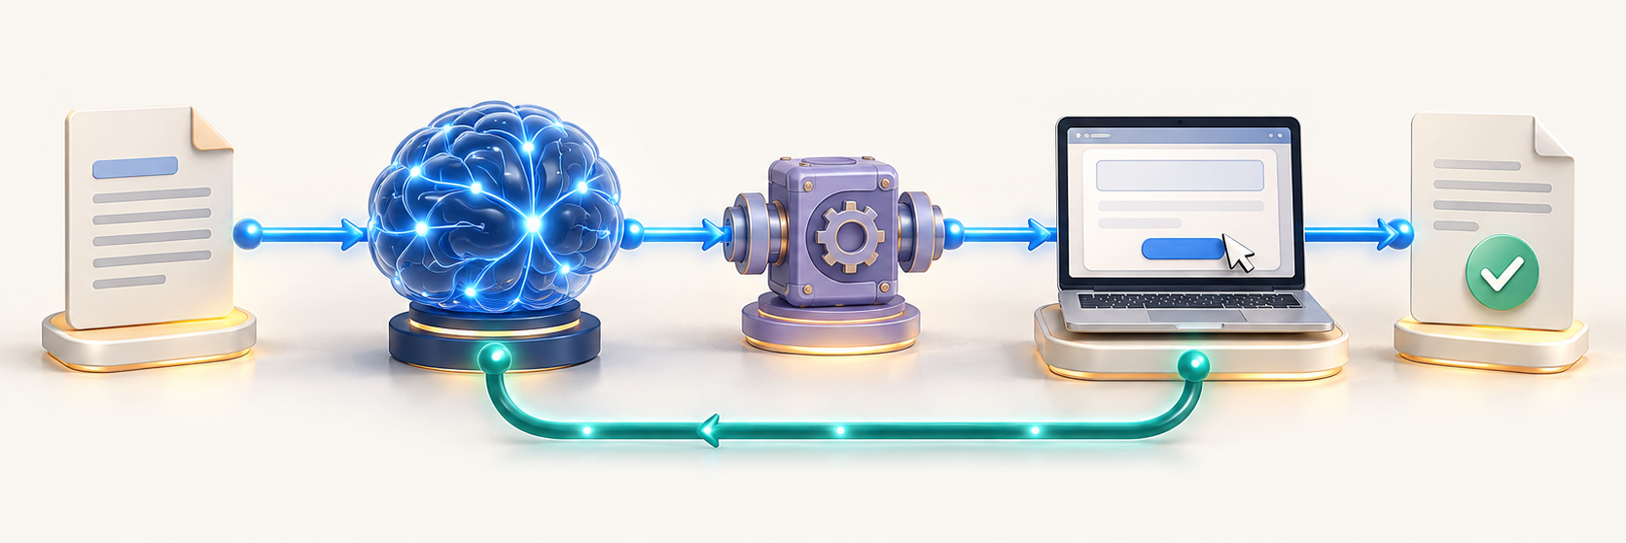
One request through the whole system
Your task
Model
CUA_REPL + CUA
Browser or app
Observed result
The returned observation gives the model new evidence
CODEX & COFFEE
DAY 5 · 13
Notes:
DAY 5 · One request through the whole system
SAY AND SHOW
Follow the request from left to right. The host makes tools available. The model proposes a tool call, the REPL executes the code, and the CUA API operates the selected surface. The model then receives the observation. The illustration groups the host, transport and execution adapter for clarity; it is not a proprietary wiring diagram.
SURFACE
All optional demos use the internal @Browser. The user does not need to write code to request Computer Use.
TIMING
Core explanation: 30 minutes in total. Read selected use cases; use the remaining examples as a reference.
SOURCES AND SCOPE
https://learn.chatgpt.com/docs/computer-use
https://learn.chatgpt.com/docs/browser
https://learn.chatgpt.com/docs/extend/mcp
https://developers.openai.com/api/docs/guides/tools-computer-use
https://developers.openai.com/api/docs/guides/tools-computer-use-sdk-drivers
CUA_REPL details come from the observed, exposed tool documentation in this teaching session. Public OpenAI Docs search returned no exact cua_repl page. Do not present this session’s wrapper as a universal public API.
VISUALS
Diagrams explain observable interfaces and responsibilities; they do not describe undisclosed model internals. Screenshots show fictional local fixtures. Concept art is an illustration, not execution evidence. Checked 30 October 2026.

Slide 14
A real CUA_REPL call
let tab = await
cua.createBrowserTab(
"iab", "http://127.0.0.1:4355/"
);
await tab.getAXState();
1
Keep a handle to this tab
2
Use the internal browser
3
Read its current state
This is the wrapper exposed in our session
CODEX & COFFEE
DAY 5 · 14
Notes:
DAY 5 · A real CUA_REPL call
SAY AND SHOW
Read the code in normal language. Let tab means save this tab reference. Await means wait for this operation to finish before the next line. iab selects the internal browser. getAXState asks for the current accessible or DOM-backed representation. Creating or binding a target can already return an initial observation in this wrapper. This root URL is illustrative; each demo supplies its exact route.
SURFACE
All optional demos use the internal @Browser. The user does not need to write code to request Computer Use.
TIMING
Core explanation: 30 minutes in total. Read selected use cases; use the remaining examples as a reference.
SOURCES AND SCOPE
https://learn.chatgpt.com/docs/computer-use
https://learn.chatgpt.com/docs/browser
https://learn.chatgpt.com/docs/extend/mcp
https://developers.openai.com/api/docs/guides/tools-computer-use
https://developers.openai.com/api/docs/guides/tools-computer-use-sdk-drivers
CUA_REPL details come from the observed, exposed tool documentation in this teaching session. Public OpenAI Docs search returned no exact cua_repl page. Do not present this session’s wrapper as a universal public API.
VISUALS
Diagrams explain observable interfaces and responsibilities; they do not describe undisclosed model internals. Screenshots show fictional local fixtures. Concept art is an illustration, not execution evidence. Checked 30 October 2026.

Slide 15
What stays alive between calls?
The REPL
The browser
The chat
Variables and tab handles
Current page and form state
Task and prior observations
These are separate kinds of state
CODEX & COFFEE
DAY 5 · 15
Notes:
DAY 5 · What stays alive between calls?
SAY AND SHOW
The JavaScript session can remember a tab handle while the browser keeps its own navigation and cookies. The conversation keeps the task and tool outputs. Resetting the REPL clears variables; it does not, by itself, mean the browser tab or its real-world effects were undone. A stale handle must be recovered through the supported interface.
SURFACE
All optional demos use the internal @Browser. The user does not need to write code to request Computer Use.
TIMING
Core explanation: 30 minutes in total. Read selected use cases; use the remaining examples as a reference.
SOURCES AND SCOPE
https://learn.chatgpt.com/docs/computer-use
https://learn.chatgpt.com/docs/browser
https://learn.chatgpt.com/docs/extend/mcp
https://developers.openai.com/api/docs/guides/tools-computer-use
https://developers.openai.com/api/docs/guides/tools-computer-use-sdk-drivers
CUA_REPL details come from the observed, exposed tool documentation in this teaching session. Public OpenAI Docs search returned no exact cua_repl page. Do not present this session’s wrapper as a universal public API.
VISUALS
Diagrams explain observable interfaces and responsibilities; they do not describe undisclosed model internals. Screenshots show fictional local fixtures. Concept art is an illustration, not execution evidence. Checked 30 October 2026.

Slide 16
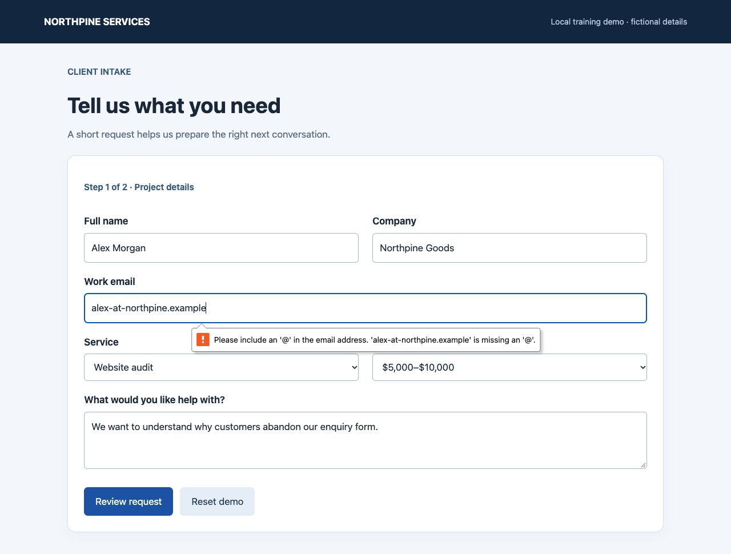
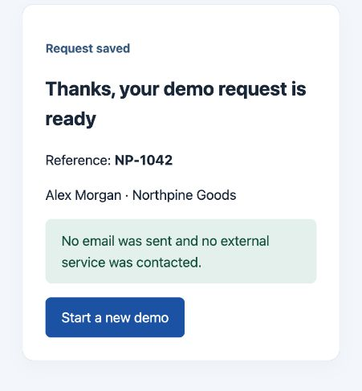
Does it watch every frame?
Think selected snapshots, not a constant video feed
Actions
+ app responses
Observation A
Observation B
CODEX & COFFEE
DAY 5 · 16
Notes:
DAY 5 · Does it watch every frame?
SAY AND SHOW
Directly answer the audience: no, this workflow does not continuously analyze every video frame as the mouse moves. It asks for selected observations. There can be several actions between observations. A screenshot shows one moment, so a transient error between captures could be missed. A recording can be useful evidence, but recording frames is not proof the model analyzed each one. Other computer-use systems can use different observation strategies.
SURFACE
All optional demos use the internal @Browser. The user does not need to write code to request Computer Use.
TIMING
Core explanation: 30 minutes in total. Read selected use cases; use the remaining examples as a reference.
SOURCES AND SCOPE
https://learn.chatgpt.com/docs/computer-use
https://learn.chatgpt.com/docs/browser
https://learn.chatgpt.com/docs/extend/mcp
https://developers.openai.com/api/docs/guides/tools-computer-use
https://developers.openai.com/api/docs/guides/tools-computer-use-sdk-drivers
CUA_REPL details come from the observed, exposed tool documentation in this teaching session. Public OpenAI Docs search returned no exact cua_repl page. Do not present this session’s wrapper as a universal public API.
VISUALS
Diagrams explain observable interfaces and responsibilities; they do not describe undisclosed model internals. Screenshots show fictional local fixtures. Concept art is an illustration, not execution evidence. Checked 30 October 2026.

Slide 17
A click, step by step
1
Read the current state
2
Choose a target
3
Send the click
4
Let the app respond
5
Observe again
6
Check the intended change
CODEX & COFFEE
DAY 5 · 17
Notes:
DAY 5 · A click, step by step
SAY AND SHOW
A click method is only one link in the chain. First choose a target from the current observation. Dispatch an input through the supported browser or app adapter. The target app processes it. Then observe the resulting state and compare it with the goal. This wrapper tells us to re-read state after actions. Some calls automatically supply an initial observation, but a bare click is not a universal guarantee of a screenshot.
SURFACE
All optional demos use the internal @Browser. The user does not need to write code to request Computer Use.
TIMING
Core explanation: 30 minutes in total. Read selected use cases; use the remaining examples as a reference.
SOURCES AND SCOPE
https://learn.chatgpt.com/docs/computer-use
https://learn.chatgpt.com/docs/browser
https://learn.chatgpt.com/docs/extend/mcp
https://developers.openai.com/api/docs/guides/tools-computer-use
https://developers.openai.com/api/docs/guides/tools-computer-use-sdk-drivers
CUA_REPL details come from the observed, exposed tool documentation in this teaching session. Public OpenAI Docs search returned no exact cua_repl page. Do not present this session’s wrapper as a universal public API.
VISUALS
Diagrams explain observable interfaces and responsibilities; they do not describe undisclosed model internals. Screenshots show fictional local fixtures. Concept art is an illustration, not execution evidence. Checked 30 October 2026.

Slide 18
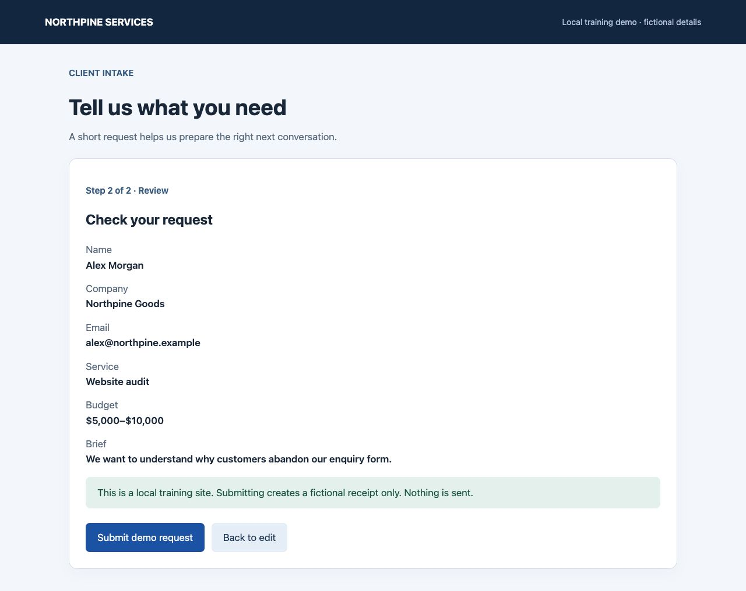
Why it looks again
The review controls existed here
The receipt exists here
CODEX & COFFEE
DAY 5 · 18
Notes:
DAY 5 · Why it looks again
SAY AND SHOW
The next screen supplies new evidence. The model can change its next action because the submission button has disappeared and a receipt is visible. Reusing the old control list after this change would be a mistake. This is exactly why fresh observations matter.
SURFACE
All optional demos use the internal @Browser. The user does not need to write code to request Computer Use.
TIMING
Core explanation: 30 minutes in total. Read selected use cases; use the remaining examples as a reference.
SOURCES AND SCOPE
https://learn.chatgpt.com/docs/computer-use
https://learn.chatgpt.com/docs/browser
https://learn.chatgpt.com/docs/extend/mcp
https://developers.openai.com/api/docs/guides/tools-computer-use
https://developers.openai.com/api/docs/guides/tools-computer-use-sdk-drivers
CUA_REPL details come from the observed, exposed tool documentation in this teaching session. Public OpenAI Docs search returned no exact cua_repl page. Do not present this session’s wrapper as a universal public API.
VISUALS
Diagrams explain observable interfaces and responsibilities; they do not describe undisclosed model internals. Screenshots show fictional local fixtures. Concept art is an illustration, not execution evidence. Checked 30 October 2026.

Slide 19
Pixels and structure answer different questions
Heading: Check your request
Name: Alex Morgan
Button: Submit demo request
Button: Back to edit
What does it look like?
What controls are exposed?
CODEX & COFFEE
DAY 5 · 19
Notes:
DAY 5 · Pixels and structure answer different questions
SAY AND SHOW
Pixels reveal alignment, clipping and visual hierarchy. A structured observation can expose a button’s role and label. It can be cheaper and more direct for selecting controls, but it is not a substitute for checking appearance. The shortened excerpt here is adapted from the observed intake state.
SURFACE
All optional demos use the internal @Browser. The user does not need to write code to request Computer Use.
TIMING
Core explanation: 30 minutes in total. Read selected use cases; use the remaining examples as a reference.
SOURCES AND SCOPE
https://learn.chatgpt.com/docs/computer-use
https://learn.chatgpt.com/docs/browser
https://learn.chatgpt.com/docs/extend/mcp
https://developers.openai.com/api/docs/guides/tools-computer-use
https://developers.openai.com/api/docs/guides/tools-computer-use-sdk-drivers
CUA_REPL details come from the observed, exposed tool documentation in this teaching session. Public OpenAI Docs search returned no exact cua_repl page. Do not present this session’s wrapper as a universal public API.
VISUALS
Diagrams explain observable interfaces and responsibilities; they do not describe undisclosed model internals. Screenshots show fictional local fixtures. Concept art is an illustration, not execution evidence. Checked 30 October 2026.

Slide 20
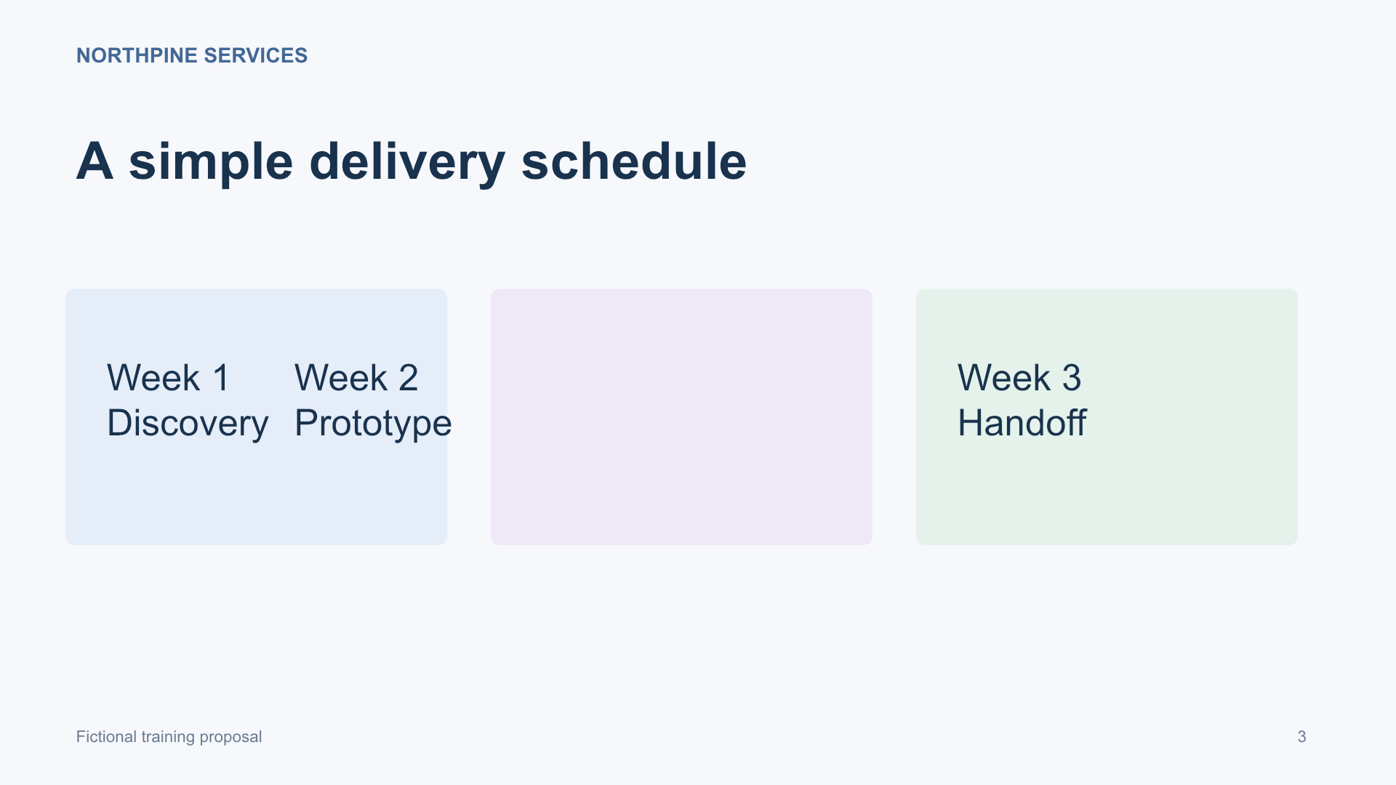
A screenshot is a view of one moment
It can show
Visible text
Layout
An open dialog
It cannot establish
Off-screen content
Hidden data
Whether a save persisted
CODEX & COFFEE
DAY 5 · 20
Notes:
DAY 5 · A screenshot is a view of one moment
SAY AND SHOW
A screenshot is useful evidence but not omniscience. The model may read visible text and infer likely controls. It can still misread small labels or miss subtle changes. Content outside the captured region, hidden tabs and database state require other observations. The underlying vision model’s exact internals are not documented here; do not claim a fixed pixel-scanning algorithm.
SURFACE
All optional demos use the internal @Browser. The user does not need to write code to request Computer Use.
TIMING
Core explanation: 30 minutes in total. Read selected use cases; use the remaining examples as a reference.
SOURCES AND SCOPE
https://learn.chatgpt.com/docs/computer-use
https://learn.chatgpt.com/docs/browser
https://learn.chatgpt.com/docs/extend/mcp
https://developers.openai.com/api/docs/guides/tools-computer-use
https://developers.openai.com/api/docs/guides/tools-computer-use-sdk-drivers
CUA_REPL details come from the observed, exposed tool documentation in this teaching session. Public OpenAI Docs search returned no exact cua_repl page. Do not present this session’s wrapper as a universal public API.
VISUALS
Diagrams explain observable interfaces and responsibilities; they do not describe undisclosed model internals. Screenshots show fictional local fixtures. Concept art is an illustration, not execution evidence. Checked 30 October 2026.

Slide 21
The structure behind a screen
DOM
Accessibility tree
A web page’s elements and properties
Controls described by roles and names
The app decides how much useful structure it exposes
CODEX & COFFEE
DAY 5 · 21
Notes:
DAY 5 · The structure behind a screen
SAY AND SHOW
DOM means Document Object Model: the browser’s structured representation of page elements. An accessibility tree describes controls in a form assistive tools can use. They are related, not identical. A canvas may expose very little. In a DOM-only tab, this wrapper’s getAXState can return a DOM-backed snapshot without numeric element indices.
SURFACE
All optional demos use the internal @Browser. The user does not need to write code to request Computer Use.
TIMING
Core explanation: 30 minutes in total. Read selected use cases; use the remaining examples as a reference.
SOURCES AND SCOPE
https://learn.chatgpt.com/docs/computer-use
https://learn.chatgpt.com/docs/browser
https://learn.chatgpt.com/docs/extend/mcp
https://developers.openai.com/api/docs/guides/tools-computer-use
https://developers.openai.com/api/docs/guides/tools-computer-use-sdk-drivers
CUA_REPL details come from the observed, exposed tool documentation in this teaching session. Public OpenAI Docs search returned no exact cua_repl page. Do not present this session’s wrapper as a universal public API.
VISUALS
Diagrams explain observable interfaces and responsibilities; they do not describe undisclosed model internals. Screenshots show fictional local fixtures. Concept art is an illustration, not execution evidence. Checked 30 October 2026.

Slide 22
Coordinates or a named control
await tab.click(
[620, 380]
);
await tab.playwright
.getByRole("button", {
name: "Review request",
exact: true
}).click();
“Click at this location”
“Find this button”
CODEX & COFFEE
DAY 5 · 22
Notes:
DAY 5 · Coordinates or a named control
SAY AND SHOW
These are examples from this session’s available wrappers, not universal APIs. A coordinate targets a point. A named locator targets a matching control in a supported browser tab. An accessible numeric index is another kind of target: it refers to the current observation, not a permanent page identifier. Some surfaces only support some of these methods.
SURFACE
All optional demos use the internal @Browser. The user does not need to write code to request Computer Use.
TIMING
Core explanation: 30 minutes in total. Read selected use cases; use the remaining examples as a reference.
SOURCES AND SCOPE
https://learn.chatgpt.com/docs/computer-use
https://learn.chatgpt.com/docs/browser
https://learn.chatgpt.com/docs/extend/mcp
https://developers.openai.com/api/docs/guides/tools-computer-use
https://developers.openai.com/api/docs/guides/tools-computer-use-sdk-drivers
CUA_REPL details come from the observed, exposed tool documentation in this teaching session. Public OpenAI Docs search returned no exact cua_repl page. Do not present this session’s wrapper as a universal public API.
VISUALS
Diagrams explain observable interfaces and responsibilities; they do not describe undisclosed model internals. Screenshots show fictional local fixtures. Concept art is an illustration, not execution evidence. Checked 30 October 2026.

Slide 23
Targets can go stale
Earlier observation
5 Button: Review request
New observation
5 Heading: Request saved
Same number. Different screen. Read it again.
CODEX & COFFEE
DAY 5 · 23
Notes:
DAY 5 · Targets can go stale
SAY AND SHOW
This is an illustrative excerpt, not a promise that the wrapper reuses that exact number. A rerender, dialog, navigation or scroll can invalidate an index or coordinate. A named locator can also fail if the label changes or multiple controls match. The answer is fresh evidence and a precise target, not blind repetition.
SURFACE
All optional demos use the internal @Browser. The user does not need to write code to request Computer Use.
TIMING
Core explanation: 30 minutes in total. Read selected use cases; use the remaining examples as a reference.
SOURCES AND SCOPE
https://learn.chatgpt.com/docs/computer-use
https://learn.chatgpt.com/docs/browser
https://learn.chatgpt.com/docs/extend/mcp
https://developers.openai.com/api/docs/guides/tools-computer-use
https://developers.openai.com/api/docs/guides/tools-computer-use-sdk-drivers
CUA_REPL details come from the observed, exposed tool documentation in this teaching session. Public OpenAI Docs search returned no exact cua_repl page. Do not present this session’s wrapper as a universal public API.
VISUALS
Diagrams explain observable interfaces and responsibilities; they do not describe undisclosed model internals. Screenshots show fictional local fixtures. Concept art is an illustration, not execution evidence. Checked 30 October 2026.

Slide 24
One call can contain several actions
await tab.playwright.getByLabel("Full name")
.fill("Alex Morgan");
await tab.playwright.getByLabel("Company")
.fill("Northpine Goods");
await tab.getAXState();
Batch predictable work, then inspect the result
CODEX & COFFEE
DAY 5 · 24
Notes:
DAY 5 · One call can contain several actions
SAY AND SHOW
A REPL call is not necessarily one mouse event. It can contain multiple awaited operations. Batch only actions whose dependencies are already understood. Stop and observe when a popup, navigation or unknown response could change what the next operation should target. Fewer calls are useful only if they preserve correctness.
SURFACE
All optional demos use the internal @Browser. The user does not need to write code to request Computer Use.
TIMING
Core explanation: 30 minutes in total. Read selected use cases; use the remaining examples as a reference.
SOURCES AND SCOPE
https://learn.chatgpt.com/docs/computer-use
https://learn.chatgpt.com/docs/browser
https://learn.chatgpt.com/docs/extend/mcp
https://developers.openai.com/api/docs/guides/tools-computer-use
https://developers.openai.com/api/docs/guides/tools-computer-use-sdk-drivers
CUA_REPL details come from the observed, exposed tool documentation in this teaching session. Public OpenAI Docs search returned no exact cua_repl page. Do not present this session’s wrapper as a universal public API.
VISUALS
Diagrams explain observable interfaces and responsibilities; they do not describe undisclosed model internals. Screenshots show fictional local fixtures. Concept art is an illustration, not execution evidence. Checked 30 October 2026.

Slide 25
Await does not mean the task is done
Input finished
Task finished
The click operation returned
The expected receipt or file exists
The application may still be loading or saving
CODEX & COFFEE
DAY 5 · 25
Notes:
DAY 5 · Await does not mean the task is done
SAY AND SHOW
Await gives the JavaScript operation a chance to finish before the next line. It does not prove a remote server accepted the request or a file finished saving. Some observation methods wait internally before capturing. Watch the returned state or a supported readiness signal rather than assuming an arbitrary sleep makes the workflow correct.
SURFACE
All optional demos use the internal @Browser. The user does not need to write code to request Computer Use.
TIMING
Core explanation: 30 minutes in total. Read selected use cases; use the remaining examples as a reference.
SOURCES AND SCOPE
https://learn.chatgpt.com/docs/computer-use
https://learn.chatgpt.com/docs/browser
https://learn.chatgpt.com/docs/extend/mcp
https://developers.openai.com/api/docs/guides/tools-computer-use
https://developers.openai.com/api/docs/guides/tools-computer-use-sdk-drivers
CUA_REPL details come from the observed, exposed tool documentation in this teaching session. Public OpenAI Docs search returned no exact cua_repl page. Do not present this session’s wrapper as a universal public API.
VISUALS
Diagrams explain observable interfaces and responsibilities; they do not describe undisclosed model internals. Screenshots show fictional local fixtures. Concept art is an illustration, not execution evidence. Checked 30 October 2026.

Slide 26
Scroll and zoom change the target
Original screenshot
1600 × 1200 display
Image sent to the model
800 × 600 image
Image point (400, 300) maps to display point (800, 600)
CODEX & COFFEE
DAY 5 · 26
Notes:
DAY 5 · Scroll and zoom change the target
SAY AND SHOW
This is a simple two-to-one scaling example. If a screenshot is cropped, also account for the crop offset. Browser CSS pixels and display pixels may differ. Scrolling changes the content at a location. For the current tool, use its documented coordinate system and the correct screenshot region; do not apply this example’s scale universally.
SURFACE
All optional demos use the internal @Browser. The user does not need to write code to request Computer Use.
TIMING
Core explanation: 30 minutes in total. Read selected use cases; use the remaining examples as a reference.
SOURCES AND SCOPE
https://learn.chatgpt.com/docs/computer-use
https://learn.chatgpt.com/docs/browser
https://learn.chatgpt.com/docs/extend/mcp
https://developers.openai.com/api/docs/guides/tools-computer-use
https://developers.openai.com/api/docs/guides/tools-computer-use-sdk-drivers
CUA_REPL details come from the observed, exposed tool documentation in this teaching session. Public OpenAI Docs search returned no exact cua_repl page. Do not present this session’s wrapper as a universal public API.
VISUALS
Diagrams explain observable interfaces and responsibilities; they do not describe undisclosed model internals. Screenshots show fictional local fixtures. Concept art is an illustration, not execution evidence. Checked 30 October 2026.

Slide 27
The returned observation
1
The selected page
0 AXWebArea: Project request
10 Heading: Check your request
32 Button: Submit demo request
33 Button: Back to edit
2
The controls it exposes
3
A fresh target for a later action
Adapted excerpt from the observed local intake form
CODEX & COFFEE
DAY 5 · 27
Notes:
DAY 5 · The returned observation
SAY AND SHOW
Read this as a structured report from the interface. The example preserves the role and labels observed in our intake rehearsal; the formatting is shortened for projection. The numeric IDs belong to that observation. A screenshot is a separate image observation. Errors are another possible result. The model can use the text to choose a supported target and then request pixels if it needs visual judgment.
SURFACE
All optional demos use the internal @Browser. The user does not need to write code to request Computer Use.
TIMING
Core explanation: 30 minutes in total. Read selected use cases; use the remaining examples as a reference.
SOURCES AND SCOPE
https://learn.chatgpt.com/docs/computer-use
https://learn.chatgpt.com/docs/browser
https://learn.chatgpt.com/docs/extend/mcp
https://developers.openai.com/api/docs/guides/tools-computer-use
https://developers.openai.com/api/docs/guides/tools-computer-use-sdk-drivers
CUA_REPL details come from the observed, exposed tool documentation in this teaching session. Public OpenAI Docs search returned no exact cua_repl page. Do not present this session’s wrapper as a universal public API.
VISUALS
Diagrams explain observable interfaces and responsibilities; they do not describe undisclosed model internals. Screenshots show fictional local fixtures. Concept art is an illustration, not execution evidence. Checked 30 October 2026.

Slide 28
Seeing the result is still a check
Requested
Executed
Observed
Verified
Export the filtered rows
The export control ran
A file downloaded
IDs and total match
CODEX & COFFEE
DAY 5 · 28
Notes:
DAY 5 · Seeing the result is still a check
SAY AND SHOW
There are two separate verification questions: did the operation happen, and is the result right? The browser download is evidence of one, and matching row IDs and totals is evidence of the other. A screenshot alone does not prove the underlying file contents.
SURFACE
All optional demos use the internal @Browser. The user does not need to write code to request Computer Use.
TIMING
Core explanation: 30 minutes in total. Read selected use cases; use the remaining examples as a reference.
SOURCES AND SCOPE
https://learn.chatgpt.com/docs/computer-use
https://learn.chatgpt.com/docs/browser
https://learn.chatgpt.com/docs/extend/mcp
https://developers.openai.com/api/docs/guides/tools-computer-use
https://developers.openai.com/api/docs/guides/tools-computer-use-sdk-drivers
CUA_REPL details come from the observed, exposed tool documentation in this teaching session. Public OpenAI Docs search returned no exact cua_repl page. Do not present this session’s wrapper as a universal public API.
VISUALS
Diagrams explain observable interfaces and responsibilities; they do not describe undisclosed model internals. Screenshots show fictional local fixtures. Concept art is an illustration, not execution evidence. Checked 30 October 2026.

Slide 29
Where time and tokens go
Observe
Text and image input
Decide
Model processing and output
Execute
Tool and application response
Check
Another observation when needed
CODEX & COFFEE
DAY 5 · 29
Notes:
DAY 5 · Where time and tokens go
SAY AND SHOW
More screenshots and more reasoning turns can mean more time and input. Size and detail can affect image cost in API use, but the exact calculation depends on the model and interface. Do not claim one click equals one fixed token charge. Reuse useful state, ask for the needed observation and avoid an endless screenshot loop. Do not cut the final correctness check to save a turn.
SURFACE
All optional demos use the internal @Browser. The user does not need to write code to request Computer Use.
TIMING
Core explanation: 30 minutes in total. Read selected use cases; use the remaining examples as a reference.
SOURCES AND SCOPE
https://learn.chatgpt.com/docs/computer-use
https://learn.chatgpt.com/docs/browser
https://learn.chatgpt.com/docs/extend/mcp
https://developers.openai.com/api/docs/guides/tools-computer-use
https://developers.openai.com/api/docs/guides/tools-computer-use-sdk-drivers
CUA_REPL details come from the observed, exposed tool documentation in this teaching session. Public OpenAI Docs search returned no exact cua_repl page. Do not present this session’s wrapper as a universal public API.
VISUALS
Diagrams explain observable interfaces and responsibilities; they do not describe undisclosed model internals. Screenshots show fictional local fixtures. Concept art is an illustration, not execution evidence. Checked 30 October 2026.

Slide 30
The boundaries are part of the machinery
Task
Access
Action
What the user authorized
Apps, sites and system permissions
What requires a person to approve
Text on a web page is task data, not new authority
CODEX & COFFEE
DAY 5 · 30
Notes:
DAY 5 · The boundaries are part of the machinery
SAY AND SHOW
A prompt can describe scope but cannot grant technical access. System permissions, app approvals and site restrictions are separate layers. A hostile page could ask the agent to send a document elsewhere; that is content to evaluate, not a new instruction from the user. Keep sending, buying, publishing and sensitive changes tied to the actual authorization. The examples in this deck do not grant permission to act on real accounts.
SURFACE
All optional demos use the internal @Browser. The user does not need to write code to request Computer Use.
TIMING
Core explanation: 30 minutes in total. Read selected use cases; use the remaining examples as a reference.
SOURCES AND SCOPE
https://learn.chatgpt.com/docs/computer-use
https://learn.chatgpt.com/docs/browser
https://learn.chatgpt.com/docs/extend/mcp
https://developers.openai.com/api/docs/guides/tools-computer-use
https://developers.openai.com/api/docs/guides/tools-computer-use-sdk-drivers
CUA_REPL details come from the observed, exposed tool documentation in this teaching session. Public OpenAI Docs search returned no exact cua_repl page. Do not present this session’s wrapper as a universal public API.
VISUALS
Diagrams explain observable interfaces and responsibilities; they do not describe undisclosed model internals. Screenshots show fictional local fixtures. Concept art is an illustration, not execution evidence. Checked 30 October 2026.

Slide 31
The complete working loop
Observe
Decide
Act
Get current evidence
Choose the next bounded action
Use the supported tool
Check
If complete, report the evidence and stop
Compare with the goal
CODEX & COFFEE
DAY 5 · 31
Notes:
DAY 5 · The complete working loop
SAY AND SHOW
Tell the whole story once without the terminology: look at where you are, choose a sensible next step, perform it, and check what happened. If there is more to do, loop with the new evidence. If the result meets the task, report it and stop. If the action is uncertain, reconcile the state before retrying.
SURFACE
All optional demos use the internal @Browser. The user does not need to write code to request Computer Use.
TIMING
Core explanation: 30 minutes in total. Read selected use cases; use the remaining examples as a reference.
SOURCES AND SCOPE
https://learn.chatgpt.com/docs/computer-use
https://learn.chatgpt.com/docs/browser
https://learn.chatgpt.com/docs/extend/mcp
https://developers.openai.com/api/docs/guides/tools-computer-use
https://developers.openai.com/api/docs/guides/tools-computer-use-sdk-drivers
CUA_REPL details come from the observed, exposed tool documentation in this teaching session. Public OpenAI Docs search returned no exact cua_repl page. Do not present this session’s wrapper as a universal public API.
VISUALS
Diagrams explain observable interfaces and responsibilities; they do not describe undisclosed model internals. Screenshots show fictional local fixtures. Concept art is an illustration, not execution evidence. Checked 30 October 2026.

Slide 32
Where the loop can break
The observation misses something
Small text, off-screen content or a brief error
1
The target changes
A popup, navigation or rerender
2
The action is unsupported
A missing control or an app restriction
3
The result is uncertain
A timeout after a save or submission
4
CODEX & COFFEE
DAY 5 · 32
Notes:
DAY 5 · Where the loop can break
SAY AND SHOW
Each failure suggests a different response. Get better evidence, recover the target, use a supported route, or ask a person to take over. A timeout does not mean nothing happened. Repeating a submit after uncertainty could create a duplicate. Authentication challenges and some protected actions require human interaction.
SURFACE
All optional demos use the internal @Browser. The user does not need to write code to request Computer Use.
TIMING
Core explanation: 30 minutes in total. Read selected use cases; use the remaining examples as a reference.
SOURCES AND SCOPE
https://learn.chatgpt.com/docs/computer-use
https://learn.chatgpt.com/docs/browser
https://learn.chatgpt.com/docs/extend/mcp
https://developers.openai.com/api/docs/guides/tools-computer-use
https://developers.openai.com/api/docs/guides/tools-computer-use-sdk-drivers
CUA_REPL details come from the observed, exposed tool documentation in this teaching session. Public OpenAI Docs search returned no exact cua_repl page. Do not present this session’s wrapper as a universal public API.
VISUALS
Diagrams explain observable interfaces and responsibilities; they do not describe undisclosed model internals. Screenshots show fictional local fixtures. Concept art is an illustration, not execution evidence. Checked 30 October 2026.

Slide 33
A better job to give Computer Use
“Use the internal browser to check this intake form.
Try one invalid email, then correct it and finish the flow.
Save the error, review and confirmation screenshots.
Tell me what worked, what failed and what you could not verify.”
CODEX & COFFEE
DAY 5 · 33
Notes:
DAY 5 · A better job to give Computer Use
SAY AND SHOW
This is a conversational example of task shape; the optional demo uses the full exact prompt with local URL and fictional inputs. Name the surface, goal, boundary, deliverable and check. The user does not need to write JavaScript; the model can select tools and write the operational code.
SURFACE
All optional demos use the internal @Browser. The user does not need to write code to request Computer Use.
TIMING
Core explanation: 30 minutes in total. Read selected use cases; use the remaining examples as a reference.
SOURCES AND SCOPE
https://learn.chatgpt.com/docs/computer-use
https://learn.chatgpt.com/docs/browser
https://learn.chatgpt.com/docs/extend/mcp
https://developers.openai.com/api/docs/guides/tools-computer-use
https://developers.openai.com/api/docs/guides/tools-computer-use-sdk-drivers
CUA_REPL details come from the observed, exposed tool documentation in this teaching session. Public OpenAI Docs search returned no exact cua_repl page. Do not present this session’s wrapper as a universal public API.
VISUALS
Diagrams explain observable interfaces and responsibilities; they do not describe undisclosed model internals. Screenshots show fictional local fixtures. Concept art is an illustration, not execution evidence. Checked 30 October 2026.

Slide 34
Choose a walkthrough when it helps
Review a proposal
Five slides with deliberate problems
35
Test a customer journey
Validation, correction and a receipt
40
Export business records
A download checked against the screen
44
CODEX & COFFEE
DAY 5 · 34
Notes:
DAY 5 · Choose a walkthrough when it helps
SAY AND SHOW
The main explanation can stop here. Invite a question, then choose the most useful prepared walkthrough. Each demo is independent and remains staged until you say Run the live demo. There is no need to run all three or depend on anything from an earlier day.
SURFACE
All optional demos use the internal @Browser. The user does not need to write code to request Computer Use.
TIMING
Core explanation: 30 minutes in total. Read selected use cases; use the remaining examples as a reference.
SOURCES AND SCOPE
https://learn.chatgpt.com/docs/computer-use
https://learn.chatgpt.com/docs/browser
https://learn.chatgpt.com/docs/extend/mcp
https://developers.openai.com/api/docs/guides/tools-computer-use
https://developers.openai.com/api/docs/guides/tools-computer-use-sdk-drivers
CUA_REPL details come from the observed, exposed tool documentation in this teaching session. Public OpenAI Docs search returned no exact cua_repl page. Do not present this session’s wrapper as a universal public API.
VISUALS
Diagrams explain observable interfaces and responsibilities; they do not describe undisclosed model internals. Screenshots show fictional local fixtures. Concept art is an illustration, not execution evidence. Checked 30 October 2026.

Slide 35
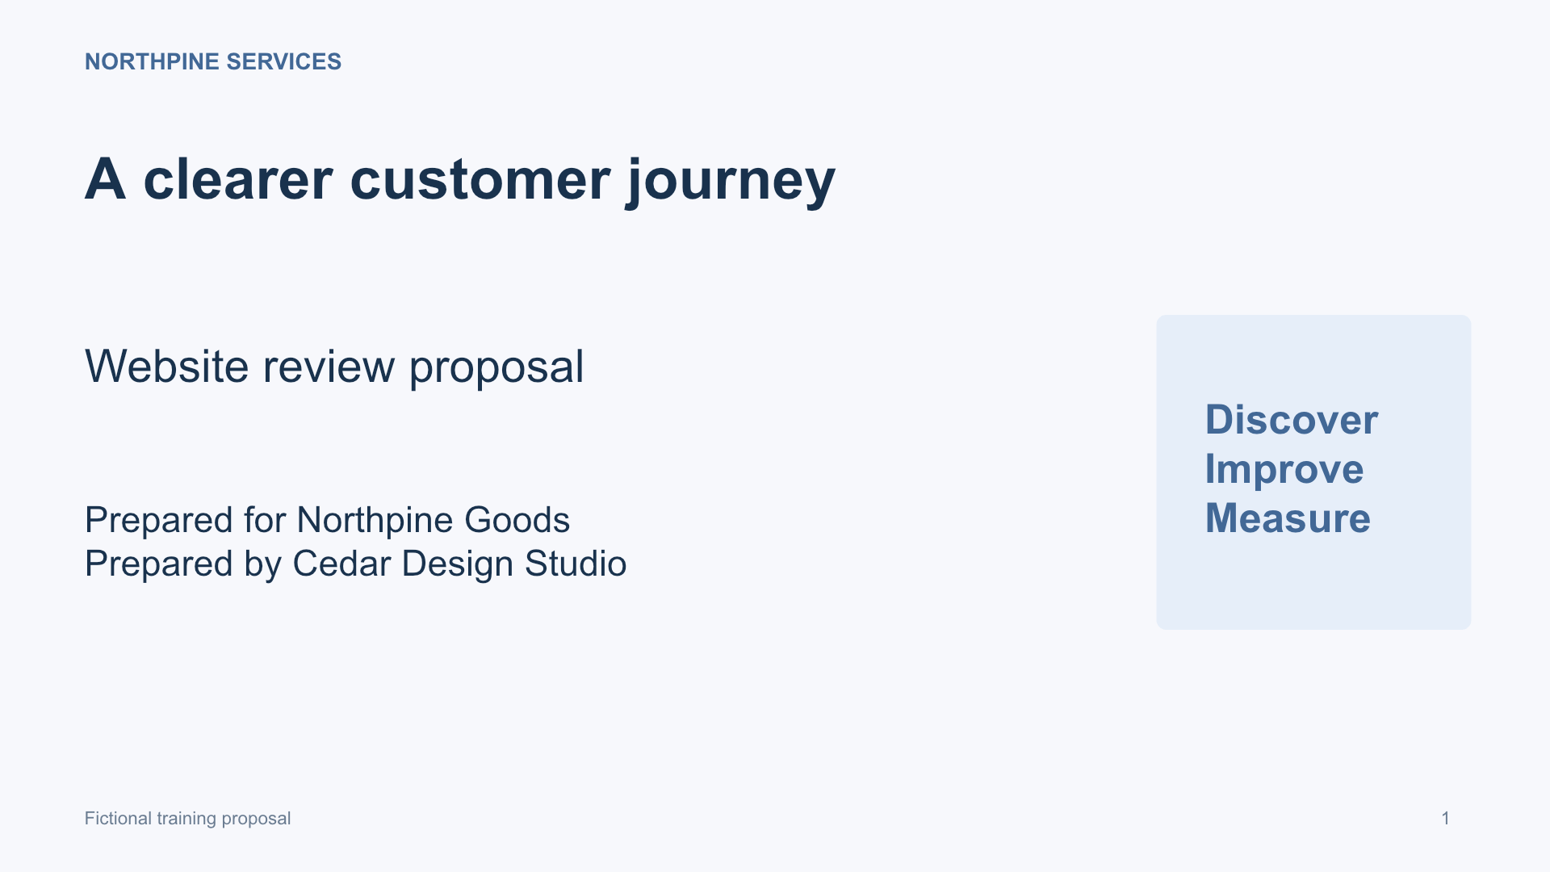
Demo 1: a second pair of eyes
A proposal is ready to send
Can Codex spot the problems before a client does?
Chat: 35 · Demo 1 — Review a PowerPoint
CODEX & COFFEE
DAY 5 · 35 · OPTIONAL
Notes:
DAY 5 · Demo 1: a second pair of eyes
SAY AND SHOW
Open the staged chat “35 · Demo 1 — Review a PowerPoint”. Start with the browser viewer at /01-review-powerpoint/portal/. Explain that the five-slide proposal contains deliberate training defects. Do not give away the answer key yet.
SURFACE
All optional demos use the internal @Browser. The user does not need to write code to request Computer Use.
TIMING
Optional walkthrough or reference within the 15-minute Q&A. Choose what answers the audience’s question.
SOURCES AND SCOPE
https://learn.chatgpt.com/docs/computer-use
https://learn.chatgpt.com/docs/browser
https://learn.chatgpt.com/docs/extend/mcp
https://developers.openai.com/api/docs/guides/tools-computer-use
https://developers.openai.com/api/docs/guides/tools-computer-use-sdk-drivers
CUA_REPL details come from the observed, exposed tool documentation in this teaching session. Public OpenAI Docs search returned no exact cua_repl page. Do not present this session’s wrapper as a universal public API.
VISUALS
Diagrams explain observable interfaces and responsibilities; they do not describe undisclosed model internals. Screenshots show fictional local fixtures. Concept art is an illustration, not execution evidence. Checked 30 October 2026.

Slide 36
The exact request
Paste into the matching staged chat, or say “Run the live demo”
Use Computer Use in the built-in internal browser (@Browser) to open http://127.0.0.1:4355/01-review-powerpoint/portal/. Review all five rendered slides with the viewer controls. Look for clipped or overlapping content, hard-to-read text and inconsistent figures. Do not edit the deck. Save a screenshot of each slide in output/ and write output/review.md with slide numbers, observed issues and specific suggested fixes. These are rendered previews of input/client-proposal.pptx, not native PowerPoint. Do not claim to have reviewed the file in Microsoft PowerPoint. Do not inspect slide XML or source code, and do not use Chrome, external browsers or personal tabs.
Copyable file: demos/01-review-powerpoint/PROMPT.txt
CODEX & COFFEE
DAY 5 · 36 · OPTIONAL
Notes:
DAY 5 · The exact request
SAY AND SHOW
SHOW
Open the staged chat associated with the previous slide. The task is already read and waiting.
EXACT PROMPT
Use Computer Use in the built-in internal browser (@Browser) to open http://127.0.0.1:4355/01-review-powerpoint/portal/. Review all five rendered slides with the viewer controls. Look for clipped or overlapping content, hard-to-read text and inconsistent figures. Do not edit the deck. Save a screenshot of each slide in output/ and write output/review.md with slide numbers, observed issues and specific suggested fixes. These are rendered previews of input/client-proposal.pptx, not native PowerPoint. Do not claim to have reviewed the file in Microsoft PowerPoint. Do not inspect slide XML or source code, and do not use Chrome, external browsers or personal tabs.
CHECK
Wait for the actual output and compare it with the screenshot. If the tool is unavailable, state the limitation; do not replace the UI task with a source parser.
SURFACE
All optional demos use the internal @Browser. The user does not need to write code to request Computer Use.
TIMING
Optional walkthrough or reference within the 15-minute Q&A. Choose what answers the audience’s question.
SOURCES AND SCOPE
https://learn.chatgpt.com/docs/computer-use
https://learn.chatgpt.com/docs/browser
https://learn.chatgpt.com/docs/extend/mcp
https://developers.openai.com/api/docs/guides/tools-computer-use
https://developers.openai.com/api/docs/guides/tools-computer-use-sdk-drivers
CUA_REPL details come from the observed, exposed tool documentation in this teaching session. Public OpenAI Docs search returned no exact cua_repl page. Do not present this session’s wrapper as a universal public API.
VISUALS
Diagrams explain observable interfaces and responsibilities; they do not describe undisclosed model internals. Screenshots show fictional local fixtures. Concept art is an illustration, not execution evidence. Checked 30 October 2026.

Slide 37
The findings need visible evidence
1
Week 2 sits in the first column
2
The middle column is empty
2
1
CODEX & COFFEE
DAY 5 · 37 · OPTIONAL
Notes:
DAY 5 · The findings need visible evidence
SAY AND SHOW
Reveal only after the live review. This is one deliberately seeded issue. Compare the agent’s claim with the actual image, then inspect its other findings. A plausible-sounding report can still miss an issue or invent one.
SURFACE
All optional demos use the internal @Browser. The user does not need to write code to request Computer Use.
TIMING
Optional walkthrough or reference within the 15-minute Q&A. Choose what answers the audience’s question.
SOURCES AND SCOPE
https://learn.chatgpt.com/docs/computer-use
https://learn.chatgpt.com/docs/browser
https://learn.chatgpt.com/docs/extend/mcp
https://developers.openai.com/api/docs/guides/tools-computer-use
https://developers.openai.com/api/docs/guides/tools-computer-use-sdk-drivers
CUA_REPL details come from the observed, exposed tool documentation in this teaching session. Public OpenAI Docs search returned no exact cua_repl page. Do not present this session’s wrapper as a universal public API.
VISUALS
Diagrams explain observable interfaces and responsibilities; they do not describe undisclosed model internals. Screenshots show fictional local fixtures. Concept art is an illustration, not execution evidence. Checked 30 October 2026.

Slide 38
The proposal-review X-ray
Open tab
Read screen
Inspect
Report
The prepared viewer
Find slide controls
Capture each slide
Specific fixes by slide
Five screenshots + review.md
CODEX & COFFEE
DAY 5 · 38 · OPTIONAL
Notes:
DAY 5 · The proposal-review X-ray
SAY AND SHOW
Expand one actual tool call in the live chat and its returned observation. Show how it moved to the next slide and why it checked again. This schematic describes the intended procedure; use the real chat for the actual trace.
SURFACE
All optional demos use the internal @Browser. The user does not need to write code to request Computer Use.
TIMING
Optional walkthrough or reference within the 15-minute Q&A. Choose what answers the audience’s question.
SOURCES AND SCOPE
https://learn.chatgpt.com/docs/computer-use
https://learn.chatgpt.com/docs/browser
https://learn.chatgpt.com/docs/extend/mcp
https://developers.openai.com/api/docs/guides/tools-computer-use
https://developers.openai.com/api/docs/guides/tools-computer-use-sdk-drivers
CUA_REPL details come from the observed, exposed tool documentation in this teaching session. Public OpenAI Docs search returned no exact cua_repl page. Do not present this session’s wrapper as a universal public API.
VISUALS
Diagrams explain observable interfaces and responsibilities; they do not describe undisclosed model internals. Screenshots show fictional local fixtures. Concept art is an illustration, not execution evidence. Checked 30 October 2026.

Slide 39
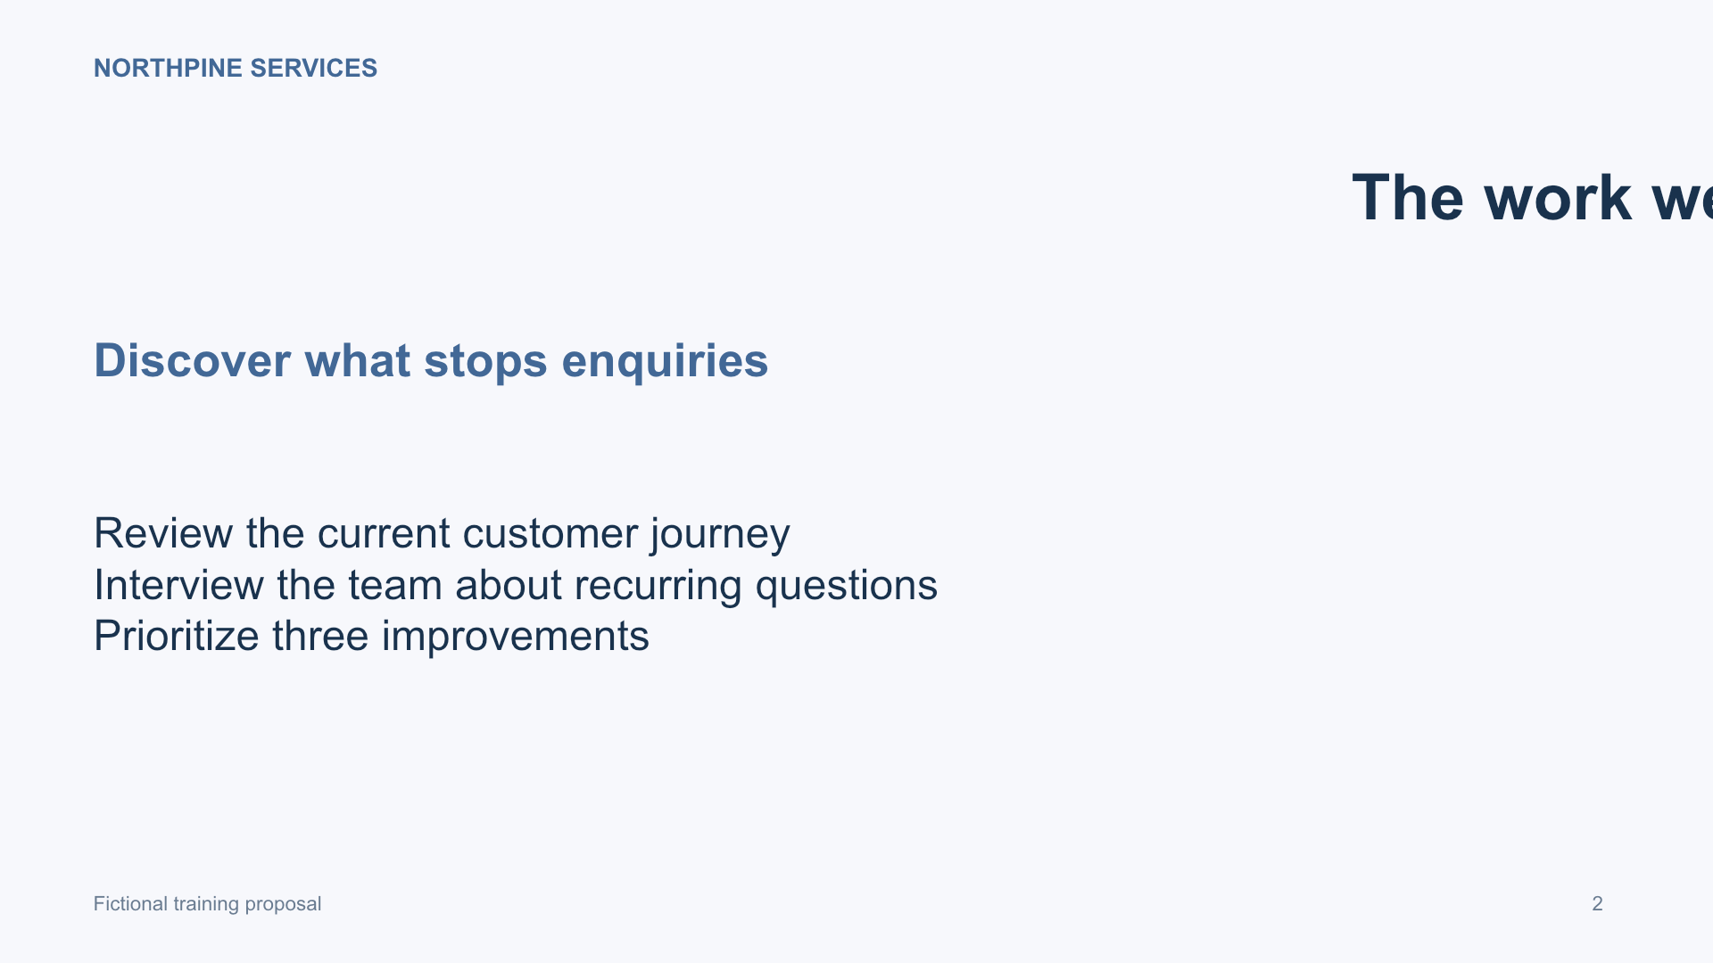
A valid file can still look wrong
The file opens
The title clips
Visual review catches a different class of issue
CODEX & COFFEE
DAY 5 · 39 · OPTIONAL
Notes:
DAY 5 · A valid file can still look wrong
SAY AND SHOW
The title extends beyond the right edge in the intentionally flawed proposal. Parsing the PPTX does not prove readable layout. This demonstration uses rendered previews, so it does not claim native PowerPoint compatibility.
SURFACE
All optional demos use the internal @Browser. The user does not need to write code to request Computer Use.
TIMING
Optional walkthrough or reference within the 15-minute Q&A. Choose what answers the audience’s question.
SOURCES AND SCOPE
https://learn.chatgpt.com/docs/computer-use
https://learn.chatgpt.com/docs/browser
https://learn.chatgpt.com/docs/extend/mcp
https://developers.openai.com/api/docs/guides/tools-computer-use
https://developers.openai.com/api/docs/guides/tools-computer-use-sdk-drivers
CUA_REPL details come from the observed, exposed tool documentation in this teaching session. Public OpenAI Docs search returned no exact cua_repl page. Do not present this session’s wrapper as a universal public API.
VISUALS
Diagrams explain observable interfaces and responsibilities; they do not describe undisclosed model internals. Screenshots show fictional local fixtures. Concept art is an illustration, not execution evidence. Checked 30 October 2026.

Slide 40
Demo 2: act like a new customer
A services firm’s intake form
One bad email
One correction
One confirmed request
Chat: 40 · Demo 2 — Test client intake
CODEX & COFFEE
DAY 5 · 40 · OPTIONAL
Notes:
DAY 5 · Demo 2: act like a new customer
SAY AND SHOW
Reload the local intake page first so the training notice returns. The prompt supplies all fictional details. Start the staged chat with “Run the live demo”.
SURFACE
All optional demos use the internal @Browser. The user does not need to write code to request Computer Use.
TIMING
Optional walkthrough or reference within the 15-minute Q&A. Choose what answers the audience’s question.
SOURCES AND SCOPE
https://learn.chatgpt.com/docs/computer-use
https://learn.chatgpt.com/docs/browser
https://learn.chatgpt.com/docs/extend/mcp
https://developers.openai.com/api/docs/guides/tools-computer-use
https://developers.openai.com/api/docs/guides/tools-computer-use-sdk-drivers
CUA_REPL details come from the observed, exposed tool documentation in this teaching session. Public OpenAI Docs search returned no exact cua_repl page. Do not present this session’s wrapper as a universal public API.
VISUALS
Diagrams explain observable interfaces and responsibilities; they do not describe undisclosed model internals. Screenshots show fictional local fixtures. Concept art is an illustration, not execution evidence. Checked 30 October 2026.

Slide 41
The exact request
Paste into the matching staged chat, or say “Run the live demo”
Use Computer Use in the built-in internal browser (@Browser) to test http://127.0.0.1:4355/02-client-intake/portal/. Dismiss the training notice. Enter Alex Morgan, Northpine Goods, Website audit, $5,000–$10,000, and the brief: We want to understand why customers abandon our enquiry form. First try the invalid email alex-at-northpine.example and check the visible validation. Correct it to alex@northpine.example. Review the details, then submit this local demo request. Save screenshots of the validation, review and confirmation in output/. Write output/test-report.md with what happened and the receipt reference. Use visible controls; do not bypass the UI or change the site code. Do not use Chrome, another external browser, or existing personal browser tabs.
Copyable file: demos/02-client-intake/PROMPT.txt
CODEX & COFFEE
DAY 5 · 41 · OPTIONAL
Notes:
DAY 5 · The exact request
SAY AND SHOW
SHOW
Open the staged chat associated with the previous slide. The task is already read and waiting.
EXACT PROMPT
Use Computer Use in the built-in internal browser (@Browser) to test http://127.0.0.1:4355/02-client-intake/portal/. Dismiss the training notice. Enter Alex Morgan, Northpine Goods, Website audit, $5,000–$10,000, and the brief: We want to understand why customers abandon our enquiry form. First try the invalid email alex-at-northpine.example and check the visible validation. Correct it to alex@northpine.example. Review the details, then submit this local demo request. Save screenshots of the validation, review and confirmation in output/. Write output/test-report.md with what happened and the receipt reference. Use visible controls; do not bypass the UI or change the site code. Do not use Chrome, another external browser, or existing personal browser tabs.
CHECK
Wait for the actual output and compare it with the screenshot. If the tool is unavailable, state the limitation; do not replace the UI task with a source parser.
SURFACE
All optional demos use the internal @Browser. The user does not need to write code to request Computer Use.
TIMING
Optional walkthrough or reference within the 15-minute Q&A. Choose what answers the audience’s question.
SOURCES AND SCOPE
https://learn.chatgpt.com/docs/computer-use
https://learn.chatgpt.com/docs/browser
https://learn.chatgpt.com/docs/extend/mcp
https://developers.openai.com/api/docs/guides/tools-computer-use
https://developers.openai.com/api/docs/guides/tools-computer-use-sdk-drivers
CUA_REPL details come from the observed, exposed tool documentation in this teaching session. Public OpenAI Docs search returned no exact cua_repl page. Do not present this session’s wrapper as a universal public API.
VISUALS
Diagrams explain observable interfaces and responsibilities; they do not describe undisclosed model internals. Screenshots show fictional local fixtures. Concept art is an illustration, not execution evidence. Checked 30 October 2026.

Slide 42
An error is part of this test
1
Invalid email entered deliberately
2
Observe the validation
1
2
3
Correct and continue
3
CODEX & COFFEE
DAY 5 · 42 · OPTIONAL
Notes:
DAY 5 · An error is part of this test
SAY AND SHOW
Read the actual validation rather than guessing. Native browser wording may vary. Correct the email to the supplied valid fictional address and verify the review screen before submitting.
SURFACE
All optional demos use the internal @Browser. The user does not need to write code to request Computer Use.
TIMING
Optional walkthrough or reference within the 15-minute Q&A. Choose what answers the audience’s question.
SOURCES AND SCOPE
https://learn.chatgpt.com/docs/computer-use
https://learn.chatgpt.com/docs/browser
https://learn.chatgpt.com/docs/extend/mcp
https://developers.openai.com/api/docs/guides/tools-computer-use
https://developers.openai.com/api/docs/guides/tools-computer-use-sdk-drivers
CUA_REPL details come from the observed, exposed tool documentation in this teaching session. Public OpenAI Docs search returned no exact cua_repl page. Do not present this session’s wrapper as a universal public API.
VISUALS
Diagrams explain observable interfaces and responsibilities; they do not describe undisclosed model internals. Screenshots show fictional local fixtures. Concept art is an illustration, not execution evidence. Checked 30 October 2026.

Slide 43
The confirmation is the evidence
NP-1042
The receipt reference belongs in the report
This training form sends no email
CODEX & COFFEE
DAY 5 · 43 · OPTIONAL
Notes:
DAY 5 · The confirmation is the evidence
SAY AND SHOW
This is the rehearsal’s visible local receipt. In the live run, confirm the actual receipt and screenshot. A broader production application would also need server, data and delivery checks; this exercise verifies the requested UI path only.
SURFACE
All optional demos use the internal @Browser. The user does not need to write code to request Computer Use.
TIMING
Optional walkthrough or reference within the 15-minute Q&A. Choose what answers the audience’s question.
SOURCES AND SCOPE
https://learn.chatgpt.com/docs/computer-use
https://learn.chatgpt.com/docs/browser
https://learn.chatgpt.com/docs/extend/mcp
https://developers.openai.com/api/docs/guides/tools-computer-use
https://developers.openai.com/api/docs/guides/tools-computer-use-sdk-drivers
CUA_REPL details come from the observed, exposed tool documentation in this teaching session. Public OpenAI Docs search returned no exact cua_repl page. Do not present this session’s wrapper as a universal public API.
VISUALS
Diagrams explain observable interfaces and responsibilities; they do not describe undisclosed model internals. Screenshots show fictional local fixtures. Concept art is an illustration, not execution evidence. Checked 30 October 2026.

Slide 44
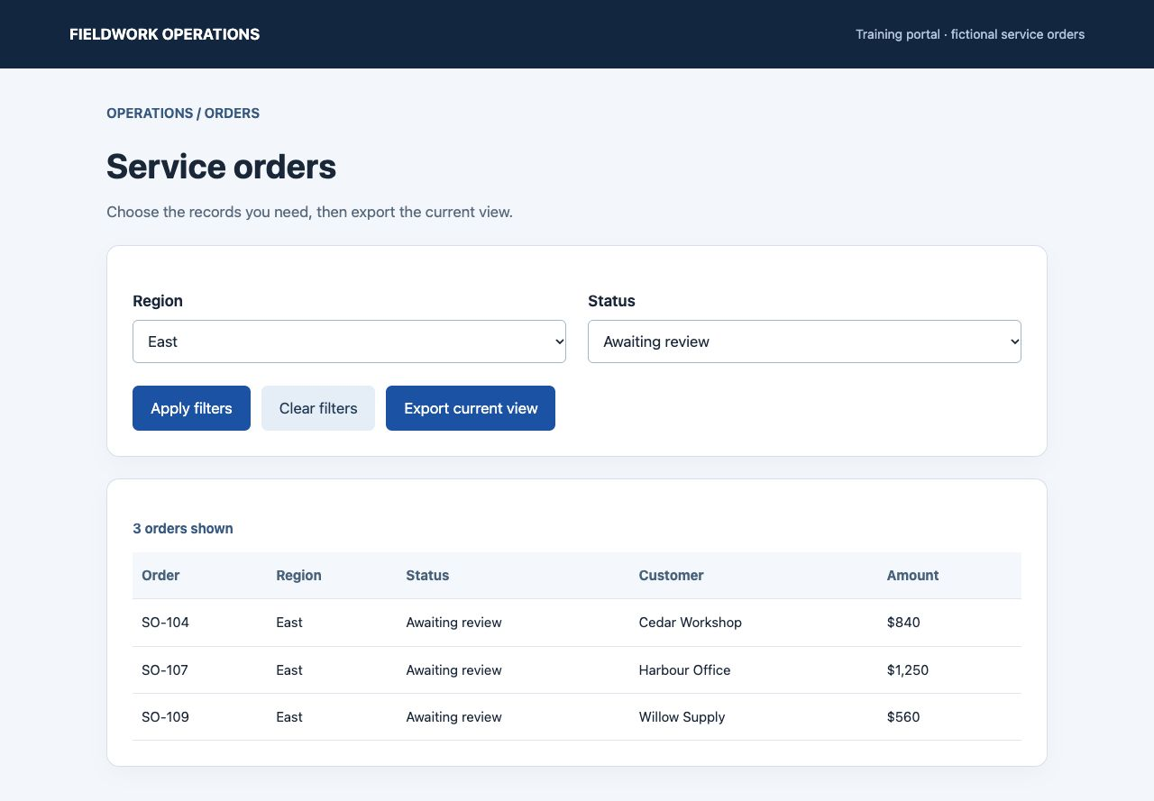
Demo 3: the records you need
An operations portal
East region
Awaiting review
Chat: 44 · Demo 3 — Export filtered orders
CODEX & COFFEE
DAY 5 · 44 · OPTIONAL
Notes:
DAY 5 · Demo 3: the records you need
SAY AND SHOW
Reset to all eight orders before starting the staged chat. Ask the agent to apply the two filters and use the export controls. The CSV verification happens after the browser download.
SURFACE
All optional demos use the internal @Browser. The user does not need to write code to request Computer Use.
TIMING
Optional walkthrough or reference within the 15-minute Q&A. Choose what answers the audience’s question.
SOURCES AND SCOPE
https://learn.chatgpt.com/docs/computer-use
https://learn.chatgpt.com/docs/browser
https://learn.chatgpt.com/docs/extend/mcp
https://developers.openai.com/api/docs/guides/tools-computer-use
https://developers.openai.com/api/docs/guides/tools-computer-use-sdk-drivers
CUA_REPL details come from the observed, exposed tool documentation in this teaching session. Public OpenAI Docs search returned no exact cua_repl page. Do not present this session’s wrapper as a universal public API.
VISUALS
Diagrams explain observable interfaces and responsibilities; they do not describe undisclosed model internals. Screenshots show fictional local fixtures. Concept art is an illustration, not execution evidence. Checked 30 October 2026.

Slide 45
The exact request
Paste into the matching staged chat, or say “Run the live demo”
Use Computer Use in the built-in internal browser (@Browser) to open http://127.0.0.1:4355/03-export-orders/portal/. Show only East region orders with status Awaiting review, apply the filters, then export the current view using the website controls. Check the export confirmation before downloading. Save a screenshot of the filtered table in output/. Copy the downloaded CSV into output/service-orders.csv, then inspect that downloaded file and write output/export-check.md with its row count, order IDs and total amount. Do not fetch the page data, read the source or generate a substitute CSV. Report any step you could not complete. Do not use Chrome, another external browser, or existing personal browser tabs.
Copyable file: demos/03-export-orders/PROMPT.txt
CODEX & COFFEE
DAY 5 · 45 · OPTIONAL
Notes:
DAY 5 · The exact request
SAY AND SHOW
SHOW
Open the staged chat associated with the previous slide. The task is already read and waiting.
EXACT PROMPT
Use Computer Use in the built-in internal browser (@Browser) to open http://127.0.0.1:4355/03-export-orders/portal/. Show only East region orders with status Awaiting review, apply the filters, then export the current view using the website controls. Check the export confirmation before downloading. Save a screenshot of the filtered table in output/. Copy the downloaded CSV into output/service-orders.csv, then inspect that downloaded file and write output/export-check.md with its row count, order IDs and total amount. Do not fetch the page data, read the source or generate a substitute CSV. Report any step you could not complete. Do not use Chrome, another external browser, or existing personal browser tabs.
CHECK
Wait for the actual output and compare it with the screenshot. If the tool is unavailable, state the limitation; do not replace the UI task with a source parser.
SURFACE
All optional demos use the internal @Browser. The user does not need to write code to request Computer Use.
TIMING
Optional walkthrough or reference within the 15-minute Q&A. Choose what answers the audience’s question.
SOURCES AND SCOPE
https://learn.chatgpt.com/docs/computer-use
https://learn.chatgpt.com/docs/browser
https://learn.chatgpt.com/docs/extend/mcp
https://developers.openai.com/api/docs/guides/tools-computer-use
https://developers.openai.com/api/docs/guides/tools-computer-use-sdk-drivers
CUA_REPL details come from the observed, exposed tool documentation in this teaching session. Public OpenAI Docs search returned no exact cua_repl page. Do not present this session’s wrapper as a universal public API.
VISUALS
Diagrams explain observable interfaces and responsibilities; they do not describe undisclosed model internals. Screenshots show fictional local fixtures. Concept art is an illustration, not execution evidence. Checked 30 October 2026.

Slide 46
Does the file match the screen?
order_id amount
SO-104 840
SO-107 1,250
SO-109 560
3 rows 2,650
Rehearsal result · compare with the live download
CODEX & COFFEE
DAY 5 · 46 · OPTIONAL
Notes:
DAY 5 · Does the file match the screen?
SAY AND SHOW
The displayed table and CSV excerpt are from the actual rehearsal. Compare row IDs, row count and total, not just the filename. The full CSV contains region, status and customer columns too.
SURFACE
All optional demos use the internal @Browser. The user does not need to write code to request Computer Use.
TIMING
Optional walkthrough or reference within the 15-minute Q&A. Choose what answers the audience’s question.
SOURCES AND SCOPE
https://learn.chatgpt.com/docs/computer-use
https://learn.chatgpt.com/docs/browser
https://learn.chatgpt.com/docs/extend/mcp
https://developers.openai.com/api/docs/guides/tools-computer-use
https://developers.openai.com/api/docs/guides/tools-computer-use-sdk-drivers
CUA_REPL details come from the observed, exposed tool documentation in this teaching session. Public OpenAI Docs search returned no exact cua_repl page. Do not present this session’s wrapper as a universal public API.
VISUALS
Diagrams explain observable interfaces and responsibilities; they do not describe undisclosed model internals. Screenshots show fictional local fixtures. Concept art is an illustration, not execution evidence. Checked 30 October 2026.

Slide 47
Reading a useful action trace
1
Tool
Which capability was called?
2
Input
Which target and arguments?
3
Observation
What actually came back?
4
Outcome
Did it meet the requested check?
CODEX & COFFEE
DAY 5 · 47 · OPTIONAL
Notes:
DAY 5 · Reading a useful action trace
SAY AND SHOW
Use the visible execution trace, returned screenshots and artifacts. Private internal reasoning is neither necessary nor a reproducible debugging artifact.
SURFACE
All optional demos use the internal @Browser. The user does not need to write code to request Computer Use.
TIMING
Optional walkthrough or reference within the 15-minute Q&A. Choose what answers the audience’s question.
SOURCES AND SCOPE
https://learn.chatgpt.com/docs/computer-use
https://learn.chatgpt.com/docs/browser
https://learn.chatgpt.com/docs/extend/mcp
https://developers.openai.com/api/docs/guides/tools-computer-use
https://developers.openai.com/api/docs/guides/tools-computer-use-sdk-drivers
CUA_REPL details come from the observed, exposed tool documentation in this teaching session. Public OpenAI Docs search returned no exact cua_repl page. Do not present this session’s wrapper as a universal public API.
VISUALS
Diagrams explain observable interfaces and responsibilities; they do not describe undisclosed model internals. Screenshots show fictional local fixtures. Concept art is an illustration, not execution evidence. Checked 30 October 2026.

Slide 48
Sources and useful boundaries
Computer Use in Codex
learn.chatgpt.com/docs/computer-use
MCP connections
learn.chatgpt.com/docs/extend/mcp
Internal browser
learn.chatgpt.com/docs/browser
Public API execution loop
developers.openai.com/api/docs/guides/tools-computer-use
CODEX & COFFEE
DAY 5 · 48 · OPTIONAL
Notes:
DAY 5 · Sources and useful boundaries
SAY AND SHOW
The cited guides describe different product surfaces. Always identify whether a behavior belongs to the desktop plugin, this session’s wrapper API or the public API. Exact controls and capabilities can change.
SURFACE
All optional demos use the internal @Browser. The user does not need to write code to request Computer Use.
TIMING
Optional walkthrough or reference within the 15-minute Q&A. Choose what answers the audience’s question.
SOURCES AND SCOPE
https://learn.chatgpt.com/docs/computer-use
https://learn.chatgpt.com/docs/browser
https://learn.chatgpt.com/docs/extend/mcp
https://developers.openai.com/api/docs/guides/tools-computer-use
https://developers.openai.com/api/docs/guides/tools-computer-use-sdk-drivers
CUA_REPL details come from the observed, exposed tool documentation in this teaching session. Public OpenAI Docs search returned no exact cua_repl page. Do not present this session’s wrapper as a universal public API.
VISUALS
Diagrams explain observable interfaces and responsibilities; they do not describe undisclosed model internals. Screenshots show fictional local fixtures. Concept art is an illustration, not execution evidence. Checked 30 October 2026.

