Slide 1

O’REILLY LIVE
Codex
& Coffee
Mark Kashef
DAY 10
Make images that belong together
Notes:
DAY 10 · Make images that belong together
0–0.5 minutes
SAY
Today we will make a small campaign for one fictional bottle. You will learn what an image model can help change and how to keep the things that matter.
DO
Open the learner kit beside the deck.
CHECK
Everyone can find the master bottle.

Slide 2
From one good image to a matching set
1
Understand the model
2
Direct one product
3
Build a consistent set
4
Make and review your own
CODEX & COFFEE
DAY 10 · 2
Notes:
DAY 10 · From one good image to a matching set
0.5–1 minutes (0.5 minutes)
SAY
We will begin with how the tool works, then make the same product appear in different places. Finally you will make a variation and audit a partner’s work. No coding experience is needed.
DO
Trace the four stops. Explain that the deck contains prepared results if generation is slow.
CHECK
Learners know they will leave with a reusable workflow.
Custom ASTER images: actual Codex image-tool outputs; backend model ID not exposed. See learner-kit/README.md. Fictional product.

Slide 3
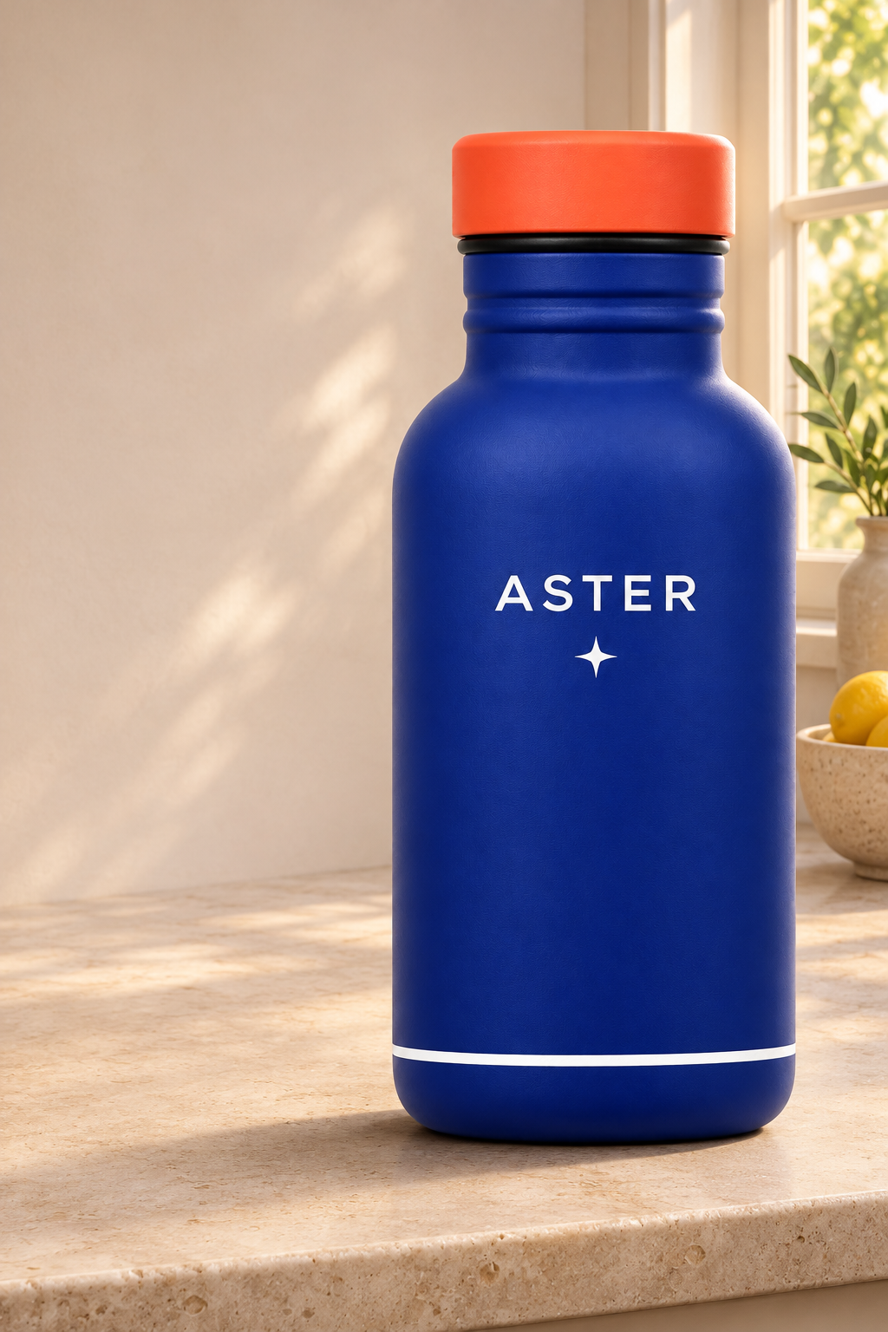
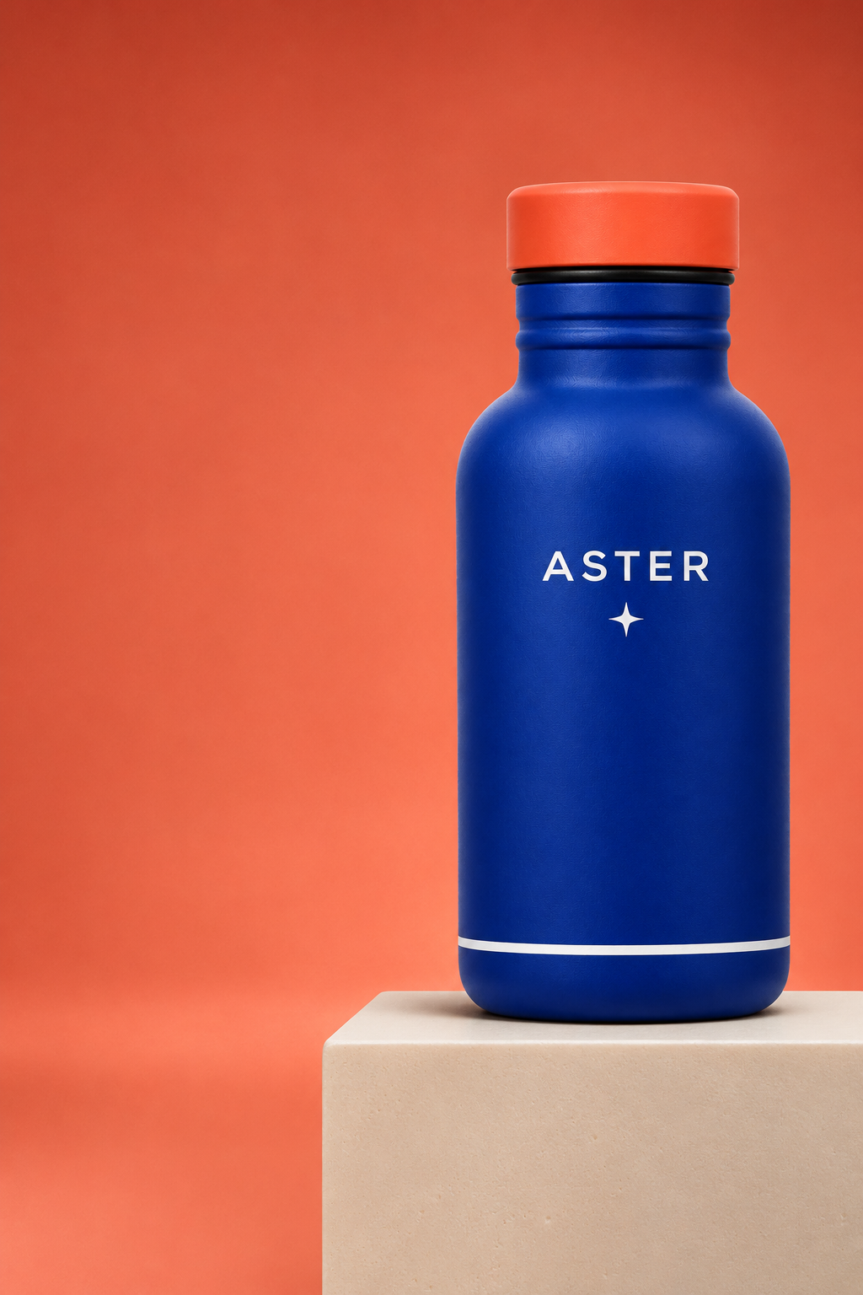
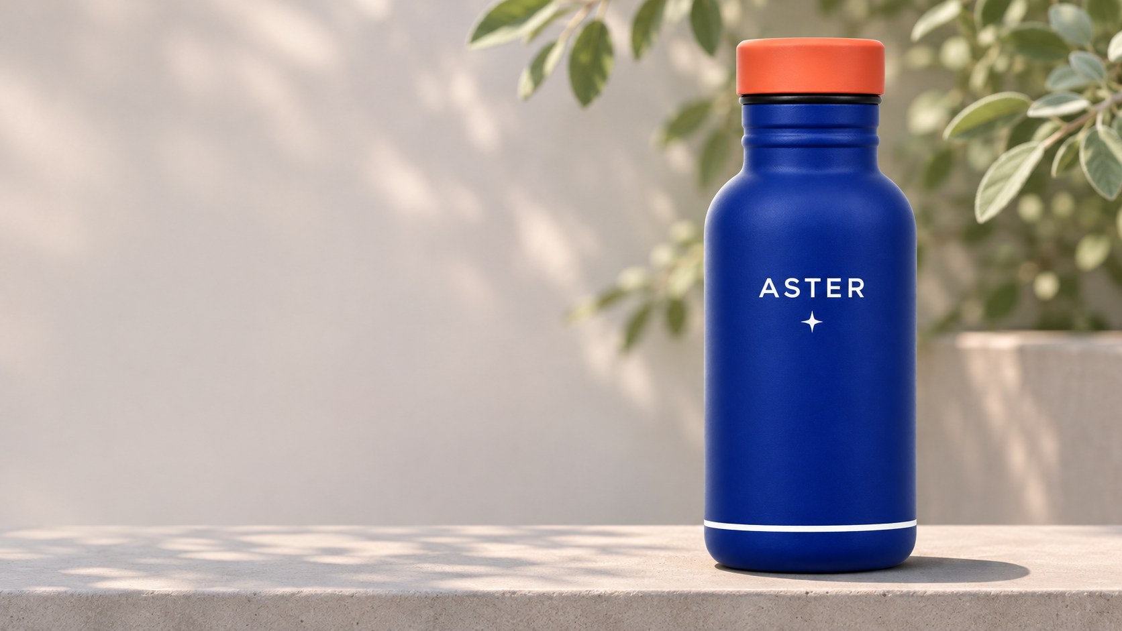
A campaign should look like one product
CODEX & COFFEE
DAY 10 · 3
Notes:
DAY 10 · A campaign should look like one product
1–1.5 minutes (0.5 minutes)
SAY
ASTER is our invented reusable water bottle. The goal is not three attractive blue bottles. The goal is the same recognizable product, with a new setting for each use.
DO
Show the master and three reference results. Ask what identifies the bottle.
CHECK
Learners separate product identity from background.
Custom ASTER images: actual Codex image-tool outputs; backend model ID not exposed. See learner-kit/README.md. Fictional product.

Slide 4
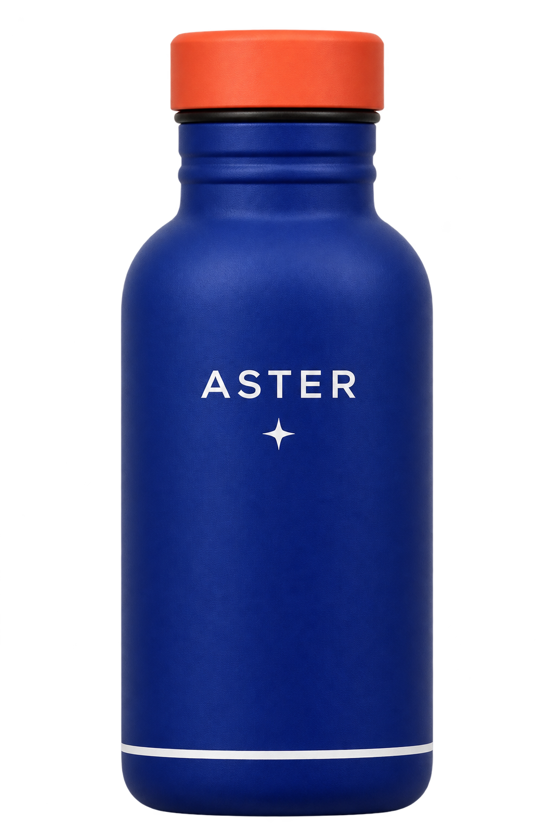
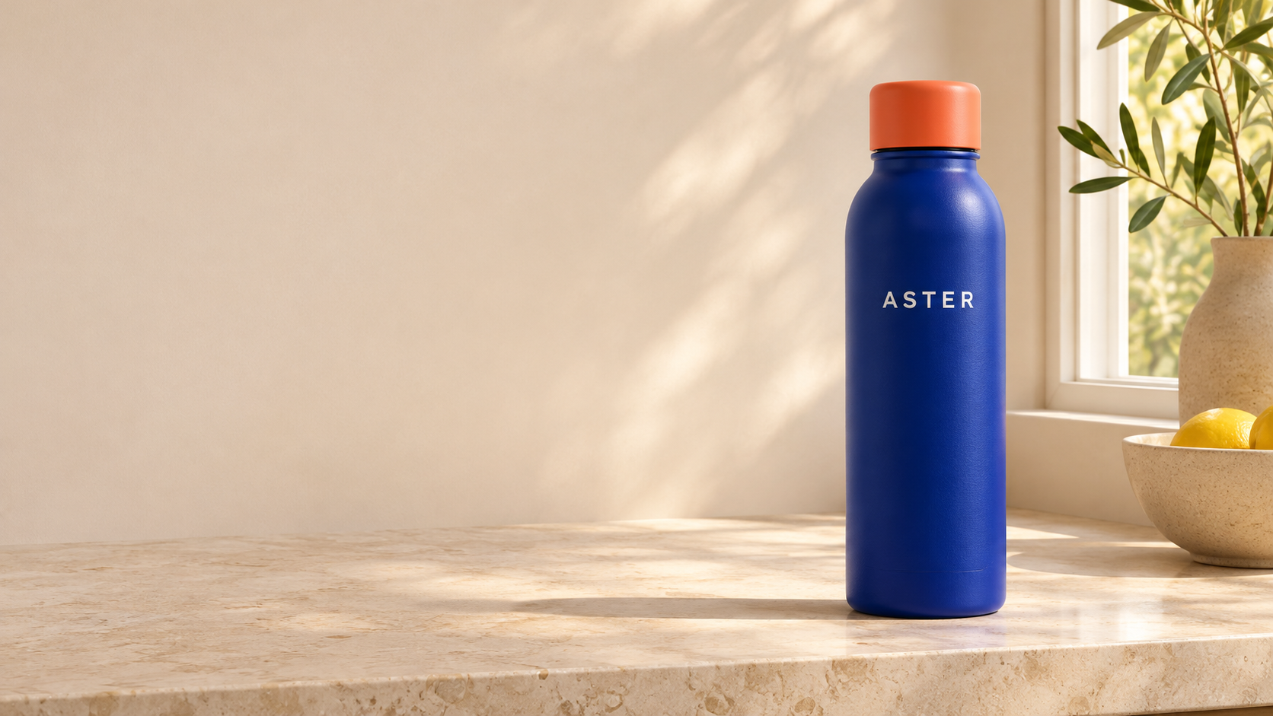
Can you spot what changed?
Approved bottle
A new request
CODEX & COFFEE
DAY 10 · 4
Notes:
DAY 10 · Can you spot what changed?
1.5–3.5 minutes (2 minutes)
SAY
Compare the approved bottle on the left with the new kitchen image. Take thirty seconds alone, then compare with a neighbor. Look past the color.
DO
Use master-v1 and loose-kitchen. Do not reveal the next slide early. Ask for shape, label and small details.
CHECK
Learners identify missing star, base stripe and changed shape.
Custom ASTER images: actual Codex image-tool outputs; backend model ID not exposed. See learner-kit/README.md. Fictional product.

Slide 5
Blue and orange were not enough
Different body shape
Missing four-point star
Missing white base stripe
CODEX & COFFEE
DAY 10 · 5
Notes:
DAY 10 · Blue and orange were not enough
3.5–4 minutes (0.5 minutes)
SAY
The kitchen photo looks believable, but its product is different. The short request described a blue bottle and an orange cap. It never supplied the original object.
DO
Point to the small label, missing star, missing base stripe and slim body.
CHECK
Learners see why attractive does not mean correct.
Custom ASTER images: actual Codex image-tool outputs; backend model ID not exposed. See learner-kit/README.md. Fictional product.

Slide 6
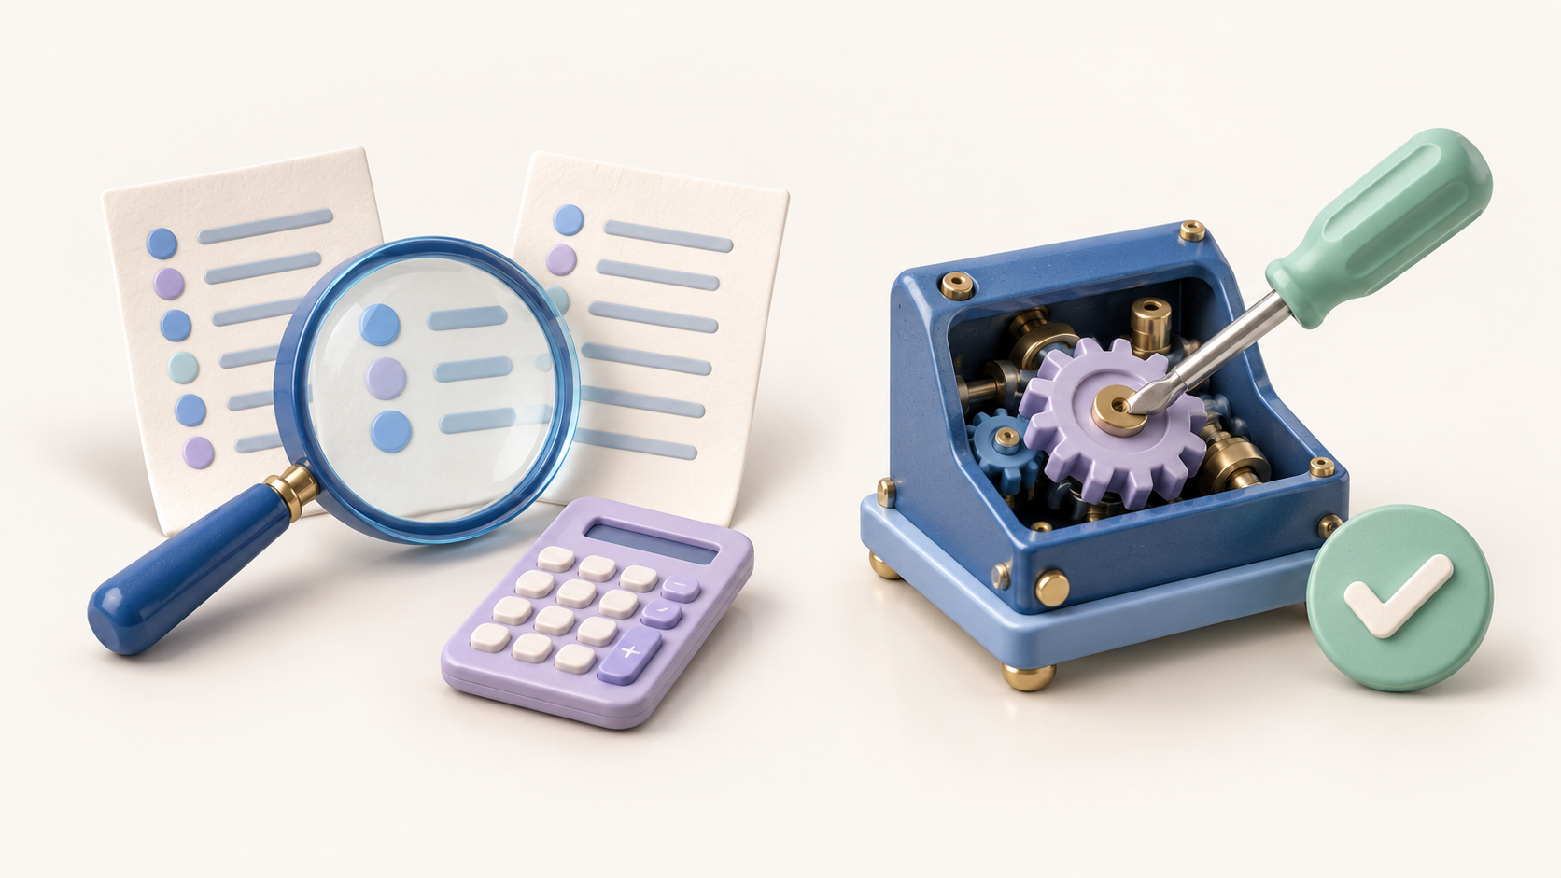
A matching deck needs a fixed visual brief
Style reference
Same reference role and visual style
Same colors, materials and lighting
Same framing and empty text space
Change this slide’s subject or scene
Reuse exact logos as files
PowerPoint text stays editable
CODEX & COFFEE
DAY 10 · 6
Notes:
DAY 10 · A matching deck needs a fixed visual brief
4–5 minutes (1 minutes)
SAY
Start by approving one reference image and writing a short visual brief. Keep its palette, medium, lighting and layout consistent across requests. Change the subject, action or setting needed for this slide. For a recurring product or character, also name the identity details that must remain. Keep exact PowerPoint titles in editable text boxes and reuse approved logo or product artwork when it must be identical.
DO
Point to the approved illustration style and the four fixed choices. Ask learners to name one thing they would change for the next slide. Explain that this is the recipe they can use immediately, before the mechanics chapter.
CHECK
Learners can name the fixed brief and the one permitted change.
SOURCE
https://developers.openai.com/api/docs/guides/image-prompting

Slide 7
Change one sentence for the next image
TEMPLATES · attach deck-style-reference.png · send one request at a time
REQUEST A
REQUEST B
Use the attached image as a style reference only. Keep its soft 3D look, rounded shapes, matte materials, blue, lavender and mint palette, warm ivory background, and gentle light. Make a wide 16:9 image for a PowerPoint slide, with one centered composition and room at the top for a heading. Do not copy the original subject.
Use the attached image as a style reference only. Keep its soft 3D look, rounded shapes, matte materials, blue, lavender and mint palette, warm ivory background, and gentle light. Make a wide 16:9 image for a PowerPoint slide, with one centered composition and room at the top for a heading. Do not copy the original subject.
Show three task cards being arranged into a plan.
Show a finished document being checked with a magnifying glass.
No text or logos.
No text or logos.
CODEX & COFFEE
DAY 10 · 7
Notes:
DAY 10 · Change one sentence for the next image
5–6.5 minutes (1.5 minutes)
SAY
Both example prompts repeat the same style reference, palette, materials, light and PowerPoint framing. Only the green scene sentence changes. These are adapted teaching templates, not the exact prompts that created the prepared pictures. Attach deck-style-reference.png for both requests. It controls the style, not the subject. The new subject changes between planning task cards and checking a document.
DO
Read the shared blue block once, then compare the two green sentences. Copy Request A or Request B separately from the kit. The combined comparison file is for reading both, not for sending as one request. Show that an unchanged brief reduces avoidable variation but still requires visual review.
CHECK
The two requests differ only in the scene sentence; the style reference, palette and framing stay fixed.
EXACT PROMPT
REQUEST A
Use the attached image as a style reference only. Keep its soft 3D look, rounded shapes, matte materials, blue, lavender and mint palette, warm ivory background, and gentle light. Make a wide 16:9 image for a PowerPoint slide, with one centered composition and room at the top for a heading. Do not copy the original subject. Show three task cards being arranged into a plan. No text or logos.
REQUEST B
Use the attached image as a style reference only. Keep its soft 3D look, rounded shapes, matte materials, blue, lavender and mint palette, warm ivory background, and gentle light. Make a wide 16:9 image for a PowerPoint slide, with one centered composition and room at the top for a heading. Do not copy the original subject. Show a finished document being checked with a magnifying glass. No text or logos.
SOURCE
https://developers.openai.com/api/docs/guides/image-prompting

Slide 8
01
What the model is doing
Enough of the machinery to direct it well
CODEX & COFFEE
DAY 10 · 8
Notes:
DAY 10 · What the model is doing
6.5–6.75 minutes (0.25 minutes)
SAY
The useful question is which parts of our request the tool can see and which decisions it still has to make.
DO
Transition from the mistake to the mental model.
CHECK
Learners expect a practical explanation.
Custom ASTER images: actual Codex image-tool outputs; backend model ID not exposed. See learner-kit/README.md. Fictional product.

Slide 9
Training connects pictures with descriptions
ILLUSTRATIVE TRAINING PAIRS
A cobalt bottle with a coral cap,
a white star and a stripe
A blue bottle beside a window
CODEX & COFFEE
DAY 10 · 9
Notes:
DAY 10 · Training connects pictures with descriptions
6.75–8 minutes (1.25 minutes)
SAY
An image–text pair gives the system a picture and words about it. Across many varied pairs, it can learn relationships between language and visual features. CLIP’s published training task matches pictures with their captions. CLIP is an image-understanding component, not itself an image generator.
DO
Show the two illustrative pairs. They use our fictional assets, not samples from a disclosed training set. Ask what “coral cap” points to.
CHECK
Learners can explain what the picture and caption each contribute.
SOURCE
https://arxiv.org/abs/2103.00020

Slide 10
Practice changes the model’s learned settings
Training example
Prediction
Measure error
Update weights
≠
→
→
→
Too purple
Repeat across many examples
CODEX & COFFEE
DAY 10 · 10
Notes:
DAY 10 · Practice changes the model’s learned settings
8–9.5 minutes (1.5 minutes)
SAY
During training, the model makes a prediction, measures an error against the training target, and adjusts its numerical weights. Weights are learned settings, not a collection of written rules. The target depends on the model: a matching caption, a missing visual token or added noise. Repeat over many batches. This is a simplified training loop.
DO
Trace the loop once, then contrast a weight update with merely attaching a new picture. The diagram is conceptual, not the disclosed 2.6 training recipe.
CHECK
Learners distinguish learning from a single generation request.
SOURCE
https://arxiv.org/abs/2006.11239

Slide 11
Better captions can teach finer details
“A bottle.”
“A cobalt bottle with a flat coral cap.
A white star sits below the brand name.”
ILLUSTRATIVE CAPTIONS
CODEX & COFFEE
DAY 10 · 11
Notes:
DAY 10 · Better captions can teach finer details
9.5–10.25 minutes (0.75 minutes)
SAY
A vague caption leaves out which object has which feature. OpenAI’s DALL·E 3 research improved prompt following by training with more descriptive generated captions. This bottle pair is our illustration of that idea. It is not an example from its actual training data.
DO
Read the short caption, then the detailed one. Ask which details the first sentence failed to name. Do not claim that 2.6 uses the exact DALL·E 3 recipe.
CHECK
Learners connect explicit relationships with clearer prompts.
SOURCE
https://cdn.openai.com/papers/dall-e-3.pdf

Slide 12
Your reference guides this request
Training updates weights
A request supplies context
CODEX & COFFEE
DAY 10 · 12
Notes:
DAY 10 · Your reference guides this request
10.25–11 minutes (0.75 minutes)
SAY
Training changes learned weights. Your prompt and reference are inputs used with the trained model. They can guide the current result without retraining the underlying image model. That is why saving a strong master is useful even if you have no training tools.
DO
Point to the training side, then the request side. Ask which side “attach ASTER-master.png” belongs to.
CHECK
Learners place an attached reference on the request side.
SOURCE
https://developers.openai.com/api/docs/guides/image-generation

Slide 13
Diffusion learns to remove added noise
COMMON APPROACH · DIFFUSION · CONCEPTUAL ILLUSTRATION
Clean image
Some noise
More noise
Mostly noise
→
→
→
CODEX & COFFEE
DAY 10 · 13
Notes:
DAY 10 · Diffusion learns to remove added noise
11–12.5 minutes (1.5 minutes)
SAY
In a diffusion training example, we know the clean image and the noise added to it. The network learns a denoising prediction at different noise levels. These panels illustrate corruption of a picture. They are not frames from a model run. OpenAI’s published DALL·E 2 used a diffusion decoder; this does not establish the hidden design of 2.6.
DO
Move from clear to noisy. Explain that noise here means random visual variation. Ask why knowing what was added makes a training target available.
CHECK
Learners describe the denoising training task.
SOURCE
https://arxiv.org/abs/2006.11239
https://arxiv.org/abs/2204.06125

Slide 14
Generation runs the learned process in reverse
COMMON APPROACH · DIFFUSION · CONCEPTUAL ILLUSTRATION
Noise
Coarse form
More detail
New image
→
→
→
The prompt guides the denoising steps
CODEX & COFFEE
DAY 10 · 14
Notes:
DAY 10 · Generation runs the learned process in reverse
12.5–13.75 minutes (1.25 minutes)
SAY
A diffusion generator starts from noise and repeatedly applies learned denoising steps. In a text-conditioned system, the description steers those steps. It produces a new sample rather than restoring a particular original training picture. Different starting noise can lead to different pictures. This is a conceptual illustration, not a recorded generation.
DO
Trace noisy to clear and point to the caption guiding the process. Connect the different starting points to our two text-only bottle trials without claiming their backend architecture.
CHECK
Learners explain why one prompt can have multiple plausible results.
SOURCE
https://arxiv.org/abs/2204.06125

Slide 15
Another approach predicts visual tokens
A token is a learned code for image content
…
→
1
2
3
4
5
6
7
Codes generated in sequence
A decoded picture
CODEX & COFFEE
DAY 10 · 15
Notes:
DAY 10 · Another approach predicts visual tokens
13.75–14.5 minutes (0.75 minutes)
SAY
A visual token is a learned code used to represent part of an image. The original DALL·E compressed images into a grid of codes, then predicted text and image tokens in sequence. The colored tiles here are only an illustration. This is a different published approach, not a statement that all image models work alike.
DO
Reveal the image-code grid from left to right. Name autoregressive once, then translate it as predicting the next code.
CHECK
Learners recognize that image models can use different generation mechanisms.
SOURCE
https://arxiv.org/abs/2102.12092

Slide 16
The new family is GPT Image 2.6
SUNBURST
FLARE
Detailed visual work
Faster iteration
Announced November 4, 2026
CODEX & COFFEE
DAY 10 · 16
Notes:
DAY 10 · The new family is GPT Image 2.6
14.5–15.25 minutes (0.75 minutes)
SAY
OpenAI announced GPT Image 2.6 Sunburst and Flare on November 4. Sunburst is positioned for detailed work. Flare is positioned for faster iteration. Your app may expose different choices than the API. Check what your account actually offers.
DO
Show the exact names. Make clear these are image models, not the chat model name.
CHECK
Learners recognize the verified names.
SOURCE
https://developers.openai.com/api/docs/changelog

Slide 17
Words and references guide new pixels
Your request
Same bottle.
New setting.
Image
model
→
→
Check the result
CODEX & COFFEE
DAY 10 · 17
Notes:
DAY 10 · Words and references guide new pixels
15.25–16 minutes (0.75 minutes)
SAY
Think of the request as a brief. The text explains what you want. A reference shows details that are difficult to describe. The model uses those inputs to create an image, then we check that image against the brief. This is a useful mental model, not OpenAI’s internal architecture diagram.
DO
Point to the text card, bottle reference, output and review loupe in order.
CHECK
Learners understand inputs, generation and review.
SOURCE
https://developers.openai.com/api/docs/guides/image-generation

Slide 18
A reference adds evidence to this request
“A blue bottle” leaves many decisions open
This bottle shows the decisions already made
CODEX & COFFEE
DAY 10 · 18
Notes:
DAY 10 · A reference adds evidence to this request
16–16.5 minutes (0.5 minutes)
SAY
The model can use a supplied image during generation or editing. Attaching our bottle gives it direct visual evidence of the cap, shoulder, lettering and stripe. It is still generating a result, so we still check it.
DO
Compare the words “blue bottle” with the actual reference. Explain that attachment is not instant retraining of the model.
CHECK
Learners can explain why a reference beats another adjective.
Custom ASTER images: actual Codex image-tool outputs; backend model ID not exposed. See learner-kit/README.md. Fictional product.

Slide 19
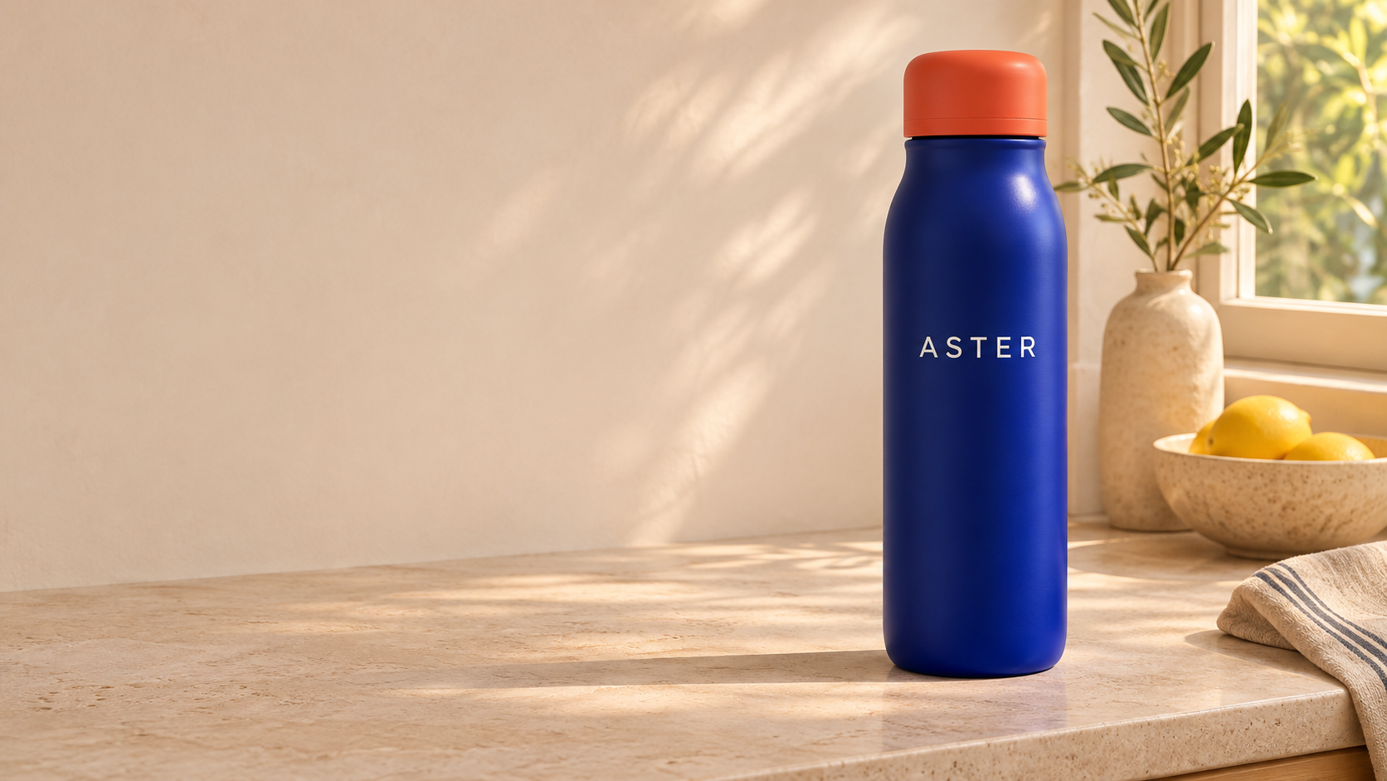
The same words can produce a new bottle
First request
Same prompt again
CODEX & COFFEE
DAY 10 · 19
Notes:
DAY 10 · The same words can produce a new bottle
16.5–17.5 minutes (1 minutes)
SAY
These two images came from the same exact text-only prompt. Neither had the master image attached. The shape, proportions and surrounding objects changed. Repeating the words did not lock identity.
DO
Show both kitchen images. Identify the cap and shoulders. These are two illustrative trials, not a statistical benchmark.
CHECK
Learners do not rely on prompt repetition alone.
Custom ASTER images: actual Codex image-tool outputs; backend model ID not exposed. See learner-kit/README.md. Fictional product.

Slide 20
Planning and polish are separate controls
Planning
Render quality
Low
Medium
High
Low
Medium
High
How much to plan before rendering
How much to spend on the rendering
CODEX & COFFEE
DAY 10 · 20
Notes:
DAY 10 · Planning and polish are separate controls
17.5–18.5 minutes (1 minutes)
SAY
In the 2.6 API, complexity controls how much the model plans before rendering. Quality controls the rendering quality. More planning can help complicated instructions, but it can also take longer and add unwanted changes. These controls may not appear in the Codex interface.
DO
Use a two-dial visual. Read low, medium, high as choices, not a ranking of prompt-writing skill.
CHECK
Learners avoid treating every maximum setting as a consistency switch.
SOURCE
https://developers.openai.com/api/docs/guides/image-generation

Slide 21
More planning can also change the picture
Low complexity
Medium complexity
High complexity
CODEX & COFFEE
DAY 10 · 21
Notes:
DAY 10 · More planning can also change the picture
18.5–19.5 minutes (1 minutes)
SAY
These are OpenAI’s published GPT Image 2.6 Sunburst examples: the same prompt at medium quality, with different complexity. The trophy, clothing and sign placement change. The current prompting guide supplies the prompt: A premium handcrafted layered paper-cut illustration of a football team celebrating a championship victory inside a packed stadium. Higher complexity is not a lock on the previous composition.
DO
Compare low, medium and high. These are official examples, distinct from our custom bottle trials. The exact published prompt is in the learner kit’s source guide.
CHECK
Learners can distinguish stronger planning from guaranteed sameness.
SOURCE
https://developers.openai.com/api/docs/guides/image-prompting#compare-complexity

Slide 22
The chat and image models do different jobs
Chat model
Image model
→
Interprets the request
and calls the tool
Generates or edits
the picture
CODEX & COFFEE
DAY 10 · 22
Notes:
DAY 10 · The chat and image models do different jobs
19.5–20.25 minutes (0.75 minutes)
SAY
In the Responses API, a mainline model can call the image-generation tool. The chat model interprets the request and can revise the prompt; the image model produces the picture. The API can return revised_prompt. Choosing a chat model does not prove which image backend made a picture.
DO
Follow the request through the two named jobs. This is the documented API pattern, not a screenshot of private internal reasoning or a guarantee of the current app’s exact routing.
CHECK
Learners separate the chat-model choice from the image-model identity.
SOURCE
https://developers.openai.com/api/docs/guides/image-generation

Slide 23
A marked-up image can point to the edit
OFFICIAL GPT IMAGE 2.6 FLARE EXAMPLE
→
Recolor the striped vase inside the red circle to solid cobalt blue ceramic. Keep its shape, the dried stems, and the rest of the kitchen unchanged. Remove the red circle from the finished photo.
CODEX & COFFEE
DAY 10 · 23
Notes:
DAY 10 · A marked-up image can point to the edit
20.25–21.25 minutes (1 minutes)
SAY
This is OpenAI’s published GPT Image 2.6 Flare example. The input combines a kitchen photo with a separate transparent annotation layer. The prompt says what should change and what should stay. The API requires a real annotation layer; circling a flattened screenshot in a chat is not automatically the same feature.
DO
Compare the circled striped vase with the blue result. Read the complete prompt. This is an official supplied example, not a new run by us. Check that the circle disappeared.
CHECK
Learners know markup specifies where, while the prompt specifies what.
EXACT PROMPT
Recolor the striped vase inside the red circle to solid cobalt blue ceramic. Keep its shape, the dried stems, and the rest of the kitchen unchanged. Remove the red circle from the finished photo.
SOURCE
https://developers.openai.com/api/docs/guides/image-generation

Slide 24

SVG output uses an image, then code
DOCUMENTED GPT IMAGE 2.6 SVG WORKFLOW
Image model
Authoring model
→
→
Creates a
reference image
Writes SVG
paths and shapes
CODEX & COFFEE
DAY 10 · 24
Notes:
DAY 10 · SVG output uses an image, then code
21.25–22.5 minutes (1.25 minutes)
SAY
The 2.6 documentation describes this pipeline: an image model creates a reference image, then an authoring model turns it into SVG. SVG stores paths and shapes rather than a grid of pixels. Quality controls the reference image. This is a disclosed output workflow, not the full neural architecture.
DO
Trace the two stages, then show OpenAI’s published Field & Flour SVG output. Explain why editable paths help when artwork needs resizing or recoloring. The intermediate reference picture is not published here, so the first box is a process label.
CHECK
Learners distinguish a documented production pipeline from a training architecture.
SOURCE
https://developers.openai.com/api/docs/guides/image-generation

Slide 25
What we can explain with confidence
Published training methods: examples and learned weights
Documented for 2.6: controls, edits and SVG workflow
Undisclosed: the full 2.6 training recipe
CODEX & COFFEE
DAY 10 · 25
Notes:
DAY 10 · What we can explain with confidence
22.5–22.75 minutes (0.25 minutes)
SAY
We now have published examples of training and generation mechanisms, plus specific 2.6 workflows. They are different levels of explanation. The current documentation does not tell us the full 2.6 training data mix, loss functions or neural architecture. Do not label the diffusion illustration as a confirmed 2.6 diagram.
DO
State the evidence boundary once, calmly, then move on.
CHECK
Learners know what is official and what we tested.
Custom ASTER images: actual Codex image-tool outputs; backend model ID not exposed. See learner-kit/README.md. Fictional product.

Slide 26
02
Give the product a fixed identity
One approved image and a short list of details
CODEX & COFFEE
DAY 10 · 26
Notes:
DAY 10 · Give the product a fixed identity
22.75–23 minutes (0.25 minutes)
SAY
We will now make the brief specific enough to audit.
DO
Open the approved master image from the kit.
CHECK
Everyone knows which image is authoritative.
Custom ASTER images: actual Codex image-tool outputs; backend model ID not exposed. See learner-kit/README.md. Fictional product.

Slide 27
ASTER has a visual fingerprint
Coral cap + seal
Two neck grooves
Body silhouette
Word + star
White base stripe
CODEX & COFFEE
DAY 10 · 27
Notes:
DAY 10 · ASTER has a visual fingerprint
23–24.5 minutes (1.5 minutes)
SAY
The important details are the coral cap and black seal, the two neck grooves, the broad body shape, the white word and star, and the thin base stripe. These are the features we check every time. A new shadow is acceptable. A missing star is not.
DO
Spend one minute having learners name features before revealing each callout. Explain that fictional ASTER is not a real client product.
CHECK
Learners can list the fixed features.
Custom ASTER images: actual Codex image-tool outputs; backend model ID not exposed. See learner-kit/README.md. Fictional product.

Slide 28
The master prompt defines the object
MASTER REQUEST · 1 OF 2 · combine both parts
Create a photorealistic studio catalog image of one original fictional reusable water bottle for the invented brand ASTER. Show the complete bottle standing upright, dead straight front view, centered, with generous transparent margin. Product design: a squat rounded-rectangle body with gently rounded shoulders, matte deep cobalt-blue powder-coated metal, a flat coral-orange screw cap with a black seal ring below it, exactly two shallow horizontal grip grooves around the upper neck, one thin white horizontal band near the base. Front label: the exact word "ASTER" in simple white uppercase sans-serif, centered horizontally on the upper-middle body; one small white four-point star directly below the word. No other words or numbers. Keep the silhouette distinctive and plausible as a real manufactured bottle.
CHECK
Does the result show the intended shape and five fixed details?
CODEX & COFFEE
DAY 10 · 28
Notes:
DAY 10 · The master prompt defines the object
24.5–25.5 minutes (1 minutes)
SAY
This is the actual first half of the request that created our master. Notice how it specifies a product rather than asking for something generally beautiful. The model did not perfectly follow the rounded-rectangle wording, so we chose the returned image as the approved reference.
DO
Read only the useful product constraints aloud. The next slide continues the same request; paste the combined file once.
CHECK
Does the result show the intended shape and five fixed details?
EXACT PROMPT
Create a photorealistic studio catalog image of one original fictional reusable water bottle for the invented brand ASTER. Show the complete bottle standing upright, dead straight front view, centered, with generous transparent margin. Product design: a squat rounded-rectangle body with gently rounded shoulders, matte deep cobalt-blue powder-coated metal, a flat coral-orange screw cap with a black seal ring below it, exactly two shallow horizontal grip grooves around the upper neck, one thin white horizontal band near the base. Front label: the exact word "ASTER" in simple white uppercase sans-serif, centered horizontally on the upper-middle body; one small white four-point star directly below the word. No other words or numbers. Keep the silhouette distinctive and plausible as a real manufactured bottle.
Custom ASTER images: actual Codex image-tool outputs; backend model ID not exposed. See learner-kit/README.md. Fictional product.

Slide 29
The master prompt defines the image
MASTER REQUEST · 2 OF 2 · same request
Soft neutral studio lighting, crisp product edges, realistic subtle surface texture, sharp clear label, premium industrial design photography. Transparent background; no floor, no drop shadow, no props, no hands, no scene. Bottle fills about 80 percent of image height. This is a master product reference for a consistency lesson.
CHECK
Is the full product sharp, readable and on a transparent background?
CODEX & COFFEE
DAY 10 · 29
Notes:
DAY 10 · The master prompt defines the image
25.5–26.25 minutes (0.75 minutes)
SAY
The second half controls the type of picture: lighting, clear label, transparent background and no extra objects. A clean front view is easier to reuse than a dramatic angle. We will judge the output, not assume the prompt guaranteed it.
DO
Point to transparency and full-product framing. Use prompts/01-master.txt for the combined original.
CHECK
Is the full product sharp, readable and on a transparent background?
EXACT PROMPT
Soft neutral studio lighting, crisp product edges, realistic subtle surface texture, sharp clear label, premium industrial design photography. Transparent background; no floor, no drop shadow, no props, no hands, no scene. Bottle fills about 80 percent of image height. This is a master product reference for a consistency lesson.
Custom ASTER images: actual Codex image-tool outputs; backend model ID not exposed. See learner-kit/README.md. Fictional product.

Slide 30
The short request leaves room for drift
Create a polished product photograph of a cobalt-blue ASTER water bottle with a coral-orange cap on a pale limestone kitchen counter beside a softly lit window. Show the entire upright bottle, front view, simple white ASTER lettering. Warm daylight, quiet premium editorial style. Landscape composition, bottle in the right half, clear empty wall on the left for slide text. No added slogans.
CHECK
Which product details did the request leave unspecified?
CODEX & COFFEE
DAY 10 · 30
Notes:
DAY 10 · The short request leaves room for drift
26.25–26.75 minutes (0.5 minutes)
SAY
Here is the complete request behind our two loose kitchen photos. It sounds natural and it gives a clear scene, but it never identifies the star, stripe or exact shape.
DO
Show the complete text and connect it to the missing features already seen.
CHECK
Which product details did the request leave unspecified?
EXACT PROMPT
Create a polished product photograph of a cobalt-blue ASTER water bottle with a coral-orange cap on a pale limestone kitchen counter beside a softly lit window. Show the entire upright bottle, front view, simple white ASTER lettering. Warm daylight, quiet premium editorial style. Landscape composition, bottle in the right half, clear empty wall on the left for slide text. No added slogans.
Custom ASTER images: actual Codex image-tool outputs; backend model ID not exposed. See learner-kit/README.md. Fictional product.

Slide 31
A useful edit prompt has four jobs
Reference
Use the attached ASTER bottle as the product reference.
Keep
Keep its silhouette, cap, grooves, lettering, star and stripe.
Change
Stand it on a pale limestone kitchen counter.
Deliver
Keep the front angle. Leave the left half quiet.
CODEX & COFFEE
DAY 10 · 31
Notes:
DAY 10 · A useful edit prompt has four jobs
26.75–28 minutes (1.25 minutes)
SAY
Start with the reference, say what must stay, describe the one change, and explain the finished framing. You can write this as an ordinary paragraph. The colors here show its structure, not required syntax.
DO
Walk through the four actual excerpts. Ask which line protects the product.
CHECK
Learners can identify each part.
Custom ASTER images: actual Codex image-tool outputs; backend model ID not exposed. See learner-kit/README.md. Fictional product.

Slide 32
The exact kitchen edit request
ATTACH · ASTER-master.png
Use the attached ASTER bottle as the product reference. Keep its front-view silhouette, coral cap, black seal, two neck grooves, cobalt body, white ASTER word, four-point star and thin white base stripe. Change only the setting: stand it on a pale limestone kitchen counter beside a softly lit window. Keep the same front angle and proportions. Match the contact shadow to the counter. Leave the left half quiet for a slide headline. Photorealistic, warm daylight. No new text, no redesign, no extra bottle.
CHECK
Check the five fixed details and landscape framing.
CODEX & COFFEE
DAY 10 · 32
Notes:
DAY 10 · The exact kitchen edit request
28–29 minutes (1 minutes)
SAY
This is the complete prompt we sent with master-v1 attached. The keep-list makes our intent clear. It cannot guarantee every pixel stays fixed.
DO
Attach the master image, paste once and show prepared output if waiting exceeds the demo slot.
CHECK
Check the five fixed details and landscape framing.
EXACT PROMPT
Use the attached ASTER bottle as the product reference. Keep its front-view silhouette, coral cap, black seal, two neck grooves, cobalt body, white ASTER word, four-point star and thin white base stripe. Change only the setting: stand it on a pale limestone kitchen counter beside a softly lit window. Keep the same front angle and proportions. Match the contact shadow to the counter. Leave the left half quiet for a slide headline. Photorealistic, warm daylight. No new text, no redesign, no extra bottle.
Custom ASTER images: actual Codex image-tool outputs; backend model ID not exposed. See learner-kit/README.md. Fictional product.

Slide 33
The reference keeps more of the identity
Approved master
Reference-guided edit
CODEX & COFFEE
DAY 10 · 33
Notes:
DAY 10 · The reference keeps more of the identity
29–30.25 minutes (1.25 minutes)
SAY
The star, stripe and neck details returned in the reference-guided version. The original and edited bottle still need a visual check. The result also came back in portrait format despite the request for a landscape composition.
DO
Compare master and kitchen edit. Name both the improvement and the missed format.
CHECK
Learners judge the whole request, including framing.
Custom ASTER images: actual Codex image-tool outputs; backend model ID not exposed. See learner-kit/README.md. Fictional product.

Slide 34
Which images pass the campaign brief?
IDENTITY FRAMING LIGHT
CODEX & COFFEE
DAY 10 · 34
Notes:
DAY 10 · Which images pass the campaign brief?
30.25–33.25 minutes (3 minutes)
SAY
Each request used the same approved master directly. We did not edit the kitchen version into the studio version and then into the terrace. This reduces opportunities to carry a mistake forward.
DO
Run a three-minute audit: one minute checking identity, one minute comparing framing and light with a partner, and one minute for accept/repair decisions. A quiet room can work alone and compare with the answer key. Kitchen and studio returned portrait; terrace returned landscape.
CHECK
Learners audit identity and format separately.
Custom ASTER images: actual Codex image-tool outputs; backend model ID not exposed. See learner-kit/README.md. Fictional product.

Slide 35
A second setting uses the same master
ATTACH · the original ASTER-master.png again
Use image 1 as the product identity reference, not merely as style inspiration. Make a photorealistic advertising image of that same ASTER bottle standing on an ivory plinth against a coral-orange studio sweep. Keep its front-view silhouette, cap, black seal ring, two neck grooves, white ASTER word, four-point star, thin white stripe and cobalt finish. Only the background and natural contact shadow should change. Match the original front camera angle. The entire bottle must be visible in the right half, with clear space on the left. Do not simplify the label or redesign the bottle.
CHECK
Did the new scene preserve the original product?
CODEX & COFFEE
DAY 10 · 35
Notes:
DAY 10 · A second setting uses the same master
33.25–34 minutes (0.75 minutes)
SAY
Here is the complete studio request. The reference line is explicit: identity reference, not merely style inspiration. The background changes; the object constraints stay.
DO
Open prompts/04-reference-studio.txt. Point to what is constant and what changes.
CHECK
Did the new scene preserve the original product?
EXACT PROMPT
Use image 1 as the product identity reference, not merely as style inspiration. Make a photorealistic advertising image of that same ASTER bottle standing on an ivory plinth against a coral-orange studio sweep. Keep its front-view silhouette, cap, black seal ring, two neck grooves, white ASTER word, four-point star, thin white stripe and cobalt finish. Only the background and natural contact shadow should change. Match the original front camera angle. The entire bottle must be visible in the right half, with clear space on the left. Do not simplify the label or redesign the bottle.
Custom ASTER images: actual Codex image-tool outputs; backend model ID not exposed. See learner-kit/README.md. Fictional product.

Slide 36
The review covers more than the product
01
Identity: shape, cap, grooves, label and stripe
02
Framing: full product, angle and usable space
03
Finish: lighting, contact shadow and readable text
CODEX & COFFEE
DAY 10 · 36
Notes:
DAY 10 · The review covers more than the product
34–35 minutes (1 minutes)
SAY
Our three reference results retained the key visible markers, but two missed landscape framing. We also inspect the apparent proportions and lettering. A small sample does not prove reliability for every product or angle.
DO
Use the check list against the kitchen image. Ask which check would have caught the format miss.
CHECK
Learners can reject an attractive but incomplete result.
Custom ASTER images: actual Codex image-tool outputs; backend model ID not exposed. See learner-kit/README.md. Fictional product.

Slide 37
A follow-up asks for one specific repair
FOLLOW-UP TEMPLATE · use only when framing is the problem
Keep the bottle exactly as shown, including its shape, cap, lettering, star and base stripe. Make the canvas landscape, with the complete bottle in the right half and empty space on the left. Change the framing only. Do not redesign the bottle.
CHECK
Did only the framing change?
CODEX & COFFEE
DAY 10 · 37
Notes:
DAY 10 · A follow-up asks for one specific repair
35–35.75 minutes (0.75 minutes)
SAY
This is a reusable follow-up template, not a completed trial. Say what failed and what must remain. Avoid asking to “make it better,” because that gives the model many new decisions.
DO
Explain that this template has not been executed in the prepared examples. During the live demo, use it only if the first result has this exact framing issue.
CHECK
Did only the framing change?
EXACT PROMPT
Keep the bottle exactly as shown, including its shape, cap, lettering, star and base stripe. Make the canvas landscape, with the complete bottle in the right half and empty space on the left. Change the framing only. Do not redesign the bottle.
Custom ASTER images: actual Codex image-tool outputs; backend model ID not exposed. See learner-kit/README.md. Fictional product.

Slide 38
Every setting starts from the master
Approved master
→
Kitchen
Studio
Terrace
CODEX & COFFEE
DAY 10 · 38
Notes:
DAY 10 · Every setting starts from the master
35.75–36.5 minutes (0.75 minutes)
SAY
A chain of edits can accumulate changes. Returning to the original reference makes the source of truth clear. It does not eliminate every error, so keep the same review checks.
DO
Trace the master to each scene. Show the kit’s fixed master filename.
CHECK
Learners avoid treating the latest output as automatically authoritative.
Custom ASTER images: actual Codex image-tool outputs; backend model ID not exposed. See learner-kit/README.md. Fictional product.

Slide 39
A new angle reveals unseen surfaces
Same front view: fewer new decisions
New angle: supply more reference views
CODEX & COFFEE
DAY 10 · 39
Notes:
DAY 10 · A new angle reveals unseen surfaces
36.5–37.25 minutes (0.75 minutes)
SAY
A front photo does not show the back, underside or full side profile. When we ask for a turn, the model must infer missing information. For an exact real product, give it the additional views or use a product render.
DO
Turn an imaginary bottle and point out what the reference could not show.
CHECK
Learners match the request to the evidence available.
Custom ASTER images: actual Codex image-tool outputs; backend model ID not exposed. See learner-kit/README.md. Fictional product.

Slide 40
03
When identical really means identical
Reuse the approved bottle as a separate image layer
CODEX & COFFEE
DAY 10 · 40
Notes:
DAY 10 · When identical really means identical
37.25–37.5 minutes (0.25 minutes)
SAY
Sometimes a near-match is not enough. A slide deck can keep the exact approved product image and change everything around it.
DO
Transition to three native slide compositions.
CHECK
Learners recognize a second production method.
Custom ASTER images: actual Codex image-tool outputs; backend model ID not exposed. See learner-kit/README.md. Fictional product.

Slide 41

Three layers make the finished slide
Editable
headline
+
Existing product image
Native slide text
New background
CODEX & COFFEE
DAY 10 · 41
Notes:
DAY 10 · Three layers make the finished slide
37.5–38.25 minutes (0.75 minutes)
SAY
These next three slides reuse the same transparent PNG as a native image object. The image model created the backgrounds separately. It never redrew the bottle for these slides.
DO
Show bottle layer, background layer and headline layer. Explain the edge-lighting tradeoff.
CHECK
Learners can distinguish image generation from layout composition.
Custom ASTER images: actual Codex image-tool outputs; backend model ID not exposed. See learner-kit/README.md. Fictional product.

Slide 42
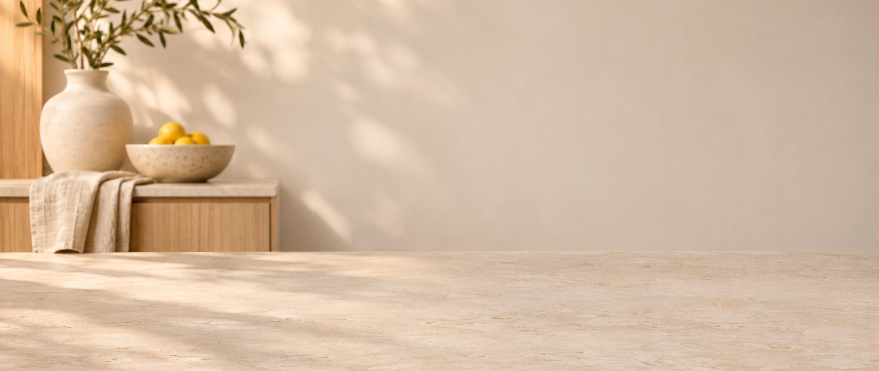
Made for the everyday
A clear place to start
CODEX & COFFEE
DAY 10 · 42
Notes:
DAY 10 · Made for the everyday
38.25–38.75 minutes (0.5 minutes)
SAY
Here is the kitchen composition. The product asset is exactly the approved PNG. The headline is editable slide text.
DO
Advance slowly enough to let learners see the visual.
CHECK
The bottle details stay fixed.
Custom ASTER images: actual Codex image-tool outputs; backend model ID not exposed. See learner-kit/README.md. Fictional product.

Slide 43
A different setting. The same ASTER.
One bottle. A bold setting.
CODEX & COFFEE
DAY 10 · 43
Notes:
DAY 10 · A different setting. The same ASTER.
38.75–39.25 minutes (0.5 minutes)
SAY
The studio background changes the mood. The bottle image remains the same. The lighting is a deliberate compromise because it comes from the original photo.
DO
Point to the unchanged label and cap.
CHECK
Learners recognize reuse across a different palette.
Custom ASTER images: actual Codex image-tool outputs; backend model ID not exposed. See learner-kit/README.md. Fictional product.

Slide 44
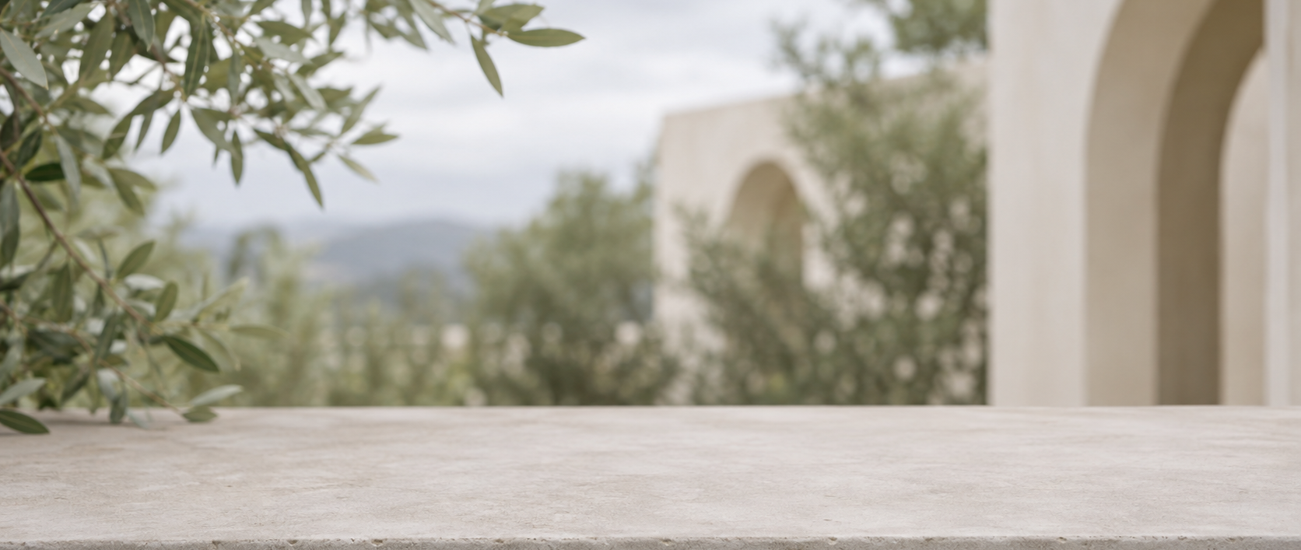
The master travels across the deck
A quieter setting
CODEX & COFFEE
DAY 10 · 44
Notes:
DAY 10 · The master travels across the deck
39.25–39.75 minutes (0.5 minutes)
SAY
The outdoor background gives us another visual. We have changed the slide setting rather than generating another product.
DO
Show the terrace image and the matching foreground.
CHECK
Learners see consistent assets across a slide series.
Custom ASTER images: actual Codex image-tool outputs; backend model ID not exposed. See learner-kit/README.md. Fictional product.

Slide 45
A natural request for exact asset reuse
SLIDE-ASSEMBLY RECIPE · three prepared results shown above
Use ASTER-master.png as the product image on three slides. Reuse that file without redrawing or stretching it. Create a kitchen background, a coral studio background and a quiet outdoor background with no bottle in them. Place the original bottle over each background at the same size. Keep the headlines as editable slide text. Check that every slide uses the same bottle file.
CHECK
Do all three slides reuse the same source image?
CODEX & COFFEE
DAY 10 · 45
Notes:
DAY 10 · A natural request for exact asset reuse
39.75–40.75 minutes (1 minutes)
SAY
This is a layout recipe you can give Codex, not a prompt asking an image model to preserve pixels. Tell it to insert the existing PNG as a slide object and generate only the backgrounds.
DO
Show the native bottle object in the prepared composition using the exported layer manifest, without taking control of the user’s apps.
CHECK
Do all three slides reuse the same source image?
EXACT PROMPT
Use ASTER-master.png as the product image on three slides. Reuse that file without redrawing or stretching it. Create a kitchen background, a coral studio background and a quiet outdoor background with no bottle in them. Place the original bottle over each background at the same size. Keep the headlines as editable slide text. Check that every slide uses the same bottle file.
Custom ASTER images: actual Codex image-tool outputs; backend model ID not exposed. See learner-kit/README.md. Fictional product.

Slide 46
The right method depends on the change
New scene + matching light
Reference edit, followed by a check
Same exact product artwork
Reuse the approved image layer
Accurate new angle
More views or a product render
CODEX & COFFEE
DAY 10 · 46
Notes:
DAY 10 · The right method depends on the change
40.75–41.5 minutes (0.75 minutes)
SAY
To change the setting and adapt the lighting, try a reference-guided edit and review it. To guarantee the same source artwork on a deck, reuse the existing image object. To turn a real product accurately, supply more views or use a product render.
DO
Point to each example and ask which fits a website campaign versus a legal product sheet.
CHECK
Learners choose a method based on the required accuracy.
Custom ASTER images: actual Codex image-tool outputs; backend model ID not exposed. See learner-kit/README.md. Fictional product.

Slide 47
04
Make the whole deck feel related
A shared brief reduces repeated design decisions
CODEX & COFFEE
DAY 10 · 47
Notes:
DAY 10 · Make the whole deck feel related
41.5–41.75 minutes (0.25 minutes)
SAY
The product is only one part of consistency. We can also fix the illustration style, light direction, palette and layout.
DO
Move from product identity to a shared visual brief.
CHECK
Learners understand style consistency as another layer.
Custom ASTER images: actual Codex image-tool outputs; backend model ID not exposed. See learner-kit/README.md. Fictional product.

Slide 48
A short visual brief keeps decisions stable
Cobalt product, coral accent, warm ivory
Front view, full object, soft light from upper left
Quiet left half for editable headlines
No extra writing inside the artwork
CODEX & COFFEE
DAY 10 · 48
Notes:
DAY 10 · A short visual brief keeps decisions stable
41.75–42.75 minutes (1 minutes)
SAY
Use a brief that describes visible choices. “Premium” is vague. A matte cobalt object, ivory surroundings and soft light from upper left are specific enough to compare. Keep the brief beside every image request.
DO
Show the palette and master. Read the fixed choices, not every hex value aloud.
CHECK
Learners can write an observable style rule.
Custom ASTER images: actual Codex image-tool outputs; backend model ID not exposed. See learner-kit/README.md. Fictional product.

Slide 49
The style prompt carries the shared rules
TEMPLATE · replace only the setting
Create a landscape background for an ASTER product slide: [describe the setting]. Use warm ivory surfaces, restrained coral accents and soft light from the upper left. Leave the left half quiet for a headline and a clear surface on the right for the product. Do not include a bottle, logos or writing. I will place the approved product image and editable text separately.
CHECK
Did only the setting change in the brief?
CODEX & COFFEE
DAY 10 · 49
Notes:
DAY 10 · The style prompt carries the shared rules
42.75–43.75 minutes (1 minutes)
SAY
This is a reusable background-only template. Use it with a scene name, then insert the approved bottle. Keep the style rules unchanged. The three earlier backgrounds used separate exact scene requests available in the kit.
DO
Explain which line is a variable and which lines are fixed. Never label the template as a verbatim completed run.
CHECK
Did only the setting change in the brief?
EXACT PROMPT
Create a landscape background for an ASTER product slide: [describe the setting]. Use warm ivory surfaces, restrained coral accents and soft light from the upper left. Leave the left half quiet for a headline and a clear surface on the right for the product. Do not include a bottle, logos or writing. I will place the approved product image and editable text separately.
Custom ASTER images: actual Codex image-tool outputs; backend model ID not exposed. See learner-kit/README.md. Fictional product.

Slide 50
Consistency includes the empty space
Headline area
Room to read
Fixed position and scale
CODEX & COFFEE
DAY 10 · 50
Notes:
DAY 10 · Consistency includes the empty space
43.75–44.5 minutes (0.75 minutes)
SAY
These outlines show where the headline and product live. The boundaries are layout guides, not part of the finished artwork. A repeated placement makes a set look intentional.
DO
Compare the grid with the campaign slide. Keep the product proportion and baseline fixed.
CHECK
Learners include framing and placement in their brief.
Custom ASTER images: actual Codex image-tool outputs; backend model ID not exposed. See learner-kit/README.md. Fictional product.

Slide 51
Your turn: a fourth setting for ASTER
1
Open the master image
2
Attach it to a new image request
3
Choose your own setting
4
Check the result against the master
CODEX & COFFEE
DAY 10 · 51
Notes:
DAY 10 · Your turn: a fourth setting for ASTER
44.5–45.5 minutes (1 minutes)
SAY
Open the kit and find ASTER-master.png. Use the image generation feature available in your account, attach the master, and paste the next prompt. No coding or API key is required for the prepared-results route.
DO
Verify learners have the reference. If image generation is unavailable, assign the audit worksheet with the supplied kitchen/studio/terrace outputs.
CHECK
Everyone has either the live route or the prepared-results route.
Custom ASTER images: actual Codex image-tool outputs; backend model ID not exposed. See learner-kit/README.md. Fictional product.

Slide 52
Lab: make the fourth campaign image
ATTACH · ASTER-master.png · replace [your setting]
Use the attached ASTER bottle as the product reference. Keep its body shape, coral cap, black seal, two neck grooves, white ASTER lettering, four-point star and thin white base stripe. Place it in [your setting]. Keep the same front view. Show the full bottle on the right, with quiet space on the left for a slide headline. Change the setting and matching light only. Do not add writing or redesign the bottle.
CHECK
Check five details, front view, full bottle and quiet left half.
CODEX & COFFEE
DAY 10 · 52
Notes:
DAY 10 · Lab: make the fourth campaign image
45.5–51.5 minutes (6 minutes)
SAY
Choose one simple setting such as a café counter or a park bench. Use the prompt as a starting point and replace the brackets. While the image runs, mark the five product features you will check.
DO
0–1 min choose scene; 1–2 attach and send; 2–4 review the reference while waiting; 4–6 inspect the output. If still waiting at minute 4, use a supplied result and continue. Do not let latency consume the review.
CHECK
Check five details, front view, full bottle and quiet left half.
EXACT PROMPT
Use the attached ASTER bottle as the product reference. Keep its body shape, coral cap, black seal, two neck grooves, white ASTER lettering, four-point star and thin white base stripe. Place it in [your setting]. Keep the same front view. Show the full bottle on the right, with quiet space on the left for a slide headline. Change the setting and matching light only. Do not add writing or redesign the bottle.
Custom ASTER images: actual Codex image-tool outputs; backend model ID not exposed. See learner-kit/README.md. Fictional product.

Slide 53
A partner checks what you missed
01
Identity: five fixed features
02
Composition: angle, full bottle, empty space
03
One next action: accept, repair or reuse
CODEX & COFFEE
DAY 10 · 53
Notes:
DAY 10 · A partner checks what you missed
51.5–54.5 minutes (3 minutes)
SAY
Trade images with a partner or compare alone against the master. A good-looking image can make small changes easy to overlook. Circle the biggest miss before deciding how to fix it.
DO
Allow one minute for identity, one for framing/light, one for choosing a single repair. Use worksheet fields. For a quiet room, have everyone privately score a supplied result then reveal the answer key.
CHECK
Each learner names one concrete failure or records that all checks passed.
Custom ASTER images: actual Codex image-tool outputs; backend model ID not exposed. See learner-kit/README.md. Fictional product.

Slide 54
Lab: fix the most important miss
FOLLOW-UP TEMPLATE · attach master + current result
The [specific detail] changed from the master. Correct that detail to match the attached master image. Keep the setting, framing and all the other bottle details as they are. Before finishing, compare the cap, neck grooves, label, star and base stripe with the master.
CHECK
Did the named detail improve without changing anything else?
CODEX & COFFEE
DAY 10 · 54
Notes:
DAY 10 · Lab: fix the most important miss
54.5–57.5 minutes (3 minutes)
SAY
Choose the one visible problem that matters most. Name it and protect the rest of the result. If no meaningful problem remains, write an acceptance note rather than inventing another edit.
DO
Use one-minute diagnosis, one-minute repair request, one-minute comparison. If the second result is still running, write the acceptance test and compare the prepared sample.
CHECK
Did the named detail improve without changing anything else?
EXACT PROMPT
The [specific detail] changed from the master. Correct that detail to match the attached master image. Keep the setting, framing and all the other bottle details as they are. Before finishing, compare the cap, neck grooves, label, star and base stripe with the master.
Custom ASTER images: actual Codex image-tool outputs; backend model ID not exposed. See learner-kit/README.md. Fictional product.

Slide 55
Would you accept it for the job?
01
Product page: exact details matter
02
Mood board: controlled variation may be fine
03
Slide series: reuse protects the approved asset
CODEX & COFFEE
DAY 10 · 55
Notes:
DAY 10 · Would you accept it for the job?
57.5–59 minutes (1.5 minutes)
SAY
Imagine this is a product page. Which differences matter? Now imagine it is a mood board. The acceptance standard changes with the use. Exact identity is easier to defend with the fixed asset.
DO
Ask for one reason to accept and one reason to reject. If there are no volunteers, compare the prepared kitchen edit against a product-page requirement.
CHECK
Learners can justify their decision using the intended use.
Custom ASTER images: actual Codex image-tool outputs; backend model ID not exposed. See learner-kit/README.md. Fictional product.

Slide 56
A repeatable way to keep images consistent
01
Choose and save the master
02
Keep a short visual checklist
03
Review every result against it
04
Reuse exact artwork when needed
CODEX & COFFEE
DAY 10 · 56
Notes:
DAY 10 · A repeatable way to keep images consistent
59–60 minutes (1 minutes)
SAY
Choose a master. Record the details that define it. Use the reference directly for edits, check every result, and reuse the original asset when exact artwork matters. You now have the prompts and all the examples to repeat this on your own.
DO
Open the learner kit README and point to prompts, master, examples and worksheet.
CHECK
Learners know their next action.
Custom ASTER images: actual Codex image-tool outputs; backend model ID not exposed. See learner-kit/README.md. Fictional product.

