Slide 1

O’REILLY LIVE
Codex
& Coffee
Mark Kashef
DAY 3
Rescuing a Vibe-Coded App
Notes:
Today is self-contained. Inspect a prepared working app, then follow an actual controlled refactor. The tangled baseline is an intentional teaching fixture, not a production incident. Outcome: separate one responsibility while preserving measured behavior.

Slide 2
Today’s agenda
01
See the quote app and the problem
02
Audit → tests → architecture → extraction → verification
03
Use focused context and project guidance
04
Replay the workflow on your own copy
05
Questions and prepared cases
CODEX & COFFEE
DAY 3 · 2
Notes:
TIMING: 1 minutes
Orient the room: a working business app, five stages and a repeatable method. 30 minutes core, 15 minutes questions or prepared discussions. No previous files needed. Watching requires only a browser; running commands requires Node.js 20+; prompting requires Codex.

Slide 3
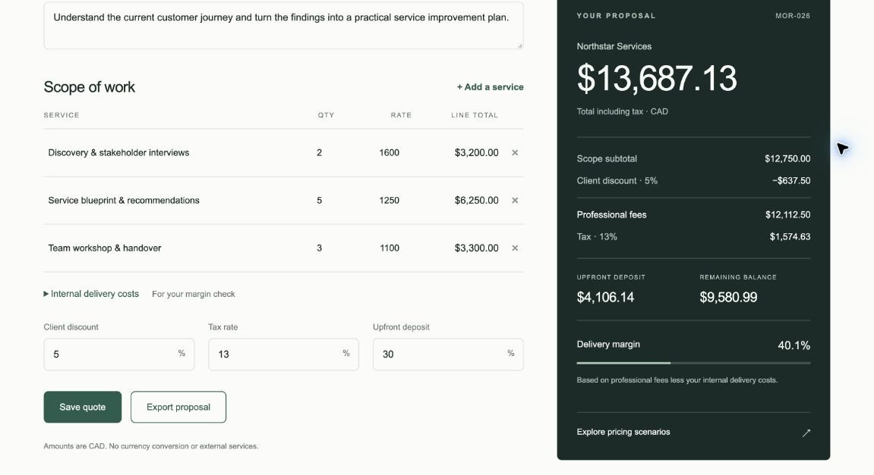
A working quote and proposal app
Same scope
5% discount
CAD 13,687.13
10% discount
CAD 12,966.75
Export excludes internal costs
CODEX & COFFEE
DAY 3 · 3
Notes:
TIMING: 2 minutes
LIVE DEMO. Open http://127.0.0.1:4323 or the public demo. Show fictional Northstar scope. Explore 0/5/10% scenarios. Change 5 to 10: total CAD 12,966.75. Reset to 5. Save, reopen and export HTML. Internal cost/margin must stay out of the proposal. Fallback: this screenshot and supplied example proposal. Return to slide 4.

Slide 4
Working software can still be tangled
app.js
Pricing
UI rendering
Saved proposals
HTML export
One working product
Quote inputs
The safe seam already exists: calculateQuote(input)
CODEX & COFFEE
DAY 3 · 4
Notes:
TIMING: 2 minutes
Show checkpoints/01-characterized/app.js. The calculator is pure but shares the file with rendering, localStorage and export. Working UI does not tell us whether responsibilities are separated. Prepared baseline, real extraction.

Slide 5

One repository or separate repositories?
MONOREPO
SEPARATE REPOSITORIES
One repo containing several projects
Each project has its own repo
Web app · Mobile app · Shared library
Web repo · Mobile repo · Library repo
This is about grouping code. Either approach can be well organized.
CODEX & COFFEE
DAY 3 · 5
Notes:
TIMING: 2 minutes
A repository stores code and its change history. A monorepo keeps multiple projects in one repository. In the alternative, often called polyrepo or multi-repo, projects have separate repositories and histories. Neither choice guarantees good architecture. The pictures show the same web app, mobile app and shared library arranged in two ways. Shared changes can be reviewed together in a monorepo; separate repositories allow independent ownership, access and release processes, with coordination required for cross-repository changes. This is a conceptual comparison, not a claim about our single-app demo. Source: https://www.atlassian.com/git/tutorials/monorepos . Illustration: built-in image_gen, Assets/monorepo-options.png.

Slide 6
Freeze the behavior before moving it
The ordinary case
The surprising case
Seeded quote
Subtotal: CAD 12,750.00
Discount: 5%
Tax: 13%
Total: CAD 13,687.13
Unit rate: 0.014
Quantity: 3
Round unit first → 0.01
Existing result → 3 cents
Keep the exact output, including quirks, during this extraction
CODEX & COFFEE
DAY 3 · 6
Notes:
TIMING: 2 minutes
Open test/fixtures.json and docs/behavior-contract.md. Characterization tests record current behavior, including quirks. Ask for 0.014 times 3 in cents. The app rounds the unit first, so its result is 3 cents. Do not improve rounding during this extraction. Tests were added before implementation.

Slide 7
01 · Audit the existing application
REPLAY PROMPT · fresh working copy
01-audit.md
Read PRODUCT-BRIEF.md and inspect app.js. Map the quote calculation to its UI, saved-quote, scenario and export callers. Identify one safe extraction boundary and behavior risks. Do not edit files. Return findings with file references.
Observed seam:
calculateQuote is pure
Four consumers:
UI, save, scenarios, export
Check the saved evidence before moving to the next stage
CODEX & COFFEE
DAY 3 · 7
Notes:
TIMING: 1 minutes
Open named chat 01 and evidence/01-audit.md. The audit had read-only scope. Check risks against actual callers. Excalidraw section 01 shows business brief and audit. The shown prompt is the compact learner replay prompt. Production chats also included local paths and ownership.

Slide 8
02 · Capture behavior and checks
REPLAY PROMPT · fresh working copy
Behavior contract
Before refactoring, characterize calculateQuote in app.js. Add literal fixtures for the seeded quote, rounding and discounts. Check normalization, output shape, row order, input mutation and errors. Run the tests against the existing app. Do not change application code.
27 checks pass
on the baseline
Literal expected results
Rounding and normalization
Input mutation and errors
Check the saved evidence before moving to the next stage
CODEX & COFFEE
DAY 3 · 8
Notes:
TIMING: 2 minutes
Open chat 02 and test/pricing.test.mjs. Run npm test in checkpoints/01-characterized: 27 pass, zero fail. Show a literal fixture and null-input TypeError. Fallback evidence/02-tests.md. Excalidraw section 02 shows fixture and contract. The shown prompt is the compact learner replay prompt. Production chats also included local paths and ownership.

Slide 9
03 · Define the target architecture
Read the business brief, behavior contract and tests. Plan one pricing extraction into domain/pricing.js while preserving the app.js entry point. Document allowed files, forbidden changes, checks and rollback. Write focused AGENTS.md guidance. Do not implement the refactor.
app.js
UI · storage · export · facade
domain/pricing.js
Pure functions · no browser
Same callers, smaller pricing boundary
CODEX & COFFEE
DAY 3 · 9
Notes:
TIMING: 2 minutes
Open chat 03, docs/architecture.md and AGENTS.md. Pricing owns math without browser dependencies. app.js is a facade: existing callers still work. Storage/UI extraction remains future work. Excalidraw section 03 shows both documents.

Slide 10
Project guidance that limits the change
AGENTS.md · teaching excerpt
Change only app.js and domain/pricing.js
Preserve output shape and rounding
Do not edit expected fixtures
No new dependencies
Run npm run check
Verify browser flows separately
Clear scope makes unintended changes easier to spot
CODEX & COFFEE
DAY 3 · 10
Notes:
TIMING: 2 minutes
Show actual AGENTS.md. Read allowed files and checks. Guidance is not a security boundary or guarantee. Put architecture reasons in architecture.md. Official guidance: https://learn.chatgpt.com/docs/agent-configuration/agents-md

Slide 11
04 · Extract one component
REPLAY PROMPT · fresh working copy
Actual change
Follow AGENTS.md and docs/architecture.md. Move the existing pricing functions into domain/pricing.js unchanged. Keep app.js callers and its calculateQuote export working. Do not edit tests, UI, storage or export behavior. Run the unchanged checks and report the scoped diff.
Moved four functions
Bodies unchanged
app.js imports the module
and keeps its export
27 unchanged tests pass
Check the saved evidence before moving to the next stage
CODEX & COFFEE
DAY 3 · 11
Notes:
TIMING: 3 minutes
Open chat 04 and extraction diff. Show app.js imports and re-export; cents stays private. No UI, storage or export rewrite. Run npm run check; fallback evidence/04-refactor.md. Excalidraw section 04 shows both files. The shown prompt is the compact learner replay prompt. Production chats also included local paths and ownership.

Slide 12
05 · Verify and hand off
REPLAY PROMPT · fresh working copy
Observed evidence
Compare checkpoints/01-characterized with the final app. Run the unchanged tests and check function identity, protected files and bounded pricing examples. Separately verify totals, scenarios, save/reopen and exported proposal privacy in the browser. Report evidence, gaps and the next safe step.
27 unchanged tests pass
8 literal cases match
1,000 bounded cases match
Browser: totals, save/reopen,
new/reset and export checked
Check the saved evidence before moving to the next stage
CODEX & COFFEE
DAY 3 · 12
Notes:
TIMING: 3 minutes
Open chat 05 and evidence/05-verification.md. Independent comparison: 750 returning inputs, 250 errors. Protected files and function identity checked. Parent separately rehearsed browser and inspected export. Sampled parity is not universal proof. Show docs/HANDOFF.md. Excalidraw section 05. The shown prompt is the compact learner replay prompt. Production chats also included local paths and ownership.

Slide 13
A fresh task with a small starting context
Paste into Codex in the finished app folder
Read PRODUCT-BRIEF.md, docs/behavior-contract.md and docs/architecture.md. Audit how pricing handles a zero-value quote. Inspect only the relevant pricing module, its caller and tests. Do not change code. Report current behavior, evidence and any unanswered question.
Expected: an evidenced explanation, with no code changes
CODEX & COFFEE
DAY 3 · 13
Notes:
TIMING: 2 minutes
LIVE PROMPT if time permits. Use final app folder. The audit requests no source edits. Expected: zero-net margin is 0 under current contract, with code/test evidence. Verify sources and no invented policy. Fallback: inspect zero-net test. Return to slide 14.

Slide 14
Context efficiency starts with task boundaries
11,441 bytes
935 bytes
Original app.js
domain/pricing.js
A smaller file for pricing questions
Read related files when needed. Bytes are not tokens, and this is not a measured billing reduction.
CODEX & COFFEE
DAY 3 · 14
Notes:
TIMING: 1 minutes
Measured UTF-8 bytes, not tokens or billing savings. Pricing-only inspection can start with the domain file. Include contract/tests/callers as needed. More chats do not automatically save tokens. Evidence: context-scope.json.

Slide 15
What changed, and what stayed the same
Changed in the extraction
Protected during extraction
app.js
Import + preserved export
domain/pricing.js
Existing pricing functions
UI and styles
Saved-quote behavior
Proposal export
Test expectations
Rounding and output shape
A focused diff is easier to review and roll back
CODEX & COFFEE
DAY 3 · 15
Notes:
TIMING: 2 minutes
Show extraction commit e480009. Function bodies unchanged; protected files compare byte-for-byte. Architecture and contract docs preceded extraction; handoff followed it. Known UI/storage issues remain explicit.

Slide 16
Replay the day without setup confusion
github.com/promptadvisers/codexandcoffee
Watch and inspect
Run your own copy
Open the browser demo
Read the five board sections
Compare the saved evidence
Download Day 3 → unzip
Open app/ in Codex
Run: npm start
Check: npm test
Node.js 20+ for local commands · No app dependency installation needed
CODEX & COFFEE
DAY 3 · 16
Notes:
TIMING: 2 minutes
Open public Day 3 page. Watch route: browser demo, slides, board, before/after source. Hands-on: download ZIP, unzip, Node20+, open app in Codex, npm start and npm test. No npm install. checkpoints/01-characterized is before; app is after. See PROMPTS.md.

Slide 17
Questions about your own application
What would you preserve first?
- Which user-visible result must stay the same?
- What is the smallest useful boundary?
- What evidence would let you accept the change?
Bring one behavior, not a request to rewrite everything
CODEX & COFFEE
DAY 3 · 17
Notes:
TIMING: 15 minutes
Minutes30–45. If quiet, use slides18–20 for five minutes each inside this slot. Ask for one behavior, evidence and a boundary. Avoid displaying private code.

Slide 18
When the math looks wrong
Rate: 0.014
Quantity: 3
Existing result: 3 cents
Do we fix the rounding inside this refactor?
CODEX & COFFEE
DAY 3 · 18
Notes:
TIMING: 0 minutes
RESERVE: up to five minutes inside Q&A. Preserve observed behavior during extraction. Capture a separate business decision and acceptance tests for a rounding change.

Slide 19
When “while you’re there” appears
The task: extract pricing
The suggestion: replace localStorage with a database
What evidence and scope would that second change need?
CODEX & COFFEE
DAY 3 · 19
Notes:
TIMING: 0 minutes
RESERVE: up to five minutes inside Q&A. Defer storage change: it needs its own persistence contract, migration, failure handling and browser checks. Record next slice in handoff.

Slide 20
When every test is green
27 pricing tests pass
The browser still fails to reopen a saved quote
Can we call the application verified?
CODEX & COFFEE
DAY 3 · 20
Notes:
TIMING: 0 minutes
RESERVE: up to five minutes inside Q&A. No. Unit checks cover pricing, not every browser flow. Reproduce save/reopen and document tested and untested scope.

