Slide 1

O’REILLY LIVE
Codex
& Coffee
Mark Kashef
DAY 9
Make an explainer people can follow
Notes:
DAY 9 · Make an explainer people can follow
0–0.5 minutes
SAY
Welcome to Day 9. Yesterday we edited video. Today we will use Codex and HyperFrames to explain ideas with video, sound and animation.
DO
Introduce the lesson and explain that the five finished examples will be unpacked.
CHECK
Learners know this lesson is about making instructional videos with Codex and HyperFrames.
Sources: https://learn.chatgpt.com/docs/build-skills ; https://learn.chatgpt.com/docs/app ; https://developers.openai.com/codex/guides/agents-md/ ; https://github.com/openai/codex ; https://hyperframes.studio/
Official screenshot: https://chatgpt.com/codex/ . Fictional examples and generated illustrations are teaching materials. Provider access checked during production; see START-HERE for actual final audio status.

Slide 2
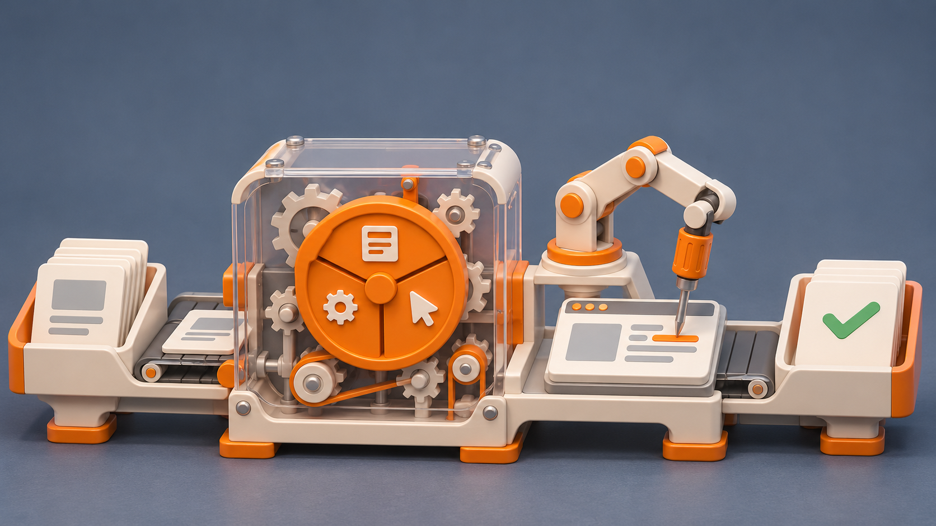
A useful video changes what someone understands
One idea
One worked example
A clear result
CODEX & COFFEE
DAY 9 · 2
Notes:
DAY 9 · A useful video changes what someone understands
0.5–1.25 minutes
SAY
The output is not just a nice-looking MP4. It is a person who can explain or do one thing afterward. Use the harness example: they should understand the model is one part of a larger system.
DO
Point from the harness example to the three learning decisions.
CHECK
Learners can name a single understanding the video should produce.
Sources: https://learn.chatgpt.com/docs/build-skills ; https://learn.chatgpt.com/docs/app ; https://developers.openai.com/codex/guides/agents-md/ ; https://github.com/openai/codex ; https://hyperframes.studio/
Official screenshot: https://chatgpt.com/codex/ . Fictional examples and generated illustrations are teaching materials. Provider access checked during production; see START-HERE for actual final audio status.

Slide 3
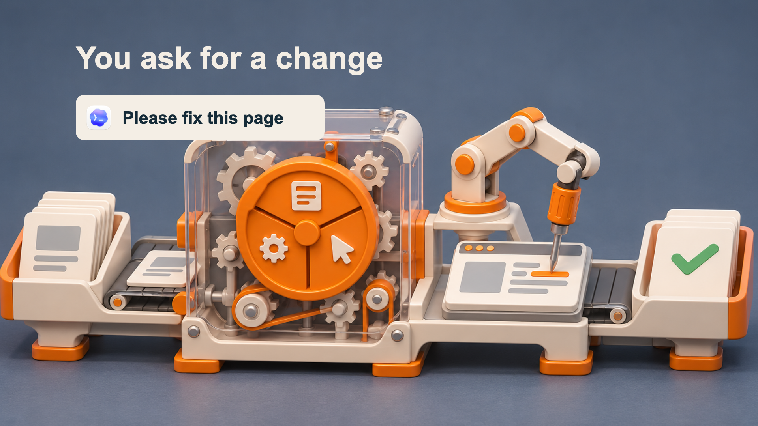

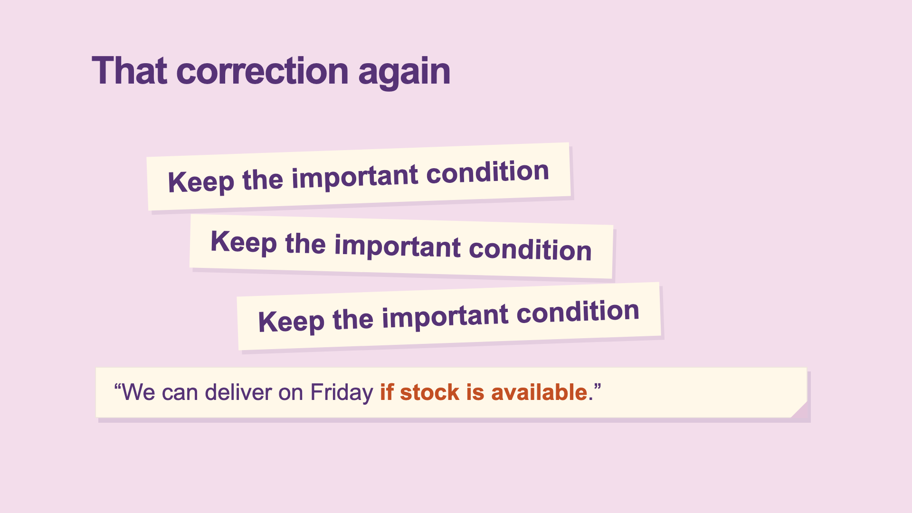
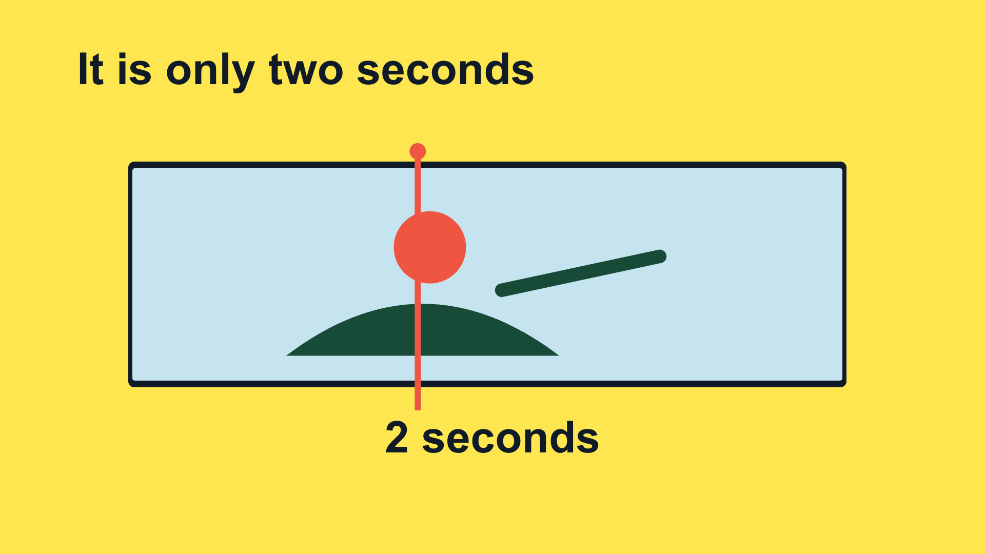
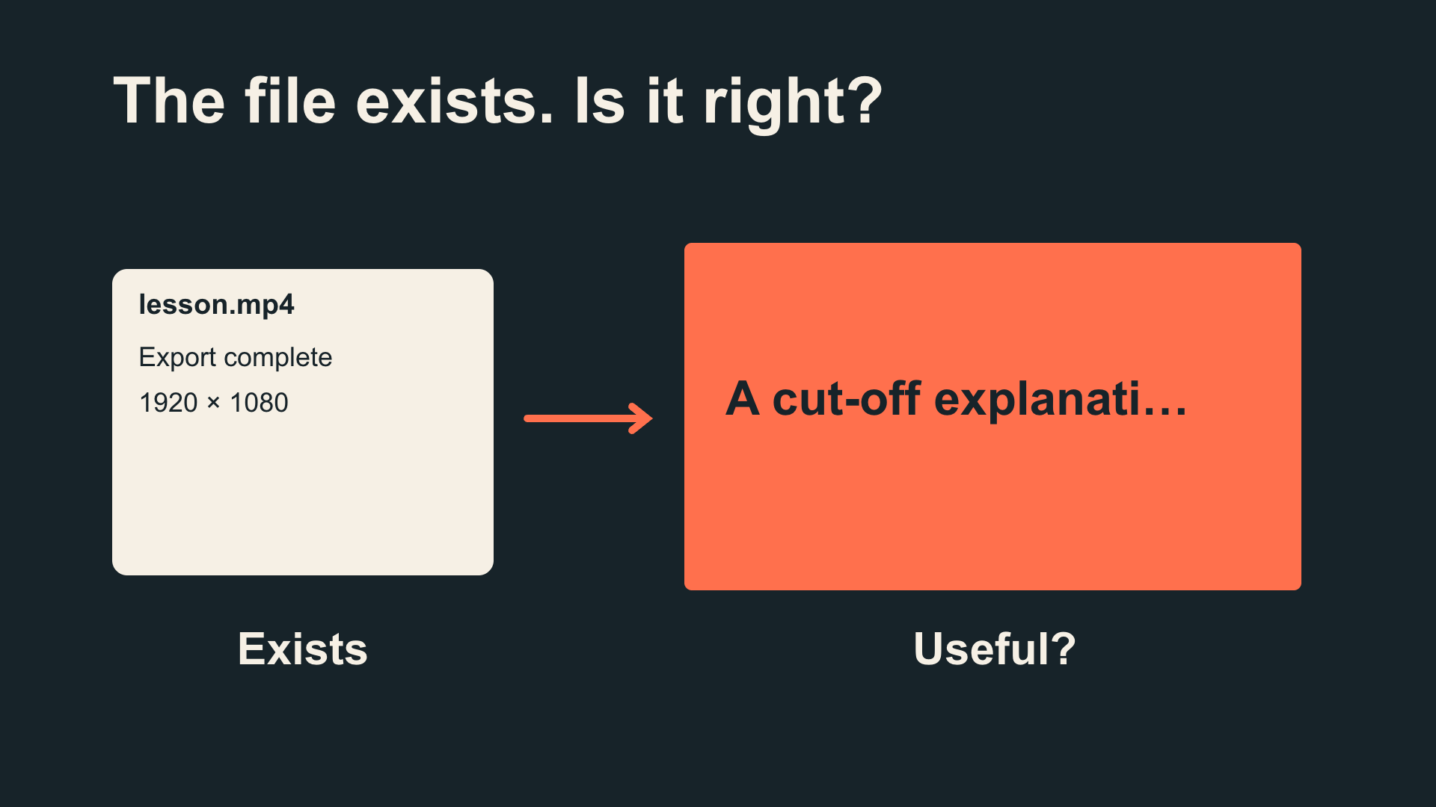
Five ideas. Five different treatments.
Harness
Project context
Skills
Video frames
Checking the result
CODEX & COFFEE
DAY 9 · 3
Notes:
DAY 9 · Five ideas. Five different treatments.
1.25–2 minutes
SAY
These five videos cover material we already know, so we can study how the explanation was made. Ask people to notice what carries the meaning: an object, a screenshot, a transformation, a timeline or a comparison.
DO
Name the five topics and ask learners to compare their visual treatments.
CHECK
Everyone can name the five subjects
Sources: https://learn.chatgpt.com/docs/build-skills ; https://learn.chatgpt.com/docs/app ; https://developers.openai.com/codex/guides/agents-md/ ; https://github.com/openai/codex ; https://hyperframes.studio/
Official screenshot: https://chatgpt.com/codex/ . Fictional examples and generated illustrations are teaching materials. Provider access checked during production; see START-HERE for actual final audio status.

Slide 4



Codex builds. HyperFrames renders.
≋
Codex
HyperFrames
FFmpeg
AI voice
Direct the work
Animate the story
Process media
Narrate clearly
CODEX & COFFEE
DAY 9 · 4
Notes:
DAY 9 · Codex builds. HyperFrames renders.
2–3 minutes
SAY
Codex writes the script and editable animation project. HyperFrames renders its timeline into video. FFmpeg processes media. The voice service supplies narration; access and costs depend on the chosen provider. Explain first, then name the tools.
DO
Point to each real logo and describe its specific role.
CHECK
Learners can distinguish directing, animating, media processing and narration.
Sources: https://learn.chatgpt.com/docs/build-skills ; https://learn.chatgpt.com/docs/app ; https://developers.openai.com/codex/guides/agents-md/ ; https://github.com/openai/codex ; https://hyperframes.studio/
Official screenshot: https://chatgpt.com/codex/ . Fictional examples and generated illustrations are teaching materials. Provider access checked during production; see START-HERE for actual final audio status.

Slide 5
01
The harness
A machine cutaway
Watch → open the brief → inspect → replay
CODEX & COFFEE
DAY 9 · 5
Notes:
DAY 9 · The harness
3–3.1 minutes
SAY
This chapter uses a machine cutaway. We will watch it, open the brief, examine the design and replay the useful moment.
DO
Introduce the next video; advance to play.
CHECK
The subject and visual treatment are clear.
Sources: https://learn.chatgpt.com/docs/build-skills ; https://learn.chatgpt.com/docs/app ; https://developers.openai.com/codex/guides/agents-md/ ; https://github.com/openai/codex ; https://hyperframes.studio/
Official screenshot: https://chatgpt.com/codex/ . Fictional examples and generated illustrations are teaching materials. Provider access checked during production; see START-HERE for actual final audio status.

Slide 6
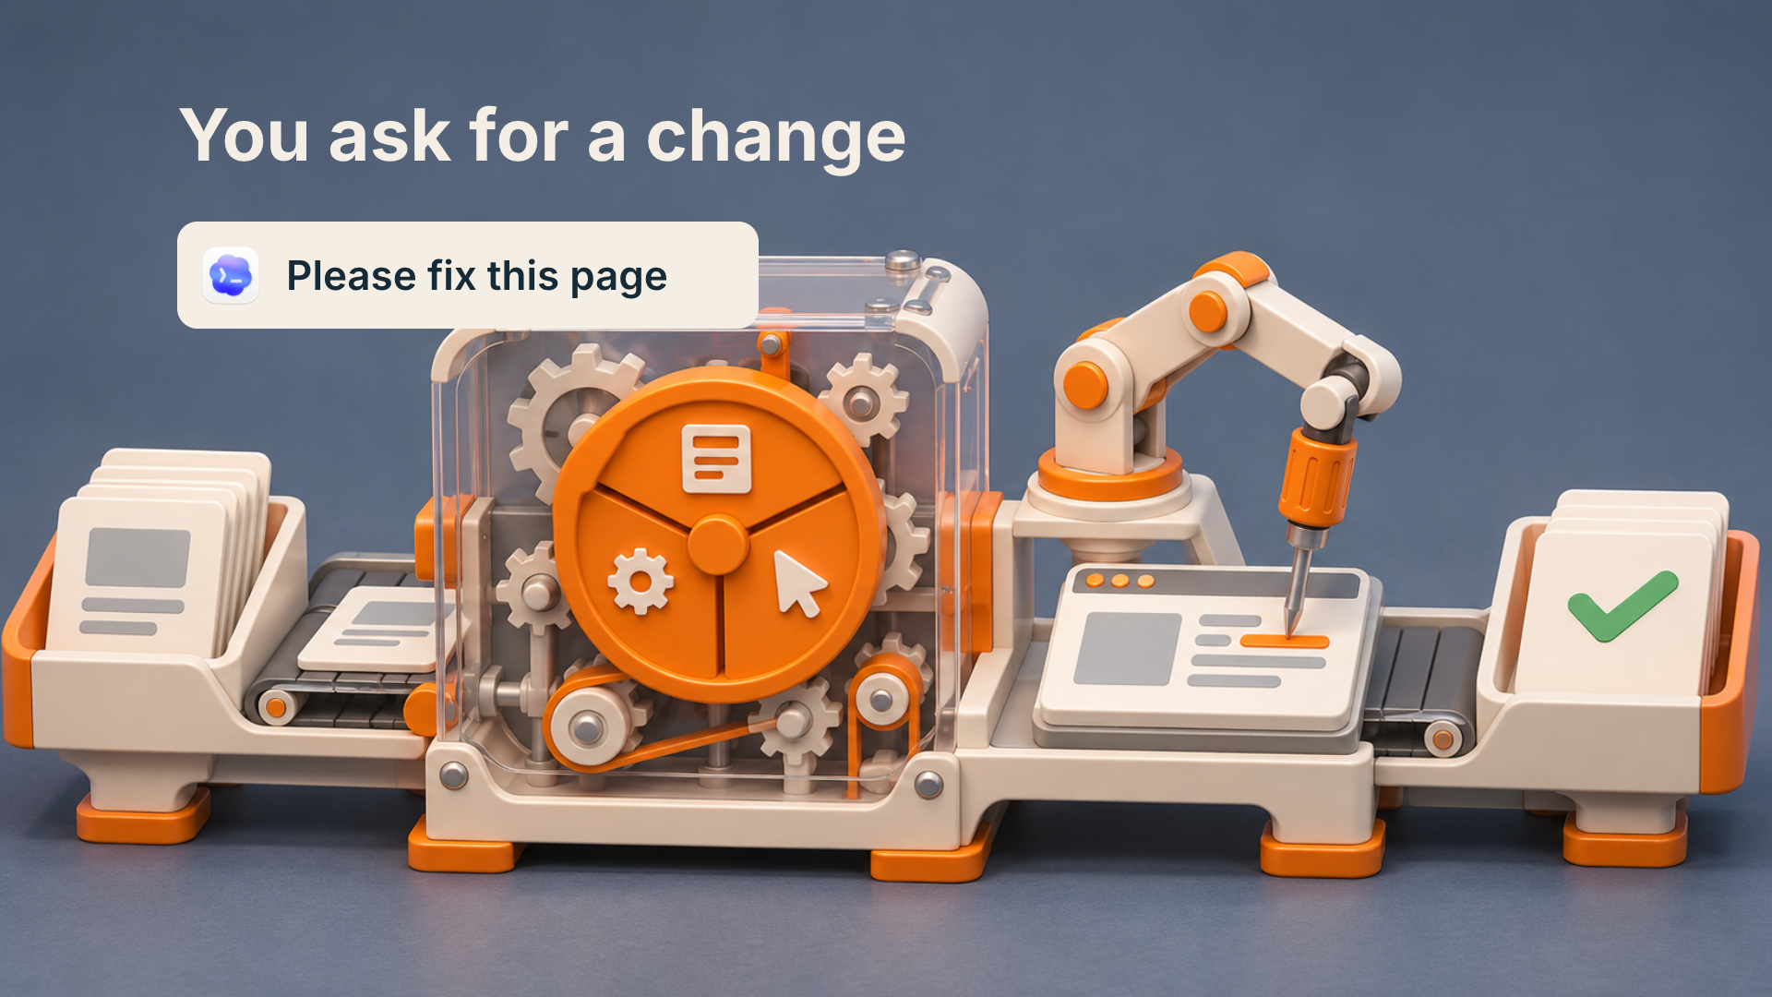
What happens after you ask?
▶
CODEX & COFFEE
DAY 9 · 6
Notes:
DAY 9 · What happens after you ask?
3.1–4.45 minutes
SAY
Watch the complete video before looking at the production instructions. Ask learners what made the idea easy or hard to follow.
DO
Play the full embedded video. Let it finish.
CHECK
The harness coordinates the work around the model.
Sources: https://learn.chatgpt.com/docs/build-skills ; https://learn.chatgpt.com/docs/app ; https://developers.openai.com/codex/guides/agents-md/ ; https://github.com/openai/codex ; https://hyperframes.studio/
Official screenshot: https://chatgpt.com/codex/ . Fictional examples and generated illustrations are teaching materials. Provider access checked during production; see START-HERE for actual final audio status.
PLAY FILE: 01-harness.mp4
Use the offline viewer’s matching video button; wait for completion.
The video is embedded on this slide. Click it to play in PowerPoint. Offline fallback: Day-09-Lesson.html in the same output folder.

Slide 7
The brief: what it needs to teach
Actual production brief · part 1 of 2
Make a short narrated HyperFrames video for people who are new to Codex. Teach the codex harness using one concrete example. Use a mechanical cutaway explainer. The viewer should leave knowing: The harness coordinates the work around the model.
CHECK
A clear audience, one idea and one example.
CODEX & COFFEE
DAY 9 · 7
Notes:
DAY 9 · The brief: what it needs to teach
4.45–5 minutes
SAY
This is the first part of the actual production brief saved before the scene files were built. The prompt is directed to Codex; HyperFrames renders the project Codex writes. Read it as a normal request, not as a magic command.
DO
Read the excerpt and point out audience, teaching goal and visual device.
CHECK
A clear audience, one idea and one example.
EXACT PROMPT
Make a short narrated HyperFrames video for people who are new to Codex. Teach the codex harness using one concrete example. Use a mechanical cutaway explainer. The viewer should leave knowing: The harness coordinates the work around the model.
Sources: https://learn.chatgpt.com/docs/build-skills ; https://learn.chatgpt.com/docs/app ; https://developers.openai.com/codex/guides/agents-md/ ; https://github.com/openai/codex ; https://hyperframes.studio/
Official screenshot: https://chatgpt.com/codex/ . Fictional examples and generated illustrations are teaching materials. Provider access checked during production; see START-HERE for actual final audio status.

Slide 8
The brief: how it should be made
Actual production brief · part 2 of 2
Use the supplied script and real product assets where relevant. Keep the words conversational, reveal each visual as it is explained, and leave time to read. Use this palette: #223C4B, #F2733C, #F4EEE5, #7DD5C5. Add a clear AI voice, quiet instrumental music, and a few sound effects tied to visible actions. Keep the editable project and save a 1080p MP4. Check the rendered frames, audio, and ending before calling it ready.
CHECK
The brief specifies assets, pacing, sound, files and checks.
CODEX & COFFEE
DAY 9 · 8
Notes:
DAY 9 · The brief: how it should be made
5–5.5 minutes
SAY
This completes the same production brief, without replacing the words with a retrospective summary. The supplied script is the eight-beat SCRIPT.md. The palette is intentional, and the deliverables and checks are explicit.
DO
Read the second half; identify what controls the look, audio and output.
CHECK
The brief specifies assets, pacing, sound, files and checks.
EXACT PROMPT
Use the supplied script and real product assets where relevant. Keep the words conversational, reveal each visual as it is explained, and leave time to read. Use this palette: #223C4B, #F2733C, #F4EEE5, #7DD5C5. Add a clear AI voice, quiet instrumental music, and a few sound effects tied to visible actions. Keep the editable project and save a 1080p MP4. Check the rendered frames, audio, and ending before calling it ready.
Sources: https://learn.chatgpt.com/docs/build-skills ; https://learn.chatgpt.com/docs/app ; https://developers.openai.com/codex/guides/agents-md/ ; https://github.com/openai/codex ; https://hyperframes.studio/
Official screenshot: https://chatgpt.com/codex/ . Fictional examples and generated illustrations are teaching materials. Provider access checked during production; see START-HERE for actual final audio status.

Slide 9
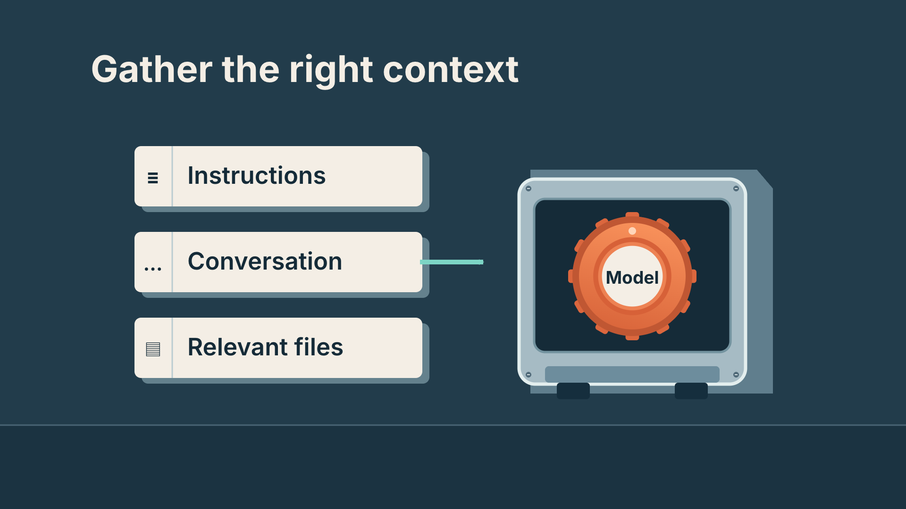
Why this design fits the idea
Slate workshop
Orange moving parts
Porcelain paper
Mint return path
Arial · bold labels
Paper enters → tool moves → result returns
Michael · restrained electronic bed
CODEX & COFFEE
DAY 9 · 9
Notes:
DAY 9 · Why this design fits the idea
5.5–6.1 minutes
SAY
A visible machine explains a hidden work cycle. The diagram grows as the explanation unfolds. Name the palette, type, motion and audio choices. These are the choices implemented in the supplied film, not optional suggestions.
DO
Point to the frame, then trace each visible design decision.
CHECK
Learners can connect the look to the teaching job.
Sources: https://learn.chatgpt.com/docs/build-skills ; https://learn.chatgpt.com/docs/app ; https://developers.openai.com/codex/guides/agents-md/ ; https://github.com/openai/codex ; https://hyperframes.studio/
Official screenshot: https://chatgpt.com/codex/ . Fictional examples and generated illustrations are teaching materials. Provider access checked during production; see START-HERE for actual final audio status.

Slide 10
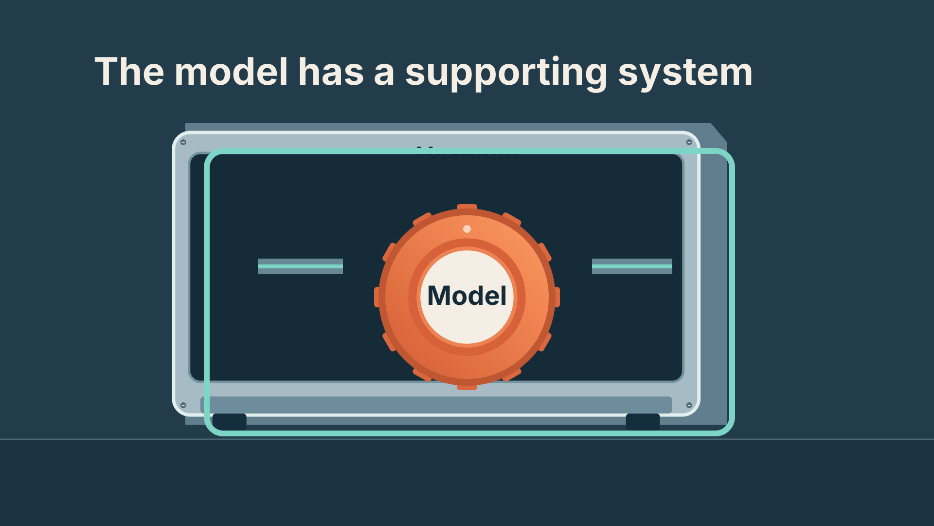
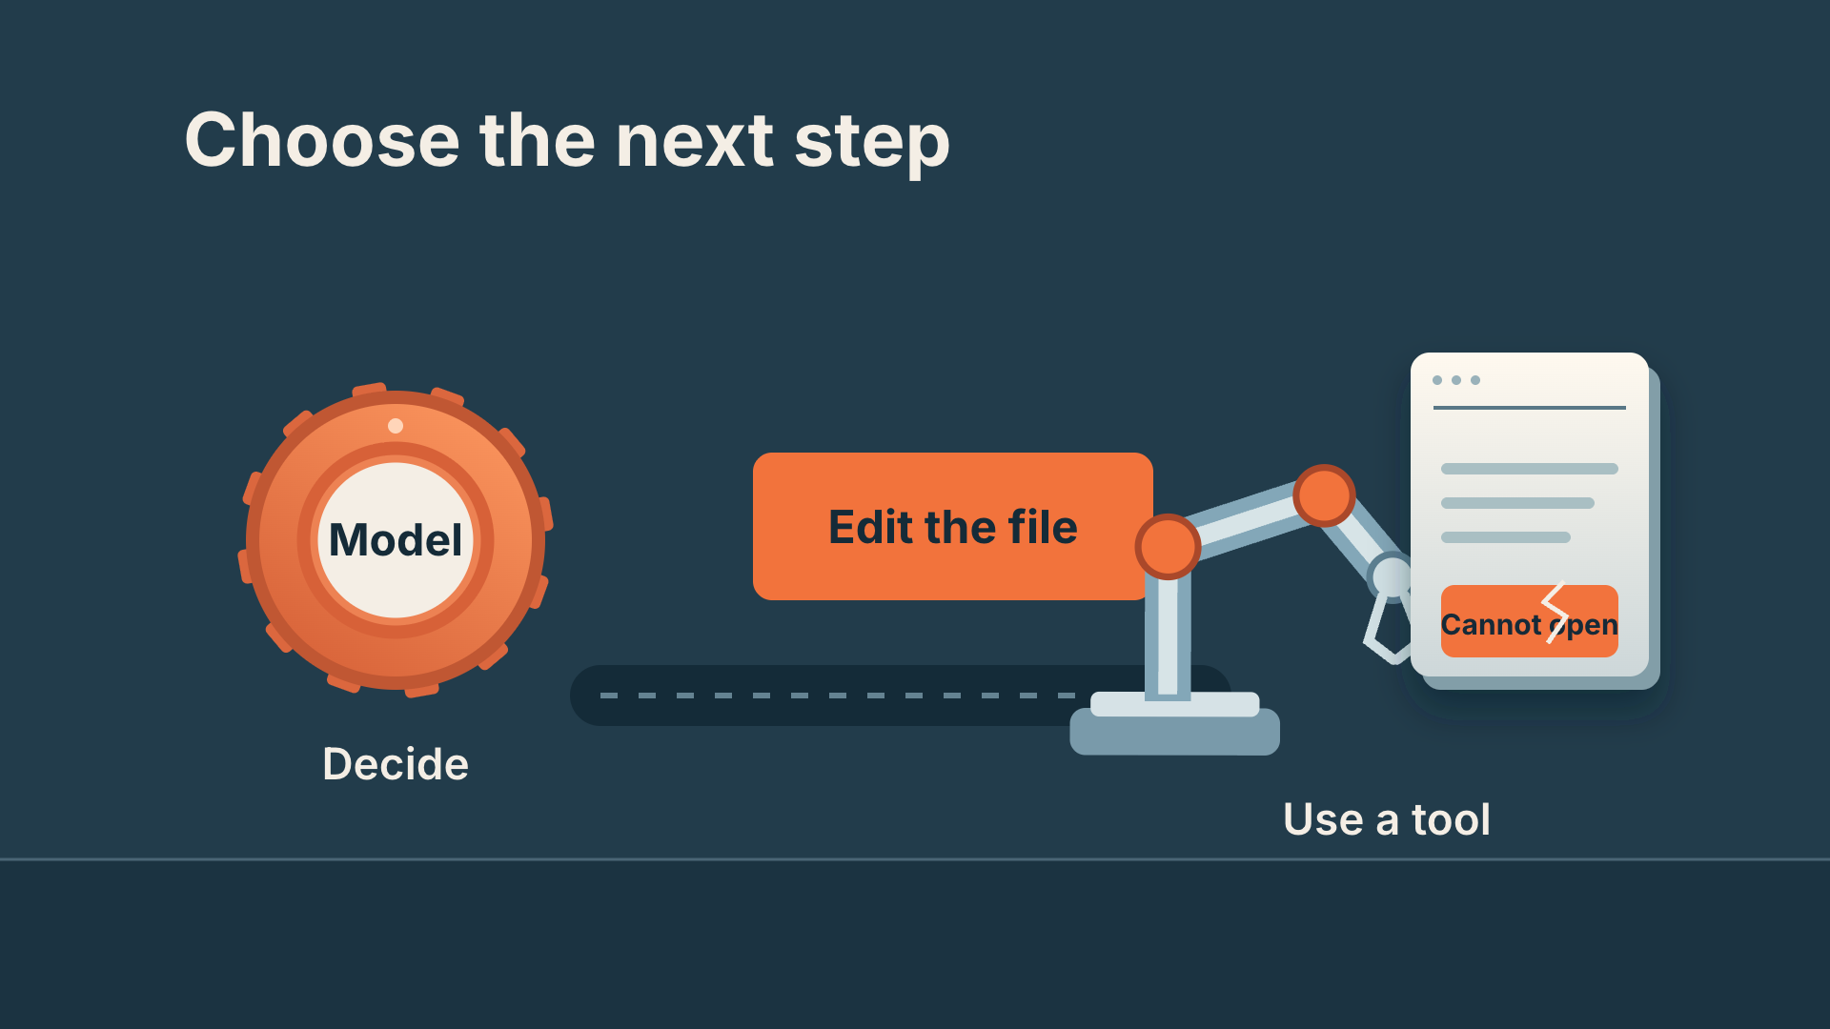
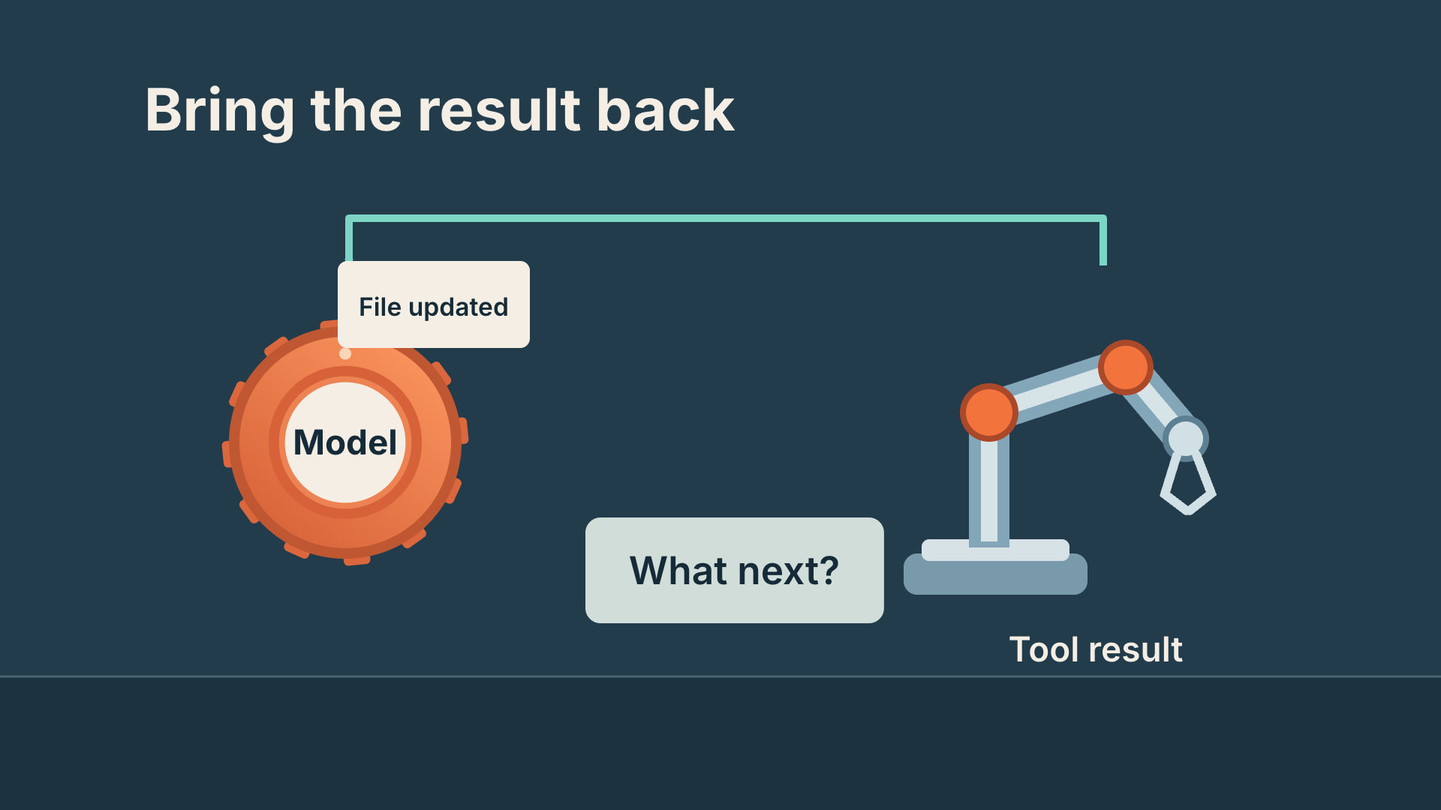
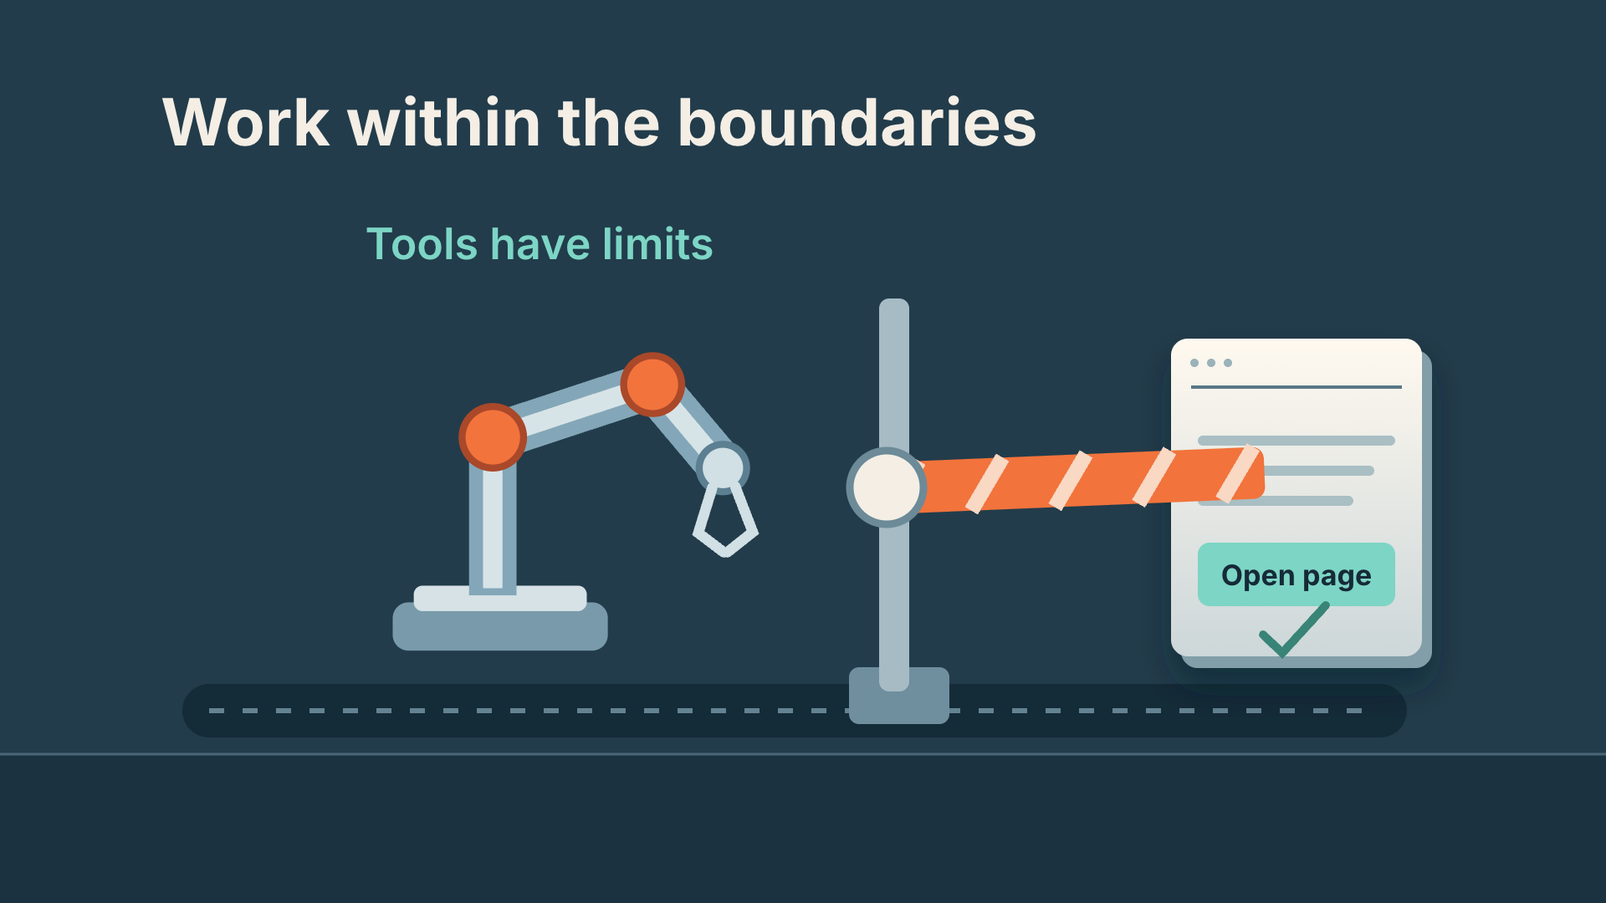
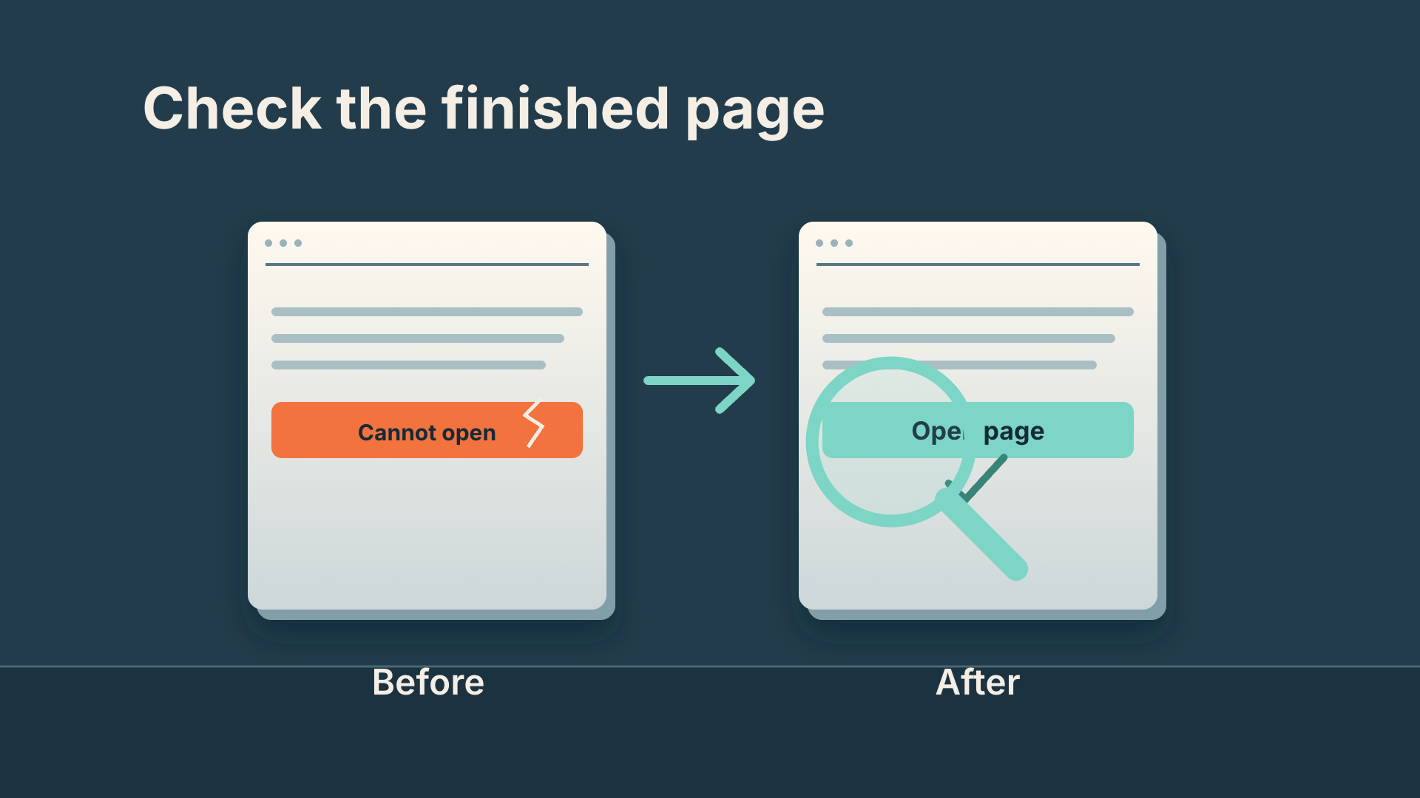
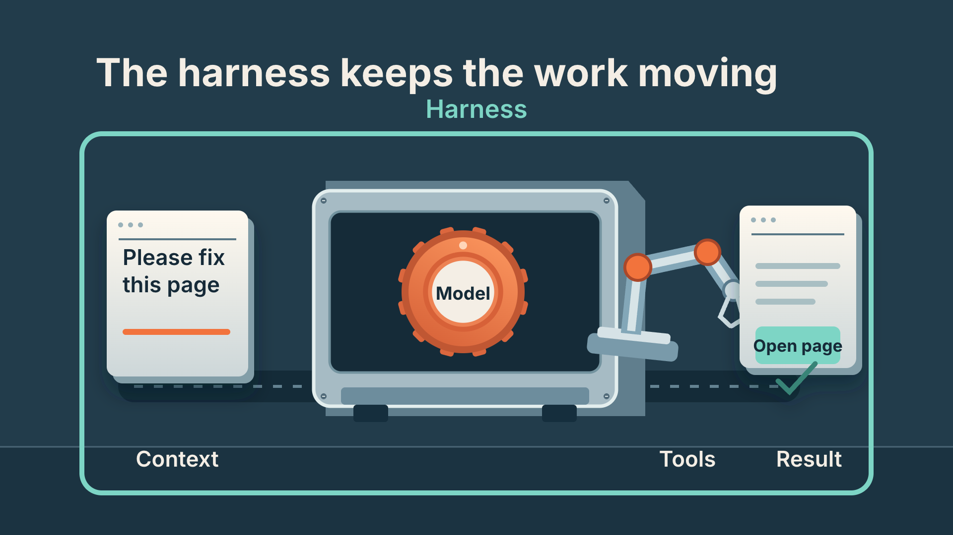
From a script to eight visual beats
1. Ask
2. Model
3. Context
4. Tool
5. Result
6. Limits
7. Check
8. Whole system
Scene 1: beats 1–3 Scene 2: beats 4–6 Scene 3: beats 7–8
CODEX & COFFEE
DAY 9 · 10
Notes:
DAY 9 · From a script to eight visual beats
6.1–6.8 minutes
SAY
The voice was written in eight short sections. Each has one visual instruction. Three editable scene files hold those eight beats. The voice lengths set the timing; the display below is the actual sequence.
DO
Walk across the thumbnails in order. Explain one causal transition rather than reading all eight titles.
CHECK
Every spoken idea has a corresponding picture.
Sources: https://learn.chatgpt.com/docs/build-skills ; https://learn.chatgpt.com/docs/app ; https://developers.openai.com/codex/guides/agents-md/ ; https://github.com/openai/codex ; https://hyperframes.studio/
Official screenshot: https://chatgpt.com/codex/ . Fictional examples and generated illustrations are teaching materials. Provider access checked during production; see START-HERE for actual final audio status.

Slide 11
The image request behind the machine
IMAGE PROMPT · actual excerpt
Full coherent physical scene on a slate blue workshop surface, warm overhead studio lighting, matte porcelain white and saturated orange physical components.
COMPOSITION · actual excerpt
The hero is a compact desktop sorting machine, seen isometrically, spanning 80% of frame.
CODEX & COFFEE
DAY 9 · 11
Notes:
DAY 9 · The image request behind the machine
6.8–7.5 minutes
SAY
These words are copied from the production files. The narration says the idea; the visual instruction describes what must happen on screen. Codex then implements the illustration and motion in the editable scene file. The separate image request is also included in IMAGE-PROMPT.md; only the opening workbench is a generated still.
DO
Read the narration and visual direction beside the matching rendered frame.
CHECK
The instruction names an action rather than just an aesthetic.
Sources: https://learn.chatgpt.com/docs/build-skills ; https://learn.chatgpt.com/docs/app ; https://developers.openai.com/codex/guides/agents-md/ ; https://github.com/openai/codex ; https://hyperframes.studio/
Official screenshot: https://chatgpt.com/codex/ . Fictional examples and generated illustrations are teaching materials. Provider access checked during production; see START-HERE for actual final audio status.

Slide 12
Watch that moment again
▶
CODEX & COFFEE
DAY 9 · 12
Notes:
DAY 9 · Watch that moment again
7.5–9 minutes
SAY
Watch the context arrive before the tool moves. This is a focused excerpt from the same finished video. Play once, pause on the useful frame, then connect the result back to the instruction. The diagram grows as the explanation unfolds.
DO
Play the embedded excerpt. Pause to discuss; the full video is still available at the earlier slide.
CHECK
The diagram grows as the explanation unfolds.
Sources: https://learn.chatgpt.com/docs/build-skills ; https://learn.chatgpt.com/docs/app ; https://developers.openai.com/codex/guides/agents-md/ ; https://github.com/openai/codex ; https://hyperframes.studio/
Official screenshot: https://chatgpt.com/codex/ . Fictional examples and generated illustrations are teaching materials. Provider access checked during production; see START-HERE for actual final audio status.
PLAY EXCERPT: 01-harness-replay.mp4
The video is embedded on this slide. Click it to play in PowerPoint. Offline fallback: Day-09-Lesson.html in the same output folder.

Slide 13
02
The workspace
A real app walkthrough
Watch → open the brief → inspect → replay
CODEX & COFFEE
DAY 9 · 13
Notes:
DAY 9 · The workspace
9–9.1 minutes
SAY
This chapter uses a real app walkthrough. We will watch it, open the brief, examine the design and replay the useful moment.
DO
Introduce the next video; advance to play.
CHECK
The subject and visual treatment are clear.
Sources: https://learn.chatgpt.com/docs/build-skills ; https://learn.chatgpt.com/docs/app ; https://developers.openai.com/codex/guides/agents-md/ ; https://github.com/openai/codex ; https://hyperframes.studio/
Official screenshot: https://chatgpt.com/codex/ . Fictional examples and generated illustrations are teaching materials. Provider access checked during production; see START-HERE for actual final audio status.

Slide 14

Give Codex the right starting point
▶
CODEX & COFFEE
DAY 9 · 14
Notes:
DAY 9 · Give Codex the right starting point
9.1–10.45 minutes
SAY
Watch the complete video before looking at the production instructions. Ask learners what made the idea easy or hard to follow.
DO
Play the full embedded video. Let it finish.
CHECK
Point to the source and say what to preserve.
Sources: https://learn.chatgpt.com/docs/build-skills ; https://learn.chatgpt.com/docs/app ; https://developers.openai.com/codex/guides/agents-md/ ; https://github.com/openai/codex ; https://hyperframes.studio/
Official screenshot: https://chatgpt.com/codex/ . Fictional examples and generated illustrations are teaching materials. Provider access checked during production; see START-HERE for actual final audio status.
PLAY FILE: 02-workspace.mp4
Use the offline viewer’s matching video button; wait for completion.
The video is embedded on this slide. Click it to play in PowerPoint. Offline fallback: Day-09-Lesson.html in the same output folder.

Slide 15
The brief: what it needs to teach
Actual production brief · part 1 of 2
Make a short narrated HyperFrames video for people who are new to Codex. Teach project context using one concrete example. Use an authentic app view plus a worked file example. The viewer should leave knowing: Point to the source and say what to preserve.
CHECK
A clear audience, one idea and one example.
CODEX & COFFEE
DAY 9 · 15
Notes:
DAY 9 · The brief: what it needs to teach
10.45–11 minutes
SAY
This is the first part of the actual production brief saved before the scene files were built. The prompt is directed to Codex; HyperFrames renders the project Codex writes. Read it as a normal request, not as a magic command.
DO
Read the excerpt and point out audience, teaching goal and visual device.
CHECK
A clear audience, one idea and one example.
EXACT PROMPT
Make a short narrated HyperFrames video for people who are new to Codex. Teach project context using one concrete example. Use an authentic app view plus a worked file example. The viewer should leave knowing: Point to the source and say what to preserve.
Sources: https://learn.chatgpt.com/docs/build-skills ; https://learn.chatgpt.com/docs/app ; https://developers.openai.com/codex/guides/agents-md/ ; https://github.com/openai/codex ; https://hyperframes.studio/
Official screenshot: https://chatgpt.com/codex/ . Fictional examples and generated illustrations are teaching materials. Provider access checked during production; see START-HERE for actual final audio status.

Slide 16
The brief: how it should be made
Actual production brief · part 2 of 2
Use the supplied script and real product assets where relevant. Keep the words conversational, reveal each visual as it is explained, and leave time to read. Use this palette: #ECF4EE, #174B38, #FFFFFF, #E7AD46. Add a clear AI voice, quiet instrumental music, and a few sound effects tied to visible actions. Keep the editable project and save a 1080p MP4. Check the rendered frames, audio, and ending before calling it ready.
CHECK
The brief specifies assets, pacing, sound, files and checks.
CODEX & COFFEE
DAY 9 · 16
Notes:
DAY 9 · The brief: how it should be made
11–11.5 minutes
SAY
This completes the same production brief, without replacing the words with a retrospective summary. The supplied script is the eight-beat SCRIPT.md. The palette is intentional, and the deliverables and checks are explicit.
DO
Read the second half; identify what controls the look, audio and output.
CHECK
The brief specifies assets, pacing, sound, files and checks.
EXACT PROMPT
Use the supplied script and real product assets where relevant. Keep the words conversational, reveal each visual as it is explained, and leave time to read. Use this palette: #ECF4EE, #174B38, #FFFFFF, #E7AD46. Add a clear AI voice, quiet instrumental music, and a few sound effects tied to visible actions. Keep the editable project and save a 1080p MP4. Check the rendered frames, audio, and ending before calling it ready.
Sources: https://learn.chatgpt.com/docs/build-skills ; https://learn.chatgpt.com/docs/app ; https://developers.openai.com/codex/guides/agents-md/ ; https://github.com/openai/codex ; https://hyperframes.studio/
Official screenshot: https://chatgpt.com/codex/ . Fictional examples and generated illustrations are teaching materials. Provider access checked during production; see START-HERE for actual final audio status.

Slide 17
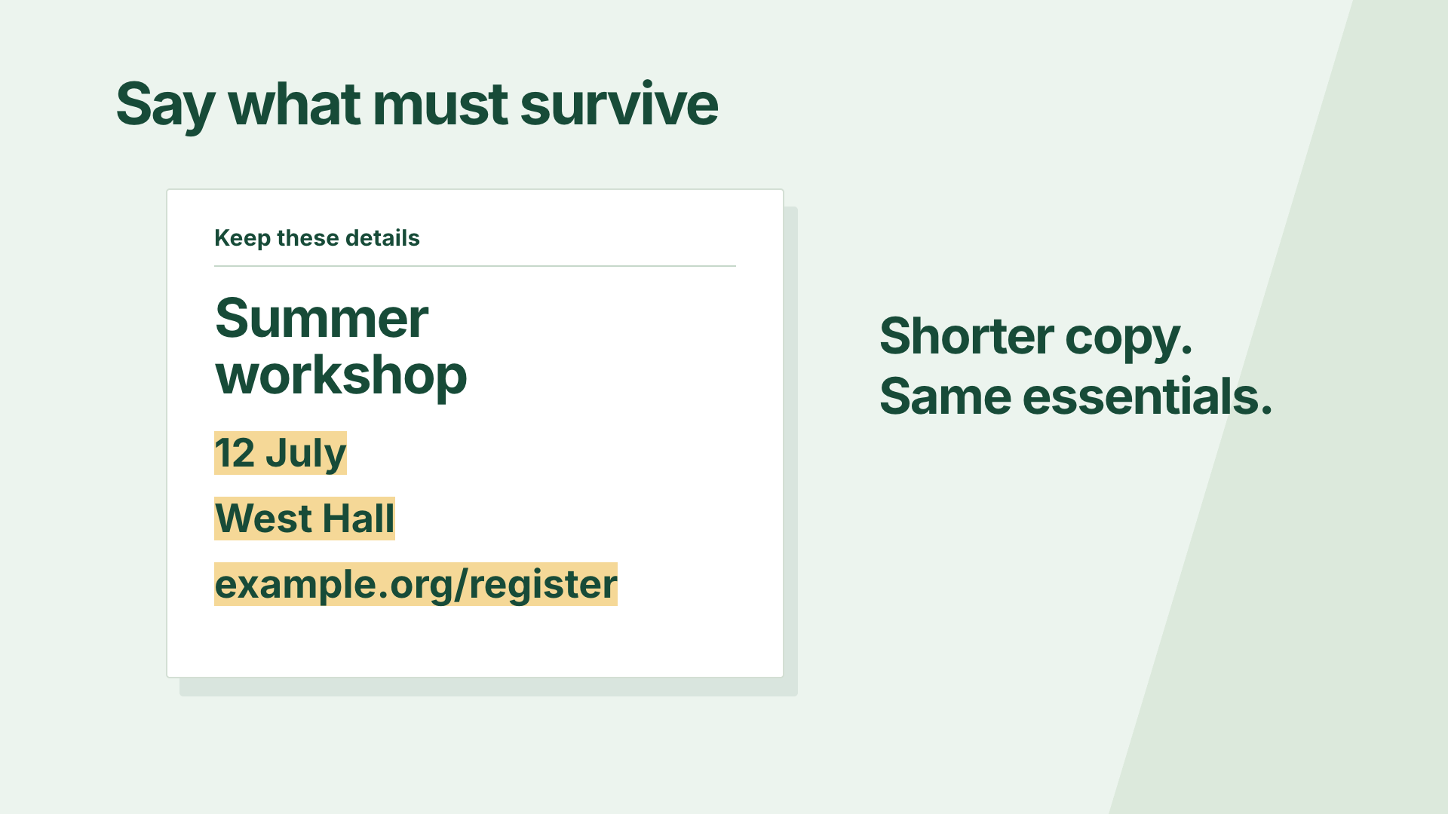
Why this design fits the idea
Sage background
Forest ink
White source pages
Mustard highlights
Inter · clear document text
Choose → zoom → highlight → compare
Heart · soft acoustic bed
CODEX & COFFEE
DAY 9 · 17
Notes:
DAY 9 · Why this design fits the idea
11.5–12.1 minutes
SAY
A real screen grounds one fictional document task. The unchanged details connect the before and after. Name the palette, type, motion and audio choices. These are the choices implemented in the supplied film, not optional suggestions.
DO
Point to the frame, then trace each visible design decision.
CHECK
Learners can connect the look to the teaching job.
Sources: https://learn.chatgpt.com/docs/build-skills ; https://learn.chatgpt.com/docs/app ; https://developers.openai.com/codex/guides/agents-md/ ; https://github.com/openai/codex ; https://hyperframes.studio/
Official screenshot: https://chatgpt.com/codex/ . Fictional examples and generated illustrations are teaching materials. Provider access checked during production; see START-HERE for actual final audio status.

Slide 18
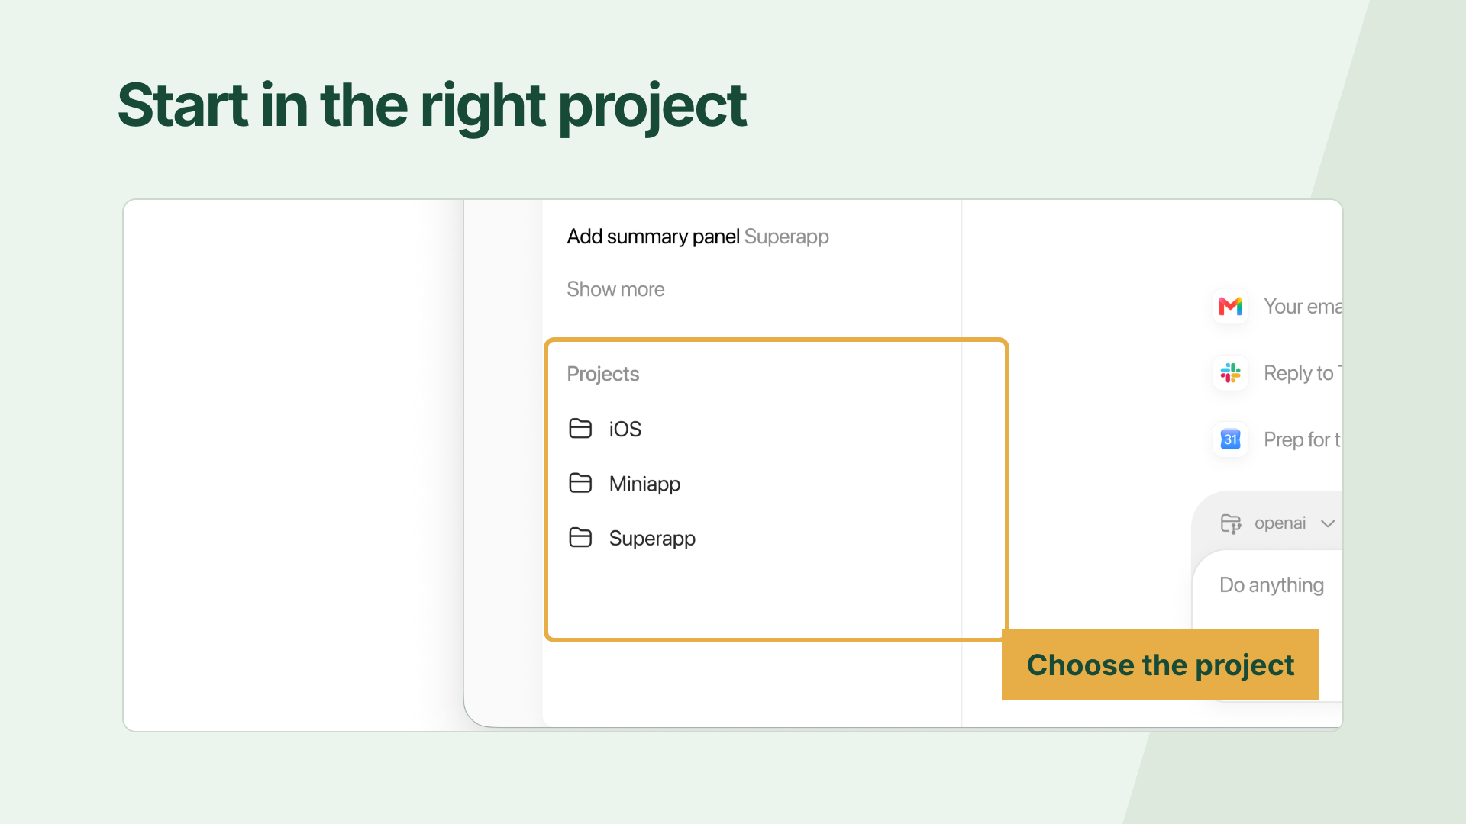
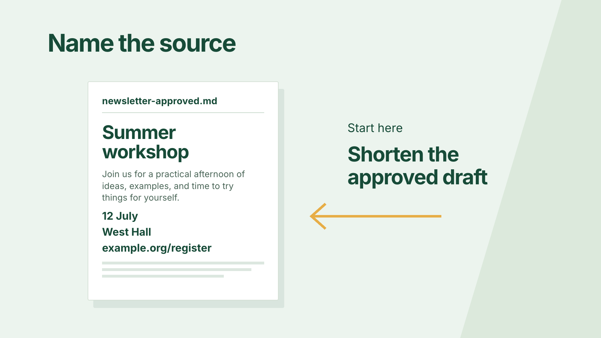
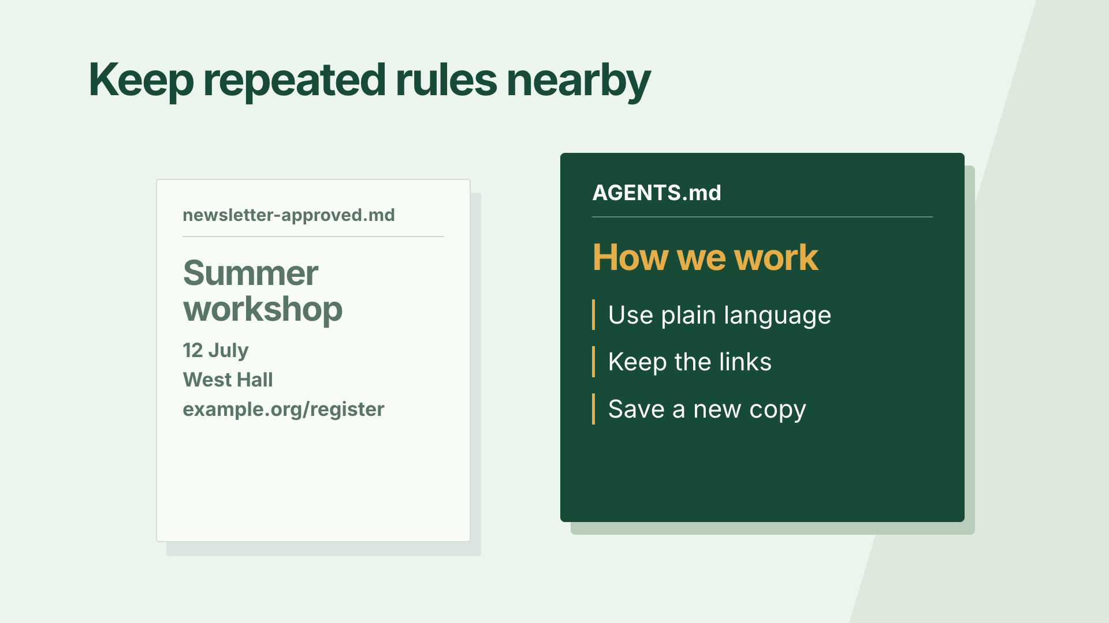
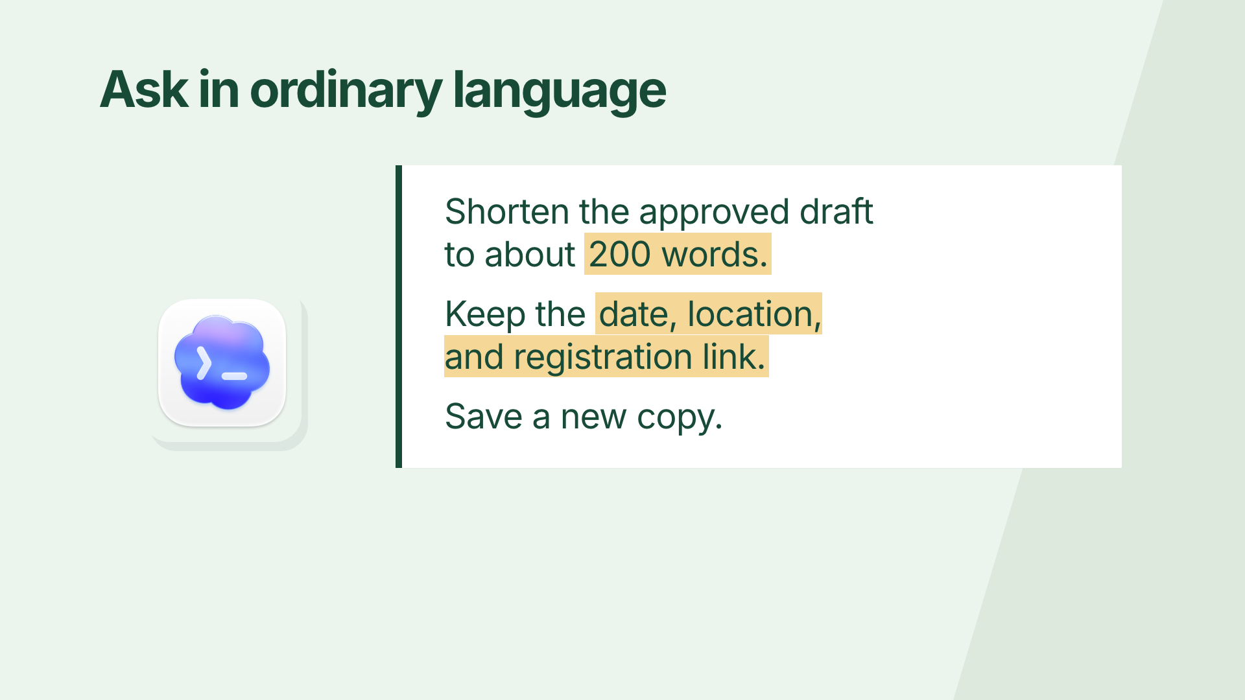
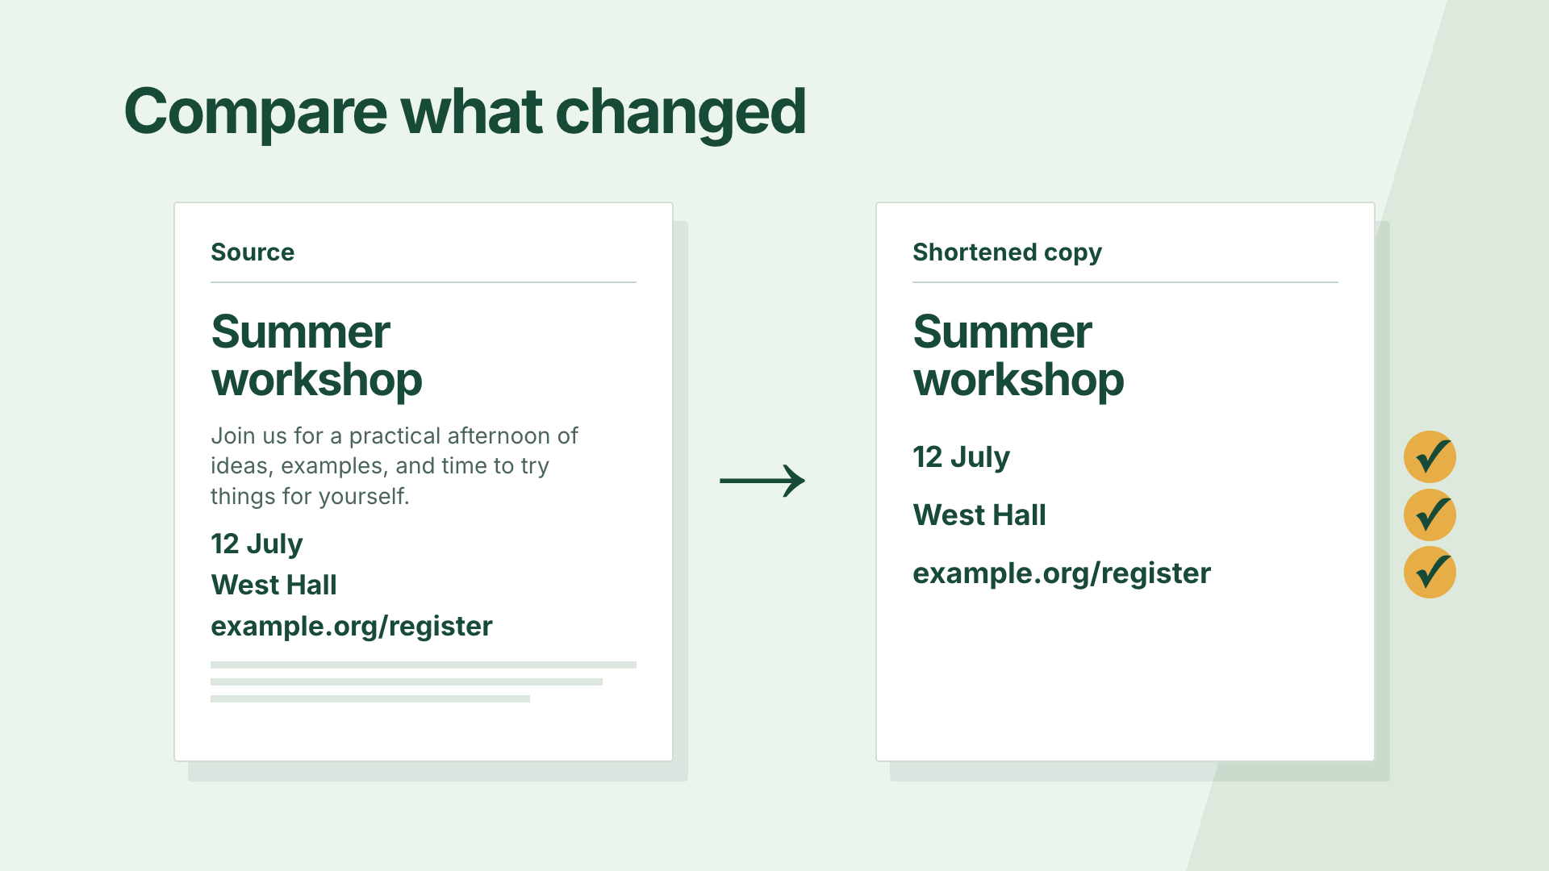
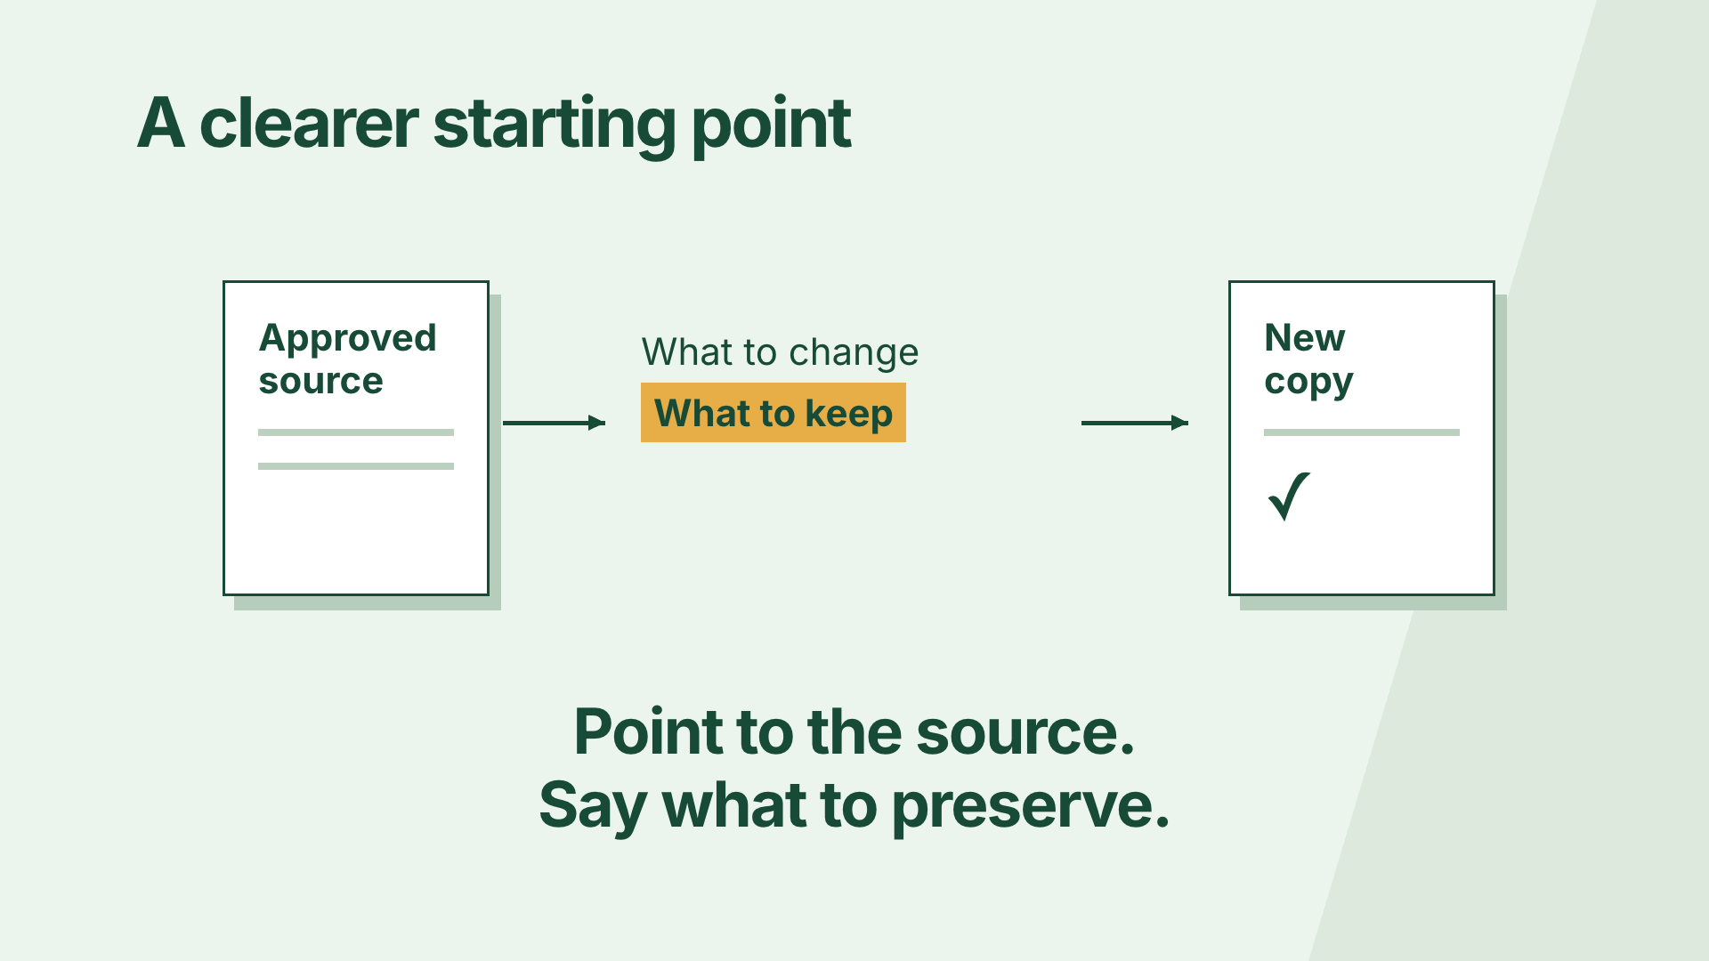
From a script to eight visual beats
1. Which source?
2. Project
3. Draft
4. Keep details
5. Rules
6. Request
7. Compare
8. Result
Scene 1: beats 1–3 Scene 2: beats 4–6 Scene 3: beats 7–8
CODEX & COFFEE
DAY 9 · 18
Notes:
DAY 9 · From a script to eight visual beats
12.1–12.8 minutes
SAY
The voice was written in eight short sections. Each has one visual instruction. Three editable scene files hold those eight beats. The voice lengths set the timing; the display below is the actual sequence.
DO
Walk across the thumbnails in order. Explain one causal transition rather than reading all eight titles.
CHECK
Every spoken idea has a corresponding picture.
Sources: https://learn.chatgpt.com/docs/build-skills ; https://learn.chatgpt.com/docs/app ; https://developers.openai.com/codex/guides/agents-md/ ; https://github.com/openai/codex ; https://hyperframes.studio/
Official screenshot: https://chatgpt.com/codex/ . Fictional examples and generated illustrations are teaching materials. Provider access checked during production; see START-HERE for actual final audio status.

Slide 19
The instruction behind this moment
VOICEOVER · actual script
A shorter version still needs the event date, the location, and the registration link. Make those details part of the request.
PICTURE · actual direction
Highlight actual date, venue, registration link in source document
CODEX & COFFEE
DAY 9 · 19
Notes:
DAY 9 · The instruction behind this moment
12.8–13.5 minutes
SAY
These words are copied from the production files. The narration says the idea; the visual instruction describes what must happen on screen. Codex then implements the illustration and motion in the editable scene file.
DO
Read the narration and visual direction beside the matching rendered frame.
CHECK
The instruction names an action rather than just an aesthetic.
Sources: https://learn.chatgpt.com/docs/build-skills ; https://learn.chatgpt.com/docs/app ; https://developers.openai.com/codex/guides/agents-md/ ; https://github.com/openai/codex ; https://hyperframes.studio/
Official screenshot: https://chatgpt.com/codex/ . Fictional examples and generated illustrations are teaching materials. Provider access checked during production; see START-HERE for actual final audio status.

Slide 20
Watch that moment again
▶
CODEX & COFFEE
DAY 9 · 20
Notes:
DAY 9 · Watch that moment again
13.5–15 minutes
SAY
Follow the same date, place and link. This is a focused excerpt from the same finished video. Play once, pause on the useful frame, then connect the result back to the instruction. The unchanged details connect the before and after.
DO
Play the embedded excerpt. Pause to discuss; the full video is still available at the earlier slide.
CHECK
The unchanged details connect the before and after.
Sources: https://learn.chatgpt.com/docs/build-skills ; https://learn.chatgpt.com/docs/app ; https://developers.openai.com/codex/guides/agents-md/ ; https://github.com/openai/codex ; https://hyperframes.studio/
Official screenshot: https://chatgpt.com/codex/ . Fictional examples and generated illustrations are teaching materials. Provider access checked during production; see START-HERE for actual final audio status.
PLAY EXCERPT: 02-workspace-replay.mp4
The video is embedded on this slide. Click it to play in PowerPoint. Offline fallback: Day-09-Lesson.html in the same output folder.

Slide 21
03
The skill
A paper transformation
Watch → open the brief → inspect → replay
CODEX & COFFEE
DAY 9 · 21
Notes:
DAY 9 · The skill
15–15.1 minutes
SAY
This chapter uses a paper transformation. We will watch it, open the brief, examine the design and replay the useful moment.
DO
Introduce the next video; advance to play.
CHECK
The subject and visual treatment are clear.
Sources: https://learn.chatgpt.com/docs/build-skills ; https://learn.chatgpt.com/docs/app ; https://developers.openai.com/codex/guides/agents-md/ ; https://github.com/openai/codex ; https://hyperframes.studio/
Official screenshot: https://chatgpt.com/codex/ . Fictional examples and generated illustrations are teaching materials. Provider access checked during production; see START-HERE for actual final audio status.

Slide 22
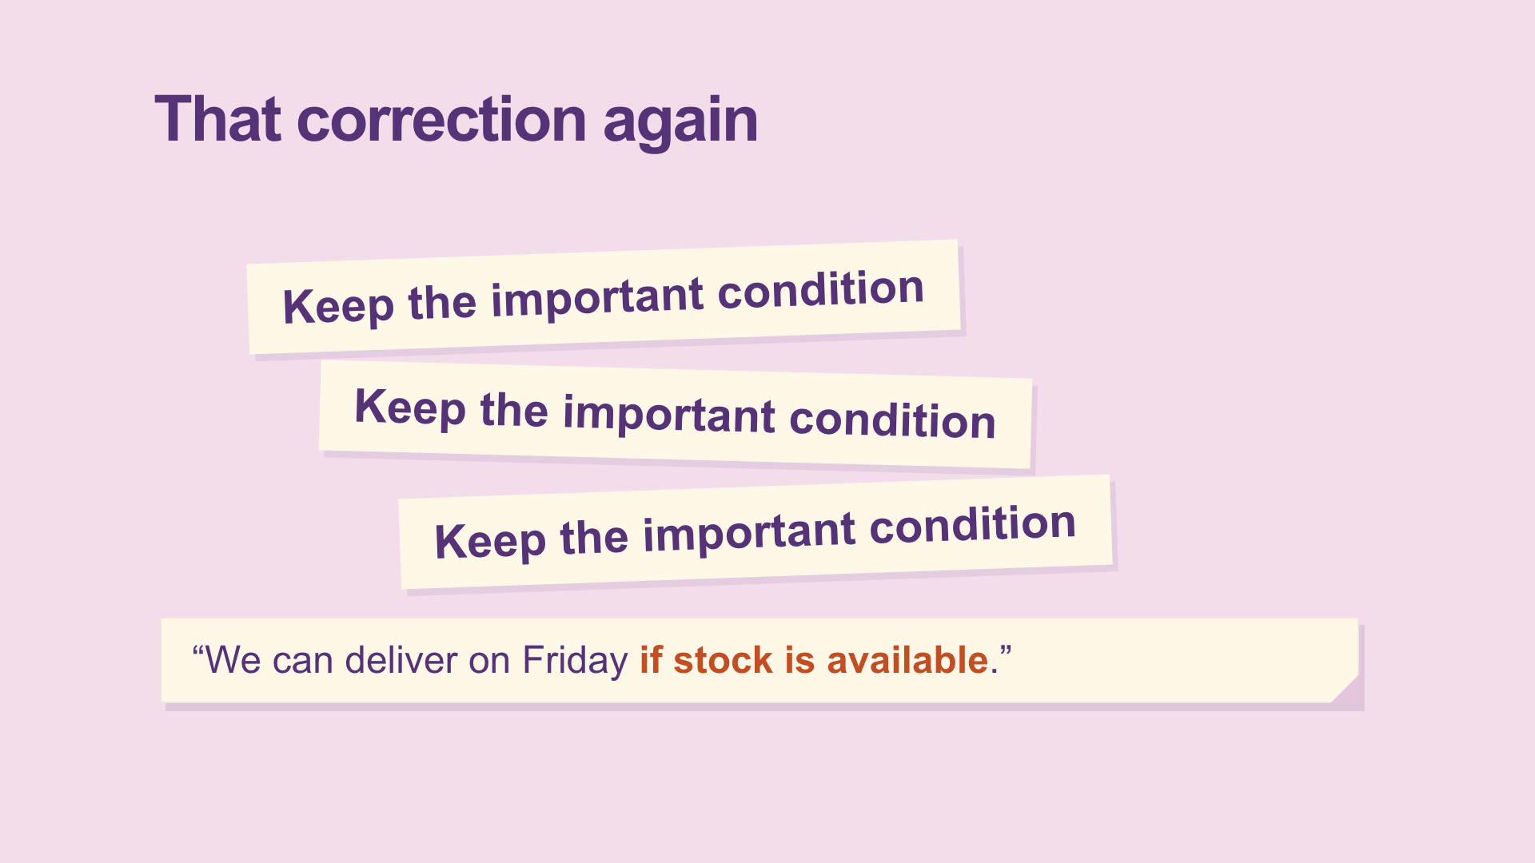
Stop repeating the same correction
▶
CODEX & COFFEE
DAY 9 · 22
Notes:
DAY 9 · Stop repeating the same correction
15.1–16.45 minutes
SAY
Watch the complete video before looking at the production instructions. Ask learners what made the idea easy or hard to follow.
DO
Play the full embedded video. Let it finish.
CHECK
A skill packages a repeatable way of working.
Sources: https://learn.chatgpt.com/docs/build-skills ; https://learn.chatgpt.com/docs/app ; https://developers.openai.com/codex/guides/agents-md/ ; https://github.com/openai/codex ; https://hyperframes.studio/
Official screenshot: https://chatgpt.com/codex/ . Fictional examples and generated illustrations are teaching materials. Provider access checked during production; see START-HERE for actual final audio status.
PLAY FILE: 03-skill.mp4
Use the offline viewer’s matching video button; wait for completion.
The video is embedded on this slide. Click it to play in PowerPoint. Offline fallback: Day-09-Lesson.html in the same output folder.

Slide 23
The brief: what it needs to teach
Actual production brief · part 1 of 2
Make a short narrated HyperFrames video for people who are new to Codex. Teach reusable skills using one concrete example. Use a cut-paper transformation. The viewer should leave knowing: A skill packages a repeatable way of working.
CHECK
A clear audience, one idea and one example.
CODEX & COFFEE
DAY 9 · 23
Notes:
DAY 9 · The brief: what it needs to teach
16.45–17 minutes
SAY
This is the first part of the actual production brief saved before the scene files were built. The prompt is directed to Codex; HyperFrames renders the project Codex writes. Read it as a normal request, not as a magic command.
DO
Read the excerpt and point out audience, teaching goal and visual device.
CHECK
A clear audience, one idea and one example.
EXACT PROMPT
Make a short narrated HyperFrames video for people who are new to Codex. Teach reusable skills using one concrete example. Use a cut-paper transformation. The viewer should leave knowing: A skill packages a repeatable way of working.
Sources: https://learn.chatgpt.com/docs/build-skills ; https://learn.chatgpt.com/docs/app ; https://developers.openai.com/codex/guides/agents-md/ ; https://github.com/openai/codex ; https://hyperframes.studio/
Official screenshot: https://chatgpt.com/codex/ . Fictional examples and generated illustrations are teaching materials. Provider access checked during production; see START-HERE for actual final audio status.

Slide 24
The brief: how it should be made
Actual production brief · part 2 of 2
Use the supplied script and real product assets where relevant. Keep the words conversational, reveal each visual as it is explained, and leave time to read. Use this palette: #F3DDEB, #563376, #FFF8E9, #DE632E. Add a clear AI voice, quiet instrumental music, and a few sound effects tied to visible actions. Keep the editable project and save a 1080p MP4. Check the rendered frames, audio, and ending before calling it ready.
CHECK
The brief specifies assets, pacing, sound, files and checks.
CODEX & COFFEE
DAY 9 · 24
Notes:
DAY 9 · The brief: how it should be made
17–17.5 minutes
SAY
This completes the same production brief, without replacing the words with a retrospective summary. The supplied script is the eight-beat SCRIPT.md. The palette is intentional, and the deliverables and checks are explicit.
DO
Read the second half; identify what controls the look, audio and output.
CHECK
The brief specifies assets, pacing, sound, files and checks.
EXACT PROMPT
Use the supplied script and real product assets where relevant. Keep the words conversational, reveal each visual as it is explained, and leave time to read. Use this palette: #F3DDEB, #563376, #FFF8E9, #DE632E. Add a clear AI voice, quiet instrumental music, and a few sound effects tied to visible actions. Keep the editable project and save a 1080p MP4. Check the rendered frames, audio, and ending before calling it ready.
Sources: https://learn.chatgpt.com/docs/build-skills ; https://learn.chatgpt.com/docs/app ; https://developers.openai.com/codex/guides/agents-md/ ; https://github.com/openai/codex ; https://hyperframes.studio/
Official screenshot: https://chatgpt.com/codex/ . Fictional examples and generated illustrations are teaching materials. Provider access checked during production; see START-HERE for actual final audio status.

Slide 25
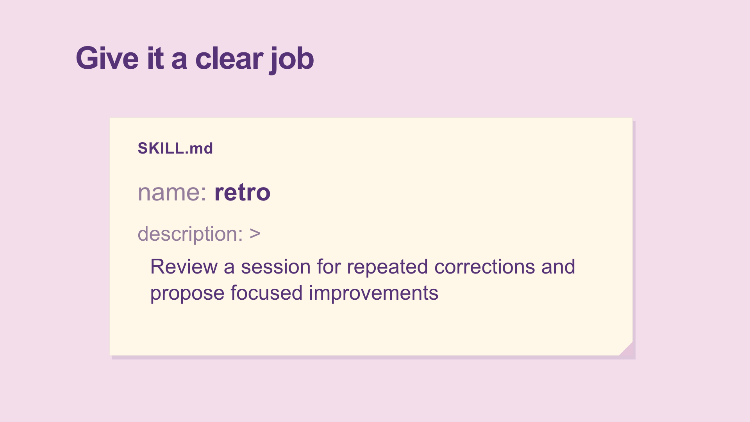
Why this design fits the idea
Blush background
Plum folders
Cream paper
Orange emphasis
Arial · bold section labels
Repeated strips → folder → method
Emma · light pizzicato bed
CODEX & COFFEE
DAY 9 · 25
Notes:
DAY 9 · Why this design fits the idea
17.5–18.1 minutes
SAY
The paper changes shape to explain reuse. The object transforms instead of cutting to a list. Name the palette, type, motion and audio choices. These are the choices implemented in the supplied film, not optional suggestions.
DO
Point to the frame, then trace each visible design decision.
CHECK
Learners can connect the look to the teaching job.
Sources: https://learn.chatgpt.com/docs/build-skills ; https://learn.chatgpt.com/docs/app ; https://developers.openai.com/codex/guides/agents-md/ ; https://github.com/openai/codex ; https://hyperframes.studio/
Official screenshot: https://chatgpt.com/codex/ . Fictional examples and generated illustrations are teaching materials. Provider access checked during production; see START-HERE for actual final audio status.

Slide 26
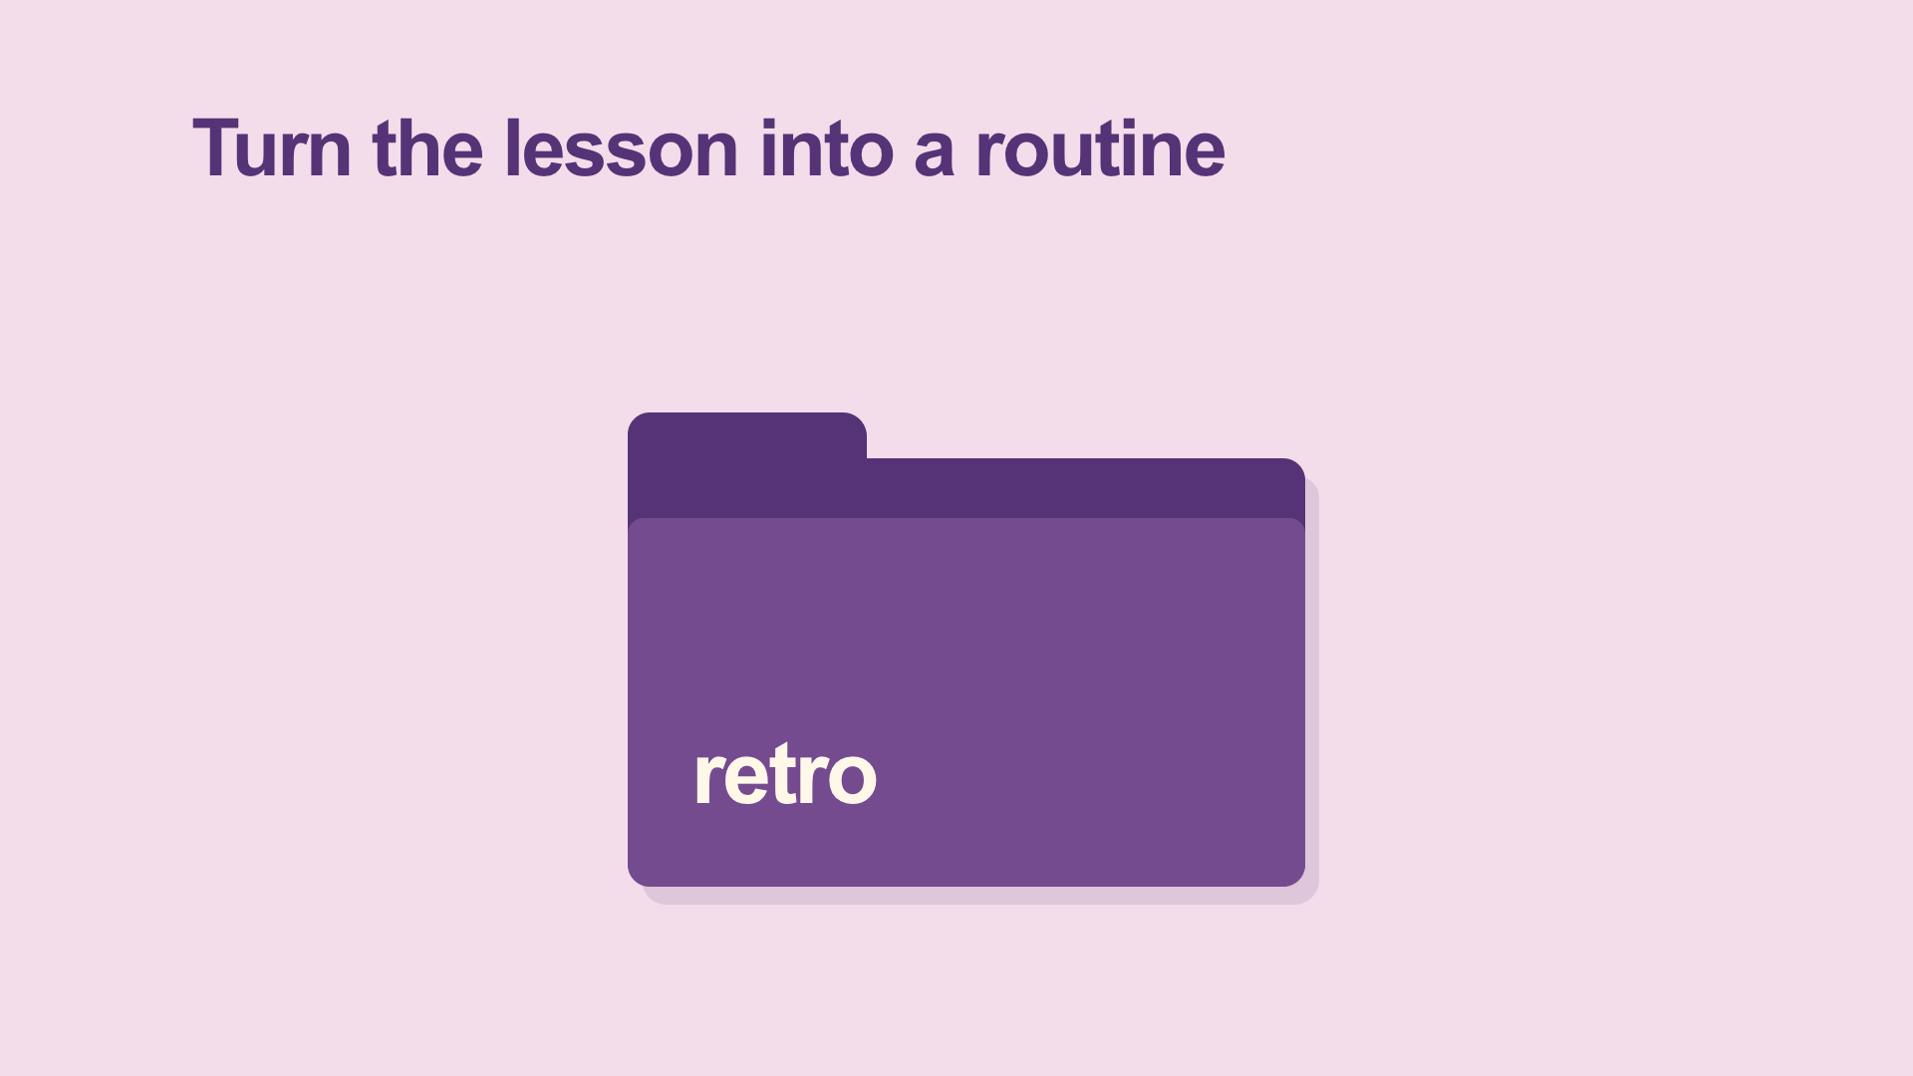
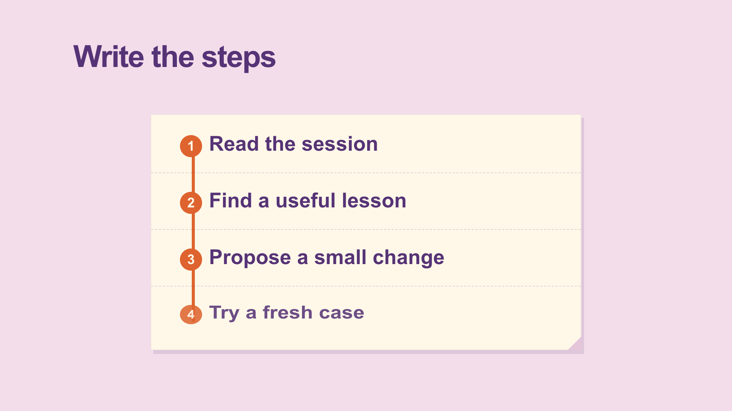
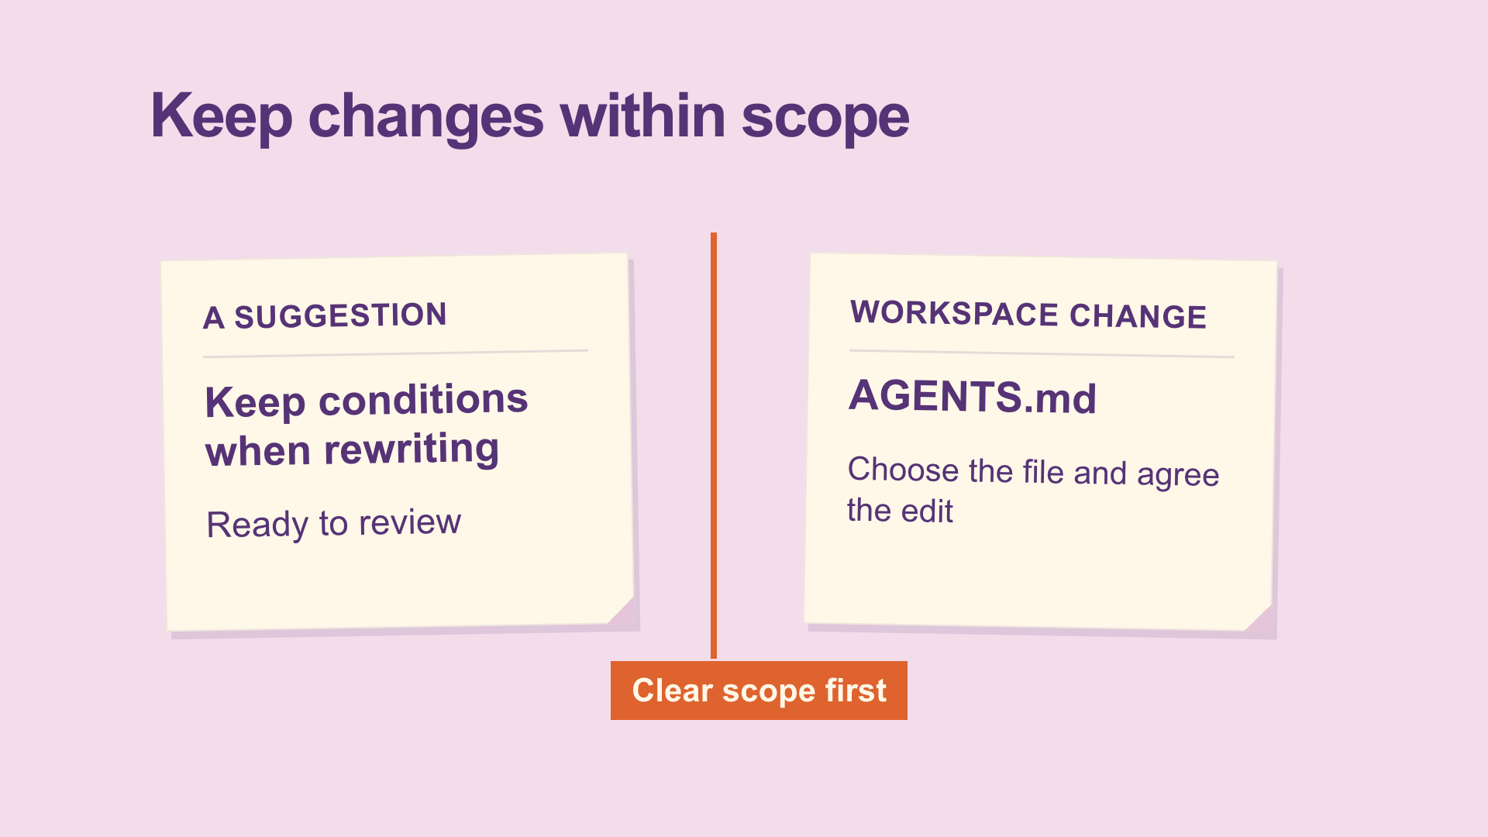
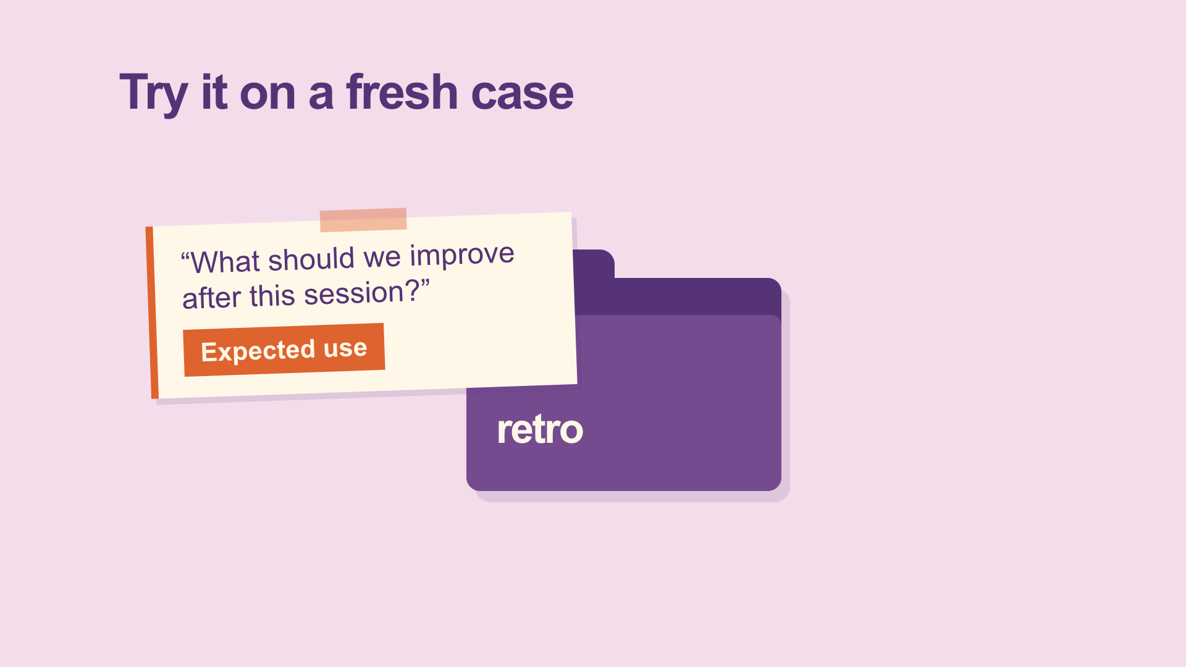
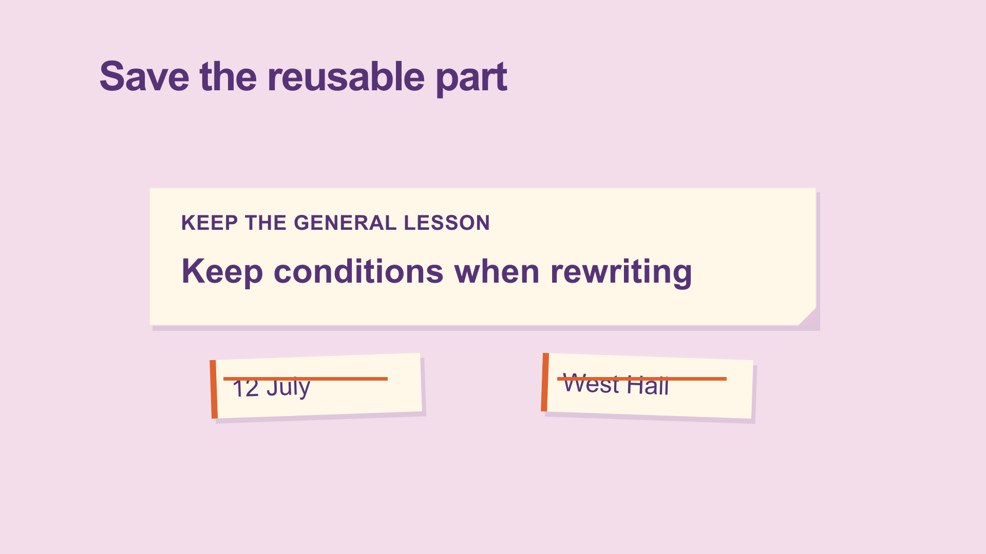
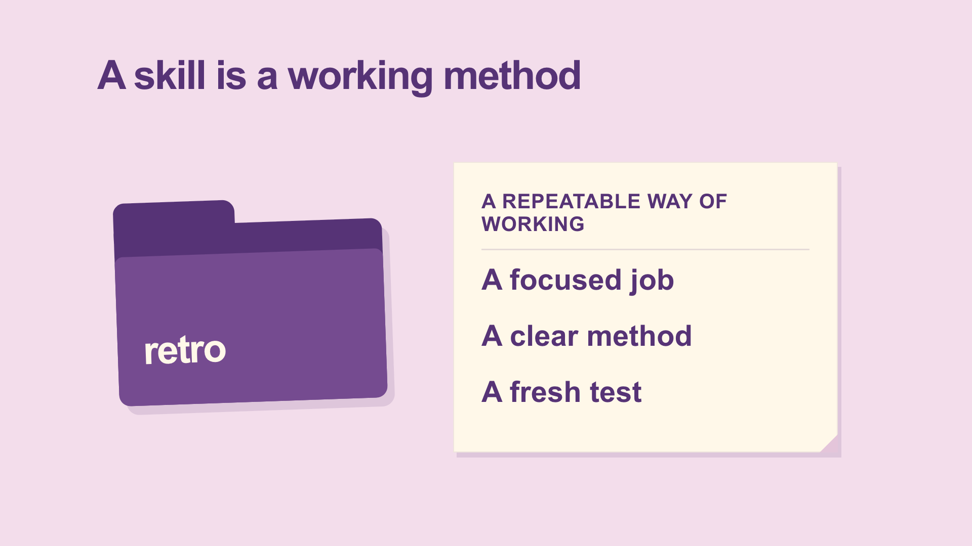
From a script to eight visual beats
1. Correction
2. Routine
3. Name + use
4. Steps
5. Scope
6. Fresh case
7. Keep lesson
8. Method
Scene 1: beats 1–3 Scene 2: beats 4–6 Scene 3: beats 7–8
CODEX & COFFEE
DAY 9 · 26
Notes:
DAY 9 · From a script to eight visual beats
18.1–18.8 minutes
SAY
The voice was written in eight short sections. Each has one visual instruction. Three editable scene files hold those eight beats. The voice lengths set the timing; the display below is the actual sequence.
DO
Walk across the thumbnails in order. Explain one causal transition rather than reading all eight titles.
CHECK
Every spoken idea has a corresponding picture.
Sources: https://learn.chatgpt.com/docs/build-skills ; https://learn.chatgpt.com/docs/app ; https://developers.openai.com/codex/guides/agents-md/ ; https://github.com/openai/codex ; https://hyperframes.studio/
Official screenshot: https://chatgpt.com/codex/ . Fictional examples and generated illustrations are teaching materials. Provider access checked during production; see START-HERE for actual final audio status.

Slide 27
The instruction behind this moment
VOICEOVER · actual script
A skill starts with a name and a description. The description says when it is useful, so Codex can choose it for a matching request.
PICTURE · actual direction
SKILL.md opens, name retro and short trigger description
CODEX & COFFEE
DAY 9 · 27
Notes:
DAY 9 · The instruction behind this moment
18.8–19.5 minutes
SAY
These words are copied from the production files. The narration says the idea; the visual instruction describes what must happen on screen. Codex then implements the illustration and motion in the editable scene file.
DO
Read the narration and visual direction beside the matching rendered frame.
CHECK
The instruction names an action rather than just an aesthetic.
Sources: https://learn.chatgpt.com/docs/build-skills ; https://learn.chatgpt.com/docs/app ; https://developers.openai.com/codex/guides/agents-md/ ; https://github.com/openai/codex ; https://hyperframes.studio/
Official screenshot: https://chatgpt.com/codex/ . Fictional examples and generated illustrations are teaching materials. Provider access checked during production; see START-HERE for actual final audio status.

Slide 28
Watch that moment again
▶
CODEX & COFFEE
DAY 9 · 28
Notes:
DAY 9 · Watch that moment again
19.5–21 minutes
SAY
Pause when the folder opens into SKILL.md. This is a focused excerpt from the same finished video. Play once, pause on the useful frame, then connect the result back to the instruction. The object transforms instead of cutting to a list.
DO
Play the embedded excerpt. Pause to discuss; the full video is still available at the earlier slide.
CHECK
The object transforms instead of cutting to a list.
Sources: https://learn.chatgpt.com/docs/build-skills ; https://learn.chatgpt.com/docs/app ; https://developers.openai.com/codex/guides/agents-md/ ; https://github.com/openai/codex ; https://hyperframes.studio/
Official screenshot: https://chatgpt.com/codex/ . Fictional examples and generated illustrations are teaching materials. Provider access checked during production; see START-HERE for actual final audio status.
PLAY EXCERPT: 03-skill-replay.mp4
The video is embedded on this slide. Click it to play in PowerPoint. Offline fallback: Day-09-Lesson.html in the same output folder.

Slide 29
04
Video frames
A visual counting lesson
Watch → open the brief → inspect → replay
CODEX & COFFEE
DAY 9 · 29
Notes:
DAY 9 · Video frames
21–21.1 minutes
SAY
This chapter uses a visual counting lesson. We will watch it, open the brief, examine the design and replay the useful moment.
DO
Introduce the next video; advance to play.
CHECK
The subject and visual treatment are clear.
Sources: https://learn.chatgpt.com/docs/build-skills ; https://learn.chatgpt.com/docs/app ; https://developers.openai.com/codex/guides/agents-md/ ; https://github.com/openai/codex ; https://hyperframes.studio/
Official screenshot: https://chatgpt.com/codex/ . Fictional examples and generated illustrations are teaching materials. Provider access checked during production; see START-HERE for actual final audio status.

Slide 30
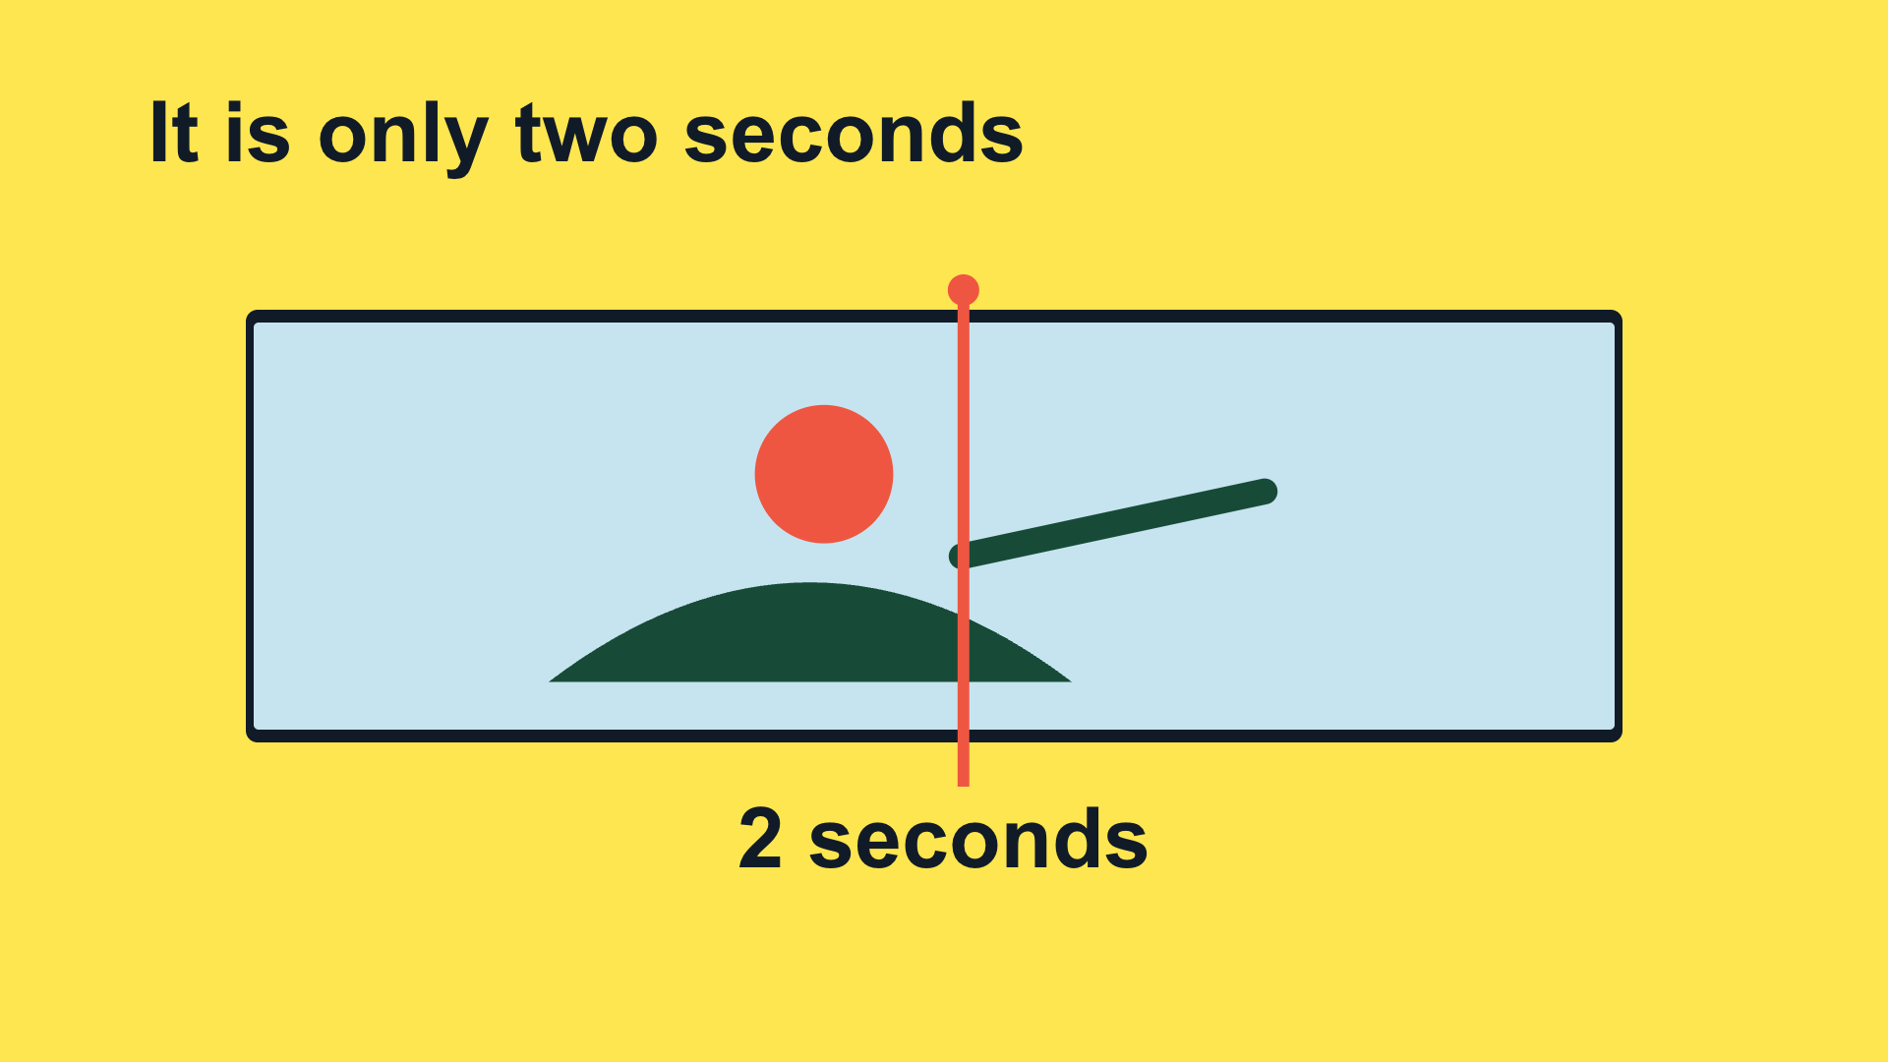
Two seconds can hide sixty pictures
▶
CODEX & COFFEE
DAY 9 · 30
Notes:
DAY 9 · Two seconds can hide sixty pictures
21.1–22.45 minutes
SAY
Watch the complete video before looking at the production instructions. Ask learners what made the idea easy or hard to follow.
DO
Play the full embedded video. Let it finish.
CHECK
Check the cut where the meaning changes.
Sources: https://learn.chatgpt.com/docs/build-skills ; https://learn.chatgpt.com/docs/app ; https://developers.openai.com/codex/guides/agents-md/ ; https://github.com/openai/codex ; https://hyperframes.studio/
Official screenshot: https://chatgpt.com/codex/ . Fictional examples and generated illustrations are teaching materials. Provider access checked during production; see START-HERE for actual final audio status.
PLAY FILE: 04-frames.mp4
Use the offline viewer’s matching video button; wait for completion.
The video is embedded on this slide. Click it to play in PowerPoint. Offline fallback: Day-09-Lesson.html in the same output folder.

Slide 31
The brief: what it needs to teach
Actual production brief · part 1 of 2
Make a short narrated HyperFrames video for people who are new to Codex. Teach frames and precise video editing using one concrete example. Use a bright frame-by-frame visual explanation. The viewer should leave knowing: Check the cut where the meaning changes.
CHECK
A clear audience, one idea and one example.
CODEX & COFFEE
DAY 9 · 31
Notes:
DAY 9 · The brief: what it needs to teach
22.45–23 minutes
SAY
This is the first part of the actual production brief saved before the scene files were built. The prompt is directed to Codex; HyperFrames renders the project Codex writes. Read it as a normal request, not as a magic command.
DO
Read the excerpt and point out audience, teaching goal and visual device.
CHECK
A clear audience, one idea and one example.
EXACT PROMPT
Make a short narrated HyperFrames video for people who are new to Codex. Teach frames and precise video editing using one concrete example. Use a bright frame-by-frame visual explanation. The viewer should leave knowing: Check the cut where the meaning changes.
Sources: https://learn.chatgpt.com/docs/build-skills ; https://learn.chatgpt.com/docs/app ; https://developers.openai.com/codex/guides/agents-md/ ; https://github.com/openai/codex ; https://hyperframes.studio/
Official screenshot: https://chatgpt.com/codex/ . Fictional examples and generated illustrations are teaching materials. Provider access checked during production; see START-HERE for actual final audio status.

Slide 32
The brief: how it should be made
Actual production brief · part 2 of 2
Use the supplied script and real product assets where relevant. Keep the words conversational, reveal each visual as it is explained, and leave time to read. Use this palette: #FDE64F, #111B28, #EF5641, #C6E4EF. Add a clear AI voice, quiet instrumental music, and a few sound effects tied to visible actions. Keep the editable project and save a 1080p MP4. Check the rendered frames, audio, and ending before calling it ready.
CHECK
The brief specifies assets, pacing, sound, files and checks.
CODEX & COFFEE
DAY 9 · 32
Notes:
DAY 9 · The brief: how it should be made
23–23.5 minutes
SAY
This completes the same production brief, without replacing the words with a retrospective summary. The supplied script is the eight-beat SCRIPT.md. The palette is intentional, and the deliverables and checks are explicit.
DO
Read the second half; identify what controls the look, audio and output.
CHECK
The brief specifies assets, pacing, sound, files and checks.
EXACT PROMPT
Use the supplied script and real product assets where relevant. Keep the words conversational, reveal each visual as it is explained, and leave time to read. Use this palette: #FDE64F, #111B28, #EF5641, #C6E4EF. Add a clear AI voice, quiet instrumental music, and a few sound effects tied to visible actions. Keep the editable project and save a 1080p MP4. Check the rendered frames, audio, and ending before calling it ready.
Sources: https://learn.chatgpt.com/docs/build-skills ; https://learn.chatgpt.com/docs/app ; https://developers.openai.com/codex/guides/agents-md/ ; https://github.com/openai/codex ; https://hyperframes.studio/
Official screenshot: https://chatgpt.com/codex/ . Fictional examples and generated illustrations are teaching materials. Provider access checked during production; see START-HERE for actual final audio status.

Slide 33
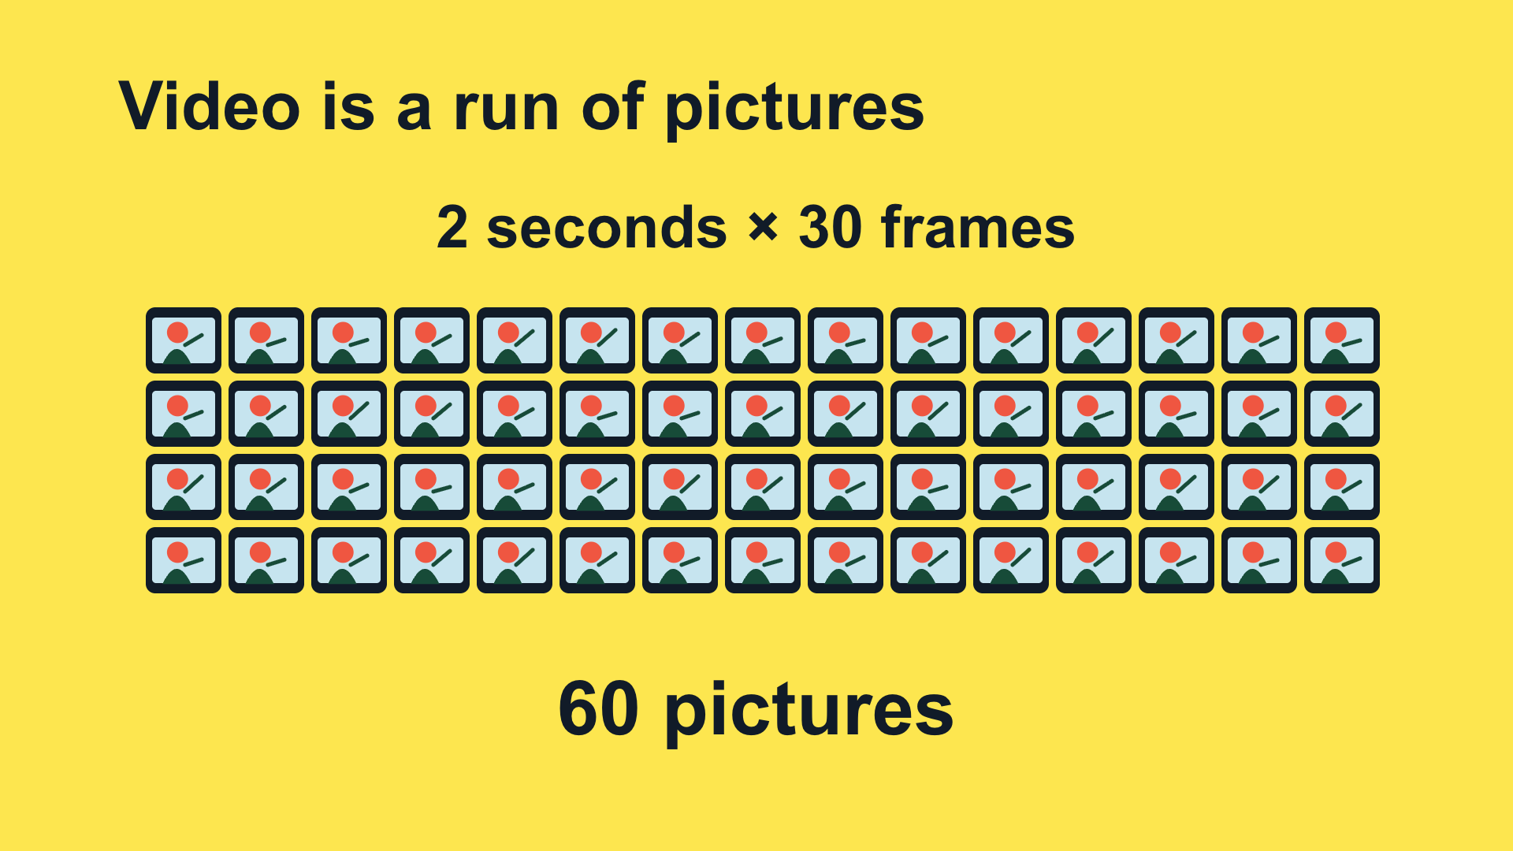
Why this design fits the idea
Yellow canvas
Dark-blue ink
Coral playhead
Sky-blue frames
Arial · oversized numbers
One picture → 60 tiles → 50 tiles
Nova · light electronic percussion
CODEX & COFFEE
DAY 9 · 33
Notes:
DAY 9 · Why this design fits the idea
23.5–24.1 minutes
SAY
You can see a quantity that sounds abstract. The changing picture count makes the arithmetic visible. Name the palette, type, motion and audio choices. These are the choices implemented in the supplied film, not optional suggestions.
DO
Point to the frame, then trace each visible design decision.
CHECK
Learners can connect the look to the teaching job.
Sources: https://learn.chatgpt.com/docs/build-skills ; https://learn.chatgpt.com/docs/app ; https://developers.openai.com/codex/guides/agents-md/ ; https://github.com/openai/codex ; https://hyperframes.studio/
Official screenshot: https://chatgpt.com/codex/ . Fictional examples and generated illustrations are teaching materials. Provider access checked during production; see START-HERE for actual final audio status.

Slide 34
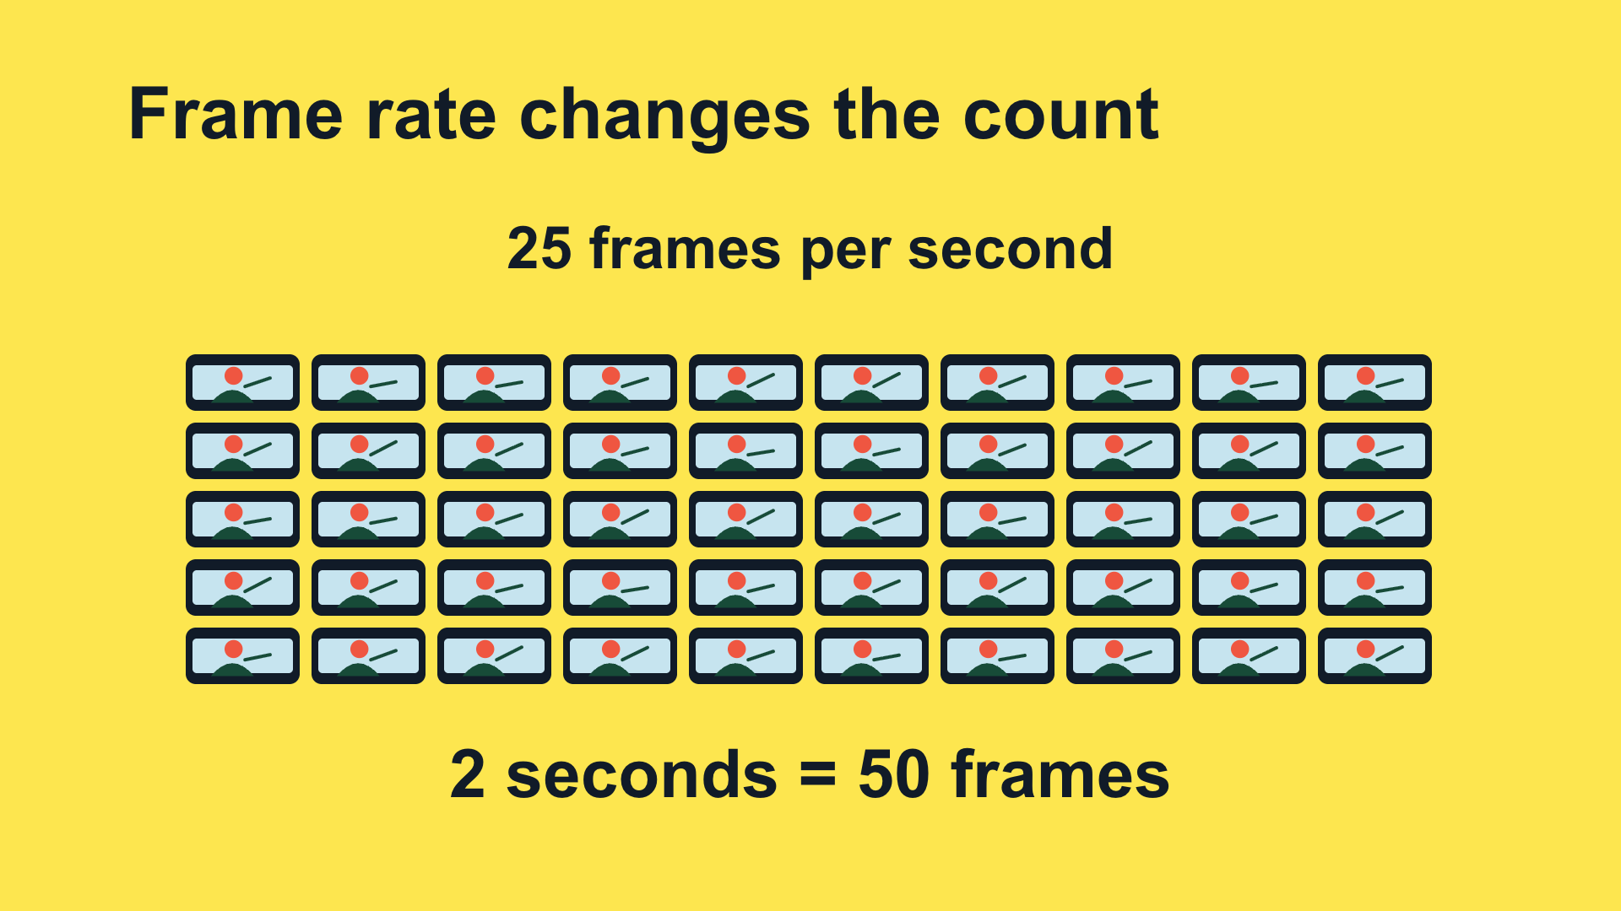
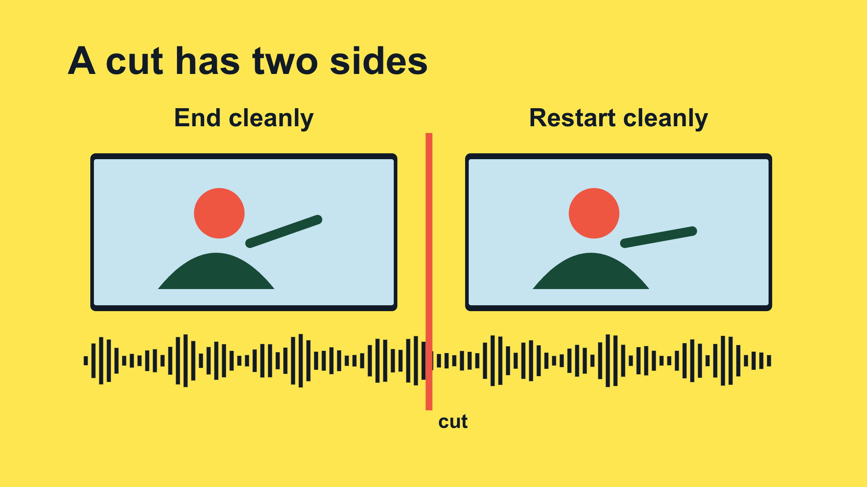
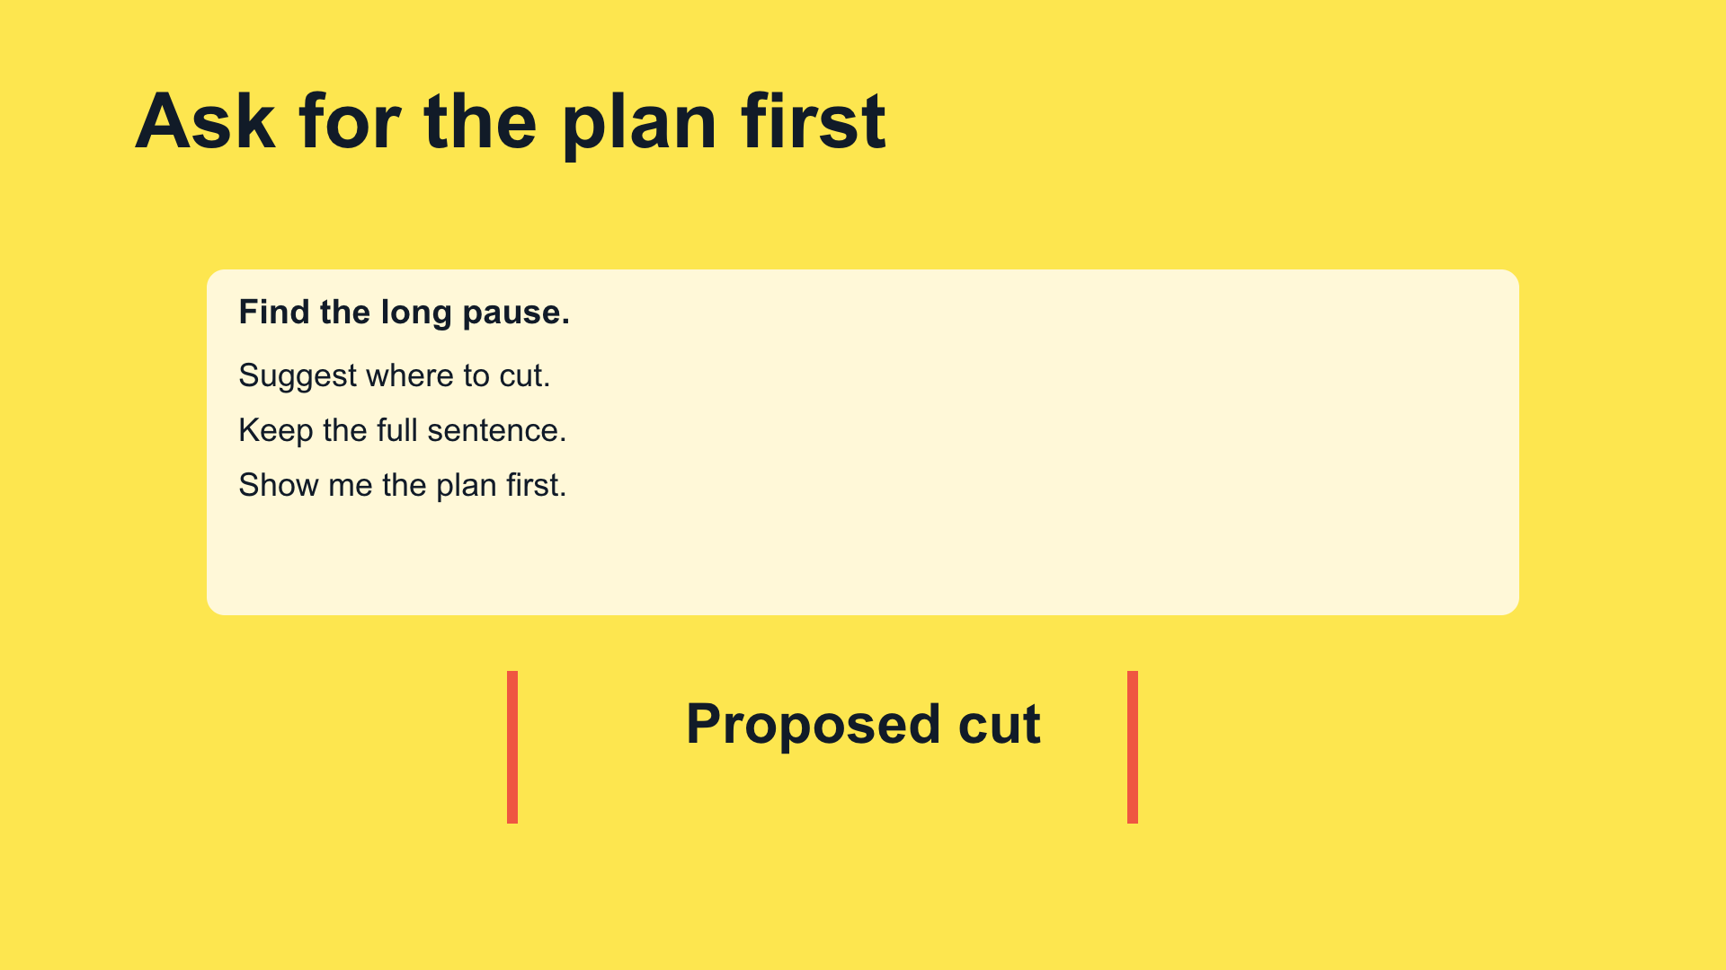
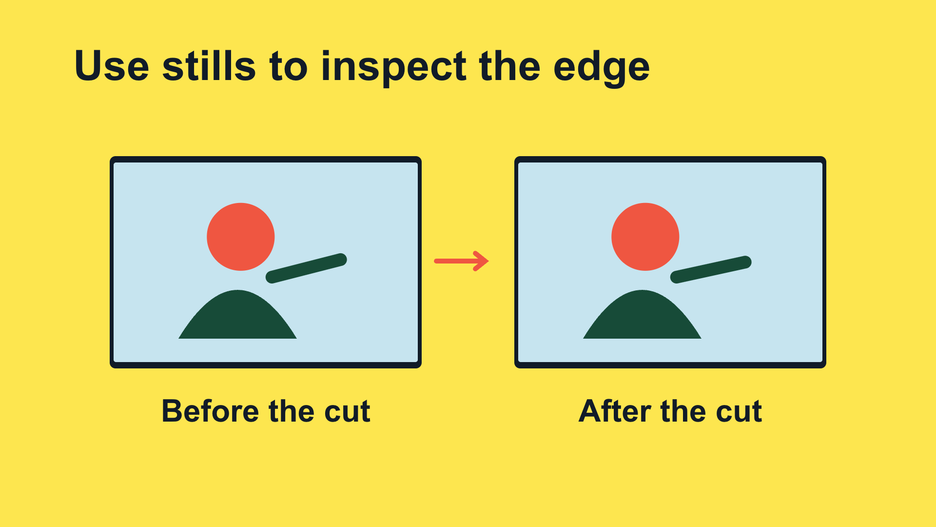
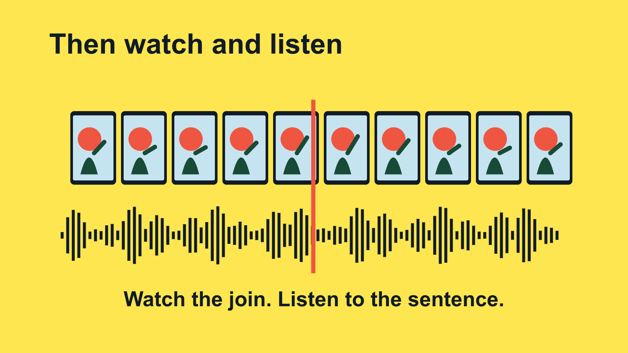
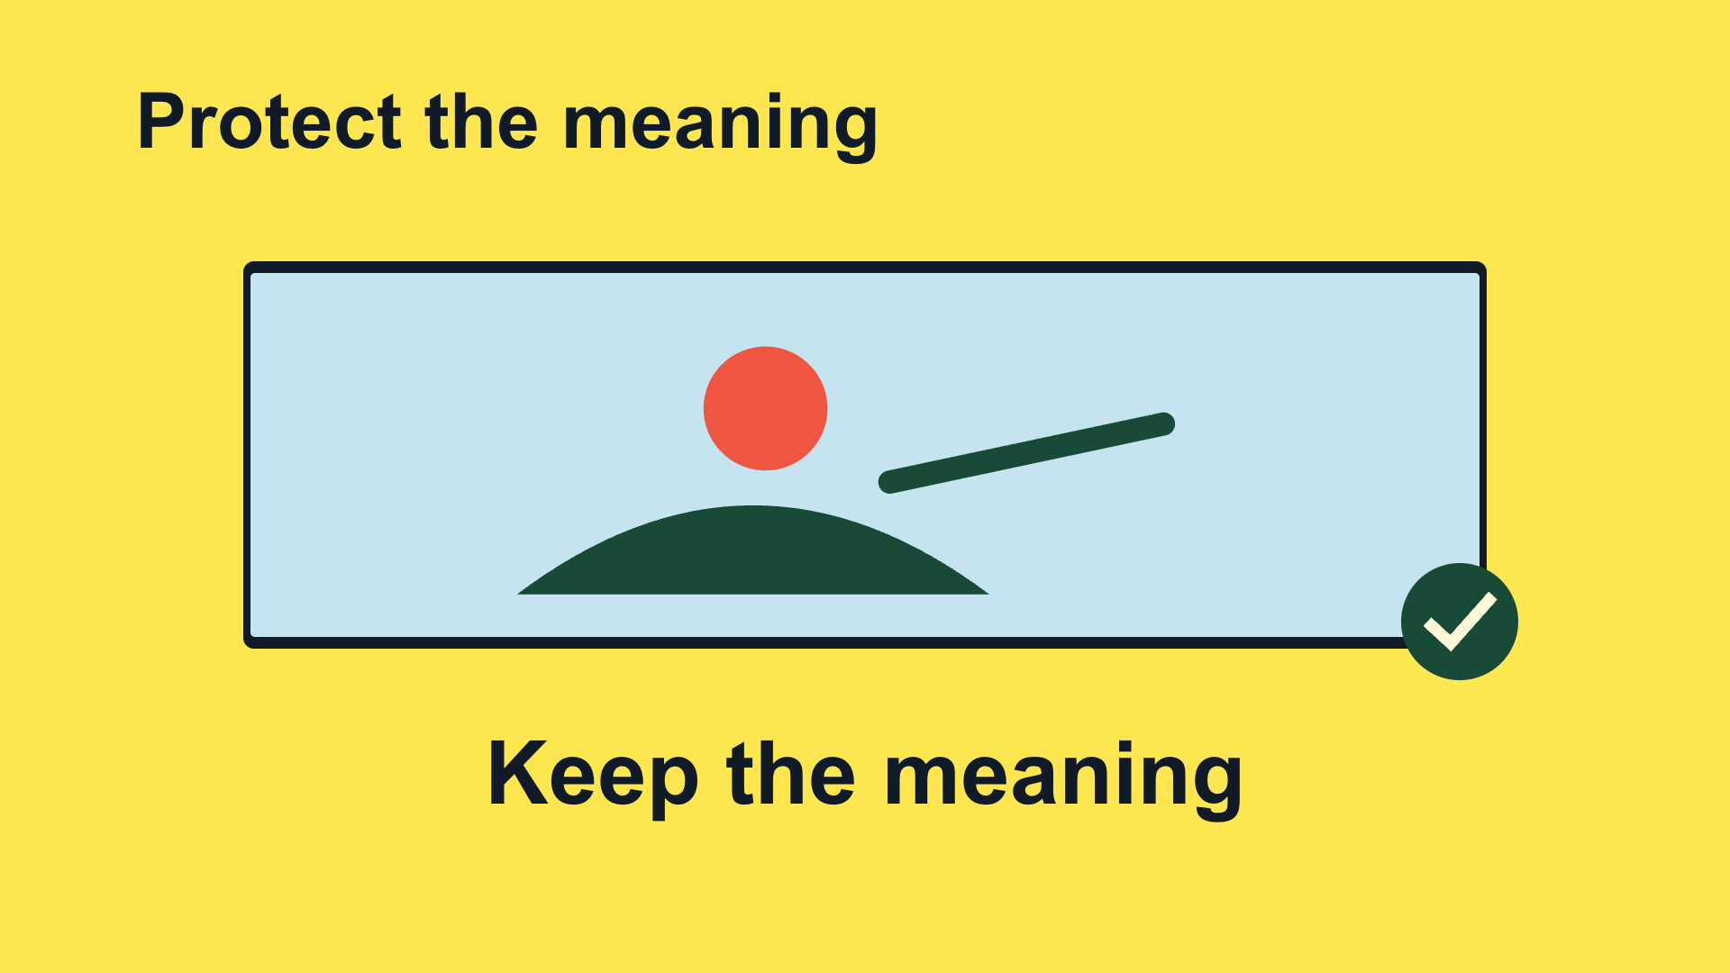
From a script to eight visual beats
1. 2 seconds
2. 60 frames
3. 50 frames
4. Cut edges
5. Plan
6. Two stills
7. Listen
8. Meaning
Scene 1: beats 1–3 Scene 2: beats 4–6 Scene 3: beats 7–8
CODEX & COFFEE
DAY 9 · 34
Notes:
DAY 9 · From a script to eight visual beats
24.1–24.8 minutes
SAY
The voice was written in eight short sections. Each has one visual instruction. Three editable scene files hold those eight beats. The voice lengths set the timing; the display below is the actual sequence.
DO
Walk across the thumbnails in order. Explain one causal transition rather than reading all eight titles.
CHECK
Every spoken idea has a corresponding picture.
Sources: https://learn.chatgpt.com/docs/build-skills ; https://learn.chatgpt.com/docs/app ; https://developers.openai.com/codex/guides/agents-md/ ; https://github.com/openai/codex ; https://hyperframes.studio/
Official screenshot: https://chatgpt.com/codex/ . Fictional examples and generated illustrations are teaching materials. Provider access checked during production; see START-HERE for actual final audio status.

Slide 35
The instruction behind this moment
VOICEOVER · actual script
A video is a sequence of still pictures, called frames. At thirty frames per second, two seconds contains sixty frames.
PICTURE · actual direction
One drawn frame expands into two rows of thirty frames, count 60
CODEX & COFFEE
DAY 9 · 35
Notes:
DAY 9 · The instruction behind this moment
24.8–25.5 minutes
SAY
These words are copied from the production files. The narration says the idea; the visual instruction describes what must happen on screen. Codex then implements the illustration and motion in the editable scene file.
DO
Read the narration and visual direction beside the matching rendered frame.
CHECK
The instruction names an action rather than just an aesthetic.
Sources: https://learn.chatgpt.com/docs/build-skills ; https://learn.chatgpt.com/docs/app ; https://developers.openai.com/codex/guides/agents-md/ ; https://github.com/openai/codex ; https://hyperframes.studio/
Official screenshot: https://chatgpt.com/codex/ . Fictional examples and generated illustrations are teaching materials. Provider access checked during production; see START-HERE for actual final audio status.

Slide 36
Watch that moment again
▶
CODEX & COFFEE
DAY 9 · 36
Notes:
DAY 9 · Watch that moment again
25.5–27 minutes
SAY
Count the frames, then notice the constant duration. This is a focused excerpt from the same finished video. Play once, pause on the useful frame, then connect the result back to the instruction. The changing picture count makes the arithmetic visible.
DO
Play the embedded excerpt. Pause to discuss; the full video is still available at the earlier slide.
CHECK
The changing picture count makes the arithmetic visible.
Sources: https://learn.chatgpt.com/docs/build-skills ; https://learn.chatgpt.com/docs/app ; https://developers.openai.com/codex/guides/agents-md/ ; https://github.com/openai/codex ; https://hyperframes.studio/
Official screenshot: https://chatgpt.com/codex/ . Fictional examples and generated illustrations are teaching materials. Provider access checked during production; see START-HERE for actual final audio status.
PLAY EXCERPT: 04-frames-replay.mp4
The video is embedded on this slide. Click it to play in PowerPoint. Offline fallback: Day-09-Lesson.html in the same output folder.

Slide 37
05
Checking work
A visible flaw and repair
Watch → open the brief → inspect → replay
CODEX & COFFEE
DAY 9 · 37
Notes:
DAY 9 · Checking work
27–27.1 minutes
SAY
This chapter uses a visible flaw and repair. We will watch it, open the brief, examine the design and replay the useful moment.
DO
Introduce the next video; advance to play.
CHECK
The subject and visual treatment are clear.
Sources: https://learn.chatgpt.com/docs/build-skills ; https://learn.chatgpt.com/docs/app ; https://developers.openai.com/codex/guides/agents-md/ ; https://github.com/openai/codex ; https://hyperframes.studio/
Official screenshot: https://chatgpt.com/codex/ . Fictional examples and generated illustrations are teaching materials. Provider access checked during production; see START-HERE for actual final audio status.

Slide 38
An export is not the finish line
▶
CODEX & COFFEE
DAY 9 · 38
Notes:
DAY 9 · An export is not the finish line
27.1–28.45 minutes
SAY
Watch the complete video before looking at the production instructions. Ask learners what made the idea easy or hard to follow.
DO
Play the full embedded video. Let it finish.
CHECK
Check the result against the original request.
Sources: https://learn.chatgpt.com/docs/build-skills ; https://learn.chatgpt.com/docs/app ; https://developers.openai.com/codex/guides/agents-md/ ; https://github.com/openai/codex ; https://hyperframes.studio/
Official screenshot: https://chatgpt.com/codex/ . Fictional examples and generated illustrations are teaching materials. Provider access checked during production; see START-HERE for actual final audio status.
PLAY FILE: 05-checks.mp4
Use the offline viewer’s matching video button; wait for completion.
The video is embedded on this slide. Click it to play in PowerPoint. Offline fallback: Day-09-Lesson.html in the same output folder.

Slide 39
The brief: what it needs to teach
Actual production brief · part 1 of 2
Make a short narrated HyperFrames video for people who are new to Codex. Teach verifying generated work using one concrete example. Use a before-and-after visual investigation. The viewer should leave knowing: Check the result against the original request.
CHECK
A clear audience, one idea and one example.
CODEX & COFFEE
DAY 9 · 39
Notes:
DAY 9 · The brief: what it needs to teach
28.45–29 minutes
SAY
This is the first part of the actual production brief saved before the scene files were built. The prompt is directed to Codex; HyperFrames renders the project Codex writes. Read it as a normal request, not as a magic command.
DO
Read the excerpt and point out audience, teaching goal and visual device.
CHECK
A clear audience, one idea and one example.
EXACT PROMPT
Make a short narrated HyperFrames video for people who are new to Codex. Teach verifying generated work using one concrete example. Use a before-and-after visual investigation. The viewer should leave knowing: Check the result against the original request.
Sources: https://learn.chatgpt.com/docs/build-skills ; https://learn.chatgpt.com/docs/app ; https://developers.openai.com/codex/guides/agents-md/ ; https://github.com/openai/codex ; https://hyperframes.studio/
Official screenshot: https://chatgpt.com/codex/ . Fictional examples and generated illustrations are teaching materials. Provider access checked during production; see START-HERE for actual final audio status.

Slide 40
The brief: how it should be made
Actual production brief · part 2 of 2
Use the supplied script and real product assets where relevant. Keep the words conversational, reveal each visual as it is explained, and leave time to read. Use this palette: #172329, #FF704D, #F6F0E5, #81BCAF. Add a clear AI voice, quiet instrumental music, and a few sound effects tied to visible actions. Keep the editable project and save a 1080p MP4. Check the rendered frames, audio, and ending before calling it ready.
CHECK
The brief specifies assets, pacing, sound, files and checks.
CODEX & COFFEE
DAY 9 · 40
Notes:
DAY 9 · The brief: how it should be made
29–29.5 minutes
SAY
This completes the same production brief, without replacing the words with a retrospective summary. The supplied script is the eight-beat SCRIPT.md. The palette is intentional, and the deliverables and checks are explicit.
DO
Read the second half; identify what controls the look, audio and output.
CHECK
The brief specifies assets, pacing, sound, files and checks.
EXACT PROMPT
Use the supplied script and real product assets where relevant. Keep the words conversational, reveal each visual as it is explained, and leave time to read. Use this palette: #172329, #FF704D, #F6F0E5, #81BCAF. Add a clear AI voice, quiet instrumental music, and a few sound effects tied to visible actions. Keep the editable project and save a 1080p MP4. Check the rendered frames, audio, and ending before calling it ready.
Sources: https://learn.chatgpt.com/docs/build-skills ; https://learn.chatgpt.com/docs/app ; https://developers.openai.com/codex/guides/agents-md/ ; https://github.com/openai/codex ; https://hyperframes.studio/
Official screenshot: https://chatgpt.com/codex/ . Fictional examples and generated illustrations are teaching materials. Provider access checked during production; see START-HERE for actual final audio status.

Slide 41
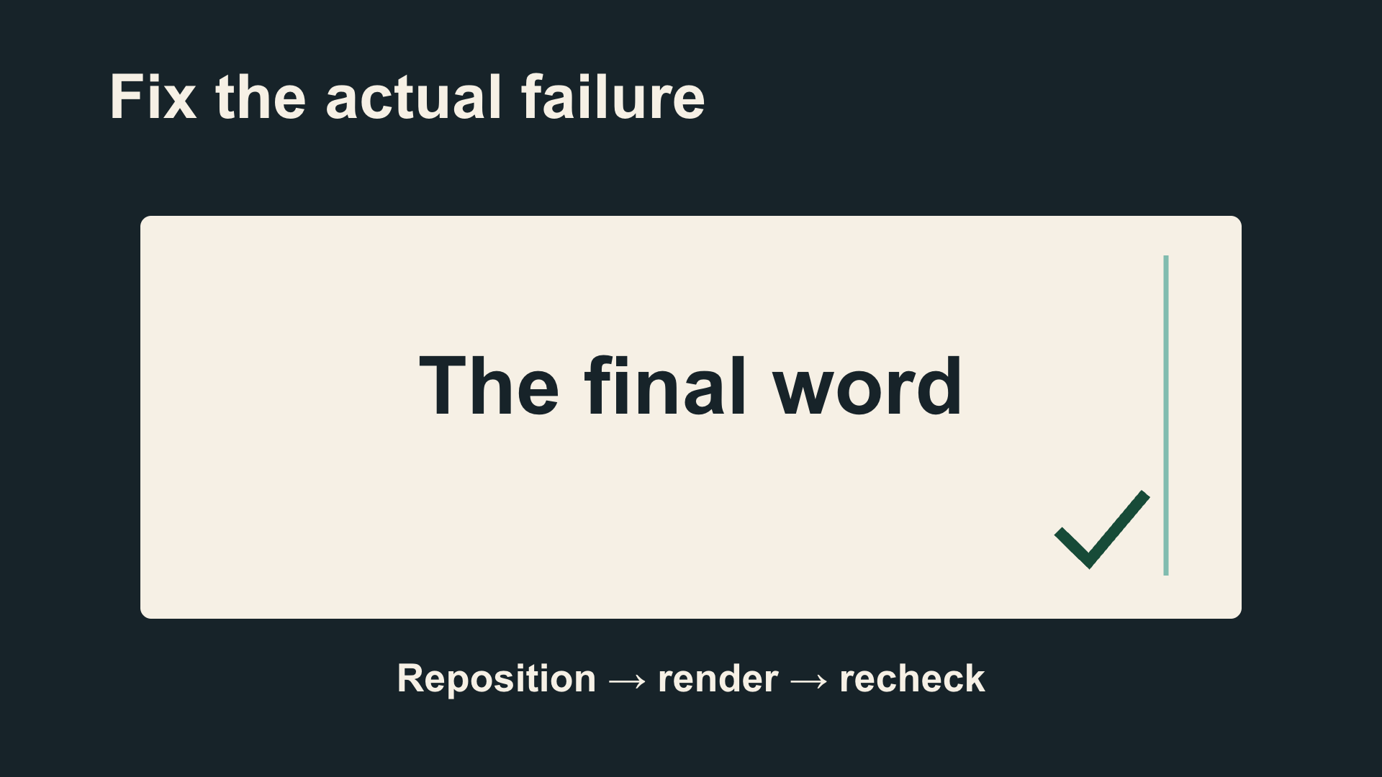
Why this design fits the idea
Charcoal background
Coral problem
Warm-white page
Sea-green repair
Arial · large, plain labels
Export → inspect → repair → verify
George · quiet documentary bed
CODEX & COFFEE
DAY 9 · 41
Notes:
DAY 9 · Why this design fits the idea
29.5–30.1 minutes
SAY
A specific failure gives the review a purpose. A visible before-and-after supports the advice. Name the palette, type, motion and audio choices. These are the choices implemented in the supplied film, not optional suggestions.
DO
Point to the frame, then trace each visible design decision.
CHECK
Learners can connect the look to the teaching job.
Sources: https://learn.chatgpt.com/docs/build-skills ; https://learn.chatgpt.com/docs/app ; https://developers.openai.com/codex/guides/agents-md/ ; https://github.com/openai/codex ; https://hyperframes.studio/
Official screenshot: https://chatgpt.com/codex/ . Fictional examples and generated illustrations are teaching materials. Provider access checked during production; see START-HERE for actual final audio status.

Slide 42
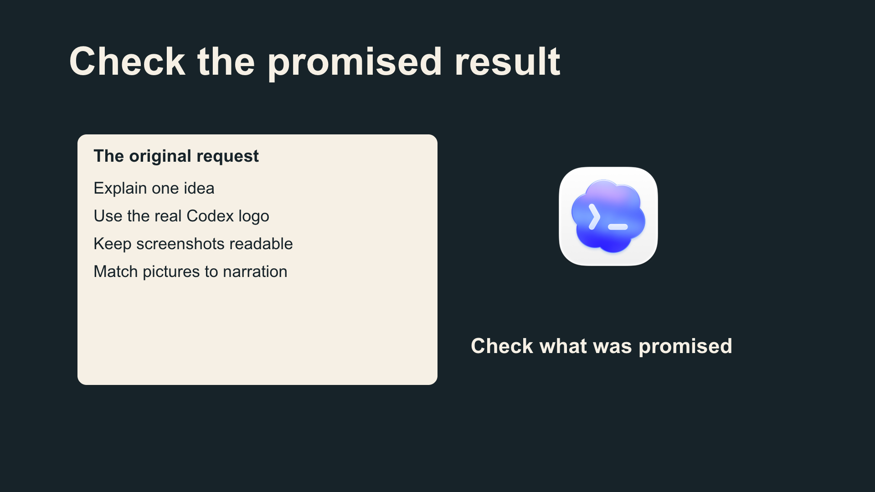
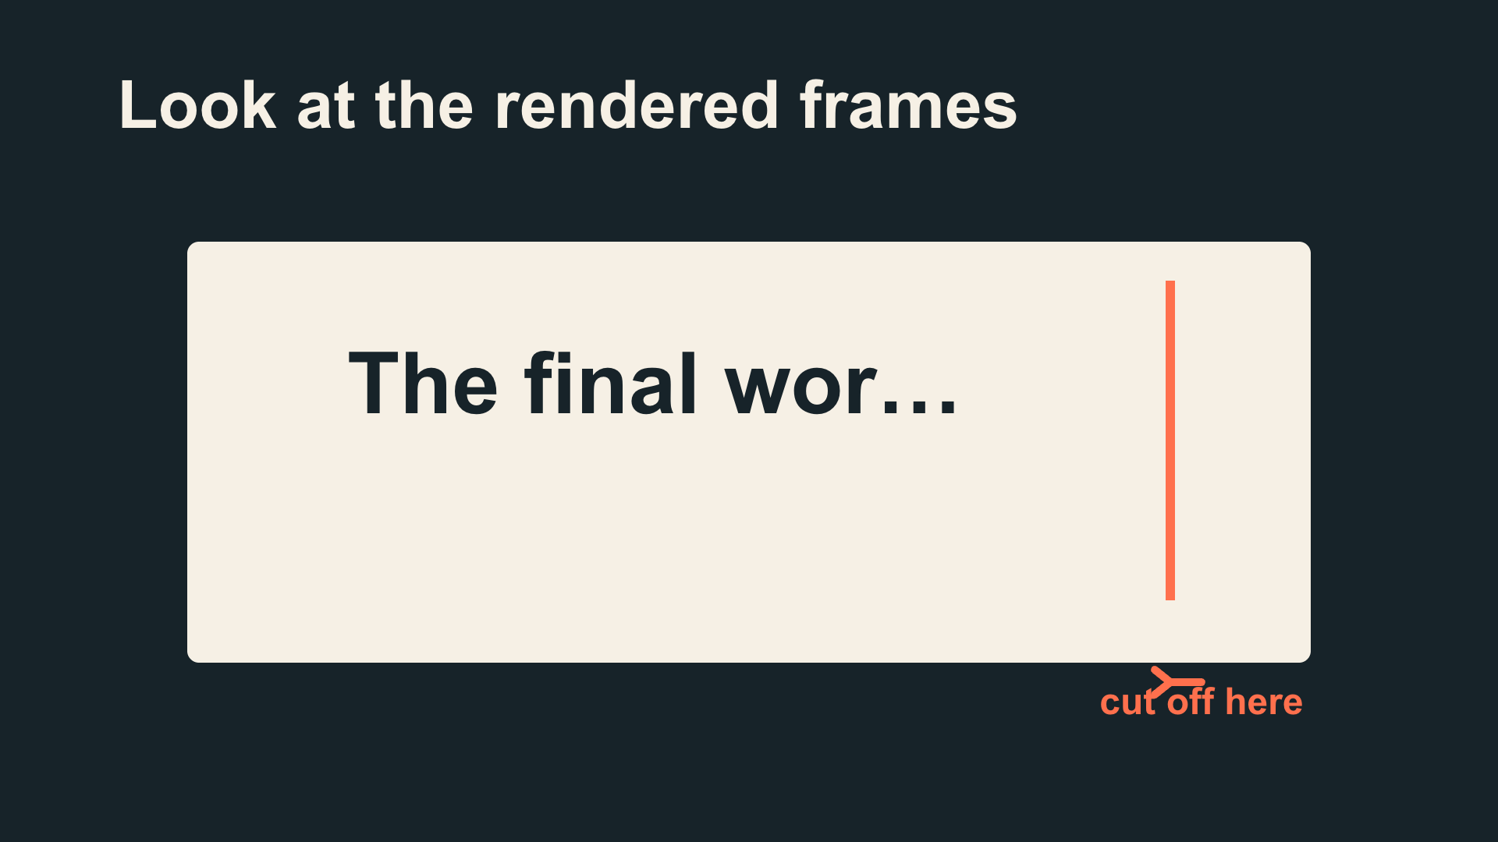
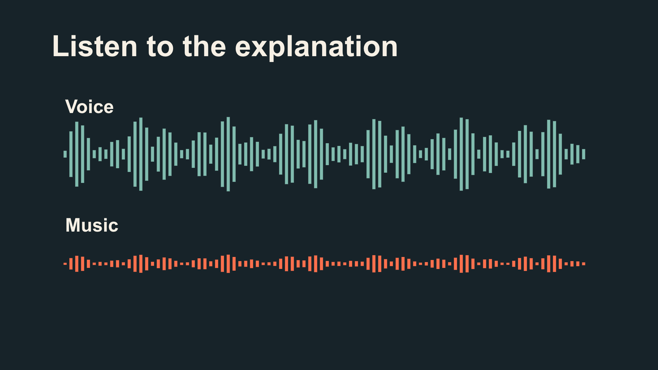
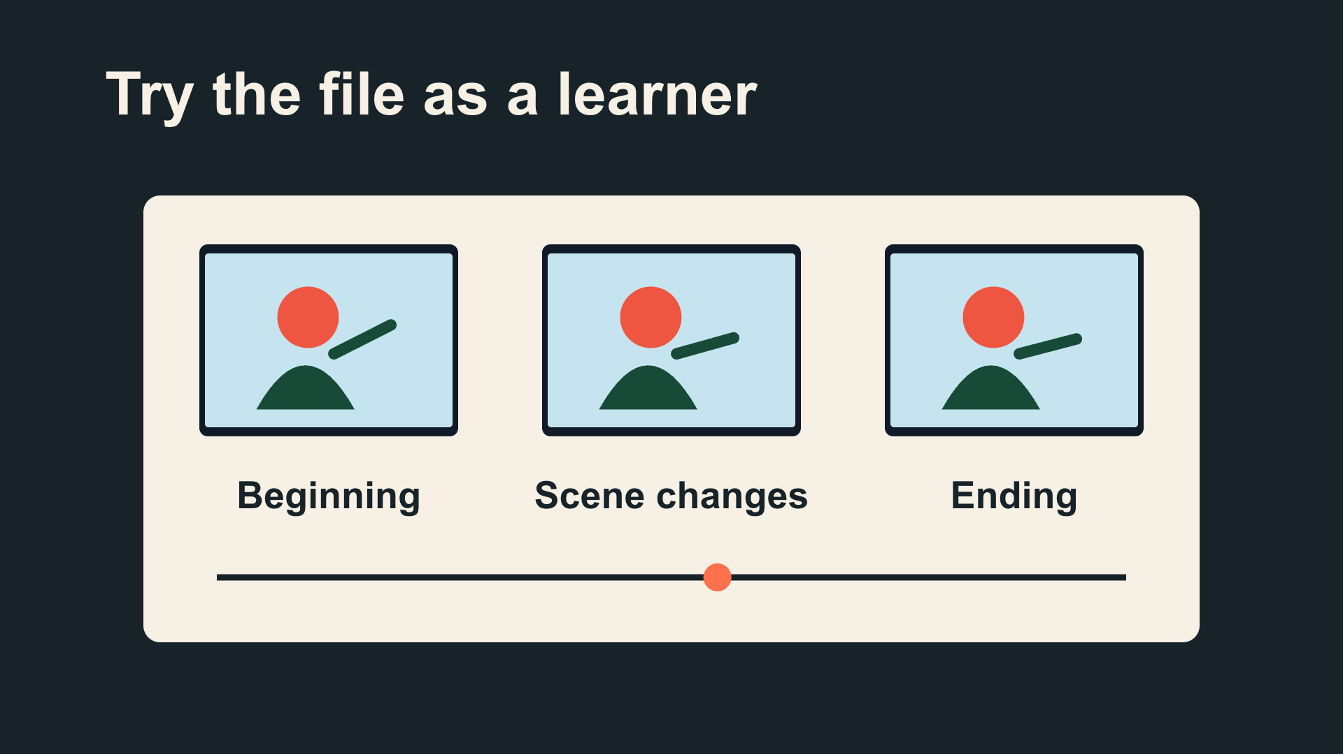
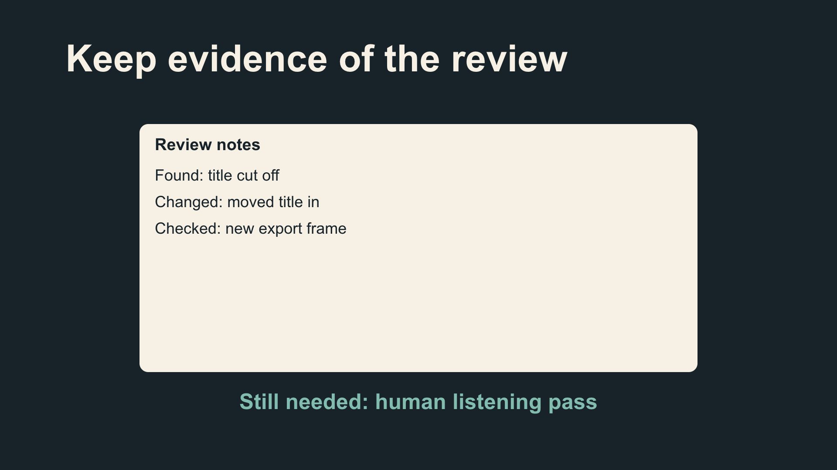
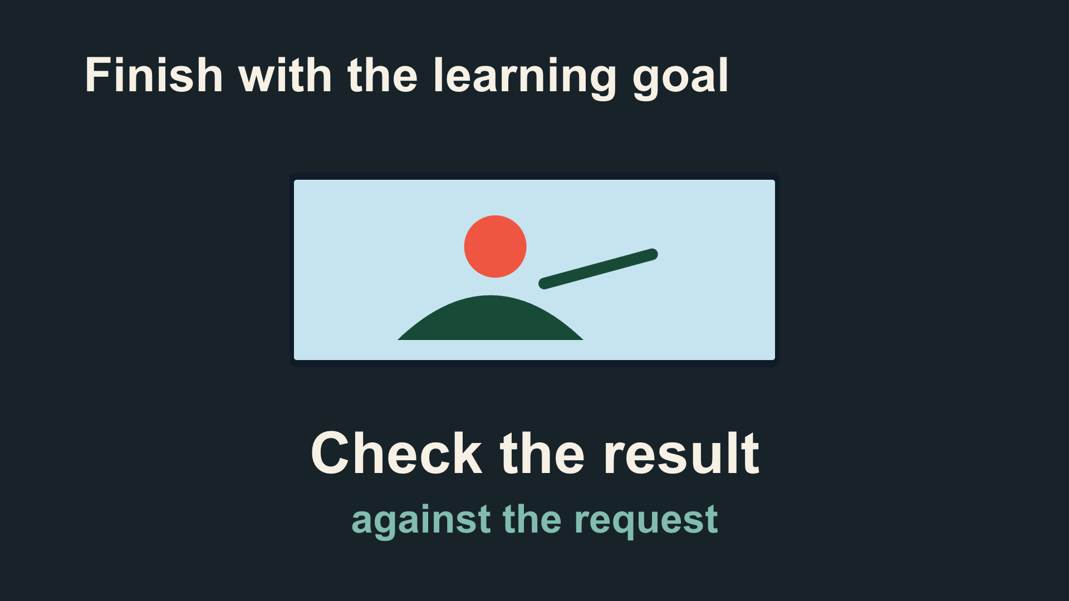
From a script to eight visual beats
1. File exists
2. Request
3. Inspect
4. Repair
5. Listen
6. Play export
7. Record
8. Learning goal
Scene 1: beats 1–3 Scene 2: beats 4–6 Scene 3: beats 7–8
CODEX & COFFEE
DAY 9 · 42
Notes:
DAY 9 · From a script to eight visual beats
30.1–30.8 minutes
SAY
The voice was written in eight short sections. Each has one visual instruction. Three editable scene files hold those eight beats. The voice lengths set the timing; the display below is the actual sequence.
DO
Walk across the thumbnails in order. Explain one causal transition rather than reading all eight titles.
CHECK
Every spoken idea has a corresponding picture.
Sources: https://learn.chatgpt.com/docs/build-skills ; https://learn.chatgpt.com/docs/app ; https://developers.openai.com/codex/guides/agents-md/ ; https://github.com/openai/codex ; https://hyperframes.studio/
Official screenshot: https://chatgpt.com/codex/ . Fictional examples and generated illustrations are teaching materials. Provider access checked during production; see START-HERE for actual final audio status.

Slide 43
The instruction behind this moment
VOICEOVER · actual script
Be specific: The title is cut off on the right. Reposition it and render that section again. That is more useful than make it better.
PICTURE · actual direction
Before/after wipe corrects title within safe area
CODEX & COFFEE
DAY 9 · 43
Notes:
DAY 9 · The instruction behind this moment
30.8–31.5 minutes
SAY
These words are copied from the production files. The narration says the idea; the visual instruction describes what must happen on screen. Codex then implements the illustration and motion in the editable scene file.
DO
Read the narration and visual direction beside the matching rendered frame.
CHECK
The instruction names an action rather than just an aesthetic.
Sources: https://learn.chatgpt.com/docs/build-skills ; https://learn.chatgpt.com/docs/app ; https://developers.openai.com/codex/guides/agents-md/ ; https://github.com/openai/codex ; https://hyperframes.studio/
Official screenshot: https://chatgpt.com/codex/ . Fictional examples and generated illustrations are teaching materials. Provider access checked during production; see START-HERE for actual final audio status.

Slide 44
Watch that moment again
▶
CODEX & COFFEE
DAY 9 · 44
Notes:
DAY 9 · Watch that moment again
31.5–33 minutes
SAY
Pause on the flaw, then compare the repair. This is a focused excerpt from the same finished video. Play once, pause on the useful frame, then connect the result back to the instruction. A visible before-and-after supports the advice.
DO
Play the embedded excerpt. Pause to discuss; the full video is still available at the earlier slide.
CHECK
A visible before-and-after supports the advice.
Sources: https://learn.chatgpt.com/docs/build-skills ; https://learn.chatgpt.com/docs/app ; https://developers.openai.com/codex/guides/agents-md/ ; https://github.com/openai/codex ; https://hyperframes.studio/
Official screenshot: https://chatgpt.com/codex/ . Fictional examples and generated illustrations are teaching materials. Provider access checked during production; see START-HERE for actual final audio status.
PLAY EXCERPT: 05-checks-replay.mp4
The video is embedded on this slide. Click it to play in PowerPoint. Offline fallback: Day-09-Lesson.html in the same output folder.

Slide 45
A reusable starting prompt
Make a 60–90 second explainer for someone new to [topic]. By the end, they should understand [one idea]. Use [one concrete example] all the way through.
First show me a short script and what we would see in each scene. Use [a visual style], a clear AI voice, quiet music, and a few sounds that match the action.
Build it in HyperFrames. Keep the project editable, export an MP4, and check the finished pictures, sound, and ending.
CHECK
The script and scene plan make sense before production starts
CODEX & COFFEE
DAY 9 · 45
Notes:
DAY 9 · A reusable starting prompt
33–34.5 minutes
SAY
This is a reusable starting brief, not a magic spell. It gives Codex the pieces needed to propose a coherent explanation. Learners can replace the topic and example. Keep it readable.
DO
Read the exact request, then identify its teaching goal and visual direction.
CHECK
The script and scene plan make sense before production starts
EXACT PROMPT
Make a 60–90 second explainer for someone new to [topic]. By the end, they should understand [one idea]. Use [one concrete example] all the way through.
First show me a short script and what we would see in each scene. Use [a visual style], a clear AI voice, quiet music, and a few sounds that match the action.
Build it in HyperFrames. Keep the project editable, export an MP4, and check the finished pictures, sound, and ending.
Sources: https://learn.chatgpt.com/docs/build-skills ; https://learn.chatgpt.com/docs/app ; https://developers.openai.com/codex/guides/agents-md/ ; https://github.com/openai/codex ; https://hyperframes.studio/
Official screenshot: https://chatgpt.com/codex/ . Fictional examples and generated illustrations are teaching materials. Provider access checked during production; see START-HERE for actual final audio status.

Slide 46
What each part of the prompt does
Audience + teaching goal
“For someone new to Codex…”
One example through the story
“Follow one request all the way through…”
Pictures + voice + sound
“Use a cutaway, clear voice and quiet music…”
Editable files + finished checks
“Keep the project. Check the MP4…”
CODEX & COFFEE
DAY 9 · 46
Notes:
DAY 9 · What each part of the prompt does
34.5–36 minutes
SAY
Point at one colored phrase at a time. Audience determines vocabulary; outcome sets the finish; example supplies continuity; look and sound control treatment; deliverables and checks define done.
DO
Match each phrase in the request to the production decision it controls.
CHECK
Each production choice traces to a phrase in the prompt.
Sources: https://learn.chatgpt.com/docs/build-skills ; https://learn.chatgpt.com/docs/app ; https://developers.openai.com/codex/guides/agents-md/ ; https://github.com/openai/codex ; https://hyperframes.studio/
Official screenshot: https://chatgpt.com/codex/ . Fictional examples and generated illustrations are teaching materials. Provider access checked during production; see START-HERE for actual final audio status.

Slide 47
Give feedback someone can act on
The frame count appears before you explain what a frame is. Introduce one still picture first, then expand it into the strip. Keep the two-second example and the same colors. Render that section again so we can compare.
CHECK
The new order fixes the learning problem
CODEX & COFFEE
DAY 9 · 47
Notes:
DAY 9 · Give feedback someone can act on
36–37 minutes
SAY
A good revision names the visible failure, the location, and what must survive. Compare it to “make it better,” which forces the model to guess.
DO
Read the exact request, then identify its teaching goal and visual direction.
CHECK
The new order fixes the learning problem
EXACT PROMPT
The frame count appears before you explain what a frame is. Introduce one still picture first, then expand it into the strip. Keep the two-second example and the same colors. Render that section again so we can compare.
Sources: https://learn.chatgpt.com/docs/build-skills ; https://learn.chatgpt.com/docs/app ; https://developers.openai.com/codex/guides/agents-md/ ; https://github.com/openai/codex ; https://hyperframes.studio/
Official screenshot: https://chatgpt.com/codex/ . Fictional examples and generated illustrations are teaching materials. Provider access checked during production; see START-HERE for actual final audio status.

Slide 48
Prepare one small scene first
Open this HyperFrames project and check that we can render it here. Tell me what is missing before installing anything or using a paid service.
CHECK
A real setup result, with missing requirements named
CODEX & COFFEE
DAY 9 · 48
Notes:
DAY 9 · Prepare one small scene first
37–37.5 minutes
SAY
Use the supplied editable project folder. Ask Codex to check local requirements before trying to render. Node and FFmpeg must be available. Narration needs either a configured provider or a supported local voice. Account access is separate from the creative prompt.
DO
Read the setup prompt and identify which requirements are checked locally.
CHECK
A real setup result, with missing requirements named
EXACT PROMPT
Open this HyperFrames project and check that we can render it here. Tell me what is missing before installing anything or using a paid service.
Sources: https://learn.chatgpt.com/docs/build-skills ; https://learn.chatgpt.com/docs/app ; https://developers.openai.com/codex/guides/agents-md/ ; https://github.com/openai/codex ; https://hyperframes.studio/
Official screenshot: https://chatgpt.com/codex/ . Fictional examples and generated illustrations are teaching materials. Provider access checked during production; see START-HERE for actual final audio status.

Slide 49
Let’s make the opening together
Use the frame-count video as a starting point. Make a 15-second opening that explains why a tiny pause can contain lots of pictures. Keep the yellow and dark-blue look. Show me the words and pictures first, then build that opening. Leave the original project alone.
CHECK
One understandable opening; original untouched
CODEX & COFFEE
DAY 9 · 49
Notes:
DAY 9 · Let’s make the opening together
37.5–40 minutes
SAY
Use a copy of one project. This is a bounded live demo: change the opening first, then render that section. The supplied finished videos are the fallback if a provider or machine is slow. Narrate the request, inspect its script, and compare a frame.
DO
Read the exact request, then identify its teaching goal and visual direction.
CHECK
One understandable opening; original untouched
EXACT PROMPT
Use the frame-count video as a starting point. Make a 15-second opening that explains why a tiny pause can contain lots of pictures. Keep the yellow and dark-blue look. Show me the words and pictures first, then build that opening. Leave the original project alone.
Sources: https://learn.chatgpt.com/docs/build-skills ; https://learn.chatgpt.com/docs/app ; https://developers.openai.com/codex/guides/agents-md/ ; https://github.com/openai/codex ; https://hyperframes.studio/
Official screenshot: https://chatgpt.com/codex/ . Fictional examples and generated illustrations are teaching materials. Provider access checked during production; see START-HERE for actual final audio status.

Slide 50
Your turn: direct a short explainer
Make a 30-second explainer for [who] about [one idea]. Follow [one example]. Use [a look and feel] and a clear, conversational voice.
Show me the script and scene plan first. Keep each scene focused. Finish with something the viewer can understand or do.
CHECK
One audience, one idea, one example, and a scene plan
CODEX & COFFEE
DAY 9 · 50
Notes:
DAY 9 · Your turn: direct a short explainer
40–43.5 minutes
SAY
Give learners five minutes to write a brief and ask for a script plus scene plan. Rendering is optional in this timed exercise. People without a working setup can write the plan in the worksheet. Walk around and ask what the viewer should know at the end.
DO
Read the exact prompt and inspect the proposed result.
CHECK
One audience, one idea, one example, and a scene plan
EXACT PROMPT
Make a 30-second explainer for [who] about [one idea]. Follow [one example]. Use [a look and feel] and a clear, conversational voice.
Show me the script and scene plan first. Keep each scene focused. Finish with something the viewer can understand or do.
Sources: https://learn.chatgpt.com/docs/build-skills ; https://learn.chatgpt.com/docs/app ; https://developers.openai.com/codex/guides/agents-md/ ; https://github.com/openai/codex ; https://hyperframes.studio/
Official screenshot: https://chatgpt.com/codex/ . Fictional examples and generated illustrations are teaching materials. Provider access checked during production; see START-HERE for actual final audio status.

Slide 51
Review it like a learner
?
Can I explain the idea back?
?
Does every scene help teach it?
?
What needs a real screenshot?
CODEX & COFFEE
DAY 9 · 51
Notes:
DAY 9 · Review it like a learner
43.5–44.5 minutes
SAY
Pairs swap plans. One person reads the script while the other points to the matching scene. If they cannot follow it without explanation, revise. Use the three checks on screen.
DO
Ask pairs to use each question on their planned scene.
CHECK
Each pair identifies one concrete improvement to the explanation.
Sources: https://learn.chatgpt.com/docs/build-skills ; https://learn.chatgpt.com/docs/app ; https://developers.openai.com/codex/guides/agents-md/ ; https://github.com/openai/codex ; https://hyperframes.studio/
Official screenshot: https://chatgpt.com/codex/ . Fictional examples and generated illustrations are teaching materials. Provider access checked during production; see START-HERE for actual final audio status.

Slide 52
Use the examples as starting points
Five editable projects
Five worked production briefs
One prompt worksheet
CODEX & COFFEE
DAY 9 · 52
Notes:
DAY 9 · Use the examples as starting points
44.5–45 minutes
SAY
Pick a treatment that fits the idea. Reuse the structure, replace the subject, and test the result with someone who was not in the room. Close on the teaching result, not on the tool list.
DO
Invite learners to choose one example and adapt its topic using the worksheet.
CHECK
Each learner has an example and a clear next edit.
Sources: https://learn.chatgpt.com/docs/build-skills ; https://learn.chatgpt.com/docs/app ; https://developers.openai.com/codex/guides/agents-md/ ; https://github.com/openai/codex ; https://hyperframes.studio/
Official screenshot: https://chatgpt.com/codex/ . Fictional examples and generated illustrations are teaching materials. Provider access checked during production; see START-HERE for actual final audio status.

