Slide 1
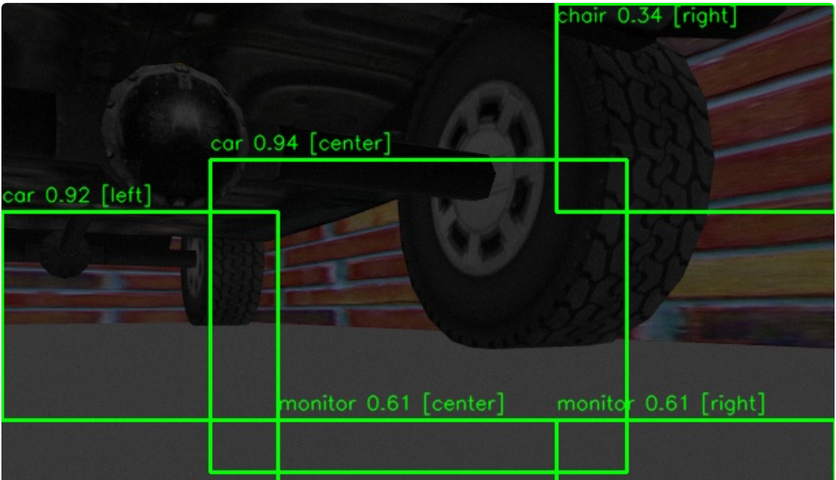
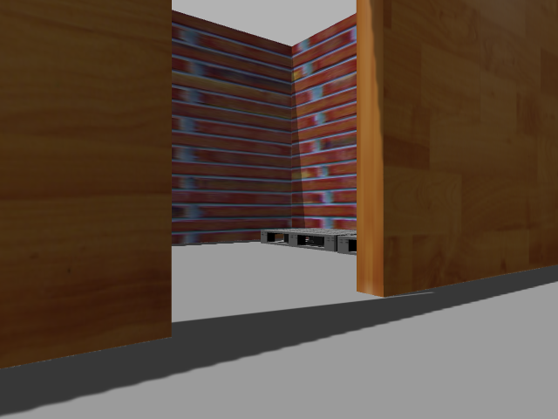
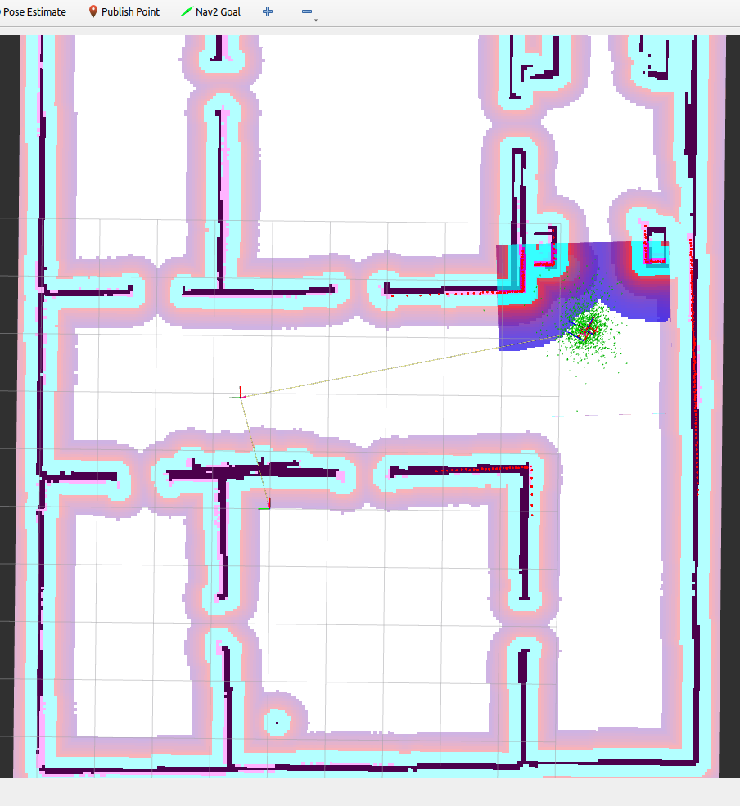
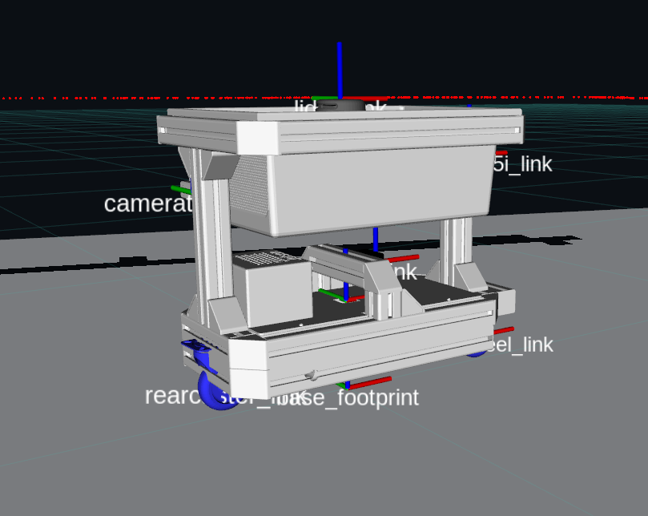
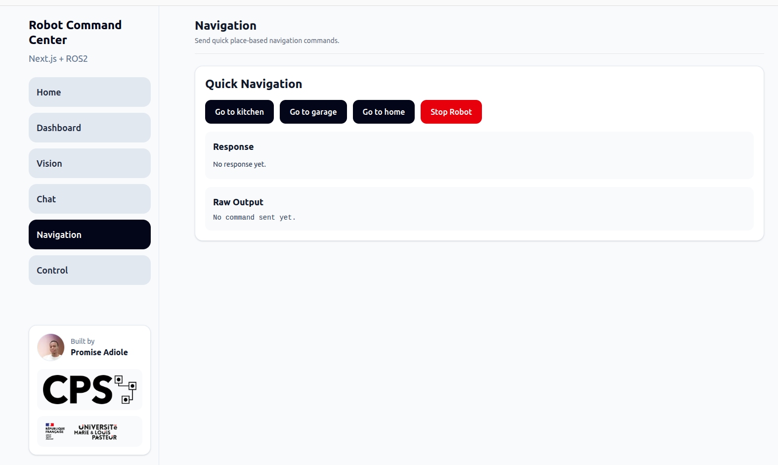
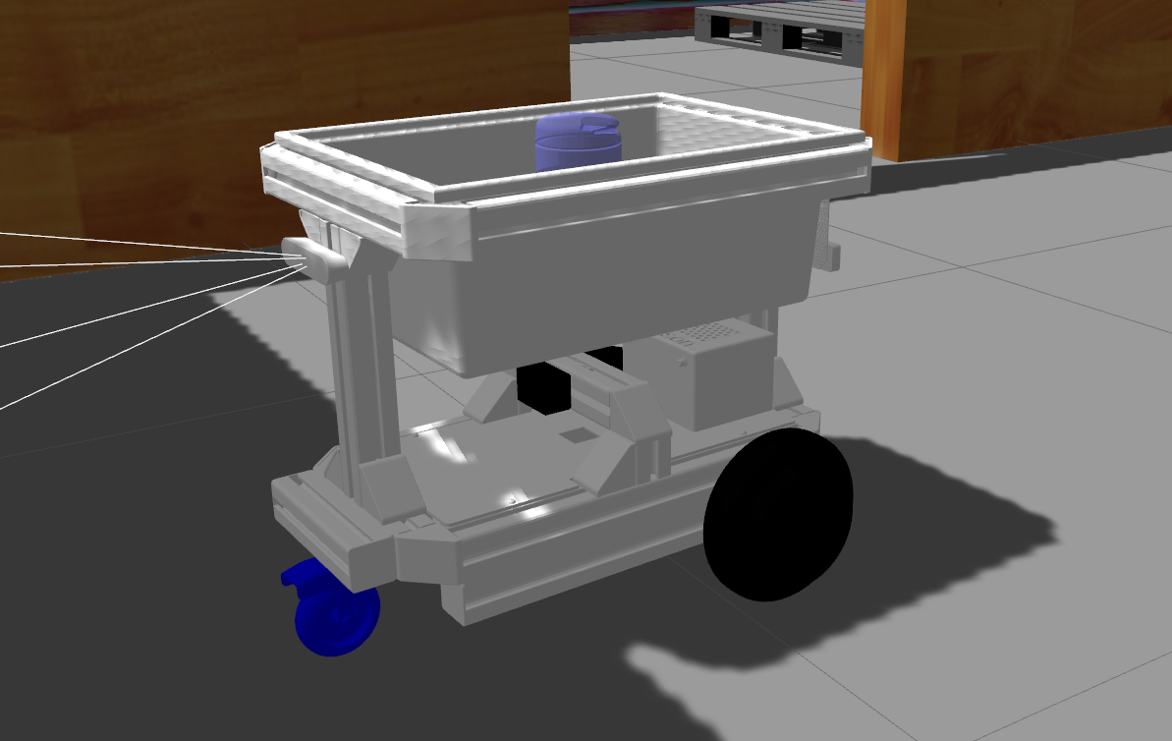
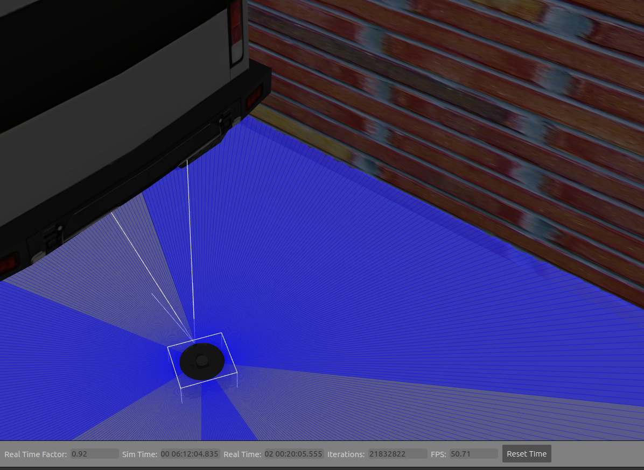
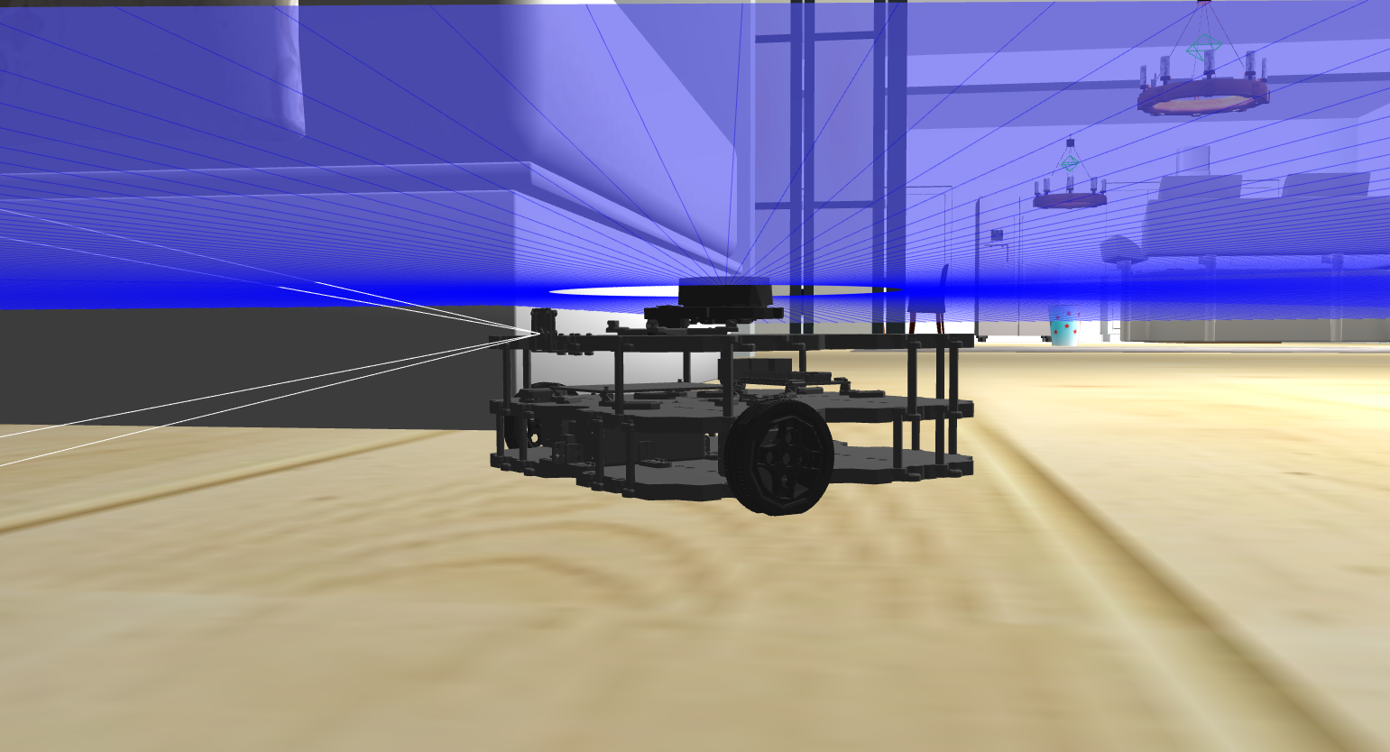
VLM Node
User commands, goal descriptions,
queries and general conversation
SAM
SAM + CLIP
RGB
Class-agnostic mask
proposals over the frame
Grounded objects
television · door
bookshelf · chair
with bearing and range
L = { l₁, l₂, … , lₙ }
mᵢ ∈ M
CLIP
Open-vocabulary labels
per mask, with confidence
oₖ
Command centre
TF · scan
costmap
Lidar
planar, 0.15-16 m
720 beams @ 10 Hz
Robot pose
LLM Node
x, y, z, θ
gpt-4.1-mini
LangGraph policy
verify · recover
Task dictionary
Action (Aₑ)
Navigation Planner
Gₙ(l)
l ∈ G_d
Command API
Localisation (AMCL)
W(c)
l ∈ C
Sen(Data)
l ∈ Q
Path planning
Mapping
G_c(l)
l ∈ G_c
ST(·)
l ∈ sT
TEN

