Slide 1


INF 311
Introduction to programming
and computer science
Les bases de l'informatique et de la
programmation
Frank NIELSEN
nielsen@lix.polytechnique.fr
Lundi 5 Mai 2008

Slide 2
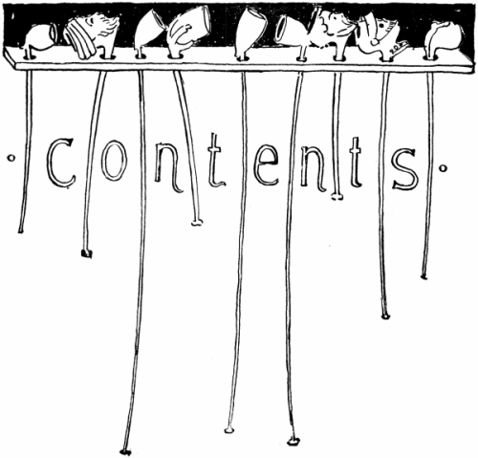
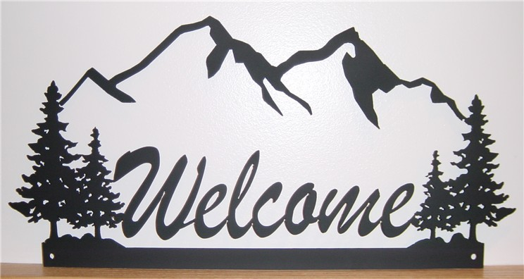
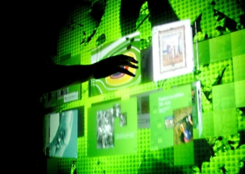
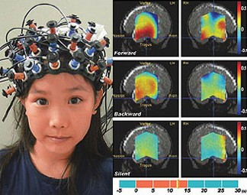
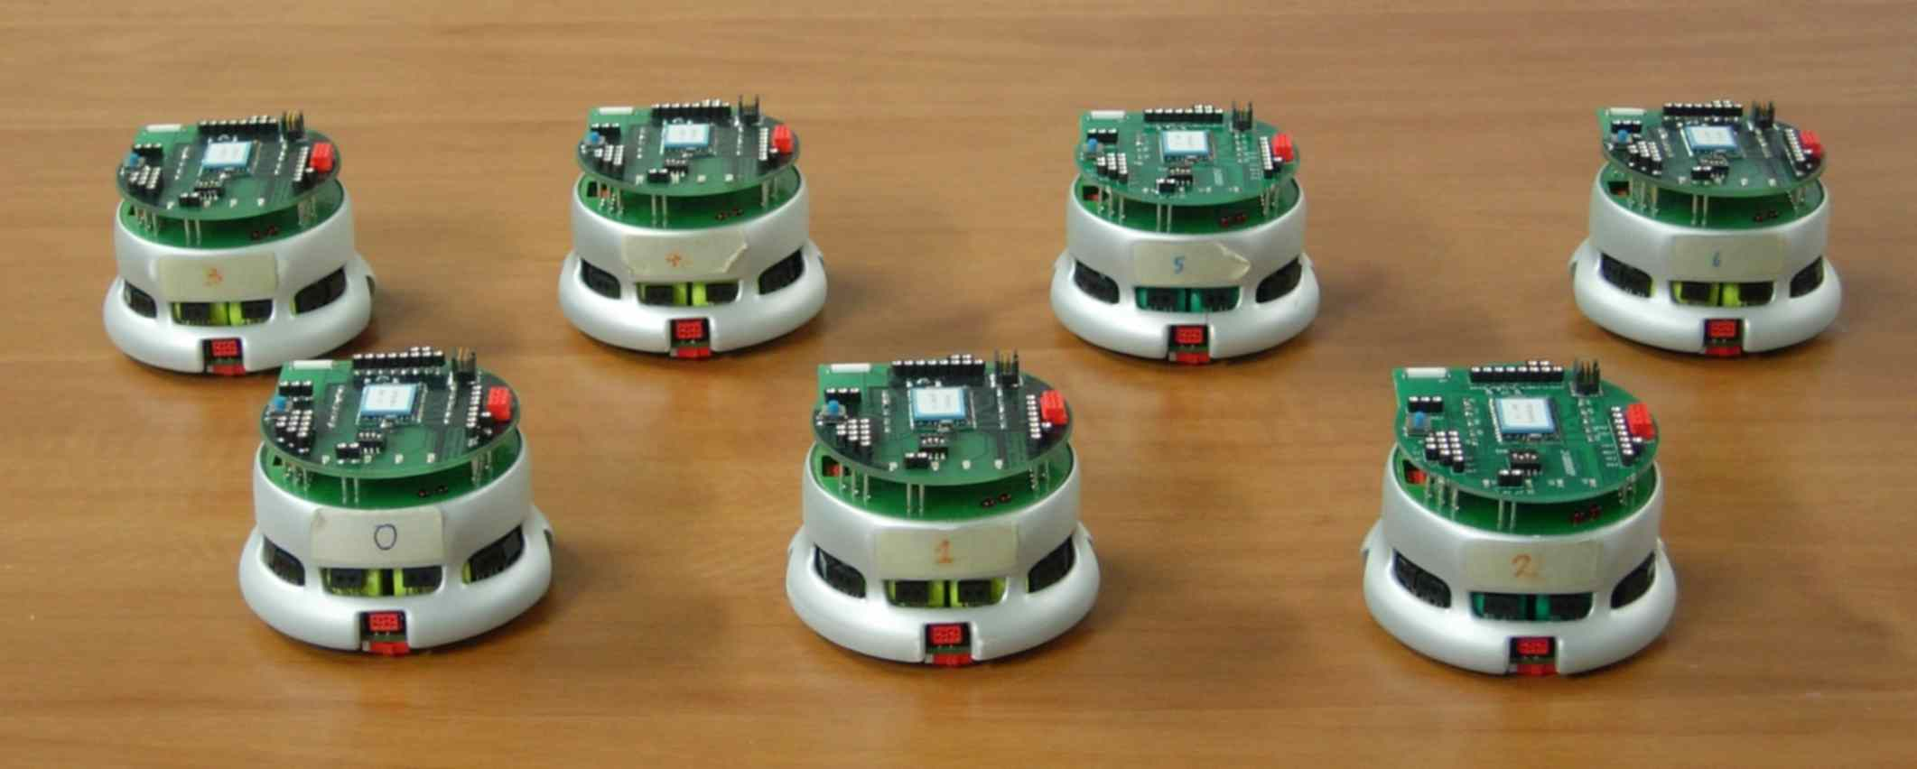
INF311 Contents
Learn to program with/in Java
Computing as a science
(some basic principles)
Popular (computer) science
MANET
HCI
BMI

Slide 3

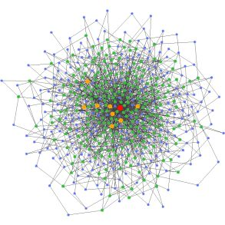
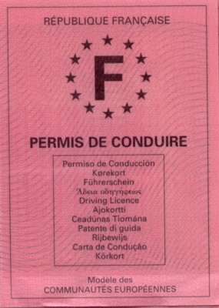


Jobs & Informatics
Over 35% of Ecole Polytechnique graduates work in CS-related jobs
(CS: computer science)
STIC: Sciences et Technologies de l'Information et des Communications
Industry
    CS Industry
    Others (information systems)
Administration
Research & Development
Not feeling fluent with CS today, is like not being able to drive a car !

Slide 4

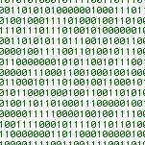

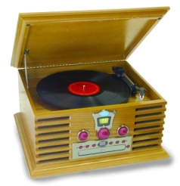
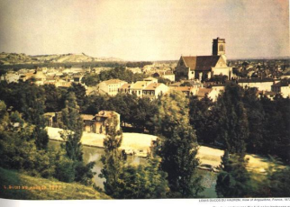
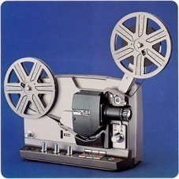
Digital world
Benefits of the analog-to-digital paradigm shift?
Dissociate contents from support : digitize/“binarize”
Contents become mere
binary 0/1 strings
Notes:
<番号>

Slide 5
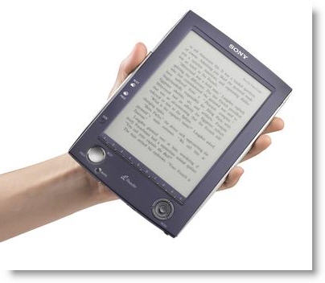
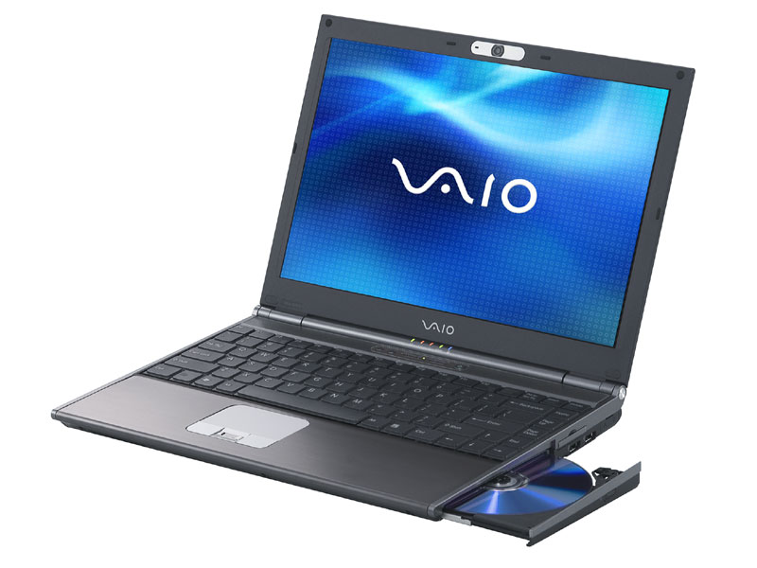
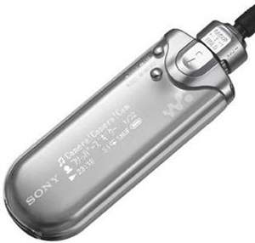
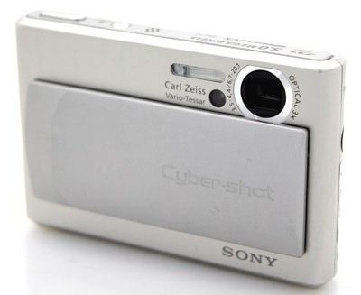
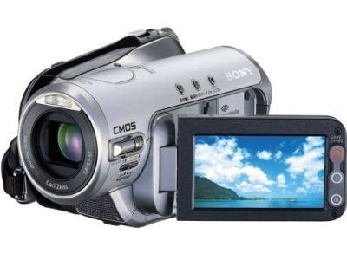
Digital world
Universal player (machine) and dedicated devices
“Multiple 0/1 readers”

Slide 6

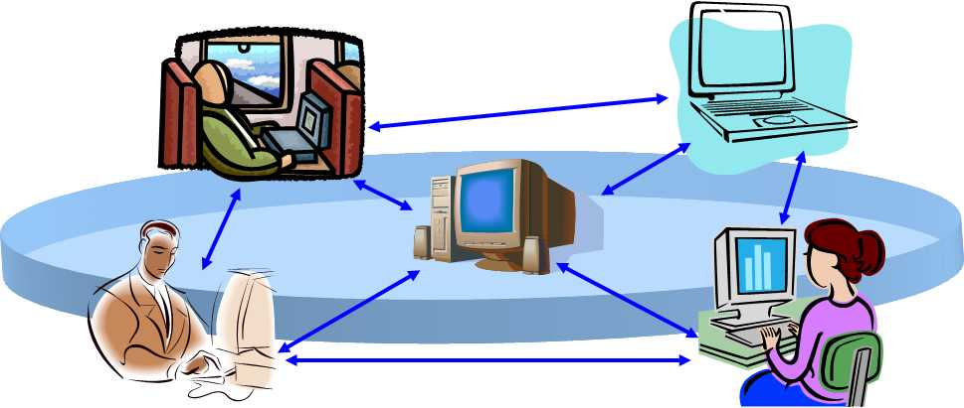

Digital world
Generic algorithms:
copying, compressing, transmitting, archiving, etc.
Text
Music
Image
Video
Data
Raise the question: What is the (digital) information?
Notes:
<番号>

Slide 7
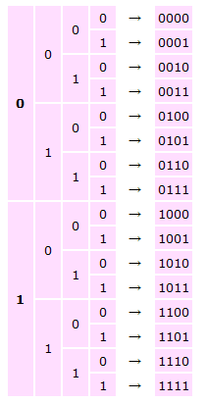
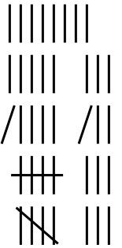


Digital world: Why 0/1 bits?
Information, first needs of counting...
Unary numeral systems:
Binary numeral systems:
8
4 bits
for counting
0 to 15
Linear number of bits for counting
vs
Logarithmic number of bits for counting

Slide 8
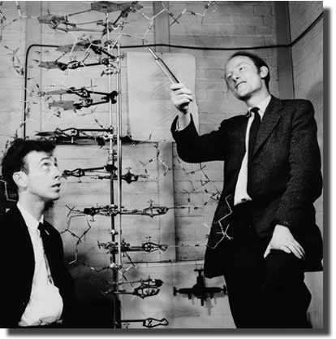
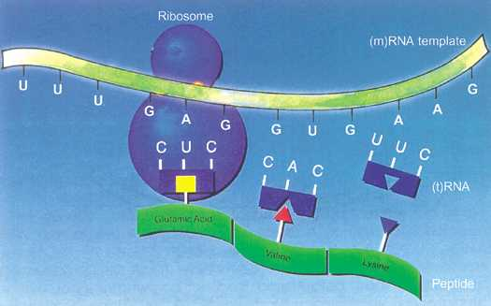
Nature of computing?
Generic algorithms:
copying, transmitting... ...genetics...
DNA (double-helix structure of DNA)
1953, James Watson and Francis Crick (Nobel prize)
Genetics

Slide 9
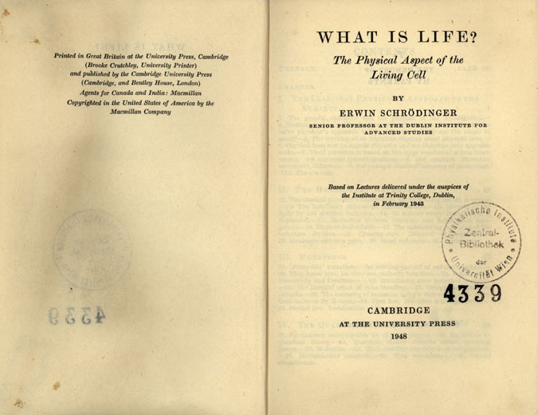

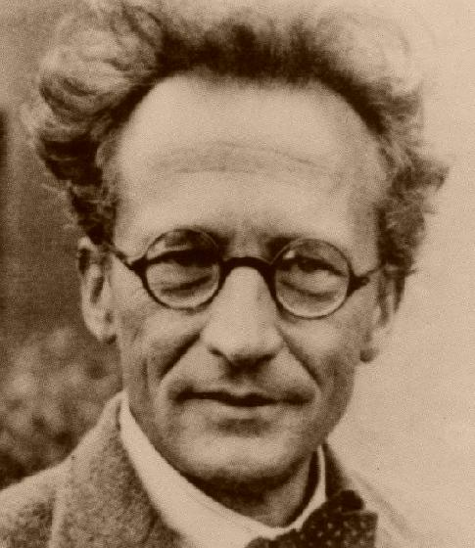
Nature of computing?
Transmit crystals?
LIFE???
Nobel, Physics 1933
First envisioned by Erwin Schroedinger (What is life?, 1944)

Slide 10

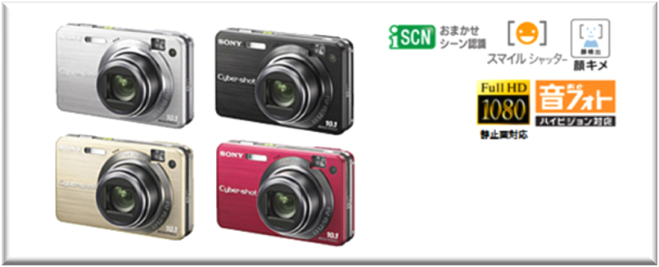
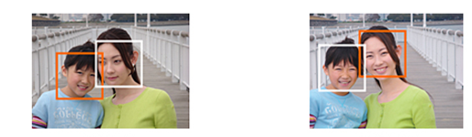
Digital world/computing
Ubiquitous computing= computing everywhere
Digital = Binary + Calculations
New features
Example:
Computational
photography
Notes:
<番号>

Slide 11
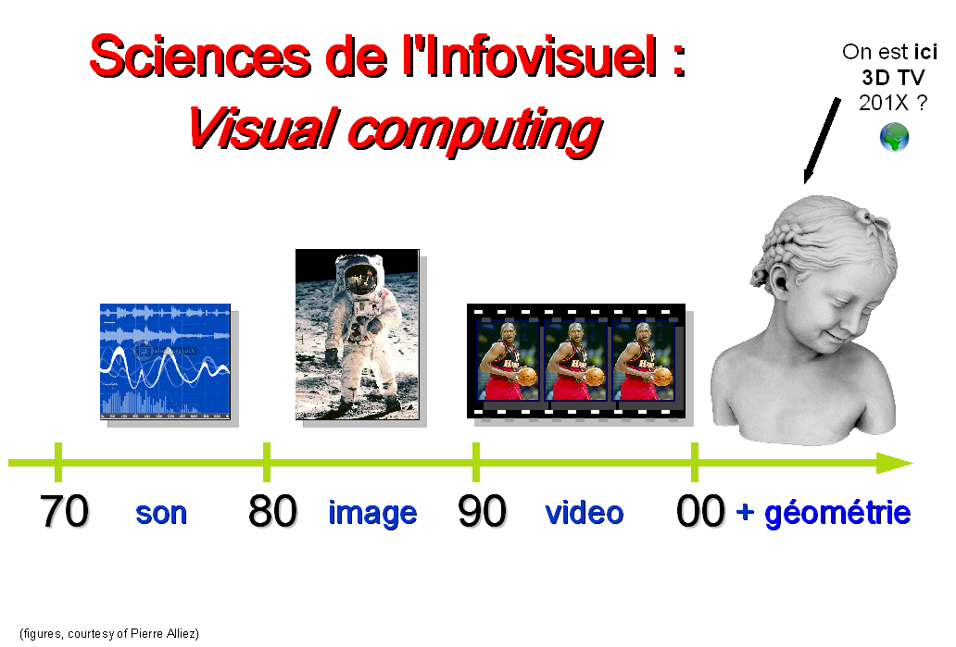
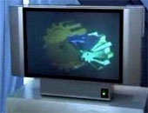
Digital world/computing
Notes:
<番号>

Slide 12
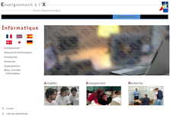
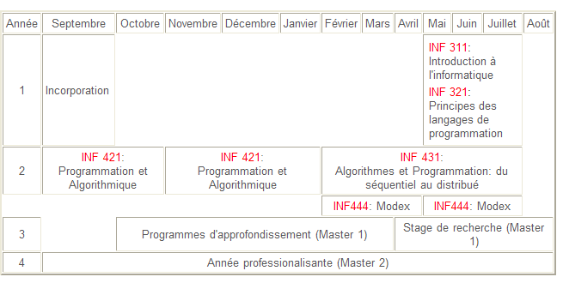
Computer Science at Ecole Polytechnique
http://www.enseignement.polytechnique.fr/informatique/
Semaine de la
Science
Welcome to INF311
INF 311
versus
INF 321?
Theses (Ph. D)

Slide 13

Synopsis of INF311
Welcome to INF311
10 lectures (Amphis) x 1h30
10 TDs x 2h (12 groups)
Travail personnel
Tutorat (x4)
Pale machine (TD en Juin)
Pale finale (HC, Lundi 7 Juillet)
Tutorat:
Jeudi 22 Mai, 13h30-15h30
Jeudi 5 Juin, 13h30-15h30
Jeudi 12 Juin, 13h30-15h30
Jeudi 19 Juin, 13h30-15h30
http://www.enseignement.polytechnique.fr/informatique/INF311/

Slide 14

INF311: Schedule
Irregularities to consider...
Amphi 1, Lundi 5 mai 10h30-12h00, TD1 13h30-15h30 (Gr1-6) et 15h45-17h45 (Gr7-12)
Amphi 2, Jeudi 15 mai 10h30-12h00
Amphi 3, Lundi 19 mai 10h30-12h00, TD2 13h30-15h30 (Gr7-12) et 15h45-17h45 (Gr1-6)
Amphi 4, Mardi 20 mai 8h30-10h00
Amphi 5, Lundi 26 mai 10h30-12h00, TD3 13h30-15h30 (Gr1-6) et 15h45-17h45 (Gr7-12)
TD4, Mercredi 28 mai 8h00-10h00 (Gr7-12) et 10h15-12h15 (Gr1-6)
Amphi 6, Lundi 2 juin 10h30-12h00, TD5 13h30-15h30 (Gr7-12) et 15h45-17h45 (Gr1-6)
TD6, Mercredi 4 juin 10h15-12h15 (Gr1-6) et 13h30-15h30 (Gr7-12)
Amphi 7, Lundi 9 juin 10h30-12h00, TD7 13h30-15h30 (Gr1-6) et 15h45-17h45 (Gr7-12)
Amphi 8, Lundi 16 juin 10h30-12h00, TD8 13h30-15h30 (Gr7-12) et 15h45-17h45 (Gr1-6)
Amphi 9, Lundi 23 juin 10h30-12h00, TD9 13h30-15h30 (Gr1-6) et 15h45-17h45 (Gr7-12)
Amphi 10, Lundi 30 juin 10h30-12h00, TD10 13h30-15h30 (Gr7-12) et 15h45-17h45 (Gr1-6)
http://www.enseignement.polytechnique.fr/informatique/INF311/

Slide 15
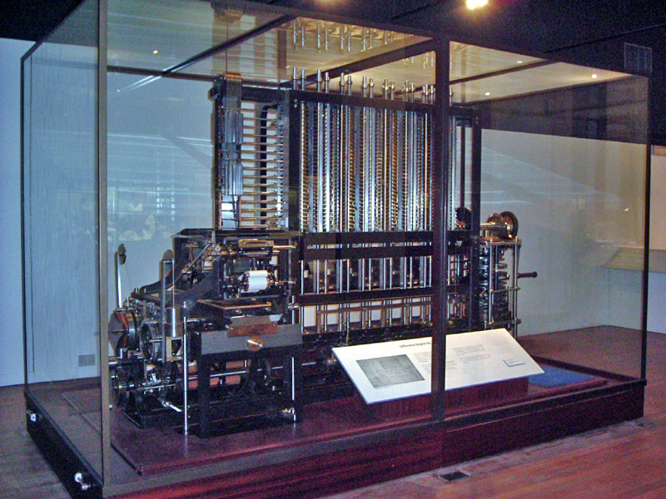
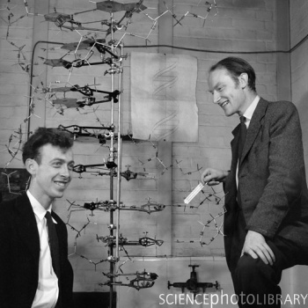
Computer science is not programming PCs
Computers
=
computing machineries
Difference engine of Charles Babbage
(conceived in 1822 on paper, built much later on)
Computing is a principle of reality (and science)
Watson and Crick 1951 (DNA double helix heredity)
Computing is 21st Century's Science of integration

Slide 16
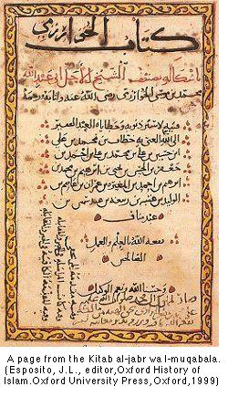
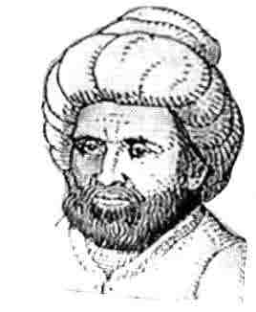

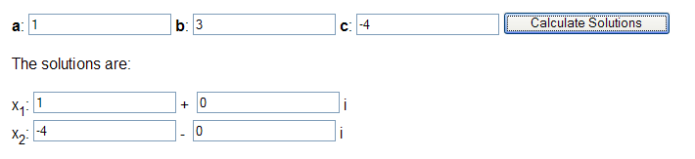

INFORMATIQUE=INFORmation + autoMATIQUE
Information= Data sets, input (discrete binary sequences of 0/1)
Automatic= General recipe that works on any input
= ALGORITHM
Al-Khwarizmi: Scholar of
scientifically flourishing Bagdad:
Algorithmi (latinization) -> Algorithm
Al jabr -> Algebra
Provide readers a generic pipeline solution
to solve a quadratic equation:
Al-Khwarizmi
(790 - 840)
http://www.akiti.ca/Quad2Deg.html

Slide 17
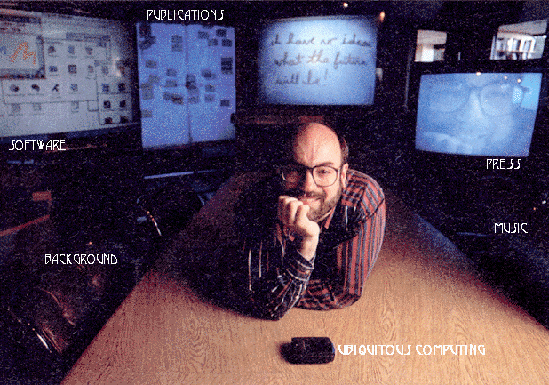
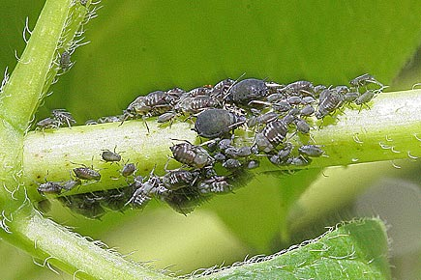
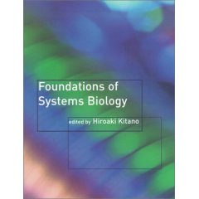
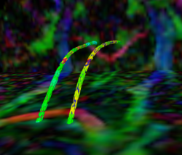

21st century computer science
Computers (and computing) are omnipresent
  -> Ubiquitous computing (Mark Weiser)
  Computers are abundant and versatile:
  (“pucerons” of Gerard Berry, College de France)
1952-1999
Xerox parc chief scientist
(Many more devices than PCs)
Science of
Integration
(complex systems)
Computing impacted all Sciences:
Computational sciences
Eg., Biology -> Systems biology
(simulation-prediction-experience in wet lab)
The Science of computing is Computer Science (CS):
Deep theoretical questions and important technologies
(eg., medical imaging such as DT-MRI, economy)
DW-MRI

Slide 18
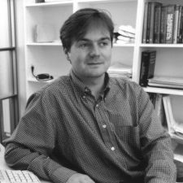
CS curriculum at Ecole Polytechnique
INF311+421 allow you to reach INF431
Open doors to MODEXs
Allow you to go to Master courses
      (International level)
But first, we need to harmonize our background with the very basics
(like solfege in music, or ...
studying the theory of driving cars before driving and conceiving them...)
About your instructor...
PhD in computational geometry (1996)
1997- Senior researcher at Sony Computer Science Laboratories
2008- Professor at LIX.

Slide 19
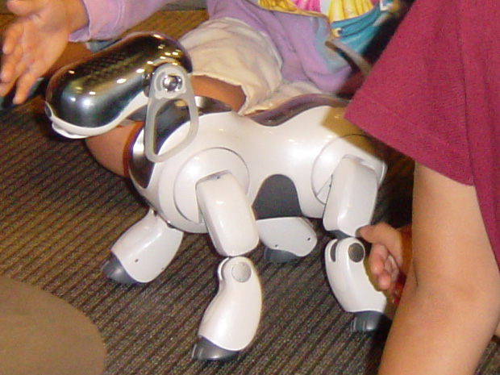
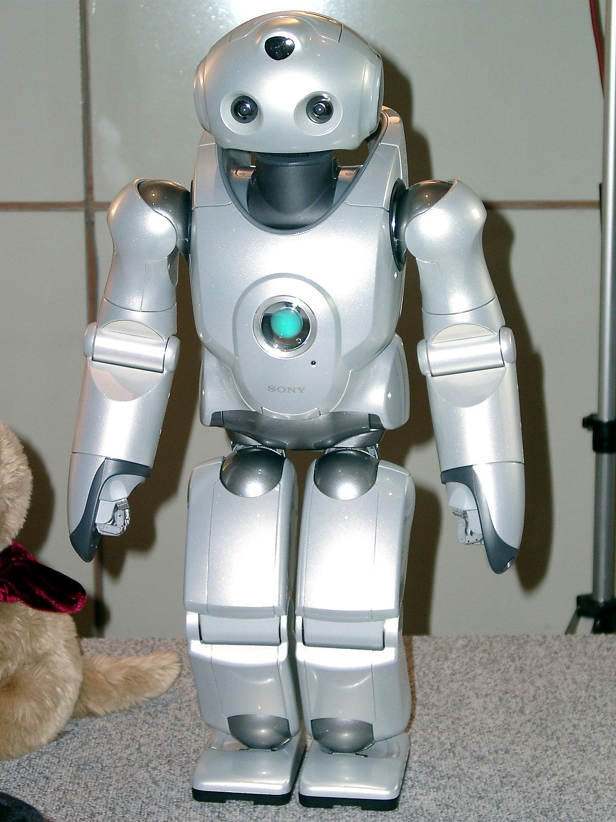
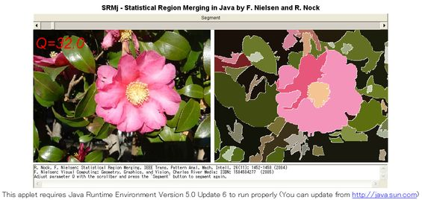
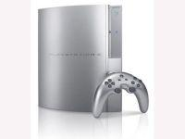
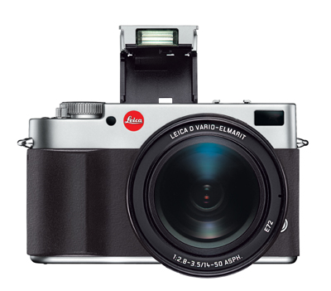
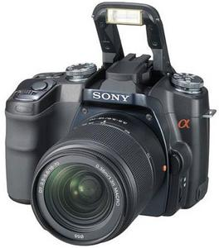
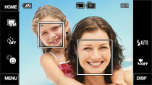
Flavor of my research in computer science
Visual computing:
Computational geometry,
Computer vision,
Computer graphics,
Machine learning
For example, tackling computational photography
Reinventing the photography: taking, sharing and experiencing photos...
Everything has yet
to be
invented!!!
Beyond 2D pixels
Beyond single flash
etc...
Analog camera
Digital camera
Smile shutter

Slide 20
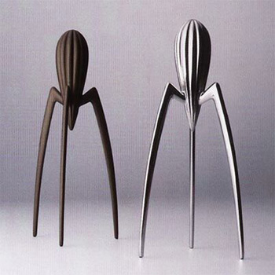
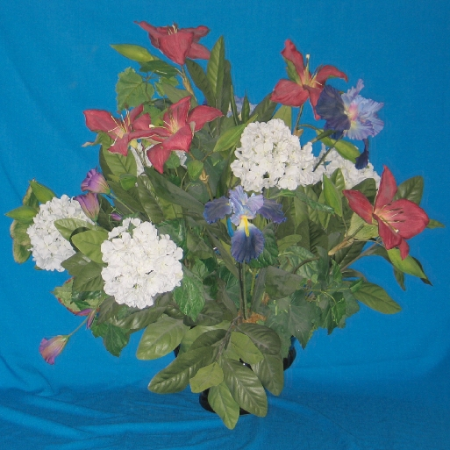
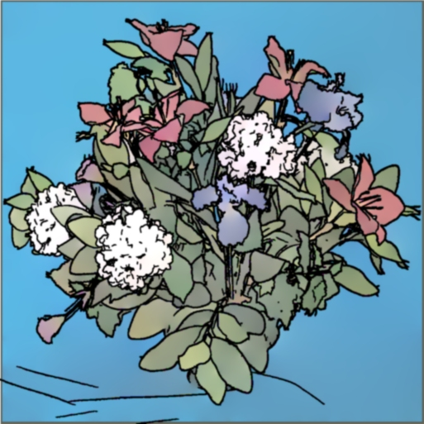
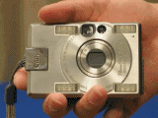
Computer science is (also) for creative minds
Not only the hardcore mathematical problems to solve,
but also innovation by unleashing the power of
digital calculus for soft problems:
Human Computer Interactions (HCI), design
Example: computational photography project (2004)
Non-photorealistic camera (NPR)
NPR Camera

Slide 21




Algorithms and their performances (resource/complexities)
There is usually not a single recipe for solving the task:
Eg., compute 5422x2319
(human decimal, machine binary, indian base 60, many tricks, etc.)
How to evaluate and compare different algorithms?
Donald Knuth
Clean framework for assessing the use of ressources:
time,
memory,
#communications,
etc.
Judge the generic algorithms not for a given instance.
Therefore, analyze:
Worst-case complexity
Average-time complexity
Modern challenges (inplace, i/o bottlenecks & streaming, etc.)
Etc.
Philippe Flajolet, INRIA

Slide 22



Programming algorithms in Java
Conceived by Bill Joy (SUN co-founder) and James Gosling
Started in 1990, for the ''next wave in computing''
On-time for the Internet and WEB (applets are Java applications, Javascript, etc.)
  Cross-platform= runs on various operating systems (Windows, UNIX, Leopard, etc.)
Typed language (a=b, with a and b from different types will generate a compiler error)
Object oriented (OO, ease the conception and modularity of applications)
Rich set of Applications Programming Interface (API)
Free Software Development Kit on many platforms (SDK)
Verbose for catching bugs and debugging applications.

Slide 23



Why programming languages?
Machines are “stupid”: they obey you 100%
-> Need to fully and precisely specify your intentions
(no room for ambiguity, the bug is yours!!!)
... Machines only “understand” 0/1 binary sequences
(eg., instruction codes of microprocessors)
Machine = Processing + Peripherals (I/O)
... controlled by an Operating System (OS)
But Human masters “natural language”
... and we need to unleash ease of programming
ASSEMBLER, FORTRAN, ALGOL, BASIC, .......JAVA
Key principle of CS: Bootstrapping!
use existing languages to create more powerful languages:
Python, Ruby, etc.

Slide 24



My first (java) program
Programmers and CScientists cherrish...
... their “Hello World” programs
class FirstProgram{
public static void main (String[ ] args){
System.out.println("Hello INF311 !");
}
}
First programs often looks magic!
Special function main: entry of the program

Slide 25


My first (java) program
Type this program into a text editor (nedit, notepad)
Save this “text” as FirstProgram.java
Compile the program FirstProgram.java
prompt% javac FirstProgram.java
Execute the compiled program
prompt% java FirstProgram
prompt% Hello INF311 !

Slide 26



My first (java) program
1) EDIT and SAVE
High-level language
concepts/abstraction
FirstProgram.java
2) COMPILE
FirstProgram.class
(Java Byte code in .class)
3) EXECUTE
java FirstProgram
(Java Virtual machine: JVM)
... low-level language
instructions for processors

Slide 27



My first algorithm in Java:
A solver for quadratic equations
In Java
Install the SDK
(you do not have
to do this in room machines)
http://www.java.com/fr/
Input: a, b, c of the quadratic equations
Solution: the at most two real roots

Slide 28

Programming: Solver for quadratic equations
class QuadraticEquationSolver
{
public static void main(String[] arg)
{
double a,b,c;
a=Math.sqrt(3.0);
b=2.0;
c=-3.0;
double delta=b*b-4.0*a*c;
double root1, root2;
root1= (-b-Math.sqrt(delta))/(2.0*a);
root2= (-b+Math.sqrt(delta))/(2.0*a);
System.out.println(root1);
System.out.println(root2);
System.out.println("Let us check the roots:");
System.out.println(a*root1*root1+b*root1+c);
System.out.println(a*root2*root2+b*root2+c);
}
}
QuadraticEquationSolver.java

Slide 29

Programming simple formula
class QuadraticEquationSolver
{
public static void main(String[] arg)
{
double a,b,c;
a=Math.sqrt(3.0);
b=2.0;
c=-3.0;
double delta=b*b-4.0*a*c;
double root1, root2;
root1= (-b-Math.sqrt(delta))/(2.0*a);
root2= (-b+Math.sqrt(delta))/(2.0*a);
System.out.println(root1);
System.out.println(root2);
System.out.println("Let us check the roots:");
System.out.println(a*root1*root1+b*root1+c);
System.out.println(a*root2*root2+b*root2+c);
}
}
Variable
(declare)
Assignments
Declare+Assign

Slide 30
Programming simple formula
class QuadraticEquationSolver
{
public static void main(String[] arg)
{
double a,b,c;
a=Math.sqrt(3.0);
b=2.0;
c=-3.0;
double delta=b*b-4.0*a*c;
double root1, root2;
root1= (-b-Math.sqrt(delta))/(2.0*a);
root2= (-b+Math.sqrt(delta))/(2.0*a);
System.out.println(root1);
System.out.println(root2);
System.out.println("Let us check the roots:");
System.out.println(a*root1*root1+b*root1+c);
System.out.println(a*root2*root2+b*root2+c);
}
}
Arithmetic expressions
Display

Slide 31


Programming: Solver for quadratic equations
Use any text editor to program
(nedit in UNIX, notepad under windows)
Indentation is up to you
-> helps read programs
Magic code for printing onto the console

Slide 32

Compiling and executing a Java program
prompt>javac filename.java
If no compile error happens, it produces a file filename.class
Then excute the compiled code.
prompt>java filename
To store output to a file:
prompt>java filename > result.txt
Redirect console to filename result.txt

Slide 33

Fundamentals of Java: Variables
A variable is uniquely named (not a reserved keyword)
A variable stores a value in a memory slot
The value of a variable is accessed by its name
The value of a variable can be modified
A=32
B=16
C=A
A
B
C
32
16
32
reference
value
Memory bank
Left hand side (reference) and right hand side (value) of = means different things

Slide 34
Fundamentals of Java: Expressions
Formed by variables, operators (+,-,/, x, etc.) and constants (1, Math.PI, etc.)
Expressions are evaluated and return a result (eventually stored in a variable)
Operators follow priority rules: 5x3+2 ?
...avoid overuse of parenthesis 5x3+2 = (5x3)+2
Few examples of expressions in Java:
// Expressions
5+3*x/y
“Hello “+”INF311!”
// Assignment (expressions) terminate with a ;
x=cx + r*Math.cos(theta);
y=cy+ r*Math.sin(theta);

Slide 35
Fundamentals of Java: Affectation (sign =)
Atomic
instruction
Var = Expression ;
Var is the name of a variable
Expression is a well-formed expression
Assignment left hand side=right hand side is decomposed as :
The Expression is evaluated yielding value v
The reference (memory slot) of Var is determined
Value v is stored in the memory slot of Var
lhs
rhs
lhs = rhs
Reference
Value
Memory bank

Slide 36
Basic types
Type = Domain of values of variables
All variables must be typed in Java
Basic types (=basic data structures):
Integers:
byte 8 bits
short 16 bits
int 32 bits [-2**31,2**31-1]
long 64 bits [-2**63,2**63-1]
Reals:
float (single precision, 32 bits)
double (double precision, 64 bits)
char 16 bits (Unicode, world languages)
boolean true or false

Slide 37


Why do we type variables?
To ensure homogeneous operations
2 +3 =5
3 +4 =7
3 +4 =7
5 +2 =???

Slide 38

Basic types: casting expressions
Euclidean (integer) division versus usual (real) division
int p=2;
int q=3;
int quotient=p/q;
int reminder=p%q; // modulo
double div=p/q;
double realdiv=(double)p/(double)q;
System.out.print(quotient);
System.out.print(“ “);
System.out.println(reminder);
System.out.println(div);
System.out.println(realdiv);
Cast (coercion)

Slide 39
Casting expressions
Implicit casting for assignment
x=Expression;
Should be of the same type. Casting: Var=(TypeOfVar)Expression;
double x=2; // implicit casting
double x=(double)2;// explicit
double x=2.0; // same type
Typing:
Safeguards for basic bugs in programs
Allows one to perform static analysis of programs

Slide 40

Implicit casting
char c='X';
int code=c;
System.out.println(code);
Answers 88 (ASCII code of X)
Coercions implicites

Slide 41

Fundamentals of Java: Types
Everything is typed (variables, constants, etc.)
Require to declare types of variables
The result of an expression has a type
Variable and expression should have the same type for assignment
Compiler warns you of implicit casting
(possible loss of precision!)
ERROR
(d=5.0f)
ERROR
(different types)

Slide 42
Recap of simple (formula) programs
Declare variables of basic types: Type var;
double x;
int n,m; //separate with a comma variables
char c;
Assignment: var=Expression;
x=2.71;
n=2008;
c='X';
Arithmetic expression: Expression1 Operator Expression2
m=300%23;
delta=b*b-4*a*c;
Declare+Assign at once (shortcut):
int year2secs=365*24*60*60;

Slide 43
Incrementing/Decrementing
x=x+1;
x=x+step;
// Instructions equivalent to
x+=1;
x+=step;
// Decrement now
x-=3;
i=2;
i++; // equivalent to i=i+1;
++i; // similar, equivalent to i=i+1;
Incrementing is useful for loops

Slide 44
Pre- and post-incremention
compare...
i=5;
j=i++; // post-incrementation
ii=5;
jj=++ii; // pre-incrementation
Var++ returns the value of var and then increment it
++Var first increment var and then return its value
Thus j=5 but jj=6

Slide 45


Chopping Programs (Language)
Syntax of programs (postponed, parsing, INF431)
Word
Sentence
Paragraph
Chapter
Book
Library
Reserved keywords
Variables
Instruction I;
Block (of instructions) {I;}
Function
Program
Library (API)

Slide 46

Commenting programs
Adopt conventions
Eg., class ClassName .... stored in file ClassName.java
Name variables explicitly (so that you can remember them easily)
Comment programs (single line // or multiple lines /* */)
// Written for INF311
class CommentProgram
{
/* This is a simple Java program that
illustrates how to comment source code */
// Entry of the program
public static void main(String[ ] args)
{// it does nothing
}
}

Slide 47
A basic skeleton program in Java
// Basic skeleton program for INF311
class Prog
{
public static void main(String[] arg)
{
int x=2008;
System.out.println(x);
}
}
Name of your program: Prog.java
Magic formula 1
Magic formula 2
> javac Prog.java
(builds a Prog.class file)
> java Prog
(execute the program)
2008

Slide 48


Integrated Development Environment (IDE)
An IDE allows one to create, edit, compile and debug seamlessly
applications at the tip of mouse clicks.
(Eg., Jcreator, www.jcreator.com/ )
Eclipse

Slide 49
A Glimpse at Lecture 2:
Block of instructions

Slide 50


Euclid's Greatest Common Divisor (GCD)
Input: Two numbers a,b
Output: Find the greatest common divisors c of a and b
Euclid's original algorithm
30=2*5*3
105=7*5*3
For example, GCD of (30,105):
Mathematical proof:
GCD(30,105)
=GCD(30,75)
=GCD(30,45)
=GCD(30,15)
=GCD(15,15)
=GCD(15,0)
=> GCD(30,105)=15
History, proof, etc http://en.wikipedia.org/wiki/Euclidean_algorithm

Slide 51
Euclid's Greatest Common Divisor (GCD)
Input: Two numbers a,b
Output: Find the greatest common divisors c of a and b
Euclid's original algorithm
class GCD {
public static void main(String[] arg)
{
// Parse arguments into integer parameters
int a= Integer.parseInt(arg[0]);
int b= Integer.parseInt(arg[1]);
while (a!=b)
{
if (a>b) a=a-b;
else b=b-a;
}
// Display to console
System.out.println(a);
}
}
History, proof, etc http://en.wikipedia.org/wiki/Euclidean_algorithm

Slide 52

Euclid's greatest common divisor (GCD)
> javac gcd.java
(compile in a gcd.class)
arg[0]
arg[1]
> java gcd 234652 3456222 > gcd.txt
(execute and store result in gcd.txt)

Slide 53





Geometric interpretation of Euclid's GCD
Visualize a (65) and b (25) on two axes
a=b=5, Stopping criterion + GCD

Slide 54


Programming is helpful for simulation
Simulation by Monte Carlo methods:
Eg., approaching PI=3.41592... using simulation
Draw a random point uniformly in a square:
Probability of falling inside a centered unit disk?
How do we get (pseudo-)random numbers in Java?
Call function random() of class Math
Math.random();
Monte-Carlo sampling extremely used
in graphics and financial economy !!!

Slide 55
Monte-Carlo estimation of PI in Java
import java.util.*;
class MonteCarloPI
{
public static void main(String [] args)
{
int iter = 10000000; // # iterations
int hits = 0;
for (int i = 0; i < iter; i++)
{
double rX = 2*Math.random() - 1.0;
double rY = 2*Math.random() - 1.0;
double dist = rX*rX + rY*rY;
if (dist <= 1.0) // falls inside the disk
hits++;
}
double ratio = (double)hits/iter; // Ratio of areas
double area = ratio * 4.0;
System.out.println("Estimation of PI: " + area+ " versus machine PI "+Math.PI);
}
}
Monte-Carlo simulation techniques proved useful in computational sciences

Slide 56



Human versus Machine
#transistors x2 every 18 months
Machines are dull but extremely fast
Designing software is difficult
(as difficult as building an Airbus)
Artifical intelligence (AI) is a
  key topic in Computer Science
Bug:
Abnormality of the system
Not by the faulty machine but by the programmer!
Small bugs, big consequences!!!
  (Ariane 501, Intel's Pentium division bug, etc.)
Cost 100 billion$/ years (Dept. of Commerce)
The Law of Accelerating Returns of Ray Kurzweil
http://www.kurzweilai.net/articles/art0134.html?printable=1

Slide 57

Small bugs, big consequences: Numerical errors
Finite precision, roundings of arithmetic operations may cause devastating effects
Predicate
Wrong evaluation of a predicate
yields a different path of instructions: Bug!
Branching
instruction
If (a<b)
then
Block 1
else
Block 2
Expressions
lhs=expression(rhs)
Small numerical errors may not be so
capital here.

Slide 58

CAPTCHA versus SPAM (Human vs Machine)
To fight undesirable bulk spam, we need
to differentiate whether it is the action of
a human or an automated jam program.
Image-recognition CAPTCHAs:
Difficult task (OCR, segmentation, etc.)
(visual) CAPTCHA
Completely Automated Public Turing test to tell Computers and Humans Apart

Slide 59





Turing test...
Pioneer of modern computer science
DNA, ribosome
Proposed the “universal” Turing machine:
A ribbon, a head, a state and an action table
(automaton)
Alan Turing, 1912-1954
(41 years old)
Turing test: proposal for a test of machine's capability to demonstrate
intelligence. Originally, for natural language conversation (and processing).
Initially, by text-only channel such a teletype machine
Association for computing machinery (ACM)'s Turing Award (250000$)
[Nobel prize in computer science]

Slide 60


Versatility of Turing tests
The Continuator of F. Pachet (Sony CSL)
www.csl.sony.fr

Slide 61






Vos enseignants et les salles de TDs
Cet apres-midi, votre premier TD
Philippe Chassignet
Salle 31
Groupes 1 & 7
David Monniaux
Salle 32
Groupes 2 & 8
Etienne Duris
Salle 33
Groupes 3 & 9
Olivier Serre
Salle 34
Groupes 4 & 10
Stephane Redon
Salle 35
Groupes 5 & 11
Yann Hendel
Salle 36
Groupes 6 & 12

Slide 62

How to get to DSI rooms
Questions, comments? nielsen@lix.polytechnique.fr

Slide 63

FIN
TD1 : Les outils indispensables
http://www.enseignement.polytechnique.fr/informatique/INF311/TD_08/index.html
Cours INF311 :
http://www.enseignement.polytechnique.fr/informatique/INF311/
http://www.enseignement.polytechnique.fr/profs/informatique/Francois.Morain/TC/X2003/Poly/www-poly001.html
Envoyez le nom de vos Delegues a:
nielsen@lix.polytechnique.fr
Remerciements:
Philippe Chassignet, Robert Cori et Francois Morain

