Slide 1



INF 311
Introduction to computer science
Lecture 10: Introduction to algorithms
Exhaustive & greedy search algorithms
Dynamic programming
Frank Nielsen
nielsen@lix.polytechnique.fr
Monday, 30th June 2008

Slide 2

Examen final 2008
Lundi 7 Juillet de 9h a 11h
Note finale (HC): 1/3 Pale machine + 2/3 Pale papier
Le polycopie INF311+transparents sont autorises
Sujet en Francais or in English (FR/EN)
Les EV2s ont le droit a 30 minutes supplementaires
Plusieurs parties independantes

Slide 3
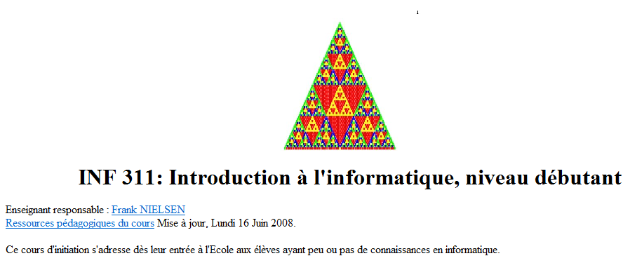
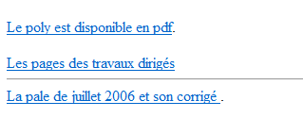
Examen final 2008
(re?)Lire le polycopie:
Chapitres 1 a 11 (130 pages)
Regarder les annales
http://www.enseignement.polytechnique.fr/informatique/INF311/

Slide 4

Agenda
A few algorithms and paradigms:
        - I/ Exhaustive search
        - II/ Greedy algorithm (set cover problems)
        - III/ Dynamic programming (knapsack)
+...Merging two lists...

Slide 5

Linked lists
next=null
public class List
{
int container;
List next; // a reference to a cell of a list
// Constructor List(head, tail)
// Build a cell so that
// the reference to the next cell is the tail
List(int element, List tail)
{
this.container=element;
this.next=tail;
}
}

Slide 6
Merging ordered linked lists
Two linked lists u and v of increasing integers
Build a new linked list in increasing order...
...using only cells of u and v (no cell creation, new)
For example:
U | 3-->6-->8-->null
V | 2-->4-->5-->7-->9-->null
Merge(U,V) | 2-->3-->4-->5-->6-->7-->8-->9-->null

Slide 7
class List
{
int container;
List next;
// Constructor List(head, tail)
List(int element, List tail)
{
this.container=element;
this.next=tail;
}
List insert(int el) // insert element at the head of the list
{
return new List(el,this);
}
void Display()
{
List u=this;
while(u!=null)
{
System.out.print(u.container+"-->");
u=u.next;
}
System.out.println("null");
}
}
Linked lists
U | 3-->6-->8-->null
V | 2-->4-->5-->7-->9-->null

Slide 8
class MergeList
{
//
// Merge two ordered lists
//
static List mergeRec(List u, List v)
{
if (u==null) return v;
if (v==null) return u;
if (u.container < v.container)
{
// Recycle cells/ no new
u.next=mergeRec(u.next,v);
return u;
}
else
{
// Recycle cells/no new
v.next=mergeRec(u,v.next);
return v;
}
}
public static void main(String [] args)
{
List u=new List(8,null);
u=u.insert(6);u=u.insert(3);
u.Display();
List v=new List(9,null);
v=v.insert(7);v=v.insert(5);
v=v.insert(4);v=v.insert(2);
v.Display();
List w=mergeRec(u,v);
w.Display();
}

Slide 9
static List sortRec(List u)
{
int i,l=u.length(), lr;
List l1, l2, split, psplit; // references to cells
if (l<=1)
return u;
else
{
l1=u;
psplit=split=u;
i=0;lr=l/2;
while (i<lr)
{i++;
psplit=split;
split=split.next;}
l2=split; // terminates with a null
psplit.next=null;
return mergeRec( sortRec(l1), sortRec(l2) );
}
}
Sort in O(n log n) time:
Split list in two halves
Recursively apply sorting
Merge ordered lists

Slide 10
public static void main(String [] args)
{
List u=new List(3,null);
u=u.insert(2);
u=u.insert(9);
u=u.insert(6);u=u.insert(1);
u=u.insert(15);u=u.insert(17);
u=u.insert(23);u=u.insert(21);
u=u.insert(19);u=u.insert(20);
u.Display();
List sortu=sortRec(u);
System.out.println("Sorted linked list:");
sortu.Display();
}
20-->19-->21-->23-->17-->15-->1-->6-->9-->2-->3-->null
Sorted linked list:
1-->2-->3-->6-->9-->15-->17-->19-->20-->21-->23-->null

Slide 11
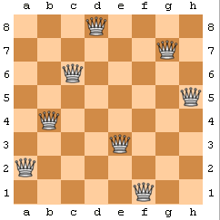
Exhaustive search (Brute force search)
The Eight Queens puzzle:
Max Bezzel (1848, chess player)
Find safe positions of 8 queens
on a 8x8 chessboard
92 distinct solutions
12 non-naive distinct solutions (rotation/symmetry)
Good exercise for designing algorithms
Generalize to n-queens

Slide 12
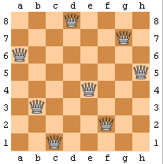
Exhaustive search & Backtracking
Brute force (naive) algorithm:
Check all 64x63x...x57/8! = 283,274,583,552 ?! solutions...
Easy to check that a configuration is not safe
(check horizontal/vertical/diagonal lines)
→ Two queens cannot be on the same line...
Therefore, incrementally place queen i (0...7)
on the i-th row, on the first free column
If there is no more free columns left, then backtrack...

Slide 13
Exhaustive search & Backtracking
Incrementally place queen i (0...7) on the first free column
If there is no more free columns left, then backtrack:
Consider the previous queen position and increment its
column position, etc., etc., etc.
... until we find a solution
(=reach a successful location for queen indexed 7)
queen: 1D Array that specifies the column position
Queen i is located at position (i,queen[i])
(with i ranging from 0 to 7)
search: Static function that returns a/all solution(s).

Slide 14
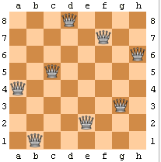
// Are queen (i1,j1) and queen (i2,j2) safe ?
static boolean WrongPos(int i1, int j1, int i2, int j2)
{ // same row?, same col?, same diag?
return (i1==i2 ||
j1==j2 ||
Math.abs(i1-i2) == Math.abs(j1-j2));
}
// Place safely queen i at column j?
static boolean FreeMove(int i, int j)
{
boolean result=true;
for(int k=0;k<i;k++)
result=result&&!WrongPos(i,j,k,queen[k]);
return result;
}
Check for the queens
placed so far
on the chessboard
Static functions to check for collisions

Slide 15
static boolean search(int row)
{
boolean result=false;
if (row==n)
{// Terminal case
DisplayChessboard();
nbsol++;
}
else
{// Exhaustive search
int j=0;
while(!result && j<n)
{
if (FreeMove(row,j))
{
queen[row]=j;
result=search(row+1); // RECURSION/BACKTRACK
}
j++; // explore all columns
}
}
return result;
}
Increment the number
of found solutions
(static class variable)

Slide 16
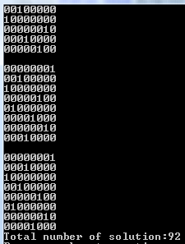
static final int n=8;
static int [] queen=new int[n];
static int nbsol;
static void DisplayChessboard()
{
int i,j;
System.out.println("");
for(i=0;i<n;i++)
{
for(j=0;j<n;j++)
{
if (queen[i]!=j) System.out.print("0");
else System.out.print("1");
}
System.out.println("");
}
}
public static void main(String [] arguments)
{
nbsol=0;
search(0); // Call exhaustive search procedure
System.out.println("Total number of solutions:"+nbsol);
}

Slide 17
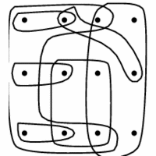
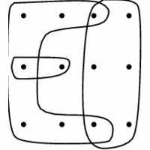
Optimization: Set Cover Problem (SCP)
• Given a graph:
– A finite set X = {1, …, n}
– A collection of subsets of S: S₁, S₂, …, S_{m}
• Problem:
– Find a subset T of {1, …, m} such that U_{j in T} S_{j}= X
– Minimize |T|
Chosen
subsets
Elements of X
Redundant covering
All elements are covered
http://www.cs.sunysb.edu/~algorith/files/set-cover.shtml

Slide 18
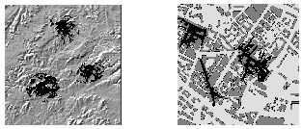
Applications of set cover problems
Wave propagation patterns
of a single antenna
Mountains
City
Choose base stations for quality of service
(cell phone network, etc)
Discretize terrain using a regular grid (set X)
Each position of antenna -> subset of covered grid areas (S)
Minimize the number of chosen antennas (X)

Slide 19
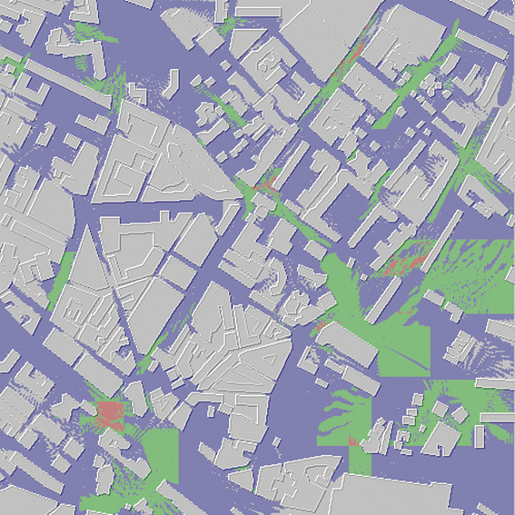
• Given a graph:
– A finite set X = {1, …, n} (=regular grid elements)
– A collection of subsets of S (=antenna patterns)
S₁, S₂, …, S_{m}
• Problem:
– Find a subset T of {1, …, m} (=subset of antennas)
such that U_{j in T} S_{j}= X
– Minimize |T|
Covered once
Covered twice
Covered thrice

Slide 20
A greedy algorithm (algorithme glouton)
GREEDY-SET-COVER(X,S)
1 M ← X // all elements must be covered
2 C ← Ø // chosen subsets
3 while M ≠ Ø do
4 select an Q Є S that maximizes |Q ח M|
5 M ← M – Q
6 C ← C U {Q}
7 return C
Output
Set Cover solution
Input

Slide 21
Visualizing a « range set »
Elements:
X = {1, …, 6}
Subsets:
S1 = {1,2,4}
S2 = {3,4,5}
S3 = {1,3,6}
S4 = {2,3,5}
S5 = {4,5,6}
S6 = {1,3}

Slide 22
Data-structure for the set cover problem
1 2 3 4 5 6
1 1 0 1 0 0 S1
0 0 1 1 1 0 S2
1 0 1 0 0 1 S3
0 1 1 0 1 0 S4
0 0 0 1 1 1 S5
1 0 1 0 0 0 S6
X = {1, …, 6}
S1 = {1,2,4}
S2 = {3,4,5}
S3 = {1,3,6}
S4 = {2,3,5}
S5 = {4,5,6}
S6 = {1,3}
M=6 SUBSETS
N=6 ELEMENTS
Incidence matrix: boolean matrix

Slide 23
class SetCover
{
int nbelements;
int nbsubsets;
boolean [][] incidenceMatrix;
//Constructor
SetCover(int nn, int mm)
{
this.nbelements=nn; this.nbsubsets=mm;
incidenceMatrix=new boolean[nbsubsets][nbelements];
for(int i=0;i<nbsubsets;i++)
for(int j=0;j<nbelements;j++)
incidenceMatrix[i][j]=false;
}
void SetSubsets(int [] [] array) // Set incidence matrix
{for(int j=0;j<array.length;j++)
{for(int i=0;i<array[j].length;i++)
incidenceMatrix[j][array[j][i]]=true;
}
}
}

Slide 24

void Display()
{
for(int i=0;i<nbsubsets;i++){
for(int j=0;j<nbelements;j++)
if (incidenceMatrix[i][j]) System.out.print("1");
else System.out.print("0");
System.out.println("");
}
}
public static void main(String [] args)
{
int [][] subsets={{0,1,3},{2,3,4}, {0,2,5},{1,2,4},{3,4,5},{0,2}};
SetCover setcover=new SetCover(6,6);
setcover.SetSubsets(subsets);
System.out.println("Set cover problem:");
setcover.Display();
}

Slide 25
static boolean [] GreedySCP(SetCover problem)
{
boolean [] result=new boolean[problem.nbsubsets];
int cover=0; int select;
for(int i=0;i<problem.nbsubsets;i++) // initially no subsets
result[i]=false;
while(cover!=problem.nbelements)
{
// Choose largest not-yet covered subset
select=problem.LargestSubset();
result[select]=true;
// Update covered matrix
cover+=problem.Cover(select);
// Update incidence matrix
problem.Update(select);
System.out.println("Selected "+select+" Number of covered elements="+cover);
problem.Display();
}
return result;
}
Greedy algorithm

Slide 26
// Number of covered element by subset i
int Cover(int i)
{
int nbEl=0;
for(int j=0;j<nbelements;j++)
if (incidenceMatrix[i][j]) ++nbEl;
return nbEl;
}
// Report the current largest subset
int LargestSubset()
{
int i, nbel, max, select;
max=-1;select=-1;
for(i=0;i<nbsubsets;i++)
{
nbel=Cover(i);
if (nbel>max) {max=nbel; select=i;}
}
return select;
}
Methods of class
SetCover

Slide 27
Methods of class
SetCover
// Update the incidence matrix
void Update(int sel)
{
int i,j;
for(i=0;i<nbsubsets;i++)
{
if (i!=sel) //use sel below so don't modify it
{
for(j=0;j<nbelements;j++)
if (incidenceMatrix[sel][j])
incidenceMatrix[i][j]=false;
}
}
// Remove the chosen subset as well
for(j=0;j<nbelements;j++)
incidenceMatrix[sel][j]=false;
}

Slide 28
Set cover problem:
110100
001110
101001
011010
000111
101000
Selected 0 Number of covered elements=3
000000
001010
001001
001010
000011
001000
Selected 1 Number of covered elements=5
000000
000000
000001
000000
000001
000000
Selected 2 Number of covered elements=6
000000
000000
000000
000000
000000
000000
Solution: 0 1 2
public static void main(String [] args)
{
int [] [] subsets ={{0,1,3},{2,3,4},
{0,2,5},{1,2,4},
{3,4,5},{0,2}};
SetCover setcover=new SetCover(6,6);
setcover.SetSubsets(subsets);
System.out.println("Set cover problem:");
setcover.Display();
boolean [] solution=GreedySCP(setcover);
System.out.print("Solution:");
for(int i=0;i<setcover.nbsubsets;i++)
if (solution[i]) System.out.print(" "+i);
System.out.println("");
}

Slide 29

Optimization bounds for greedy algorithm
CoptT<= Cgreedy <= ApproximationFactor x Copt
Upper bound:
Approximation factor is at most H(n)<=log(n)
2 sets is optimal solution
but greedy chooses 3 sets here
Lower bound:
Approximation factor can be as big as Omega(log(n))
Difficult to approximate: cannot beat (1-eps)Opt unless P=NP

Slide 30
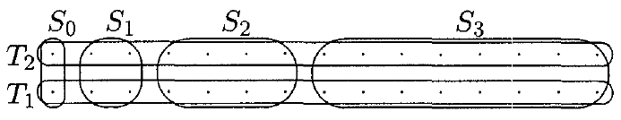
int [] [] subsets={{0,1,2,3,4,5,6},{7,8,9,10,11,12,13},
{0,7},{1,2,8,9},{3,4,5,6,10,11,12,13}};
SetCover setcover=new SetCover(14,5);
Set cover problem:
11111110000000
00000001111111
10000001000000
01100000110000
00011110001111
Selected 4 Number of covered elements=8
11100000000000
00000001110000
10000001000000
01100000110000
00000000000000
Selected 3 Number of covered elements=12
10000000000000
00000001000000
10000001000000
00000000000000
00000000000000
Selected 2 Number of covered elements=14
00000000000000
00000000000000
00000000000000
00000000000000
00000000000000
Solution: 2 3 4
Etc...
Easy to build generic examples
where greedy does not behave well
with O(log n) approximation ratio

Slide 31
Knapsack problem (sac a dos)
(First version)
Given:
A set of n Objects O1, ..., On with
corresponding weights W1, ..., Wn
And a bag (knapsack) of capacity W
Find:
All the ways of choosing objects to fully fill the bag

Slide 32
n=4
2^4=16
1 1 1 1
1 1 1 0
1 1 0 1
1 1 0 0
1 0 1 1
1 0 1 0
1 0 0 1
1 0 0 0
0 1 1 1
0 1 1 0
0 1 0 1
0 1 0 0
0 0 1 1
0 0 1 0
0 0 0 1
0 0 0 0
Filling the knapsack
Need to enumerate all possibilities:
n objects => 2^n choices
(2, 4, 8, 16, 32, 64, ...)
How to program this?
n is a variable
(cannot fix the number of nest loops)
Need to enumerate all combinations:
= Exhaustive search

Slide 33
Enumerating: A recursive approach
static void Display(boolean [] tab)
{
for(int i=0;i<tab.length;i++)
if (tab[i]) System.out.print("1 ");
else
System.out.print("0 ");
System.out.println("");
}
static void Enumerate(boolean [] selection, int pos)
{
if (pos==selection.length-1)
Display(selection);
else
{
pos++;
selection[pos]=true;
Enumerate(selection,pos);
selection[pos]=false;
Enumerate(selection,pos);
}
}
public static void main(String[] args)
{
int n=4;
int i;
boolean [] select=new boolean[n];
for(i=0;i<n;i++)
select[i]=false;
Enumerate(select,-1);
}

Slide 34
Fully filling the knapsack
final static int n=10; // 10 objects
static int [] weight={2,3,5,7,9,11,4,13,23,27};
static void SolveKnapSack(boolean [] chosen, int goal, int i, int total)
{
numbercall++; // keep track of total number of calls
if ((i>=chosen.length)&&(total!=goal)) return;
if (total==goal)
{ Display(chosen, goal);
numbersol++; // total number of solutions
}
else
{
chosen[i]=true;// add item first
SolveKnapSack(chosen,goal,i+1,total+weight[i]);
chosen[i]=false; // and then remove it
SolveKnapSack(chosen,goal,i+1,total);
}
}

Slide 35
final static int n=10; // 10 objects
static int [] weight={2,3,5,7,9,11,4,13,23,27};
public static void main(String [] args)
{
int totalweight=51;
numbersol=0;
numbercall=0;
System.out.println("Knapsack:");
boolean [] chosen=new boolean[n];
SolveKnapSack(chosen, totalweight, 0, 0);
System.out.println("Total number of
solutions:"+numbersol);
System.out.println(" #calls="+numbercall);
}
Knapsack:
2+3+5+7+11+23+0=51
2+5+7+9+11+4+13+0=51
2+5+4+13+27+0=51
2+7+11+4+27+0=51
2+9+4+13+23+0=51
2+9+13+27+0=51
3+5+7+9+4+23+0=51
3+5+7+9+27+0=51
3+5+7+13+23+0=51
3+5+9+11+23+0=51
7+4+13+27+0=51
9+11+4+27+0=51
11+4+13+23+0=51
11+13+27+0=51
Total number of solutions:14
#calls=2029

Slide 36
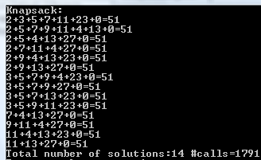
Exhaustive search: Branch & bound
static void SolveKnapSack(boolean [] chosen, int goal, int i, int total)
{
numbercall++;
if (total>goal) return; // cut
if ((i>=chosen.length)&&(total!=goal)) return;
if (total==goal)
{ Display(chosen, goal);
numbersol++;
}
else
{
chosen[i]=true;// add item first
SolveKnapSack(chosen,goal,i+1,total+weight[i]);
chosen[i]=false; // and then remove it
SolveKnapSack(chosen,goal,i+1,total);
}
}
Stop recursion if we already
exceed the weight amount

Slide 37
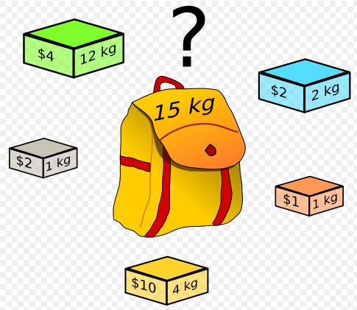
Knapsack: Fundamental optimization problem
Given a bag capacity (15 kg),
maximize the utility (price) of selected objects
(NP-hard problem)

Slide 38





Knapsack optimization problem
Given
weights
utility
Maximum weight (capacity of bag)
Optimize
such that
(Maybe there exists several solutions)

Slide 39

Knapsack: Example
= 12
8 objects
weight
utility

Slide 40
Dynamic programming (Knapsack)
Dynamic programming computes a table...
... from which a solution can be retrieved.
Requires a relational equation to deduce
solutions progressively.

Slide 41
Dynamic programming (Knapsack)
Let u(i,j) be the maximum utility by
taking objects in {1, ...,i} with total weight <=j
If i=1 then u(i,j)=0 for j<p1
        and u(i,j)=A1 for j>=P1
If i>1
u(i,j)=max( u(i-1,j) , u(i-1,j-Pi)+Ai )
Do not take object Oi
Take object Oi:
gain Ai
but leave room: Pi

Slide 42
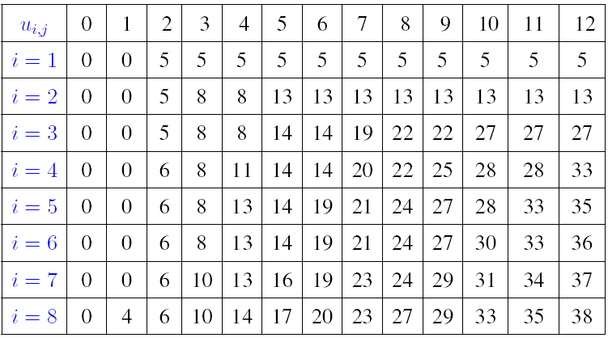
weight
Pmax= 12
utility
u(i,j)=max( u(i-1,j) , u(i-1,j-Pi)+Ai )
Optimization result: Maximum utility, given Pmax

Slide 43
Reading back: Solution
Choose (38=33+5, 2-2=0)
5=5 do not choose
5=5 do not choose
Choose (33=27+6,4-2=2)
Choose (27=14+13,8-4=4)
24=24, do not choose
Choose (14, 11-3=8)
Choose (4, 11)
Choose (Utility=0, Pmax=12)
From the table, chosen solution: O8, O7, O5, O4, O1

Slide 44
static int nbObjects=8;
static int [] weight={2,3,5,2,4,6,3,1};
static int [] utility={5,8,14,6,13,17,10,4};
static int weightmax=12;
static int [] [] array;
static void SolveDP()
{
int i,j;
array=new int[nbObjects][weightmax+1];
// initialize the first row
for(j=0;j<=weightmax;j++)
if (j<weight[0]) array[0][j]=0;
else array[0][j]=utility[0];
// for all other rows
for(i=1;i<nbObjects;i++)
{
for(j=0;j<=weightmax;j++)
if (j-weight[i]<0) array[i][j]=array[i-1][j];
else
array[i][j]=max( array[i-1][j],
array[i-1][j-weight[i]]+utility[i]);
}
}

Slide 45
static void InterpretArray()
{
int i,u,w;
u=0;
w=weightmax;
for(i=nbObjects-1;i>=1;i--)
{
if (array[i][w]!=array[i-1][w])
{System.out.print((i+1)+" ");
w=w-weight[i];
u=u+utility[i];
}
}
if (array[0][w]!=0);
{System.out.println("1");
w=w-weight[0];
u=u+utility[0];
}
System.out.println("Cross check:"+u+" remaining weight "+w);
}

Slide 46
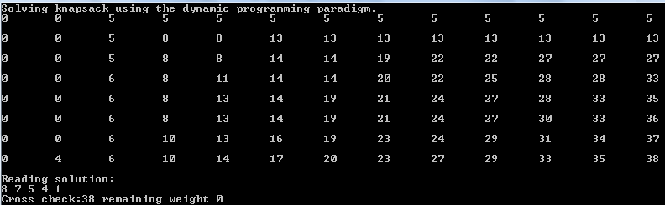
public static void main(String[] args)
{
System.out.println("Solving knapsack using the dynamic
programming paradigm.");
SolveDP();
Display();
System.out.println("Reading solution:");
InterpretArray();
}

Slide 47
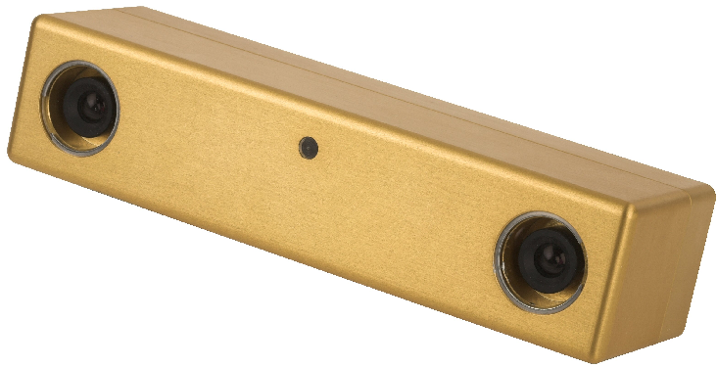
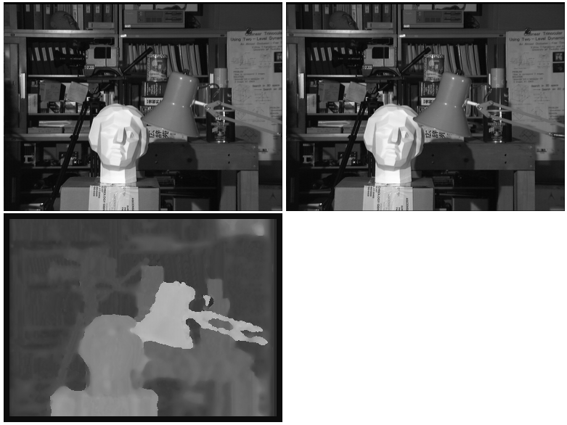

Dynamic programming: binocular stereo matching
Dynamic
Programming
Benchmark:
http://vision.middlebury.edu/~schar/stereo/web/results.php

Slide 48
Optimization: A brief summary
Exhaustive search: recursion but O(2^n) complexity
Can be improved by backtracking (cuts)
Greedy algorithm: Polynomial O(n^3)
but yields an approximation
Dynamic programming yields an exact solution
but requires O(weightxobjects) time
(weights should not be too bigs)

Slide 49


Last but not least: Java applets!
Applets are special java programs...
...that can run into your favorite Internet browser
You need to:
(1) write a web page with <APPLET> </APPLET> tags
(2) write and compile the Java applet code (javac)
Advantages of applets are:
(1) to be accessible worldwide
(2) to provide graphics

Slide 50
import java.awt.*;
import java.applet.*;
class Point2D
{double x,y;
Point2D()
{this.x=300.0*Math.random();
this.y=300.0*Math.random();}}
public class AppletINF311 extends Applet {
final static int n=100;
static Point2D [] set;
public void init() {
int i;
set=new Point2D[n];
for(i=0;i<n;i++)
set[i]=new Point2D();}
public void paint(Graphics g) {int i;
for(i=0;i<n;i++)
{
int xi, yi;
xi=(int)set[i].x; yi=(int)set[i].y;
g.drawRect(xi, yi,1,1);
}
g.drawString("INF311!", 50, 60 );
}
}

Slide 51
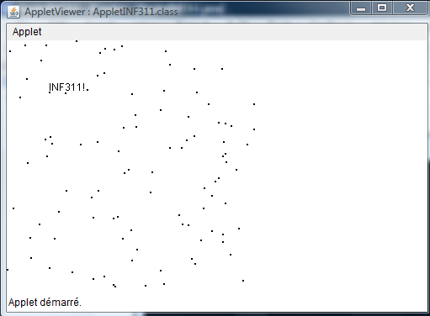
<APPLET
code = "AppletINF311.class"
width = "500"
height = "300"
>
</APPLET>
Java applets

Slide 52
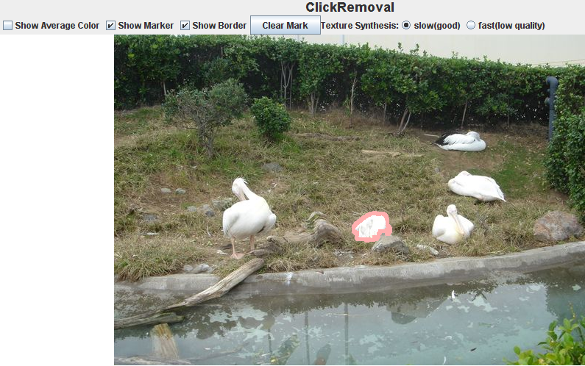
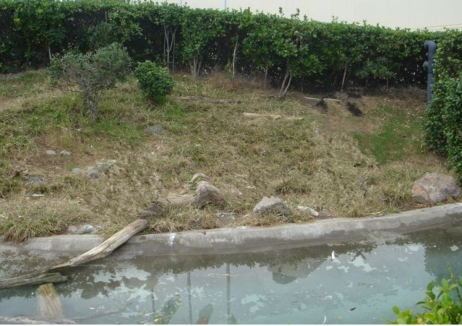
Java applets for online demos...
Hallucination (mirage)
Two technologies in use:
Image segmentation
Texture synthesis (hole filling)
Try it !!! http://www.sonycsl.co.jp/person/nielsen/ClickRemoval/
F. Nielsen, R. Nock ClickRemoval: interactive pinpoint image object removal. ACM Multimedia 2005

Slide 53
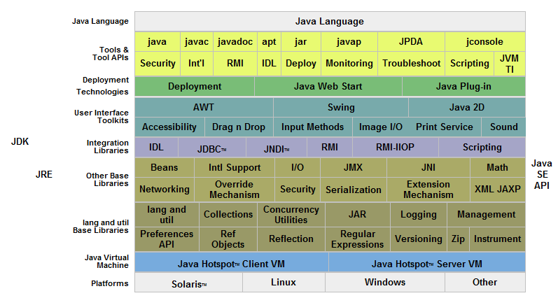
There is much more in Java!
JDKTM 6 Documentation

Slide 54
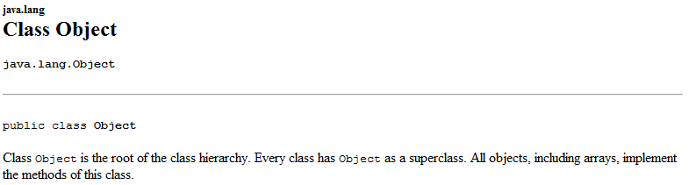
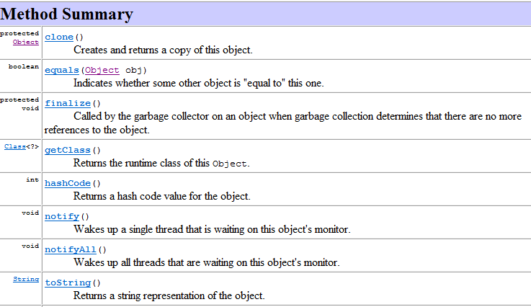
A glimpse at object inheritance
All objects inherit from the topmost object: Object
...meaning some methods are already predefined
Can overwrite the
method toString

Slide 55
A glimpse at object inheritance
Object
public String toString()
(superclass)
class Point2D
{double x,y;
// Constructor
Point2D(double xi, double yi)
{this.x=xi;this.y=yi; }
// Overrides default method
public String toString()
{return "["+x+" "+y+"]"; }
}
class SuperClass
{
public static void main(String [] a)
{
Point2D myPoint=new Point2D(Math.PI, Math.E);
System.out.println("Point:"+myPoint);
}
}
Point2D
public String toString()

Slide 56
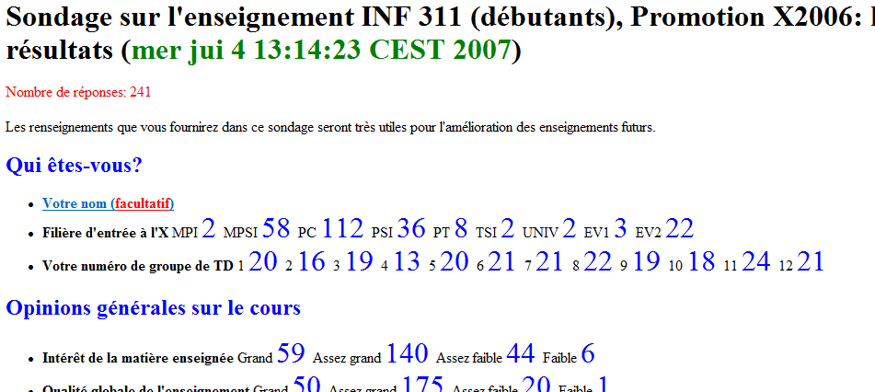
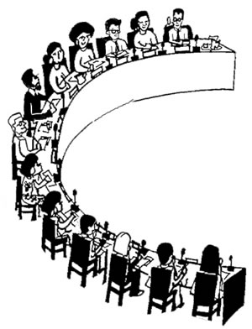

http://www.enseignement.polytechnique.fr/profs/informatique/Robert.Cori/Questionnaire/resultatSondage.html
Please answer the poll INF311
(in TD10)
Inspired by Rober Cori...

Slide 57
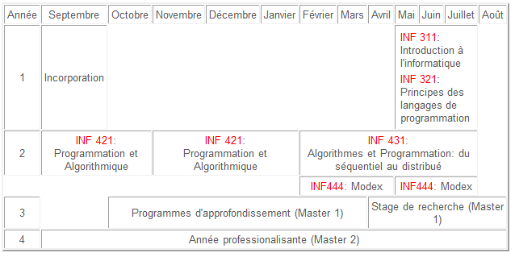

Merci et a bientot!
http://www.enseignement.polytechnique.fr/informatique/
M1 Informatique, thematique Image
Colloquium Nov. on visual computing.

