Slide 1


INF 311
Introduction to programming and
computer science
Lecture 2: constants, booleans
loops, control structures
Frank Nielsen
nielsen@lix.polytechnique.fr
Thursday, May 15 2008

Slide 2
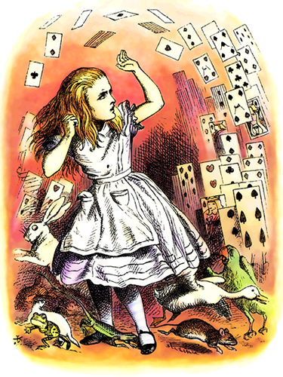


Recap of Lecture 1
Variables, Assignments, Expressions
TDs: Frequently Asked Questions (FAQs)
TD: travaux diriges
FAQs: Foire aux questions

Slide 3


Upper case versus Lower case
Java distinguishes between
uppercases (A..Z) and lowercases (a..z)
Unix differentiates upper/lower case filenames
class UpperLowerCase
{
public static void main (String arguments[])
{
int MyVar;
// this variable is different from MyVar
int myvar;
// Generate a syntax error at compile time:
// cannot find symbol variable myVar
System.out.println(myVar);
}
}

Slide 4
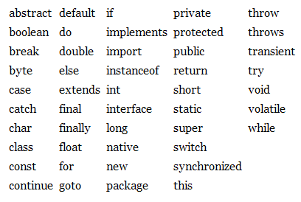
Reserved keywords
You cannot choose reserved keywords for variable names:
class ReservedKeyword
{public static void main (String arg[]){
double x,y;
// Generate a syntax error:
// "not a statement"
int import;
}
}
Reserved keywords in Java:

Slide 5
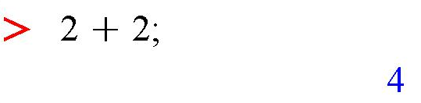

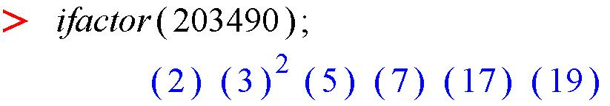

Displaying versus Computing
You need to display if you'd like to see the result of
evaluating an expression
System.out.println displays on the console with a return carriage
System.out.print displays on the console without a return carriage
Confusing in Maple:
Interpreter: compute:display
Java is not Maple nor SciLab!

Slide 6
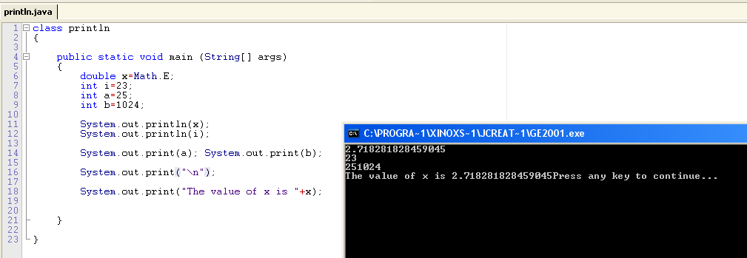
Output: Displaying values & messages
System.out.println(stringname): displays a string with a return carriage
System.out.print(stringname): displays a string without return line
System.out.println(value): converts (cast) numerical value into a string
                and displays it
System.out.println(''The value of x is ''+x):
Converts the numerical value of x into a string and concatenate that string
with the constant string '' The value of x is ''
Display=write to console or to text file if it is redirected (as in java toto > result.txt )

Slide 7
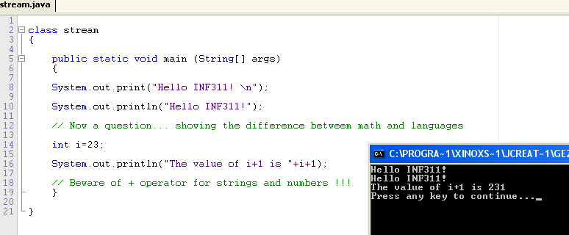

More on System.out.print[ln]
Equivalences of stream output:
System.out.print(''\n'') = System.out.println('''');
System.out.print(''Hello INF311 \n'') = System.out.println(''INF311'');
Priority order+casting operations...

Slide 8


Display: String concatenations...
Cumbersome to type several
System.out.println and System.out.print
Shortcut: String concatenations « + »...
Operator (expression)
int a=1, b=-2;
System.out.print("a="); System.out.print(a);
System.out.print(" b="); System.out.println(b);
System.out.println("a="+a+" b="+b);
String s1="Lecture in", s2=" Java";
String s=s1+s2;// string concatenation
System.out.println(s);

Slide 9




Reading input in Java: Class TC
Writing on the console using System.out.print[ln]
But unfortunately no equivalent for System.in !!!
There are good reasons that you'll understand once you master Java...
We created tailored input functions for reading int, double, etc.
(proprietary code of Ecole Polytechnique)
System.out.print("Input an integer (+<Enter>):");
int a=TC.lireInt();
System.out.print("Input a real (+<Enter>):");
double b=TC.lireDouble();
System.out.println("I read:"+a+" "+b);
http://www.enseignement.polytechnique.fr/informatique/INF311/TD_08/index.html

Slide 10
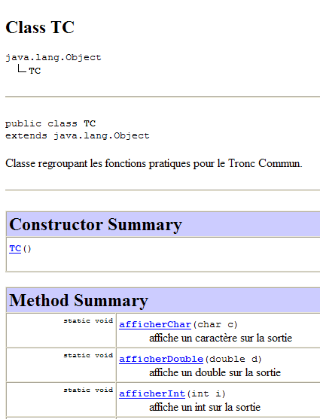

General purpose class TC
1. Download the class TC from:
http://www.enseignement.polytechnique.fr/informatique/INF311/TD_08/index.html
Courtesy of Julien Cervelle (and many others):
http://www.enseignement.polytechnique.fr/profs/informatique/Julien.Cervelle/TC/
http://www.enseignement.polytechnique.fr/profs/informatique/Julien.Cervelle/TC/TC.html
2. Compile it:
prompt% javac TC.java
Press Enter!!!
It produces a file named TC.class
(Java byte code)
Java source code are in *.java, compiled code in *.class

Slide 11




Source code .java vs byte code .class
Java source code are in *.java, compiled code in *.class
Always upload in TD the java source code: File.java !!!
%prompt javac TestTC.java
%prompt javac TC.java
TestTC.class
(byte code)
TC.class
(bytecode)
%prompt java TestTC
JVM
Java Virtual Machine
JRE (Runtime env.)
Microprocessor
Executing a java program invokes loading the java byte code .class to the JVM
The Java Virtual Machine (JVM) translates instructions to microprocessor instructions

Slide 12
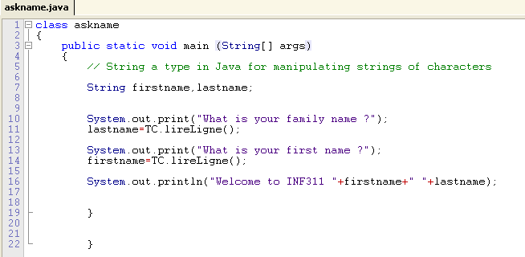

Java programs with input and output
I/O= Input/output
More with class TC : TC.lireLigne();
(gestions des entrees/sorties simplifiees en francais)

Slide 13


Input/output (I/O) redirections
The console is the default for both input and output
Redirect input/output from/to text files as well using « < » and « > »
class Redirection{
public static void main(String args[])
{
int integer=TC.lireInt();
double real=TC.lireDouble();
System.out.println("Integer="+integer);
System.out.println("Real="+real);
}
}
Unix philosophy
(redirections+pipes)
Console: prompt% java Redirection

Slide 14

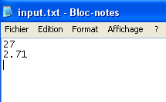
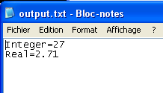
Input/output (I/O) redirections
Redirect input/output from/to text files as well using « < » and « > »
Create a file text input.txt and
type an integer followed by a real
[user%machine] java Redirection < input.txt
prompt%java Redirection < input.txt > output.txt
Evaluation for
TDs/Pales
output.txt

Slide 15
Conditional structure: IF ... ELSE ...
From Exercice 3 of TD1
int h1 = 1, m1 = 56, s1 = 15;
System.out.print("hh mm ss : ");
int h2 = TC.lireInt();
int m2 = TC.lireInt();
int s2 = TC.lireInt();
int hs1 = 3600*h1 + 60*m1 + s1;
int hs2 = 3600*h2 + 60*m2 + s2;
int d=hs2-hs1;
if (d>0) System.out.println("larger");
else
if (d<0) System.out.println("smaller");
else System.out.println("identical");
Boolean predicate
true or false
Parenthesis (blocks) of IF
Elif in Maple is « else if » in Java (no shortcut)

Slide 16

Syntax, compilation, and bugs
A syntaxically correct program compiled but:
It does not mean that it is bug free!
A bug yield an unexpected result, or worse a system crash
class QuadraticEquation
{
public static void main(String[] arg)
{
double a,b,c; // choose a=1, b=1, c=1
a=TC.lireInt();
b=TC.lireInt();
c=TC.lireInt();
double delta=b*b-4.0*a*c;
double root1, root2;
// BEWARE: potentially Not a Number (NaN) for neg. discriminant!
root1= (-b-Math.sqrt(delta))/(2.0*a);
root2= (-b+Math.sqrt(delta))/(2.0*a);
}
}

Slide 17


Declaring constants
/* Declare a constant (not a variable)
to bypass using Math.PI */
final double PI = 3.14; // constant
Numeric bug in predicate !
// Constant
final double PI = 3.14;
int a=1;
double b=a+PI;
if (b==4.14) // Equality test are dangerous!!!
System.out.println("Correct result");
else
{System.out.println("Incorrect result");
System.out.println("a="+a+" b="+b+" PI="+PI);
}
}

Slide 18

Syntax and compilation
Syntax errors are easy program bugs (mistyping?)
...But syntaxically correct program may be difficult to understand
int i=3;
// syntax below is valid!
int var=i+++i;
What is the value of var?
Protecting Java Source with Code obsfucation
Avoid reverse engineering of applications

Slide 19

Lecture videos on Internet
rtsp://helixium.polytechnique.fr/ecole/tc/Nielsen_amphi1.rm
Download free Real Player

Slide 20





Java at home (in the dorms, caserts)
Poll ! ... (laptop, Java, Windows)
1. Install the free Java Development Kit (JDK)
http://java.sun.com/javase/downloads/index.jsp
2. Install Integrated Development Env. Jcreator v3.5
Live Demo!
http://www.jcreator.com/
Basic guide at: http://www.dix.polytechnique.fr/INF311/

Slide 21

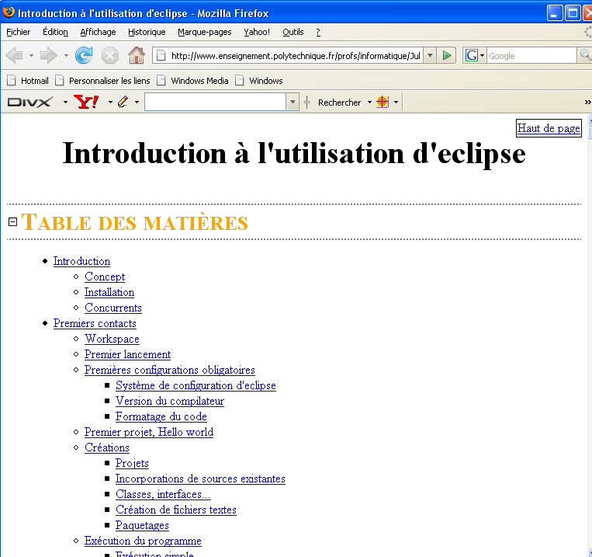
Click on telecharger (download)
http://www.polytechnique.fr/eleves/
Introduction to Eclipse
http://www.enseignement.polytechnique.fr/profs/informatique/Julien.Cervelle/eclipse/

Slide 22
Points Administratifs
Utiliser le tutorat, semaine prochaine
Choisir les delegues
          nielsen@lix.polytechnique.fr
INF311 <-> INF321
Jeudi 22 Mai, 13h30-15h30
Jeudi 5 Juin, 13h30-15h30
Jeudi 12 Juin, 13h30-15h30
Jeudi 19 Juin, 13h30-15h30

Slide 23

Today...
Lecture 2: constants, booleans
loops, control structures

Slide 24

Program: Data,computations + workflow
The control structures define the set of instructions being executed
(aiguillage des trains)
For example, a branching condition:
In Java, we do not use the word then
if (a<b) [then]
c=a; // Do-something-1
else
c=b; // Do-something-2
There are two potential instructions paths depending on the predicate:
a<b, -> c=a;
or
a>=b, -> c=b;
c is selected as
the minimum
of a and b

Slide 25

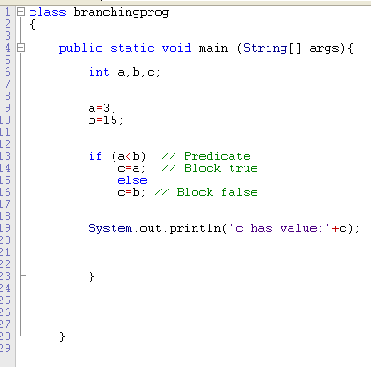

Controling program workflow
Two kinds:
Branching tests: (if else, switch)
Repeat structure: Loop (while, for)
Predicate: true or false
if there is a numerical error at
that stage we take the wrong
flow and this yields a bug, with
potential desastrous effects.
Key difference with maths.

Slide 26

Annotating programs: comments!
Writing comments is good for (1) yourself and
for (2) others to proofread and debug your code
In fact, there are some paradigms to write in a single file both
the clean documentations, and
the code.
Exempla gratia (e.g.) cweb, Literate programming, etc.
D. Knuth
http://www.literateprogramming.com/
In INF311, we rather write short programs, so we consider the standard comments:
// This is a single line comment
/* I can also write comments on
several lines
by using these delimiters */

Slide 27
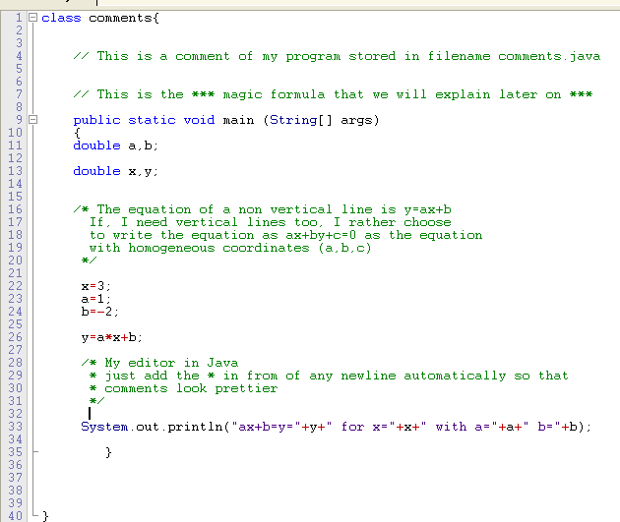

Comments: single versus multiple lines
(Jcreator IDE)

Slide 28
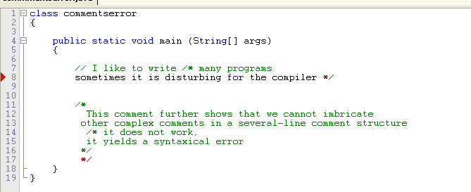

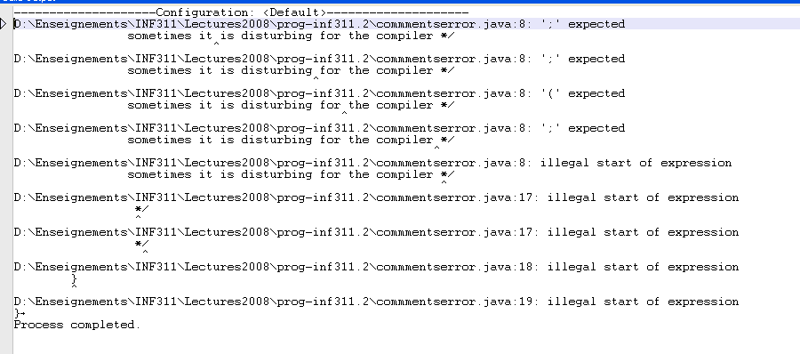
Comments...
with errors!
The compiler is verbose: Try to fix the first error first (greedy approach)

Slide 29
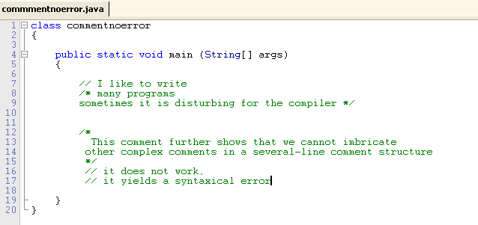

Comments...
repaired... = Syntaxically correct program
Do not forget:
Writing good comments is as important as writing source code
You will thank yourself for doing this once you look back at your programs months later

Slide 30

Structures of Java programs
Comments // or /* */
Constants (Math.PI, etc.)
Variables (typed) with valid identifiers (not reserved keyword)
Operators +,-,/,%, etc. for expressions
Reserved language keywords: if, for, while, etc.
A set of instructions is called a block
Blocks can be delimited by parenthesis {Block}
{ // This is a block
// (non control structure inside it)
var1=Expression1;
var2=Expression2;
var3=Expression3;
...
}

Slide 31
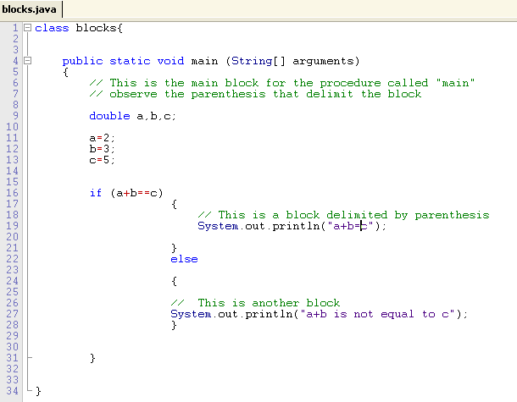
Structures of java programs: Blocks
Principal block
Block 1
Block 2

Slide 32
Conditional structures:
if (predicate) Block1 else Block2
Essential control structure for executing a (block of) operations if a condition is true
(or false for the else-Block)
if (condition) Instruction
if (condition) {
Instruction1;
Instruction2;
Instruction3;
... ;
}
if (condition)
BlockForTrueCase
else
BlockForFalseCase
predicate
Block=sequence of instructions

Slide 33
Conditional structures: Compact form
if (predicate) Inst1 else Inst2
Conditional instruction for singe instruction block can be called
using the ternary operator (3 operands) « ? : »
BoolOperand1 ? TypeOperandTrue2 : TypeOperandFalse3
double x1=Math.PI;
double x2=Math.E;
double min=(x1>x2)? x2 : x1; // min value
double diff= (x1>x2)? x1-x2 : x2-x1; // absolute val.
System.out.println(min+" difference with max="+diff);
2.718281828459045 difference with max=0.423310825130748

Slide 34
Instructions and conditions
Instructions always terminate with a semi colon ;
    (except potentially the last one in a block)
    A set of instructions encapsulated in { } is a block
    The block has the same syntax as an instruction
    Variables can be declared in a block
    A condition is a boolean expression
    that returns either true or false :
    = A predicate

Slide 35
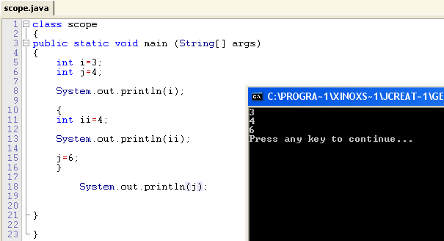
Variables and blocks
Very different from C++!
(Java better controls the syntax of programs, better semantic)
We cannot declare twice a same variable in encapsulated block

Slide 36
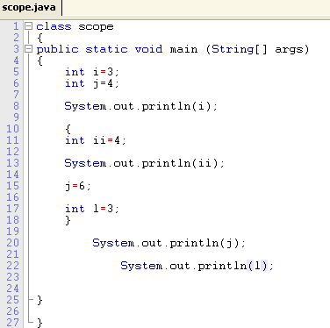
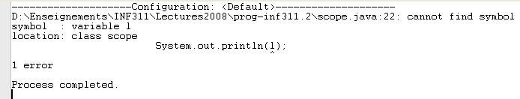
Variables and blocks: Scopes
Error!!! Variable l is not defined in the block it here

Slide 37

Boolean operators for comparisons
a==b Test of equality (for basic types)
a!=b Test for difference [ equivalent to ! (a==b) ]
Inequalities:
a<b True if and only if (iff.) a<b
a<=b True iff. a<b or a=b
a>b True iff. a>b
a>=b True iff. a>b or a=b
Beware: a=b is assignment not test (test of equality is ==)
Typing helps you avoid this mistake:
int a=3;
if (a=3) System.out.println("THEN-PART");
else System.out.println("ELSE-PART");
incompatible types found : int
required: boolean

Slide 38
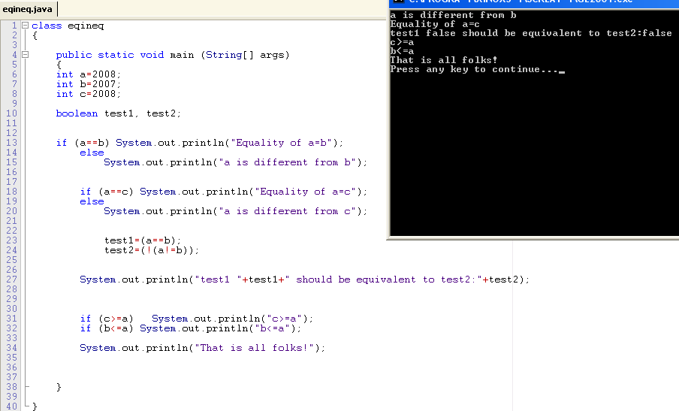
Boolean operators for comparisons

Slide 39
Boolean operators for comparisons
Boolean comparisons are of type boolean
class Boolean{
public static void main(String[] args)
{
boolean b1 = (6-2) == 4;
boolean b2 = 22/7 == 3+1/7.0 ;
boolean b3 = 22/7 == 3+ 1/7;
System.out.println(b1); // true
System.out.println(b2); // false
System.out.println(b3); // true
}
}
(6-2) == 4 evalutes to true but 22/7 == 3+1.0/7 evaluates to false

Slide 40
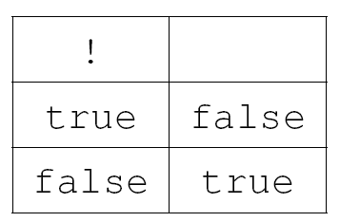
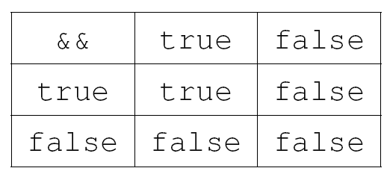
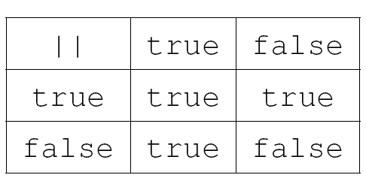
More on boolean operators: Tables
Unary operator:
NOT !
Binary connector operators:
AND &&
OR ||

Slide 41
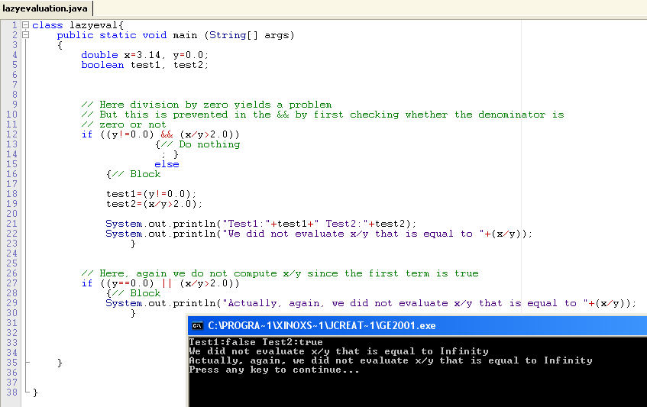
Priority order for boolean expressions
Lazy evaluation of boolean binary operators:
If a is false we do not need to evaluate b in a && b
If a is true we do not need either to evaluate b in a || b

Slide 42

Few remarks
Key difference between assignment (=) and logical test ==
Do not forget the semi-colon at the end of Instructions;
Indent your code and structure it into blocks for clarity
Think of nested if control structures
if (condition1)
{BlockT1;}
else
{
if (condition2)
{BlockT2;}
else {BlockF2;}
}
Nested if

Slide 43
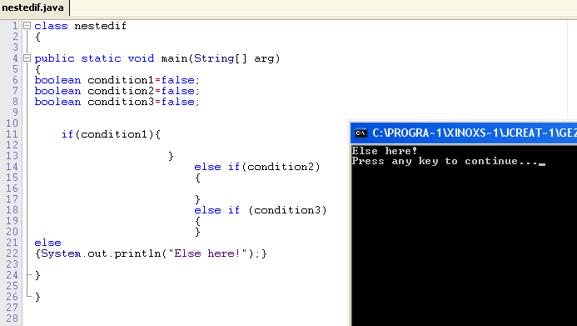
Nested conditionals (nested if)
Set curly brackets { } to increase code readibility

Slide 44
Loops: While/do for iterations
Structure for iterating
Process a single instruction or a block until the given boolean expression is true
(thus may loop forever... and program may not terminate)
Boolean expression is re-evaluated at each round
We can exit the loop at any time using the keyword break;
while (boolean_expression)
single_instruction;
while (boolean_expression)
{ block_instruction;}
do
{ block_instruction;}
while (boolean_expression);
At least, the loop
is executed once.

Slide 45
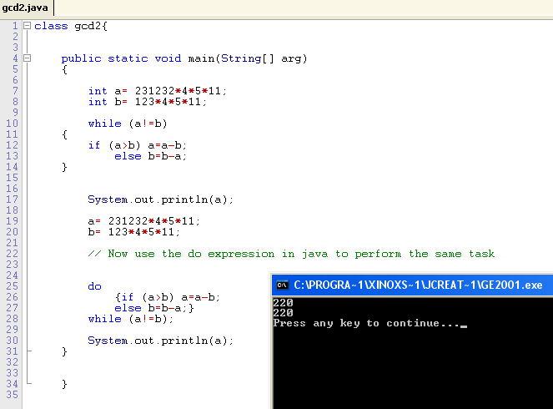
Loops: Euclid' GCD algorithm
Greatest common divisor of two integers a and b
While
Do

Slide 46
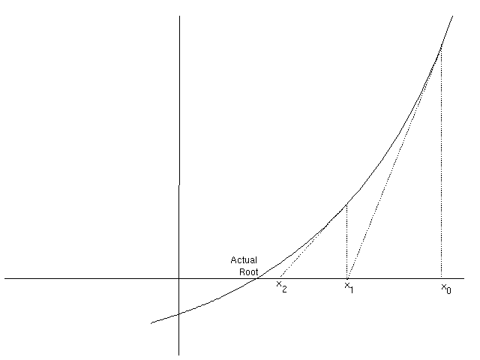
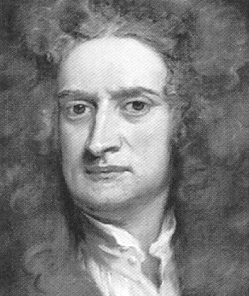

Loops: Newton's method
Converge to a root of the function f
Use to calculate the square root function
f(x)=x*x-a
double a = 2.0, x, xold;
x = a;
do{
xold = x;
// compute one iteration
x = (xold+a/xold)/2;
System.out.println(x);
} while(Math.abs(x-xold) > 1e-10);
Setting
y=f'(xprev)(x-xprev)+f(xprev)=0
give new value for x
1.5
1.4166666666666665
1.4142156862745097
1.4142135623746899
1.4142135623730949

Slide 47


do
{ block_instruction;}
while (boolean_expression);
Loops:
Syracuse and termination conjecture
Replace x by x/2 (for x odd) and x by 3x+1 (for x even)
Start from any given x, does the replacing alway terminate (x=1)
do{
if ((n%2)==0)
n/=2;// divide by 2
else
n=3*n+1;
} while (n>1);
Nobody knows whether this programs stops for any given input (open problem)
No counter example from simulation so far but no termination proof too!

Slide 48

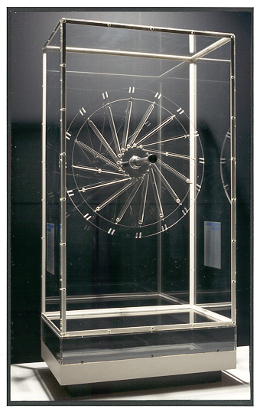
Loops: Perpetual movements...
Easy to do when programming.... ESC key or Control-C to escape!
Always ensure that loops terminate when programming
int i=0;
while (true)
i++;
for(i=0;i>=0;i++)
; // common mistyping error
for(i=0;i>=0;i++)
{ }

Slide 49
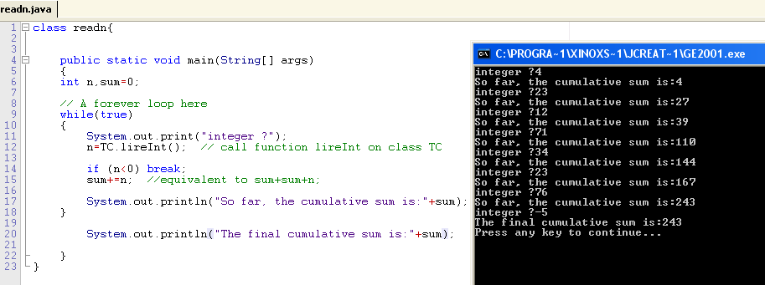
Loops: Breaking the loop with break
Read a sequence of non-negative natural integers and
compute the cumulative sum of the sequence.
Observe the shortcut:
sum+=n; that is equivalent to assignment sum=sum+n;

Slide 50

Loops: For... iterations
Allows one to execute a block of instructions, and
Increment the counter at each round
Semantically equivalent to a while loop
Often used for program readibility (e.g., for a range of integers)
for(instruction1; boolean_condition; instruction2)
block_instruction3;
Equivalence with While construction
instruction1;
while (boolean_condition)
{block_instruction3;
instruction2;}

Slide 51
Loops: For... iterations
for(instruction1; boolean_condition; instruction2)
block_instruction3;
class ForLoop
{
public static void main(String args[])
{
int i, n=10;
int cumulLoop=0;
for(i=0;i<n;i++) cumulLoop+=i;
int cumul=(n*(n-1))/2; // closed-form solution
System.out.println(cumulLoop+" closed-form:"+cumul);
}
}
We get 45

Slide 52

Loops: For... iterations (unlooping)
int cumulLoop=0;
for(i=0;i<n;i++) cumulLoop+=i;
int cumulLoop=0;
i=0; // Initialization
cumulLoop+=i;
i++; // i=1 now
// i<n so we continue...
cumulLoop+=i;
i++; // i=2 now
// i<n so we continue...
cumulLoop+=i;
...
cumulLoop+=i; // i=n-1
i++; // i=n now
// i is not i<n so we stop...
Unlooping...

Slide 53
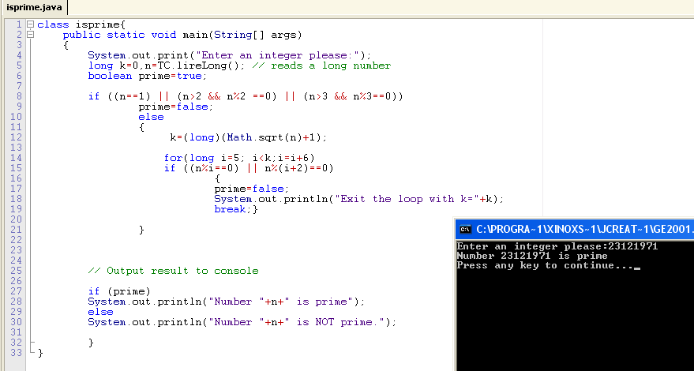

Examples of for loop: IsPrime
Program that determines whether a given integer is prime or not.
209=11x19

Slide 54
Multiple choices: switch
Avoid nested if-else structures for multiple choices
class ProgSwitch
{public static void main(String arg[]){
System.out.print("Input a digit in [0..9]:");
int n=TC.lireInt();
switch(n)
{
case 0: System.out.println("zero"); break;
case 1: System.out.println("one"); break;
case 2: System.out.println("two"); break;
case 3: System.out.println("three"); break;
default: System.out.println("Above three!");
break;
}}}

Slide 55
Natural integers and int
Difference between mathematics (infinite precision) and computing.
Computing: discrete algorithms working on finite representations
of numbers
Source of many bugs !!!
Typically, an algorithm can be correct but its implementation
buggy because of numerical errors.
int: maximum machine-representable int is 2^31-1
(in the old days, written as 2**31-1)
long: maximum machine-representable long is 2^63-1

Slide 56

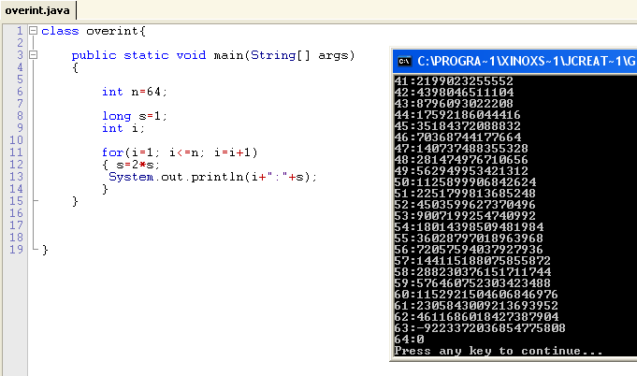
Overflow problems...
A toy example
Computes 2^s, but at some point 2^64 cannot fit 64-bit, we get first
- negative number (leading bit set to 1 by the arithmetic logic unit - ALU)
- then zero!!!!

Slide 57
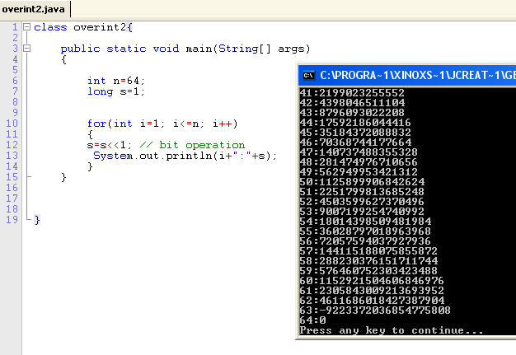
Overflow problems: revisited
Increment:
i++
or
++i
Declaration
inside the For
Multiplication is just
a bit shift << to the right

Slide 58
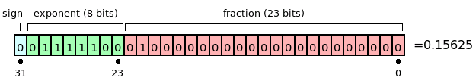
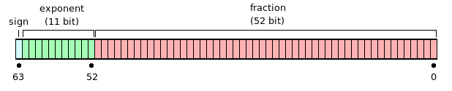
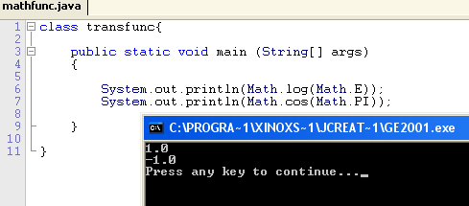
Floating points & numerical precisions
32-bit IEEE 754 floating point.
64-bit IEEE 754 floating point.
float (32-bit) or double (64-bit) have sign, exponent and matissa parts
Examples: float a=0.3; float b=2e-8 (scientific engineering); float c=1.1f;
Math class contains important ''constants'': Math.PI, Math.E, etc.
and transcendental functions: Math.log(), Math.exp(), Math.sin(), Math.cos()
http://en.wikipedia.org/wiki/IEEE_floating-point_standard

Slide 59

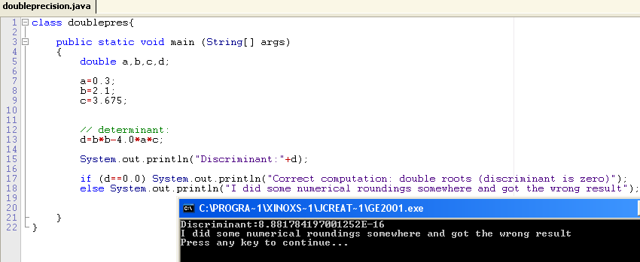
Loosing numerical precision...
A bug
Usually, difficult to
test for the zero
(use threshold or better analysis)

Slide 60

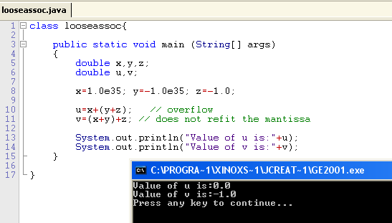
Loosing associativity rule
Rounding & truncations to fit the standard yields the loss of associativity
Better to add numbers having already the same exponent decomposition...

Slide 61

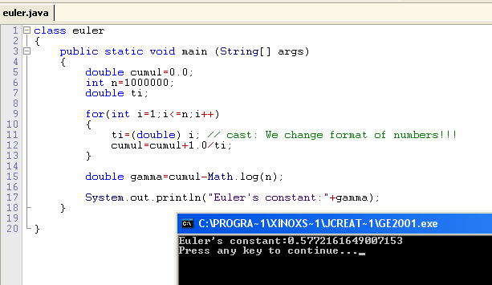
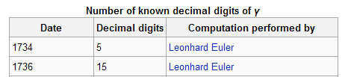

Computing Euler-Mascheroni 's constant

Slide 62
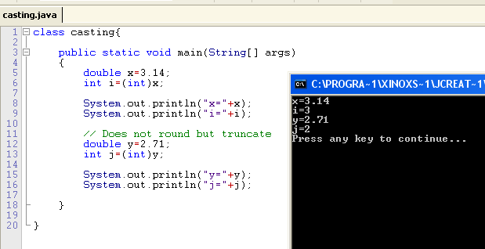
Types and conversions: Cast operator
All variables and constants are typed: Math.PI is a (static) double
Variables should be declared according to their type: double x; int i; etc
The type of variable determines the operator and meaning:
Exempla gratia, 3.0+2.1 (double) or ''Hello ''+'' INF311'' (String)
The expression is also typed (by the compiler)
For assignment =, the left-hand side (variable) and right-hand side (expression)
should have the same type.
Casting types
with parenthesis (type):
double x=3.14;
int i=(int)x;
double x=(double)i;

Slide 63
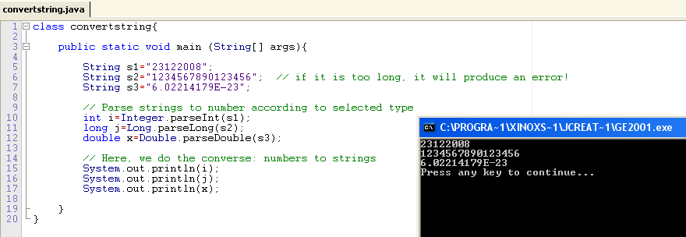
Converting strings to numbers...
Use Type.parseType(String stringtoparse)

Slide 64

A glimpse at functions
Declaring functions in Java
class INF311{
public static typeF F(type1 arg1, ..., typeN argN)
{
// Description
Block of instructions;
}
}
This kind of function is also called a static method
Functions must be defined inside classes
A function not returning a result has type void
                (also known as a procedure)

Slide 65
Defining the body of a function in Java
class INF311{
public static typeF F(type1 arg1, ..., typeN argN)
{
// Description
Block of instructions;
}
}
Body of a function
Body should contain an instruction return to indicate the result
If branching structures are used (if or switch) ,
then a return should be written for all different branches.
Otherwise we get a compiler error! (why? => not type safe!)

Slide 66
A few examples of basic functions
class FuncDecl{
public static int square(int x)
{return x*x;}
public static boolean isOdd(int p)
{if ((p%2)==0) return false; else return true;}
public static double distance(double x, double y)
{if (x>y) return x-y; else return y-x;}
public static void display(double x, double y)
{System.out.println("("+x+","+y+")");
return; // return void
}
public static void main (String[] args)
{
display(square(2),distance(5,9));
int p=123124345;
if (isOdd(p)) System.out.println("p is odd");
else System.out.println("p is even");
}
}

