Slide 1


INF 311
Introduction to Java programming
Lecture 3: functions and recursivity
Frank Nielsen
nielsen@lix.polytechnique.fr
Monday 19th May 2008

Slide 2

So far... Executive review
Lecture 1: Java=Typed compiled programming language
Variables: Type var; (boolean, int, long, float, double)
Assignment: var=Expression; (with type checking)
Expression: Operand1 Operator Operand2 (+-*/%)
Instruction (;) & comments // or /* */

Slide 3
So far... Executive review
Lecture 2: Program workflow (blocks/branching/loops)
Determine the set of instructions at runtime
Blocks: sequence of instructions { }
Branching condition: if predicate B1 else B2
(switch case break)
Loops: while, do, for and escaping break
Numerical precisions: finite-precision arithmetic
(absurd results, loose of associativity, etc.)

Slide 4
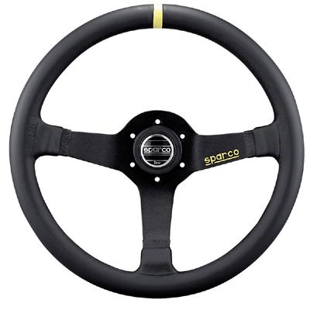
This week: Getting ready in Java
Amphi 3: Functions and recursivity (now)
TD2: loops/if/functions (this afternoon)
Amphi 4: Arrays and Strings (tomorrow Tues. at 8:30am)
(+popular science)
Tutorat: Jeudi!
http://www.enseignement.polytechnique.fr/informatique/INF311/
nielsen@lix.polytechnique.fr

Slide 5

Today...
Lecture 3:
Functions and Recursion

Slide 6
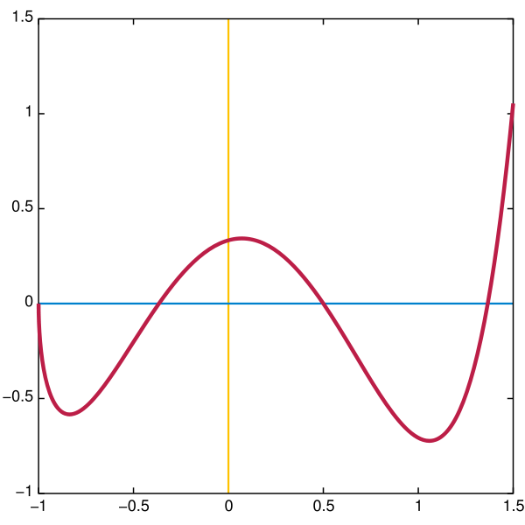

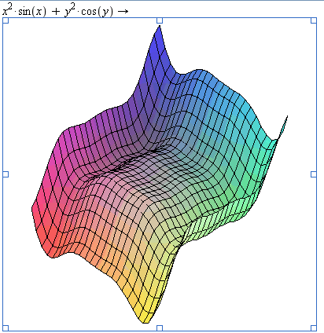
Meaning of a function in mathematics ?
Source (X) and target (Y) domains
A map that associates to elements of X elements of Y
An element of X is associated at most once to a member of Y
The mapping gives always the same result (deterministic/no randomness)
Functions of several variables may be built blockwise...
    ...using Cartesian product of spaces

Slide 7
Meaning of functions for computing ?
A portion of a program processing data and returning a result
A function not returning a result is also called a procedure
A function has typed parameters as arguments
A function usually yields the same result for a given set of arguments
(except for side-effects or use of pseudo-randomness)
A function needs to be declared first before calling it elsewhere
TypeF F(Type1 arg1, Type2 arg2, ..., TypeN argN)
{
TypeF result;
block of instructions;
return result;
}

Slide 8
Declaring functions in Java
class INF311{
public static typeF F(type1 arg1, ..., typeN argN)
{
// Description
Block of instructions;
}
...
}
This kind of function is also called a static method
Functions must be defined inside classes
A function not returning a result has type void
                (also known as a procedure)

Slide 9
Defining the body of a function in Java
Class INF311{
public static typeF F(type1 arg1, ..., typeN argN)
{
// Description
Block of instructions;
}
}
Body of a function
Body should contain an instruction return to indicate the result
If branching structures are used (if or switch) , a return should be
written for all different branches. Otherwise we get acompiler error!

Slide 10
Defining the body of a function in Java
class INF311{
public static typeF F(type1 arg1, ..., typeN argN)
{
// Description
Block of instructions;
}
}
Body of a function
Body should contain an instruction return to indicate the result
If branching structures are used (if or switch) ,
then a return should be written for all different branches.
... Otherwise we get a compiler error! (why? => not type safe!)

Slide 11
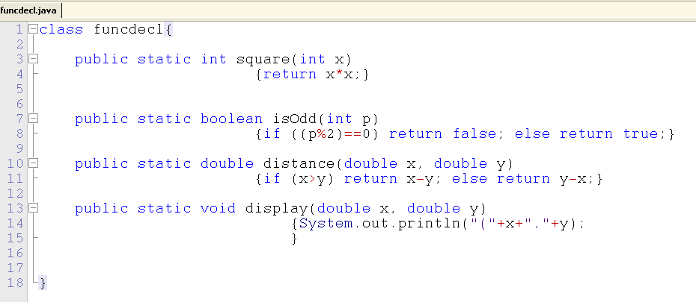
Using functions in Java

Slide 12
A few examples of basic functions
class FuncDecl{
public static int square(int x)
{return x*x;}
public static boolean isOdd(int p)
{if ((p%2)==0) return false;
else return true;}
public static double distance(double x, double y)
{if (x>y) return x-y;
else return y-x;}
public static void display(double x, double y)
{System.out.println("("+x+","+y+")");
return; // return void
}
public static void main (String[] args)
{
...
}
}

Slide 13
A few examples of basic functions
class FuncDecl{
public static int square(int x){...}
public static boolean isOdd(int p) {...}
public static double distance(double x, double y) {...}
public static void display(double x, double y) {...}
public static void main (String[] args)
{
display(3,2);
display(square(2),distance(5,9));
int p=123124345;
if (isOdd(p))
System.out.println("p is odd");
else System.out.println("p is even");
}
}

Slide 14
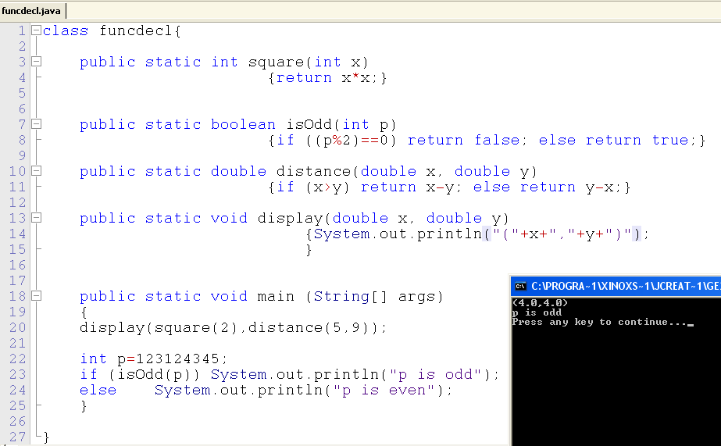
Functions... JCreator IDE

Slide 15
Benefits of using functions
Modularity (ease of presentation)
Code re-use (program once, re-use many times!)
                -> library (API)
Ease certification of correctness and test routines.

Slide 16
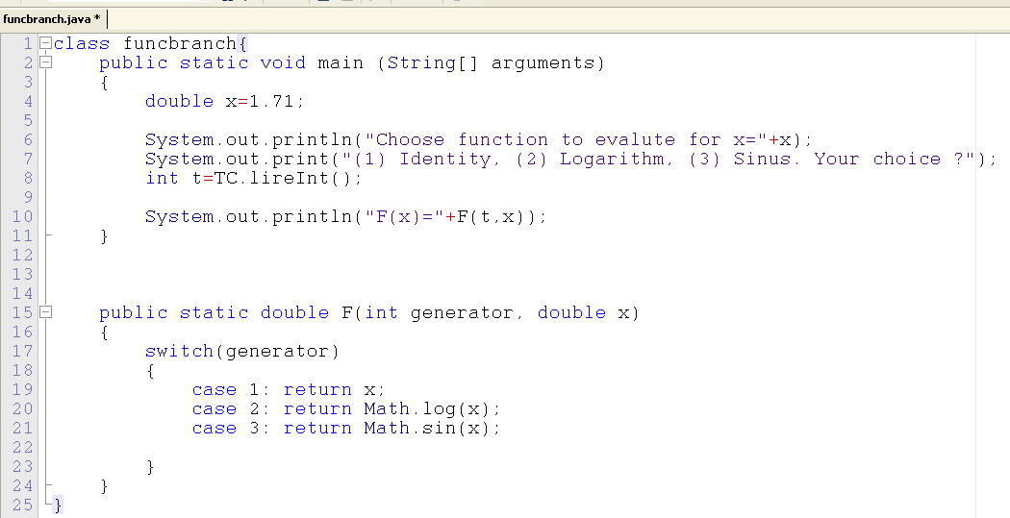
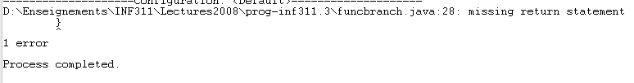
Functions with branching structures
This compiled but there is
an error (break keyword?!)
ERROR!!!

Slide 17
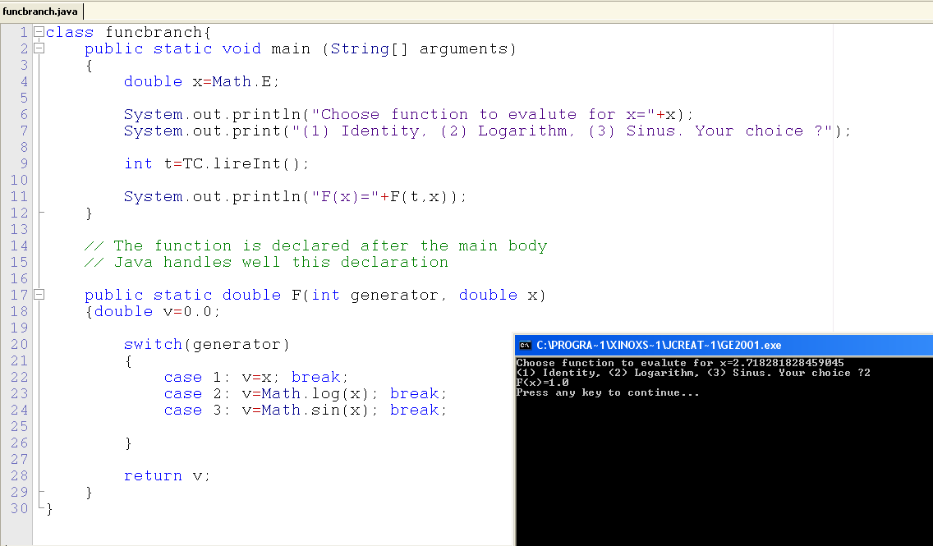
Functions with branching structures
(correct program)

Slide 18

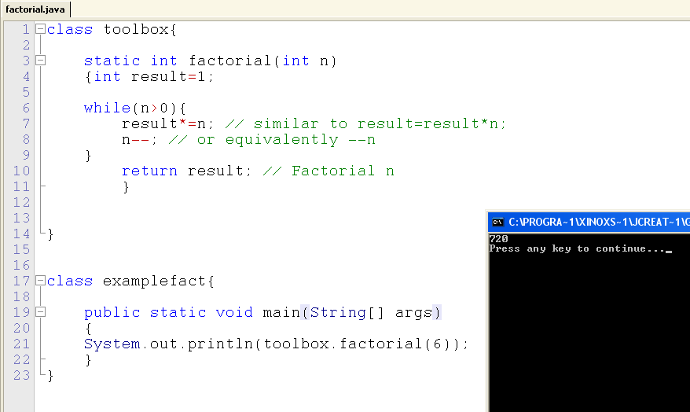
Factorial function n! in Java
Call function factorial in class « toolbox »

Slide 19
Calling functions: Inner Mechanism
TypeF result=F(param1, param2, ..., paramN);
param1, ..., paramN should be of the same types as the ones declared in the function
A function call can be used inside an expression,
or even as a parameter of another function (nested calls)
Example: F1(F2(x),F3(x))
Assignment's rule checks at compile time for type equivalence:
System.out.println(IsPrime(23121971));
double dist=distance(u,v);
Beyond the scope of the function's class, we need to put the
function' class with a dot. Requires the function to be public.
Math.cos(x);
TD2.factorial(n);
TC.lireInt();

Slide 20
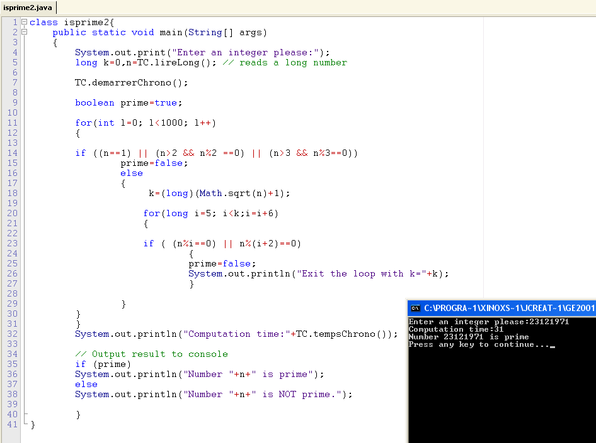
Revisiting IsPrime: measuring time
Function call in class TC:
TC.demarrerChrono();
We repeat this computation
1000 times to measure
the elapsed time
Function call in class TC:
TC.tempsChrono();

Slide 21


Potential side effects of functions:
Static variables (effet de bord)
Function that might modify/alterate the environment
For example:
... displaying a value
... But also modify a variable of the base class
A class variable is declared inside the class scope,
      ...not in function bodies
Class variables are declared using the keyword static

Slide 22
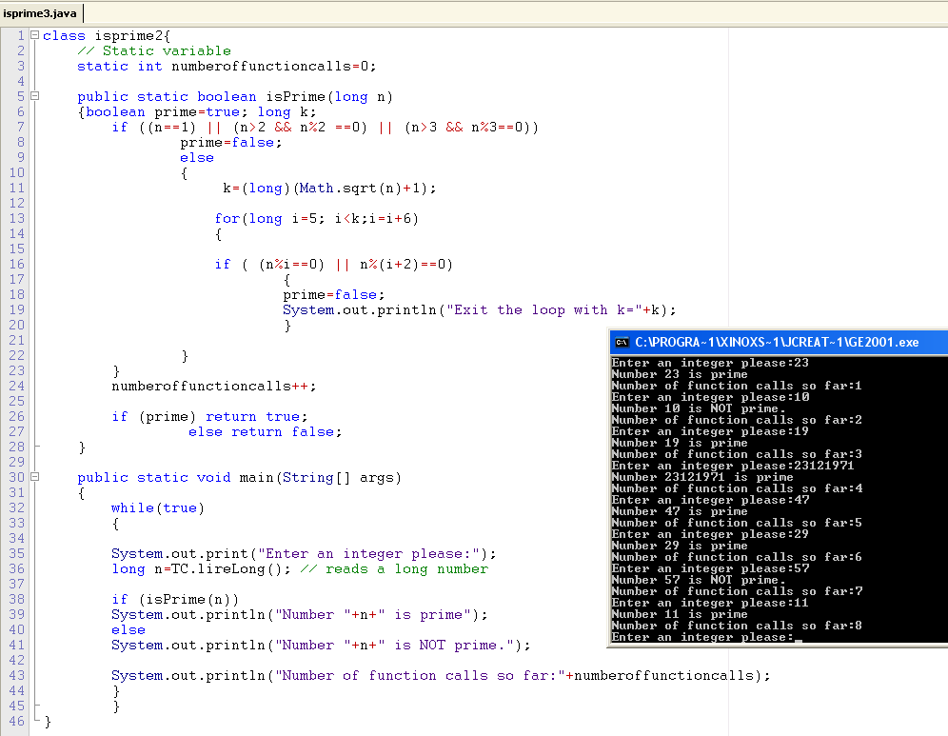
Side effects of functions: Static variables
Declaration of class variable
static int classvar;
Counting
number of
function calls

Slide 23
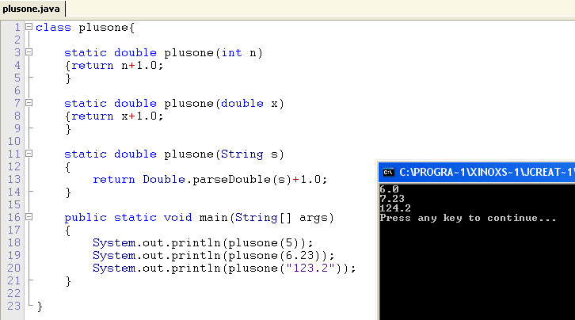
Function: Signature and overloading
signature of a function = ordered sequence of parameter types
Two functions with different signatures can bear the same name
(since the compiler can distinguish them!)
static double plusone(...)
int
double
String

Slide 24
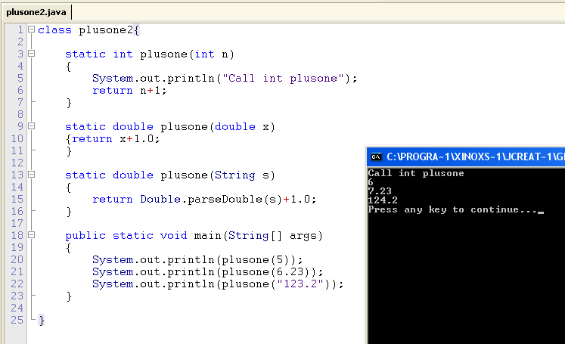
Function: Signature and overloading
Although the function result type is important,
Java does not take into account it for creating signatures...

Slide 25
Function: Signature and overloading
static int plusone (int n)
static double plusone(int n)
!!! COMPILATION ERROR !!!
class SignatureError{
public static int plusone(int n)
{return n+1;}
public static double plusone(int n)
{return n+1.0;}
public static void main(String args[])
{} }
C:\J\Signature.java:6: plusone(int) is already defined in SignatureError
static double plusone(int n)

Slide 26

Executing functions in Java
Work place of the function is created when the function is called
... and destroyed once it is executed (value returned)
Parameter values are equal to the results of the expressions
Function parameters are allocated in memory reserved for the function
If a parameter is modified inside the function body,
  it remains unchanged in the calling function.
public static void main(String args[])
Pile d'execution
passage par valeur seulement en Java!

Slide 27
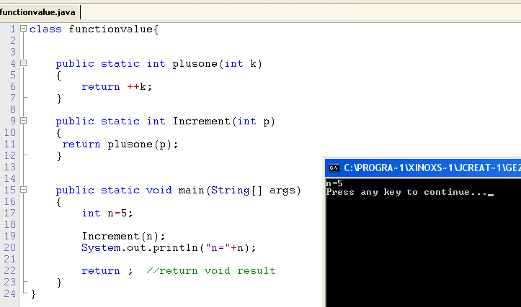
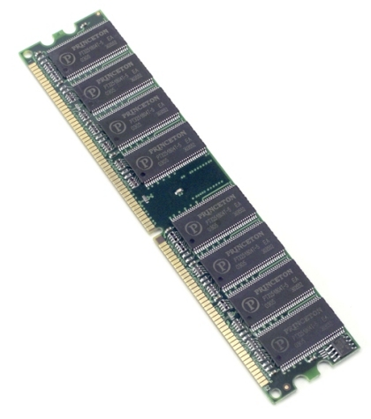
Executing functions in Java
Memory
for plusone
As soon as we exit this
function, k takes its original
value of (5)
Memory
for Increment
Memory
for main
Memory
(stack)
passage par valeur

Slide 28
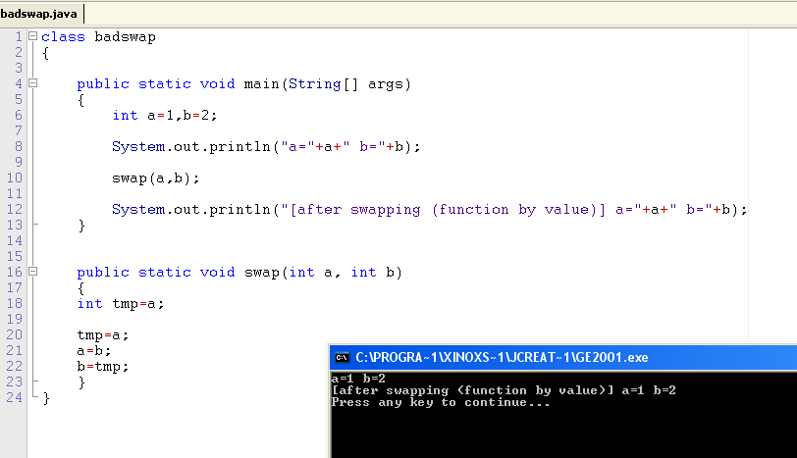
Executing functions in Java
(In C++, swapping is easy)

Slide 29
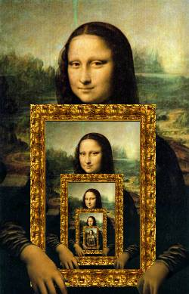
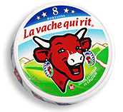
Principle of recursion
A beautiful principle of computing !
Loosely speaking, ...
...the inverse of inductivism in mathematics
A function that calls itself...
...not forever, so that there should be stopping states...
...Function parameters should tend to the ones that do not
...require recursion to finalize the computation...
But all this is an informal glimpse of recursion (self-structure)

Slide 30
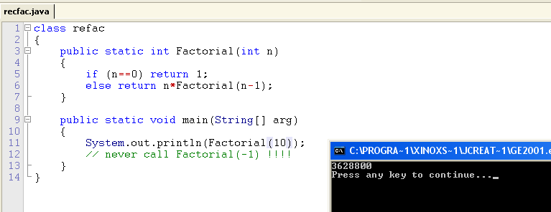
Example: Revisiting the factorial

Slide 31
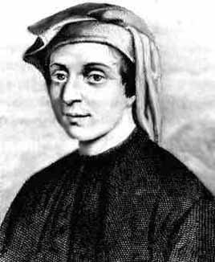
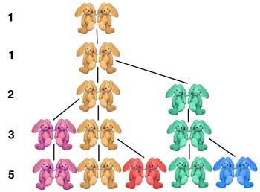
Example: Fibonacci numbers
Leonard de Pise
(1170- 1245)
1, 1, 2, 3, 5, 8, 13, 21, 34, 55......
Population growth:
Newly born pair of M/F rabbits are put in a field.
Newly born rabbits take a month to become mature, after which time
... They produce a new pair of baby rabbits every month
Q.: How many pairs will there be in subsequent years?

Slide 32

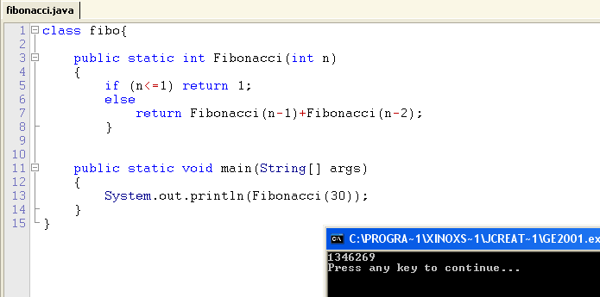
Example: Fibonacci numbers
Leonard de Pise
Much better algorithms at....
http://fr.wikipedia.org/wiki/Suite_de_Fibonacci

Slide 33
Understanding a recursive function
int fibo(int n)
{int x,y;
if(n <= 1) return 1;
x=fibo(n-1);
y=fibo(n-2);
return x+y;}
recursive function called:
Allocation of memory for local variables
Stack operations to compute
... Call the function with other parameters, if required
Process operations that remains on the stack
x=fibo(2)
y=fibo(1)
return x+y
Recursive calls
fibo(3)

Slide 34
Understanding a recursive function
x=fibo(1)
y=fibo(0)
return x+y
fibo(1)
return 1;
x=fibo(2)
y=fibo(1)
return x+y
fibo(2)
fibo(3)

Slide 35
Understanding a recursive function
fibo(2)
x=1
y=fibo(0)
return x+y
x=fibo(2)
y=fibo(1)
return x+y
fibo(0)
return 0;
fibo(3)

Slide 36
Understanding a recursive function
fibo(2)=1
x=1
y=0
return x+y
x=fibo(2)
y=fibo(1)
return x+y
fibo(3)

Slide 37
Understanding a recursive function
x=1
y=fibo(1)
return x+y
fibo(3)
fibo(1)=1
return 1;

Slide 38
Understanding a recursive function
x=1
y=1
return x+y
fibo(3)=2
As we can see, there is a lot of redundant work here.
-> Very inefficient algorithm.
Can cause stack overflow if the #recursive calls...
...become too large
0, 1, 1, 2, 3, 5, 8, 13, 21, 34, 55, 89, 144, 233, 377, 610, 987, 1597, 2584, 4181, 6765, 10946, ..

Slide 39
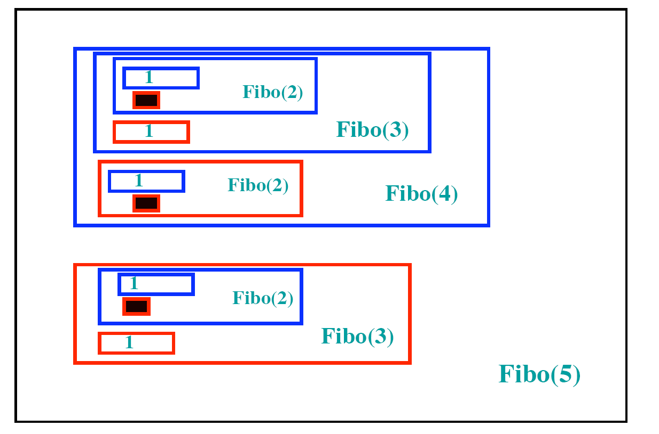
Understanding a recursive function

Slide 40
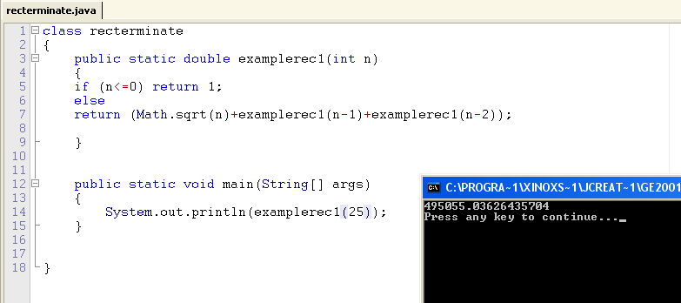
Recursion: Halting problem
When does a recursive program terminate?
The arguments always decrease and
there is always a stopping criterion

Slide 41
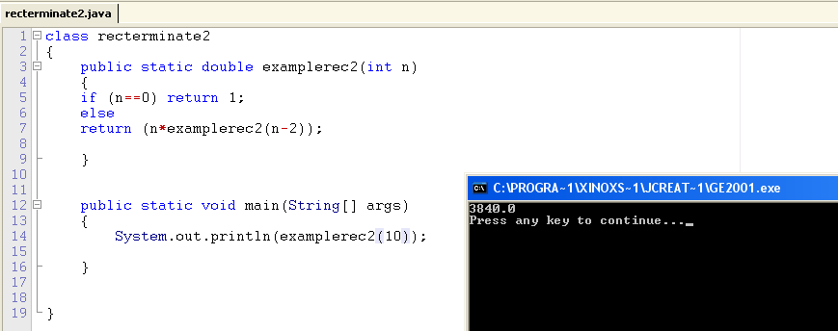
Recursion: Halting problem

Slide 42
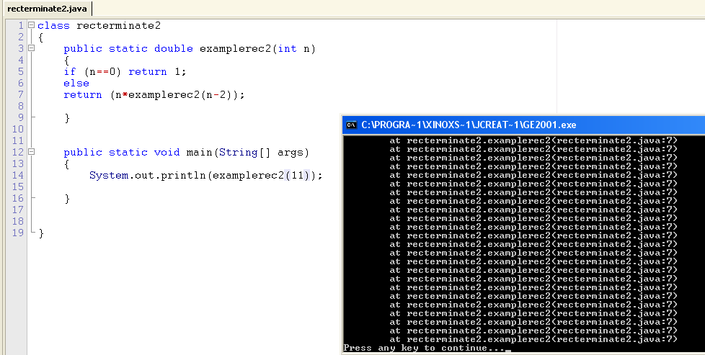
Recursion: Halting problem
Do we always reach
that terminal state?
Does not always halt because
we may never reach terminal case (n=0) for odd numbers

Slide 43
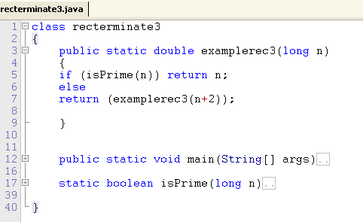
Recursion: Halting problem
What do you think of this one?
Stack overflow

Slide 44
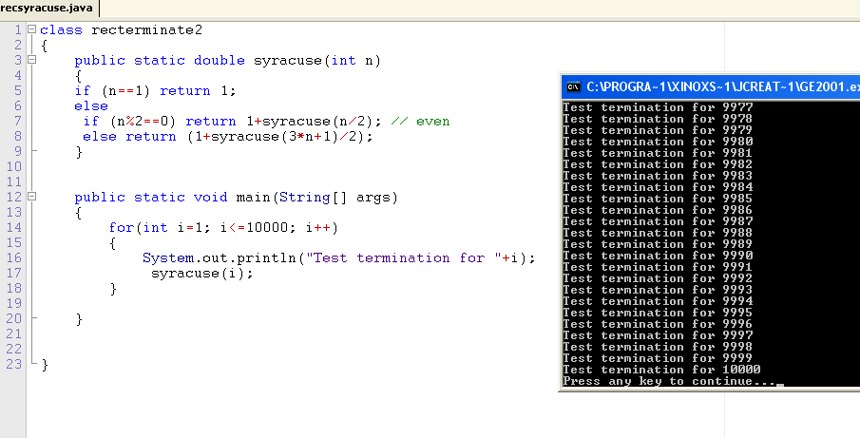
Recursion: Halting problem
Syracuse problem and termination conjecture
Conjectured to halt
(computer simulation helps intuition but does not give a full proof)

Slide 45
Halting problem: Computer Science
There is provably no algorithm that can take as input a
program (binary string) and return true
if and only if this program halts.
Proof skipped
http://en.wikipedia.org/wiki/Halting_problem

Slide 46

Récursivité terminale
if (n<=1) return 1; else
return n*f(n-1);
What happens if we call Factorial(100) ?
Recursive calls are alwaysof the form return f(...);
->No instruction (computation) after the function
(Factorial is not terminal since return n*f(n-1); )
Does not put function calls on the stack
(thus avoid stack overflow)

Slide 47
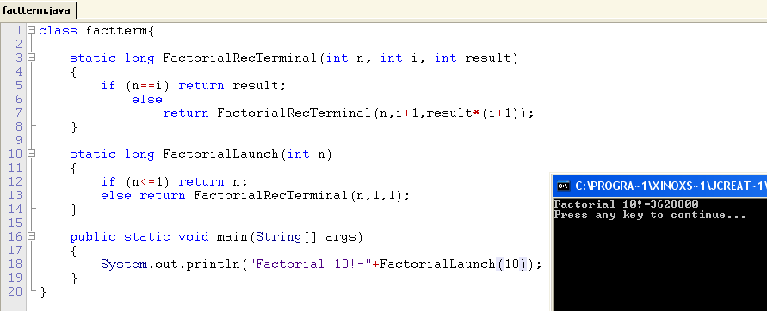
factorial with terminal recursion
Arguments plays the role of accumulators
What happens if we call Factorial(100) ?

Slide 48
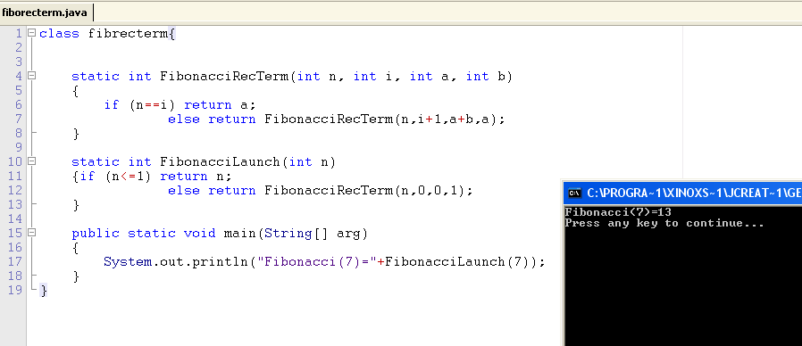
Terminal Recursion:
Revisiting Fibonacci
accumulator
0, 1, 1, 2, 3, 5, 8, 13, 21, 34, 55, 89, 144, 233, 377, 610, 987, 1597, 2584, 4181, 6765, 10946, ...

Slide 49
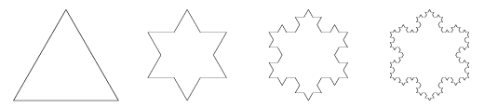
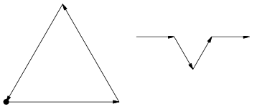
Recursivity and Nature
Drawing fractal curves and motifs
Koch's snowflake
Fractals:
Patterns that are present at different scales
The curve at stage n is defined recursively...
....from the curve at stage n-1

Slide 50
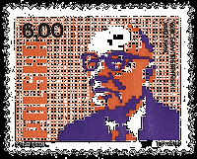
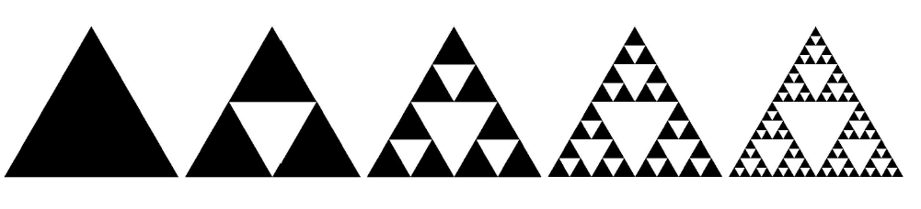
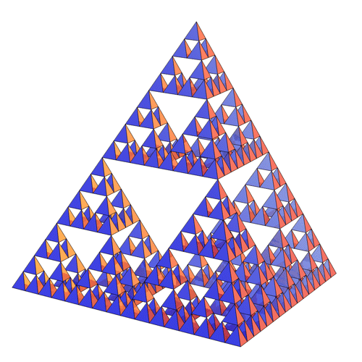
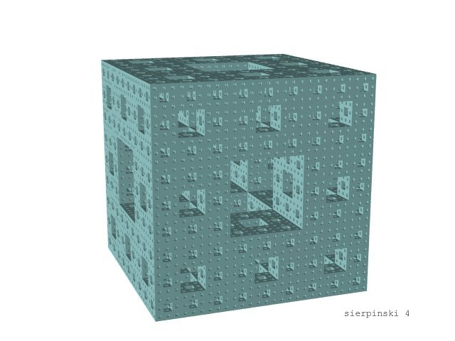
Fractal: Sierpinski motif
Waclaw Sierpinski
(1882-1969)
Polish mathematician
Generation 1
Generation 2
Generation 3
Generation 4
Generation 5
The recursive pattern is given by a simple rewritting rule:
Replace a triangle by 3 triangles defined by the...
midpoints of the edges of the source triangle

Slide 51
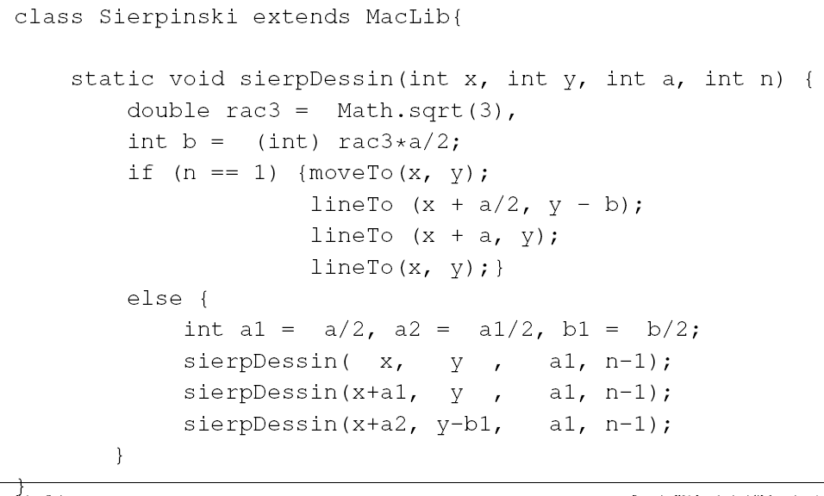
Sierpinski curve (2D pyramid)
http://www.enseignement.polytechnique.fr/profs/informatique/Philippe.Chassignet/MACLIB/Java/maclib_java.html

Slide 52
