Slide 1


INF 311
Introduction to Java Programming
Lecture 4: arrays and strings
Frank Nielsen
nielsen@lix.polytechnique.fr

Slide 2


Why do we need arrays?
To handle many variables at once
Processing many data or generating many results
In mathematics, we are familiar with variables
with indices:
In most languages, indices start at zero
(and not one).
...Just a convention

Slide 3
Declaring arrays in Java
For a given type, TYPE[ ] is the type of arrays
storing elements of type TYPE.
For arrays declared within the scope of functions:
int [ ] x;
boolean [ ] prime;
double [ ] coordinates;
float [ ] [ ] matrix;
For arrays declared in the body of a class, use the keyword static:
(array variables can be used by any function of the class)
static int [ ] x;
static boolean [ ] prime;

Slide 4
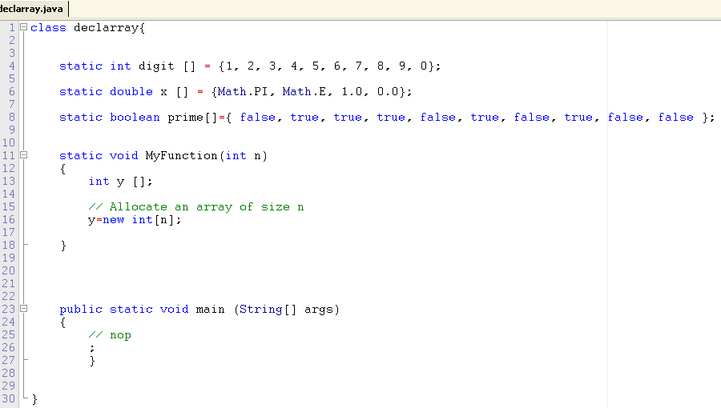
Building and initializing arrays
Observe:
static boolean prime[ ]={ false, true, true, true, false, true, false, true, false, false };
but not
static boolean prime[10]={ false, true, true, true, false, true, false, true, false, false };

Slide 5
Building and initializing arrays
Declare array with the reserved keyword new
Specify the size of the array at built time
Arrays can be declared and initialized at once too:
int [ ] x;
x=new int [32];
boolean [ ] prime = new boolean[16];
Arrays initialized by enumerating all its values:
int [ ] prime={2, 3, 5, 7, 11, 13, 17, 19};

Slide 6
Size of arrays
Size of arrays is given by the member function length:
prime.length;
System.out.println(prime.length);
Size of arrays fixed for once, cannot be changed:
array.length=23; // Generate an error

Slide 7
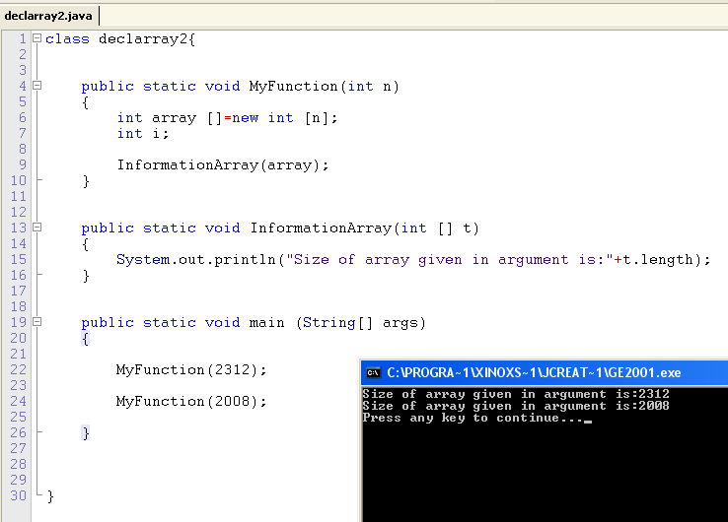
Size of arrays

Slide 8
Index range of arrays and exceptions
Powerful mechanism of modern languages (Java, C++)
If index is out of range, an exception is raised on the fly:
ArrayIndexOutOfBounds
Out of range accesses may not be detected by the compiler:
Bug that yields termination or system crash
... However, fortunately, Java can catch exceptions too.

Slide 9
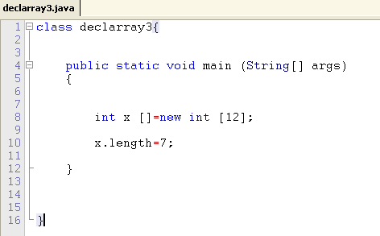
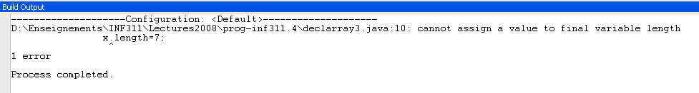
Size of arrays cannot be modified

Slide 10
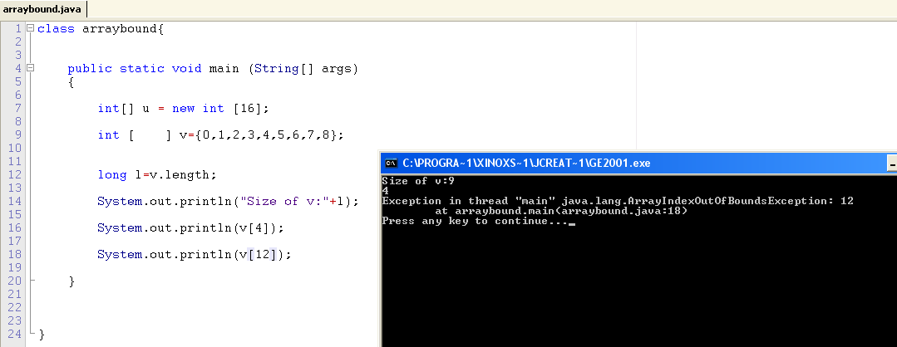
Index range of arrays and exceptions
Observe the correct parsing

Slide 11
The concept of references
An array is allocated as a single contiguous memory block
Java is managing memory so you do not have to free it
once the array is not used anymore: garbage collector
An array variable is, in fact, a reference to the array
This reference of the array is the symbolic address of
the first element (index 0)
Thus, when we write...
int [ ] v = {0, 1, 2, 3, 4};
int [ ] t =v;
t[2]++;
System.out.println(t[2]++);
... the elements of the array v are not copied verbatim to t. Only the reference!!!

Slide 12
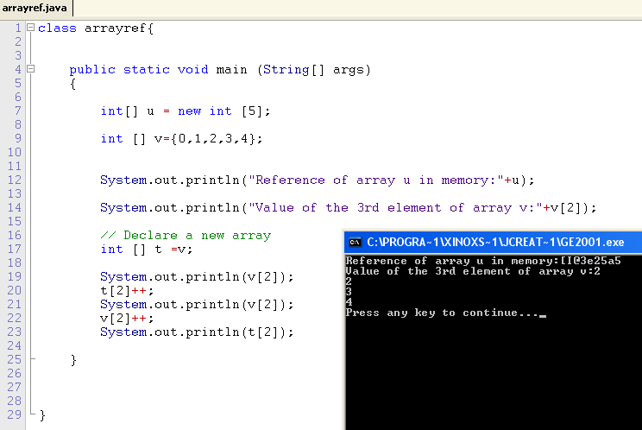
Arrays & references

Slide 13
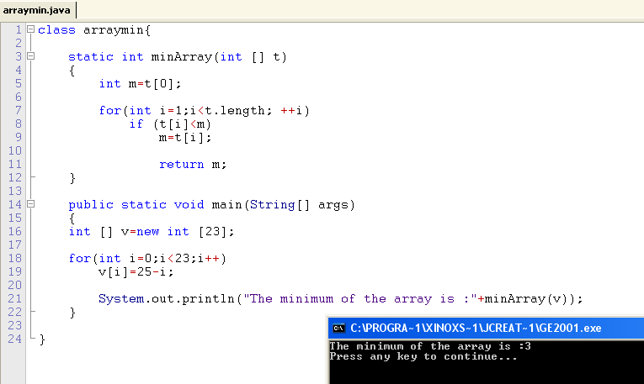
Functions & arrays
Functions and procedures can have arrays as arguments.
(remember that array types are: TypeElement[ ])
Example: Function that returns the minimum of an array of integers

Slide 14
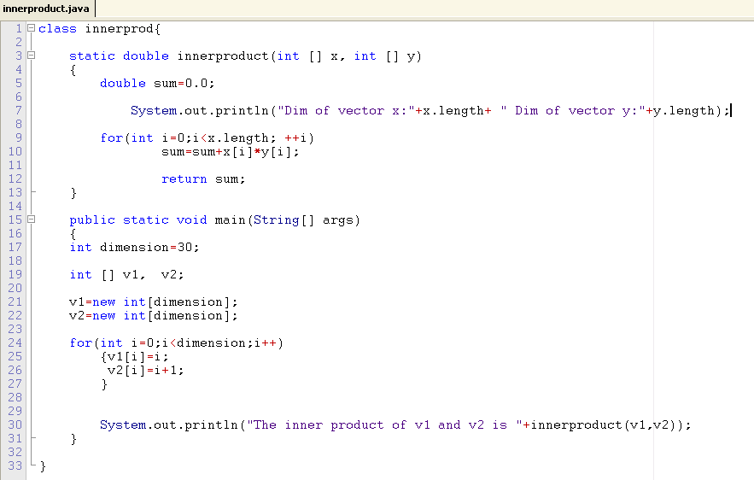
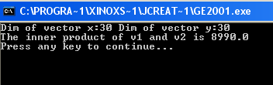
Functions & arrays
Example: Function that returns the inner product of 2 vectors
(produit scalaire)

Slide 15
Array arguments in functions
A variable that has a type array is a reference to the array
(the memory address of the first element)
Therefore an argument of type array does not copy
all array elements in the memory allocated for the function,
but rather allocate a single memory reference:
a machine word.
static void MyFunction(int [ ] x)
MyFunction(v);
Only the reference of v is copied to the memory allocated for
the function MyFunction.

Slide 16
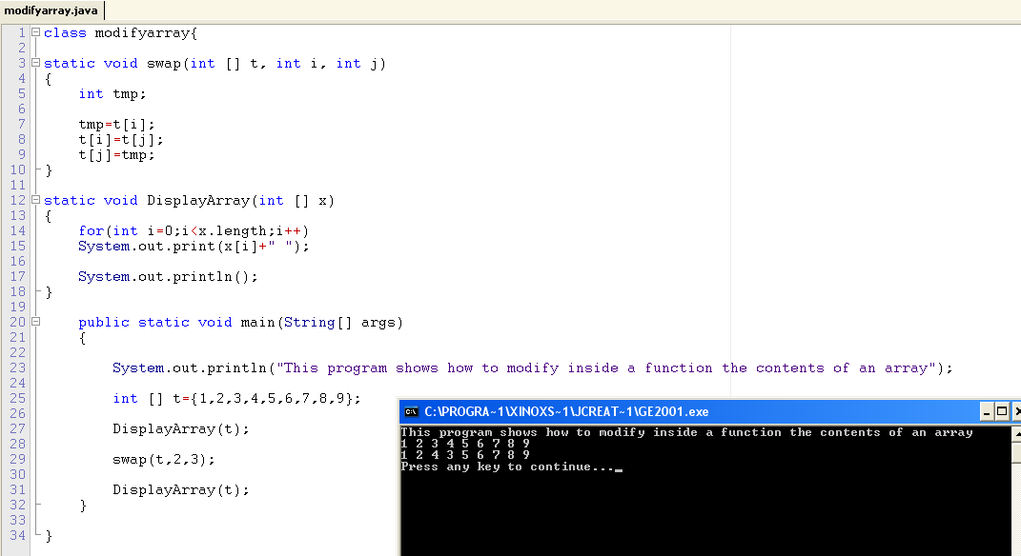
Array arguments in functions
Thus we can modify the inside a function the contents of
the array: the values of the elements of the array.

Slide 17
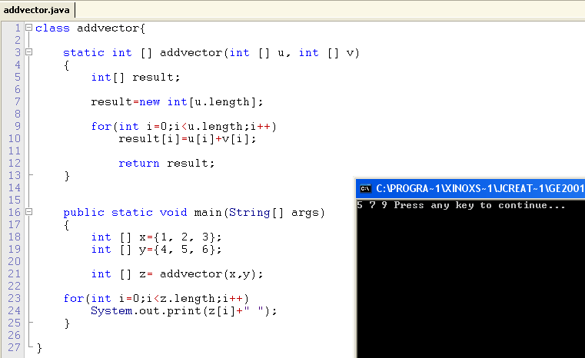
Functions returning an array

Slide 18
Arrays of arrays...
So far, we described linear array (1D).
What about matrices (2D arrays)?
A bidimensional array (n,m) consists of n lines,
each of which is an array of m elements
int [ ] [ ] matrix;
matrix=new int[n][m];
By default, at initialization, the array is filled up with zero
Change the contents of 2D arrays using 2 nested loops:
for(int i=0; i<n; i++)
for(int j=0; j<m;j++)
matrix[i][j]=i*j+1;

Slide 19
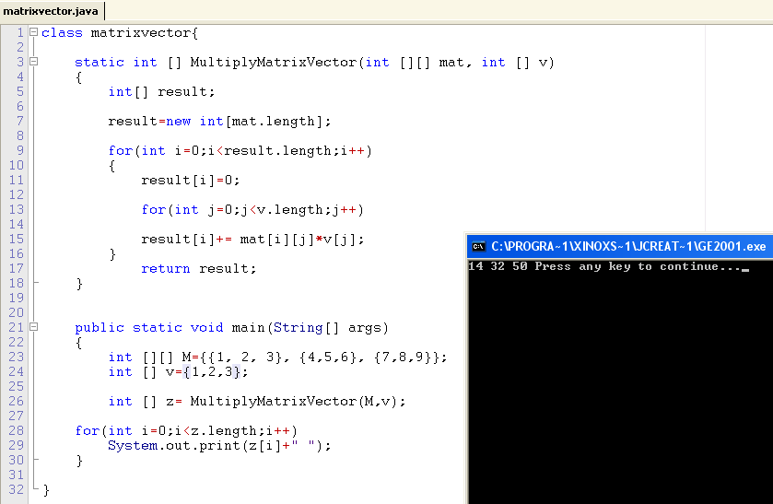
2D Arrays: Matrix x vector product

Slide 20
Dichotomic search
Also called binary search algorithm
Assume we are given a sorted array of size n:
array[0] < array[1] < ... < array[n-1]
and a query key p
Seek whether there is an element in the array that has value p
That is, give a function that return the index of the element in
the array with value p, or that returns -1 otherwise.

Slide 21
Dichotomic search: Think recursion!
Start with a search interval [left, right] with left=0 and right=n-1
Let m denote the middle of this interval: m=(left+right)/2
If array[m]=p then we are done, and we return m;
If array[m] <a, then if the solution exists it is in [m+1,right]
If array[m]>a, then if the solution exists it is in [left,m+1]
The search algorithm terminates if left>right, we return -1;

Slide 22
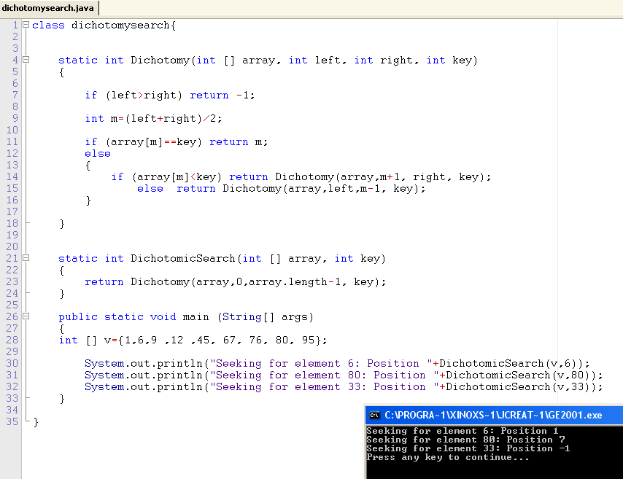
Dichotomic search: Recursion

Slide 23
Strings: Basic objects in Java
A string of character is an object with type String
A variable of type String is a reference on that object:
String school= ''Ecole Polytechnique'';
String vars=school;
Once built, a string object cannot be modified
Beware: use only for moderate length strings,
otherwise use the class StringBuffer

Slide 24
Class String: Some methods
A method is a function or procedure on an object class
Method Length() : gives the number of characters
String s= ''anticonstitutionnellement'';
System.out.println(s.length());
Method equals():
s1.equals(s2): Predicate that returns true if and only if the
two strings s1 and s2 are made of the same sequence of characters.
String s1=''Poincare'';
String s2=TC.lireMotSuivant();
System.out.println(s1.equals(s2));
Beware: s1==s2 is different!
It compares the reference of the strings.
(Physical versus logical equality test)

Slide 25
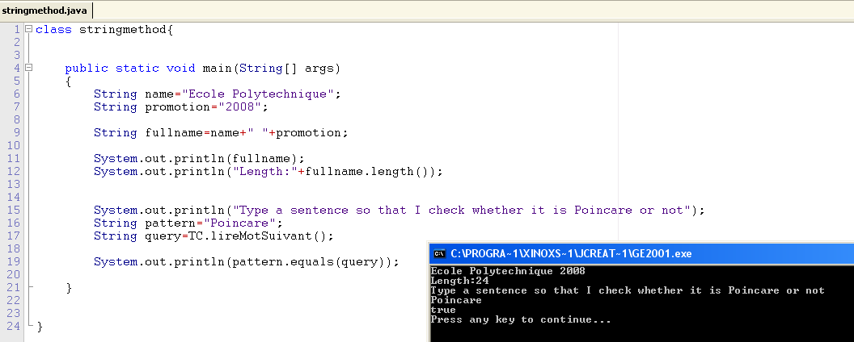
Class String in action...

Slide 26
Class String: More methods
Method charAt():
s.charAt(i) gives the character at the (i+1)th position in string s.
String s= ''3.14159265'';
System.out.println(s.charAt(1));
Method compareTo():
u.compareTo(v) compares lexicographically the strings u with v.
String u=''lien'', v=''lit'', w=''litterie'';
System.out.println(u.compareTo(v));
System.out.println(v.compareTo(w));

Slide 27
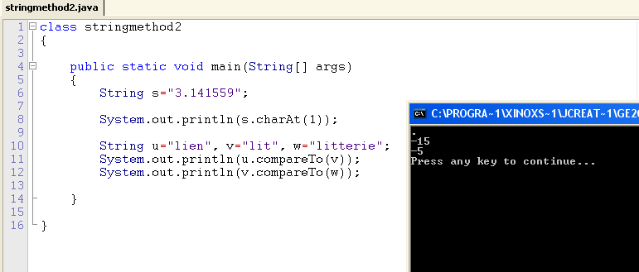
Class String: More methods

Slide 28
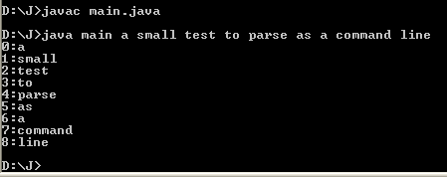
Demystifying the main function
class ClassName
{
public static void main(String[ ] args)
{
...
}
}
Function main has an array of string of characters as arguments
These strings are stored in args[0], args[1], ...
... when calling java main s0 s1 s2 s3
Use Integer.parseInt() to convert a string into an integer

Slide 29
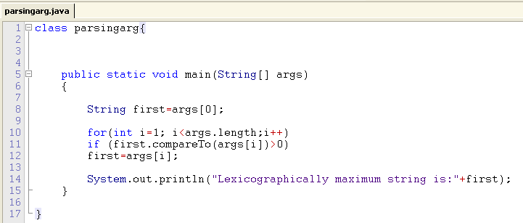

Parsing arguments in the main function

Slide 30
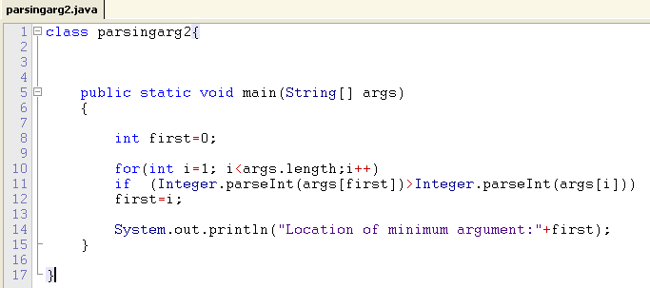

Parsing arguments in the main function

Slide 31
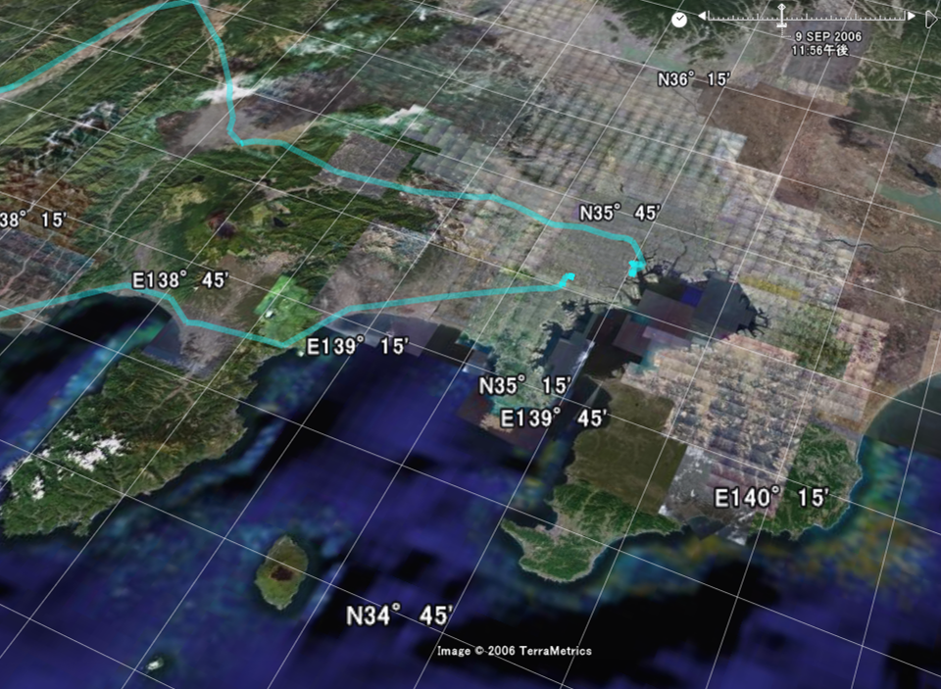

Realworld Folksonomy &
PlaceEngine
+LiFELONG TAGGING
Jun Rekimoto
The University of Tokyo
Sony Computer Science Laboratories (SonyCSL)‏
Presented by Frank NIELSEN – INF311
Popular computer science series
Notes:
<numéro>

Slide 32
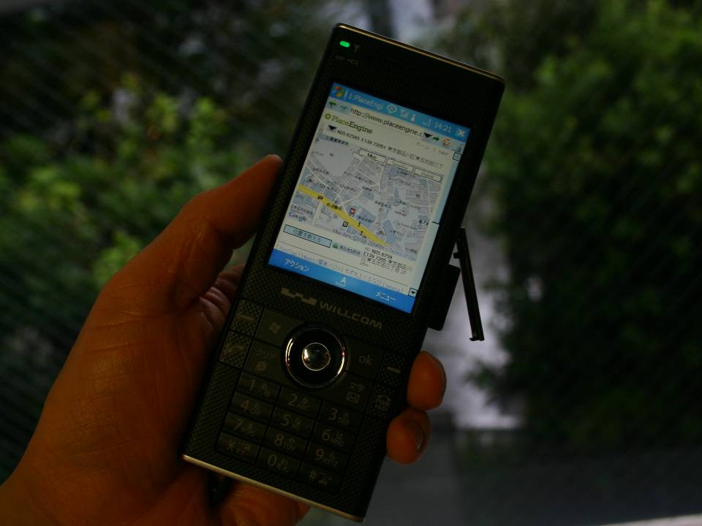

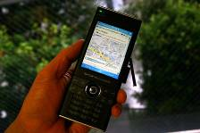
WiFi-based Position Recognition：
Works both indoors and outdoors
Very Fast (< 1sec) vs. GPS cold start (10-20sec)‏
Any WiFi-Devices can be location-aware
DB Query
location
(Latitude, Longitude)‏
WiFi APs info
(MAC, RSSI)‏
Access Point DB
    Received Signal Strength Indication (RSSI) Media Access Control address (MAC address)‏
Notes:
<numéro>

Slide 33
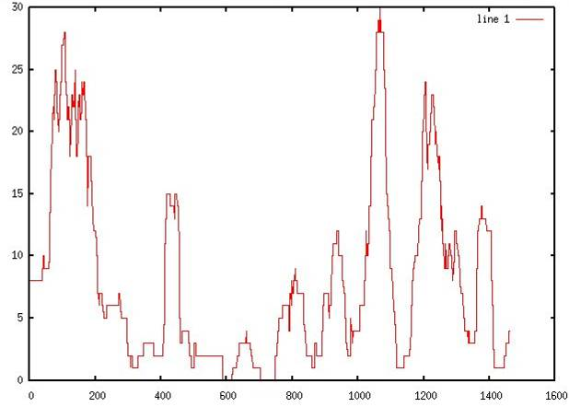


Rekimoto War Walking 2005
# Number Access Points.
Yokohama
Gotanda
t
Notes:
<numéro>

Slide 34
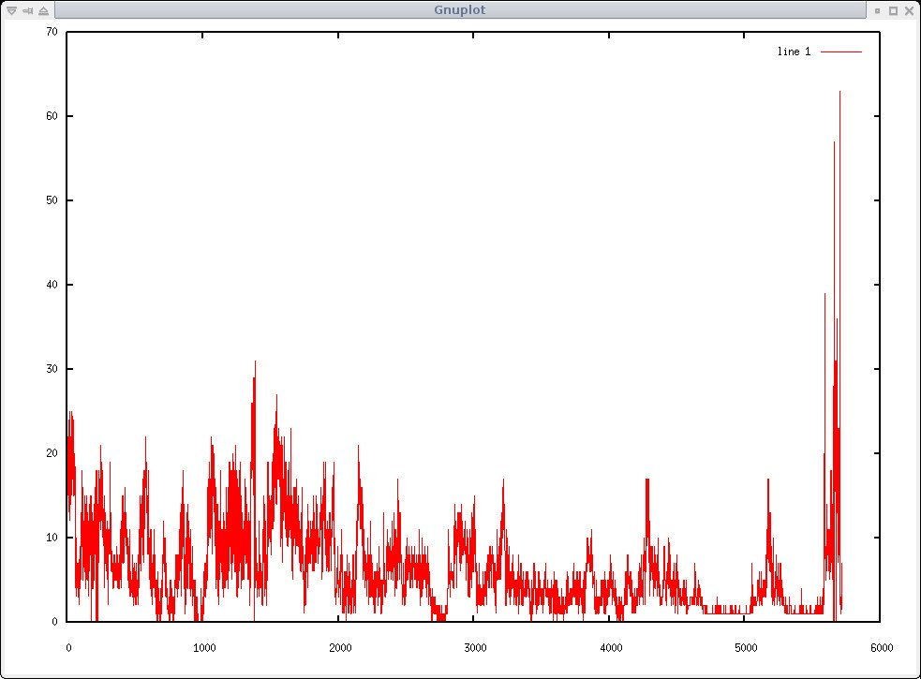

War Walking in Paris 2006.10
Notes:
<numéro>

Slide 35
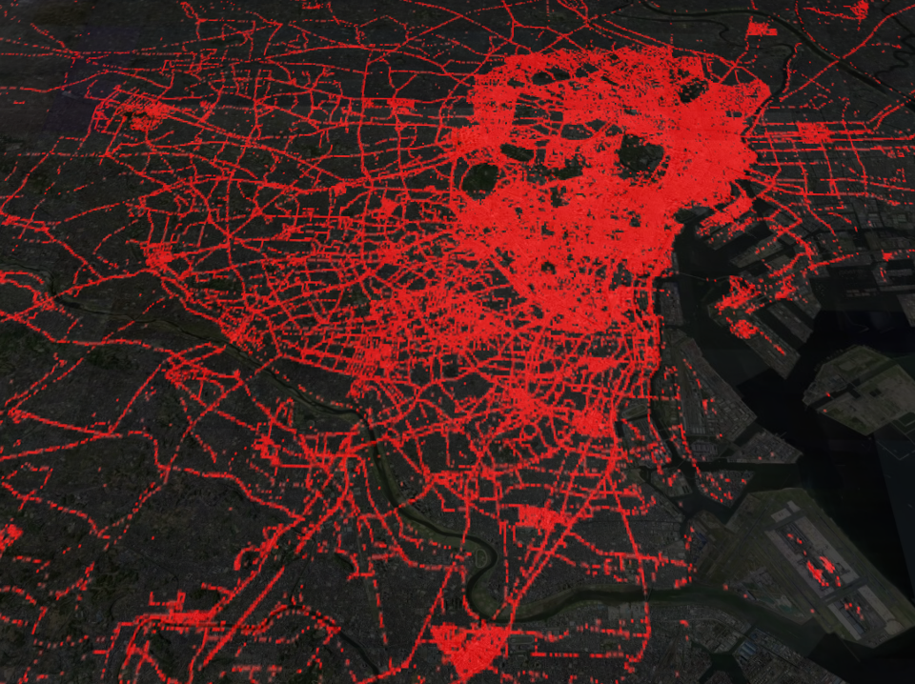
Access Point location estimation results
2007.6
Tokyo Area
700,000 APs
Notes:
<numéro>

Slide 36
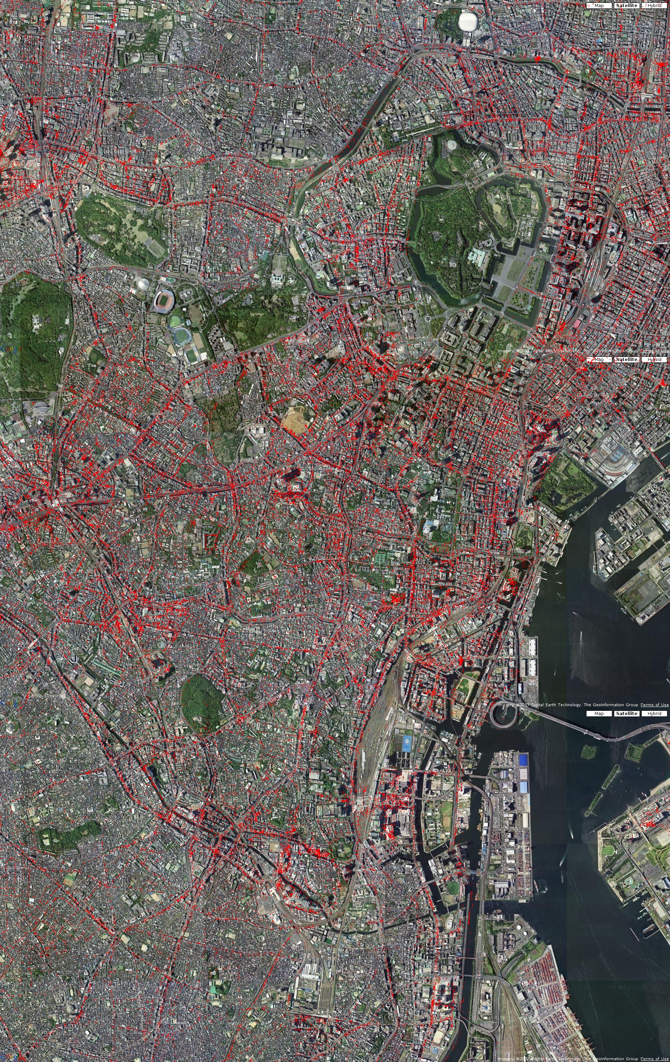
Notes:
<numéro>

Slide 37
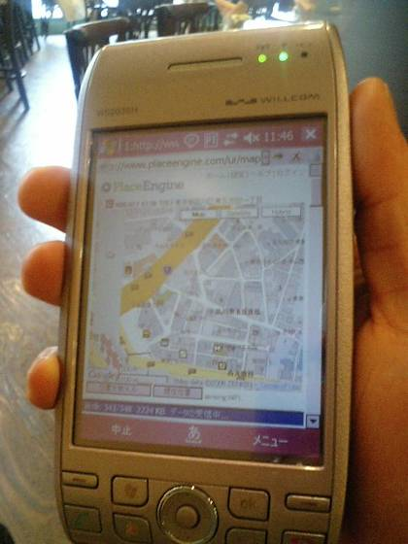
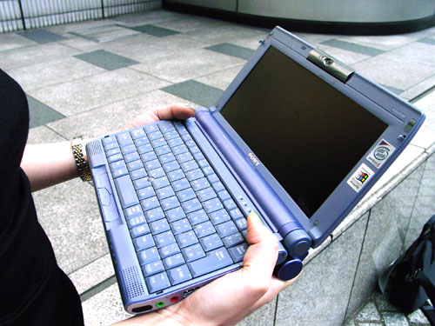
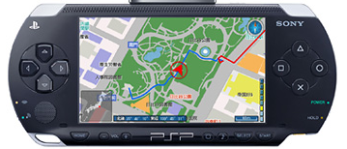
PlaceEngine Architecture
End User Registration
(10%)‏
online users
Log by Other Institutions
(25%)‏
Crawl by CSL
(65 %)‏
Location
Estimation
Access Point
Location Estimation
API
offline users
Master
DB
Location
Estimation
server
www.placeengine.com
DB subset
LE subset
Notes:
<numéro>

Slide 38
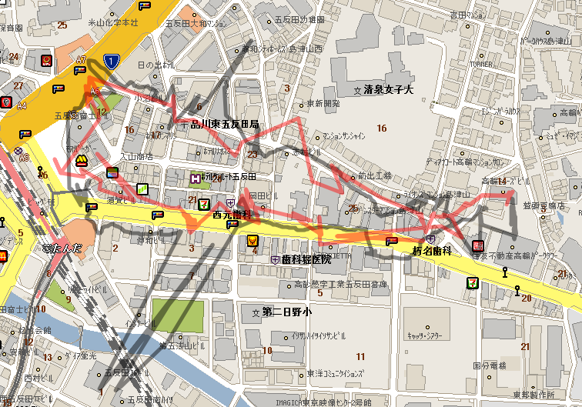
GPS
Real
Indoor
Indoor
Notes:
<numéro>

Slide 39
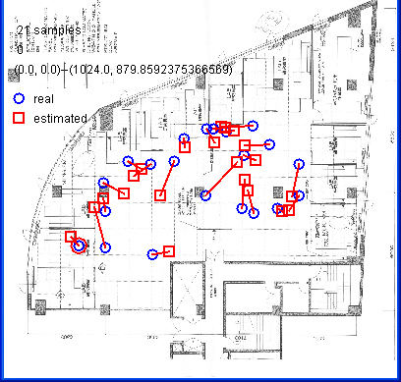
Indoor Estimation Results
(Rekimoto 2003 SonyCSL OpenHouse)‏
AP
Location Estimated by a simple
non-linear mapping
(to compensate wall reflections etc.)‏
Notes:
<numéro>

Slide 40
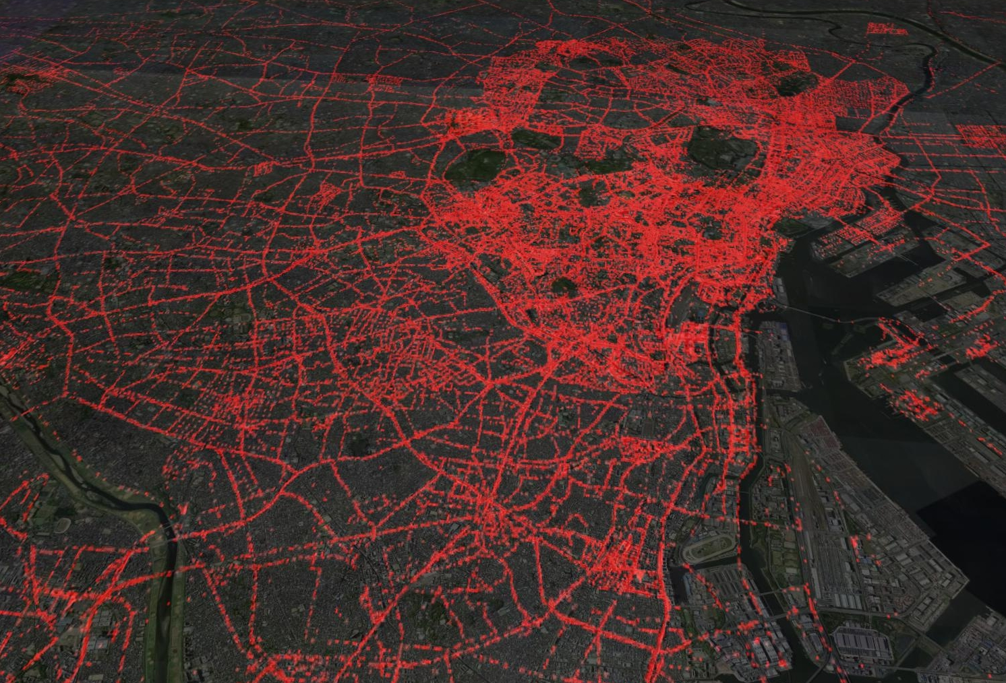
PlaceEngine Location Database
Huge Realworld Database (> 700,000)‏
  no one has total information
How to gather data?
  mega merging of (user participating) sensing information
Folksonomy → “Sensonomy”
Notes:
<numéro>

Slide 41
Sensonomy
Geographically Distributed
Large (City to Planet) Scale
Participated by many users
Sensing Network
Notes:
<numéro>

Slide 42
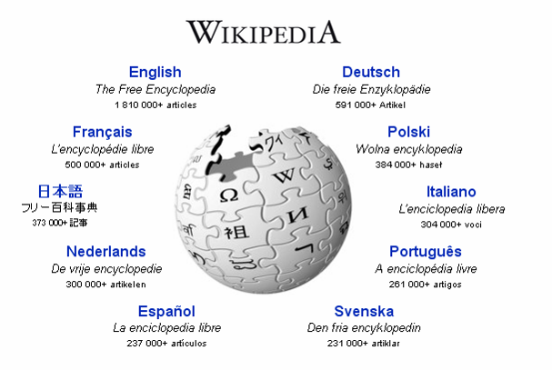

    Le pouvoir est dans la multitude anonyme
Notes:
<numéro>

Slide 43
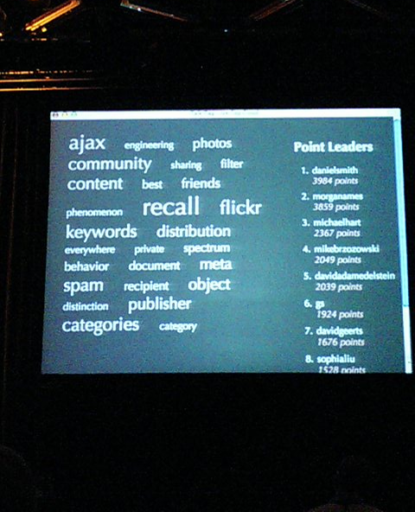

Folksonomy
CHI 2006 Panel on Folksonomy
Notes:
<numéro>

Slide 44
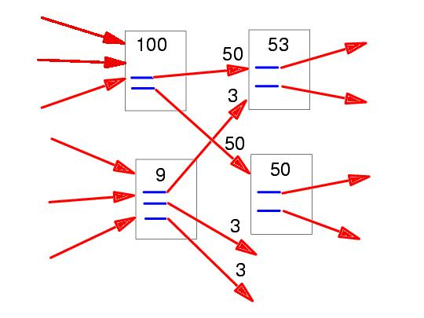
Google PageRank
Unintentional folksonomy
Lawrence Page, Sergey Brin, Rajeev Motwani, Terry Winograd, 'The PageRank Citation Ranking: Bringing Order to the Web', 1998,
Notes:
<numéro>

Slide 45
Access Point Position Estimation
This location is UNKNOWN
(except for Public Hotspot APs)‏
WiFi Access Point
Notes:
<numéro>

Slide 46


Access Point Estimation (cont.)‏
GPS
WiFi
MAP
This location is UNKNOWN
WiFi
GPS
These Locations are KNOWN
Notes:
<numéro>

Slide 47

Access Point Estimation (cont.)‏
Queries from unknown location also contribute to Database growth.
This location is UNKNOWN
Tell me
Where I am
Query
(tell me Where I am)‏
WiFi
This location is ALSO UNKNOWN
Notes:
<numéro>

Slide 48
Realworld Folksonomy
Database Improvement from accesses
analogy of “co-occurrence (共起関係) in text-mining
Ａ
ＡＰ
ＡＰ（updated）
ＡＰ
dist_{max}(RSS) + distmax(RSS)
dist_{max}(RSS)‏
ＡＰ（updated）
dist_{max}(RSS)‏
ＡＰ
Observation Point
(location KNOWN)‏
Observation Point
(location UNKNOWN)‏
dist_{max}(RSS)‏
１%
Place location (unkown query)‏
９９%
Notes:
<numéro>

Slide 49
A Simulation
true
LEGEND
2000 APs
  1% known position (seeds)‏
  99% unknown positions
User Info
  99% just query
  1% with current position
Very Simple Update Algorithm
Note:
  Users don’t know AP positions
estimated
Real Data:
95.2% query
4.8% register
Notes:
<numéro>

Slide 50
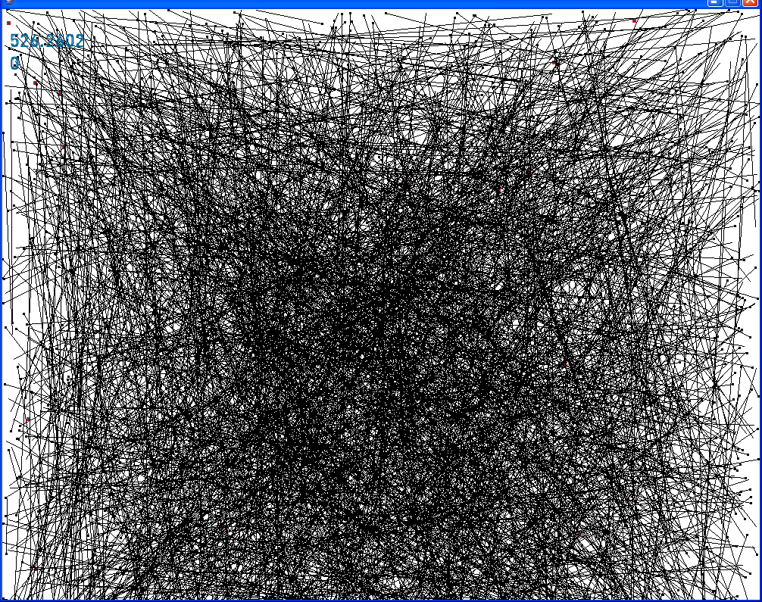
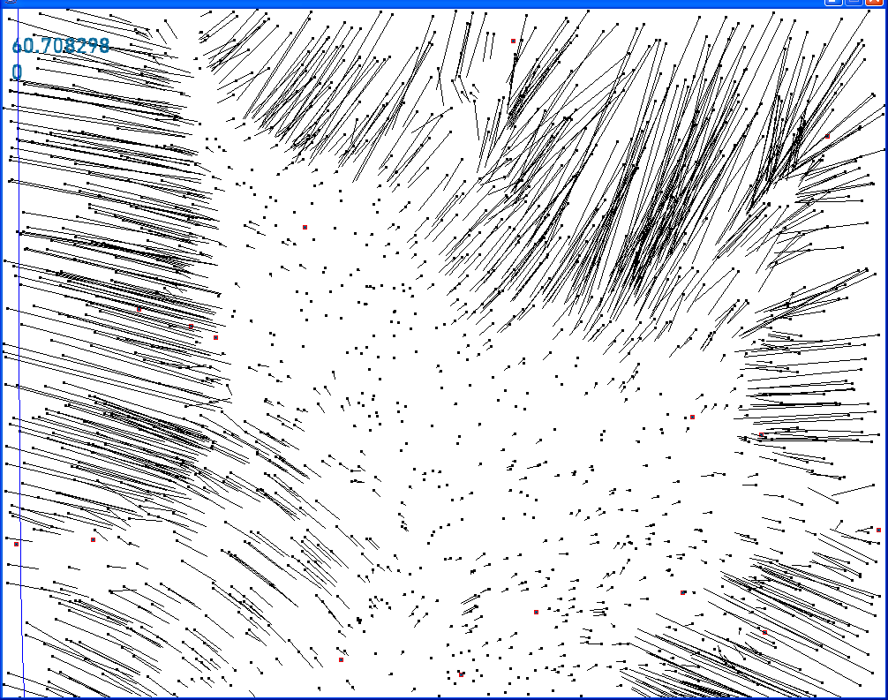
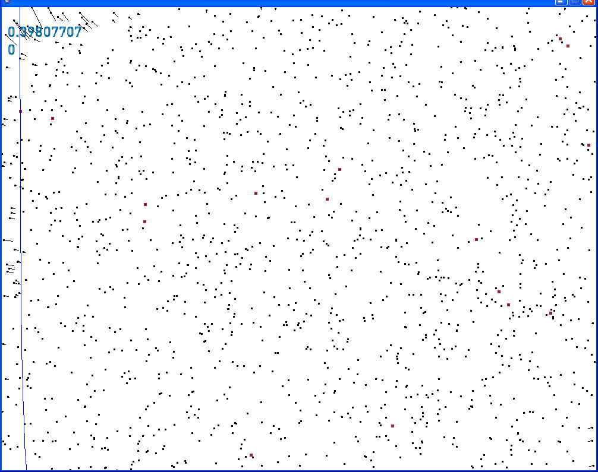
Initially Random
Exact positions
(Groundtruth)‏
Query+sensonomy
Notes:
<numéro>

Slide 51
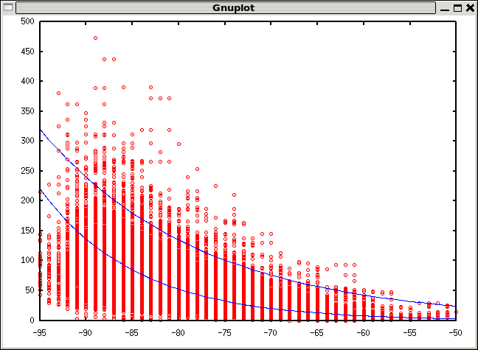
Evaluation: RSSI & distance to (known) Access points
(800 hotspot access points)‏
Distance（ｍ）
RSSI (Received Signal Strength) (dBm)‏
Notes:
<numéro>

Slide 52
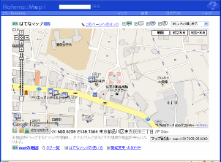
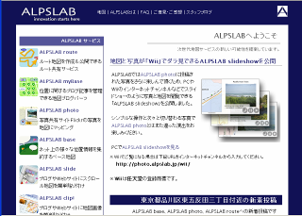
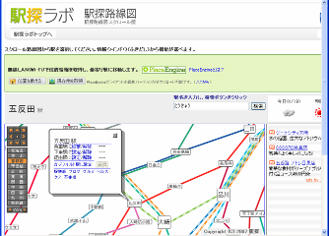
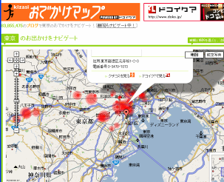
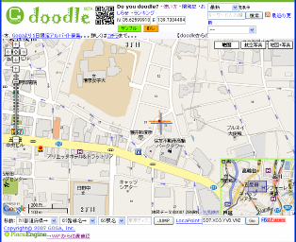
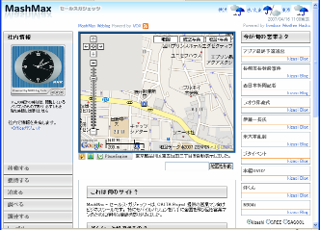
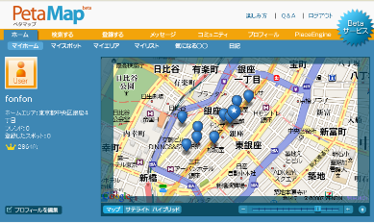
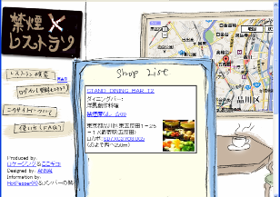
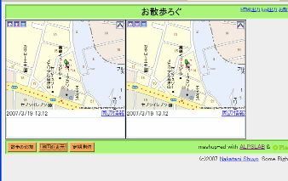
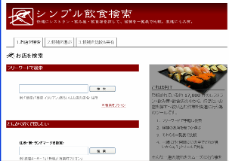
PlaceEngine API
MASH UP
Notes:
<numéro>

Slide 53
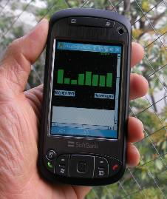
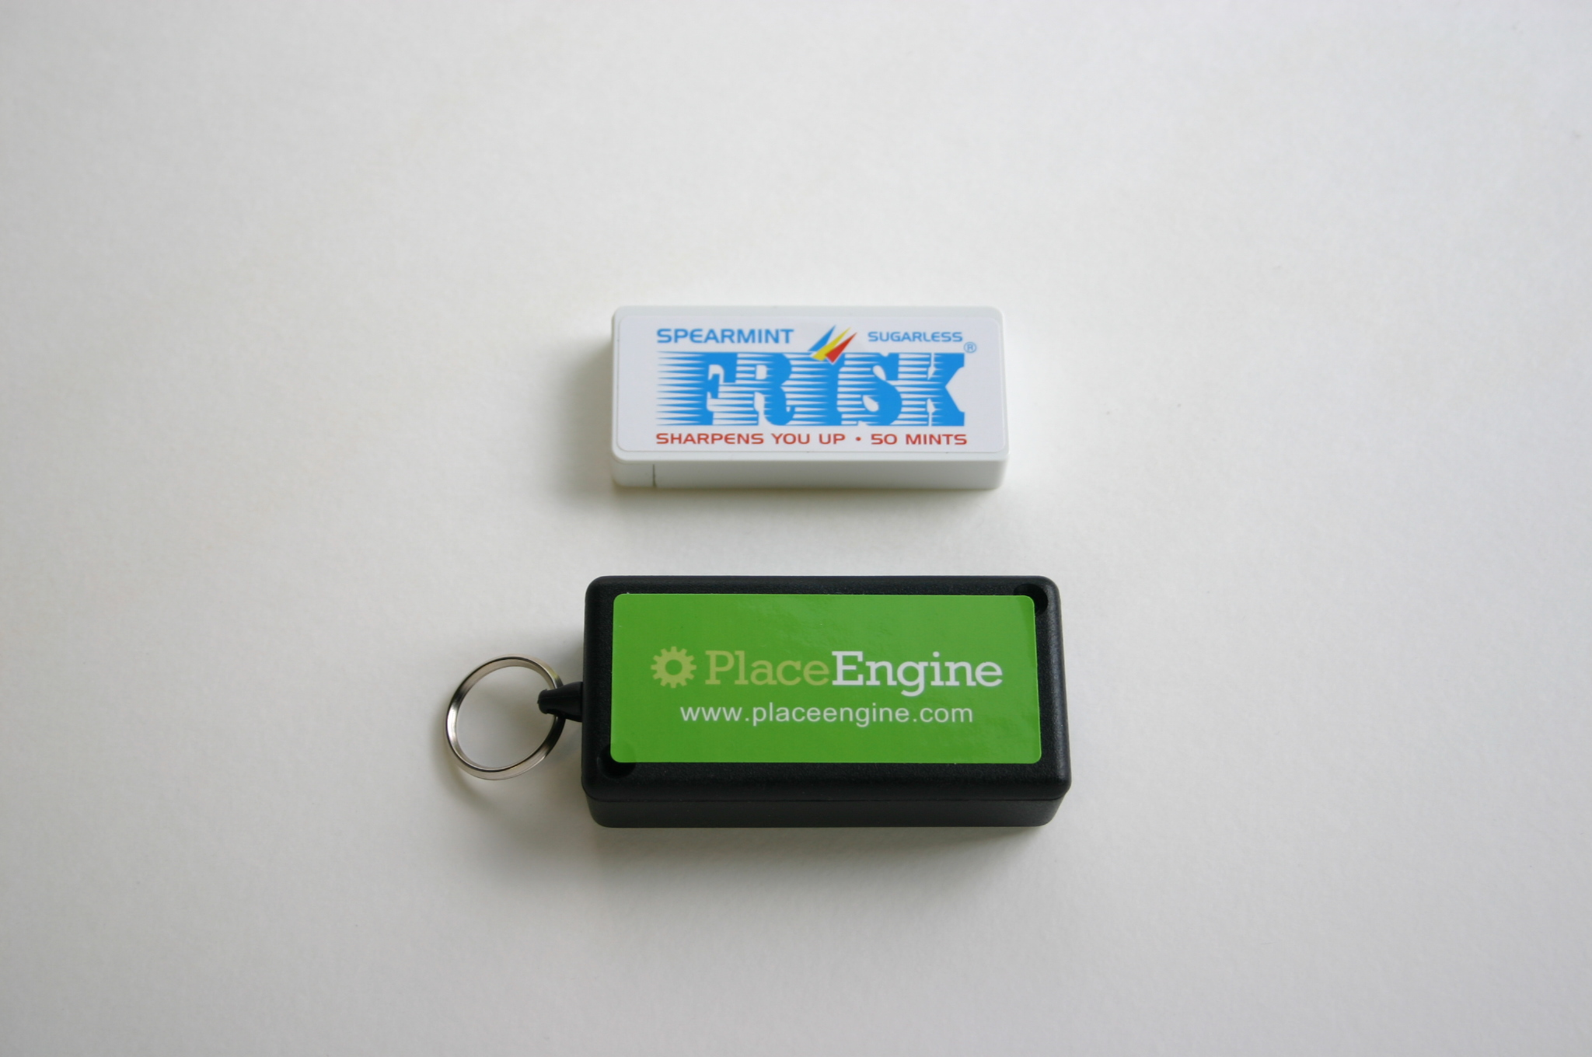
LifeTag
Location Life Logging
  WiFi positioning
  no operation, just carry
  works indoors & outdoors
WHEN = WHERE
  memory support
  life pattern analysis
  activity prediction
Notes:
<numéro>

Slide 54

LifeTag
LifeTag
AVR microcontroller
USB interface
USB interface
WiFi Module
Flash Memory
LIFETAG prototype 1
Notes:
<numéro>

Slide 55

GPS Logging
WiFi Logging
Indoor location
NO
YES
Intermittent operation
(for power saving)‏
NO
YES
Battery lifetime
10 hours
1 week
Notes:
<numéro>

Slide 56

Automatic Recording
Notes:
<numéro>

Slide 57

Life Bookmarking
Notes:
<numéro>

Slide 58
139.730518 35.625954 1157023605 wifi
139.730516 35.625955 1157023653 wifi
139.730518 35.625954 1157023714 wifi
139.730559 35.626012 1157023775 wifi
139.730343 35.626014 1157023837 wifi
139.72964 35.625728 1157023898 wifi
139.729264 35.625775 1157023959 wifi
139.727745 35.626497 1157024020 wifi
139.726077 35.626821 1157024081 wifi
139.725559 35.626941 1157024142 wifi
139.72485 35.627074 1157024203 wifi
139.724556 35.626261 1157024264 wifi
139.724315 35.626311 1157024325 wifi
139.724399 35.625942 1157024387 wifi
139.724283 35.626309 1157024448 wifi
139.715426 35.633614 1157024692 wifi
139.715033 35.63386 1157024753 wifi
139.715033 35.63386 1157024814 wifi
139.715033 35.63386 1157024875 wifi
139.715033 35.63386 1157024936 wifi
139.682615 35.60666 1157025607 wifi
139.664109 35.583979 1157025973 wifi
139.662247 35.581179 1157026034 wifi
139.659815 35.576127 1157026095 wifi
139.65462 35.565581 1157026253 wifi
139.648527 35.555817 1157026315 wifi
139.646514 35.552622 1157026377 wifi
139.639583 35.543508 1157026438 wifi
139.634768 35.53706 1157026499 wifi
139.63443 35.536479 1157026560 wifi
139.632995 35.535917 1157026621 wifi
139.632985 35.535898 1157026682 wifi
139.631946 35.535918 1157026743 wifi
139.724315 35.626311 1157024325 wifi
139.724399 35.625942 1157024387 wifi
139.724283 35.626309 1157024448 wifi
139.715426 35.633614 1157024692 wifi
139.715033 35.63386 1157024753 wifi
139.715033 35.63386 1157024814 wifi
139.715033 35.63386 1157024875 wifi
139.715033 35.63386 1157024936 wifi
139.682615 35.60666 1157025607 wifi
139.664109 35.583979 1157025973 wifi
139.730518 35.625954 1157023605 wifi
139.730516 35.625955 1157023653 wifi
139.730518 35.625954 1157023714 wifi
139.730559 35.626012 1157023775 wifi
139.730343 35.626014 1157023837 wifi
139.72964 35.625728 1157023898 wifi
139.729264 35.625775 1157023959 wifi
139.727745 35.626497 1157024020 wifi
139.726077 35.626821 1157024081 wifi
139.725559 35.626941 1157024142 wifi
139.72485 35.627074 1157024203 wifi
139.724556 35.626261 1157024264 wifi
139.724315 35.626311 1157024325 wifi
139.724399 35.625942 1157024387 wifi
139.724283 35.626309 1157024448 wifi
139.715426 35.633614 1157024692 wifi
139.715033 35.63386 1157024753 wifi
139.715033 35.63386 1157024814 wifi
139.715033 35.63386 1157024875 wifi
139.715033 35.63386 1157024936 wifi
139.682615 35.60666 1157025607 wifi
139.664109 35.583979 1157025973 wifi
139.662247 35.581179 1157026034 wifi
139.659815 35.576127 1157026095 wifi
139.65462 35.565581 1157026253 wifi
139.648527 35.555817 1157026315 wifi
139.646514 35.552622 1157026377 wifi
139.639583 35.543508 1157026438 wifi
139.634768 35.53706 1157026499 wifi
139.63443 35.536479 1157026560 wifi
139.632995 35.535917 1157026621 wifi
139.632985 35.535898 1157026682 wifi
139.631946 35.535918 1157026743 wifi
139.724315 35.626311 1157024325 wifi
139.724399 35.625942 1157024387 wifi
139.724283 35.626309 1157024448 wifi
139.715426 35.633614 1157024692 wifi
139.715033 35.63386 1157024753 wifi
139.715033 35.63386 1157024814 wifi
139.715033 35.63386 1157024875 wifi
139.715033 35.63386 1157024936 wifi
139.682615 35.60666 1157025607 wifi
139.664109 35.583979 1157025973 wifi
139.632995 35.535917 1157026621 wifi
139.632985 35.535898 1157026682 wifi
139.631946 35.535918 1157026743 wifi
139.724315 35.626311 1157024325 wifi
139.724399 35.625942 1157024387 wifi
139.724283 35.626309 1157024448 wifi
139.715426 35.633614 1157024692 wifi
139.715033 35.63386 1157024753 wifi
139.715033 35.63386 1157024814 wifi
139.715033 35.63386 1157024875 wifi
139.715033 35.63386 1157024936 wifi
139.682615 35.60666 1157025607 wifi
139.664109 35.583979 1157025973 wifi
139.730518 35.625954 1157023605 wifi
139.730516 35.625955 1157023653 wifi
139.730518 35.625954 1157023714 wifi
139.730559 35.626012 1157023775 wifi
139.730343 35.626014 1157023837 wifi
139.72964 35.625728 1157023898 wifi
139.729264 35.625775 1157023959 wifi
139.727745 35.626497 1157024020 wifi
139.726077 35.626821 1157024081 wifi
139.725559 35.626941 1157024142 wifi
139.72485 35.627074 1157024203 wifi
139.724556 35.626261 1157024264 wifi
139.724315 35.626311 1157024325 wifi
139.724399 35.625942 1157024387 wifi
139.724283 35.626309 1157024448 wifi
139.715426 35.633614 1157024692 wifi
139.715033 35.63386 1157024753 wifi
139.715033 35.63386 1157024814 wifi
139.715033 35.63386 1157024875 wifi
139.715033 35.63386 1157024936 wifi
139.682615 35.60666 1157025607 wifi
139.664109 35.583979 1157025973 wifi
139.662247 35.581179 1157026034 wifi
139.659815 35.576127 1157026095 wifi
139.65462 35.565581 1157026253 wifi
139.648527 35.555817 1157026315 wifi
139.646514 35.552622 1157026377 wifi
139.639583 35.543508 1157026438 wifi
139.634768 35.53706 1157026499 wifi
139.63443 35.536479 1157026560 wifi
139.632995 35.535917 1157026621 wifi
139.632985 35.535898 1157026682 wifi
139.631946 35.535918 1157026743 wifi
139.724315 35.626311 1157024325 wifi
139.724399 35.625942 1157024387 wifi
139.724283 35.626309 1157024448 wifi
139.715426 35.633614 1157024692 wifi
139.715033 35.63386 1157024753 wifi
139.715033 35.63386 1157024814 wifi
139.715033 35.63386 1157024875 wifi
139.715033 35.63386 1157024936 wifi
139.682615 35.60666 1157025607 wifi
139.664109 35.583979 1157025973 wifi
139.632995 35.535917 1157026621 wifi
139.632985 35.535898 1157026682 wifi
139.631946 35.535918 1157026743 wifi
139.724315 35.626311 1157024325 wifi
139.724399 35.625942 1157024387 wifi
139.724283 35.626309 1157024448 wifi
139.715426 35.633614 1157024692 wifi
139.715033 35.63386 1157024753 wifi
139.715033 35.63386 1157024814 wifi
139.715033 35.63386 1157024875 wifi
139.715033 35.63386 1157024936 wifi
139.682615 35.60666 1157025607 wifi
139.664109 35.583979 1157025973 wifi
139.724399 35.625942 1157024387 wifi
139.724283 35.626309 1157024448 wifi
139.715426 35.633614 1157024692 wifi
139.715033 35.63386 1157024753 wifi
139.715033 35.63386 1157024814 wifi
139.715033 35.63386 1157024875 wifi
139.715033 35.63386 1157024936 wifi
139.682615 35.60666 1157025607 wifi
139.664109 35.583979 1157025973 wifi
139.632995 35.535917 1157026621 wifi
139.632985 35.535898 1157026682 wifi
139.631946 35.535918 1157026743 wifi
139.724315 35.626311 1157024325 wifi
139.724399 35.625942 1157024387 wifi
139.724283 35.626309 1157024448 wifi
139.715426 35.633614 1157024692 wifi
139.715033 35.63386 1157024753 wifi
139.715033 35.63386 1157024814 wifi
139.715033 35.63386 1157024875 wifi
139.715033 35.63386 1157024936 wifi
139.682615 35.60666 1157025607 wifi
139.664109 35.583979 1157025973 wifi
Notes:
<numéro>

Slide 59

Rekimoto 8/26 PM
Notes:
<numéro>

Slide 60

LifeVector (subject “R”, 2006.8-2007.3)‏
Notes:
<numéro>

Slide 61

Notes:
<numéro>

Slide 62

Notes:
<numéro>

Slide 63

Notes:
<numéro>

Slide 64



Experience Arithmetic
user A
user B
=
&
user A and B’s common place
Notes:
<numéro>

Slide 65


Autonomous Traceability
Notes:
<numéro>

Slide 66

Notes:
<numéro>

Slide 67
Summary
PlaceEngine : location everywhere
Sensonomy = Realworld + Folksonomy
LifeTag: locaiton life-logging
  People’s complete location log
  Every object will have location log.
Privacy
Notes:
<numéro>

