Slide 1



INF 311
Introduction to Java programming
Lecture 5: Classes and Objects
Frank Nielsen
nielsen@lix.polytechnique.fr
Monday 26th May 2008

Slide 2
Agenda de la semaine (INF311)
Maintenant, Amphi 5: programmation objet (OO)
Cet apres-midi: TD3 (fonctions et recursion)
Mercredi 28 Mai (8h-12h15) : TD4 (tableaux et chaines)

Slide 3
So far...: Executive summary
Lecture 1: Variable, Expression, Assignment
Lecture 2: Loops (for while do)
              Conditional structures (if else switch)
Boolean predicate and connectors (|| &&)
Loop escape break
Lecture 3: functions (static) and recursion (terminal or not)
Lecture 4: Objects
2 Juin: Revisions generales pour la pale machine

Slide 4
Indenting source code (.java)
Increase code readibility
Avoid mistyping bugs (matching { })
Source code formatter, pretty printer, beautifier
Different conventions are possible (but choose one)
Implemented more or less in Software (S/W) Nedit, Jcreator, Jindent, etc...

Slide 5
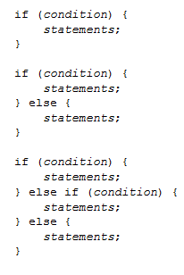
Identing source code (.java)
http://java.sun.com/docs/codeconv/
Examples for if else conditions

Slide 6



Indenting source code (.java)
http://java.sun.com/docs/codeconv/

Slide 7
Indenting source code (.java)
Bytecode size and indentation:
    Does not change fundamentally
Bytecode is not human readable
Demo Indent.java:
notepad
Jcreator
& produced bytecode Indent.class
open bytecode

Slide 8
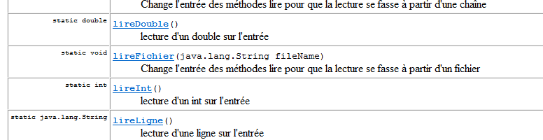
Identing source code (.java)
Sometimes in Java code (Internet), comments include commands
for generating automatically documentation by other tools:
... Like javadoc (paradigm literate programming, etc.)
La classe TC se trouve a:
http://www.enseignement.polytechnique.fr/informatique/profs/Julien.Cervelle/TC/
Class TC
http://java.sun.com/j2se/javadoc/

Slide 9
Functions in Java
Static functions that returns a type (eventually void)
Functions are called inside the main procedure
(or in other function body)
Displaying and calling function are different
(be not confused with SciLab or Maple
System.out.println(function());
Java is a compiled OO language , not an interpreter

Slide 10
Functions: void/display
Java cannot cast void type into a String,
so the compiler javac generates an error.
(type checking)
class Functions
{
static void PascalTriangle(int depth)
{//...
return ;
}
public static void main(String[] toto)
{
System.out.println(PascalTriangle(5));
}
}
'void' type not allowed here

Slide 11

Functions: void/display
Java is not an interpreter like SciLab or Maple
Functions are called within a block of instructions...
... not in the console!!!!
class Functions
{
static double f(double x)
{return x;}
static void main(String[] args)
{ }
}

Slide 12
Variables: static or not...
Static variables are declared in the class body
class Toto
{
static int count1, count2;
...
}
Otherwise non-static variables (usual) are
declared in function bodies (main, etc.)
public static void main(String[] args)
{double x;int i;}
Variables are kept in memory in their function scope {...}
Static variables are kept in memory and can be shared by
several functions...

Slide 13
static or not...
class Functions
{
static int count1, count2;
static void f1(){count1++;}
static void f2(){count2++;}
public static void main(String[] args)
{
count1=0;
count2=0;
for(int i=0;i<1000;i++)
{
double rand=Math.random();
if (rand<0.5)
{f1();}
else
{f2();}
}
System.out.println("count1:"+count1);
System.out.println("count2:"+count2);
}
}

Slide 14
class BadSwap
{
static void swap(int arg1, int arg2)
{
int tmp;
tmp=arg1;
arg1=arg2;
arg2=tmp;
}
public static void main(String[] toto)
{
int a=3;
int b=2;
System.out.println("a:"+a+" b:"+b);
swap(a,b);
System.out.println("After the swap...");
System.out.println("a:"+a+" b:"+b);
}
}
Java is pass by value
...and arrays and objects are pass by reference

Slide 15
Managing memory & functions
When calling a function f, the current function (main) indicates
.....where to write the value of the result
To obtain the result, function f uses a local memory
In that local memory, values of arguments are available
swap
//current function body {}
int a=3,b=2;
swap(a,b)
Value of arg1
Value of arg2
Value of tmp
Value of a
main
Value of b
Memory address

Slide 16
1. Create memory for local variables of function main
2. Assign values for a and b
static void swap(int arg1, int arg2)
{
int tmp;
tmp=arg1;
arg1=arg2;
arg2=tmp;
}
public static void main(String[] toto)
{
int a=3;
int b=2;
swap(a,b);
}
3
a
main
2
b
Memory address

Slide 17
3. create local space for function swap
static void swap(int arg1, int arg2)
{
int tmp;
tmp=arg1;
arg1=arg2;
arg2=tmp;
}
public static void main(String[] toto)
{
int a=3;
int b=2;
swap(a,b);
}
swap
arg1
arg2
tmp
3
a
main
2
b
Memory address

Slide 18
4. evaluate expression for getting values of arg1 and arg2
swap(a,b) becomes swap(3,2)
static void swap(int arg1, int arg2)
{
int tmp; // 0 is default value
tmp=arg1;
arg1=arg2;
arg2=tmp;
}
public static void main(String[] toto)
{
int a=3;
int b=2;
swap(a,b);
}
swap
3
arg1
2
arg2
0
tmp
3
a
main
2
b
Memory address

Slide 19
5. Execute instruction tmp=arg1
static void swap(int arg1, int arg2)
{
int tmp; // 0 is default value
tmp=arg1;
arg1=arg2;
arg2=tmp;
}
public static void main(String[] toto)
{
int a=3;
int b=2;
swap(a,b);
}
swap
3
arg1
2
arg2
3
tmp
3
a
main
2
b
Memory address

Slide 20
6. Execute instruction arg1=arg2
static void swap(int arg1, int arg2)
{
int tmp; // 0 is default value
tmp=arg1;
arg1=arg2;
arg2=tmp;
}
public static void main(String[] toto)
{
int a=3;
int b=2;
swap(a,b);
}
swap
2
arg1
2
arg2
3
tmp
3
a
main
2
b
Memory address

Slide 21
7. Execute the sequence of instructions in the swap block
Notice that here the swapped has been performed
static void swap(int arg1, int arg2)
{
int tmp; // 0 is default value
tmp=arg1;
arg1=arg2;
arg2=tmp;
}
public static void main(String[] toto)
{
int a=3;
int b=2;
swap(a,b);
}
swap
2
arg1
3
arg2
3
tmp
3
a
main
2
b
Memory address

Slide 22
5. Execute the sequence of instructions in the swap block
static void swap(int arg1, int arg2)
{
int tmp; // 0 is default value
tmp=arg1;
arg1=arg2;
arg2=tmp;
}
public static void main(String[] toto)
{
int a=3;
int b=2;
swap(a,b);
}
swap
2
arg1
3
arg2
3
tmp
3
a
main
2
b
Memory address

Slide 23
8. Return result of function swap (here void!!!)
9. Release memory allocated for swap
static void swap(int arg1, int arg2)
{
int tmp; // 0 is default value
tmp=arg1;
arg1=arg2;
arg2=tmp; // we omitted return ;
}
public static void main(String[] toto)
{
int a=3;
int b=2;
swap(a,b);
}
Variables a and b
have kept their original values
3
a
main
2
b
Memory address

Slide 24
Memory for static variables
class SwapStatic
{
static int a,b;
static void swap()
{
...
}
public static void main(String[] toto)
{
a=3;
b=2;
swap();
}
}
tmp
swap
0
main
3
a
2
b
Memory for static variables
of class SwapStatic
Memory address

Slide 25
class SwapStatic
{
static int a,b;
static void swap()
{
int tmp;// ok not to be static
tmp=a;
a=b;
b=tmp;
}
public static void main(String[] toto)
{
a=3;
b=2;
System.out.println("a:"+a+" b:"+b);
swap();
System.out.println("After the swap...");
System.out.println("a:"+a+" b:"+b);
}
}
By passing
using static

Slide 26
Memory for arrays and
pass by reference
Arrays are allocated a continuous memory location
for storing TYPE elements
The value of the array variable is a reference to the beginning of the array
tab[size-1]
TypeElement [ ] tab= new TypeElement[size]
tab[1]
tab[0]
Array variable tab is a reference
Memory for arrays (heap)

Slide 27
Memory management using new
Type [] tab=new Type[Expression];
Evaluate Expression to get an integer value.
Arrays are stored not in the local function memory,
  but rather in the global program memory:
heap, tas en francais
A cell (array element) in the heap (program memory)
is accessible by any function which has
as a local (non-static) variable a reference to the array.

Slide 28
class ArrayReference
{
public static void swap(int [] t, int i, int j)
{
int tmp;
tmp=t[i];
t[i]=t[j];
t[j]=tmp;
}
public static void Display(int [] tab){... »
public static void main(String[] args)
{
//int [] array=new int[10];
int [] array={0,1,2,3,4,5,6,7,8,9};
Display(array);
swap(array,1,2);
Display(array);
}
}
0 1 2 3 4 5 6 7 8 9
0 2 1 3 4 5 6 7 8 9

Slide 29
Memory management using new
class BuildArray{
// Return a reference to an array
public static int [] BuildArray(int size, int defaultval)
{
int [] result=new int[size];
for(int i=0;i<size;i++) result[i]=defaultval;
return result;
}
public static void Zero(int[] tab, int pos)
{
tab[pos]=0;
}
public static void main(String [] argarray)
{
int v []=BuildArray(10,4);
Display(v);
Zero(v,2);
Display(v);
}
...}
4 4 4 4 4 4 4 4 4 4
4 4 0 4 4 4 4 4 4 4

Slide 30

Today...
Lecture 5:
Classes and Objects

Slide 31
Synopsis of this lecture
Objects and records (fields, enregistrements)
Object constructors
Class type variables: References
Functions on objects: Methods
Array of objects
Examples

Slide 32

Why do we need objects?
Encapsulate functions/data acting on a same domain
For example, the String type
Allows one to work on complex entities: Data structures
For examples:
Dates are triplets of numbers (MM/DD/YYYY)
2D point with co-ordinates (x,y)
Student: Lastname, Firstname, Group, etc.
These are called object records (fields)
Java is an oriented-object (OO) programming language

Slide 33
Declaring classes and objects
Choose record/field names (enregistrement)
Define a type of each record
Similar to variables but without keyword static
Class is then a new type with name...
                ... the class name

Slide 34
Toy example
public class Date
{
int dd;
int mm;
int yyyy;
}
Fields (champs/enregistrements) are also called object variables
Do not have the leading keyword static
Let day be a variable of type Date then
day.dd day.mm dd.yyyy
are variables of type int

Slide 35
Toy example
public class Student
{
String Lastname;
String Firstname;
int Company;
double [ ] Marks;
...
}
Class Student encapsulates data attached to a student identity.

Slide 36
Constructors
To use an object, we first need to build it
We construct an object using the instruction new
But first, we need to define a constructor for the class
A constructor is a method (non-static function) ...
...bearing the class' name
This method does not return a result but assigns...
...values to the object's field
Use this.field to access field of the object

Slide 37
Constructors
public class Date
{
int dd;
int mm;
int yyyy;
// Constructor
public Date(int day, int month, int year)
{this.dd=day;
this.mm=month;
this.yyyy=year;}
}
Create an object of type Date
Date day=new Date(23,12,1971);

Slide 38
Public class YYY stored in YYY.java
public class Date
{
int dd;
int mm;
int yyyy;
public Date(int day, int month, int year)
{
this.dd=day;
this.mm=month;
this.yyyy=year;
}
}
class TestDate{
public static void main(String args)
{
Date day=new Date(23,12,1971);
}
}
Filename: Date.java
Filename: TestDate.java

Slide 39
Constructors
Possibly several constructors (with different signatures)
Best, to define a single one with all fields initialized
Keyword this means the currently built object
(not compulsory to write it explicitly but recommended)
public Date(int day, int month, int year)
{dd=day;
this.mm=month;
yyyy=year;
}
If no constructor is built, the system uses the by-default one
(not recommended)
Date day=new Date();// see poly pp. 59-61
day.yyyy=1971;

Slide 40
The null object
This object is common to all classes
Not possible to assign its fields
Nor retrieve values of its fields, either
(exception nullPointerException raised)
Used for initializing a variable of type object:
Student stud=null;
It is often recommender to check if an object is null or not:
if( stud!=null) stud.company=2;

Slide 41
Functions/methods on objects
Objects can be parameters of functions
static TypeF F(Object1 obj1, ..., ObjectN objN)
Functions may return an object as a result:
static boolean isBefore (Date d1, Date d2)
static Date readDate()

Slide 42
Example
public class Date
{
int dd;
int mm;
int yyyy;
public static final String[ ] months={
"January", "February", "March", "April", "May",
"June", "July", "August", "September", "October",
"November", "December"
};
// Constructor
public Date(int day, int month, int year)
{
this.dd=day;
this.mm=month;
this.yyyy=year;
}
}

Slide 43

class TestDate{
static void Display(Date d){
System.out.println("The "+d.dd+" "+Date.months[d.mm-1]+" of "+d.yyyy);
}
static boolean isBefore(Date d1, Date d2)
{
boolean result=true;
if (d1.yyyy>d2.yyyy) result=false;
if (d1.yyyy==d2.yyyy && d1.mm>d2.mm) result=false;
if (d1.yyyy==d2.yyyy && d1.mm==d2.mm && d1.dd>d2.dd) result=false;
return result;
}
public static void main(String[] args)
{
Date day1=new Date(23,12,1971);
Display(day1);
Date day2=new Date(23,6,1980);
System.out.println(isBefore(day1,day2));
}
}
Example

Slide 44
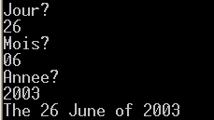
class TestDate{
...
static Date lireDate()
{
int jj, mm, aaaa;
System.out.println("Jour?");
jj=TC.lireInt();
System.out.println("Mois?");
mm=TC.lireInt();
System.out.println("Annee?");
aaaa=TC.lireInt();
Date day=new Date(jj,mm,aaaa);
return day;
}
public static void main(String[] args)
{
Display(lireDate());
}
}

Slide 45

Variable of Type Object: Reference
A variable of type Object is a reference on that object
It stores the memory address of this referenced object
Thus when we write:
Date day1=new Date(23,12,1971);
Date day2=day1;
Display(day2);
day2.mm=6;
Display(day1);
The date d1 is not copied, only the reference of...
...d1 is assigned to d2

Slide 46
Copying objects...
To copy (clone) an object to another we need to do it fieldwise
// Two Scenarii:
// day2 has already been created...
day2.dd=day1.dd;
day2.mm=day1.mm;
day2.yyyy=day1.yyyy;
// day2 object has not yet been created...
static Date Copy(date day1)
{
Date newdate=new Date (day1.dd,day1.mm,day1.yyyy);
return newdate;
}
...
Date d2=Copy(d1);

Slide 47
Comparing two objects...
Do not use == for object equality
To compare objects, use a tailored predicate:
static boolean isEqual(Date d1, Date d2)
{
return (d1.dd == d2.dd &&
d1.mm == d2.mm &
d1.yyyy== d2.yyyy);
}

Slide 48

Comparing two objects...
public static void main(String[] args)
{
Date day1=new Date(23,12,1971);
Date day2=day1; // beware not copying here. Just memory reference
Date day3=new Date(23,12,1971);
System.out.println(isEqual(day1,day3));
System.out.println(day1);
System.out.println(day2);
System.out.println(day3);
}
Physical (memory) versus logical equality

Slide 49
Array of objects
Since classes defines new types...
            ... we can create array of objects
To build an array of objects: new nameT[sizearray]
Date [ ] tabDates=new Date[31];
When an array of object is built, the elements Date[i]
are all initialized to the null object.

Slide 50
Example
public class XEvent
{
Date when;
String what;
public XEvent(Date d, String text)
{
this.when=d;
this.what=text;
}
}
Filename XEvent.java
public class Date
{
...
void Display()
{
System.out.println(dd+" "+months[mm-1]+" "+yyyy);
}
...
}
Filename Date.java

Slide 51
public class TestXEvent
{
public static void Display(XEvent e)
{
System.out.print(e.what+": ");
e.when.Display();
}
public static void main(String [] args)
{
Date d1=new Date(26,6,2008);
XEvent e1=new XEvent(d1,"Birthday Julien");
Display(e1);
XEvent [] tabEvent=new XEvent[5];
tabEvent[0]=e1;
}
}

Slide 52

public class TestXEvent
{public static void Display(XEvent e)
{ System.out.print(e.what+": ");
e.when.Display(); }
public static boolean older(XEvent e1, XEvent e2)
{return Date.isBefore(e1.when,e2.when);}
public static XEvent oldest(XEvent[] tab)
{
XEvent result=tab[0];
for(int i=1;i<tab.length;++i)
if (older(tab[i],result)) result=tab[i];
return result;
}
public static void main(String [] args)
{
Date d1=new Date(26,6,2003);
XEvent e1=new XEvent(d1,"Birthday Julien");
Date d2=new Date(20,11,2000);
XEvent e2=new XEvent(d2,"Birthday Audrey");
Date d3=new Date(23,6,1971);
XEvent e3=new XEvent(d3,"Birthday Me");
Display(e1);
XEvent [] tabEvent=new XEvent[3];
tabEvent[0]=e1;tabEvent[1]=e2;tabEvent[2]=e3;
System.out.print("Oldest person::");Display(oldest(tabEvent));
}
}

Slide 53
Objects with array members
Fields of objects may be arrays themselves
always built with new Type[sizearray]
// sizearray might be an expression, i.e., 3*n+2
It is not necessary at compile time to know statically...
.... the array sizes
class Polynome{
int degree;
double [ ] coefficients;
};

Slide 54
Strings: Basic objects in Java
A string of character is an object with type String
A variable of type String is a reference on that object:
String school= ''Ecole Polytechnique'';
String vars=school;
Once built, a string object cannot be modified
Beware: use only for moderate length strings,
otherwise use the class StringBuffer

Slide 55
Class String: Some methods
A method is a function or procedure on an object class
Method Length() : gives the number of characters
String s= ''anticonstitutionnellement'';
System.out.println(s.length());
Method equals():
s1.equals(s2): Predicate that returns true if and only if the
two strings s1 and s2 are made of the same sequence of characters.
String s1=''Poincare'';
String s2=TC.lireMotSuivant();
System.out.println(s1.equals(s2));
Beware: s1==s2 is different!
It compares the reference of the strings.
(Physical versus logical equality test)

Slide 56
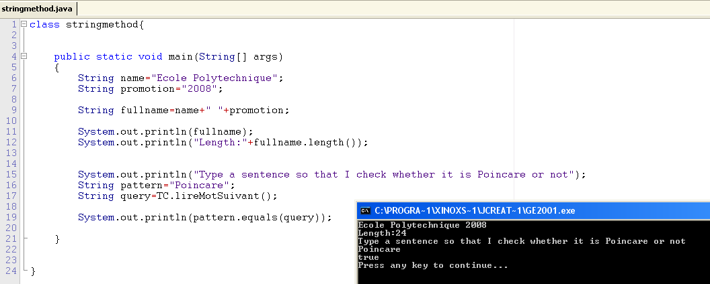
Class String in action...

Slide 57
Class String: More methods
Method charAt():
s.charAt(i) gives the character at the (i+1)th position in string s.
String s= ''3.14159265'';
System.out.println(s.charAt(1));

Slide 58

Method compareTo():
u.compareTo(v) compares lexicographically the strings u with v.
String u=''lien'', v=''lit'', w=''litterie'';
System.out.println(u.compareTo(v));
System.out.println(v.compareTo(w));
From Javadoc...
http://java.sun.com/j2se/1.4.2/docs/api/java/lang/String.html

Slide 59
Lexicographic total order on strings
If there is a position k at which strings differ:
this.charAt(k)-anotherString.charAt(k):
String s1="Marin",s2="Martin"; // -11 from i to t
int index=3;// meaning 4th pos
System.out.println(s1.compareTo(s2));
System.out.println(s1.charAt(index)-s2.charAt(index));
else the difference of string lengths:
this.length()-anotherString.length():
String s3="Bien",s4="Bienvenue";
System.out.println(s3.compareTo(s4));
System.out.println(s3.length()-s4.length());

Slide 60
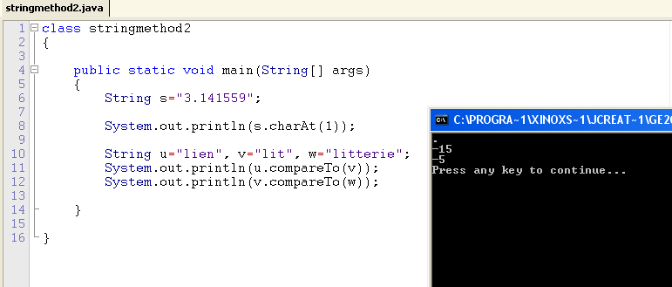
Class String: More methods

Slide 61
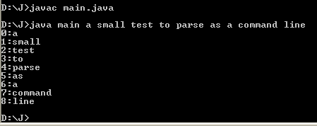
Demystifying the main function
class ClassName
{
public static void main(String[ ] args)
{
...
}
}
Function main has an array of string of characters as arguments
These strings are stored in args[0], args[1], ...
... when calling java main s0 s1 s2 s3
Use Integer.parseInt() to convert a string into an integer

Slide 62
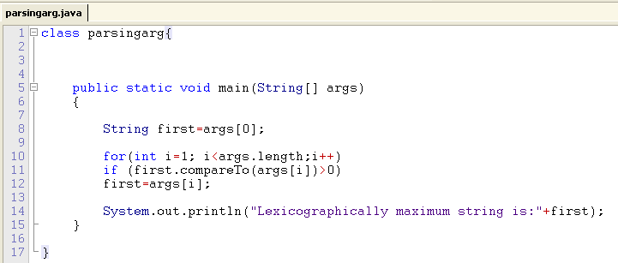

Parsing arguments in the main function

Slide 63
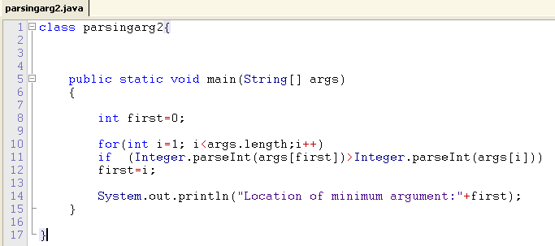

Parsing arguments in the main function

Slide 64
class Point
{
int x,y;
Point(int xx, int yy){x=xx;y=yy;}
public void Display()
{System.out.println("("+x+","+y+")")}
} // end of class Point
class Skeleton
{
// Static class variables
static int nbpoint=0;
static double x;
static boolean [] prime;
static int f1(int p){return p/2;}
static int f2(int p){return 2*p;}
public static void main(String [] argArray)
{
System.out.println(f2(f1(3))+" versus (!=) "+f1(f2(3)));
Point p,q;
p=new Point(2,1); nbpoint++;
q=new Point(3,4); nbpoint++;
p.Display();q.Display();
} }
More evolved Java
program skeleton...
2 versus (!=) 3
(2,1)
(3,4)

