Slide 1



INF 311
Introduction to Java programming
Lecture 6: Rehearsal / Révisions
(pour la pale machine du 4 Juin 2008)
Frank Nielsen
nielsen@lix.polytechnique.fr
Monday, 2nd June 2008

Slide 2







Feel free to ask questions!!!
Philippe Chassignet
Salle 31
Groupes 1 & 7
philippe.chassignet@polytechnique.edu
David Monniaux
Salle 32
Groupes 2 & 8
david.monniaux@ens.fr
Etienne Duris
Salle 33
Groupes 3 & 9
etienne.duris@univ-paris-est.fr
Olivier Serre
Salle 34
Groupes 4 & 10
serre@liafa.jussieu.fr
Stephane Redon
Salle 35
Groupes 5 & 11
stephane.redon@inria.fr
Yann Hendel
Salle 36
Groupes 6 & 12
hendel@lix.polytechnique.fr

Slide 3
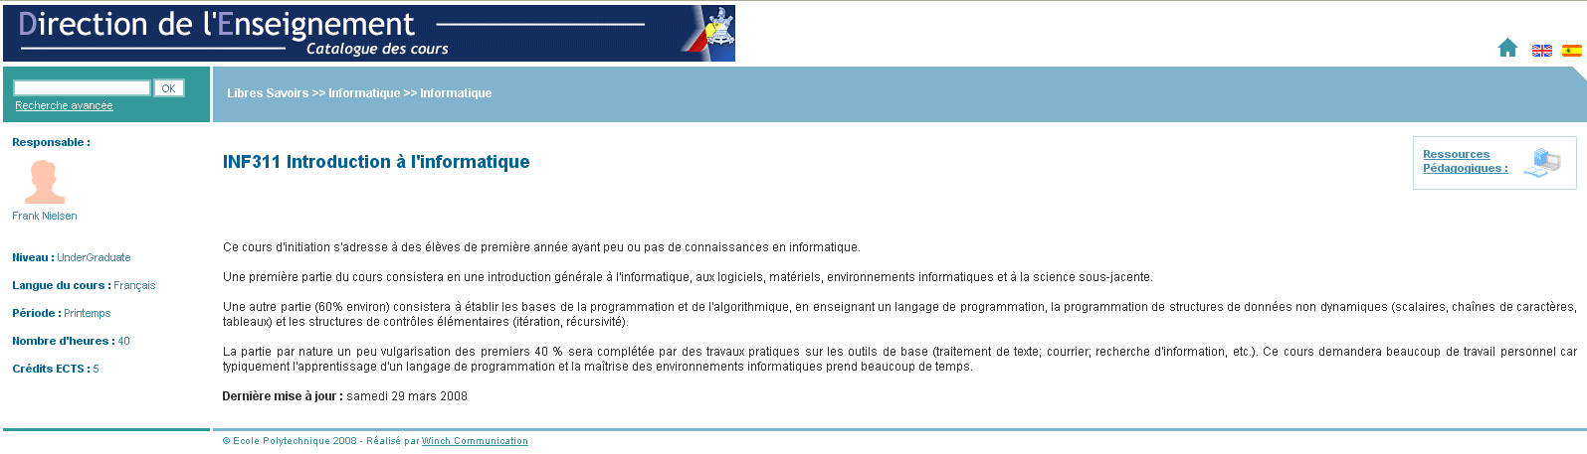
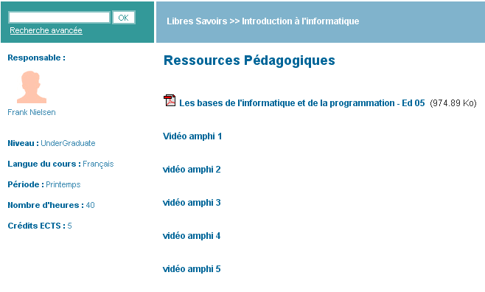
Videos of lectures are online
http://www.catalogue.polytechnique.fr/cours.php?id=2385
Cannot watch these videos?
Contact DSI
http://www.dsi.polytechnique.fr/
or
Coard Jean-Paul (M.)
<Jean-Paul.Coard@Polytechnique.edu>

Slide 4

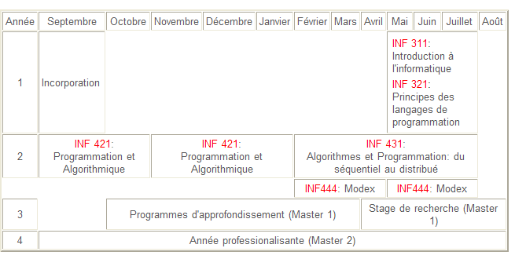
Computer Science at Ecole Polytechnique
http://www.enseignement.polytechnique.fr/informatique/
INF311 half-road!!!
Filiere Image
MPRI, etc.
Theses (Ph. D)

Slide 5
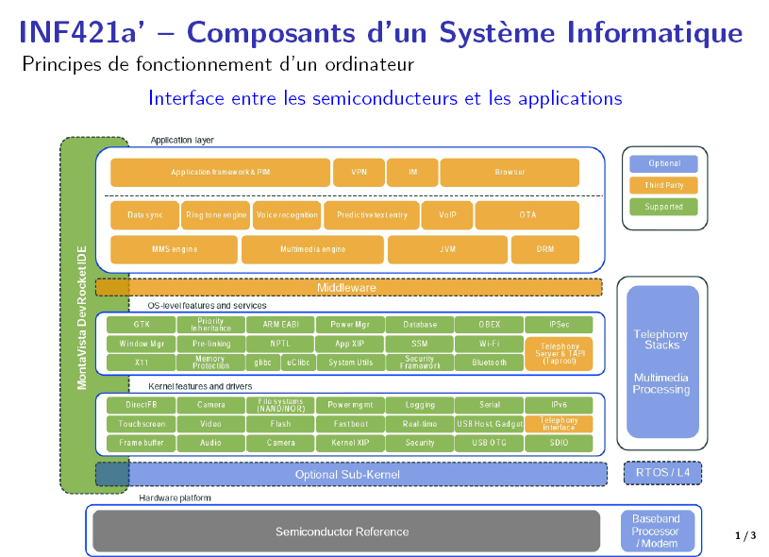

Slide 6
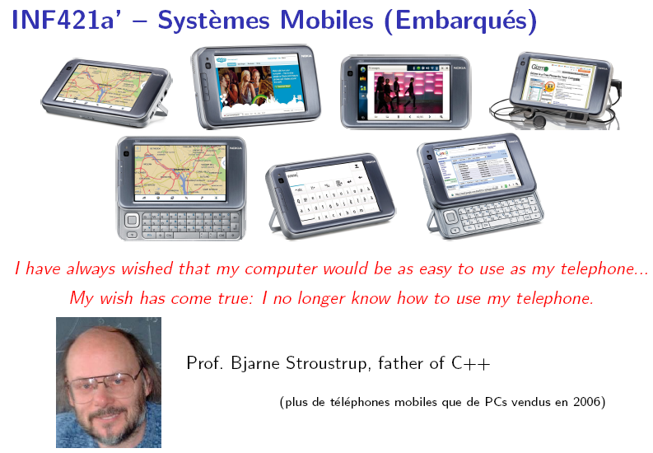
Serveurs et virtualizations

Slide 7

Agenda
Lecture 6: Rehearsal
(pour la pale machine,Mercredi 4 Juin)
TD5: This afternoon
TD6: Pale machine, Mercredi 4 Juin
Lectures 7, 8,9 ,10:
Java Programming
+
Basic Algorithms/Data-Structures

Slide 8
Bien preparer la pale machine
Lire le polycopie (4 chapitres): pages 11-57
Finir les TDs (salle machine)
S'entrainer avec les annales
Bien comprendre et maitriser:
- variables, affectation
- typage et regle de coercion
- fonctions (statiques)
- passage par valeur
- tableaux et passage par reference
- pile d'execution (et appels recursifs)
- chaines de caracteres & String (compareTo)

Slide 9
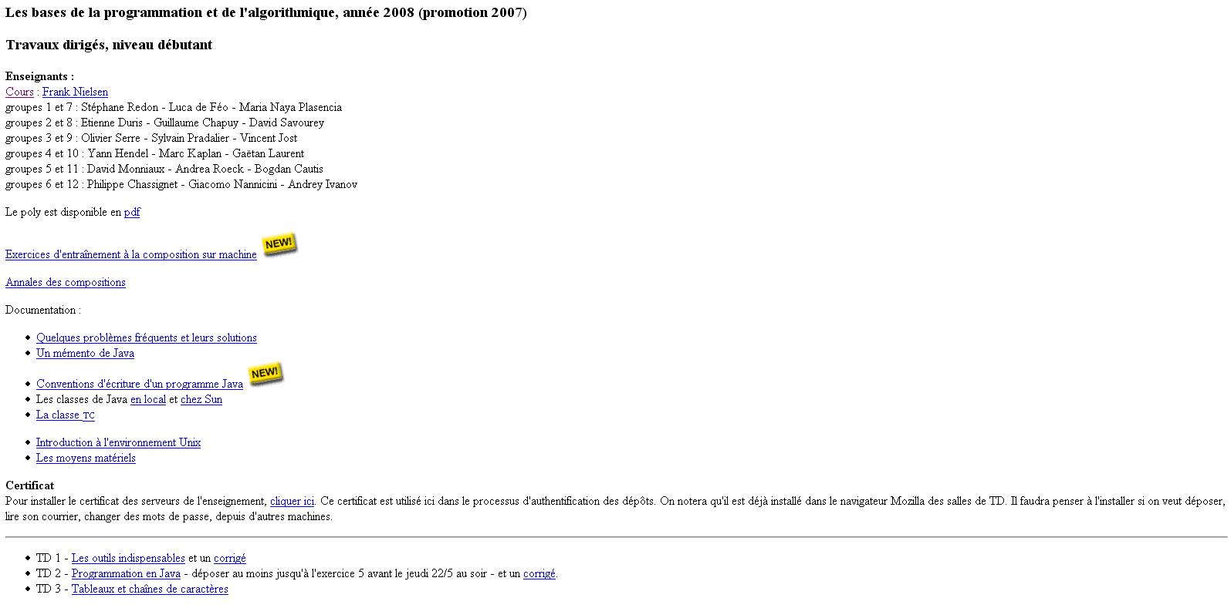
Bien preparer la pale machine
URL page TD:
http://www.dix.polytechnique.fr/INF311/TD_08/
https://www.enseignement.polytechnique.fr/informatique/INF311/TD_08/INF311-entrainement-1.php

Slide 10


Answering
Questions
Frank Nielsen
nielsen@lix.polytechnique.fr

Slide 11
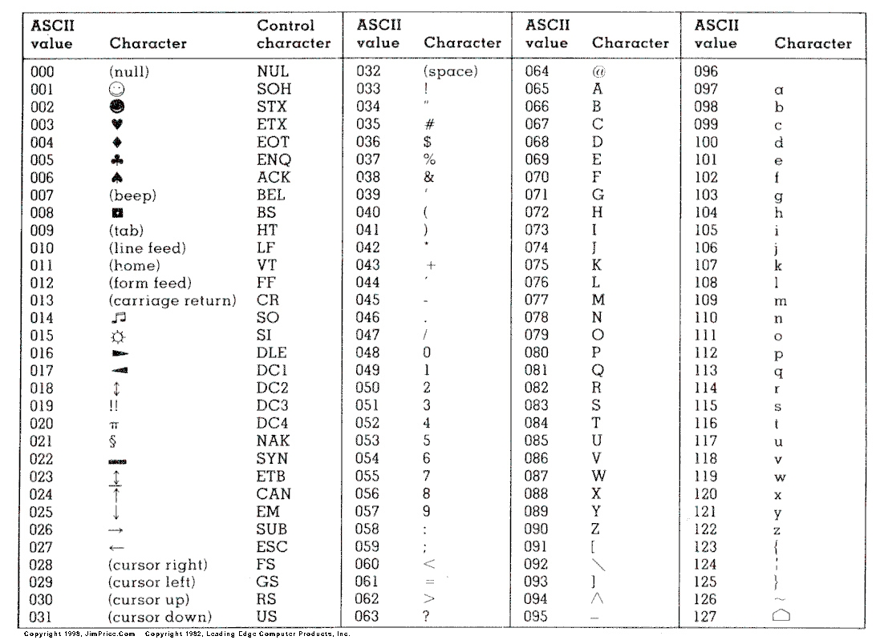

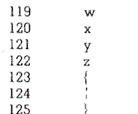
Lexicographic order... characters
American Standard Code for Information Interchange (ASCII)
Distance between two characters:
          =span in ASCII code table
Java distinguishes lower/upper cases: A is not a
Java codes char using two bytes (UNICODE)
http://en.wikipedia.org/wiki/ASCII

Slide 12
Lexicographic order... characters
char c1,c2;
c1='a';
c2='z';
// Compare character code
if (c1<c2)
{System.out.println(c1+" is before "+c2);}
else
{System.out.println(c1+" is after or equal to "+c2);}
int codec1=c1; // type casting/conversion
int codec2=c2; // type casting conversion
System.out.println("Code ASCII for "+c1+":"+codec1);
System.out.println("Code ASCII for "+c2+":"+codec2);
a is before z
Code ASCII for a:97
Code ASCII for z:122

Slide 13
String method compareTo():
u.compareTo(v) compares lexicographically the strings u with v.
String u="Polycopie", v="Polytechnique";
System.out.println(u.compareTo(v));
// => -17
Polycopie
Polytechnique
c:99
t:116
-17
Differ at fifth position: return 'c'-'t'=-17
(using ASCII code value)
System.out.println("c:"+(int)'c');
System.out.println("t:"+(int)'t');
int diff='c'-'t';
System.out.println(diff);

Slide 14
Lexicographic order... characters
String method compareTo():
u.compareTo(v) compares lexicographically the strings u with v.
In case there is no place characters differ, then
0 if strings are perfectly identical
Length(u) – Length(v) otherwise (substring)
String a="champagne",b="champ";
System.out.println(a.compareTo(b));
System.out.println(a.length()-b.length());
champagne
champ
9-5=4

Slide 15
Lexicographic order... strings
// Static function for comparing two strings
static int LexicographicOrder(String p, String q)
{
int i=0;
while(i<p.length() && i<q.length())
{
if (p.charAt(i)==q.charAt(i))
i++;
else
return p.charAt(i)-q.charAt(i);
}
return p.length()-q.length();
}
...
String p="Papillon", q="Papier", r="Papillonner";
System.out.println(LexicographicOrder(p,q)); //7
System.out.println(LexicographicOrder(p,r)); //-3

Slide 16
Converting lower to upper cases
//
// Convert to upper case
//
static String LowerToUpper(String s)
{
String result="";
char c;
for(int i=0;i<s.length();i++)
{
c=(char)(s.charAt(i)-32); //32=2^5
result+=c; //concatenation, append c to result
}
return result;
}
...
String s=LowerToUpper("convert a simple sentence");

Slide 17
Testing equality of characters
class TestEquality
{
// In Java, characters are stored using two bytes
//(for UNICODE, 65K characters)
public static void Identical(char c1, char c2)
{
System.out.println("Integer code for char "+c1+":"+(int)c1);
System.out.println("Integer code for char "+c2+":"+(int)c2);
if (c2==c1) System.out.println("Characters are identical:"+c1+"="+c2);
else
System.out.println("Characters are different:"+c1+"<>"+c2);
}
public static void main(String[] args)
{
char c1,c2;
Identical('a','A');
Identical('a','a');
Identical('a','b');
}
}
Integer code for char a:97
Integer code for char A:65
Characters are different:a<>A
Integer code for char a:97
Integer code for char a:97
Characters are identical:a=a
Integer code for char a:97
Integer code for char b:98
Characters are different:a<>b

Slide 18
Strings: Testing physical equality
public static void PhysicalIdentical(String c1, String c2)
{
if (c2.compareTo(c1)==0)
{ System.out.println("Strings are identical:"+c1+"="+c2);
}
else
{
System.out.println("Strings are different:"+c1+"<>"+c2);
}
}
String s1="Coucou",s2="Coucou", s3=s1, s4="Salut";
PhysicalIdentical(s1,s2);
PhysicalIdentical(s3,s1);
PhysicalIdentical(s1,s4);
...
Strings are identical:Coucou=Coucou
Strings are identical:Coucou=Coucou
Strings are different:Coucou<>Salut
Physical = Are the contents the same?
Logical (references) equality => Physical equality

Slide 19
Testing equality
Physical = Are the contents the same?
public static void Message(boolean b)
{
if (b) System.out.println("Equal");
else System.out.println("Different");
}
public static boolean PhysicalIdentical(int [] tab1, int [] tab2)
{
if (tab1.length!=tab2.length)
return false;
else
{
for(int i=0;i<tab1.length;i++)
if (tab1[i]!=tab2[i])
return false;
}
return true;
}
int [] t1={1,2,3};
int [] t2={2,3,4};
int [] t3={1,2,3};
int [] t4=t1;
Message(PhysicalIdentical(t1,t4));
Message(PhysicalIdentical(t1,t3));
Message(PhysicalIdentical(t1,t2));
Equal
Equal
Different

Slide 20

Testing equality
Logical = Are the references the same?
public static boolean LogicalIdentical(int [] tab1, int [] tab2)
{
System.out.println("References:"+tab1+" "+tab2);
if (tab1!=tab2)
return false;
else
return true;
}
References:[I@3e25a5 [I@3e25a5
Equal
References:[I@3e25a5 [I@19821f
Different
References:[I@3e25a5 [I@addbf1
Different
int [] t1={1,2,3};
int [] t2={2,3,4};
int [] t3={1,2,3};
int [] t4=t1;
Message(LogicalIdentical(t1,t4));
Message(LogicalIdentical(t1,t3));
Message(LogicalIdentical(t1,t2));
Caution!
You can be logically different
but physically identical:
See test (t1,t3)

Slide 21
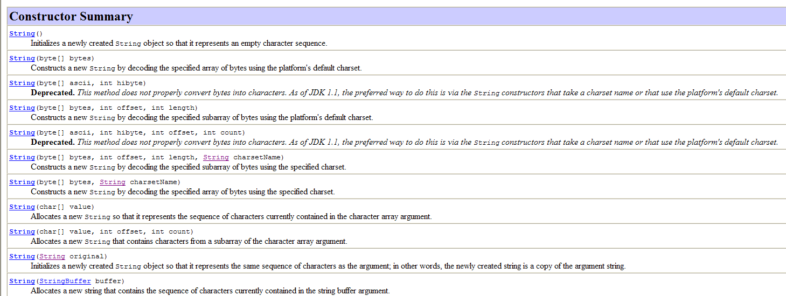
Strings...: if you want to know more
Use methods/constructors(11) described in the documentation (javadoc)
Tutorial at http://java.sun.com/docs/books/tutorial/java/data/strings.html
Eleven constructors!!!!

Slide 22

Managing/reporting errors
class TestException
{
public static double [] AddVector(double [] v1, double [] v2)
{
double [] result=new double[v1.length];
for(int i=0;i<v1.length;i++)
result[i]=v1[i]+v2[i];
return result;
}
public static void main(String [] args)
{
double [] x={1.0, 2/3.0};
double [] y={0.5, 0.2};
double [] z={0.0, 1.0, 2.0};
double [] a=AddVector(x,y);
double [] b=AddVector(x,z);
}
}
Place sentinels to avoid program misuses.
Magic formula:
throw new RuntimeException("message")

Slide 23
Magic formula:
throw new RuntimeException("message")
class TestException
{
public static double [] AddVector(double [] v1, double [] v2)
{
double [] result=new double[v1.length];
if (v1.length!=v2.length)
throw new RuntimeException("Vectors do not have same dimension!");
for(int i=0;i<v1.length;i++)
result[i]=v1[i]+v2[i];
return result;
}
public static void main(String [] args)
{
double [] x={1.0, 2/3.0};
double [] y={0.5, 0.2};
double [] z={0.0, 1.0, 2.0};
double [] a=AddVector(x,y);
double [] b=AddVector(x,z);
}
}
Exception in thread "main" java.lang.RuntimeException: Vectors do not have same
dimension!
at TestException.AddVector(TestException.java:9)
at TestException.main(TestException.java:24)

Slide 24
Writing safe programs is hard
(programs that do not crash)
public static double [] AddVector(double [] v1, double [] v2)
{
double [] result=new double[v1.length];
if (v1==null || v2==null || v1.length!=v2.length)
throw new RuntimeException("Vectors do not have same dimension!");
for(int i=0;i<v1.length;i++)
result[i]=v1[i]+v2[i];
return result;
}
...
double [] w=null;
double [] c=AddVector(x,w);
...
Exception in thread "main" java.lang.RuntimeException: Vectors do not have same
dimension!
at TestException.AddVector(TestException.java:9)
at TestException.main(TestException.java:24)
How do you know that this function is always safe?
=> In practice: You need to prove it (eg., static analysis)

Slide 25
Functions can have objects as arguments...
... and also return an object as a result:
public static ObjRes Function(Obj1 o1, ..., ObjN oN)
{
ObjRes result=new ObjRes();
...
return result;
}
Static function returns an object ObjRes
Objects given as parameters

Slide 26
class Obj1{} // Default constructor
class Obj2{}
class Obj3{}
class Obj4{}
class Obj5{}
class ObjRes{}
class TestObject
{
public static ObjRes F(Obj1 o1, Obj2 o2, Obj3 o3, Obj4 obj4, Obj5 obj5)
{
ObjRes res=new ObjRes();
return res;
}
public static void main(String [] args)
{
Obj1 obj1=null;
Obj2 obj2=null;
Obj3 obj3=null;
Obj4 obj4=null;
Obj5 obj5=null;
ObjRes res;
res=F(obj1, obj2,obj3, obj4, obj5);
}
}

Slide 27
Question on:
Static functions and non-static methods on objects
Static functions of a class (INF311)
Non-static functions of a class are methods (OO)
class Date
{int dd;int mm;int yyyy;
public static final String[ ] months={
"January", "February", "March", "April", "May","June", "July", "August", "September", "October",
"November", "December" };
// Static function
public static void Display(Date day)
{System.out.println(day.dd+" "+months[day.mm-1]+" "+day.yyyy); }
// Method for the object date
void Display()
{System.out.println(this.dd+" "+months[this.mm-1]+" "+this.yyyy); }
// Constructor
public Date(int day, int month, int year)
{
this.dd=day;
this.mm=month;
this.yyyy=year;
}
}

Slide 28
...
// Static function
public static void Display(Date day)
{System.out.println(day.dd+" "+months[day.mm-1]+" "+day.yyyy); }
// Method for the object date
void Display()
{System.out.println(dd+" "+months[mm-1]+" "+yyyy); }
...
public static void main(String[] args)
{
Date day1=new Date(23,12,1971);
Date day2=day1; // beware not copying here. Just memory reference
Date day3=new Date(23,12,1971);
System.out.println(isEqual(day1,day3));
System.out.println(day1);
System.out.println(day2);
System.out.println(day3);
// call static function Display (give object as argument)
Date.Display(day1);
// call the method on the object (no args)
day1.Display();
}

Slide 29
Question on:
Objects, reserved keywords, and type
Declaring a class Object => new type Object created
But Object does not become a reserved keyword.
class TestD
{
public static void main(String[] args)
{
System.out.println("Type de la classe");
Date d=new Date(27,05,2008);
int Date=3;
d.Display();
System.out.println("La valeur entiere de la var Date est:"+Date);
// Date.Display(d); invalid!!!
// Date is now considered as a variable of type int
}
}
Compiler and semantic of source codes
Convention: var begins with lower case
class begins with an upper case

Slide 30


Today...
Lecture 6:
Rehearsal
Finir les TDs
S'entrainer (annales)
Lire le polycopie

Slide 31
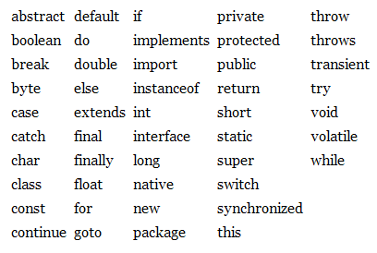
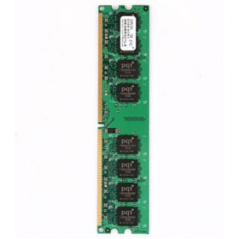
The Fundamentals.
I.1. Variable: Declaration
A variable is uniquely named (not a reserved keyword)
A variable stores a value in a memory slot (reference)
A variable has a type
A=32;
B=16;
int A;
int B;
A
B
32
16
Variable declaration
Check types at compilation
Memory bank

Slide 32
The Fundamentals.
I.2. Variable: Assignment
var=value;
Stores value at memory location referenced by var
Thus the semantic of a variable in assignment is:
Left hand side: (memory) reference
Right hand side: value

Slide 33
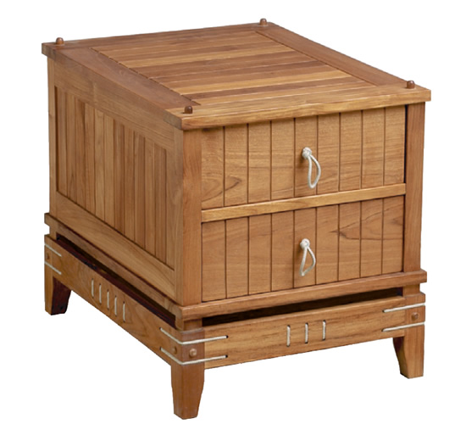
The Fundamentals.
I.2. Variable: Variable assignment
varQ=varP;
Get the value at memory location referenced by varP
Store that value at memory location referenced by varQ
Left hand side is STORE......................Insert
Right hand side is GET.........................Retrieve
STORE(varQ)=GET(varP);

Slide 34
The Fundamentals.
I.3. Variable: Incrementing
var=var+constant;
Get the value at memory location @var referenced by var
Increment that value by the constant
Store the incremented result at memory @var
var+constant is a well-formed expression
var+=constant;

Slide 35
The Fundamentals.
I.4. Variable: Pre-/post-Incrementing
var=var+1;
++var;
var++;
Pre-incrementation:
increment var by one
return the value of var
Post-incrementation:
return the value of var
increment var by one
++/-- are unary operators (in expressions)

Slide 36
The Fundamentals.
I.5. Variable: Expression Assignment
var=Expression;
var=16;
var=14*3/5-2*3;
Evaluate Expression, and then
Store the value at memory location referenced by var
var=Expr1 op Expr 2;
var=varP*varQ-3;
var=varP%3-5*2;

Slide 37
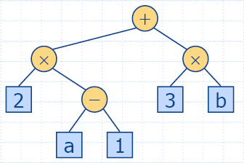
The Fundamentals.
I.5. Expressions: Priority rules
var=ComplexExpression;
M=325%27; // Integer division (modulo)
delta=b*b-4*a*c;
internal nodes: operators
external nodes: operands
arithmetic expression tree:
2*(a-1)+3*b
(2 × (a −1) + (3 × b))
Priority rules of operators: Disambiguate lack of parenthesis

Slide 38
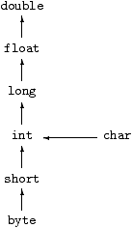
The Fundamentals.
I.5. Common errors
Incrementation
Integers (int long) and reals (float double)
Type checking and implicit casting
int i=0;
double i;// ERROR: already defined
double I;// OK: lower case different from upper case
i=i++; // i is 0, ERROR? Mistyping?
// meant i++;
int p=2;
int q=3;
// Take care p/q is 0 (integer division)
if (p/q<0.5) System.out.println("2p<q");
else System.out.println("2p>q");

Slide 39
The Fundamentals.
I.6. Explicit/implicit casting
// Explicit casting
double p=2.3;
int ptrunc=(int)p; // loss of precision ptrunc=2
// Implicit casting
char c='T';
int codec=c; // ASCII code of c
System.out.println(c+" "+codec);
// we get T 84
byte b=3;
double res=b+c;
System.out.println(res); // 87.0
CODE
Example: byte+char=int

Slide 40
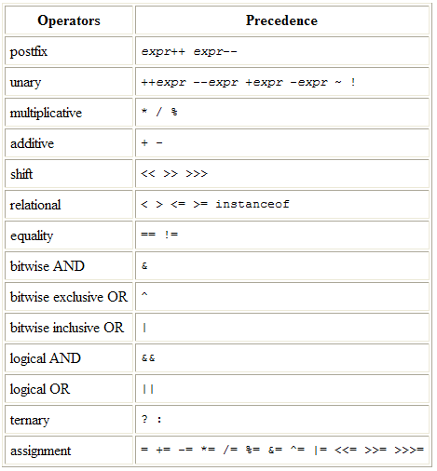
The Fundamentals.
I.7. Java operators....Expressions
Unary, binary, ternary
Operators
Operands
Java has many operators...
int i=4;
int j=3;
int res=++i*j++%--i; //3
res=--i-++j*(i<4?3:4);
System.out.println(res);// -12
res=--i-++j*i<4?3:4;// 3
System.out.println(res);
}

Slide 41

The Fundamentals.
II.1. Boolean expressions
Bool algebra is 0/1 (true/false) algebra
+ OR Gate ||
TRUE + TRUE = TRUE
TRUE + FALSE = TRUE
FALSE + TRUE = TRUE
FALSE + FALSE = FALSE
* AND Gate &&
TRUE * TRUE = TRUE
TRUE * FALSE = FALSE
FALSE * TRUE = FALSE
FALSE * FALSE = FALSE
George Boole (1815 - 1864)
- XOR...
De Morgan's laws:
NOT(A + B) = (NOT(A) * NOT(B))
NOT(A * B) = (NOT(A) + (NOT(B))
In Java, use connectors || and && for creating boolean expressions

Slide 42
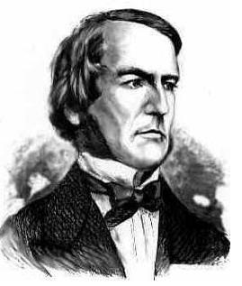
The Fundamentals.
II.1. Boolean expressions
boolean a=true, b=false;
boolean or,and;
boolean expression;
or=a||b;
System.out.println(or);
and=a&&b;
System.out.println(and);
expression=(a||b)&&a||!a;
System.out.println(expression);//true
Boole, George
The mathematical analysis of logic, 1847,
A Treatise on the Calculus of Finite Differences, 1860
Priority order: var=true||Expression;
=> Expression is not evaluated

Slide 43
The Fundamentals.
II.1. Conditional structure if
if (BooleanExpression)
{BlockA}
else
{BlockB}
if (!BooleanExpression)
{BlockB}
else
{BlockA}
Getting the minimum of a and b:
if (a<b)
c=a; // Block1
else
c=b; // Block2

Slide 44
The Fundamentals.
II.2. Conditional structure: nested if
if (BooleanExpression1)
{BlockA}
else
if (BooleanExpression2)
{BlockB}
else
if BooleanExpression2)
{BlockC}
else
{BlockD}

Slide 45
The Fundamentals.
II.3. Conditional structure: switch
switch(n)
{
case 0: InstructionSequence0;
break;
case 1: InstructionSequence1;
break;
case 2: InstructionSequence2;
break;
case 3: InstructionSequence3;
break;
default: InstructionDefault;
break;

Slide 46
The Fundamentals.
II.3. Conditional structure: switch
class SwitchTest
{
public static void main(String[] args)
{char c='a';int code;
switch(c)
{
case 'a': case 'A':
code=1;
break;
case 'b': case 'B':
code=2;
break;
default:
code=0;
break;
}
System.out.println("Code="+code);
}
}

Slide 47
The Fundamentals.
II.4. While loop
while (boolean_expression)
{ block_instruction;}
Evaluate boolean_expression
Execute the block of instruction if and only if it is true
while (boolean_expression)
Single_instruction;
Forever running program...
while (true);

Slide 48

The Fundamentals.
II.4. While loop
Unrolling the while loop
int i=0, res=0;
res=res+i*i;//res=0
i++;//i=1 (i<10) is true
res=res+i*i;// res=1
i++;//i=2 (i<10) is true
res=res+i*i;// res=5
i++;//i=3 (i<10) is true
res=res+i*i;
i++;//i=4 (i<10) is true
res=res+i*i;
i++;//i=5 (i<10) is true
res=res+i*i;
i++;//i=6 (i<10) is true
res=res+i*i;
i++;//i=7 (i<10) is true
res=res+i*i;
i++;//i=8 (i<10) is true
res=res+i*i;
i++;//i=9 (i<10) is true
res=res+i*i;// res=285
i++;//i=10 (i<10) is false
int i=0, res=0;
while(i<10)
{
res=res+i*i;
i++;
}
//res=285 i=10

Slide 49

The Fundamentals.
II.5. For loop: Convenient for iterating
for(instruction1; boolean_condition; instruction2)
block_instructions;
Equivalence with While construction
instruction1;
while (boolean_condition)
{
block_instructions;
instruction2;
}

Slide 50
The Fundamentals.
II.5. For loop: Convenient for iterating
int i, n=10;
int cumulLoop=0;
for(i=0;i<n;i++)
{cumulLoop+=i;}
int cumulLoop=0;
i=0; // Initialization
cumulLoop+=i;
i++; // i=1 now
// i<n so we continue...
cumulLoop+=i;
i++; // i=2 now
// i<n so we continue...
cumulLoop+=i;
...etc...
cumulLoop+=i; // i=n-1
i++; // i=n now
// i is not i<n so we stop...

Slide 51
The Fundamentals.
III.1. Defining a static function
public static typeF F(type1 arg1, ..., typeN argN)
{
// Description
Block of instructions;
}
typeF is the type of the return value
type1... typeN are the types of arguments
Java passes arguments through value
If typeF is void then it is a procedure

Slide 52
The Fundamentals.
III.2. Function calls and memory stack
class FunctionCallSample
{
public static void f(double x)
{
x=1;
System.out.println(x);//1
return;
}
public static void main(String[] args)
{
int y=0;
f(y);
System.out.println(y);//0
}
}
0
y
Memory for
main
Java is pass by value (function arguments)

Slide 53
Pass by value y (=0) to variable x in function f
class FunctionCallSample
{
public static void f(double x)
{
x=1;
System.out.println(x);//1
return;
}
public static void main(String[] args)
{
int y=0;
f(y);
System.out.println(y);//0
}
}
Memory for
f
0
x
0
y
Memory for
main

Slide 54
Assign in function f variable x to 1
class FunctionCallSample
{
public static void f(double x)
{
x=1;
System.out.println(x);//1
return;
}
public static void main(String[] args)
{
int y=0;
f(y);
System.out.println(y);//0
}
}
Memory for
f
1
x
0
y
Memory for
main

Slide 55
Return from function. Release memory in stack
class FunctionCallSample
{
public static void f(double x)
{
x=1;
System.out.println(x);//1
return;
}
public static void main(String[] args)
{
int y=0;
f(y);
System.out.println(y);//0
}
}
0
y
Memory for
main

Slide 56
The Fundamentals.
III.3. Function and efficiency
Avoid to call many times a function with the same arguments
=> use temporary variables to store intermediate results
// for all j
g(f(t)[i]).[j]
// much better to do as
String [] tmp=f(t)[i];// computed once
g(tmp).[j]

Slide 57
The Fundamentals.
IV.1. Arrays
Arrays of elements of type ELEMENT_TYPE are
of type ELEMENT_TYPE []
Declare array variables as ELEMENT_TYPE [] MyTab;
Allocate memory for arrays with keyword new
Size in new is an expression that is evaluated
boolean [ ] prime = new boolean[16];
double [] DblArray; DblArray=new double[3*n+1]
int [ ] prime={2, 3, 5, 7, 11, 13, 17, 19};

Slide 58
The Fundamentals.
IV.2. Arrays: Size
prime.length;
System.out.println(prime.length);
Beware: for Strings s, use method length()
s.length();
Strings are not arrays of characters!!!
Index of arrays begin at 0... to length-1:
for(int i=0;i<tab.length;++i)
....
for(int=tab.length-1;i>=0;--i)
...

Slide 59
The Fundamentals.
IV.2. Arrays: Size and lazy evaluation
In loops, check whether the index goes out of bound first
Otherwise, you'll get an exception: ArrayIndexOutOfBounds
int n=tab.length;
while (tab[i]=='#' && i<n)
{
...
i++;
}
If i=n, we do not check
whether tab[n]='#' or not.
Thus, we avoid the exception
ArrayIndexOutOfBounds
int n=tab.length;
while (i<n && tab[i]=='#')
{
...
i++;
}
Lazy evaluation of
boolean expression
A && B
If A is false, do not evaluate B

Slide 60
The Fundamentals.
IV.3. Arrays: Pass by reference
A variable that has a type array is a reference to the array
(the memory address of the first element)
Therefore an argument of type array does not copy
all array elements in the memory allocated for the function,
but rather allocate a memory reference:
static void MyFunction(int [ ] x)
MyFunction(v);
// the contents of v may thus be changed
// by some instructions
Only the reference of v is copied to the memory allocated for
the function MyFunction.

Slide 61
The Fundamentals.
IV.3. Arrays: Pass by reference
class ArrayRef{
// Increment all elements by one
public static void MyFunction(int [] tab)
{
for(int i=0;i<tab.length;i++)
tab[i]++;
}
public static void main(String [] args)
{
int x [] ={0,1,2};
MyFunction(x);
System.out.println(x[0]+" "+x[1]+" "+x[2]);
}
}
1 2 3
Memory allocation of arrays is in the heap, not stored in the memory stack of function calls

Slide 62
The Fundamentals.
IV.3. Arrays: Pass by reference
class ArrayRef2{
// Increment all elements by one
public static void MyFunction(int [] tab)
{
int l=tab.length;
tab=new int[l]; // Attn.: WRONG TO DO SO!!!!
for(int i=0;i<l;i++) tab[i]=0;
}
public static void main(String [] args)
{
int x [] ={0,1,2};
MyFunction(x);
System.out.println(x[0]+" "+x[1]+" "+x[2]);
}
}
0 1 2
Reference of x does not change after function call MyFunction

Slide 63
The Fundamentals.
IV.4. Arrays and linear search
Usual problem: Search if an element is already inside an array:
Return the index of the position, if search is positive, or
Return -1 if element is not found.
Beware: Do not use == for comparing cell elements.
Use instead a function (method), say compareTo
== of basic types (int, double) test for (physical) equality
== of array/object types test for equality of the references only
(not the contents)

Slide 64
class Point
{double x,y;
Point(double xx, double yy) {this.x=xx; this.y=yy;}
boolean isEqual(Point q) {return (this.x==q.x && this.y==q.y);}
}
class PointSearch
{
public static int Inside(Point [] t, Point q)
{for(int i=0;i<t.length;i++)
{if (q.isEqual(t[i])) return i; } // do not use == here
return -1;}
public static void main(String[] tabofargs)
{
Point [] tab=new Point[10];
for(int i=0;i<tab.length;i++)
tab[i]=new Point(i,i*i);
Point query1=new Point(2,4);
System.out.println(Inside(tab,query1)); //2
Point query2=new Point(3,8);
System.out.println(Inside(tab,query2)); //-1
}
}

Slide 65
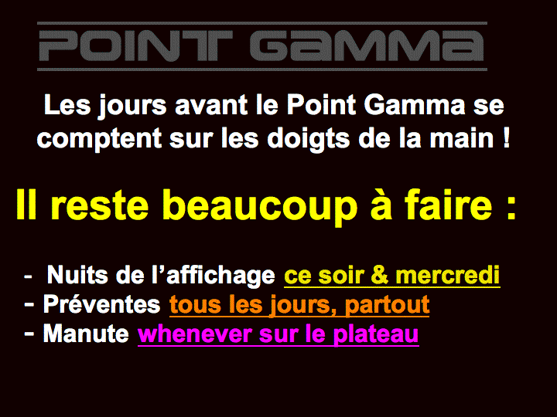

Slide 66


