Slide 1

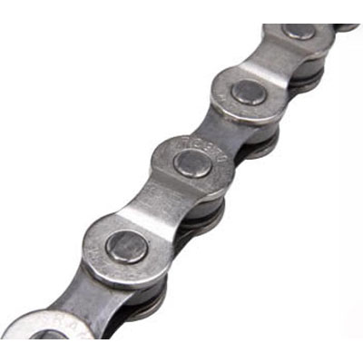


INF 311
Introduction to Java programming
and computer science
Lecture 8: Linked lists
Frank Nielsen
nielsen@lix.polytechnique.fr
Monday 16th June 2008

Slide 2
Agenda
Cells and linked lists
Basic static functions on lists
Recursive static functions on lists
Hashing: Resolving collisions
Summary of search method
    (with respect to time complexity)

Slide 3
Summary of Lecture 7
Searching:
Sequential search (linear time) / arbitrary arrays
Dichotomic search (logarithmic time) / ordered arrays
Sorting:
Selection sort (quadratic time)
Quicksort (recursive, in-place, O(n log n) exp. time)
Hashing
Methods work on arrays...
...weak to fully dynamic datasets

Slide 4

Memory management in Java:
AUTOMATIC
Working memory space for functions (stack):
PASS-BY-VALUE
Global memory for storing arrays and objects:
Allocate with new
Do not free allocated objects, Java does it for you!
GARBAGE COLLECTOR
(GC for short)
Ramasse miettes
http://en.wikipedia.org/wiki/Java_(programming_language)

Slide 5
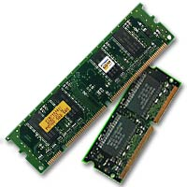
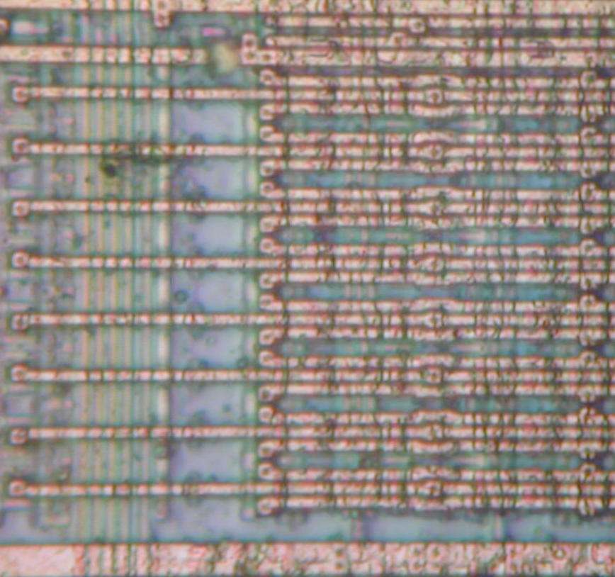
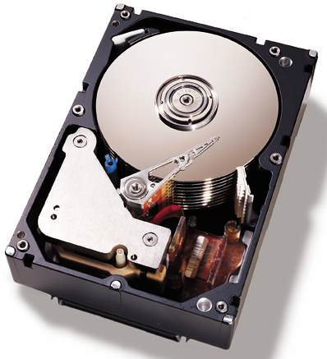
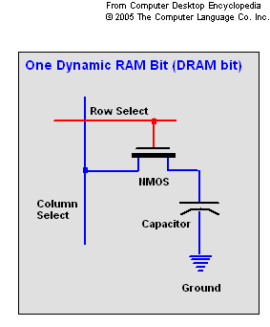
Memory management
DRAM: volatile memory
1 bit: 1 transistor/1 capacitor,
constantly read/rewritten
HDD: hard disk, static memory
Dynamic RAM
RAM cells
Dynamic memory: Linear arrays...
Problem/Efficiency vs Fragmentation...

Slide 6
class Toto
{
double x;
String name;
Toto(double xx, String info)
{this.x=xx;
// For mutable object do this.name=new Object(info);
this.name=info;}
};
class VisualizingMemory
{
public static void Display(Toto obj)
{
System.out.println(obj.x+":"+obj.name);
}
public static void main(String[] args)
{
int i;
Toto var=new Toto(5,"Favorite prime!");
double [] arrayx=new double[10];
Display(var);
}
}
Visualizing memory
A representation
Functions
Heap
Display
(pass by reference)
array[9]
...
array[1]
array[0]
main
int i (4 bytes)
Double [ ] array
Toto var
Object Toto
x
name
local variables
stack execution
pass-by-value
(non-persistent)
arrays
objects
persistent

Slide 7

Garbage collector (GC)
No destructor:
for objects
for arrays
Objects no longer referred to are automatically collected
You do not have to explicitly free the memory
Java does it automatically on your behalf
Objects no longer needed can be explicitly “forgotten”
obj=null;
array=null;

Slide 8


Flashback: Searching
Objects are accessed via a corresponding key
Each object stores its key and additional fields
One seeks for information stored in an object from its key
                (key= a handle)
All objects are in the main memory (no external I/O)
Today!
More challenging problem:
Adding/removing or changing object attributes dynamically

Slide 9

Linked list: cells and links
Sequence is made of cells
Each cell stores an object (cell=container)
Each cell link to the following one
            (=refer to, =point to)
The last cell links to nothing (undefined)
To add an element, create a new cell that...
    ...points to the first one (=head)
Garbage collector takes care of cells not pointed by others

Slide 10



Linked list: cells and links
head
tail
termination
12
99
37
Cell = wagon
Link = magnet
Container:
Any object is fine

Slide 11

Lisp: A language based on lists
Lisp (1958) derives from "List Processing Language"
Still in widespread use nowdays
(list '1 '2 'foo)
(list 1 2 (list 3 4))
(12 (99 (37 nil)))
(head tail)
http://en.wikipedia.org/wiki/LISP

Slide 12

Advantages of linked lists
Store and represent a set of objects
But we do not know beforehand how many...
Add/remove dynamically to the set elements
Arrays: Memory compact data-structure for static sets
Linked lists: Efficient data-structure for dynamic sets
but use references to point to successors
(reference= 4 bytes)

Slide 13
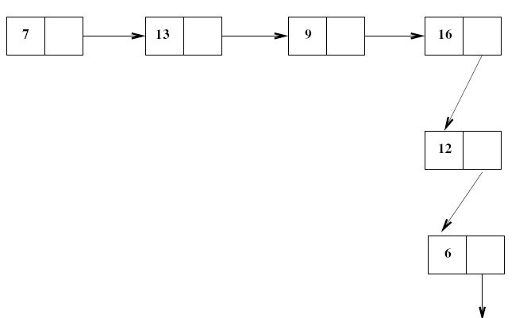
Linked lists
head
reference

Slide 14
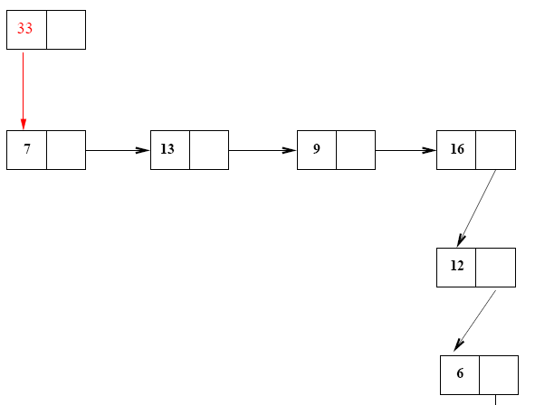
Dynamic insertion
Insert 33
Constant time operation
(think of how much difficult it is to do with arrays)

Slide 15
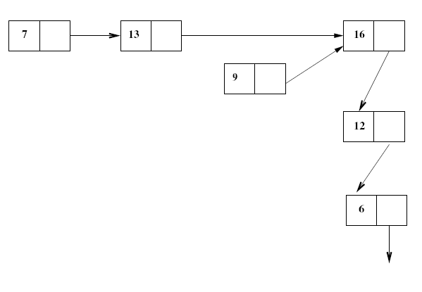
Dynamic deletion
Delete 9
Constant time operation
(think of how much difficult it is to do with arrays)

Slide 16
Abstract lists
Lists are abstract data-structures supporting
the following operations (interface):
Constant: Empty list listEmpty (null)
Operations:
Constructor: List x Object → List
Head: List → Object (not defined for listEmpty)
Tail: List → List (not defined for listEmpty)
isEmpty: List → Boolean
Length: List → Integer
belongTo: List x Object → Boolean
...

Slide 17
Linked list in Java
null is the empty list (=not defined object)
A cell is coded by an object (class with fields)
Storing information in the cell = creating field
(say, double, int, String, Object)
Pointing to the next cell amounts to contain
  a reference to the next object

Slide 18
public class List
{
int container;
List next;
// Constructor List(head, tail)
List(int element, List tail)
{
this.container=element;
this.next=tail;
}
static boolean isEmpty(List list)
{// in compact form return (list==null);
if (list==null) return true;
else return false;
}
static int head(List list)
{return list.container;}
static List tail(List list)
{return list.next;}
}

Slide 19

Common mistake
Cannot access fields of the null object
Exception nullPointerException is raised
Perform a test if (currentCell!=null)
to detect wether the object is void or not,
before accessing its fields
static int head(List list)
{if (list!=null)
return list.container;
else
return -1; }

Slide 20
public class List
{...}
class ListJava{
public static void main (String[] args)
{
List myList=new List(23,null);
}
}
Function stack
Memory
List object
null
Container (int)
Reference to list
23
MyList (4 bytes)
Reference
main

Slide 21
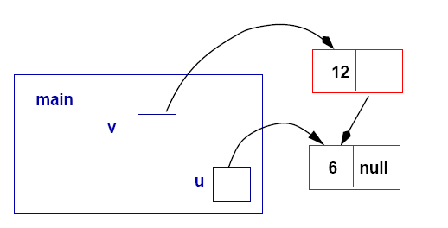
class ListJava{
public static void main (String[] args)
{
List u=new List(6,null);
List v=new List(12,u);
}
}

Slide 22
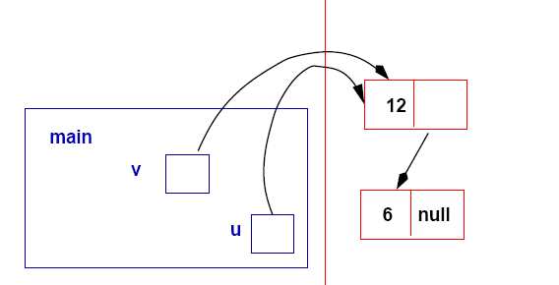
u=v;

Slide 23
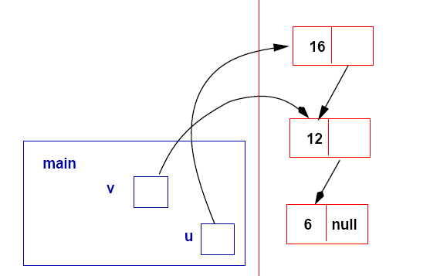
u=new List(16,u);

Slide 24
Browsing lists
Start from the head, and
inspect element by element (chaining with references)
until we find the empty list (termination)
static boolean belongTo(int element, List list)
{
while (list!=null)
{
if (element==list.container) return true;
list=list.next;
}
return false;
}
Linear complexity O(n)

Slide 25
List: Linear search complexity O(n)
class ListJava{
public static void main (String[] args)
{
List u=new List(6,null);
u=new List(16,u);
u=new List(32,u);
u=new List(25,u);
System.out.println(List.belongTo(6,u));
System.out.println(List.belongTo(17,u));
}
}
==
equals
static boolean belongTo(int element, List list)
{
while (list!=null)
{
if (element==list.container) return true;
list=list.next;
}
return false;
}

Slide 26
class ListString
{
String name;
ListString next;
// Constructor
ListString(String name, ListString tail)
{this.name=new String(name); this.next=tail;}
static boolean isEmpty(ListString list)
{return (list==null);}
static String head(ListString list)
{return list.name; }
static ListString tail(ListString list)
{return list.next;}
static boolean belongTo(String s, ListString list)
{
while (list!=null)
{
if (s.equals(list.name))
return true;
list=list.next;
}
return false;
}
}
Generic lists

Slide 27
class ListString
{
String name;
ListString next;
...
static boolean belongTo(String s, ListString list)
{
while (list!=null)
{
if (s.equals(list.name))
return true;
list=list.next;
}
return false;
}
}
class Demo{...
ListString l=new ListString("Frank",null);
l=new ListString("Marc",l);
l=new ListString("Frederic",l);
l=new ListString("Audrey",l);
l=new ListString("Steve",l);
l=new ListString("Sophie",l);
System.out.println(ListString.belongTo("Marc",l));
System.out.println(ListString.belongTo("Sarah",l));
}
Generic lists

Slide 28

Length of a list
static int length(ListString list)
{
int l=0;
while (list!=null)
{l++;
list=list.next;
}
return l;
}
Note that because Java is pass-by-value
(reference for structured objects),
we keep the original value, the head of the list,
after the function execution.
System.out.println(ListString.length(l));
System.out.println(ListString.length(l));

Slide 29

Dynamic insertion:
Add an element to a list
static ListString Insert(String s, ListString list)
{
return new ListString(s,list);
}
Call static function Insert of the class ListString
l=ListString.Insert("Philippe", l);
l=new ListString("Sylvie",l);

Slide 30
Pretty-printer of lists
Convenient for debugging operations on lists
static void Display(ListString list)
{
while(list!=null)
{
System.out.print(list.name+"-->");
list=list.next;
}
System.out.println("null");
}
Philippe-->Sophie-->Steve-->Audrey-->Frederic-->Marc-->Frank-->null
ListString.Display(l);

Slide 31

Dynamic deletion: Removing an element
Removing an element from a list:
Search for the location of the element,
if found then adjust the list (kind of list surgery)
Garbage collector takes care of the freed cell
Take care of the special cases:
List is empty
Element is at the head
E==query
v.next=w.next
v
w=v.next

Slide 32
Dynamic deletion: Removing an element
static ListString Delete(String s, ListString list)
{
// if list is empty
if (list==null)
return null;
// If element is at the head
if (list.name.equals(s))
return list.next;
// Otherwise
ListString v=list;
ListString w=list.next; //tail
while( w!=null && !((w.name).equals(s)) )
{v=w; w=v.next;}
// A bit of list surgery here
if (w!=null)
v.next=w.next;
return list;
}
Complexity of removing is at least the complexity of
finding if the element is inside the list or not.

Slide 33
Recursion & Lists
Recursive definition of lists yields effective recursive algorithms too!
static int lengthRec(ListString list)
{
if (list==null)
return 0;
else
return 1+lengthRec(list.next);
}
System.out.println(ListString.lengthRec(l));

Slide 34
Recursion & Lists
static boolean belongToRec(String s, ListString list)
{
if (list==null) return false;
else
{
if (s.equals(list.name))
return true;
else
return belongToRec(s,list.next);
}
}
...
System.out.println(ListString.belongToRec("Marc",l));
Note that this is a terminal recursion
(thus efficient rewriting is possible)

Slide 35
Recursion & Lists
Displaying recursively a linked list
static void DisplayRec(ListString list)
{
if (list==null)
System.out.println("null");
else
{
System.out.print(list.name+"-->");
DisplayRec(list.next);
}
}
...
ListString.DisplayRec(l);

Slide 36
Copying lists
Copy the list by traversing the list from its head,
and cloning one-by-one all elements of cells
(fully copy objects like String etc. stored in cells)
static ListString copy(ListString l)
{
ListString result=null;
while (l!=null)
{
result=new ListString(l.name,result);
l=l.next;
}
return result;
}
ListString lcopy=ListString.copy(l);
ListString.Display(lcopy);
Beware: Reverse the list order

Slide 37
Copying lists: Recursion
static ListString copyRec(ListString l)
{
if (l==null)
return null;
else
return new ListString(l.name,copyRec(l.next));
}
Preserve the order
ListString.DisplayRec(l);
ListString lcopy=ListString.copy(l);
ListString.Display(lcopy);
ListString lcopyrec=ListString.copyRec(l);
ListString.Display(lcopyrec);
Sophie-->Audrey-->Frederic-->Marc-->null
Marc-->Frederic-->Audrey-->Sophie-->null
Sophie-->Audrey-->Frederic-->Marc-->null

Slide 38
Building linked lists from arrays
static ListString Build(String [] array)
{
ListString result=null;
// To ensure that head is the first array element
// decrement: from largest to smallest index
for(int i=array.length-1;i>=0;i--)
result=new ListString(array[i],result);
return result;
}
String [] colors={"green", "red", "blue", "purple", "orange", "yellow"};
ListString lColors=ListString.Build(colors);
ListString.Display(lColors);
green-->red-->blue-->purple-->orange-->yellow-->null

Slide 39

Summary on linked lists
Allows one to consider fully dynamic data structures
Singly or doubly linked lists (List prev,succ;)
Static functions: Iterative (while) or recursion
List object is a reference
  (pass-by-reference of functions; preserve head)
Easy to get bugs and never ending programs
                (null empty list never encountered)
Do not care releasing unused cells
  (garbage collector releases them automatically)

Slide 40
Hashing: A fundamental technique
Store object x in array position h(x) (int)
Major problem occurs if two objects x and y
    are stored on the same cell: Collision.
Key issues in hashing:
Finding good hashing functions that minimize collisions,
Adopting a good search policy in case of collisions
Object Obj=new Object();
int i;
i=h(Obj);// hashing function
array[i]
int i;
array[i]

Slide 41
Hashing functions
Given a universe X of keys and for any x in X,
  find an integer h(x) between 0 and m
Usually easy to transform the object into an integer:
For example, for strings just add the ASCII codes of characters
The problem is then to transform
      a set of n (sparse) integers
into a compact array of size m<<N.
(<< means much less than)

Slide 42
Hashing functions
Key idea is to take the modulo operation
h(k) = k mod m where m is a prime number.
static int m=23;
// TRANSCODE strings into integers
static int String2Integer(String s)
{
int result=0;
for(int j=0;j<s.length();j++)
result=result*31+s.charAt(j);
// this is the method s.hashCode()
return result;
}
// Note that m is a static variable
static int HashFunction(int l)
{return l%m;}

Slide 43
public static void main (String[] args)
{
String [] animals={"cat","dog","parrot","horse","fish",
"shark","pelican","tortoise", "whale", "lion",
"flamingo", "cow", "snake", "spider", "bee", "peacock",
"elephant", "butterfly"};
int i;
String [] HashTable=new String[m];
for(i=0;i<m;i++)
HashTable[i]=new String("-->");
for(i=0;i<animals.length;i++)
{int pos=HashFunction(String2Integer(animals[i]));
HashTable[pos]+=(" "+animals[i]);
}
for(i=0;i<m;i++)
System.out.println("Position "+i+"\t"+HashTable[i]);
}

Slide 44
Position 0 --> whale
Position 1 --> snake
Position 2 -->
Position 3 -->
Position 4 -->
Position 5 -->
Position 6 -->
Position 7 --> cow
Position 8 --> shark
Position 9 -->
Position 10 -->
Position 11 -->
Position 12 --> fish
Position 13 --> cat
Position 14 -->
Position 15 --> dog tortoise
Position 16 --> horse
Position 17 --> flamingo
Position 18 -->
Position 19 --> pelican
Position 20 --> parrot lion
Position 21 -->
Position 22 -->
Collisions in
the hash table

Slide 45
Hashing: Solving collision
Open address methodology
...record in another location that is still open...
Store object X at the first free hash table cell
starting from position h(x)
To seek whether X is in the hash table, compute h(x)
and inspect all hash table cells until h(x) is found or a
free cell is reached.
Complexity of search time ranges from
constant O(1) to linear O(m) time

Slide 46
Position 0 whale
Position 1 snake
Position 2 bee
Position 3 spider
Position 4 butterfly
Position 5 null
Position 6 null
Position 7 cow
Position 8 shark
Position 9 null
Position 10 null
Position 11 null
Position 12 fish
Position 13 cat
Position 14 peacock
Position 15 dog
Position 16 horse
Position 17 tortoise
Position 18 flamingo
Position 19 pelican
Position 20 parrot
Position 21 lion
Position 22 elephant
String [] HashTable=new String[m];
// By default HashTable[i]=null
for(i=0;i<animals.length;i++)
{
int s2int=String2Integer(animals[i]);
int pos=HashFunction(s2int);
while (HashTable[pos]!=null)
pos=(pos+1)%m;
HashTable[pos]=new String(animals[i]);
}

Slide 47
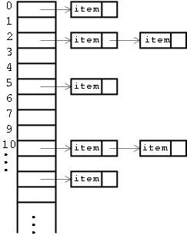
Hashing: Solving collision
Chained Hashing
For array cells not open, create linked lists
Can add as many elements as one wishes

Slide 48
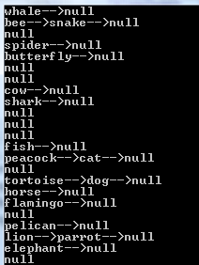
ListString [] HashTable=new ListString[m];
for(i=0;i<m;i++)
HashTable[i]=null;
for(i=0;i<animals.length;i++)
{
int s2int=String2Integer(animals[i]);
int pos=HashFunction(s2int);
HashTable[pos]=ListString.Insert(animals[i],HashTable[pos]);
}
for(i=0;i<m;i++)
ListString.Display(HashTable[i]);

Slide 49

Executive summary of data-structures
Arrays = Pertinent data-structure for almost static data sets
Lists = Data-structure for fully dynamic data sets

Slide 50
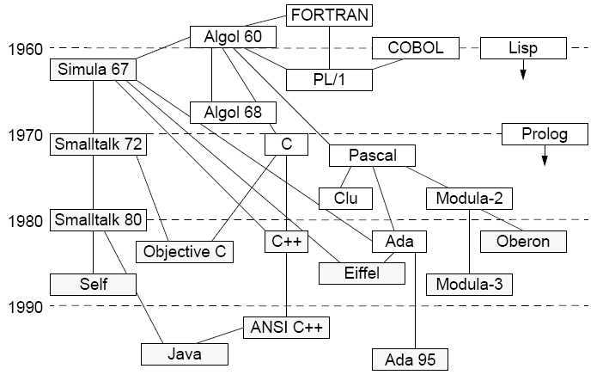
Java has many more modern features
INF 311
Objects/inheritance, Generics, APIs

Slide 51

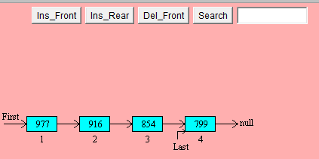
We presented the concept of linked lists:
A generic abstract data-structure with a set
of plain (while) or recursive static functions.
In lecture 9, we will further revisit linked lists
and other dynamic data-structures using the
framework of objects and methods.
http://www.cosc.canterbury.ac.nz/mukundan/dsal/LinkListAppl.html
http://en.wikipedia.org/wiki/Linked_list

