Slide 1

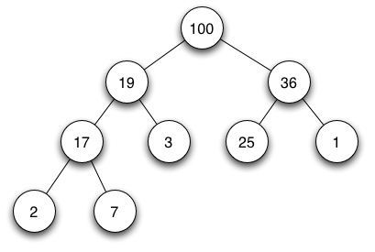


INF 311
Introduction to computer science
and java programming
Lecture 9: data-structures & non-static methods
(=object methods)
Frank Nielsen
nielsen@lix.polytechnique.fr
Monday 23th June 2008

Slide 2
Agenda
FIFO data-structures
(= First In First Out)
Heap data-structures
Non-static methods
(= object methods)
Revisiting lists (OO-style)

Slide 3
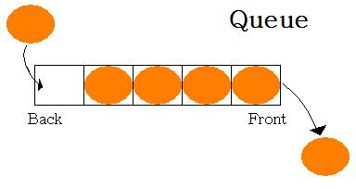
FIFOs: Mastering queues
Objects are considered in turn, one by one
Process each object according to their arrival time
While objects are processed, others are queued
First object should be first served!
Basic examples:
Waiting in a queue at the post office.
Printing « jobs> on a printer.
FIFO = First In First Out !

Slide 4
A basic solution
Stack objects in an array as soon as they arrive
To stack an incoming object, should know the index
of the last location
Should also know the index of the last processed object
(so that we can process the next one)
While processing an object, others can come in the array
(= queued)

Slide 5
A basic solution
An array: container array for storing objects
Two indices: lastProcessed and freePlace
To add an object x, we do array[freePlace]=x and
we then increment: freePlace++
To process an object, we increment lastProcessed and
we process array[lastProcessed]

Slide 6
Visual depiction of a FIFO
-1
0
1
n-1
freePlace
lastProcessed

Slide 7
FIFO: Queuing objects
O1
freePlace
lastProcessed
array[freePlace++]=O1;

Slide 8
Queuing another object
O1
O2
freePlace
lastProcessed
array[freePlace++]=O2;

Slide 9
Processing and queuing
O1
O2
O3
freePlace
lastProcessed
Process(array[lastProcessed++]);
array[freePlace++]=O3;
Processing and queuing can be done in parallel using threads

Slide 10
Programming queues
static int lastProcessed=-1;
static int freePlace=0;
static double[] container=new double[1000];
static void add(double Object)
{
if (freePlace<1000)
{container[freePlace]=Object;
freePlace++;}
}
static double process()
{
if (freePlace-lastProcessed>1)
{ // Do something here
lastProcessed++;
return container[lastProcessed];
}
else
return -1.0; // special return code: no process
}

Slide 11

class QueueDouble
{
static int lastProcessed=-1;
static int freePlace=0;
// Max objects is set to 1000
static double[] container=new double[1000];
// Stack in FIFO order
static void add(double a)
{...}
// Process in FIFO order
static double process()
{...}
public static void main(String[] arg)
{
System.out.println("Queue demo:");
add(3.0);
add(5.0);
add(7.0);
System.out.println(process());
System.out.println(process());
System.out.println(process());
System.out.println(process());
System.out.println(process());
}
FIFO:
First In First Out

Slide 12
Exercise: FIFO in action!
Let A be a set of integers such that:
1 belongs to A, and
If a belongs to A, then 2*a+1 and 3*a belongs to A
Question:
For a given n, display all integers less or equal to n
that belong to A.

Slide 13
Programming queues
Start with a FIFO initialized with element 1
Use a boolean array to store whether a belong to A
(= marks, tag elements)
For each element a of the FIFO do:
Compute 2*a+1 and 3*a
Add them to the FIFO if they are less than n
...and not yet encountered (=marked)
Terminate when the FIFO is empty
Display all marked elements (=result)

Slide 14

final static int n=1000; static int lastProcessed=-1;
static int freePlace=0; static int[] container=new int[n];
static boolean[] mark=new boolean[n];
static void add(int a)
{if (freePlace<n) {container[freePlace]=a;freePlace++;}}
static boolean Empty()
{ return ((freePlace-lastProcessed)==1); }
static void process()
{int a;
lastProcessed++; a=container[lastProcessed];
if (a<n) mark[a]=true;
if (2*a+1<n) add(2*a+1);
if (3*a<n) add(3*a);
}
public static void main(String[] arg)
{int i;
for(i=0;i<n;i++) mark[i]=false;
add(1);
while(!Empty())
process();
for(i=0;i<n;i++)
{if (mark[i])
System.out.print(i+" ");}
System.out.println("");
}

Slide 15
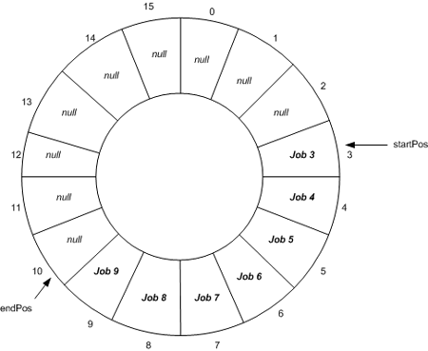
A few remarks on FIFOs
Set beforehand the size of the array?
Can wrap the array using mod MAX_SIZE
(=circular ring, extend arrays, etc.)
...But how to check whether the queue is empty
... or full with circular arrrays?

Slide 16
Priority queues: Heaps (=tas)
Objects are considered in turn
Need to process them according to their priorities
While processing an objects, other may arrive
  (= are being queued)
Serve the object with the highest priority first
Examples:
Ressource request
Operating system tasks

Slide 17


Defining mathematically heaps
A heap is a sequence of integers:
stored compactly in an array such that:
For example:
37, 22, 31, 16, 17, 2, 23, 12, 6, 9
( heap of 10 elements)
i=7
j=(int)(7/2)=3

Slide 18
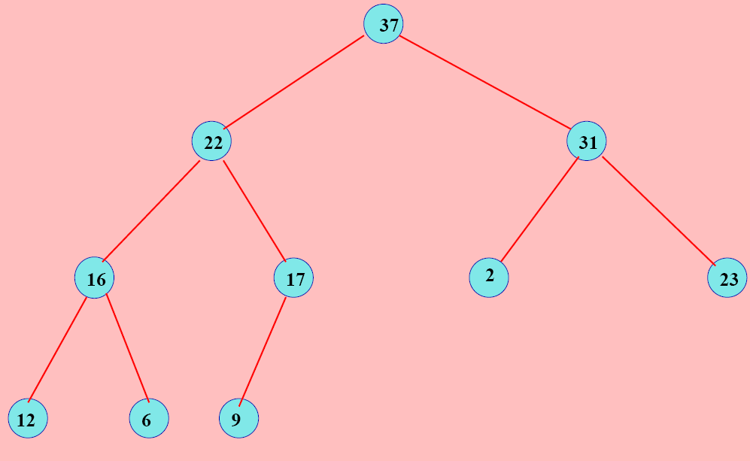
Drawing a heap
Draw a heap as a tree (=special graph Vertex/Edge)
Each node i contains a value t[i] and has
  0, 1 or 2 siblings that contain nodes of values
  less than its parent
Node i has children 2i and 2i+1
t[i]
37, 22, 31, 16, 17, 2, 23, 12, 6, 9:
Read layer by layer,
from the root til the leaves

Slide 19
Storing and manipulating heaps
Easy to code with a linear array
public class Heap
{
int size;
int [] label;
static final int MAX_SIZE=10000;
Heap()
{
this.size=0;
this.label=new int[MAX_SIZE];
}
public static void main(String[] args)
{}
}

Slide 20
Fundamental property of heaps
Largest value is stored at the root of the tree, namely
at the first element of the array.
static int maxHeap(Heap h)
{
return h.label[0];
}

Slide 21
Adding an element in a heap
Add the new element in position n (=n+1th element)...
But the condition that the array is a heap is violated...
So that we swap the element until...
. ...it satisfies the heap constraint

Slide 22
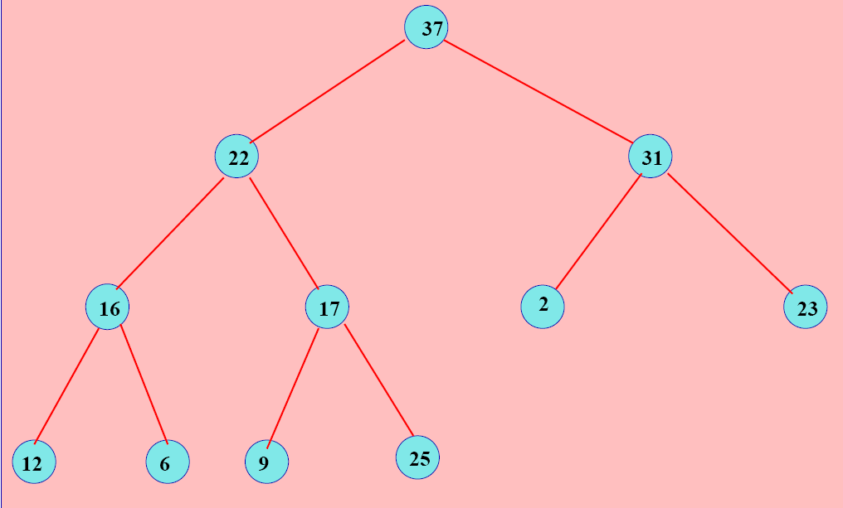
Example: Add element 25
Swap with your parent!
Not a heap anymore!!! 25>17

Slide 23
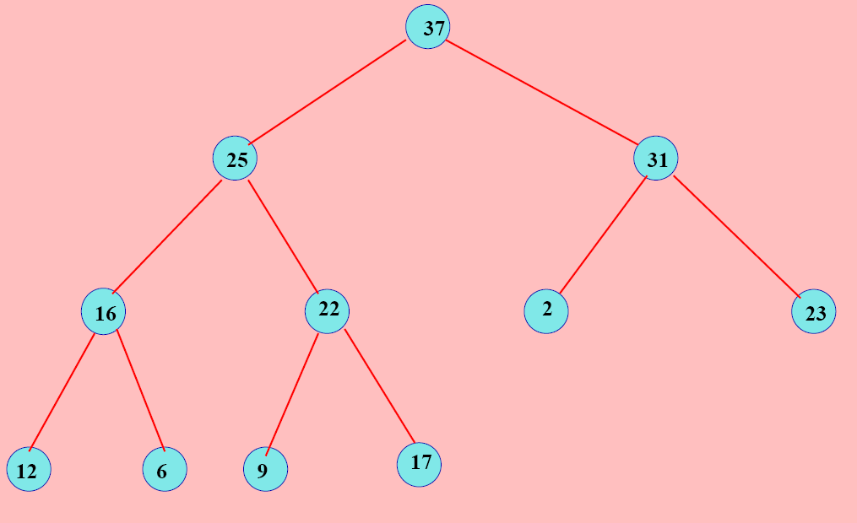
Add element 25... and swap!!!
It is a heap now!

Slide 24
Adding an element in the heap
static void addHeap(int element, Heap h)
{
h.label[h.size]=element;
h.size++;
int i=h.size;
int j=i/2;
while (i>1 && h.label[i]>h.label[j])
{
int tmp=h.label[i];
h.label[i]=h.label[j];
h.label[j]=tmp;
i=j; // swap
j=i/2;
}
}

Slide 25
Removing the largest element of a heap
We move the element at position (n-1) and
put it at the root (position 0)
But it is not anymore a heap...
So we swap to the bottom until...
  ...the heap condition is satisfied

Slide 26
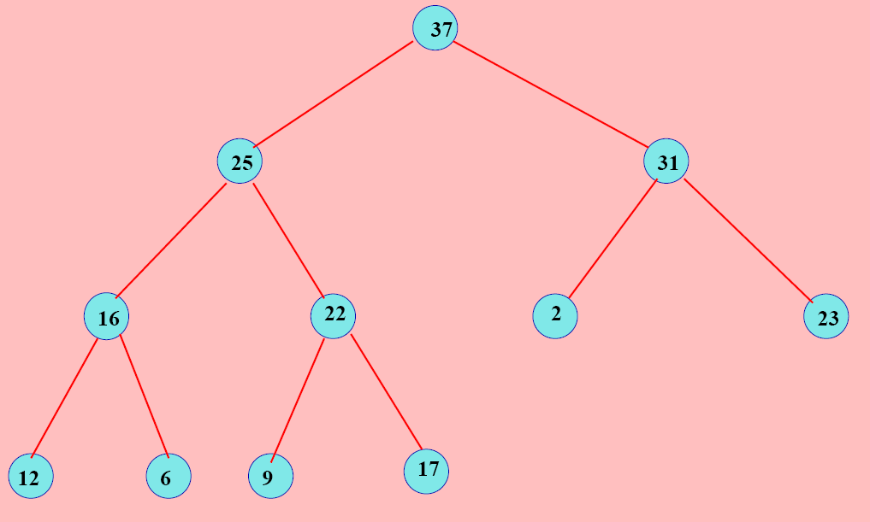
Removing the largest element of a heap
37

Slide 27
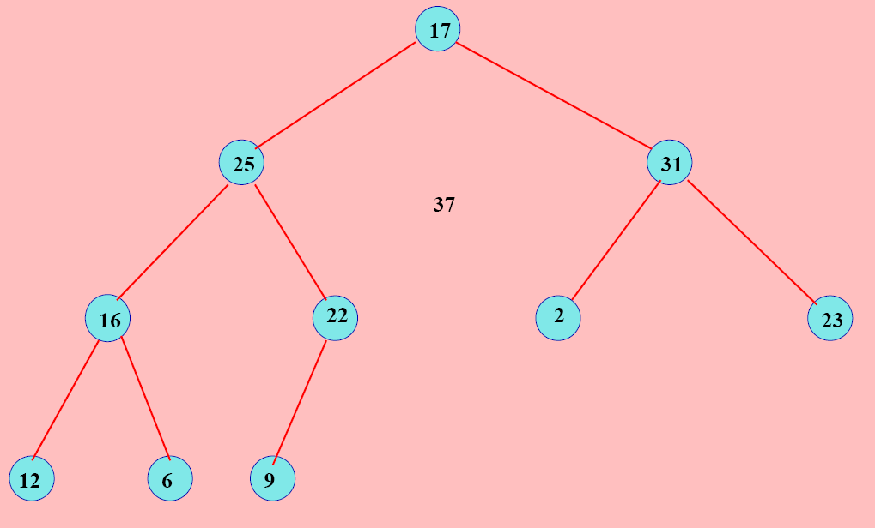
17

Slide 28
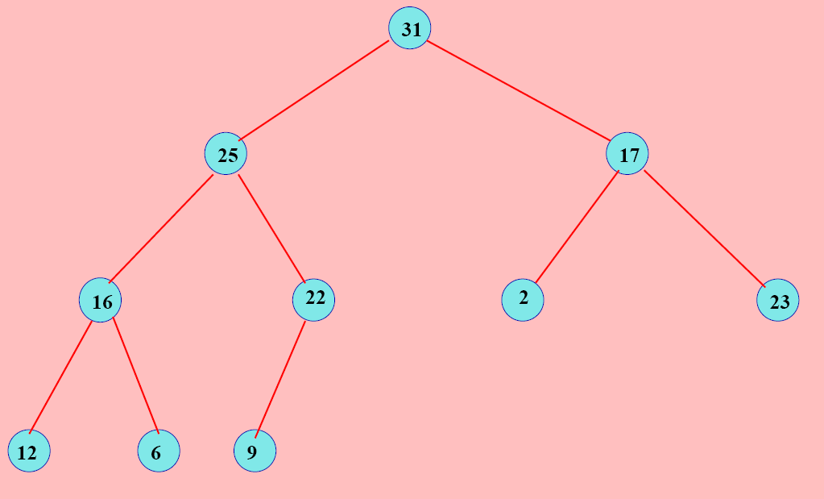
Then Swap parent-child...

Slide 29
Removing the largest element of a heap
static int removeHeap(int element, Heap h)
{
h.label[0]=h.label[h.size-1];
h.size--;
int i=0,j,k,tmp;
while(2*i<=h.size)
{
j=2*i;
if (j<h.size && h.label[j+1]>h.label[j])
j++;
if (h.label[i]<h.label[j])
{tmp=h.label[i];
h.label[i]=h.label[j];
h.label[j]=tmp;
i=j;}
else break;
}
return h.label[h.size-1];
}

Slide 30
Non-static methods and objects
Do not write static in front of the method
Method is thus attached to the object for which it applies for
For example, we prefer:
u.display() rather than display(u)
u.addElement(a) instead of addElement(a,u)
To reference the object on which the method is called upon
use this
Object-oriented programming paradigm (OO)

Slide 31
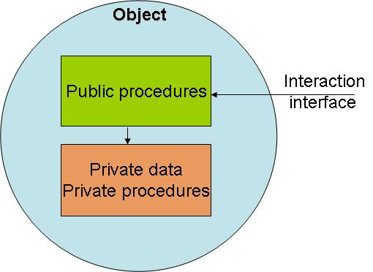
Object-oriented programming paradigm (OO)
Design a software as a set of objects and methods
applying on these objects
Ask yourself first:
- What are the objects?
- What are the methods?
Usually, a method often modifies the object (=fields)
  on which it applies for.
  (But not always, for example: Obj.Display())

Slide 32
class Box
{
double width, height, depth;
Box(double w, double h, double d)
{
this.width=w; this.height=h; this.depth=d;
}
double Volume()
{return this.width*this.height*this.depth;}
}
class OOstyle
{
static double Volume(Box box)
{return box.width*box.height*box.depth;}
public static void main(String[] s)
{
Box myBox=new Box(5,2,1);
System.out.println("Volume by static method:"+Volume(myBox));
System.out.println("Volume by object method:"+myBox.Volume());
}
}
OO style:
object methods
versus
static functions
Object (non-static) method

Slide 33
class Toolkit
{
static final double PI=3.14;
static double Square(double x)
{return x*x;}
static double Cubic(double x)
{return x*x*x;}
}
class StaticFuncStyle
{
public static void main(String[] s)
{
double radius=0.5;
double volSphere=(4/3.0)*Toolkit.PI*Toolkit.Cubic(radius);
double areaDisk=Toolkit.PI*Toolkit.Square(radius);
}
}
Static methods are
useful for defining:
- Constants
- Basic functions
....in a library.

Slide 34
Heaps revisited in Object-Oriented style
int maxHeap()
{
return this.label[0];
}
void add(int element)
{
...
}
void removeTop()
{
...
}
Observe that the keyword static has disappeared

Slide 35
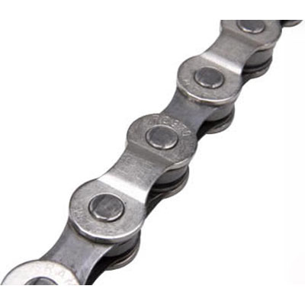

List in object-oriented style
A cell stores information (say, an integer) and
point/refer to the next one.
Pointing to another cell means storing a reference
to the corresponding cell.

Slide 36
Pay special attention to null !!!
Remember that we cannot access fields of the null object
Throw the exception nullPointerException
Thus we need to check whether the current object is null
or not, before calling the method
In the reminder, we consider that all lists (also the void list)
contain a first cell that stores no information.

Slide 37
Revisiting the linked list (OO style)
public class List
{
int element;
List next;
List(int el, List l)
{
this.element=el;
this.next=l;
}
static List EmptyList()
{
return new List(0,null);
}
boolean isEmpty()
{
return (this.next==null);
}
}

Slide 38
Revisiting the linked list (OO style)
int length()
{
List u=this;
int res=0;
while(u!=null) {res++;u=u.next;}
return res-1;
}
boolean belongsTo(int el)
{
List u=this.next;
while(u!=null)
{
if (el==u.element) return true;
u=u.next;
}
return false;
}

Slide 39
Revisiting the linked list (OO style)
void add(int el)
{List u=this.next;
this.next=new List(el,u);
}
void delete(int el)
{
List v=this;
List w=this.next;
while(w!=null && w.element !=el)
{
v=w;
w=w.next;
}
if (w!=null) v.next=w.next;
}

Slide 40
Revisiting the linked list (OO style)
void display()
{
List u=this.next;
while(u!=null)
{System.out.print(u.element+"->");
u=u.next;}
System.out.println("null");
}
static List FromArray(int [] array)
{
List u=EmptyList();
for(int i=array.length-1; i>=0; i--)
u.add(array[i]);
return u;
}

Slide 41

Revisiting the linked list (OO style)
public static void main(String[] args)
{
int [] array={2,3,5,7,11,13,17,19,23};
List u=FromArray(array);
u.add(1);
u.display();
u.delete(5);
u.display();
System.out.println(u.belongsTo(17));
System.out.println(u.belongsTo(24));
}

Slide 42

Stacks (LIFO): Last In First Out
Two basic operations for that data-structure:
Push: Add an element on top of the stack
Pull: Remove the topmost element

Slide 43
Stacks (LIFO) using arrays
class StackArray
{
int nbmax;
int index;
int [ ] array;
// Constructors
StackArray(int n)
{
this.nbmax=n;
array=new int[nbmax]; index=-1;
System.out.println("Succesfully created a stack array object...");
}
// Methods
void Push(int element)
{
if (index<nbmax-1)
array[++index]=element; }
int Pull()
{
if (index>=0 ) return array[index--];
else return -1;
}
}

Slide 44
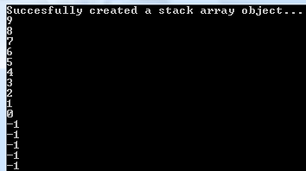
class DemoStack{
public static void main(String [] args)
{
StackArray myStack=new StackArray(10);
int i;
for(i=0;i<10;i++)
myStack.Push(i);
for(i=0;i<15;i++)
System.out.println(myStack.Pull());
}

Slide 45
Stacks (LIFO) using linked lists
class List
{
int element;
List next;
// Constructor
List(int el, List tail)
{
this.element=el;
this.next=tail;
}
List insertHead(int el)
{
return new List(el,this);
}
}

Slide 46
class Stack
{
List list;
Stack()
{
list=null;
}
void Push(int el)
{
if (list!=null)
list=list.insertHead(el);
else
list=new List(el,null);
}
int Pull()
{int val;
if (list!=null)
{val=list.element;
list=list.next;}
else val=-1;
return val;
}
}

Slide 47

Stacks: API
// Use a Java package here
import java.util.Stack;
public class MainClass {
public static void main (String args[]) {
Stack s = new Stack();
s.push("A");
s.push("B");
s.push("C");
System.out.println(s);
}
}

Slide 48
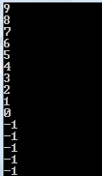
Stacks (LIFO) using linked lists
class DemoStackList
{
public static void main(String [] args)
{
Stack myStack=new Stack();
int i;
for(i=0;i<10;i++)
myStack.Push(i);
for(i=0;i<15;i++)
System.out.println(myStack.Pull());
}
}
Notice: Same code as StackArray demo program.

Slide 49
Static functions versus methods
Static (class) functions:
Access static/local variables only.
        « class methods »
        Potentially many arguments in functions
Object methods:
      Access object fields (using this)
      Access (class) static variables too.
      Objects are instances of classes
      Data encapsulation
      (=functions with limited number of arguments)
      Constructor (= field initialization)

Slide 50
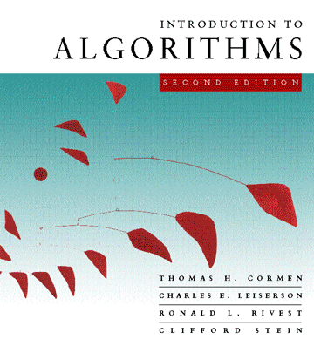
Next time, last lecture!
INF311:
Basics of Java programming (L1-L6)
Basics of data-structures (L7-L9)
Introduction to algorithms (L10):
        - Greedy algorithm for set cover problems
        - RANSAC (power of randomized algorithm)
        - Dynamic programming for matrix chain product
Examen final: Lundi 7 Juillet

