Slide 1
CS595 CAPSTONE · CHECKPOINT REVIEW
ProofShape
From a working reconstruction pipeline to a hosted, measured inspection system
Tabeen · Mamadou · Yashi
San Francisco Bay University · 13 November 2026
github.com/proofshape/proofshape
Notes:
[Opening] ProofShape turns a phone into a coarse 3D inspection tool: a supplier photographs a part on a printed reference board, we rebuild a metric 3D model, and, once a buyer's CAD is loaded, we return Pass, Fail, Rescan or Unverifiable. This checkpoint covers four areas of progress: phone capture reaching the real service, metric scale anchored on the board and checked with calipers, stricter provenance, and VLM supervision of capture frames. Then where we stand against the plan, and what comes next. Coarse means several millimetres on hand-sized parts: this complements CMM inspection, it does not replace it.

Slide 2
Three engineers, one shared backlog
TEAM INFORMATION
Presenter · Yashi
M
Mamadou
Y
Yashi
T
Tabeen Raoof
@mbj1994
@dalwalyk
@TabeenRaoof
RECENT WORK
RECENT WORK
RECENT WORK
• C-20 capture gate + orbit maths; real iPhone check
• R-31 macOS Open3D/torch deadlock fix
• R-32 backend comparison, with Tabeen
• C-22 agent conversation view
• C-21 GitHub Pages + fail-closed hosting
• G-02 six-specimen batch printed on A1 mini
• A-13 pinned live Gemini agent model
• Two-run live agent check, no fallback
• Ground-truth + GenAI integration reviews
• Close-out review for G-02
• A-05 disagreement map + next-view ranking
• R-32 backend matrix, with Mamadou
• G-01 printer/calibration settings
• P-33 Android parking decision (D-065)
• A-11 contract v1.1 ready for boundary
Presents slides 8–10
Presents slides 2–4
Presents slides 5–7
Lanes are places in the code, not people: anyone can take any story, and a different teammate reviews it.
Notes:
[Presenter: Yashi] We're three engineers sharing one backlog. Lanes are places in the repository, not people, so everyone has worked across reconstruction, capture and inspection. Every story is one pull request reviewed by one of the other two; co-owned stories are marked 'with'. The chips show who presents which slides.

Slide 3




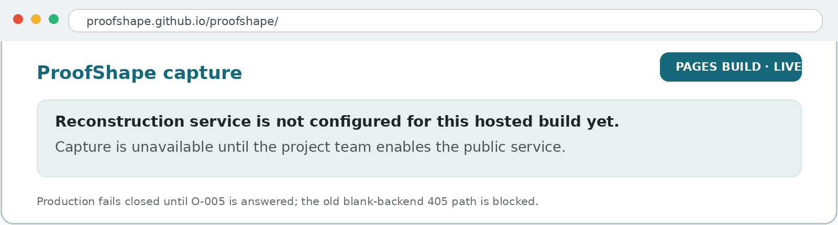
Capture is now phone-tested, hosted, and safer in production
PROGRESS 1 OF 4 · CAPTURE + HOSTING
Presenter · Yashi
iPhone browser
GitHub Pages
Safety gate
Reconstruction service
camera + gyro
deployed from main
O-005 before paid backend
model + report path
NEW CAPTURE EVIDENCE · SINCE OCT 30
iPhone 13
1 h
real-device C-20 check
C-22 assistant view
roll + landscape → On target
timeout + stale-reply protection
Hosted build current state — intentionally fail-closed until a public reconstruction service is enabled.
LIVE
3
WHAT WE LEARNED
Hosting is not the same as enabling the paid backend. The page is live, but capture stays disabled until O-005 is answered and one real hosted iPhone session succeeds.
GitHub Pages from main
O-005 safety questions
same URL for the hosted demo
CORS · token · order gate
Notes:
[Presenter: Yashi] Until this week the phone app only talked to a mock. C-13 connected it to the real reconstruction service. The key fix: photos taken through the browser carry no focal length, so the service now calibrates the camera from the printed board in the photos. One real session, 14 frames, produced a metric model. Another, with no board in view, failed with an explicit error rather than a wrong model. Phone sessions still fail more often than the golden photos, and we don't yet know why, so reliability is open work, not done.

Slide 4
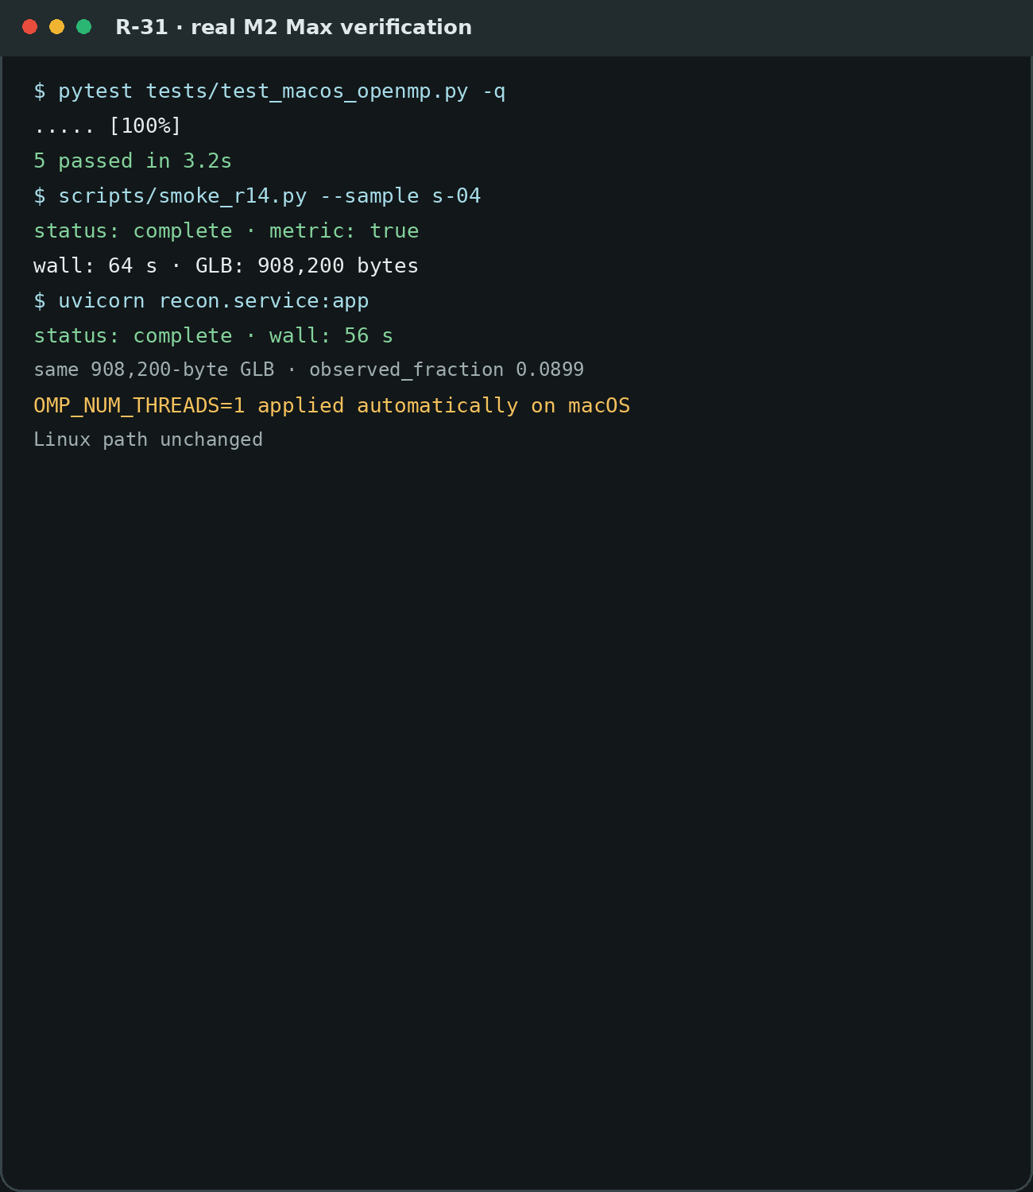
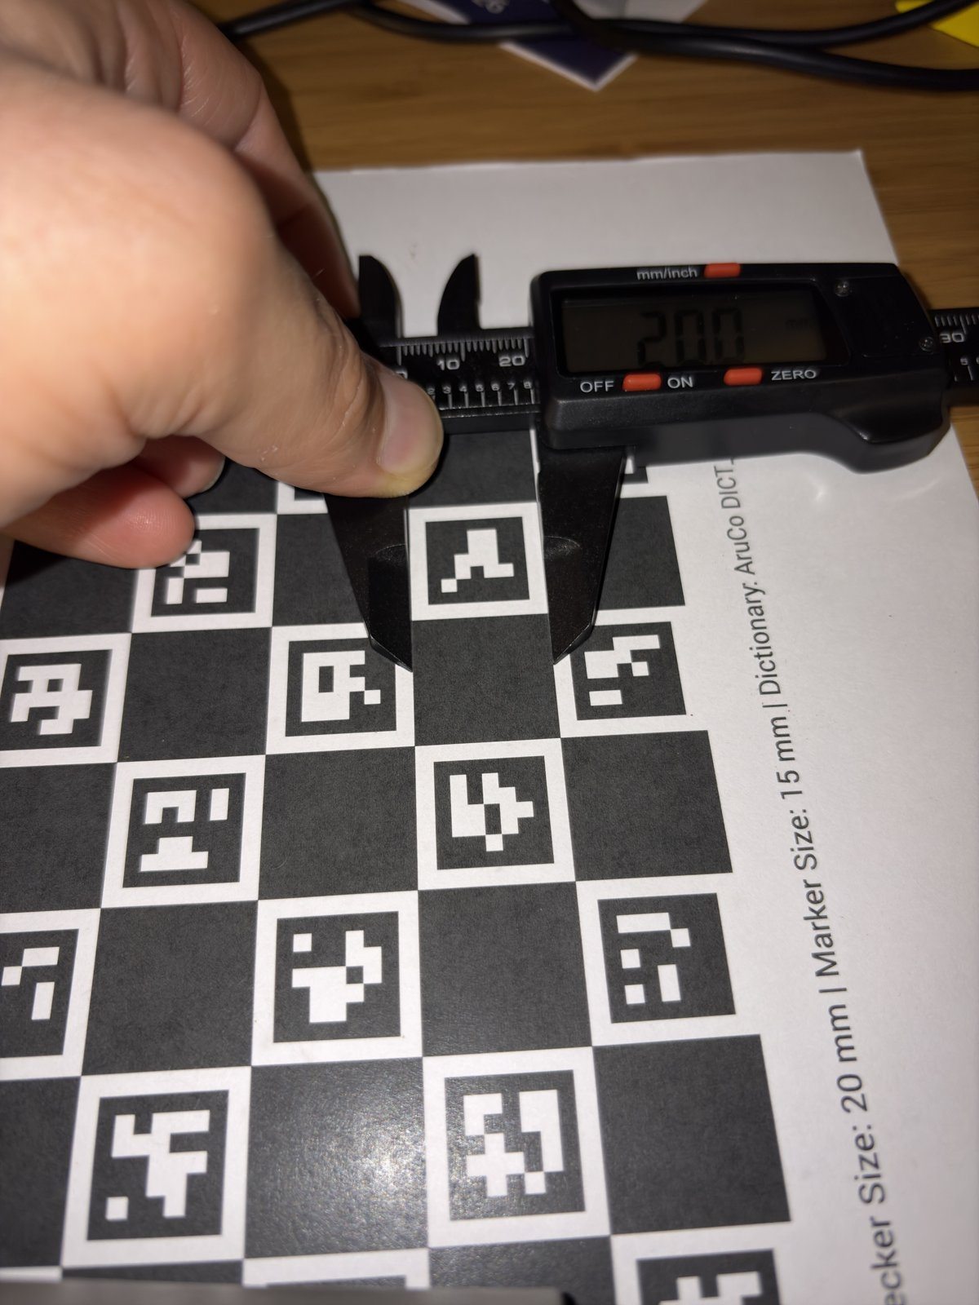
The Mac deadlock is fixed; backend comparison exposed the next limits
PROGRESS 2 OF 4 · RECONSTRUCTION RELIABILITY
Presenter · Yashi
R-31 · MAC RELIABILITY
WHAT THE MATRIX SHOWED
5 / 5
VGGT
regression test · 3.2 s
64 s / 56 s
s-04 fitted rotation: 6.1° / –1.3° / 1.2°
smoke / uvicorn · same 908,200-byte GLB
MASt3R
same placement: 41.0° / 21.5° / –6.4°
R-32 · SAME FRAMES, MULTIPLE BACKENDS
VGGT 6/6 complete
MASt3R 4/6 complete
COLMAP 0/6 complete
Same physical placement, very different fitted poses. Two s-05 MASt3R runs also hit a provenance crash on non-manifold edges (#300).
MASt3R fits were inconsistent; COLMAP refused every frame set. The spike ruled out an easy backend swap.
Ratios are against nominal CAD; no accuracy or tolerance is claimed.
Recorded real-Mac evidence from R-31: deadlock reproduced without the guard, then fixed.
Notes:
[Presenter: Yashi] Metric scale comes from the printed board. The old fit through camera centres made every model 4 to 9 percent small; R-23 anchors scale on the board corners in the scene, and all five golden objects now read 0.997 to 0.999. Then we checked the truth itself with calipers, ten placements per feature. The parts are within half a millimetre of their CAD, so the shrinkage R-22 saw on s-05's walls is the reconstruction's, not the print's. And the printed board is slightly large: about 0.1 percent across and 0.46 percent down. That is small, but it is measured rather than assumed, and a single scale factor can't correct it. These are raw readings at 0.1 mm resolution, not an accuracy figure.

Slide 5
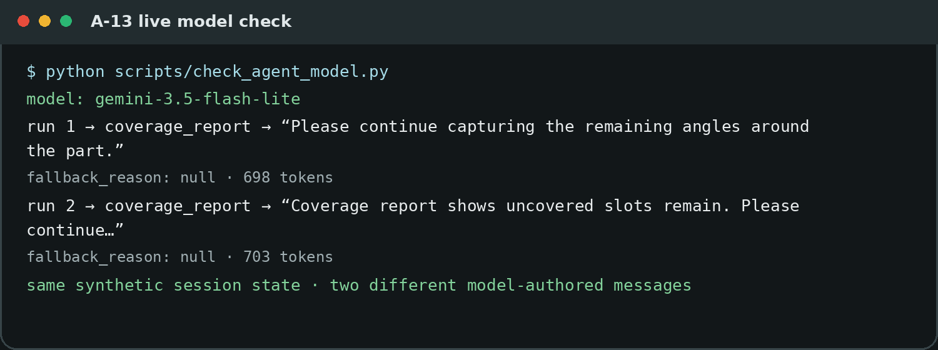
Generative AI now guides capture without touching the verdict
PROGRESS 3 OF 4 · GENERATIVE AI
Presenter · Tabeen
A-05 · UNSEEN SURFACE DISAGREES MORE
A-05 · NEXT-VIEW HAND-OFF
0.6 s
1.0 s
24th → 1st
s-04 disagreement map
s-02 disagreement map
C-08 best view vs disagreement-best view
The map changes ranking, but not served geometry or the verdict. Getting the ranking to the phone still needs a contract field.
A-13 · LIVE GEMINI AGENT
DONE · PR #326
Median seed-to-seed spread: unseen > seen on both prepared fixtures. Map build: 0.6 s (s-04), 1.0 s (s-02).
The hard rule: disagreement is capture guidance only; it never contributes to Pass / Fail.
Notes:
[Presenter: Tabeen] Every vertex is labelled Observed or Unobserved, and only Observed geometry may ever pass or fail a part. R-24 made that stricter: only pixels the reconstruction model is confident about count as an observation, which removed 3 to 4.5 percent of observations, always toward Unobserved. Then we reviewed every Done story. The tests were all green, but we found 24 bugs in behaviour the tests didn't cover. The most serious: the back of a thin wall, hidden behind its front, could be labelled Observed. R-25 fixed that with a camera-facing check. On the five golden objects, Observed vertices fell 4 to 7 percent and none gained Observed, which is the safe direction. It also showed that most camera-facing samples fail our 5 mm depth gate, an unmeasured assumption we will calibrate rather than tune now. Three of the ten follow-up stories are done.

Slide 6
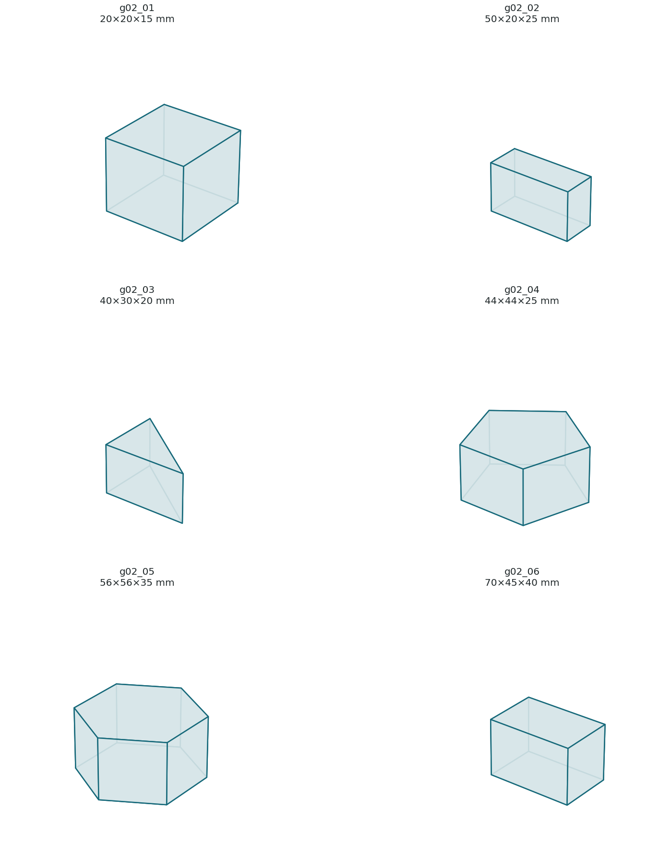




The six-part specimen batch is printed and the σ_floor path is finally open
PROGRESS 4 OF 4 · GROUND TRUTH
Presenter · Tabeen
G-02 · SIX PRINTED SPECIMENS
CLEAN-CHECKOUT + CI EVIDENCE
THE BOUNDARY
6 / 6
For G-04, the printed part—not nominal CAD—is truth. No tolerance is set until σ_floor is measured.
final prints on A1 mini
18 / 18
your Windows clean-checkout test
GROUND-TRUTH STATUS
G-01 printer + calibration · done
1,205 + 1
G-02 specimen batch · done
Grey Bambu PLA Basic · A1 mini · 0.20 mm Standard · 2 wall loops · 15% grid.
Final size range: 20×20×15 mm to 70×45×40 mm.
GitHub CI: passed + skipped
G-03 caliper every specimen · ready
#329
G-08 photograph batch · ready
merged; G-03 / G-08 / G-11 unlocked
G-11 robustness set · ready
Targeted local check: 18 passed in 2.58 s.
Notes:
[Presenter: Tabeen] About a third of the project is generative AI. Our test for what counts: run it twice, and it can give two different answers, so the reconstruction model doesn't count, but the VLM does. A-01 samples frames during capture and asks a pinned Gemini model whether it is the same part, a screen photo, well lit, or blocked by hands. In one real run it flagged a photo of a screen and a wrong part. That's one run, not an accuracy figure. A-11 now shows the model's one-line tip to the supplier while they capture; it was the first change to our frozen API contract, version 1.1. The model never touches geometry and can never pass a part. The capture agent's tools and its deterministic fallback are done; shape completion is the next generative piece.

Slide 7
Feature freeze is here; measurement and integration are now the critical path
TIMELINE · PLAN AGAINST ACTUAL
Presenter · Tabeen
M0
M1
M2
M3
M4
M5–M8
SEP 8
SEP 25
OCT 9
OCT 16
OCT 30
NOV 13 – DEC 18
MET
LATE
LATE
LATE
PARTLY
NOW
A mesh from real photographs (R-01)
Real phone → real service reached Oct 29 (C-13)
VLM + agent + disagreement map complete by Nov 12
Printer setup + six specimens complete Nov 12
Inspection pieces exist; final verdict chain still incomplete
Freeze boundary today · harden · backup demo · defense
WHAT THIS MEANS
Core reconstruction, capture UX, provenance and GenAI components are built. The remaining schedule risk is not another model—it is physical ground truth, contract integration and one safe hosted end-to-end run.
Notes:
[Presenter: Tabeen] The plan has a gate at each sprint boundary. Reconstruction is done, but we're behind on inspection, and we'd rather say so than hide it. Phone-to-service arrived a month late. The VLM now flags a screen photo and tells the supplier, but rejecting the frame is still to build. Two gates aren't met: σ_floor, the smallest deviation we can measure, needs printed specimens, and printing is the next step; and the end-to-end verdict needs registration, which has started. The feature freeze on Nov 13 is the date that matters next.

Slide 8
Turn the printed batch into a defensible σ_floor
WHAT'S NEXT 1 OF 2 · MEASURE BEFORE WE JUDGE
Presenter · Mamadou
G-01 + G-06 ✓
G-02 ✓
G-03 · NEXT
G-08 · NEXT
G-04
I-07
Printer + board truth
Six specimens
Caliper every edge + height
25–30 photos per specimen
Error + σ_floor
Tolerances + verdict
No accuracy or tolerance is claimed until it is measured (D-003). The printed part, not nominal CAD, is the truth.
NOW UNBLOCKED
MEASUREMENT RULE
EXPECTED OUTPUT
G-03, G-08 and G-11 all became Ready when G-02 merged. The physical batch is no longer the blocker.
Caliper each printed feature, photograph each specimen, then compare reconstruction error against the measured print.
A measured reconstruction baseline and σ_floor that can justify the final Pass / Fail / Rescan thresholds.
Notes:
[Presenter: Mamadou] Before the system can judge a part, we need σ_floor: the smallest deviation it can tell apart from its own noise. That comes from printed specimens with caliper truth: book the lab printer and check it with a cube, print the specimens, photograph them, then measure the error. G-06, the first link, is done. Of the review's ten follow-up stories, three are done: the hard-rule fix, the portrait-intrinsics fix and the synthetic-generator tests. Next are the flat parts the segmentation deletes today, and the mesh-cleanup fixes. Two issues still need a team decision; the third, the error codes, was settled with the contract update.

Slide 9
Close the contract and run the whole product from the hosted page
WHAT'S NEXT 2 OF 2 · HOSTED END-TO-END
Presenter · Mamadou
1
IN PROGRESS
2
NEXT
3
NEXT
C-21 / O-005
A-11 → R-34
X-02 / X-03
Safe public host
Order contract
Integration + demo
Confirm CORS preflight, decide public-token exposure, and reject unknown order codes before GPU work. Then run one real iPhone session from GitHub Pages.
Merge contract v1.1 at the Nov 13 boundary. R-34 adds order code + CAD/spec storage and the gate that stops unknown codes.
Capture → reconstruct → inspect → report. Use measured σ_floor for verdicts, then record the backup demo once the full loop is stable.
Target demo flow: GitHub Pages → order code → guided capture → 3D model → CAD deviation → Pass / Fail / Rescan / Unverifiable.
DEVICE TESTING
C-23 Android check · parked until pre-expo if time allows (D-065)
A-11 contract boundary · Nov 13
C-21 hosted phone run · after O-005
Notes:
[Presenter: Mamadou] With a metric model and provenance in place, inspection aligns it to the buyer's CAD. I-03 finds candidate poses with scale held fixed, and reports what scale would fit best, which catches a substituted or wrongly printed part. I-04 refines the pose, and I-05 flags when two orientations fit about equally well, instead of picking one silently. Then the verdict compares only observed geometry. On the generative side: choosing a shape-completion model, letting the VLM veto an unsafe Pass, and the capture agent's own loop.

Slide 10
Project evidence used for this checkpoint
REFERENCES
Presenter · Mamadou
1
ProofShape GitHub repository: stories, decisions, tests, pull requests and CI
2
C-20 / PR #264: capture gate, roll/landscape maths and real iPhone check
3
R-31 / PR #274: macOS Open3D + torch deadlock fix and M2 Max verification
4
R-32 / PR #280: VGGT / MASt3R / COLMAP backend comparison
5
A-05 / PR #314: disagreement map and next-view ranking
6
C-22 / PR #323 and A-13 / PR #326: agent conversation UI + live Gemini model check
7
C-21 / PR #298 and #328: GitHub Pages hosting and production fail-closed behavior
8
G-02 / PR #329: six-specimen batch, clean-checkout test and ground-truth unlocks
9
ProofShape proposal, sprint plan, manual, decisions D-065/D-066/D-068, and 30 Oct checkpoint deck
Every number on these slides traces to a story’s recorded result, pull request, CI run or the team’s previous checkpoint evidence.
Notes:
[Presenter: Mamadou] Everything on these slides comes from the repository: each number traces to a story's recorded result or a pull request. Thank you; happy to take questions.

