Slide 1
ProofShape
Turning a smartphone into a coarse 3D inspection tool for manufactured parts
Biweekly Progress Review · 18 September 2026
CS595 Capstone · San Francisco Bay University · Fall 2026
@TabeenRaoof · @dalwalyk · @mbj1994 github.com/proofshape/proofshape

Slide 2
OUR STANDING TEMPLATE
Every review answers the same four questions
Fixed template, so preparing a review is assembly rather than invention — that is what keeps seven reviews at ~18 person-hours instead of eating the schedule reserve.
1
What we said we would do last time
slide 6
2
What works now
slides 7–10
3
What slipped, and why
slide 13
4
What we will have by the next review
slide 14
ProofShape · CS595 · 18 Sept 2026
2

Slide 3
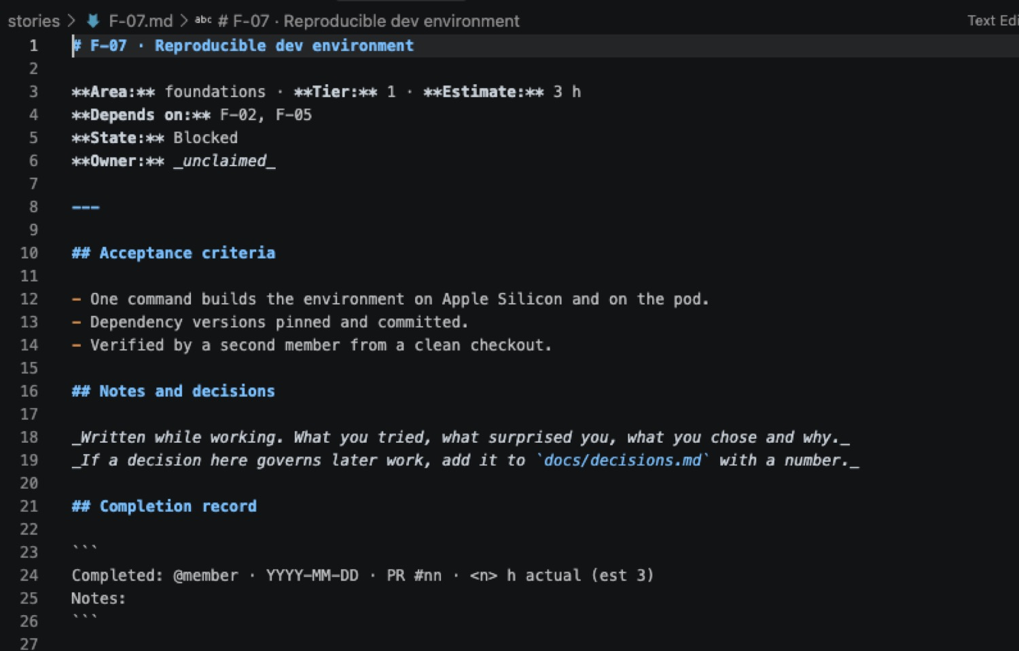
HOW WE PLANNED IT · 1 OF 3
We planned the work as stories, not as a to-do list
One story = one pull request = one or two work sessions.
  If it grows past that, it gets split — review quality collapses on large diffs.
22 stories written out in full.
  7 foundations, 15 reconstruction engine. Later phases are titles only, elaborated one sprint ahead — most detail written in September would be wrong by November.
The ID says where the work lives, not its priority.
  F foundations · R reconstruction · C capture · I inspection · A generative AI. R-04 is not "step 4" — the Depends-on line is the only ordering that matters.
Every story carries a state, and a script keeps them honest.
  Blocked → Ready → Claimed → In review → Done.
Every story is a file with the same shape: dependencies, state, owner, testable acceptance criteria, working notes, and a completion record that takes real hours — not the estimate copied across.
ProofShape · CS595 · 18 Sept 2026
3

Slide 4
HOW WE PLANNED IT · 2 OF 3
Nothing reaches main except through a reviewed pull request
Eight branch-protection rules on main — and we proved each one by trying to break it, not by trusting the checkbox.
Gate | What it enforces
Pull request required | No direct pushes to main — proven: a direct push was rejected (GH006)
1 approving review | Proven: a merge without approval was refused by policy
Stale approvals dismissed | New commits invalidate an existing approval
Status checks required | ruff + TypeScript must pass before merge is possible
Branch up to date | No merging against a stale main
Force push / deletion blocked | History cannot be rewritten
Admins cannot bypass | Applies to the repository owner too — nobody has an override
Conversation resolution | Review threads must be resolved, not ignored
Author cannot approve their own PR — a GitHub rule, not a policy choice. The reviewer's job ends at approval; the author merges.
ProofShape · CS595 · 18 Sept 2026
4

Slide 5
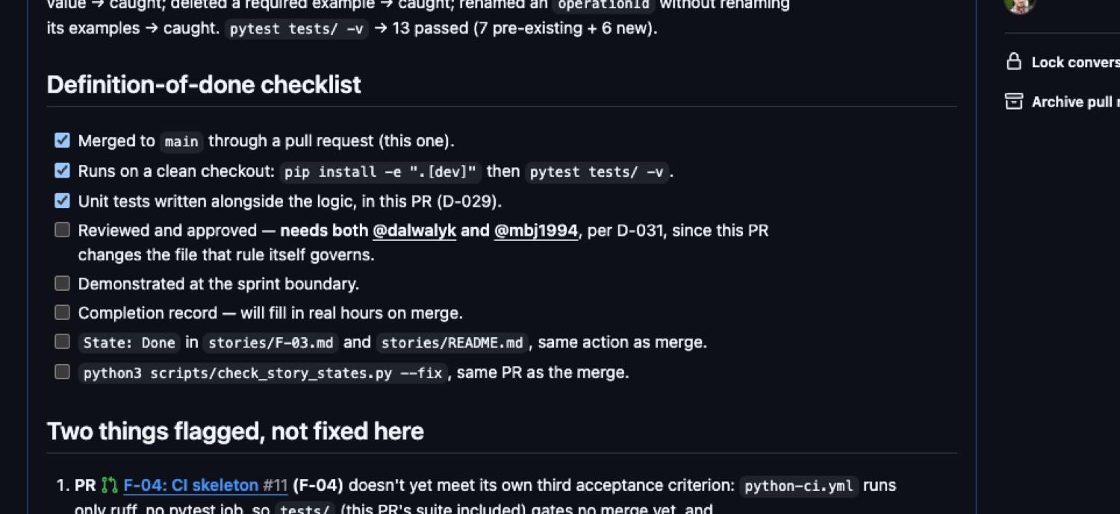
HOW WE PLANNED IT · 3 OF 3
Decisions are recorded with their reasoning, and rules are automated
32
13
2
0
decisions logged
with the why, not just the what
automated tests
run on every pull request
required CI checks
ruff · TypeScript
rules that rely
on remembering
A decision without its reasoning gets reversed by whoever forgets it.
  D-005, the hard rule: geometry the camera did not see can never pass or fail a part — only trigger a Rescan. Enforced in the data format, with a test that fails the build if a report violates it.
Where a rule could be a script, it is a script.
  A checklist raises the odds a person does the right thing; it does not verify they did.
Tests are written during implementation — a joint obligation.
  Engineer and AI assistant both. Never deferred to a follow-up story.
The definition-of-done checklist on a live pull request — unticked boxes are the point. This one is held open because D-031 requires both other members to approve a change to the file that rule itself governs.
ProofShape · CS595 · 18 Sept 2026
5

Slide 6
QUESTION 1
What we said we would do
From the proposal, presented 5 September:
  Tier 1 — photos in, metric 3D model out. Never cut.
  Tier 2 — CAD alignment, deviation heatmap, Pass / Fail / Rescan / Unverifiable verdict.
  Tier 3 — stretch. Generative-AI components are never cut, regardless of tier.
Three people × ~9 h/week × ~13 weeks ≈ 349 person-hours.
  Nine sprints, gates M0–M8, seven graded reviews.
For this first stretch specifically: stand up the repository, freeze the interface, get CI running, provision the GPU, and shoot the golden capture set.
ProofShape · CS595 · 18 Sept 2026
6

Slide 7
QUESTION 2 · THE NUMBERS
What works now
4 / 7
19
2
13
foundation stories Done
merged, reviewed, tested
pull requests opened
15 merged · 2 closed · 2 open
stories in flight
GPU pod · golden capture
tests green
on every PR
Demonstrable today
The public repository, with all eight protection gates proven by trying to break them.
CI running on every pull request — a lint failure now blocks a merge.
The frozen interface contract, with 13 tests, including one that enforces the hard rule.
The printed ChArUco reference board, verified at 100% scale with calipers.
Three golden-capture sessions shot: two objects, two lighting conditions, 79 frames.
No runnable reconstruction pipeline yet — that is honest, and it is what the next two weeks are for.
ProofShape · CS595 · 18 Sept 2026
7

Slide 8
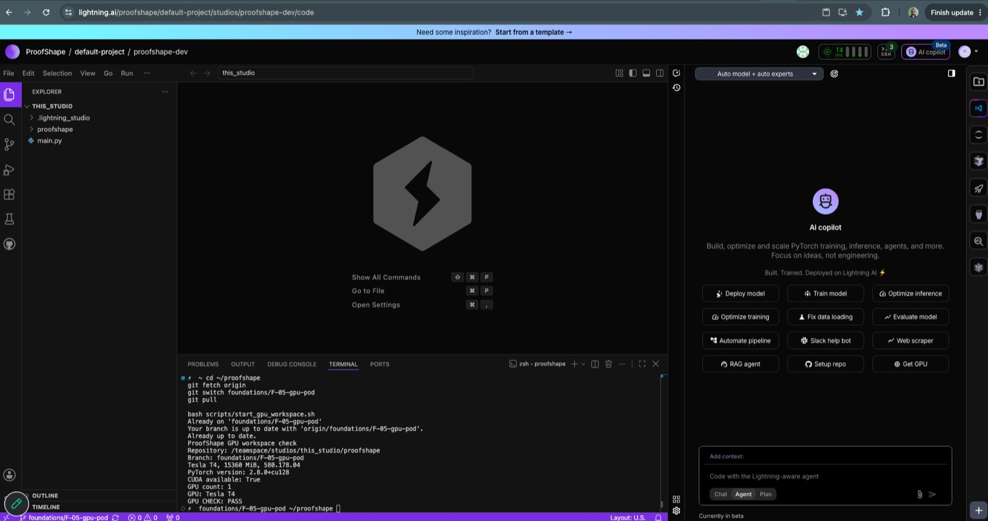
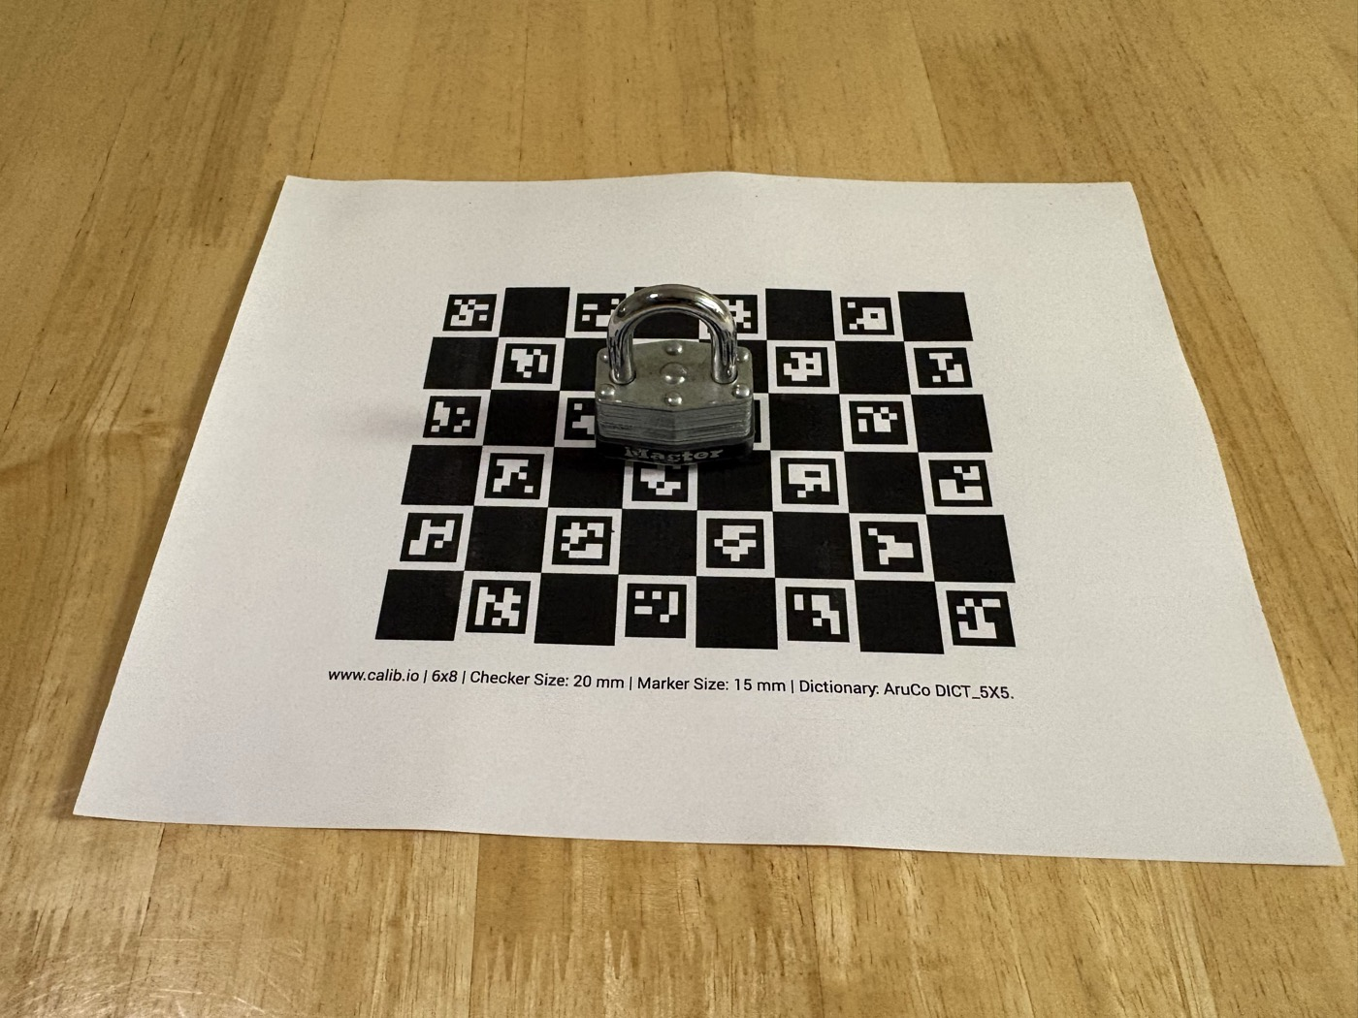
QUESTION 2 · EVIDENCE, NOT CLAIMS
The parts that are real today
GPU workspace running the shared smoke test: Tesla T4, PyTorch 2.8.0+cu128, CUDA available, GPU CHECK: PASS.
Golden capture in progress — printed ChArUco board verified at 100% scale with calipers, part centred, whole sheet in frame.
Both are honestly incomplete
F-05 — GPU access is proven for one member, not three. RunPod needed a payment method for the network volume, so Lightning AI was evaluated as a no-upfront-cost alternative. Which platform we standardise on is an open team decision, and the story stays Claimed until all three can connect and re-provisioning has been rehearsed.
F-06 — two of three objects shot, 79 frames, both lighting conditions done for the lock. Still needed: a third object and a CAD model for at least one of them.
ProofShape · CS595 · 18 Sept 2026
8

Slide 9
QUESTION 2 · THE DETAIL
Foundations, story by story
Story | What it delivered | State | Owner | PR | Actual / est
F-01 | Public repo, 8 protection rules, proven | Done | @TabeenRaoof | #1 | — / 2 h
F-02 | Repo skeleton, module boundaries, packaging | Done | @dalwalyk | #6 | 3 h / 3 h
F-03 | Interface contract v1, frozen + 6 tests | Done | @TabeenRaoof | #13 | 4.5 h / 3 h
F-04 | CI skeleton — ruff, tsc, eslint, required | Done | @dalwalyk | #11, #12 | — / 3 h
F-05 | GPU pod, three-way access | Claimed | @mbj1994 | in flight | — / 4 h
F-06 | Golden capture set | Claimed | @mbj1994 | in flight | — / 5 h
F-07 | Reproducible dev environment | Blocked | — | — | — / 3 h
Two of the four completed stories have no actual hours recorded. We have since made that a rule: the field takes a measured number or stays visibly blank — never the estimate copied across.
ProofShape · CS595 · 18 Sept 2026
9

Slide 10
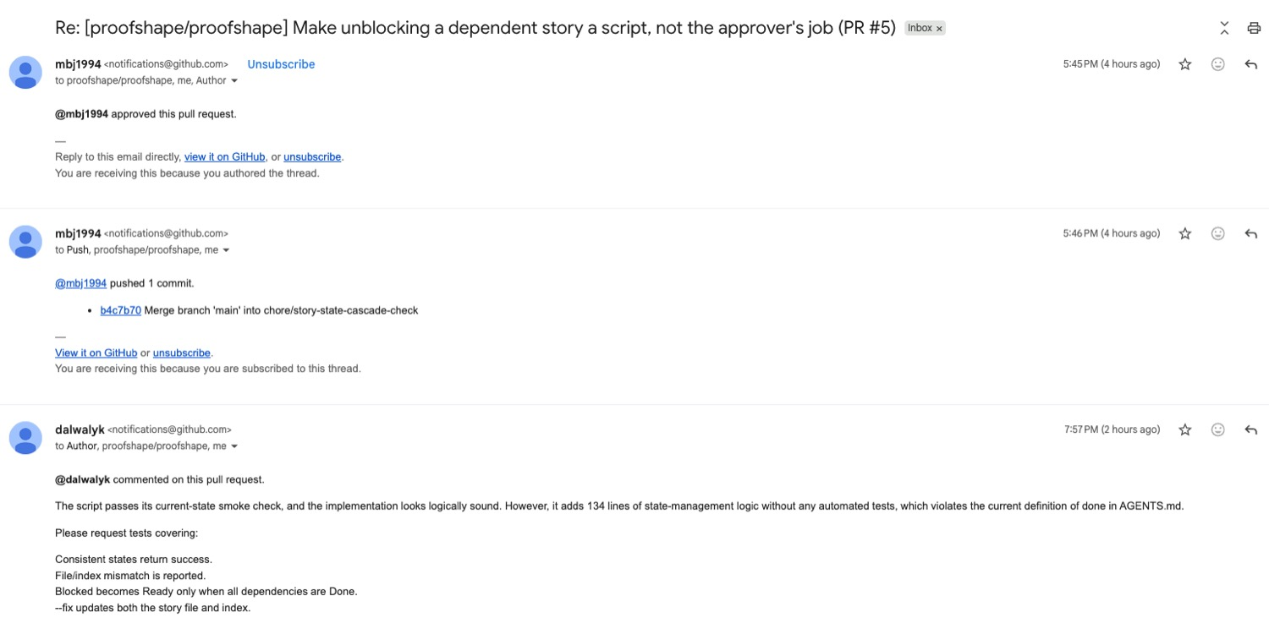
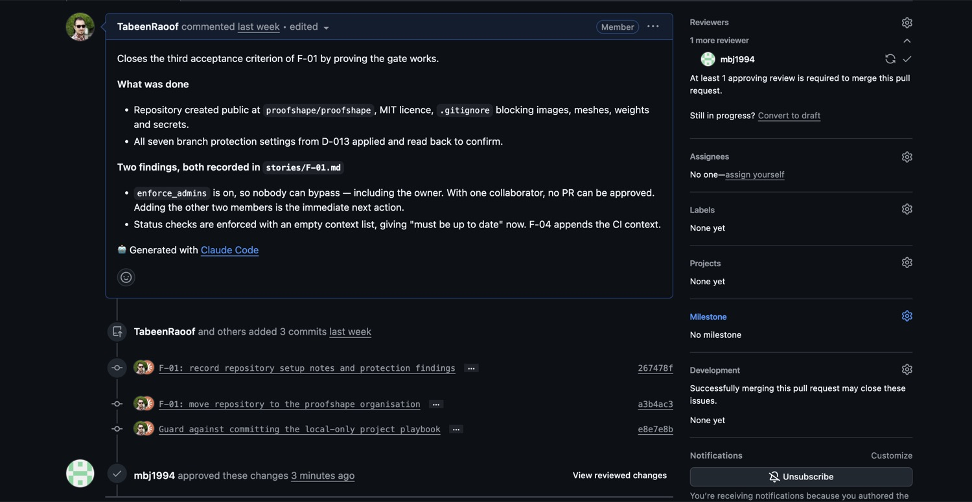
QUESTION 2 · THE PROCESS WORKING
Every change was reviewed — including the ones we got wrong
A reviewer blocking a merge on our own rules: “it adds 134 lines of state-management logic without any automated tests, which violates the current definition of done in AGENTS.md” — followed by the exact test cases required.
The gate itself: “At least 1 approving review is required to merge this pull request.” It applies to the repository owner too — nobody has an override.
Review also caught two defects that looked clean: a merge that silently duplicated a story's status block, and a second that silently dropped an entire decision entry. Both reported as mergeable by GitHub; both found by reading the merge, not trusting it.
Two pull requests were closed rather than merged — one redundant, one based on a misreading of our own approval rule. That disagreement was settled by quoting the rule, not by seniority.
ProofShape · CS595 · 18 Sept 2026
10

Slide 11
THE MAIN CHANGE SINCE THE PROPOSAL
Change of plan: three lanes became one shared front
BEFORE — as proposed
NOW — as we are actually working
Lane 1 — Capture front end
Stage 1 — Foundations
one owner · 97 h
all three · repo, contract, CI, pod, fixtures
→
Lane 2 — Reconstruction backend
Stage 2 — Reconstruction engine
one owner · 97 h
all three · the hardest risk, retired first
Lane 3 — Inspection and truth
Stage 3 — Capture · Inspection · AI
one owner · 97 h
built against something that already works
Three people building three different things in parallel from day one.
Lanes are now places in the repository, not people.
Why we changed it
Total hours do not set the finish date — the serial chain does. About 42 of the 93 engine hours can only run one story after another, so that chain advances at one person's pace no matter how many people are free. Adding people to it changes nothing.
The reconstruction engine is the hardest risk in the project. Retiring it first means everything downstream is built against something real instead of a guess.
ProofShape · CS595 · 18 Sept 2026
11

Slide 12
THE SAME MILESTONES, A DIFFERENT SHAPE OF WORK
Re-planned timeline
Sep
today
Oct
Nov
Dec
Foundations
done
all three
Engine — parallel starts
R-01 · R-02 · R-11 · R-12
Engine — the serial chain
critical chain — sets the finish date
R-04→R-06→R-07→R-08→R-14→R-15
Engine — off-chain work
R-03 · R-05 · R-09 · R-10 · R-13
Thin capture thread
C-01→C-03, in spare time
Capture app
C-04→C-12
Inspection
I-01→I-10
Generative AI
A-01→A-09 · never cut
Integration · demo · defence
I1–I4, recorded backup
M1
M2
M3
M4
M5
M7
M8
M1 (25 Sept) is at risk. The chain needs ~40 hours to reach a working endpoint — about four and a half weeks from a 3 Sept start, which lands in early October, not late September. We are flagging it now rather than at the gate.
ProofShape · CS595 · 18 Sept 2026
12

Slide 13
QUESTION 3
What slipped, and why
No runnable reconstruction pipeline yet.
  Two weeks went into foundations and process. That was deliberate — but it means nothing reconstructs a part today.
M1 (25 Sept) will not be met as scheduled.
  The critical-chain arithmetic says early October. We are saying so now, a week before the gate, rather than at it.
F-03 took 4.5 hours against a 3-hour estimate.
  Five API operations, ten worked examples, six tests and a new contributing rule. Recorded as the real number — that is how the next estimate gets less wrong.
Two completed stories have no actual hours recorded at all.
  Caught in review. Now a written rule: measured number, or visibly blank — never the estimate copied across, which looks identical to a real measurement.
Golden capture needed three attempts.
  First set framed the part too small; the retake caught the phone silently switching lenses mid-session, which would have invalidated the camera calibration.
ProofShape · CS595 · 18 Sept 2026
13

Slide 14
QUESTION 4 · BY 2 OCTOBER
What we will have by the next review
Story | What it delivers | Owner
F-05 | GPU pod provisioned, all three members able to connect and run a smoke test | @mbj1994
F-06 | Golden capture set complete — third object, CAD model, download script + checksum | @mbj1994
F-07 | Reproducible environment — one command, same result on laptop and pod | unclaimed
R-02 | ChArUco board detected, metric camera pose per frame | unclaimed
R-01 | The reconstruction model run on the golden capture, end to end | unclaimed
R-04 | Metric alignment — the bottleneck the whole chain waits on | unclaimed
The commitment
By the next review we will show the golden capture going into the reconstruction model and a metric point cloud coming out — a running pipeline, not slides. If the chain stalls, that is the first thing we will say.
ProofShape · CS595 · 18 Sept 2026
14

Slide 15
Where we are
The scaffolding is finished and proven — repository, contract, CI, review process.
All three of us are now on the reconstruction engine, because that is the risk worth retiring first.
The interface is frozen, so capture and inspection can be built against it without waiting.
M1 will slip by roughly a week. We would rather say that now than at the gate.
github.com/proofshape/proofshape

