Slide 1
Melbourne C++ User Group
Type Erasure
Paul Rooney - 8th January 2018

Slide 2

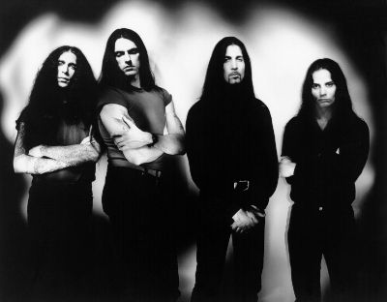
Type Erasure
+

Slide 3
What is type erasure
In programming languages, type erasure refers to the load-time process by which explicit type annotations are removed from a program, before it is executed at run-time.
wikipedia

Slide 4
Type erasure in an OO language
It’s as simple as this in java
Object x = “foo”;
Type erasure is the reason you can’t have primitive types used in java generics e.g. List<int>.

Slide 5
Type erasure in c
In c and c++ we can use a void pointer to erase the type completely.
void* erased = &any_value;
This is not satisfactory for general use in c++, as it gives us no type safety at all.
To some extent union is also perfoms type erasure.

Slide 6
Why is it not so simple for c++?
Unlike java, c# etc. c++ does not force all objects to have an implicit base class.
Void pointers do not offer us type safety and ownership semantics that we can get in other ways.

Slide 7
So what can we do instead?
We can create a wrapper type that implements the polymorphism and the user type need not use inheritance.
The type however must adhere to some interface.
We could use templates here but we are aiming to avoid infecting everything from needing to be templatized.

Slide 8
So whats the basic idea then?
We will create a base class type first.
struct concept
{
virtual void action() = 0;
}
Did we forget anything?

Slide 9
We forgot the virtual destructor
struct concept
{
virtual void action() = 0;
virtual ~concept = default;
{

Slide 10
Now for the child class
template <class T>
class model : public concept
{
T val;
model(T&& t) : val(forward<T>(t)) {}
void action() override
{
// do something with val
}
};

Slide 11
Pointer semantics
The issue with what we have so far is that it requires the use of pointer semantics.
We really need to wrap these things in another class to get value sematics and to manage lifetime.

Slide 12
A use for type erasure std::thread
std::thread has to launch threads using a c interface.
It requires a static function to be passed as the callback.
It gets tedious and untidy having a different static function for each thread you use, only to use that function to get back into the context of whatever object you are launching it from.
It also has void pointers in its interface.

Slide 13
Implementing std::thread
We can use a concept class with an invoke interface.
We can allocate a model that captures the function we want to execute. The type is erased when we assign it to a concept pointer and pass it to pthread_create.
We must use a raw new, as pthread_create wont increment the ref count of a shared_ptr.

Slide 14
Implementing std::thread
In the pthread function we cast the void* back to concept* and call the invoke virtual function. Then free the newed concept.
A proper implementation might use type_traits to detect if a member function pointer was passed in ctor and expect the next argument to be to the object to be considered this.

Slide 15
What are the drawbacks
Repetition in function calls (you often see the same function defined or implemented in 3 places).
Heap allocations needed.
Virtual functions needed.
Requires copy or move operations.
Extra classes needed. Its difficult to reuse the concept and model classes as they often do something quite specific.
Lots of niggly unknowns (propagating cv qualifiers, rvalues etc.)

Slide 16
But on the upside
Templates dont permate code, meaning potential compilation speed issues, bloat and clients requiring compilations when you make changes.
Dont force you to inherit from a common base, which causes coupling.
Small buffer optimization can eliminate heap allocations.
Gives value sematics to polymorphism.

Slide 17
Where else is this used in the stl?
std::any which is the very personification of type erasure.
std::function what is a function after all but its return type and argument types, regardless of being a free function, lambda, functor etc.. (dont know how member functions fit into this).
std::shared_ptr the deleter function is type erased.
Probably more.

Slide 18
Std::any
Std::any allows any type to be assigned to a non templated type. Once we have assigned the value to the any instance we will need to use std::any_cast to get it back.
std::any has no discernable interface except that it holds knowledge of the true type it stores and its concept is able to clone itself.
This can be implemented as RTTI, but doesnt have to be. It can also be implemented by comparing two templated function. If the type is the same in both cases the function will be equal, template functions are instantiated once for each type (see stack overflow).

Slide 19
std::any
int main()
{
std::any erased = 1;
erased = “foo”;
auto s = std::any_cast<std::string>(erased);
// throws std::bad_any_cast exception.
any_cast<complex>(erased);
}

Slide 20
std::function
A function can be though of as typed by its return type and argument list. Its name and what it does are not important from the point of view of being able to invoke it.
std::function allows a function to be stored regardless of its actual type. You can store a free function, a lamdba, a bind object or functor in the same object.
We have a concept with an invoke pure virtual method and a model that holds the actual function and invokes it.

Slide 21
Boost::TypeErasure
Allows user to define concepts using a macro that spells out a name and a function that all items conforming to the concept must implement.
Provides a set of predefined type erased concepts
Allows metaprogramming to compose concepts. Using boost::mpl container types.
Header only (is that good or bad?) so no linking required.

Slide 22
Other libraries
Newer c++17 library, with no external dependencieshttps://github.com/boost-experimental/te
Adobe poly library.

Slide 23
Other examples
any_iterator - http://thbecker.net/free_software_utilities/type_erasure_for_cpp_iterators/any_iterator.html
Plenty of other boost libraries e.g any_range

Slide 24
Looking to the future
Proposal for std:recover to specify unified interface for type erasure in standard library.
Type erasure should play nicely with concepts.

Slide 25
Videos
Sean Parent – Better code runtime polymorphism (longer version of “base class of all evil talk”).
CppCon 2014: Cheinan Marks "Practical Type Erasure"

Slide 26
Links
Kevlin Henney – C++ report Aug 2000 Valued Conversions
Scott Meyers - C++ Aha moments #5 Understanding how deleters work in Boost’s shared_ptr.
5 part blog series by Andrzej Akrzemi https://akrzemi1.wordpress.com/2013/11/18/type-erasure-part-i/
Thomas Becker -On the Tension Between Object-Oriented and Generic Programming in C++
std::function implementation using proposed std:recover https://github.com/potswa/cxx_function
std::any without RTTI - https://stackoverflow.com/questions/51361606/stdany-without-rtti-how-does-it-work

Slide 27
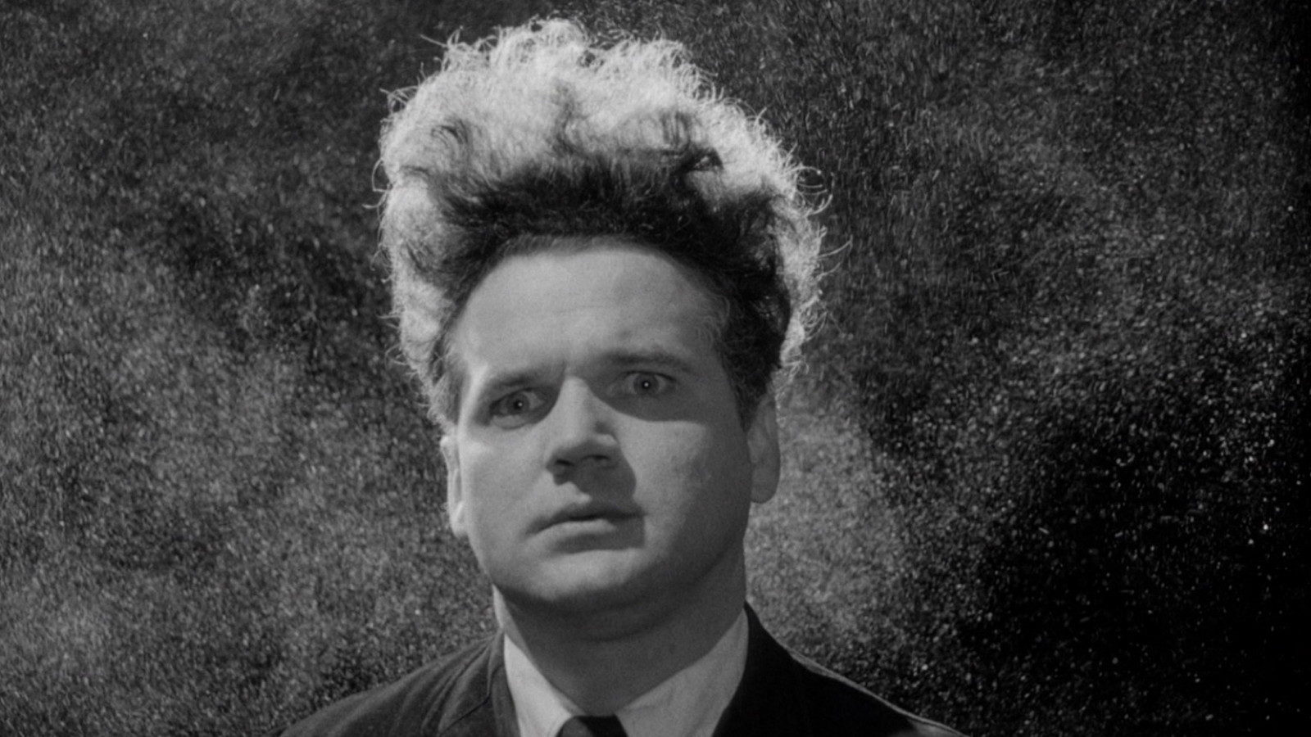
The end

Slide 28
Questions
?

