Slide 1
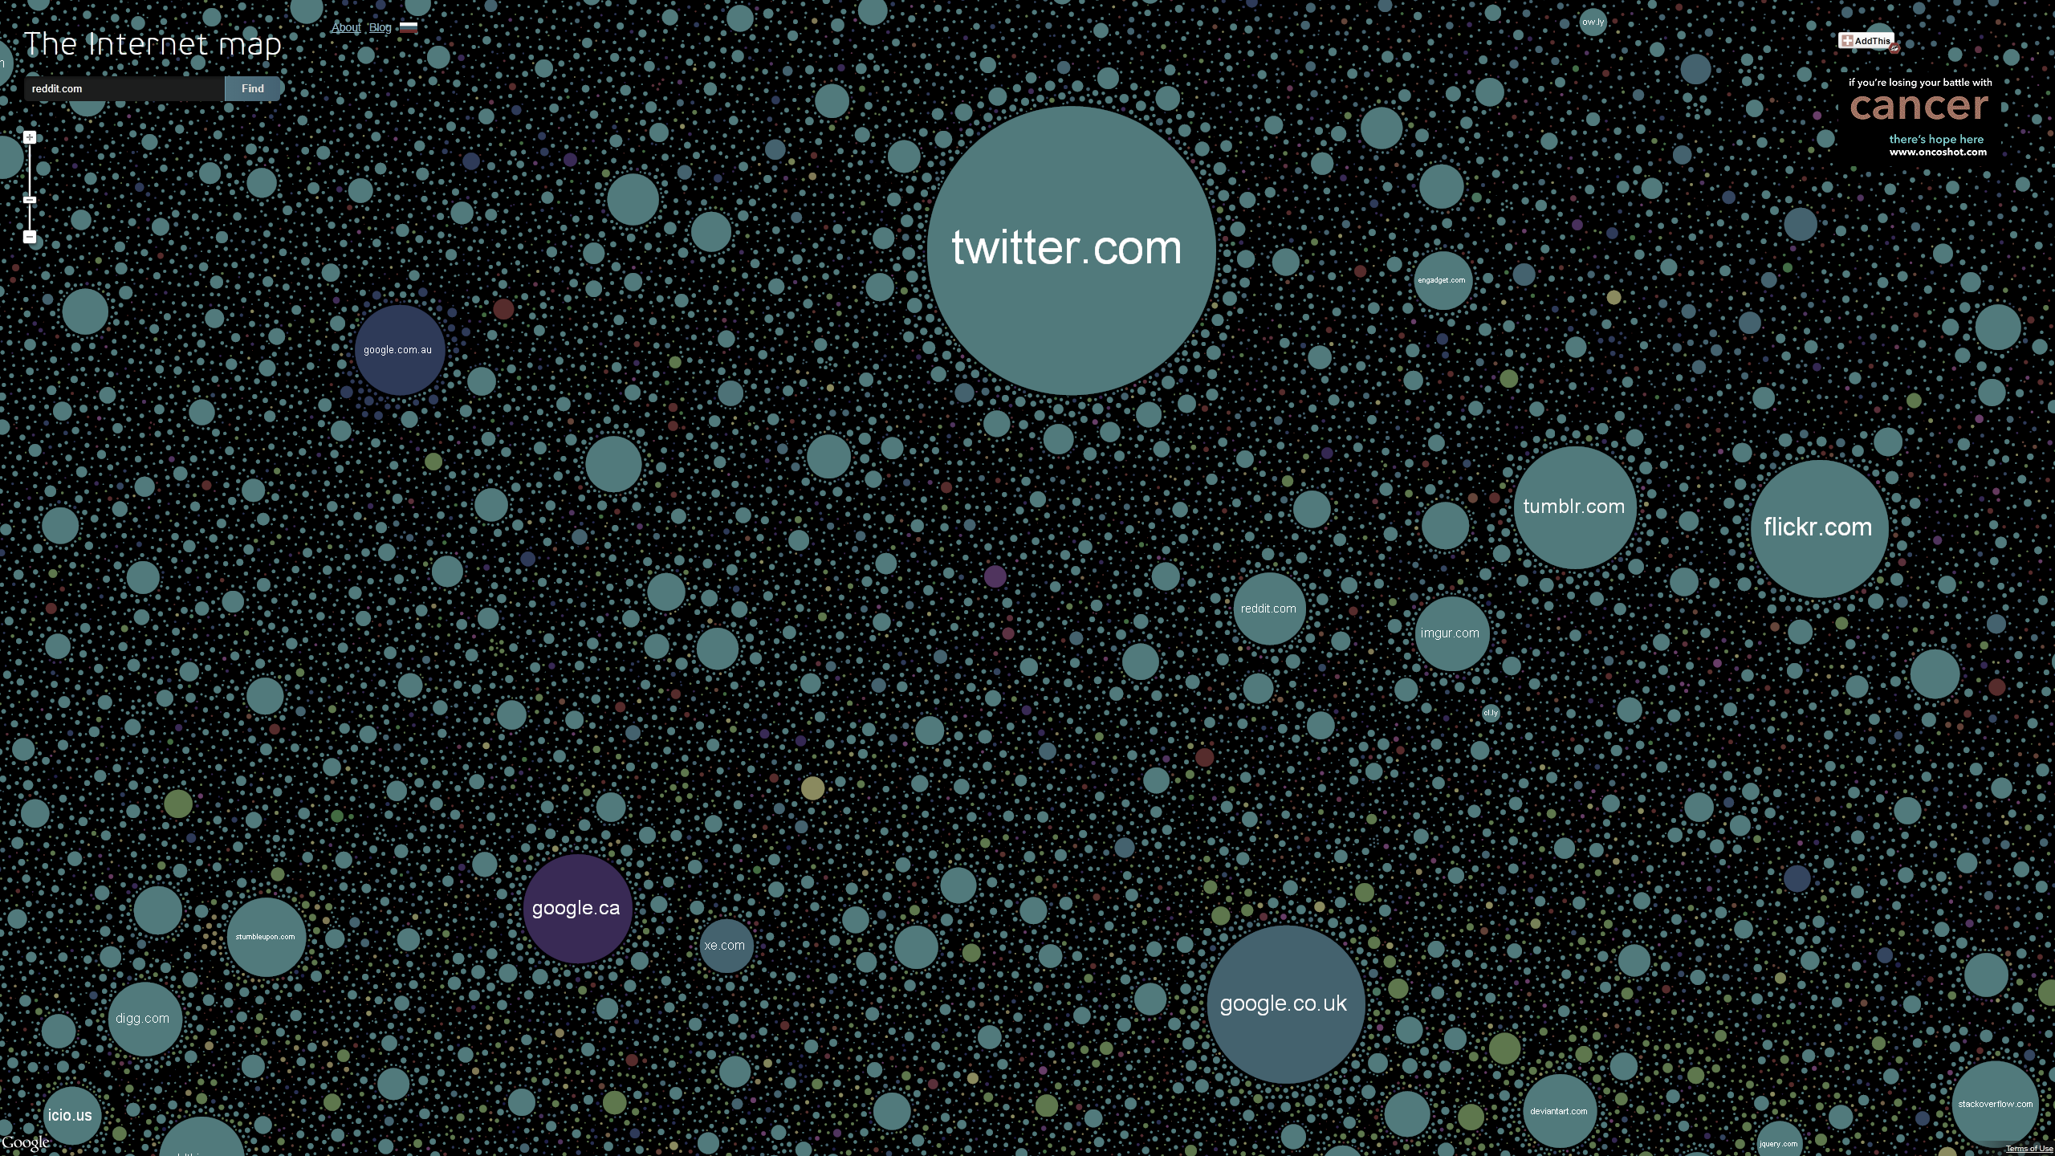
Size o
Notes:
Sensory:
Size of elements giving an easy comparison against nearby neighbors
Shape of elements giving an idea of the scope of the domain
Color of the elements giving a way to categorize the various data points
Location of the elements giving a semblance of who they are closely related to
Arbitrary:
Domain Names require knowledge of the English language
The layout of the pages require you to actively search for a given site, making it difficult to understand what you're looking at from a quick, random glance
Methods of interaction need to be trained/taught in order to take advantage of the data
Basic knowledge of what the internet is, how sites are related, and their categorical meanings are also necessary
Aspects Processed by MoVP:
First thing we recognize are the shapes of the graphs and the color coordination, as well as the negative space between each of the groupings
Following that, we begin to see the grouped clustering of the elements, and start to gain an understading about the size differences, as well as an approximation of what the distances between the sites means. We may also start to see patterns of similar clusters around larger sites
Lastly, we are able to connect the dots regarding the relations between all the elements on the page. That the size of the element is related to the popularity of the site, that each point is close to others that it’s related to, that colors signify differences in content, the intrinsic meaning of the negative space (mostly the sheer quantity of data points and how you can zoom in for a very long time and still see new data.

Slide 2
Sensory and Arbitrary Properties
Sensory:
Size of elements giving an easy comparison against nearby neighbors
Shape of elements giving an idea of the scope of the domain
Color of the elements giving a way to categorize the various data points
Location of the elements giving a semblance of who they are closely related to
Arbitrary:
Domain Names require knowledge of the English language
The layout of the pages require you to actively search for a given site, making it difficult to understand what you're looking at from a quick, random glance
Methods of interaction need to be trained/taught in order to take advantage of the data
Basic knowledge of what the internet is, how sites are related, and their categorical meanings are also necessary

Slide 3
Model of Visual Processing
Stage 1: Recognize are the shapes of the graphs and the color coordination, as well as the negative space between each of the groupings
Stage 2: Following that, we begin to see the grouped clustering of the elements, and start to gain an understading about the size differences, as well as an approximation of what the distances between the sites means. We may also start to see patterns of similar clusters around larger sites
Stage 3: Lastly, we are able to connect the dots regarding the relations between all the elements on the page. That the size of the element is related to the popularity of the site, that each point is close to others that it’s related to, that colors signify differences in content, the intrinsic meaning of the negative space (mostly the sheer quantity of data points and how you can zoom in for a very long time and still see new data.

