Slide 1




+
<-
UseR! 2019
july 10, 2019
Cécile SAUDER, Jean Delmotte
Cécile Sauder, Jean Delmotte

Slide 2


KEEP
CALM
AND
LAUNCH

Slide 3

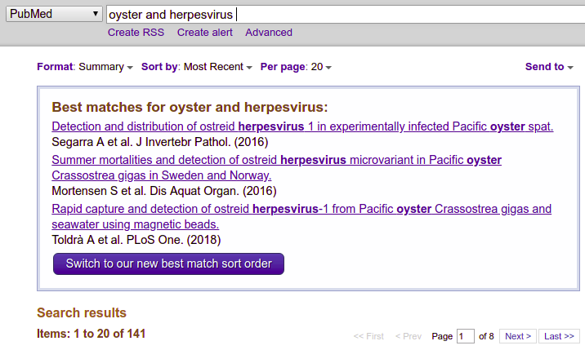
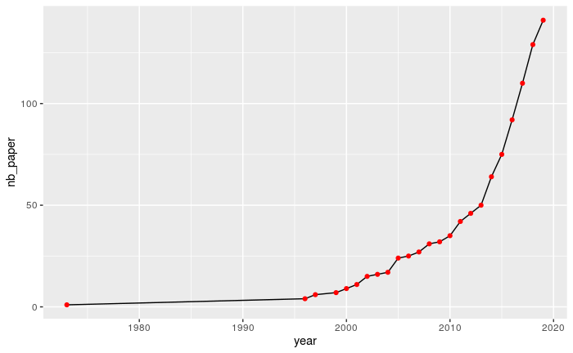
Time evolution of number of article with these keywords
oyster herpesvirus

Slide 4

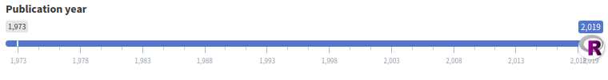
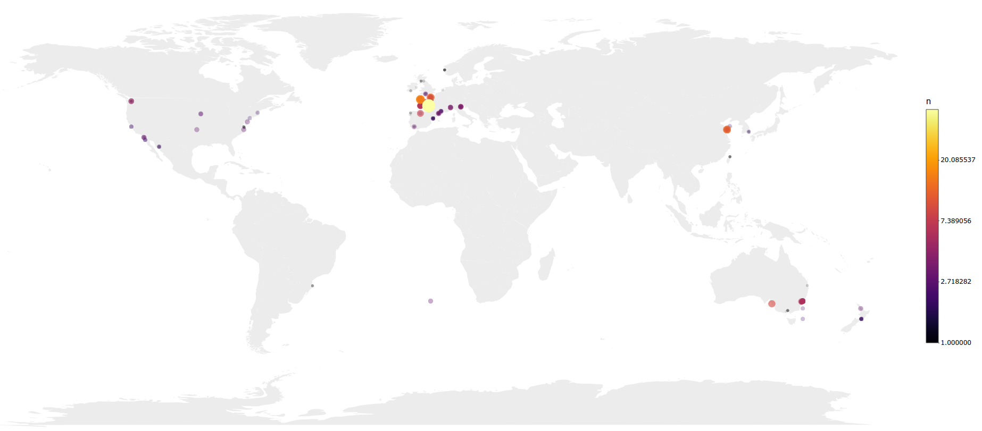
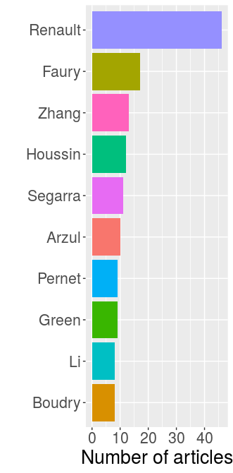
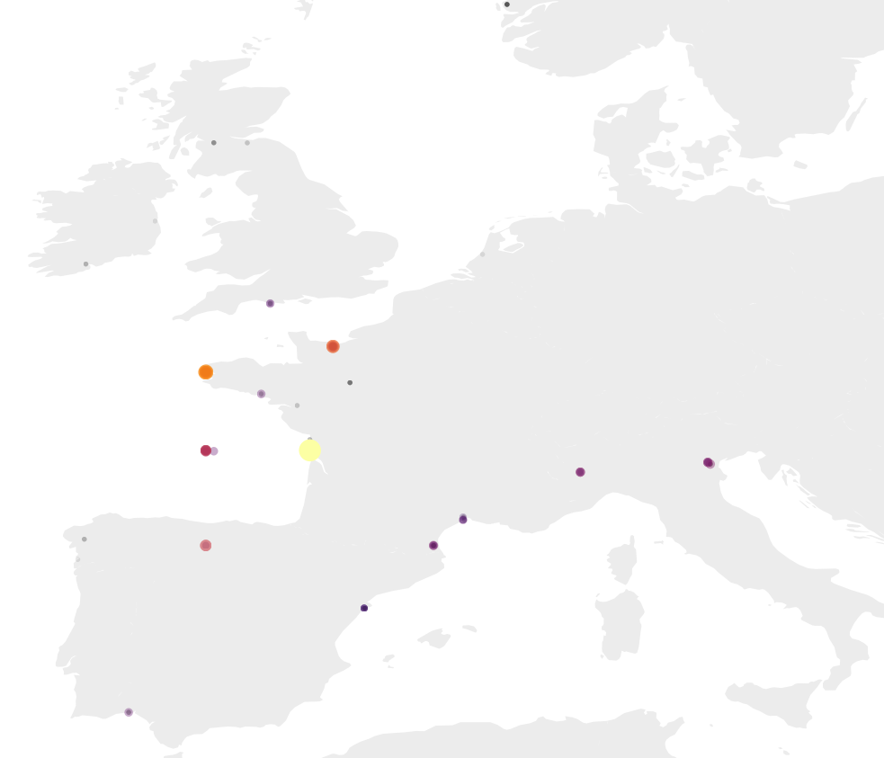
Top 10 authors

Slide 5


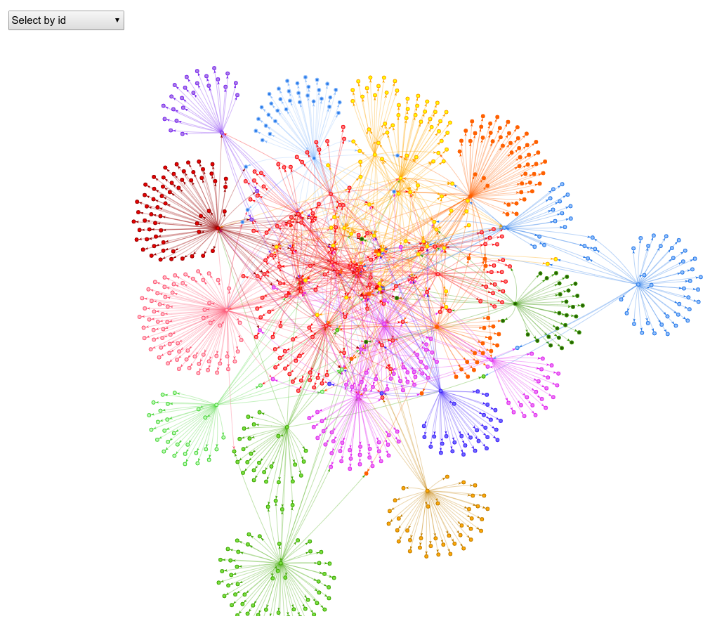
Citations network graph
oyster herpesvirus

Slide 6
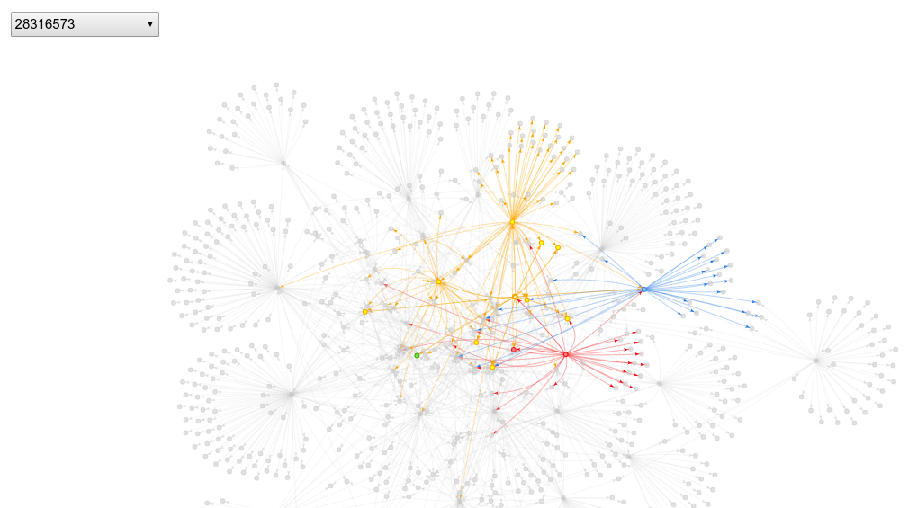
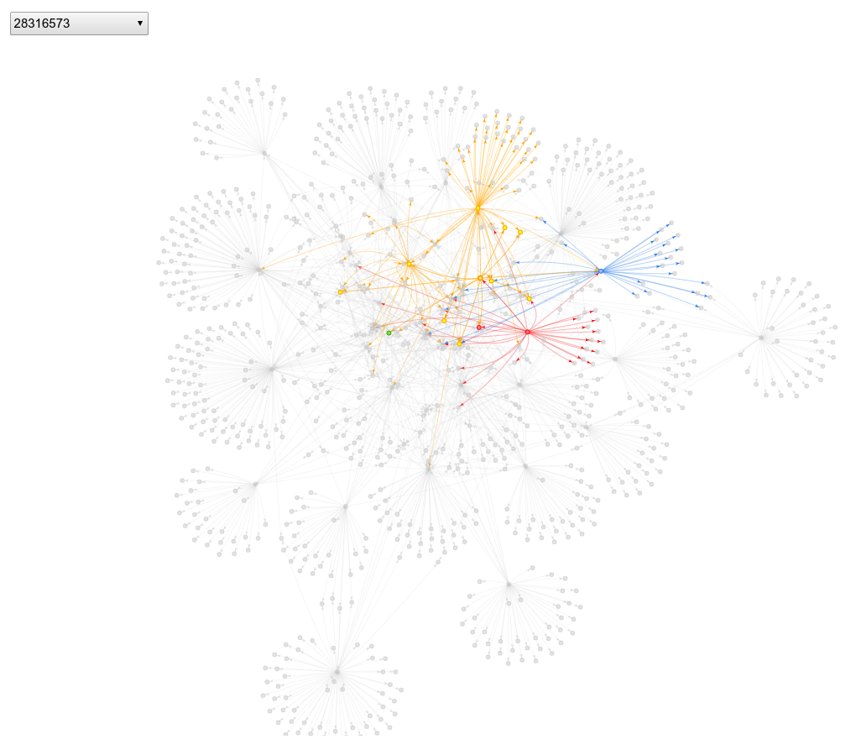
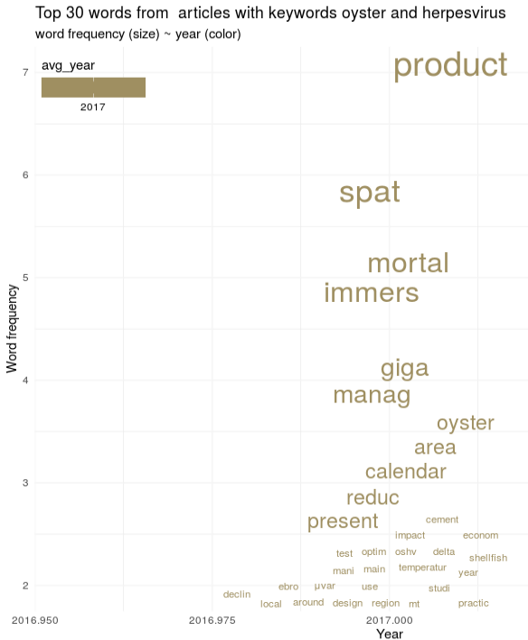
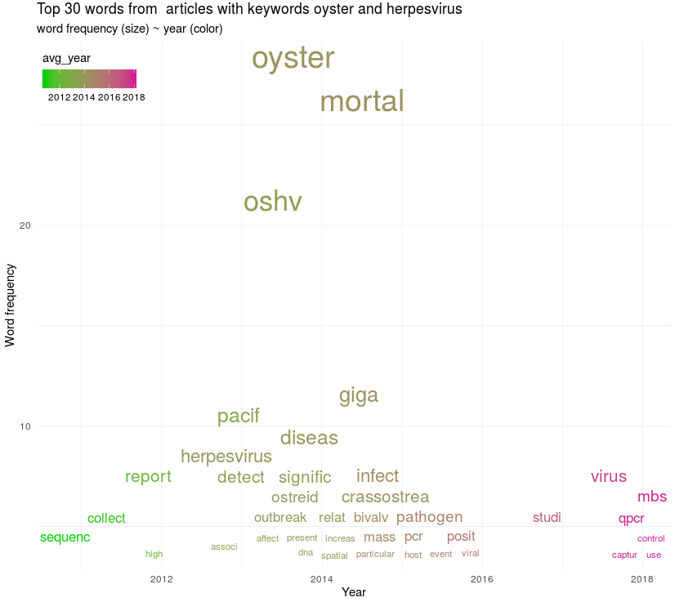
Citations network graph
oyster herpesvirus

Slide 7

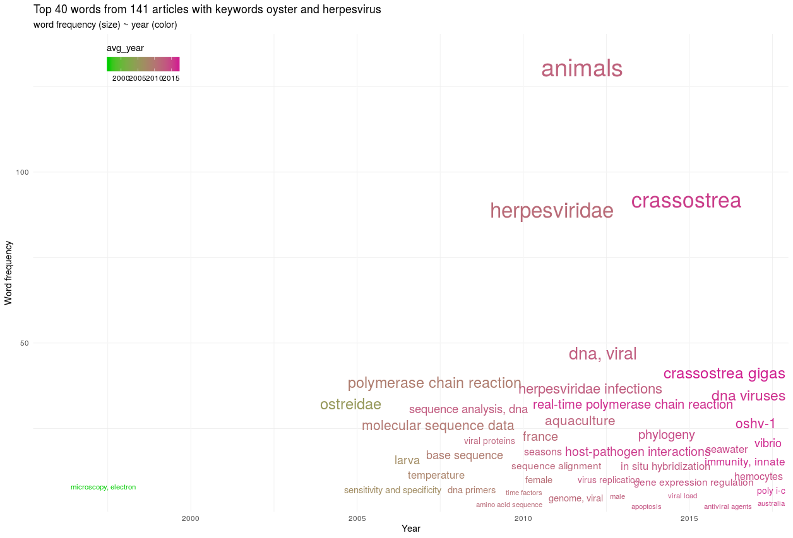
Chatterplot for keywords
oyster herpesvirus

Slide 8
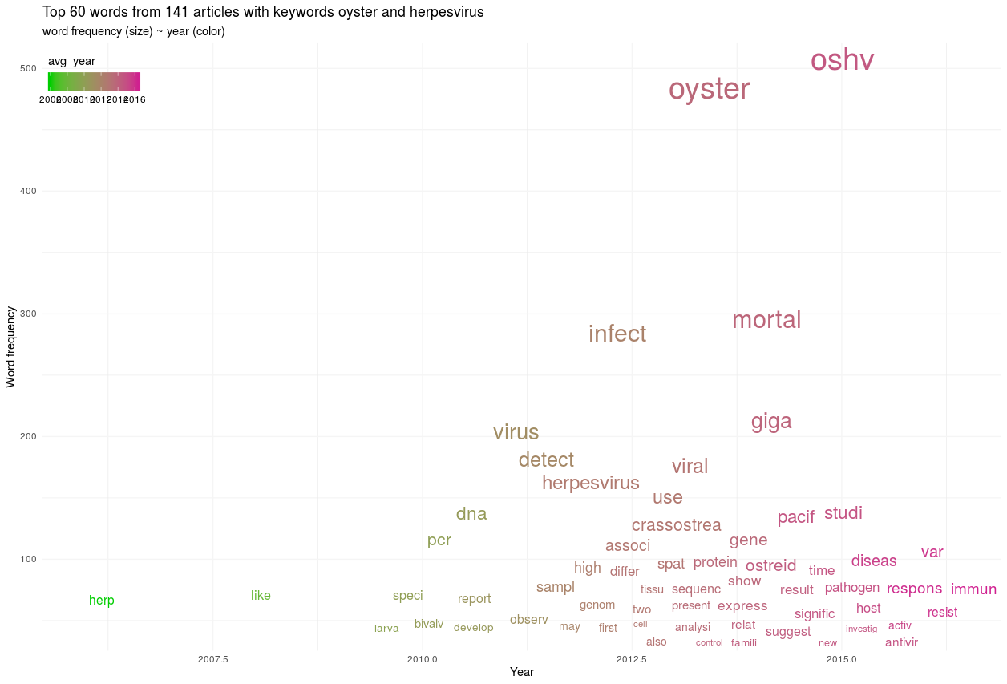
Chatterplot for abstracts
oyster herpesvirus

Slide 9
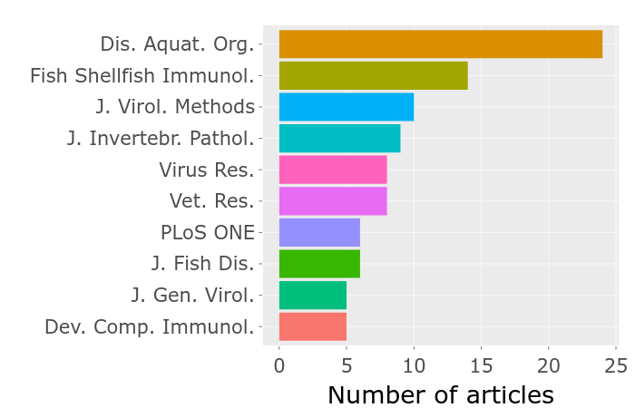
Top 10 journals
oyster herpesvirus

Slide 10
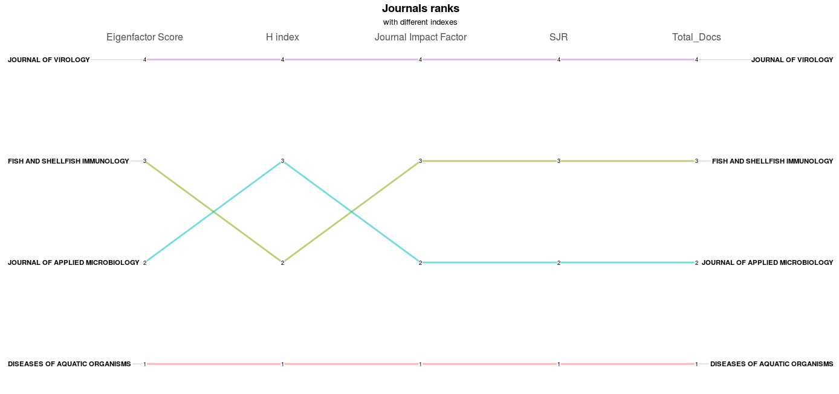
Indexes
oyster herpesvirus

Slide 11
What still needs to be done
oyster herpesvirus

Slide 12
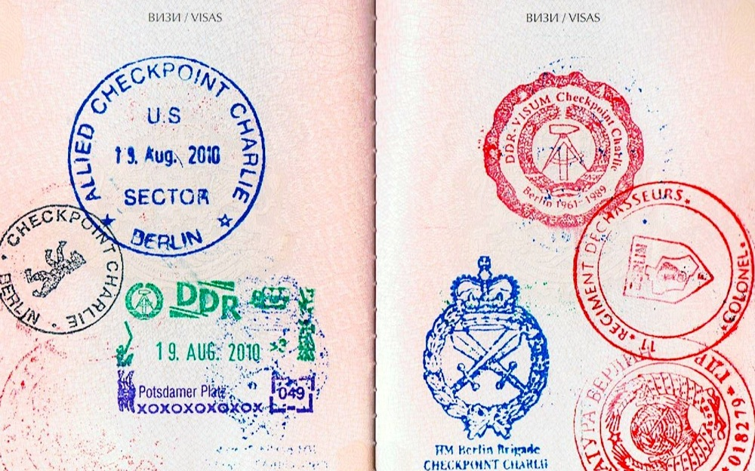
tripdown :
ce qu’il reste à faire
Cette diapo !
Redimensionner et orienter les photos avec Magick
Suggestions : pull request
Cécile SAUDER
cecile.sauder@gmail.com

Slide 13

https://cecilesauder.shinyapps.io/bibliographer
https://github.com/cecilesauder/bibliographeR
UseR! 2019
july 10, 2019
Cécile SAUDER, Jean Delmotte
Cécile Sauder, Jean Delmotte

Slide 14


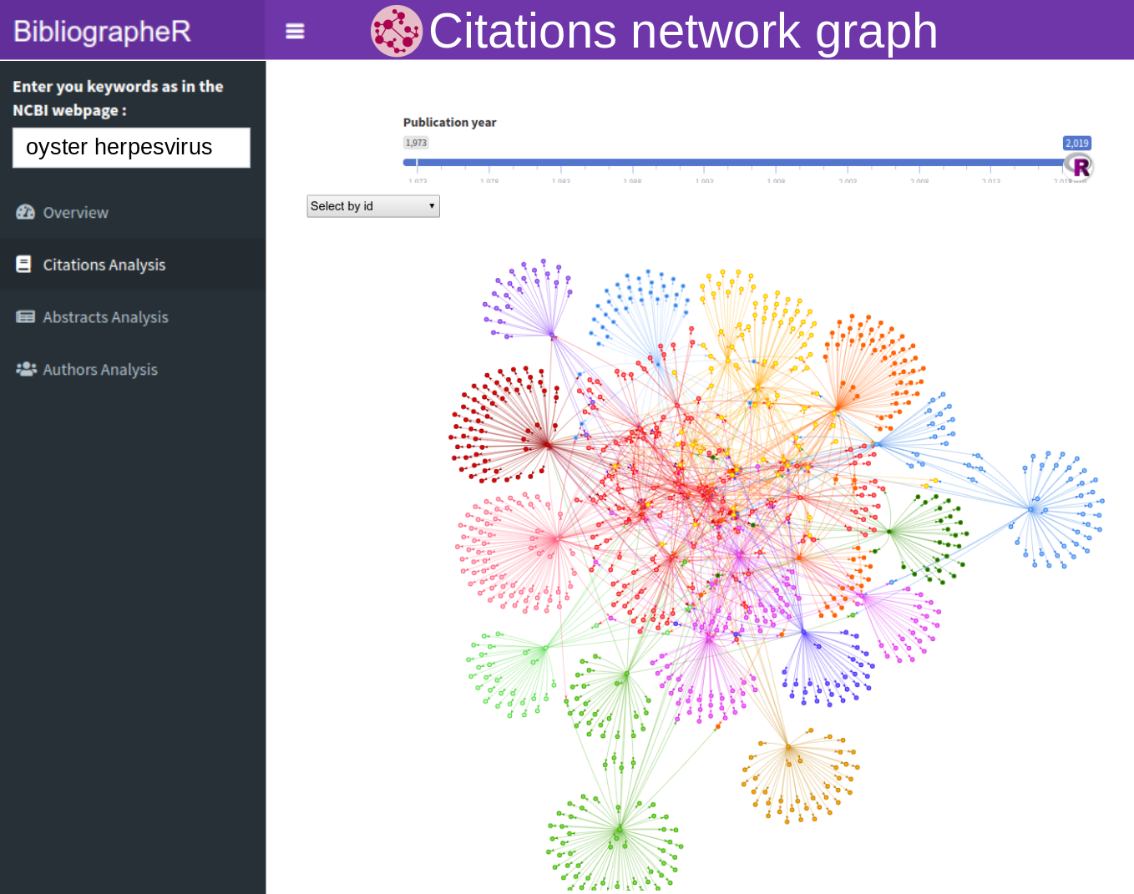
Top 10 authors
Using NCBI directly
Using BibliographeR

Slide 15
