Slide 1


A PropEr Talk
Kostis Sagonas
With PropEr help by
Manolis Papadakis
Eirini Arvaniti

Slide 2

A PropEr announcement

Slide 3
A PropEr question
Why did you create PropEr?

Slide 4
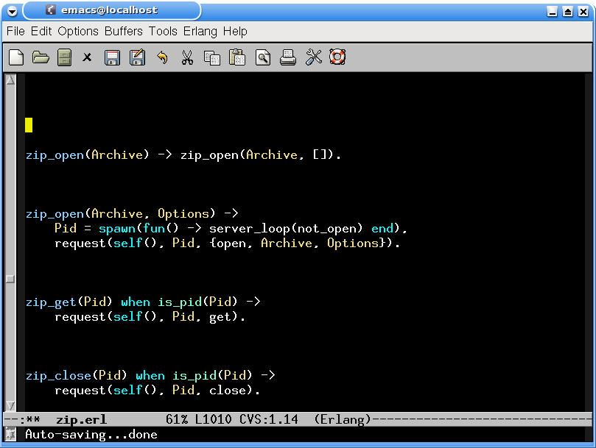
How Erlang modules used to look

Slide 5
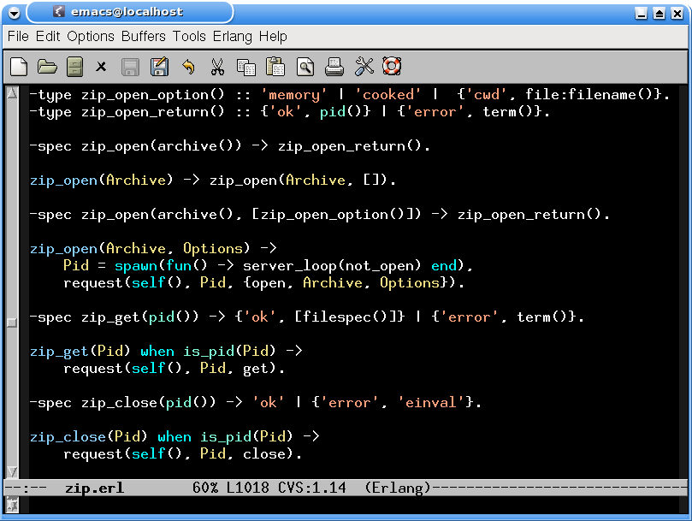
How modern Erlang modules look

Slide 6


A PropEr start...

Slide 7

PropEr progress four months later

Slide 8
PropEr: A property-based testing tool
Inspired by QuickCheck
Available open source under GPL
Has support for
  Writing properties and test case generators
    ?FORALL/3, ?IMPLIES, ?SUCHTHAT/3, ?SHRINK/2,
    ?LAZY/1, ?WHENFAIL/2, ?LET/3, ?SIZED/2,
    aggregate/2, choose2, oneof/1, ...
  Concurrent/parallel “statem” and “fsm” testing
Fully integrated with the language of types and specs
  Generators often come for free!

Slide 9
Testing simple properties (1)‏
-module(simple_props).
%% Properties are automatically exported.
-include_lib("proper/include/proper.hrl").
%% Functions that start with prop_ are considered properties
prop_t2b_b2t() ->
?FORALL(T, term(), T =:= binary_to_term(term_to_binary(T))).
1> c(simple_props).
{ok,simple_props}
2> proper:quickcheck(simple_props:prop_t2b_b2t()).
....................................................................................................
OK: Passed 100 test(s)‏
true

Slide 10
Testing simple properties (2)‏
%% Testing the base64 module:
%% encode should be symmetric to decode:
prop_enc_dec() ->
?FORALL(Msg, union([binary(), list(range(1,255))]),
begin
EncDecMsg = base64:decode(base64:encode(Msg)),
case is_binary(Msg) of
true -> EncDecMsg =:= Msg;
false -> EncDecMsg =:= list_to_binary(Msg)‏
end
end).

Slide 11
PropEr integration with simple types
%% Using a user-defined simple type as a generator
-type bl() :: binary() | [1..255].
prop_enc_dec() ->
?FORALL(Msg, bl(),
begin
EncDecMsg = base64:decode(base64:encode(Msg)),
case is_binary(Msg) of
true -> EncDecMsg =:= Msg;
false -> EncDecMsg =:= list_to_binary(Msg)‏
end
end).

Slide 12
PropEr shrinking
%% A lists delete implementation
-spec delete(T, list(T)) -> list(T).
delete(X, L) ->
delete(X, L, []).
delete(_, [], Acc) ->
lists:reverse(Acc);
delete(X, [X|Rest], Acc) ->
lists:reverse(Acc) ++ Rest;
delete(X, [Y|Rest], Acc) ->
delete(X, Rest, [Y|Acc]).
prop_delete() ->
?FORALL({X,L}, {integer(),list(integer())},
not lists:member(X, delete(X, L))).

Slide 13
PropEr shrinking
41> c(simple_props).
{ok,simple_props}
42> proper:quickcheck(simple_props:prop_delete()).
.........................................!
Failed: After 42 test(s).
{12,[-36,-1,-2,7,19,-14,40,-6,-8,42,-8,12,12,-17,3]}
Shrinking ...(3 time(s))‏
{12,[12,12]}
false

Slide 14
PropEr integration with types
-type tree(T) :: 'leaf' | {'node',T,tree(T),tree(T)}.
%% A tree delete implementation
-spec delete(T, tree(T)) -> tree(T).
delete(X, leaf) ->
leaf;
delete(X, {node,X,L,R}) ->
join(L, R);
delete(X, {node,Y,L,R}) ->
{node,Y,delete(X,L),delete(X,R)}.
join(leaf, T) -> T;
join({node,X,L,R}, T) ->
{node,X,join(L,R),T}.
prop_delete() ->
?FORALL({X,L}, {integer(),tree(integer())},
not lists:member(X, delete(X, L))).

Slide 15
What one would have to write in EQC
tree(G) ->
?SIZED(S, tree(S, G)).
tree(0, _) ->
leaf;
tree(S, G) ->
frequency([
{1, tree(0, G)},
{9, ?LAZY(
?LETSHRINK(
[L,R],
[tree(S div 2, G),tree(S div 2, G)],
{node,G,L,R}
))}
]).

Slide 16
What one has to write in PropEr
This slide intentionally left blank

Slide 17
PropEr testing of specs
-module(myspecs).
-export([divide/2, filter/2, max/1]).
-spec divide(integer(), integer()) -> integer().
divide(A, B) ->
A div B.
-spec filter(fun((T) -> term()), [T]) -> [T].
filter(Fun, List) ->
lists:filter(Fun, List).
-spec max([T]) -> T.
max(List) ->
lists:max(List).

Slide 18
PropEr testing of specs
1> c(myspecs).
{ok,myspecs}
2> proper:check_spec({myspecs,divide,2}).
!
Failed: After 1 test(s).
An exception was raised: error:badarith.
Stacktrace: [{myspecs,divide,2}].
[0,0]
Shrinking (0 time(s))‏
[0,0]
false
.... AFTER FIXING THE PROBLEMS ....
42> proper:check_specs(myspecs).

Slide 19
PropEr integration with remote types
We want to test that array:new/0 can handle any combination of options
Why write a custom generator (which may rot)?
We can use the remote type as a generator!
-type array_opt() :: ’fixed’ | non_neg_integer()‏
| {’default’, term()}
| {’fixed’, boolean()}
| {’size’, non_neg_integer()}.
-type array_opts() :: array_opt() | [array_opt()].
-module(types).
-include_lib("proper/include/proper.hrl").
prop_new_array_opts() ->
?FORALL(Opts, array:array_opts(),
array:is_array(array:new(Opts))).

Slide 20
PropEr testing of stateful systems
PropEr can be used to test these as well
  We simply have to define a callback for the PropEr statem or fsm behavior
What are these behaviors?
  Libraries that can be used to test a system by generating and performing API calls to that system
The callback module specifies a PropEr abstract model of the system under test

Slide 21
PropEr testing of stateful systems
PropEr statem or fsm libraries
  automatically generate test cases from the model and
  execute them to test the real implementation against the model
However, the test cases should be generated strictly before they are run
  otherwise, they are not repeatable and we cannot shrink them

Slide 22
PropEr statem testing of pdict
Intention: test put/2, get/1, erase/1 operations
Test cases are sequences of symbolic API calls
command([]) ->
{call, erlang, put, [key(), integer()]};
command(_State) ->
oneof([{call, erlang, put, [key(), integer()]},
{call, erlang, get, [key()]},
{call, erlang, erase, [key()]}]).
-define(KEYS, [a,b,c,d]).
key() ->
elements(?KEYS).

Slide 23
PropEr commands
We have put a rule: first generate, then execute
What if we need to use the result of a previous call in a subsequent one?
Commands to the rescue!
PropEr automatically binds the result of each symbolic call to a symbolic variable
[{set, {var,1}, {call, erlang, put, [a,42]}},
{set, {var,2}, {call, erlang, erase, [a]}},
{set, {var,3}, {call, erlang, put, [b,{var,2}]}}]

Slide 24
The PropEr model states
A model of the system's internal state (at least of the useful part of it!)‏
We model the process dictionary as a property list
initial_state() -> [].
next_state(State, _Result, {call,erlang,put,[Key,Value]}) ->
State ++ [{Key,Value}];
next_state(State, _Result, {call,erlang,erase,[Key]}) ->
proplists:delete(Key, State);
next_state(State, _Result, {call,erlang,get,[_Key]}) ->
State.

Slide 25
PropEr pre- and post- conditions
precondition(_, {call,erlang,put,[_Key,_Val]}) ->
true;
precondition(State, {call,erlang,get,[Key]}) ->
proplists:is_defined(Key, State);
precondition(State, {call,erlang,erase,[Key]}) ->
proplists:is_defined(Key, State).
postcondition(State, {call,erlang,put,[Key,_]}, undefined) ->
not proplists:is_defined(Key, State);
postcondition(State, {call,erlang,put,[Key,_Val]}, Old) ->
{Key,Old} =:= proplists:lookup(Key, State);
postcondition(State, {call,erlang,get,[Key]}, Val) ->
{Key,Val} =:= proplists:lookup(Key, State);
postcondition(State, {call,erlang,erase,[Key]}, Val) ->
{Key,Val} =:= proplists:lookup(Key, State);
postcondition(_, _, _) ->
false.

Slide 26
A PropEr property for pdict...
random symbolic
command sequence
generator
evaluate the command
sequence
prop_pdict() ->
?FORALL(Cmds, commands(?MODULE),
begin
{Hist,State,Res} = run_commands(?MODULE, Cmds),
clean_up(),
?WHENFAIL(io:format("H: ~w\nSt: ~w\nRes: ~w\n",
[Hist, State, Res]),
Res =:= ok)‏
end).
clean_up() ->
lists:foreach(fun(Key) -> erlang:erase(Key) end, ?KEYS).
the PropEr
thing to do...
tests pass when
no exception is
raised and all
postconditions are true

Slide 27
...with a PropEr failure
42> proper:quickcheck(pdict_statem:prop_pdict()).
............!
Failed: After 13 test(s).
[{set,{var,1},{call,erlang,put,[a,-12]}},{set,{var,2},{call,erlang,put,[a,-18]}}, {set,{var,3},{call,erlang,put,[c,4]}},{set,{var,4},{call,erlang,put,[b,6]}},
{set,{var,5},{call,erlang,erase,[b]}},{set,{var,6},{call,erlang,put,[d,39]}},
{set,{var,7},{call,erlang,get,[a]}}]
H: [{[],undefined},{[{a,-12}],-12},{[{a,-12},{a,-18}],undefined},{[{a,-12},{a,-18},{c,4}],undefined},{[{a,-12},{a,-18},{c,4},{b,6}],6},{[{a,-12},{a,-18},{c,4}],undefined},{[{a,-12},{a,-18},{c,4},{d,39}],-18}]
St: [{a,-12},{a,-18},{c,4},{d,39}]
Res: {postcondition,false}
Shrinking ....(4 time(s))‏
[{set,{var,1},{call,erlang,put,[a,-12]}},
{set,{var,2},{call,erlang,put,[a,-18]}},
{set,{var,7},{call,erlang,get,[a]}}]
H: [{[],undefined},{[{a,-12}],-12},{[{a,-12},{a,-18}],-18}]
St: [{a,-12},{a,-18}]
Res: {postcondition,false}
false

Slide 28
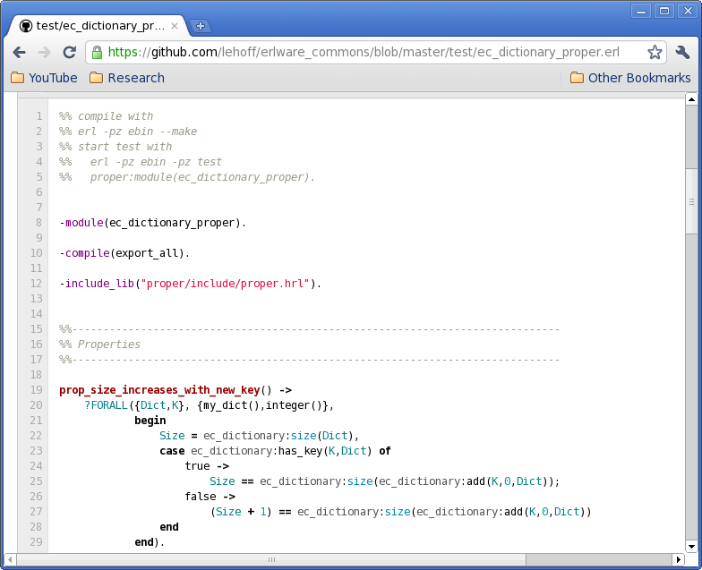
PropEr already used out there!

Slide 29
Quote from a PropEr user
“I ran PropEr using statem on a real example which I already had for EQC. It was just to switch include file, recompile and run!”

Slide 30
Property-based testing by experts
From: Ulf Wiger on erlang-questions
Date: 16/3/2011, 18:13
When I use ordered_set ets over gb_trees it has more than once been due to the fact that you can do wonderful stuff with first, next, prev and last - and gb_trees doesn't have them.
I've made a stab at implementing these functions for the gb_trees data structure, together with a quickcheck spec to verify that they work as expected (you can use eqc mini to run the tests). I think they are reasonably efficient, but perhaps someone can think of a way to optimize them?
Have at it, and pls use the spec to verify that you didn't break them (recalling that an incorrect program can be made arbitrarily fast)‏

Slide 31
Code from Ulf Wiger
-module(gb1).
-compile(export_all).
-include_lib("eqc/include/eqc.hrl").
gb_next(K, {_, T}) ->
gb_next_1(K, T).
gb_next_1(K, {K1, _, Smaller, Bigger}) when K < K1 ->
case gb_next_1(K, Smaller) of
none ->
case gb_next_1(K, Bigger) of
none ->
{value, K1};
{value, K2} ->
{value, erlang:min(K1, K2)}
end;
{value, _} = Res ->
Res
end;
gb_next_1(K, {K1, _, _, Bigger}) when K > K1 ->
gb_next_1(K, Bigger);
gb_next_1(K, {_, _, _, Bigger}) ->
case Bigger of
nil ->
none;
{K1, _, Smaller, _} ->
case gb_next_1(K, Smaller) of
none ->
{value, K1};
{value, _} = Res ->
Res
end
end;
gb_next_1(_, nil) ->
none.
gb_prev(K, {_, T}) ->
gb_prev_1(K, T).
gb_prev_1(K, {K1, _, Smaller, Bigger}) when K > K1 ->
case gb_prev_1(K, Bigger) of
none ->
case gb_prev_1(K, Smaller) of
none ->
{value, K1};
{value, K2} ->
{value, erlang:max(K1, K2)}
end;
{value, _} = Res ->
Res
end;
gb_prev_1(K, {K1, _, Smaller, _}) when K < K1 ->
gb_prev_1(K, Smaller);
gb_prev_1(K, {_, _, Smaller, _}) ->
case Smaller of
nil ->
none;
{K1, _, _, Bigger} ->
case gb_prev_1(K, Bigger) of
none ->
{value, K1};
{value, _} = Res ->
Res
end
end;
gb_prev_1(_, nil) ->
none.

Slide 32
More code from Ulf Wiger
first({_, T}) ->
first_1(T).
first_1({K,_,nil,_}) ->
{value, K};
first_1({_,_,Smaller,_}) ->
first_1(Smaller);
first_1(nil) ->
none.
last({_, T}) ->
last_1(T).
last_1({K,_,_,nil}) ->
{value, K};
last_1({_,_,_,Bigger}) ->
last_1(Bigger);
last_1(nil) ->
none.
prop_first() ->
?FORALL(L, list(int()),
begin
{T, Sorted} = make_tree(L),
case first(T) of
none -> Sorted == [];
{value,X} -> X == hd(Sorted)‏
end
end).
prop_last() ->
?FORALL(L, list(int()),
begin
{T, Sorted} = make_tree(L),
case last(T) of
none -> Sorted == [];
{value,X} -> X == lists:last(Sorted)‏
end
end).
prop_prev() ->
?FORALL(L, list(int()),
begin
{T, Sorted} = make_tree(L),
ok == all_prev(lists:reverse(Sorted), T)‏
end).
prop_next() ->
?FORALL(L, list(int()),
begin
{T, Sorted} = make_tree(L),
ok == all_prev(lists:reverse(Sorted), T)‏
end).
all_next([X], T) ->
{X,none} = {X,gb_next(X, T)},
ok;
all_next([A,B|Rest], T) ->
{A,{value,B}} = {A,gb_next(A, T)},
all_next([B|Rest], T);
all_next([], _) ->
ok.
all_prev([X], T) ->
{X,none} = {X,gb_prev(X, T)},
ok;
all_prev([A,B|Rest], T) ->
{A,{value,B}} = {A,gb_prev(A, T)},
all_prev([B|Rest], T);
all_prev([], _) ->
ok.
make_tree(L) ->
T = lists:foldl(fun(X,T) ->
gb_trees:enter(X,1,T)‏
end, gb_trees:empty(), L),
Sorted = [K || {K,_} <- gb_trees:to_list(T)],
{T, Sorted}.

Slide 33
A closer look at the code
-module(gb1).
-compile(export_all).
-include_lib("eqc/include/eqc.hrl").
gb_next(K, {_, T}) ->
gb_next_1(K, T).

Slide 34
A better version
-module(gb1).
-export([gb_next/2, gb_prev/2,
first/1, last/1]).
-include_lib("eqc/include/eqc.hrl").
-spec gb_next(term(), gb_tree()) -> ’none’ | {’value’, term()}.
gb_next(K, {_, T}) ->
gb_next_1(K, T).

Slide 35
A PropEr version
-module(gb1).
-export([gb_next/2, gb_prev/2,
first/1, last/1]).
-include_lib("proper/include/proper.hrl").
-spec gb_next(term(), gb_tree()) -> ’none’ | {’value’, term()}.
gb_next(K, {_, T}) ->
gb_next_1(K, T).

Slide 36
A closer look at the properties
prop_next() ->
?FORALL(L, list(int()),
begin
{T, Sorted} = make_tree(L),
ok == all_prev(lists:reverse(Sorted), T)‏
end).
make_tree(L) ->
T = lists:foldl(fun(X,T) ->
gb_trees:enter(X,1,T)‏
end, gb_trees:empty(), L),
Sorted = [K || {K,_} <- gb_trees:to_list(T)],
{T, Sorted}.

Slide 37
Comments from a guru
From: John Hughes on erlang-questions
Date: 16/3/2011, 20:58
Nice!
Slight typo: you tested prev twice... your prop_next actually tested prev, it's a copy-and-paste of prop_prev without the renaming to next!
One drawback of your approach is that you only test next and prev on gb_trees constructed using empty and enter. Conceivably the other functions could create gb_trees with a different structure that you might fail on.
Here's some code that uses ALL of the constructors to build the test data (no bugs found though!).

Slide 38
Code from a guru
From: John Hughes on erlang-questions
%% gb_tree constructors
gb() ->
?SIZED(Size,
frequency([{1,{call,gb_trees,empty,[]}},
{1,{call,gb_trees,
from_orddict,[orddict()]}},
{Size,?LAZY(compound_gb())}])).

Slide 39
More code from a guru
From: John Hughes on erlang-questions
compound_gb() ->
?LETSHRINK([GB], [gb()],
oneof([{call,gb_trees,Fun,Args++[GB]}
|| [Fun|Args] <-
lists:map(fun tuple_to_list/1,
gb_constructors())]
++
[{call,erlang,element,
[3,{call,gb_trees,
take_smallest,[GB]}]},
{call,erlang,element,
[3,{call,gb_trees,
take_largest,[GB]}]}])).

Slide 40
Even more code from a guru
From: John Hughes on erlang-questions
gb_constructors() ->
[{balance},
{delete,key()},
{delete_any,key()},
{enter,key(),val()},
{insert,key(),val()},
{update,key(),val()}].
key() ->
nat().
val() ->
int().
orddict() ->
?LET(L, list({key(),val()}),
orddict:from_list(L)).

Slide 41
The PropEr solution
Why not just write this?
Compare with:
prop_next() ->
?FORALL(T, gb_tree(key(),val()),
ok == all_next(gb_trees:keys(T), T)).
%% gb_tree constructors
gb() ->
?SIZED(Size,
frequency([{1,{call,gb_trees,empty,[]}},
{1,{call,gb_trees,from_orddict,[orddict()]}},
{Size,?LAZY(compound_gb())}])).
prop_next() ->
?FORALL(L, list(int()),
begin
{T, Sorted} = make_tree(L),
ok == all_prev(lists:reverse(Sorted), T)‏
end).
gb_constructors() ->
[{balance},
{delete,key()},
{delete_any,key()},
{enter,key(),val()},
{insert,key(),val()},
{update,key(),val()}].
key() ->
nat().
val() ->
int().
orddict() ->
?LET(L, list({key(),val()}),
orddict:from_list(L)).
compound_gb() ->
?LETSHRINK([GB],[gb()],
oneof([{call,gb_trees,Fun,Args++[GB]}
|| [Fun|Args] <-
lists:map(fun tuple_to_list/1,gb_constructors())]
++
[{call,erlang,element,
[3,{call,gb_trees,take_smallest,[GB]}]},
{call,erlang,element,
[3,{call,gb_trees,take_largest,[GB]}]}])).

Slide 42
Is this really all?
Yes, but we recommend that you also write:
Do I really need to write these type declarations?
Well, no. You could write the property as:
-type key() :: integer().
-type val() :: integer().
prop_next() ->
?FORALL(T, gb_tree(integer(),integer()),
ok == all_next(gb_trees:keys(T), T)).

Slide 43
I do not believe this...
OK, let’s do a demo...

Slide 44

Thanks from the PropEr developers!

