Slide 1
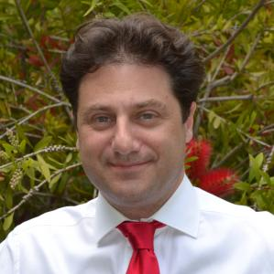
A PropEr Creation
Kostis Sagonas

Slide 2
Overview
Introductory rambling part:
  How PropEr was created
  Myths vs. reality
A taste of PropEr technology
Some PropEr advice
Current uses and exciting projects using PropEr
PropEr thoughts on open- vs. closed-source software development in Erlang
PropEr thoughts on licenses

Slide 3
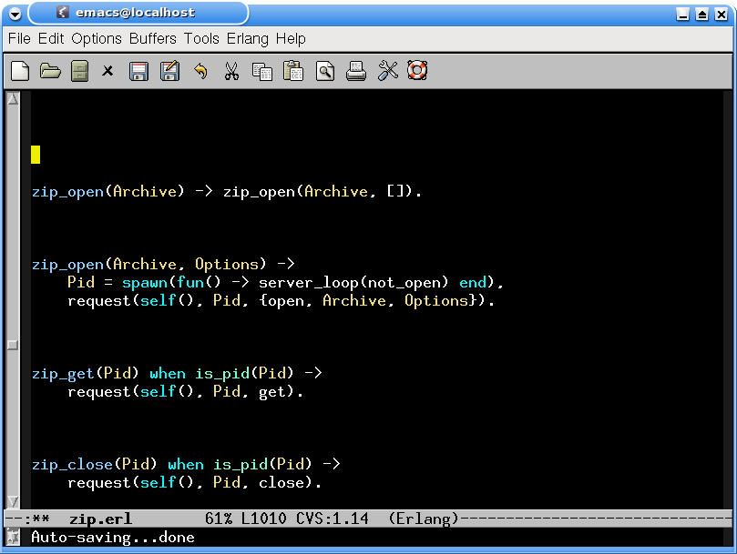
How PropEr was created
A Canada trip: Montreal, September 2000

Slide 4
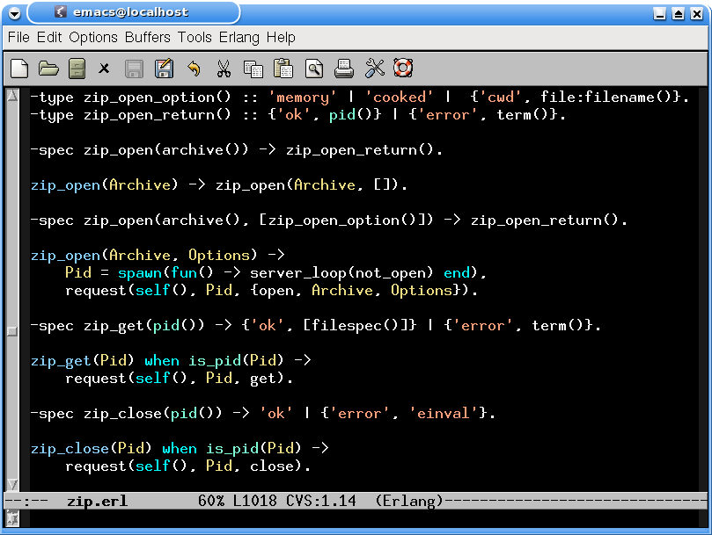
How PropEr was created
Another Canada trip: Victoria, September 2008

Slide 5
How PropEr was created
From John Hughes (20/10/2008):
… By the way, we'd be happy to supply an academic license for QuickCheck for your student in Greece, on the same terms as to our ProTest partners. The advantage over doing something yourself based on … <IDEA> ... would be that you would get our compositional approach to shrinking built-in, which makes it very easy to define, use, and combine shrinking strategies. In fact, it would be very interesting to see if he can come up with some smart ways of deriving generators automatically, or more easily. This is one of the most important areas for improvement in this kind of testing.

Slide 6
How PropEr was created
My reply:
Indeed it is. I'll think about it ... that particular student is not committed yet. One thing is for certain though: I have no grants here, so even one Euro for a license of any sort is one Euro too much :-(
From John Hughes (21/10/2008):
Well, I suppose an alternative is that the student deliver something of value to us... like a report or whatever, so that we could "sponsor" the project with a license. It does cost us a little bit to provide one, but if there's something useful that comes out of the project, then we could take that cost. I guess we'd want the right to make use of any results royalty-free in return (although presumably you'd be planning to publish any interesting results anyway, so the question is really pretty moot).

Slide 7
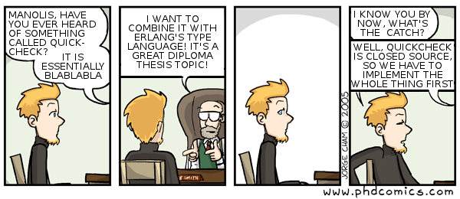
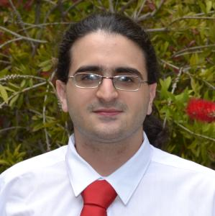
How PropEr was created
A trip at the Erlang Factory, London, June 2009
  QuickCheck tutorial
Back in Athens, October/November 2009

Slide 8
How PropEr was created
Athens, November 2009 – March 2010
  Complete support for properties and generators
    ?FORALL/3, ?LET, ?IMPLIES, ?SUCHTHAT/3,
    ?SHRINK/2, ?LAZY/1, ?SIZED/2, …
    aggregate/2, choose2, oneof/1, …
Athens, March 2010 – May 2010
  Complete intregration with types and specs
Stockholm, April 2010
  I hear about Trifork’s Triq implementation
London, June 2010
  QuviQ announces EQC Mini

Slide 9
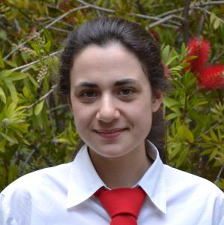
How PropEr was created
Athens, September/October 2010
  Plans to extend PropEr with component for testing stateful systems
Athens, November 2010 – March 2011
  Implementation of ‘statem’
San Francisco, March 2011
  Informal announcement of PropEr
Athens, April/May 2011
  Implementation of ‘fsm’
London, June 2011
  A PropEr announcement of the tool

Slide 10
Myth vs. reality
“We reversed-engineered QuviQ QuickCheck by access to its code or from its bytecode”
  None of us ever used EQC or owned a copy
  EQC Mini was released after we already had more (all?) of its functionality in PropEr
  None of the PropEr developers ever used EQC Mini since then (not even to check compatibility with PropEr)
  A clean-room implementation from scratch
  “Inspiration” from open-source projects (github)
  Help from some EQC users

Slide 11
Myth vs. reality
“... it is quite easy to be in a position where you are funded by external bodies, in the case of PropEr being funded by a large university and also EU grants, and then afford to give the software away for free...”
  We received absolutely no funding for working on PropEr
  There is actually NO MONEY at all in Greece, let alone research grants from the University or government !
  The National Technical University of Athens has NOT been part of the ProTest EU project

Slide 12
Myth vs. reality
“... I also think it makes it a tad rich to release it under something as restrictive as the GPL given that it's the profits of the commercial companies, by virtue of paying taxes, that have in effect funded the software...”
  We received absolutely no funding for working on PropEr
  Whether EU funded research projects should give back their research outcome back to society for free under unrestricted licenses is a matter of debate...

Slide 13
PropEr
A Property-based Testing Tool for Erlang
Available open source under GPL v3
  (more on that later...)
Has support for
  Writing properties and test case generators
  Concurrent/parallel “statem” and “fsm” testing
Full integration with the language of types and function specifications
  Generators often come for free!

Slide 14
Testing simple properties (1)‏
-module(simple_props).
%% Properties are automatically exported.
-include_lib("proper/include/proper.hrl").
%% Functions that start with prop_ are considered properties
prop_t2b_b2t() ->
?FORALL(T, term(), T =:= binary_to_term(term_to_binary(T))).
1> c(simple_props).
{ok,simple_props}
2> proper:quickcheck(simple_props:prop_t2b_b2t()).
....................................................................................................
OK: Passed 100 test(s)‏
true

Slide 15
Testing simple properties (2)‏
%% Testing the base64 module:
%% encode should be symmetric to decode:
prop_enc_dec() ->
?FORALL(Msg, union([binary(), list(range(1,255))]),
begin
EncDecMsg = base64:decode(base64:encode(Msg)),
case is_binary(Msg) of
true -> EncDecMsg =:= Msg;
false -> EncDecMsg =:= list_to_binary(Msg)‏
end
end).

Slide 16
PropEr integration with simple types
%% Using a user-defined simple type as a generator
-type bl() :: binary() | [1..255].
prop_enc_dec() ->
?FORALL(Msg, bl(),
begin
EncDecMsg = base64:decode(base64:encode(Msg)),
case is_binary(Msg) of
true -> EncDecMsg =:= Msg;
false -> EncDecMsg =:= list_to_binary(Msg)‏
end
end).

Slide 17
PropEr shrinking
%% A lists delete implementation
-spec delete(T, list(T)) -> list(T).
delete(X, L) ->
delete(X, L, []).
delete(_, [], Acc) ->
lists:reverse(Acc);
delete(X, [X|Rest], Acc) ->
lists:reverse(Acc) ++ Rest;
delete(X, [Y|Rest], Acc) ->
delete(X, Rest, [Y|Acc]).
prop_delete() ->
?FORALL({X,L}, {integer(),list(integer())},
not lists:member(X, delete(X, L))).

Slide 18
PropEr shrinking
41> c(simple_props).
{ok,simple_props}
42> proper:quickcheck(simple_props:prop_delete()).
.........................................!
Failed: After 42 test(s).
{12,[-36,-1,-2,7,19,-14,40,-6,-8,42,-8,12,12,-17,3]}
Shrinking ...(3 time(s))‏
{12,[12,12]}
false

Slide 19
PropEr integration with types
-type tree(T) :: 'leaf' | {'node',T,tree(T),tree(T)}.
%% A tree delete implementation
-spec delete(T, tree(T)) -> tree(T).
delete(X, leaf) ->
leaf;
delete(X, {node,X,L,R}) ->
join(L, R);
delete(X, {node,Y,L,R}) ->
{node,Y,delete(X,L),delete(X,R)}.
join(leaf, T) -> T;
join({node,X,L,R}, T) ->
{node,X,join(L,R),T}.
prop_delete() ->
?FORALL({X,L}, {integer(),tree(integer())},
not tree_member(X, delete(X, L))).

Slide 20
What one would have to write in EQC
tree(G) ->
?SIZED(S, tree(S, G)).
tree(0, _) ->
leaf;
tree(S, G) ->
frequency([
{1, tree(0, G)},
{9, ?LAZY(
?LETSHRINK(
[L, R],
[tree(S div 2, G), tree(S div 2, G)],
{node, G, L, R}
))}
]).

Slide 21
What one has to write in PropEr
This slide intentionally left blank

Slide 22
Integration with recursive types
41> c(mytrees).
{ok,mytrees}
42> proper:quickcheck(mytrees:prop_delete()).
.......................!
Failed: After 24 test(s).
{6,{node,19,{node,-19,leaf,leaf},
{node,6,leaf,{node,6,leaf,leaf}}}}
Shrinking .(1 time(s))‏
{6,{node,6,{node,6,leaf,leaf}}}
false

Slide 23
Generators from recursive types
Takes place, roughly, in the following steps
Detect recursion
Inline (non-recursive) type definitions
Normalize by pushing unions to the top level
Find base cases
Prepare the recursive calls
Determine shrinking behavior
Compose a generator

Slide 24
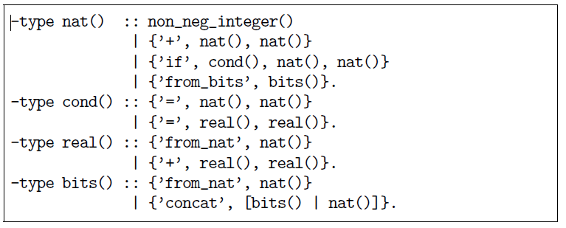
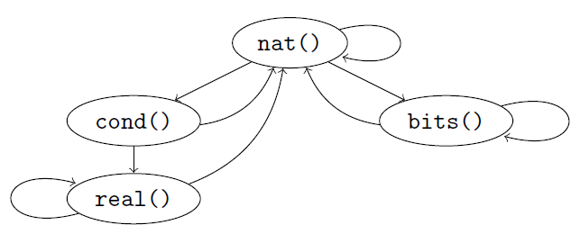
Example: detecting recursion

Slide 25
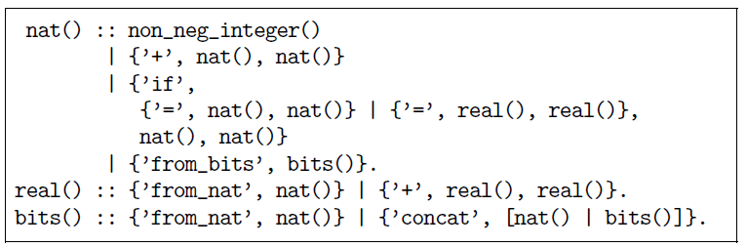
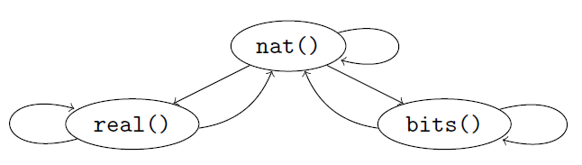
Example: after inlining

Slide 26
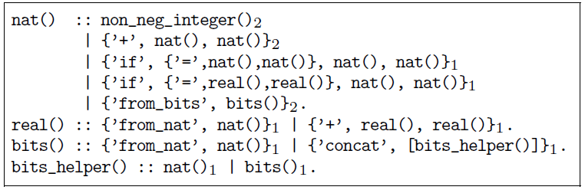
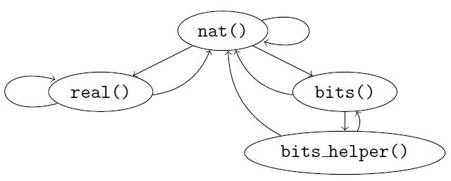
Example: after normalization

Slide 27
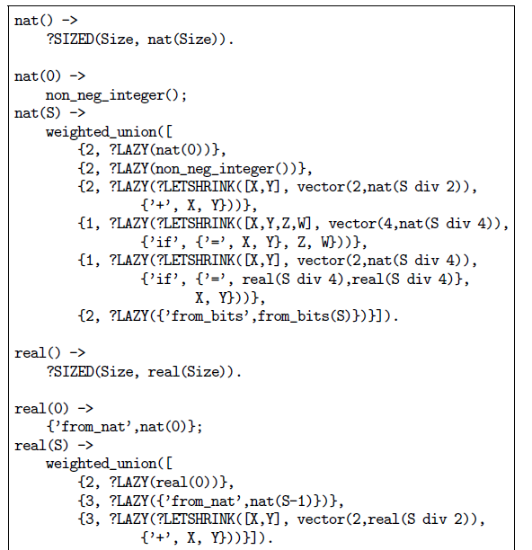
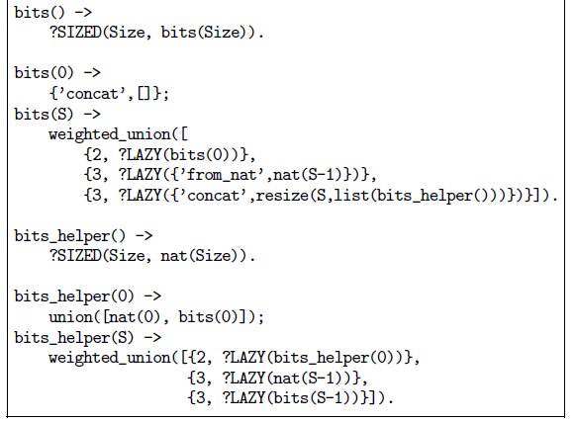
Example: the generated generator

Slide 28
PropEr integration with remote types
We want to test that array:new/0 can handle any combination of options
Why write a custom generator (which may rot)?
We can use the remote type as a generator!
-type array_opt() :: ’fixed’ | non_neg_integer()‏
| {’default’, term()}
| {’fixed’, boolean()}
| {’size’, non_neg_integer()}.
-type array_opts() :: array_opt() | [array_opt()].
-module(types).
-include_lib("proper/include/proper.hrl").
prop_new_array_opts() ->
?FORALL(Opts, array:array_opts(),
array:is_array(array:new(Opts))).

Slide 29
PropEr testing of specs
-module(myspecs).
-export([divide/2, filter/2, max/1]).
-spec divide(integer(), integer()) -> integer().
divide(A, B) ->
A div B.
-spec filter(fun((T) -> term()), [T]) -> [T].
filter(Fun, List) ->
lists:filter(Fun, List).
-spec max([T]) -> T.
max(List) ->
lists:max(List).

Slide 30
PropEr testing of specs
1> c(myspecs).
{ok,myspecs}
2> proper:check_spec({myspecs,divide,2}).
!
Failed: After 1 test(s).
An exception was raised: error:badarith.
Stacktrace: [{myspecs,divide,2}].
[0,0]
Shrinking (0 time(s))‏
[0,0]
false
.... AFTER FIXING THE PROBLEMS ....
42> proper:check_specs(myspecs).

Slide 31
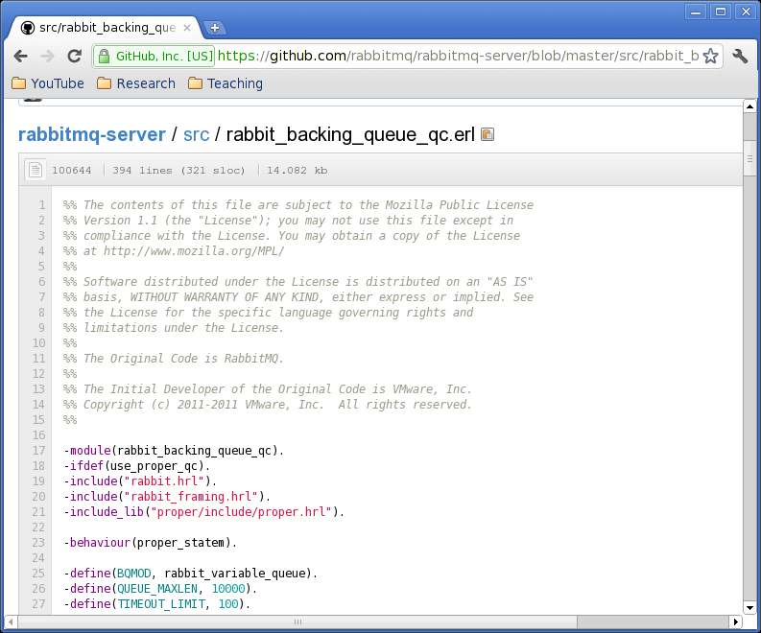
PropEr uses

Slide 32
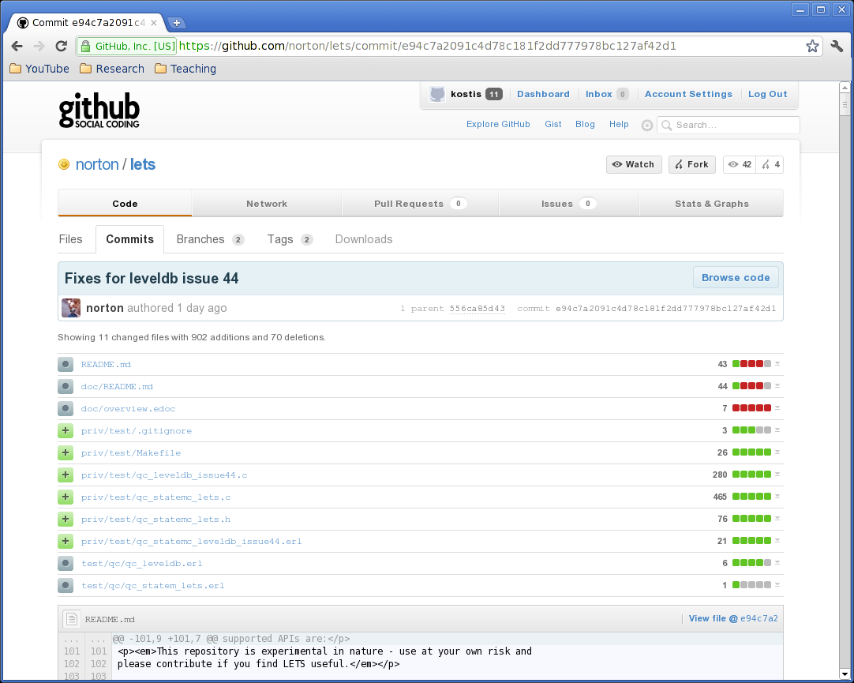
PropEr uses

Slide 33
Some observations from PropEr uses
Erlang’s type language is often less expressive than desired for property-based testing
  e.g. not possible to specify that binaries should contain valid UTF8 characters
Function specs cannot express argument dependencies
  e.g. dependencies between args of lists:nth/2
Users often under-specify function domains
Function signatures can often be used as simple specifications of functions

Slide 34
Lessons learned
Unit testing and property-based testing require different mindsets
  Difficult to come up with “interesting” properties
  Tricky to express them
    often one debugs the property rather than the code
Writing generators for recursive types is tricky and requires significant time and effort
  PropEr significantly eases this task

Slide 35
Some PropEr advice
Start with testing the functional core
Break the testing into smaller, simpler to express (partial) correctness properties
Write properties for readability
For generators of recursive datatypes
  Just write the data type and rely on PropEr
  Put a global size bound if the above is not enough
  Only if the steps above are not enough resort to using ?LAZY/1, ?LETSHRINK/1, resize, …

Slide 36
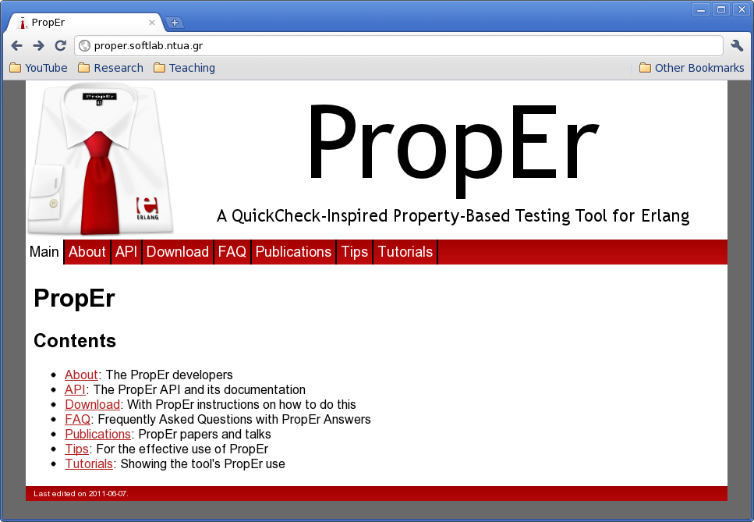
More info on our PropEr website

Slide 37
Open vs. closed source tools
All developers of PropEr are firm believers of the value of open source development tools
Many advantages:
  More eyes that read code ⇒ more robust code
  Easier to understand how the software works
  Allows for user contributions (hopefully!)
  ...
More advantages if also free:
  The Greek population can afford them!

Slide 38
PropEr licence
GPL v3
Long series of mail exchanges with the FSF
…
For the time being:
  GPL v3 but ...
  with a (still implicit) Open-Source Exception

Slide 39
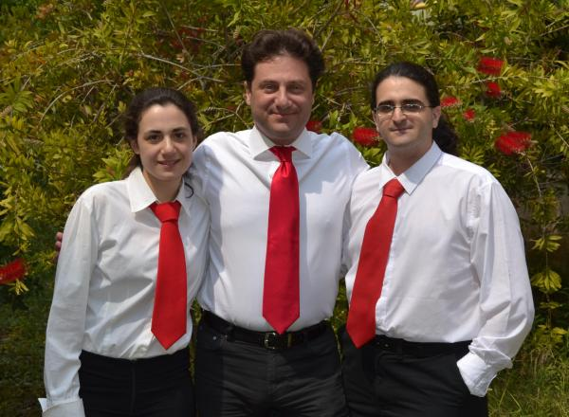
Thanks from the PropEr developers!

Slide 40


Slide 41
