Slide 1
Data Handling Introduction to R
HYPOTHESIS TESTING
Module Code: DH101
Module Leader: Farzana Rahman
Office: GE201
Email: f.r@institute.ac.uk

Slide 2

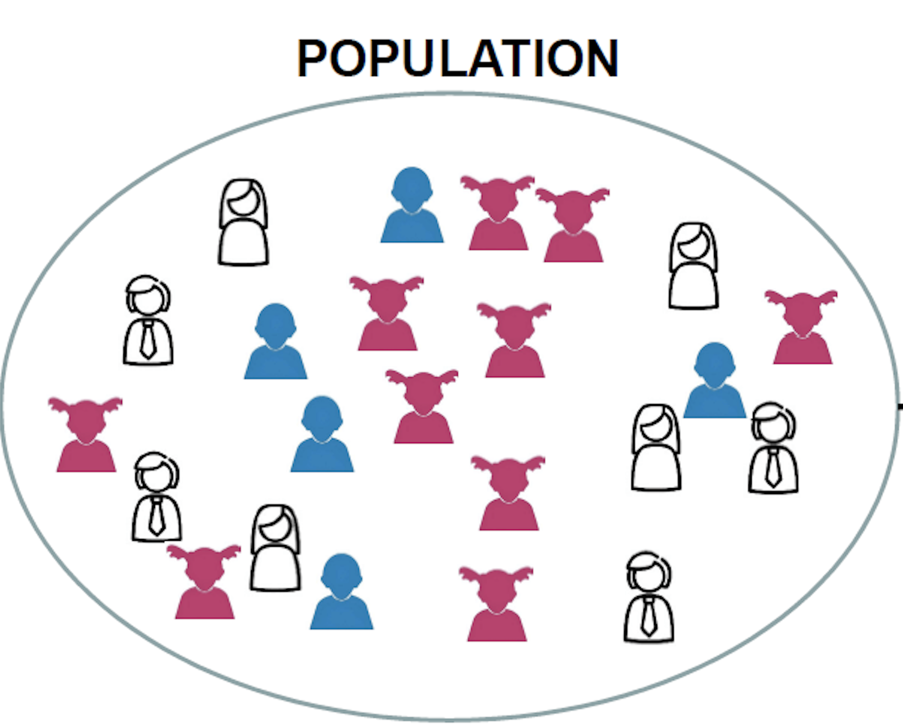
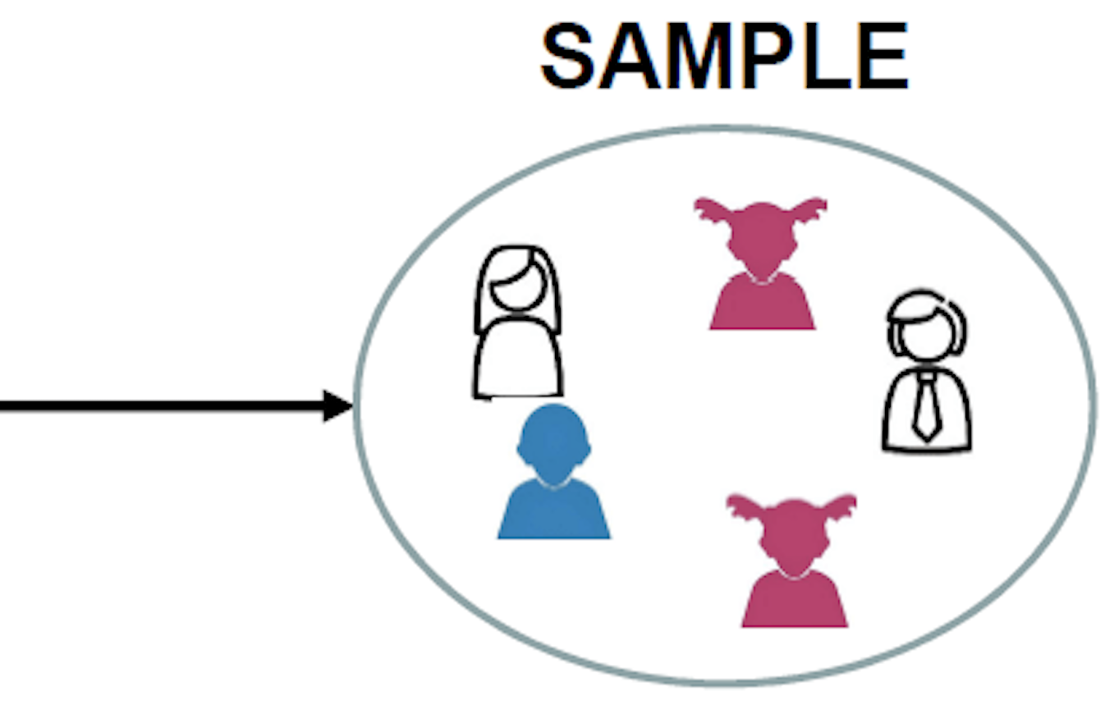

Hypothesis testing
What is it?
POPULATION
SAMPLE
Notes:
A hypothesis testing is a key procedure in inferential statistics. It is based on the idea that we can tell things about a population by taking a sample from it. For example, if we go to an orchard and want to know if the apples in that orchard taste , good or bad, we cannot eat all the apples to tell that! Rather we can take a sample and try the apples to decide taste of apples in that orchard.

Slide 3
Hypothesis testing
Hypotheses (Null Hypothesis, H₀ and Alternative Hypothesis, H₁ or H_{A} )
Significance (⍺ = 0.05)
Sample
P-value
Decision (If P-value < ⍺ (Reject H₀), If P-value > ⍺ (Accept H₀))

Slide 4
Hypothesis testing: T- test
What is a t-test?
“Significant difference between the means of two groups.”
Types of t-test:
One sample test
Two sample test
Independent (unpaired)
Dependent (paired)
Notes:
T-test is a statistical test that checks the significant difference between the means of two groups. The significant difference mean that the results are seen are mostly not likely due to sampling error. in any experiment or observation that involves sampling from a population, there is always the possibility that an observed effect would have occurred due to sampling error alone. But if result is "significant," then we may conclude that the observed effect actually reflects the characteristics of the population rather than just sampling error or chance.
One sample t test: We use one sample t-test when we have one type of population and we want to see if the population mean is significantly different to the hypothesised mean.
Two sample independent: Two populations who are independent. Comparing the mean response of two groups of patients on treatment VS control in a clinical trial.
Two sample dependent : Comparing the blood pressure of patients before and after treatment

Slide 5
Hypothesis testing: One Sample T-test
Q 1: A microarray supplier claims that their microarray failure rate is 2.1%. A lab would like to know whether this reflects the failure rates that they’ve observed over the last 12-months, so they have collected failure rate data on a monthly basis.
 | Month | Failure
1 | January | 2.90
2 | February | 2.99
3 | March | 2.48
4 | April | 1.48
5 | May | 2.71
6 | June | 4.17
7 | July | 3.74
8 | August | 3.04
9 | September | 1.23
10 | October | 2.72
11 | November | 3.23
12 | December | 3.40
Hypothesis
Significance
Sample
P-value
Decision
Null hypothesis: Mean monthly failure rate = 2.1%
Alternative hypothesis: Mean monthly failure rate ≠ 2.1%
Two-tail test
Significance level, ⍺ = 0.05

Slide 6

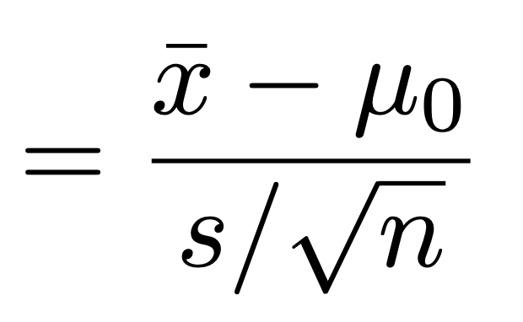

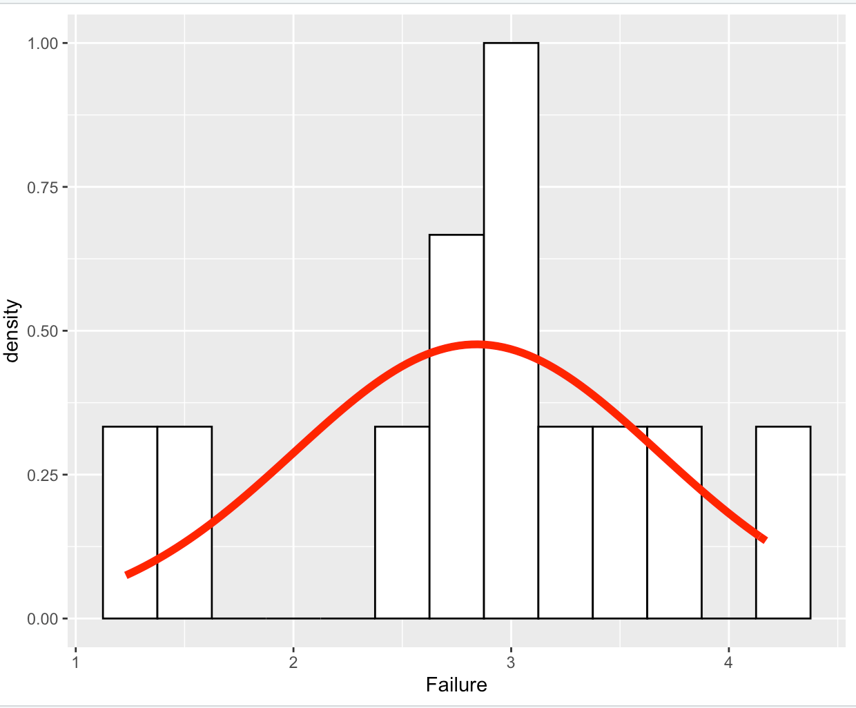



Hypothesis testing: One Sample T-test
The one sample t-test is based on the formula:
Where, is the sample mean
is the hypothesised mean
is the sample standard deviation
is the sample size
Notes:
Key points to decide one sample test: 1. The observations are independent 2. The observations are normally distributed. Here the data are normally distributed

Slide 7
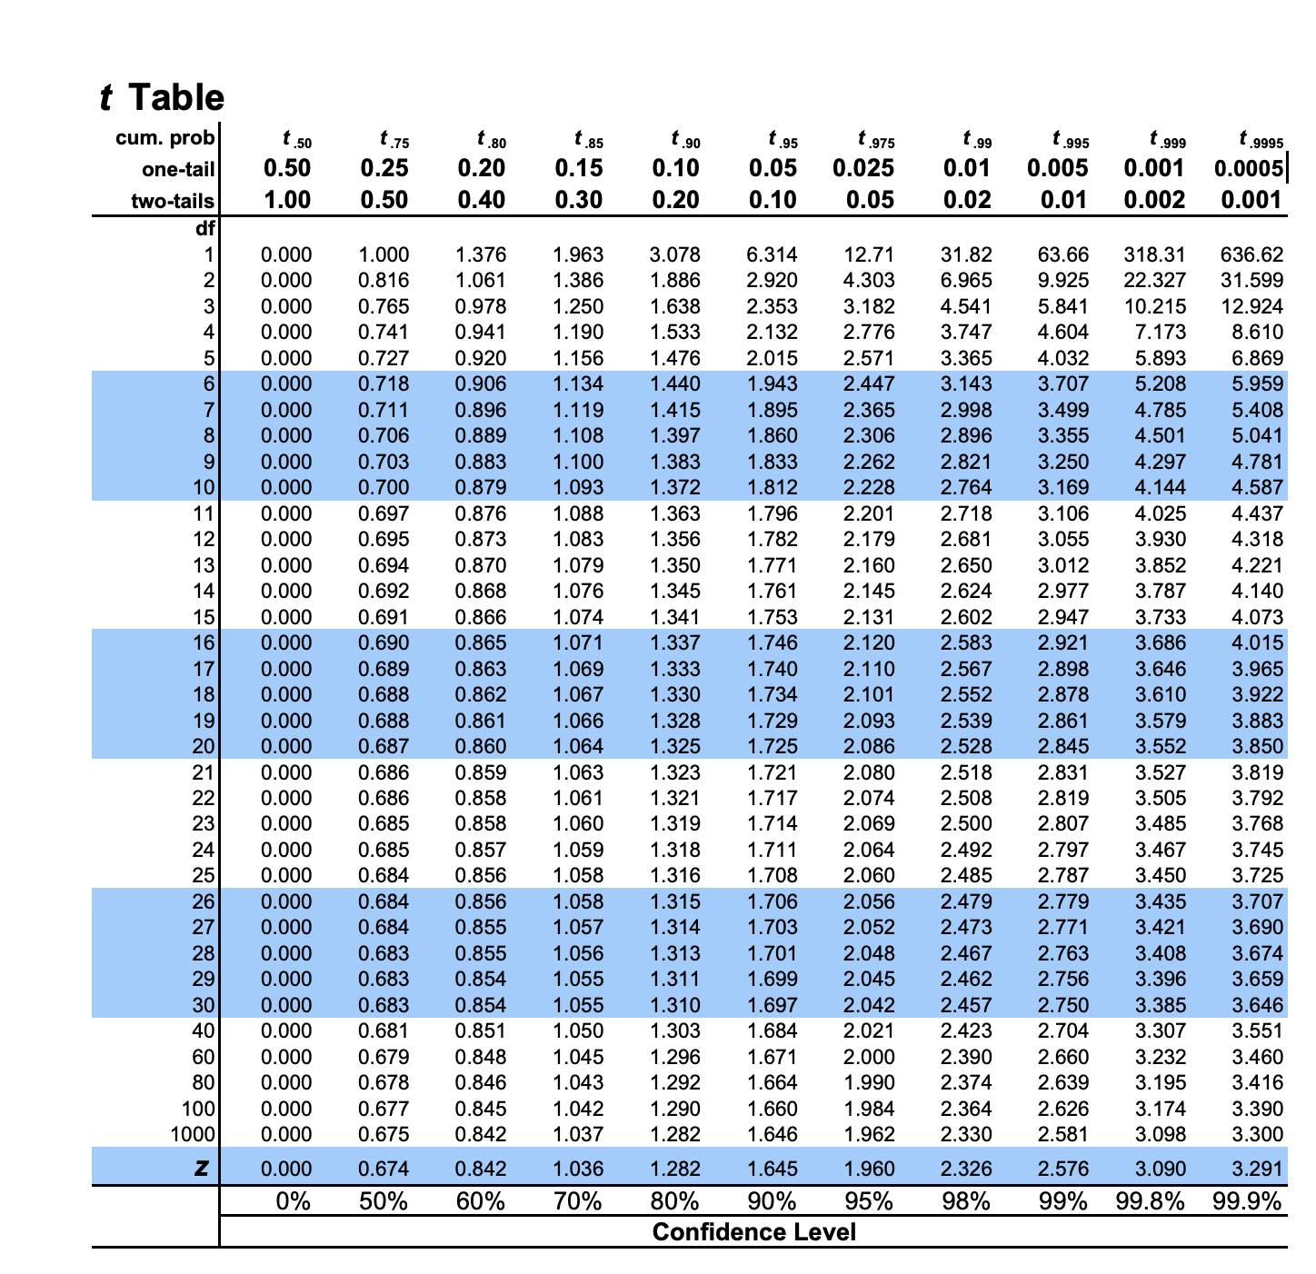
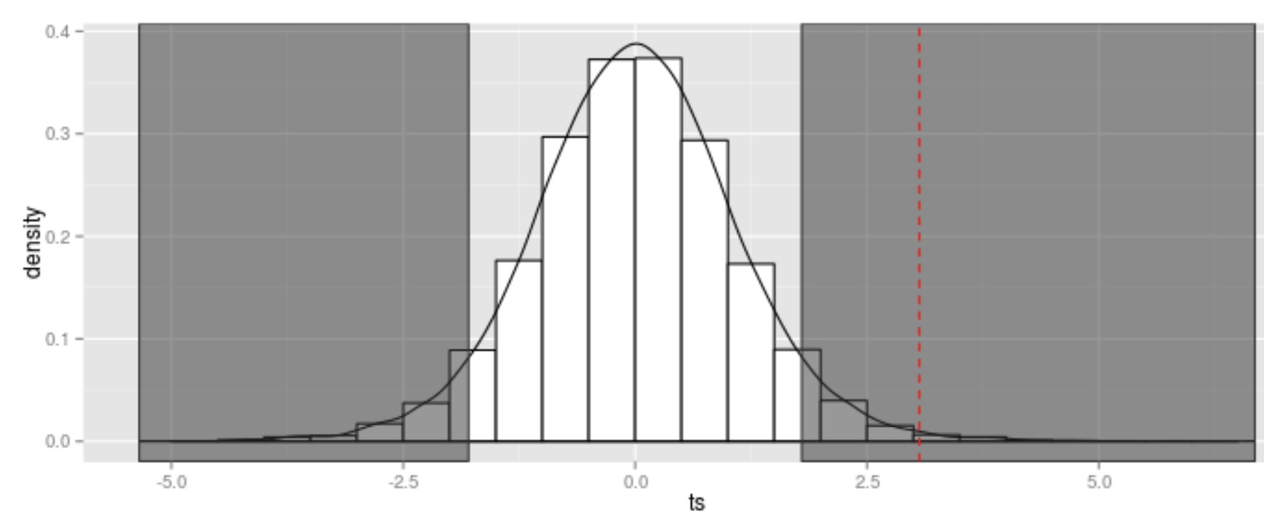
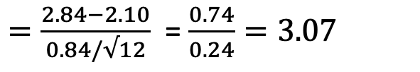
 | Month | Failure
1 | January | 2.90
2 | February | 2.99
3 | March | 2.48
4 | April | 1.48
5 | May | 2.71
6 | June | 4.17
7 | July | 3.74
8 | August | 3.04
9 | September | 1.23
10 | October | 2.72
11 | November | 3.23
12 | December | 3.40
Hypothesis testing: One Sample T-test
The one sample t-test is based on the formula:
$=\frac{2.84−2.10}{0.84/√12}$ = $\frac{0.74}{0.24}=3.07$
Degrees of freedom = n-1 = 12-1 =11
P-value 0.01 < 0.05, therefore reject the null hypothesis.
Therefore, there is evidence to suggest that the failure
rate of the microarrays from this supplier is not 2.1.

Slide 8
Hypothesis testing: One Sample T-test using R
Why R?
Open Source
Powerful Statistical tool for both Science and Research
Libraries
Machine Learning
Download R: https://www.r-project.org/
Download R IDE RStudio: https://www.rstudio.com/

Slide 9
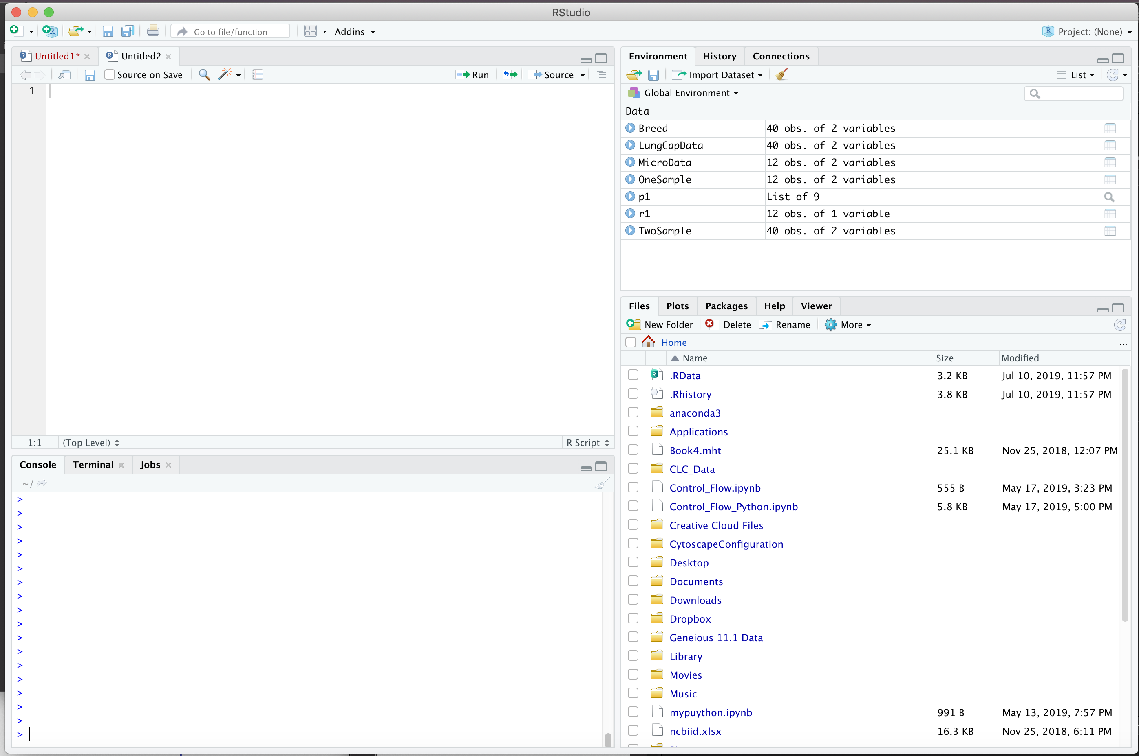
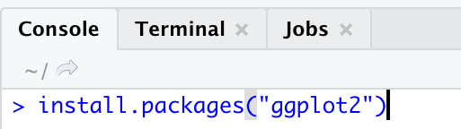
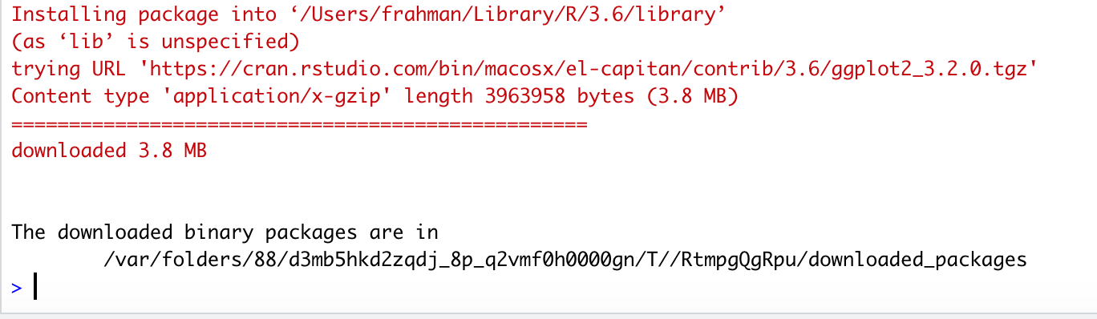
Hypothesis testing: One Sample T-test using R
Q 1: A microarray supplier claims that their microarray failure rate is 2.1%. A lab would like to know whether this reflects the failure rates that they’ve observed over the last 12-months, so they have collected failure rate data on a monthly basis.
 | Month | Failure rate (%)
1 | January | 2.90
2 | February | 2.99
3 | March | 2.48
4 | April | 1.48
5 | May | 2.71
6 | June | 4.17
7 | July | 3.74
8 | August | 3.04
9 | September | 1.23
10 | October | 2.72
11 | November | 3.23
12 | December | 3.40

Slide 10
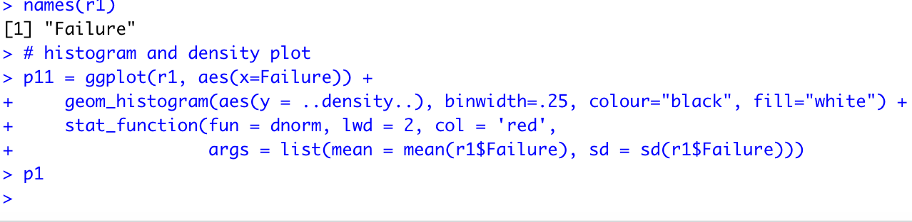
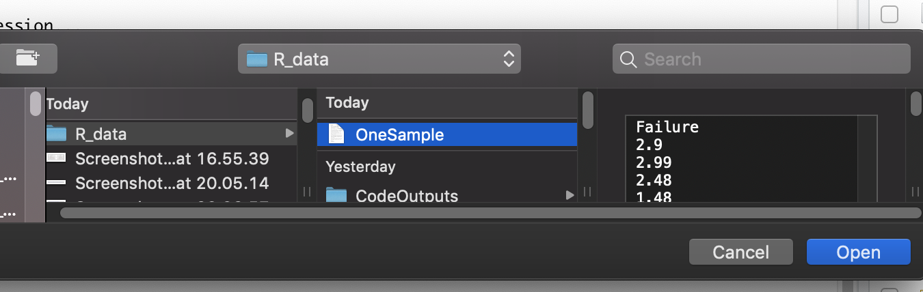
Hypothesis testing: One Sample T-test using R

Slide 11
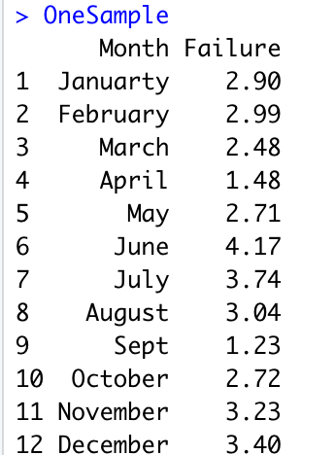
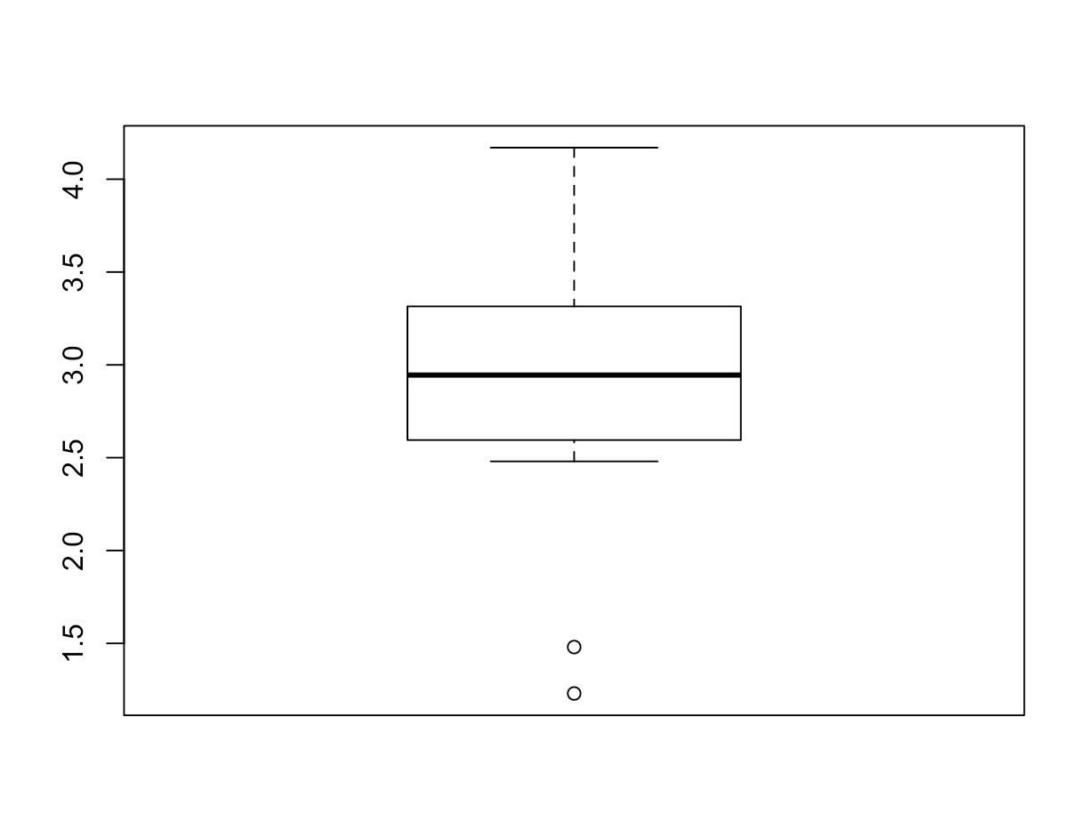
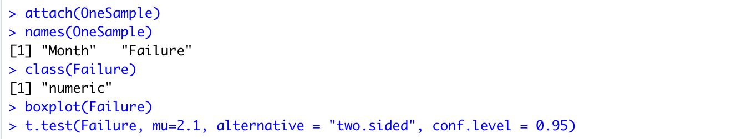
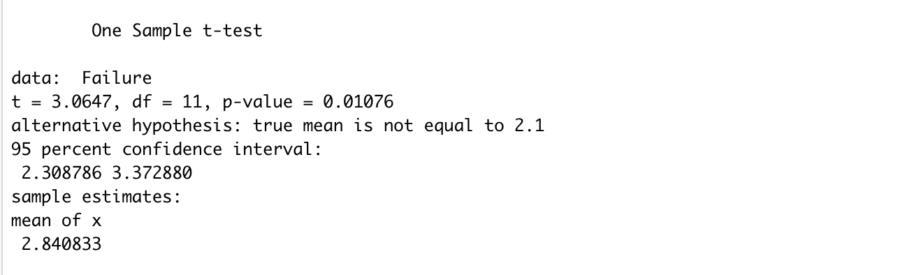
Hypothesis testing: One Sample T-test using R

Slide 12
Hypothesis testing: One Sample T-test using R
P-value 0.01 < 0.05, therefore reject the null hypothesis.
Therefore, there is evidence to suggest that the failure
rate of the microarrays from this supplier is not 2.1.

Slide 13
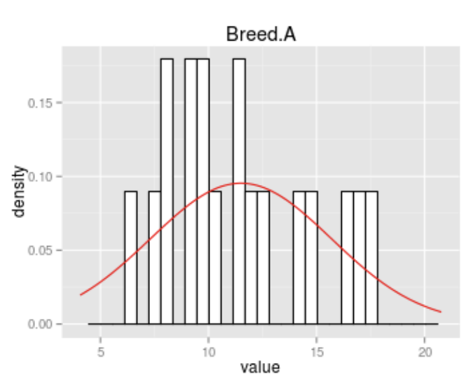
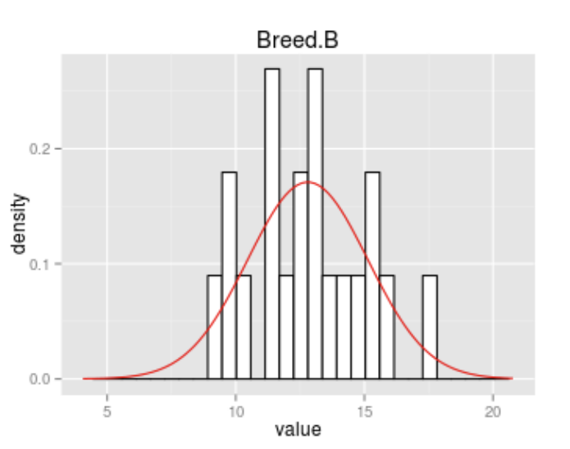
Hypothesis testing: Two Sample T-test
Q2. A researcher is interested in the effect of breed on weight in 4 week old male mice. 40 male mice were used, 20 of breed A and 20 of breed B.
 | Breed | Weight | Breed | Weight
1 | A | 20.77 | B | 15.51
2 | A | 9.08 | B | 12.93
3 | A | 9. | B | 11.5
4 | A | 8.13 | B | 16.07
5 | A | 16.54 | B | 15.51
6 | A | 11.36 | B | 17.66
7 | A | 11.47 | B | 11.25
8 | A | 12.1 | B | 13.65
9 | A | 14.04 | B | 14.28
10 | A | 16.82 | B | 13.21
11 | A | 6.32 | B | 10.28
12 | A | 17.51 | B | 12.41
13 | A | 9.87 | B | 9.63
14 | A | 12.41 | B | 14.75
15 | A | 7.39 | B | 9.81
16 | A | 9.23 | B | 13.02
17 | A | 4.06 | B | 12.33
18 | A | 8.26 | B | 11.9
19 | A | 10.24 | B | 8.98
20 | A | 14.64 | B | 11.29

Slide 14
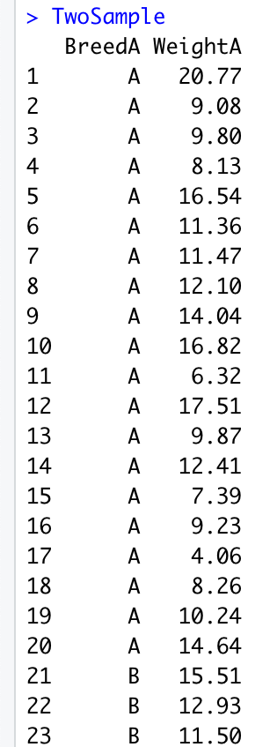
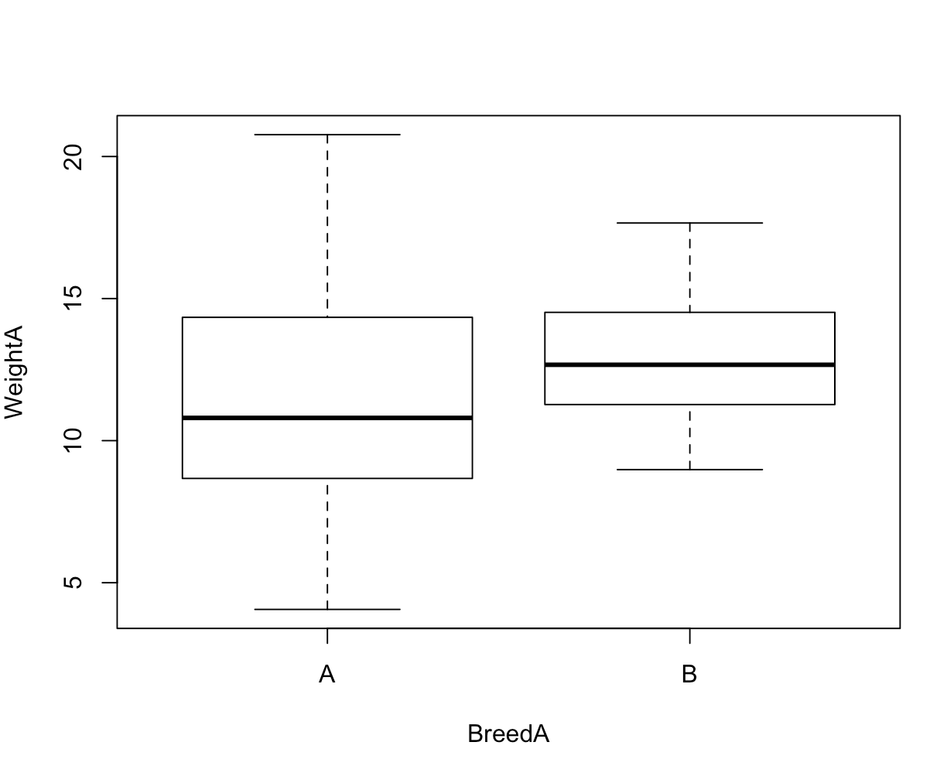
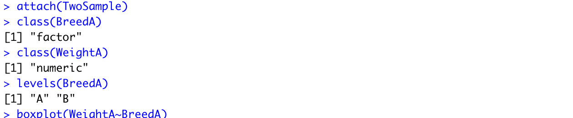
Hypothesis testing: Two Sample T-test

Slide 15
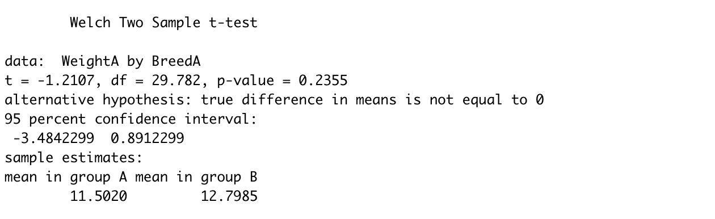
Hypothesis testing: Two Sample T-test
P-value 0.24 > 0.05, therefore this is not a significant result as there is no evidence of a difference in the weight of male mice at 4 weeks old between Breeds A and B.

Slide 16

Data Repository
Github link: https://github.com/propicee/lec1
Provide today’s lecture at:
https://bit.ly/2LPUTSC

