Slide 1

Solution
Convert AVI to MP4

Slide 2
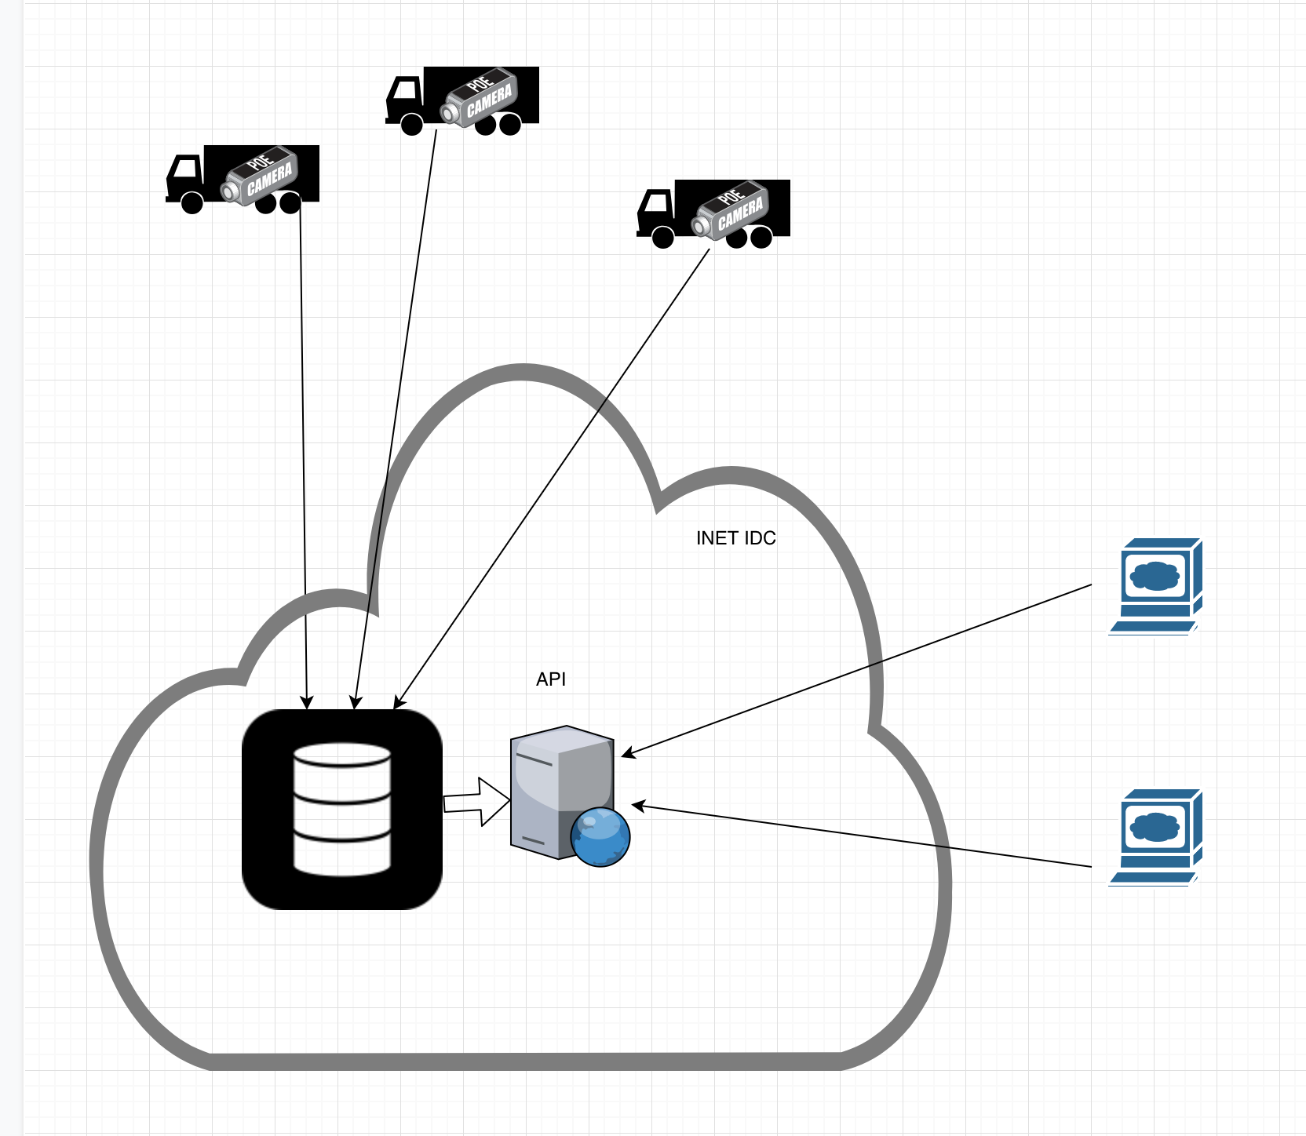
Diagram

Slide 3
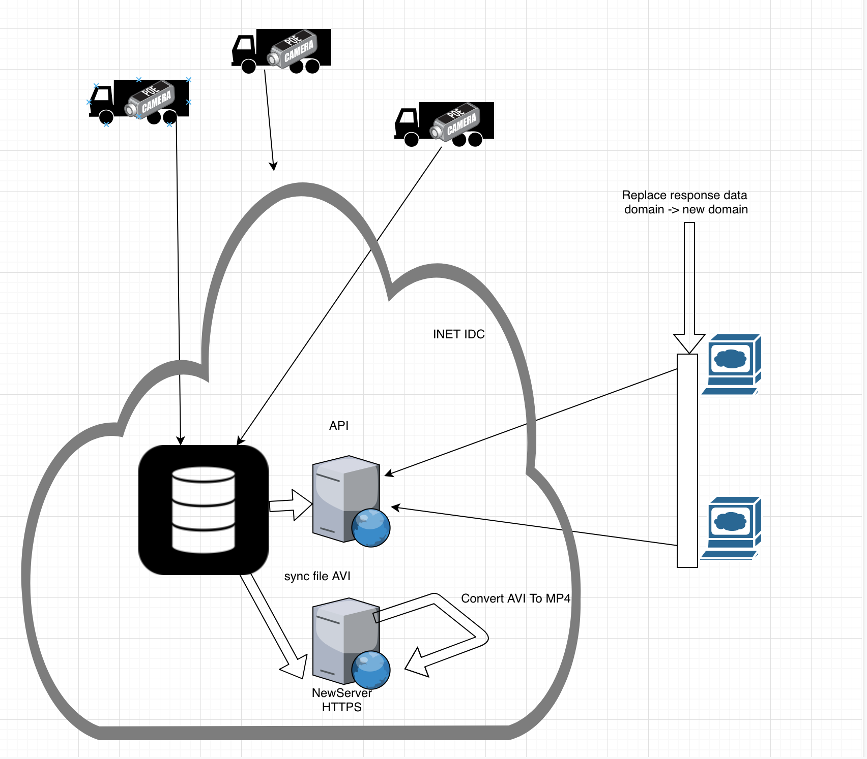
Solution

Slide 4
New Server
Webserver + SSL
Sync file AVI from existing Server to New Server
Convert AVI to MP4

Slide 5
Client
Call API to existing interface just replace domain in response data to new domain

