Slide 1
Name – Prithibi Ghosh
Class – XI
Section – B2
Roll number - 11

Slide 2
Topic = Wildlife Photography

Slide 3
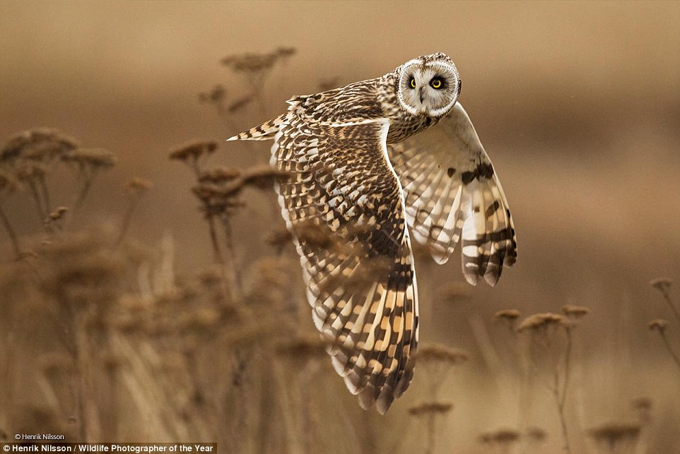
Marsel van Oosten is a Dutch photographer specializing in nature and wildlife photography. He has been overall winner of the Wildlife Photographer of the Year and Travel Photographer of the Year competitions. He published books like :- 1) Wild Romance: Africa's most romantic safari lodges. Cape Town: Struik Lifestyle. 2) Mother: A Tribute to Mother Earth. Kempen, Germany

Slide 4
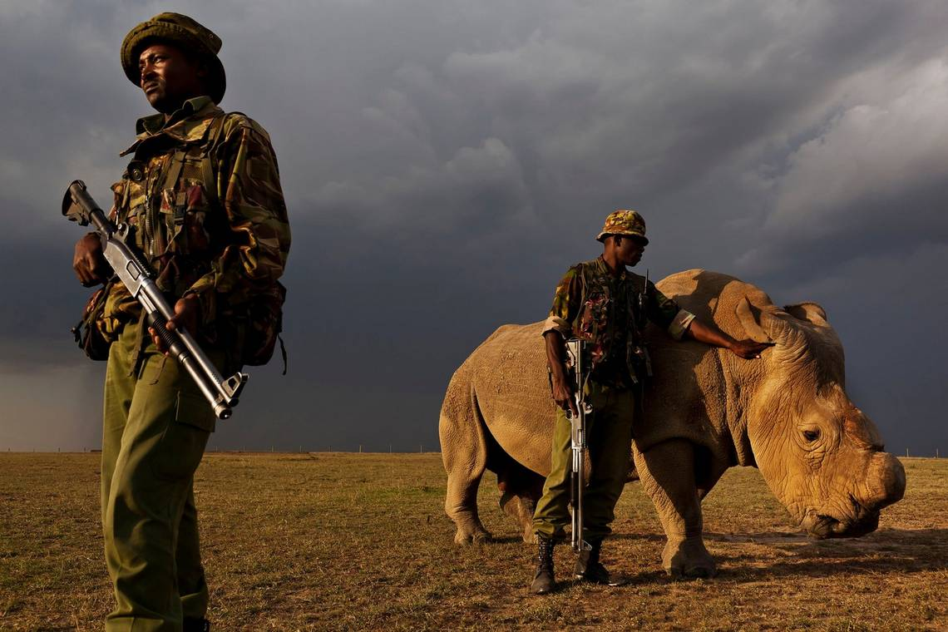
Brent Stirton is a Senior Photographer for Getty Images, based in New York. His award-winning work has been widely recognized for its powerful depiction of issues related to conflict, health and environmental issues. He won prizes like:- 1) 8 awards from World Press Photo Awards (2003-2014) 2) 8 awards from Pictures of the Year POY 3) Visa d'Or 2008 Visa Pour L'Image

Slide 5
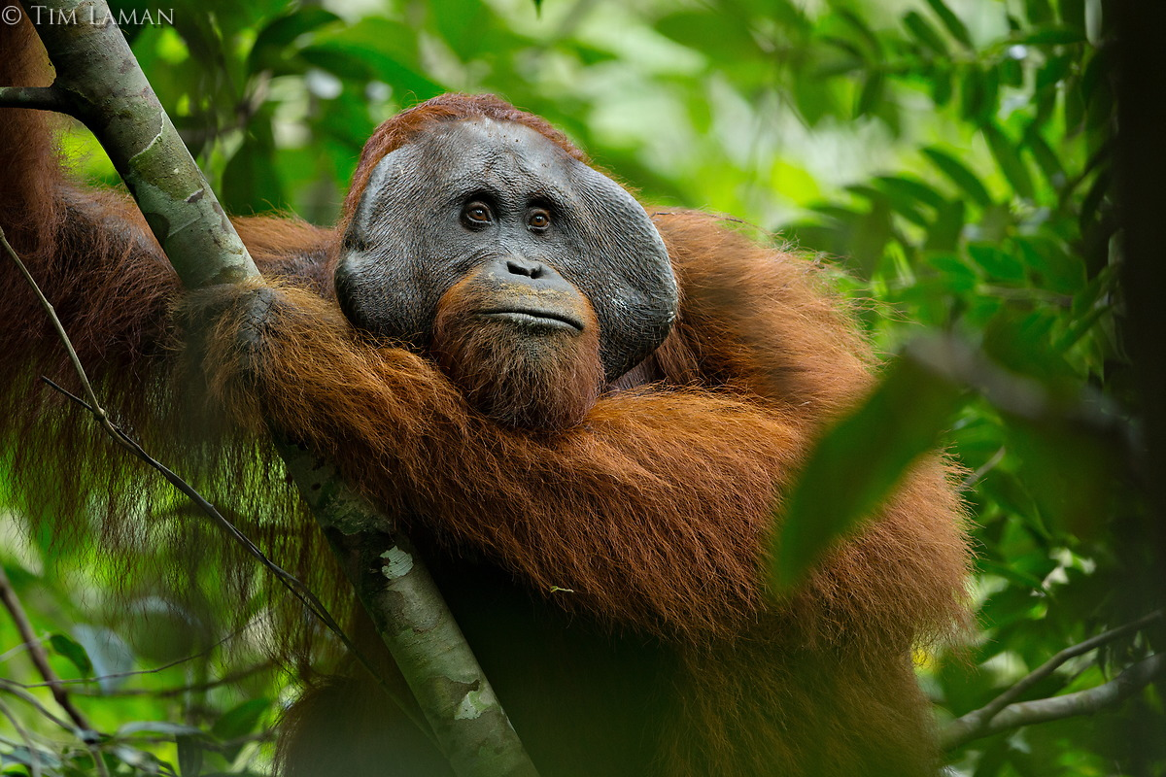
Timothy G. Laman is an American ornithologist, wildlife photojournalist and filmmaker. He is notable for documenting all the species of bird-of-paradise in their native habitat during research expeditions with colleague Edwin Scholes of the Cornell Lab of Ornithology. He published books like :- 1) Glimpses of Paradise (November 20, 2012). 2) Ape's fig challenge wins photo award (October 18, 2016).

Slide 6
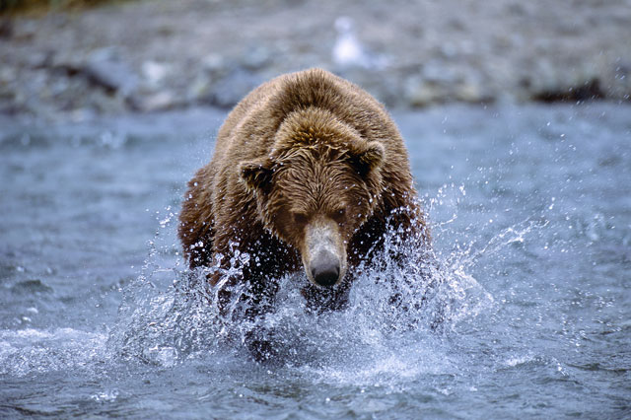
Thomas D. Mangelsen (born January 6, 1946) is an American nature and wildlife photographer and conservationist. He is most famous for his photography of wildlife in the Greater Yellowstone Ecosystem, as he has lived inside the zone in Jackson, Wyoming, for over 40 years. He won prizes like:- 1) In 2014, he was awarded the Design and Production Award for Trade Books Illustrated for Yellowstone Wildlife. 2) His book Grizzlies of Pilgrim Creek, An Intimate Portrait of 399, The Most Famous Bear of Greater Yellowstone won several awards

