Slide 1
Graph 3-coloring in Forth
Andrey Proskurin (12122381)

Slide 2
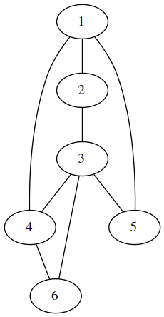
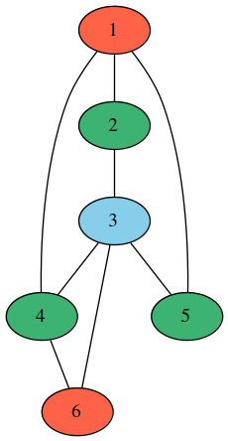
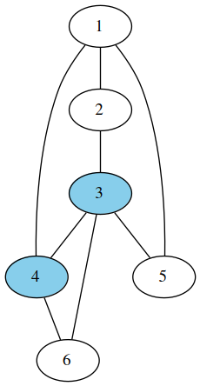
Graph Coloring
✓
˟

Slide 3
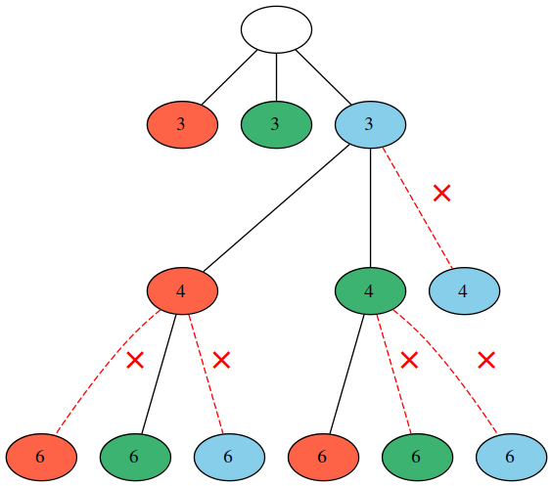
Backtracking

Slide 4
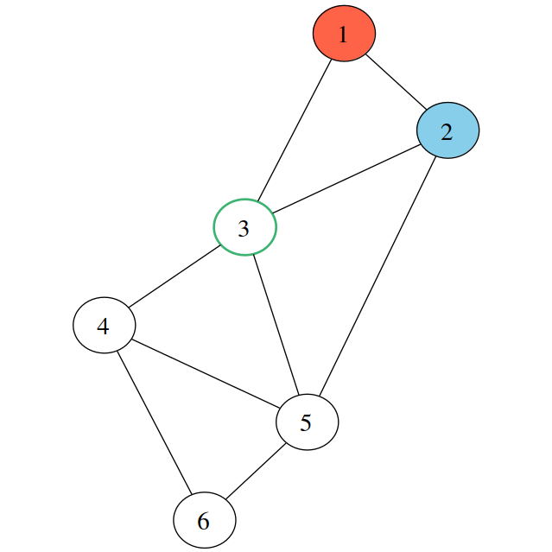
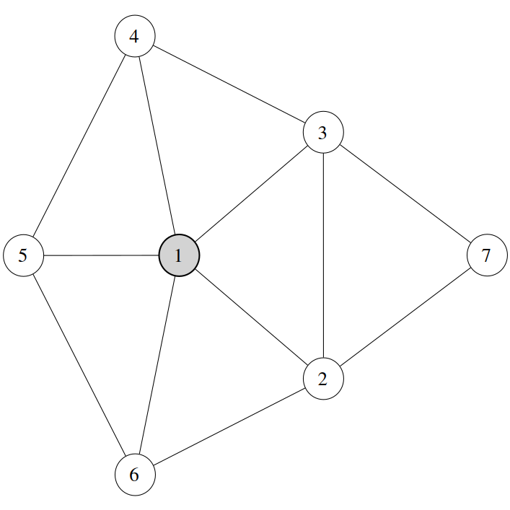
Heuristics
Order of node selection has a huge impact on the backtracking runtime.
Use Binary Heap to efficiently extract next node with the best heuristic value.
Minimum-Remaining-Values Heuristic
Maximum-Degree Heuristic

Slide 5
Benchmarks
Graph | Naive | Heuristics
random_80_283 (neg) | 1m 4s | 29 ms
random_140_217 (pos) | > 1 Hour | 70 ms

Slide 6
Forth-specific language features
Using parsing words to read Dimacs files
: c postpone \ ;
: e parse-name s>number parse-name s>number ( ... ) ;
Foreach neighbor macro
: foreach-neighbor ( node -- )
]] cells edges + $@ bounds +do [[
; immediate
: end-foreach ( -- )
]] cell +loop [[
; immediate
Using the Return Stack

