Slide 1
Whole of Government Data
A.
D R A F T

Slide 2

Commonwealth Government Corporate Services Benchmarking Portal
Whole of Government Overview– Level 1
Agency: All
Participating Agencies
 | 2014-15 | 2015-16
Extra Large | 1 | 1
Large | 16 | 17
Medium | 14 | 18
Small | 10 | 14
Extra Small | 8 | 13
Micro | 2 | 2
Total | 51 | 65
FY: ALL
D R A F T

Slide 3
Commonwealth Government Corporate Services Benchmarking Portal
Whole of Government Overview– Level 2
Agency: PM&C
FY: ALL
Level 1 Service: All
D R A F T

Slide 4
Commonwealth Government Corporate Services Benchmarking Portal
Whole of Government Overview– Level 3
Agency: PM&C
FY: ALL
Level 1 Service: Financial Services
D R A F T

Slide 5
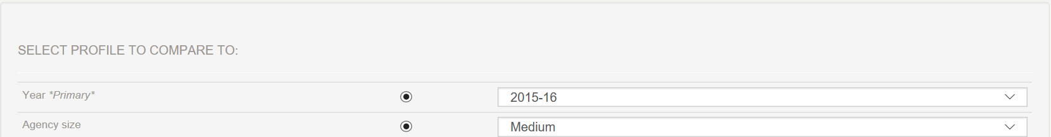
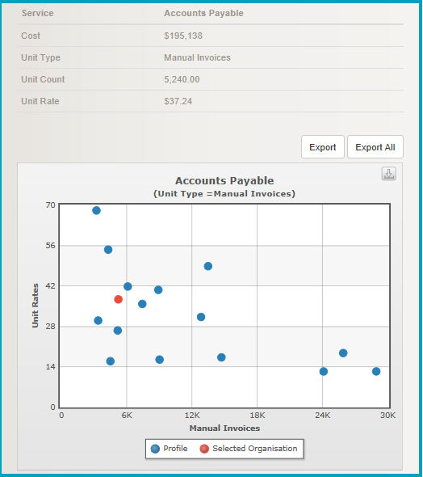
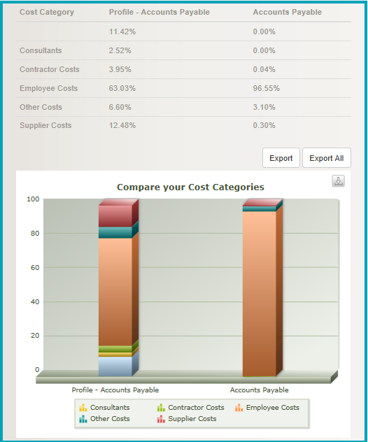
Commonwealth Government Corporate Services Benchmarking Portal
Whole of Government Overview– Level 3
Agency: PM&C
FY: 2016
Level 1 Service: Financial Services
Level 2 Service: Accounts Payable
D R A F T

Slide 6
Commonwealth Government Corporate Services Benchmarking Portal
Whole of Government Overview– Level 4
Agency: All
Unit Rate Movement Trends
($ / Manual Invoice)
Agency Size:
Large
FY: ALL
Level 1 Service: Financial Services
Level 2 Service: Accounts Payable
D R A F T

Slide 7
Individual Agency Cost Performance Dashboards
B.
D R A F T

Slide 8
Commonwealth Government Corporate Services Benchmarking Portal
Agency Performance Dashboard – Level 1
Agency: PM&C
All Services
FY: 2016 / 17
D R A F T

Slide 9
Commonwealth Government Corporate Services Benchmarking Portal
Agency Performance Dashboard – Level 2
Agency: PM&C
Agency Unit Cost
WoG Av. Unit Cost
Medium Agencies
Financial Services
Agency Volumes
FY: 2016 / 17
Level 1 Service: Financial Services
Accounts Payable
Accounts Receivable
Credit Card
Agency Comparison: Medium Size
Example Only
Example Only
Example Only
Ledger Management
Asset Management
Travel
Example Only
Example Only
Example Only
D R A F T

Slide 10
Commonwealth Government Corporate Services Benchmarking Portal
Agency Performance Dashboard – Level 3
Agency: PM&C
Accounts Payable
FY: 2016 / 17
Level 1 Service: Financial Services
Level 2 Service: Accounts Payable
D R A F T

Slide 11
Ad-hoc Anlaysis
C.
D R A F T

Slide 12
Commonwealth Government Corporate Services Benchmarking Portal
Ad-Hoc Analysis Tool
Agency: All
Agency Size:
All
FY: 2015/16
Level 1 Service: Financial Services
Level 2 Service:
All
Organisational Unit:
All
Cost Cateogory:
All
Total Cost: Yes
Unit Cost: No
Volumes: No
FTE: No
D R A F T

Slide 13
Commonwealth Government Corporate Services Benchmarking Portal
Ad-Hoc Analysis Tool
Agency: All
Agency Size:
Medium
FY: 2015/16
Level 1 Service: Financial Services
Level 2 Service: Accounts Payable
Organisational Unit:
All
Cost Cateogory:
All
Total Cost: Yes
Unit Cost: No
Volumes: No
FTE: No
D R A F T

